Slide 1
Weeding Robot

Slide 2
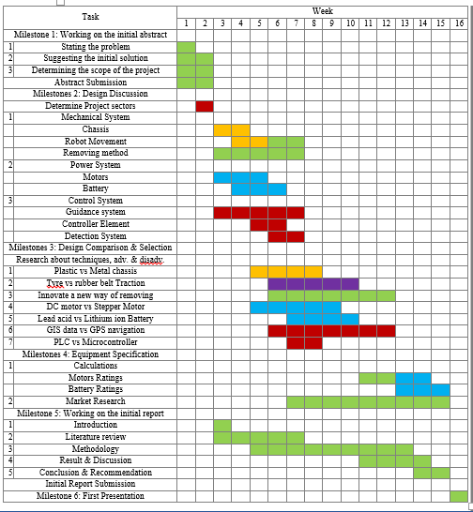
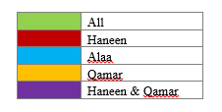
Time schedule (1st semester)

Slide 3
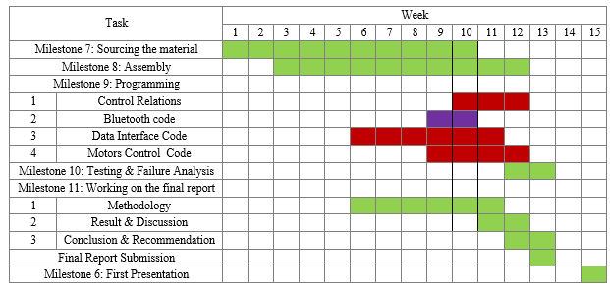
Time schedule (2nd semester)

Slide 4
Mechanical System
Control System
Power System

Slide 5
Chassis
Removing method
Robot movement

Slide 6
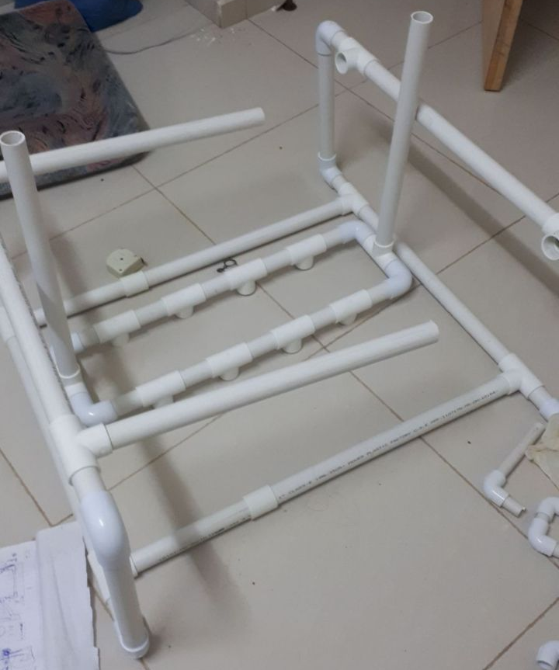
PolyVinylChloride (PVC Pipes)

Slide 7
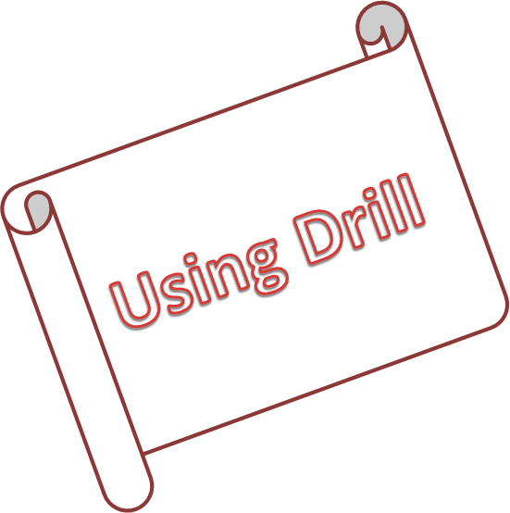

Slide 8
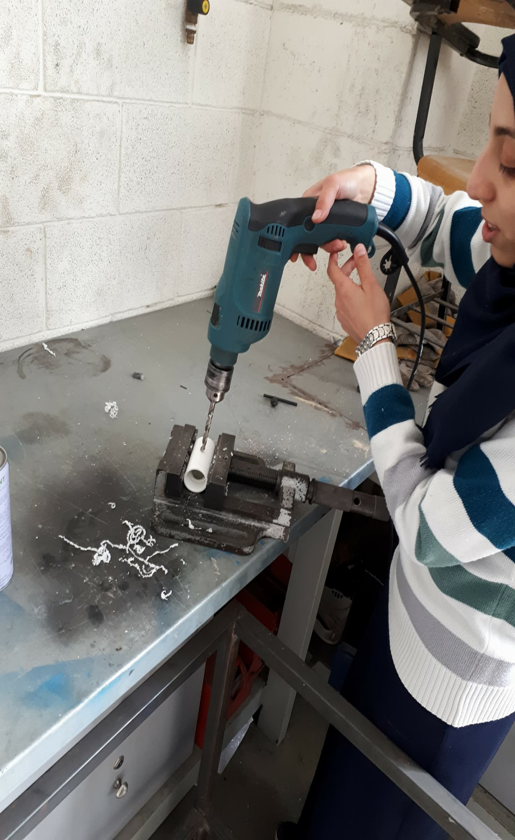
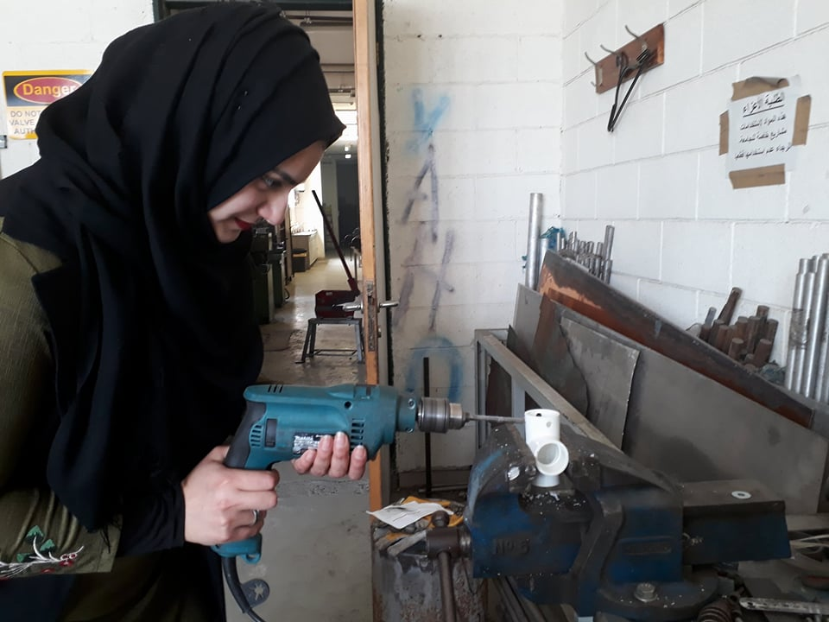

Slide 9
USING Cutter

Slide 10
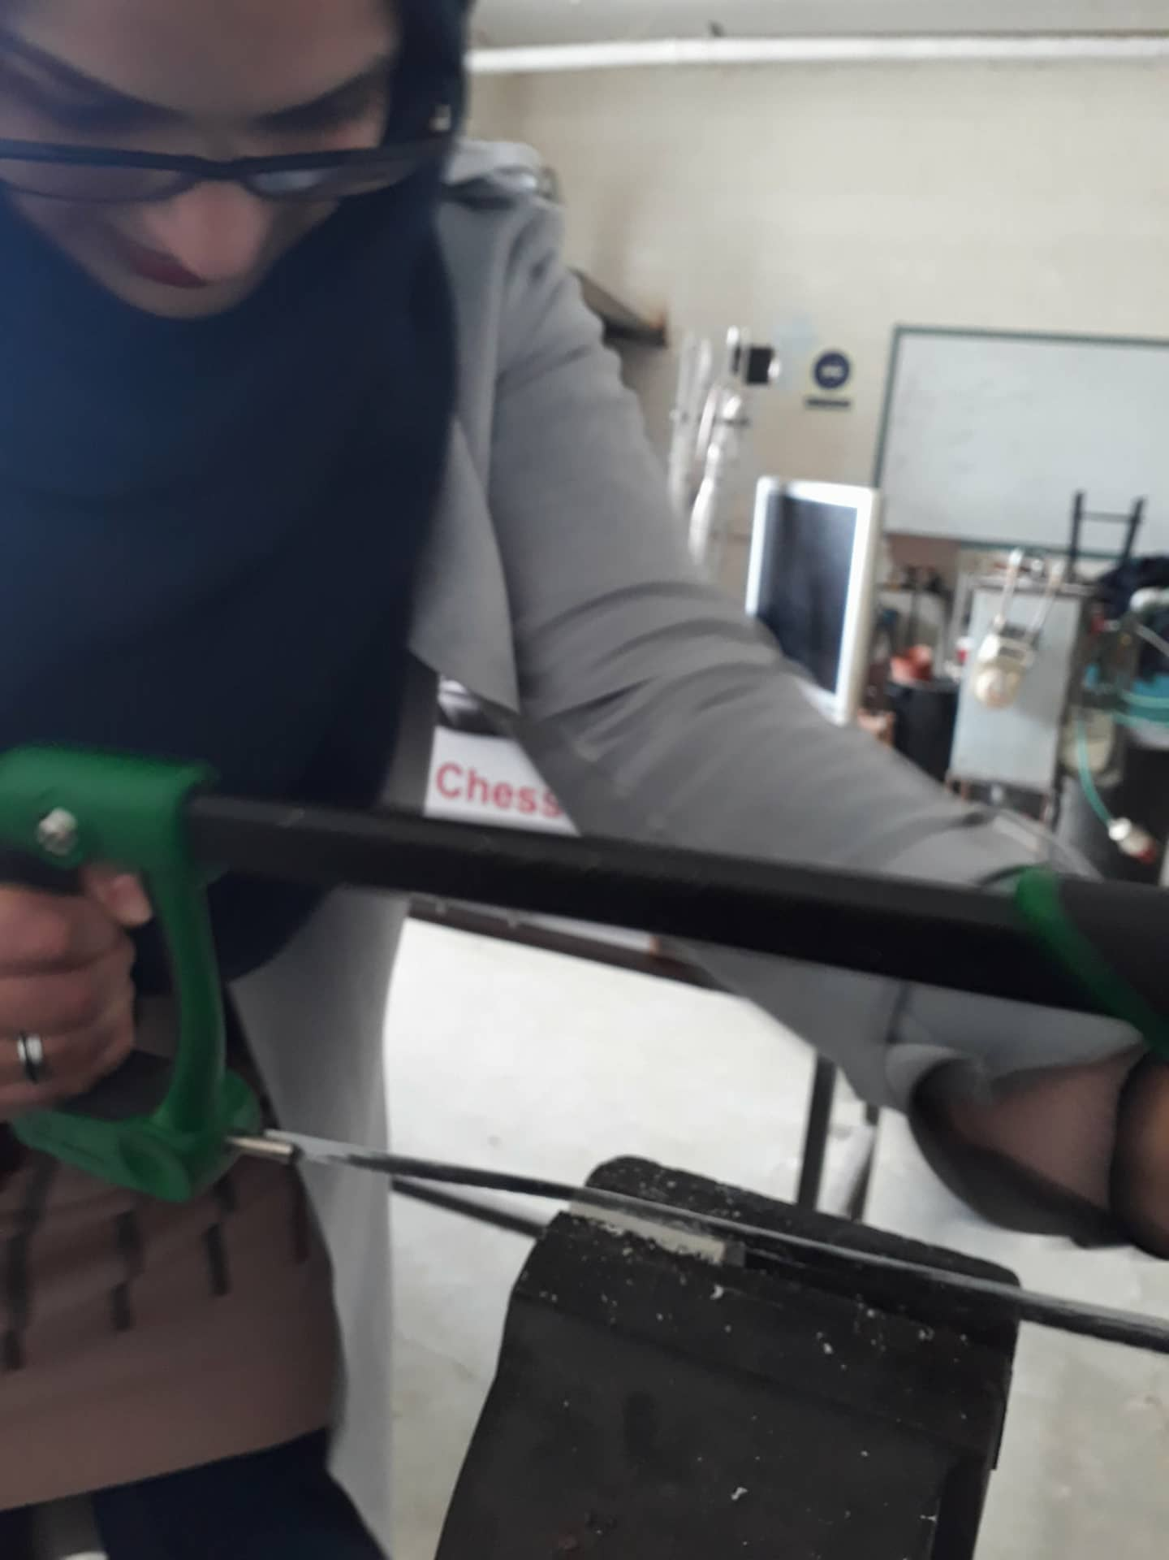
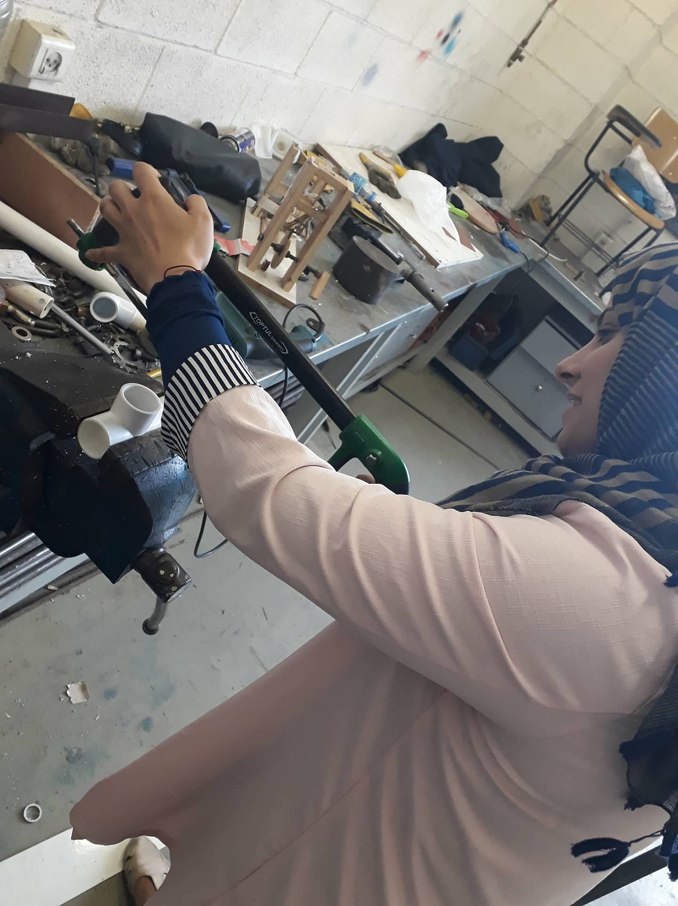

Slide 11
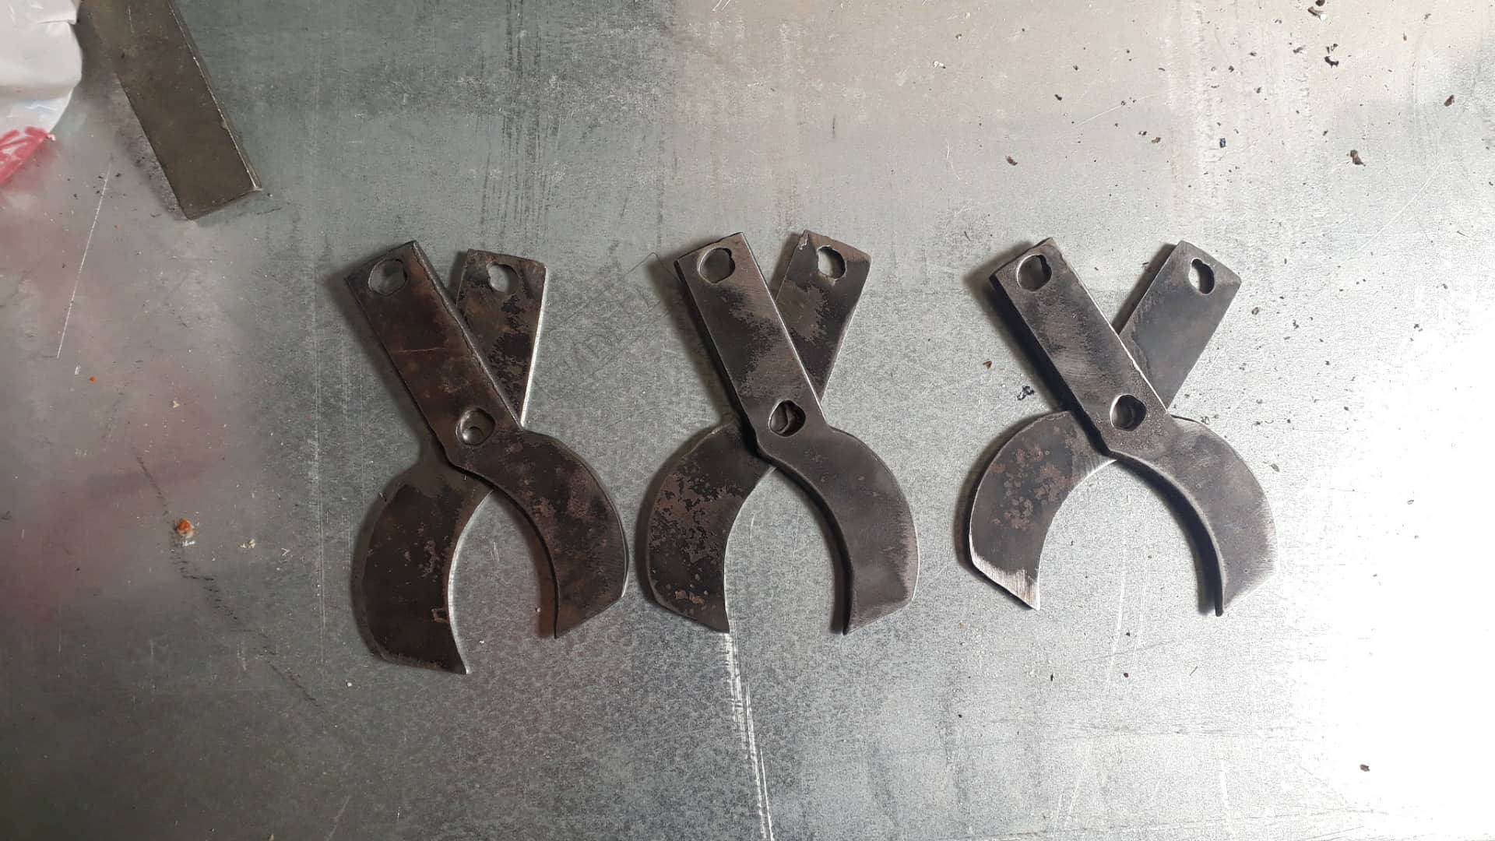
Removing methods

Slide 12
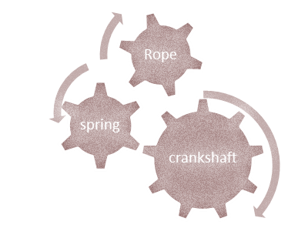
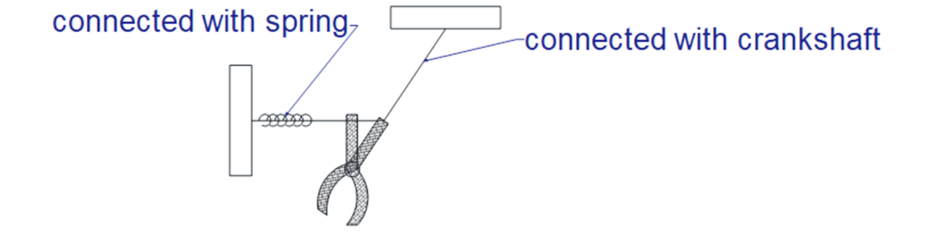

Slide 13
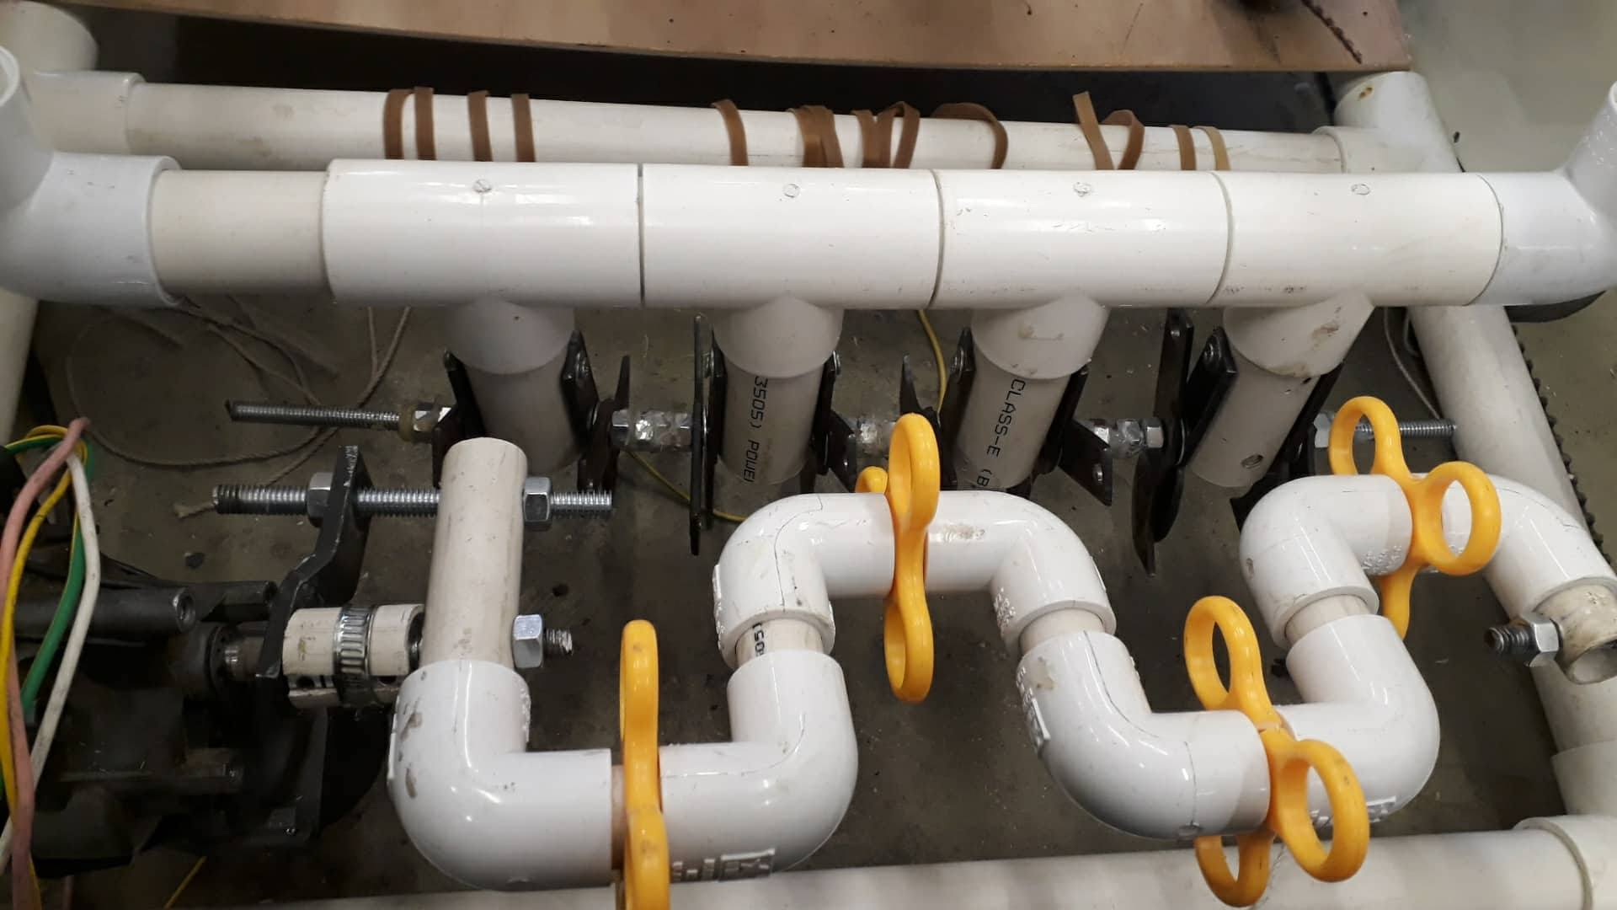

Slide 14
Robot movement
Timing Belt
DISK
Robot movement

Slide 15
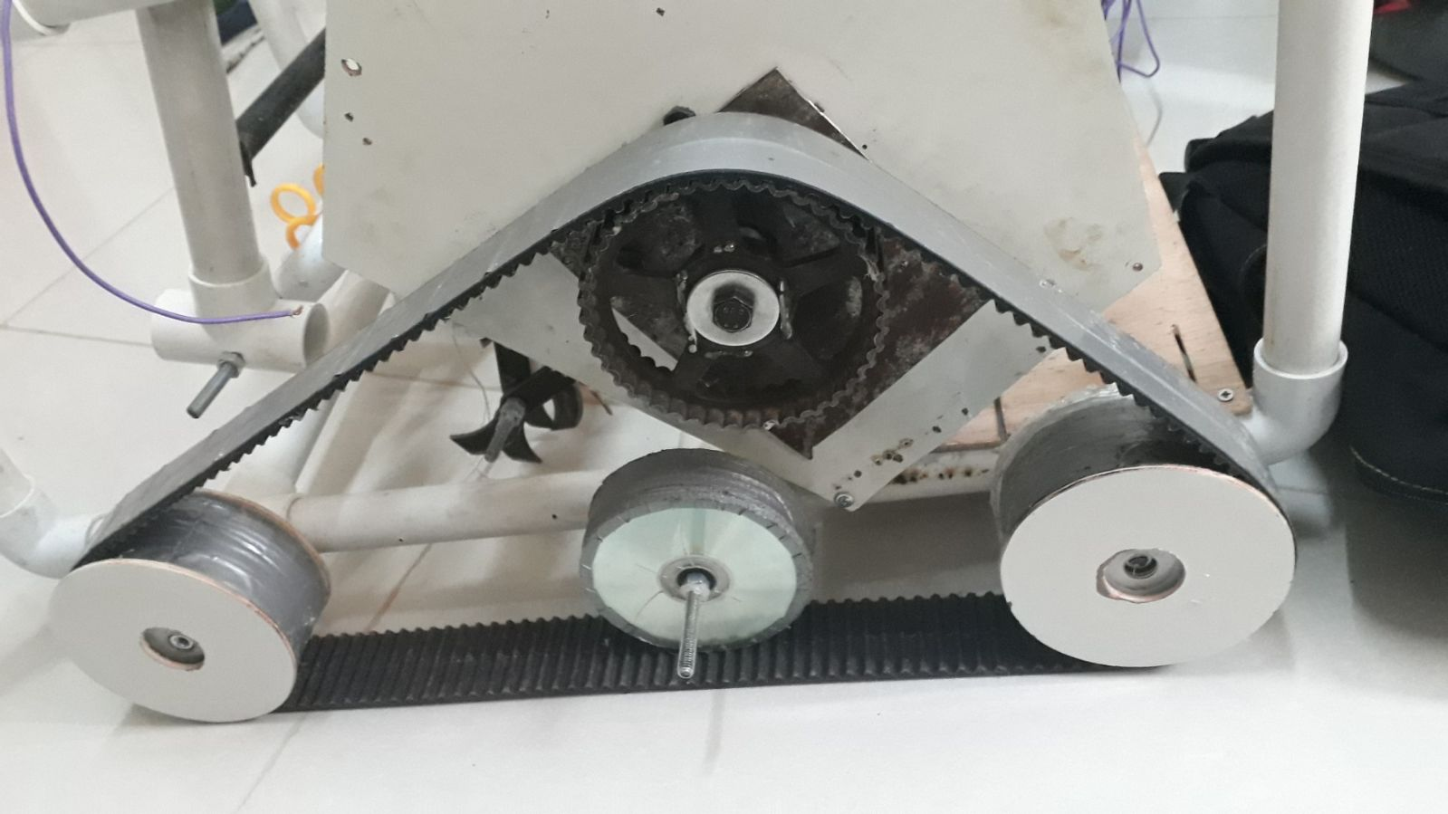

Slide 16
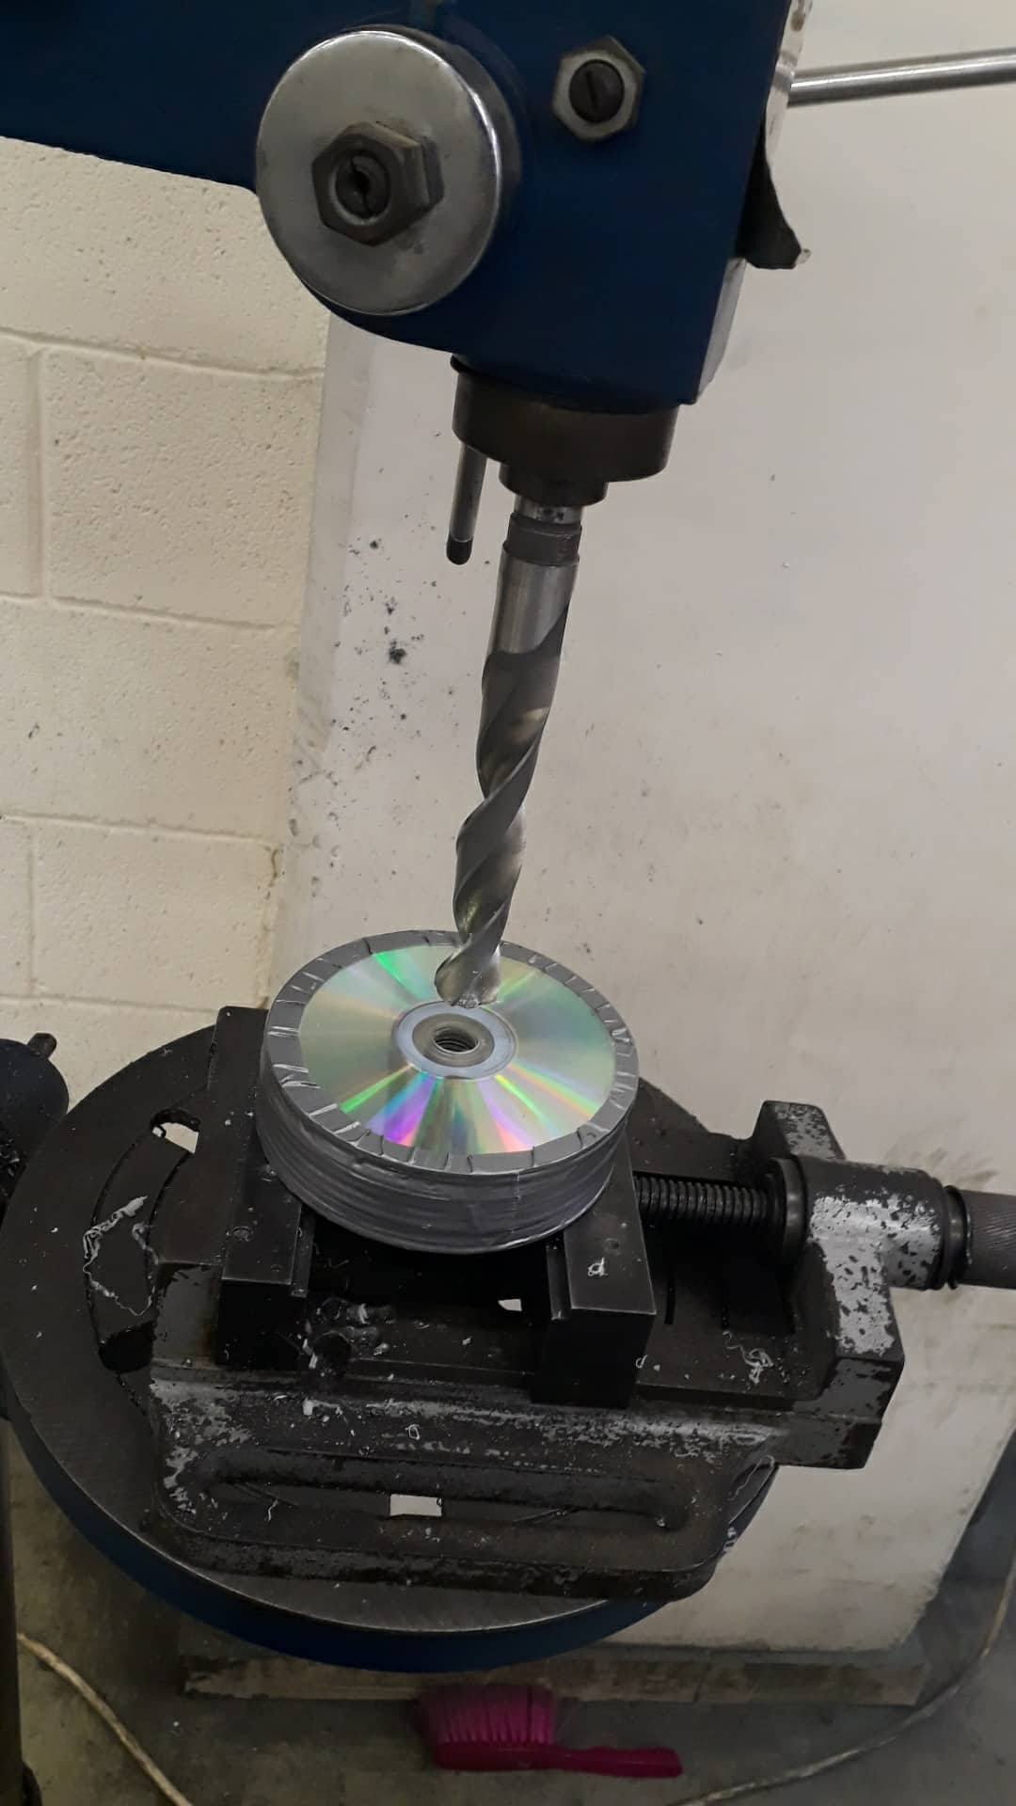
DON’T FORGET
The safety Rule when use this technical method

Slide 17
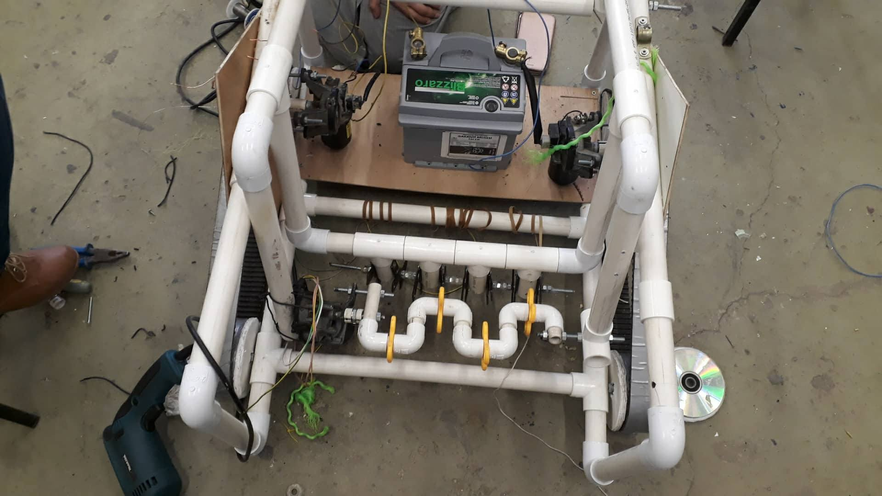
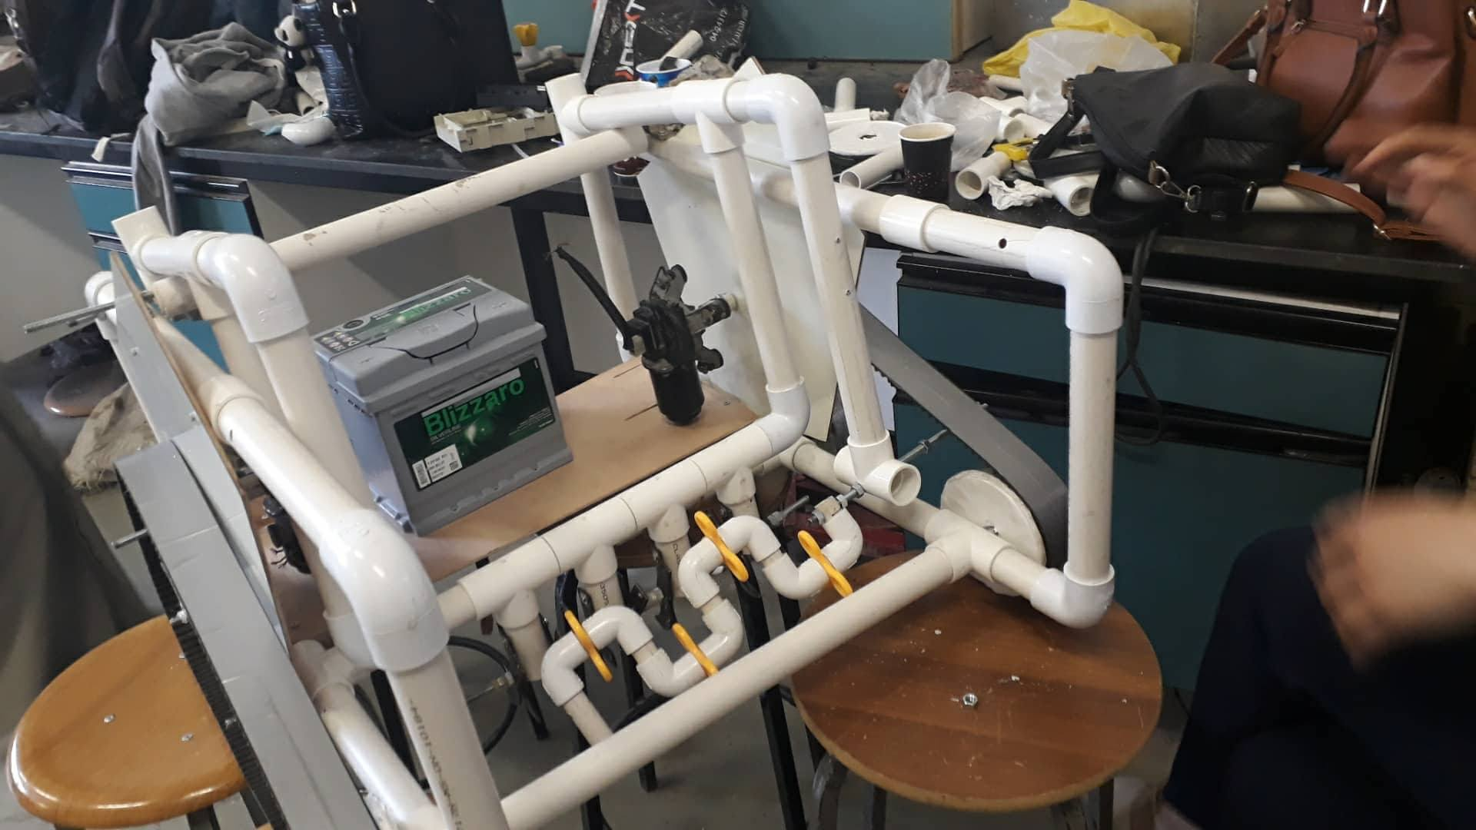
Finally

Slide 18
Power system
battery
motors

Slide 19
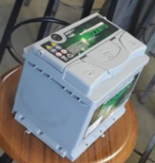
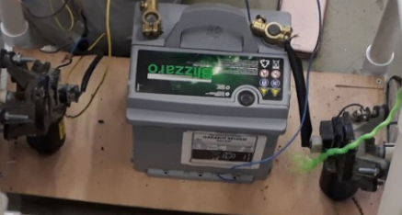
Battery:
Using lead acid battery 12 V / 40 Ah

Slide 20
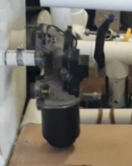
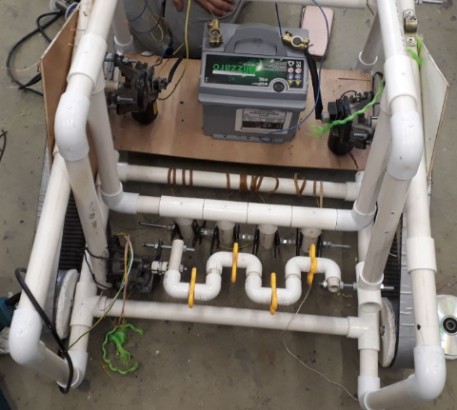
Motors:
We use 4 of wiper motors

Slide 21
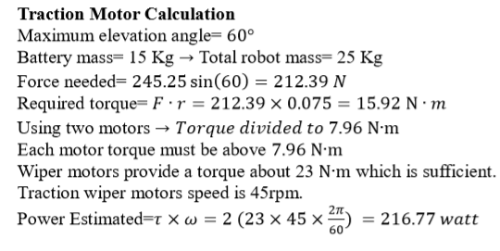
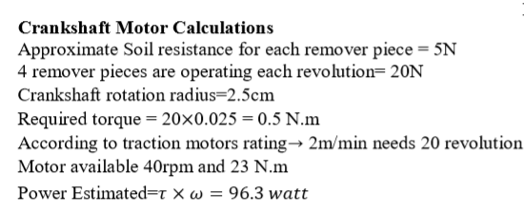
Calculation:

Slide 22
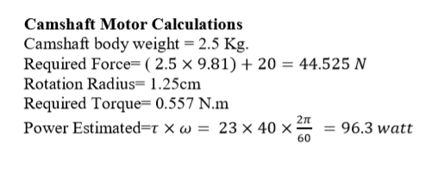
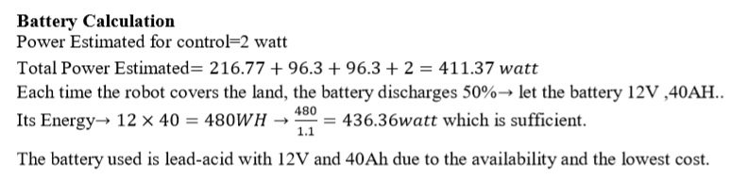

Slide 23
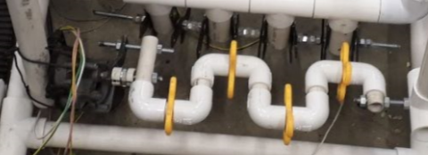
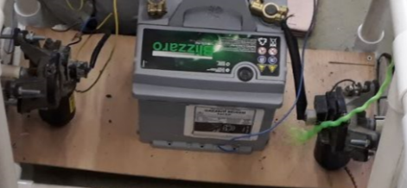
Wiper motor for crankshaft
Two wiper motors for traction

Slide 24
Control System
System Architecture
Data Processing and transfer
Programming and Coding
Feedback System
Detection System

Slide 25
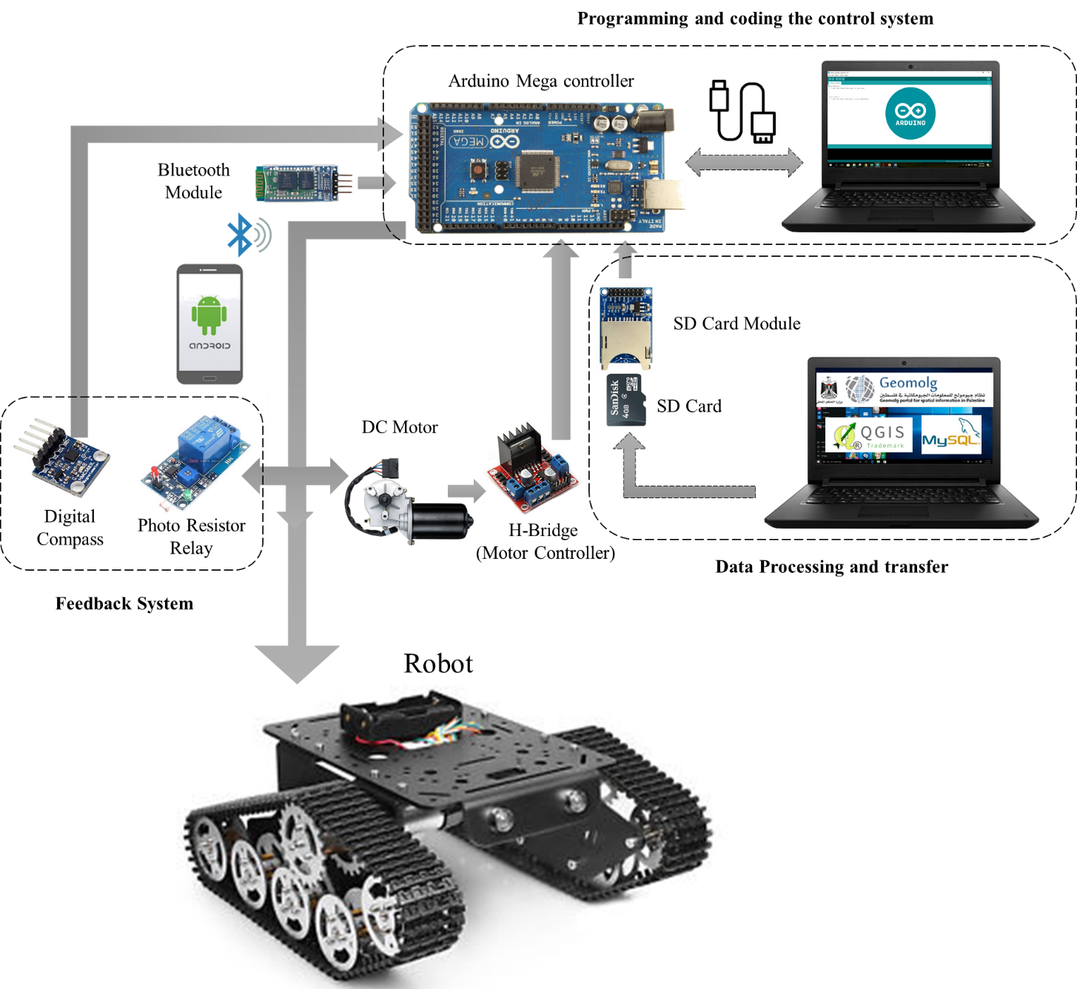

Slide 26
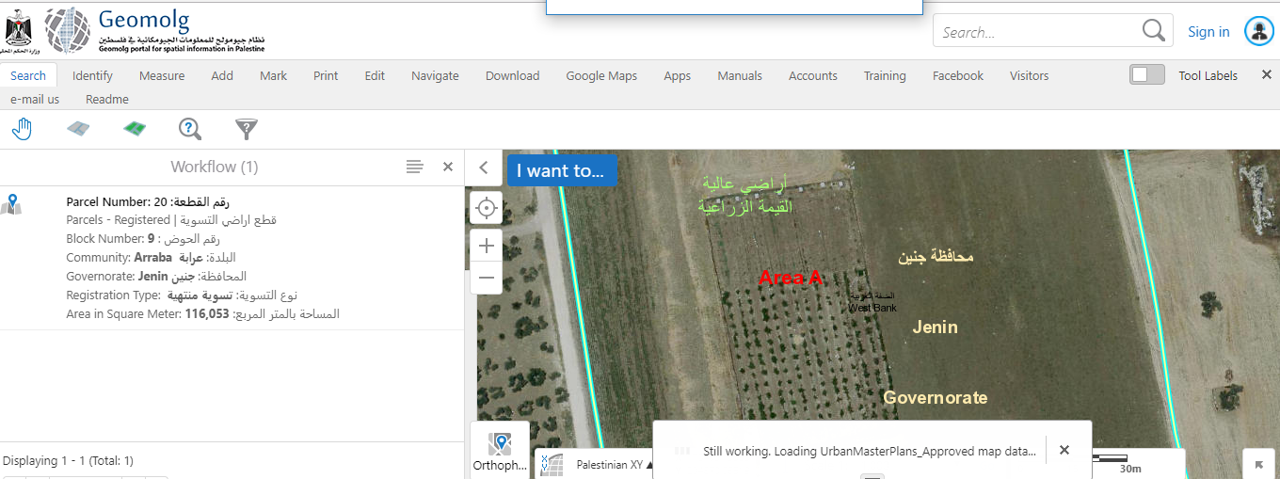

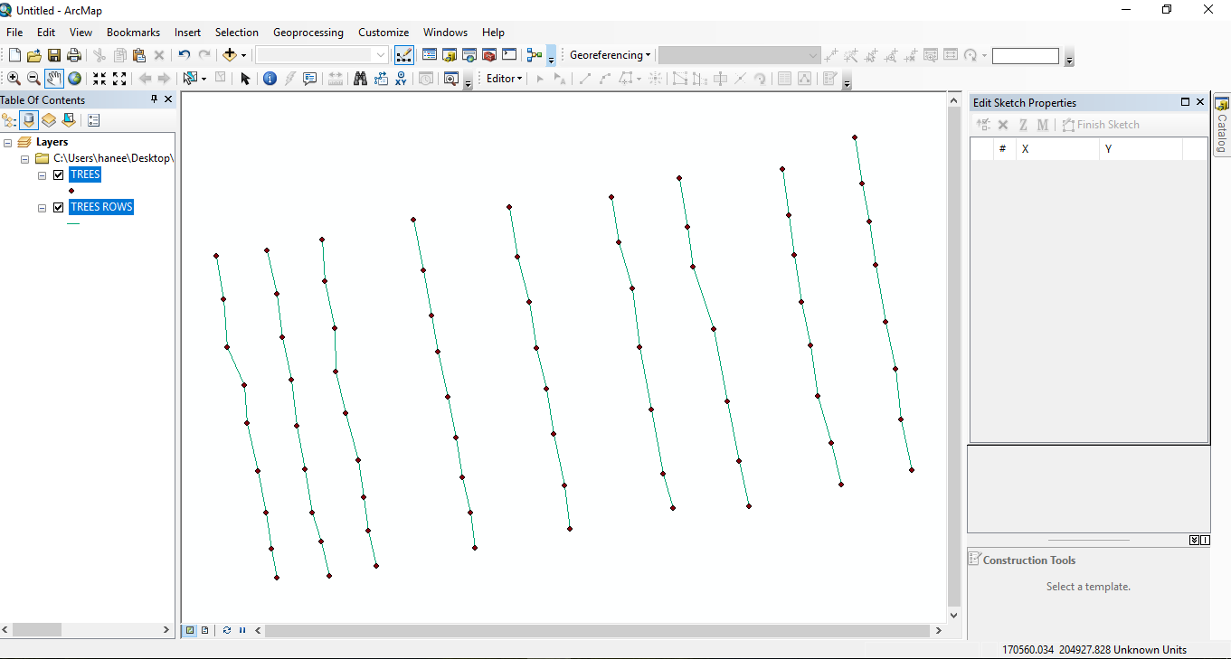


Slide 27
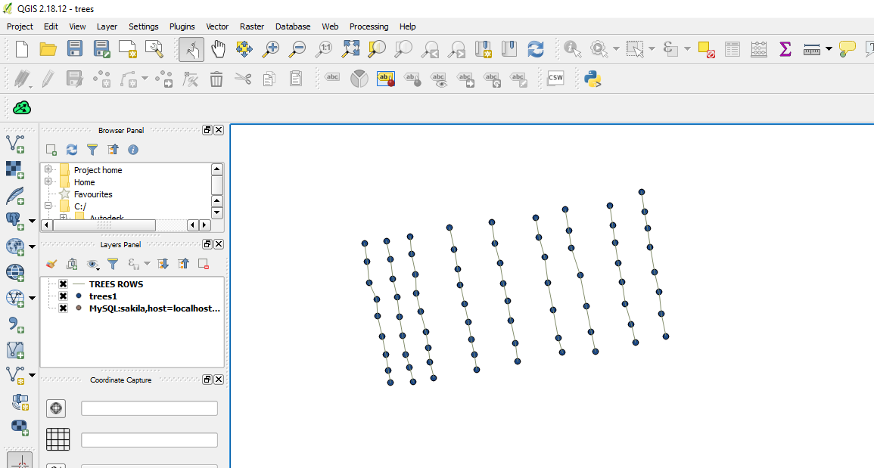

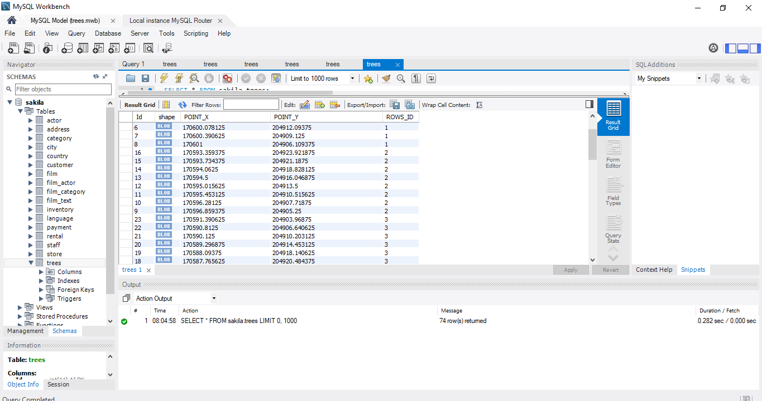


Slide 28
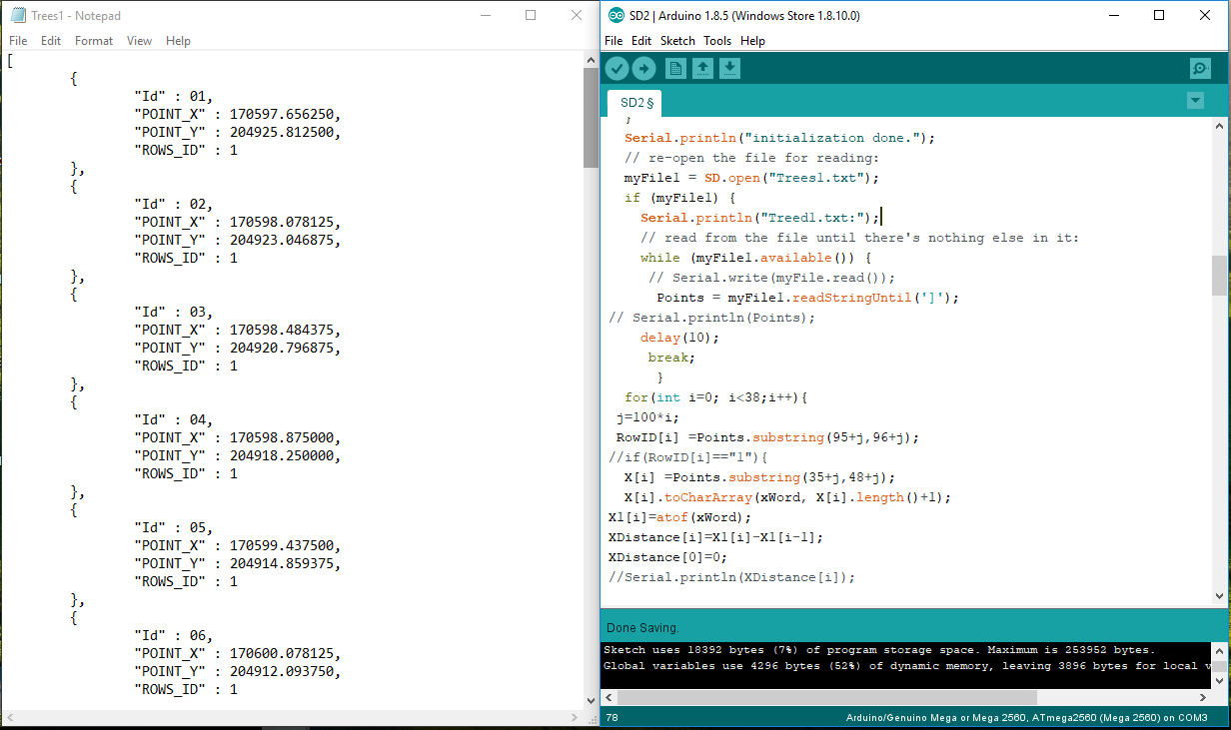




Slide 29
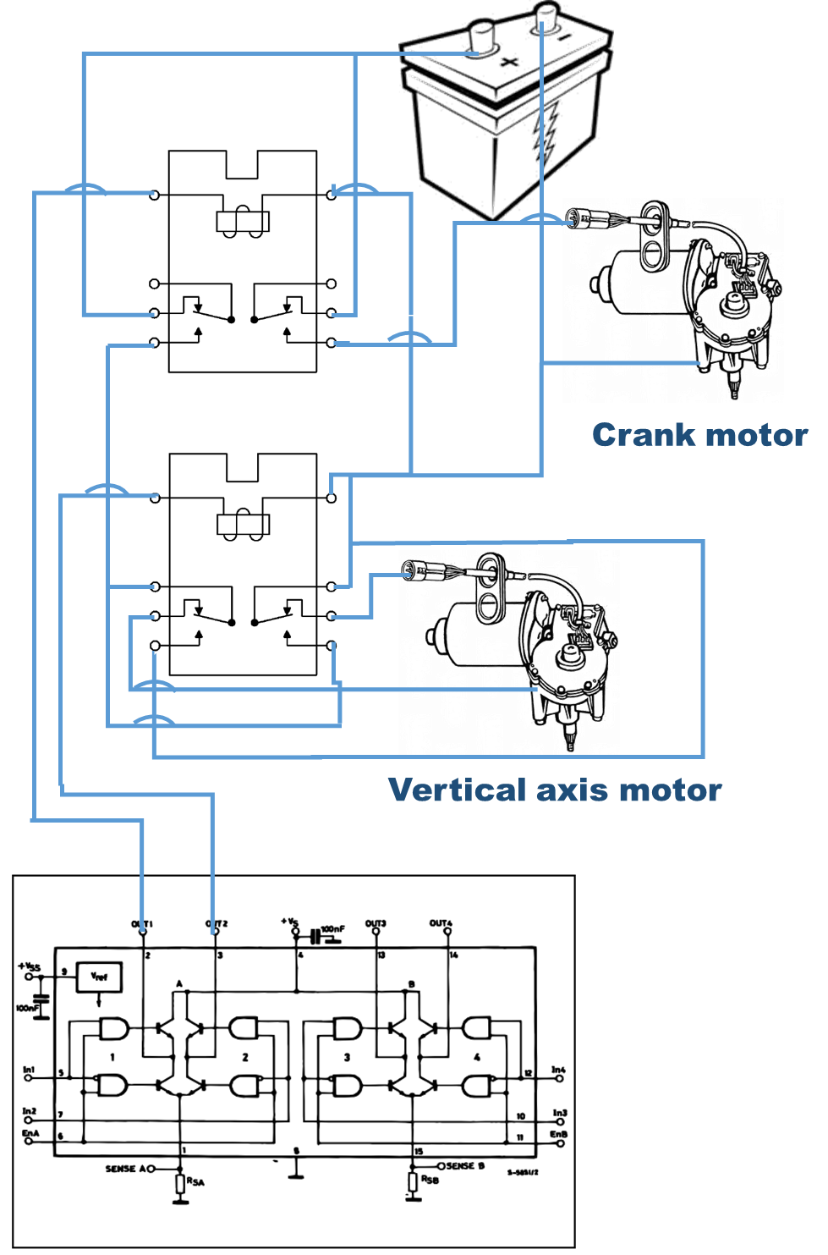
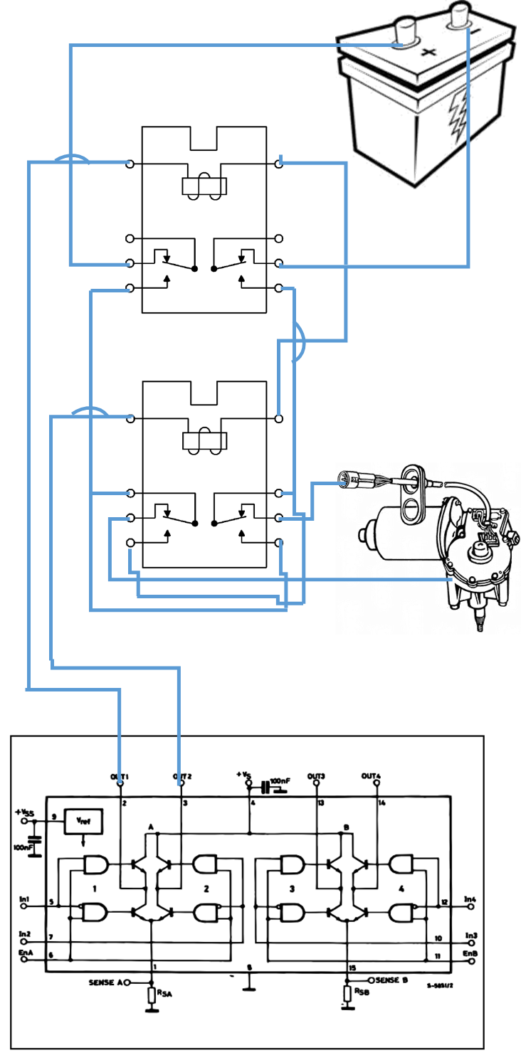
Traction Motor (R&L)

Slide 30
Truth table of H-bridge with the motor
enAR | enBL | In1R (enR) | In2R | In3L (enL) | In4L | Move
1 | 1 | 0 | x | 0 | x | Stop
1 | 1 | 0 | x | 1 | 0 | Turn Right
1 | 1 | 1 | 0 | 0 | x | Turn left
1 | 1 | 1 | 0 | 1 | 0 | Forward
1 | 1 | 1 | 1 | 1 | 1 | Reverse
1 | 1 | 1 | 1 | 1 | 0 | Sharp right
1 | 1 | 1 | 0 | 1 | 1 | Sharp Left

Slide 31
Cost
Material | Price (NIS)
PVC pipes & fittings + Shipping | 200 +200
Remover Pieces | 150
Robot accessories | 200
Tools used | 50
Motors | 220
Battery | 350
Control Element | 80
Control components | 200
Motors assembly | 350
Total | 2000

Slide 32
Any Questions?

