Slide 1

Faculty of Engineering & IT Industrial Engineering Department
Industrial Engineering Program
Improving Statistical Process Control Using Artificial Neural Networks
Prepeared by:
Amani Nassasra (12029429)
Zahra Maqboul (12028079)
Ehab Mashaqi (11820995)
Supervised by:
Dr.Basheer Shaheen

Slide 2

Table of Contents
01
Introduction
04
Results and Discussion
02
Data collection and processing
05
conclusion
03
Statistical Process Control Analysis

Slide 3

Introduction
01

Slide 4

Problem statement
Industries face challenges in maintaining quality and stability, such as underusing IoT and AI in SPC.
04
03
ML techniques are needed for dynamic production and consistent quality.
02
Traditional QC methods are limited by manual, costly, and reactive measures.
Growing data volume requires advanced anomaly detection and better tech integration.
01

Slide 5



Project objectives
Development of ANN-based QC model
Improve modeling and predictive capabilities
Ensure adaptability and scalability
i
Continuous improvement

Slide 6







Previous Works
  Research was conducted on the Google Scholar database, focusing on studies published between 2017 and 2024.
  Fifty research works were collected then twenty studies were actively selected based on two key selection criteria

Slide 7
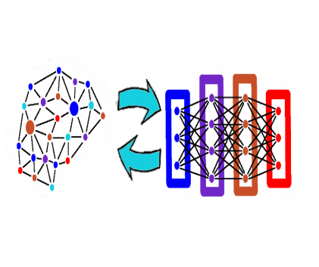
Artificial Neural Networks
Definition ANNs
ANNs are computational systems modeled after the neural structure of the human brain.
Neural Network Layers
ANNs are made up of node layers, including input, output, and one or more hidden layers
Node Connections
Weights, bias

Slide 8
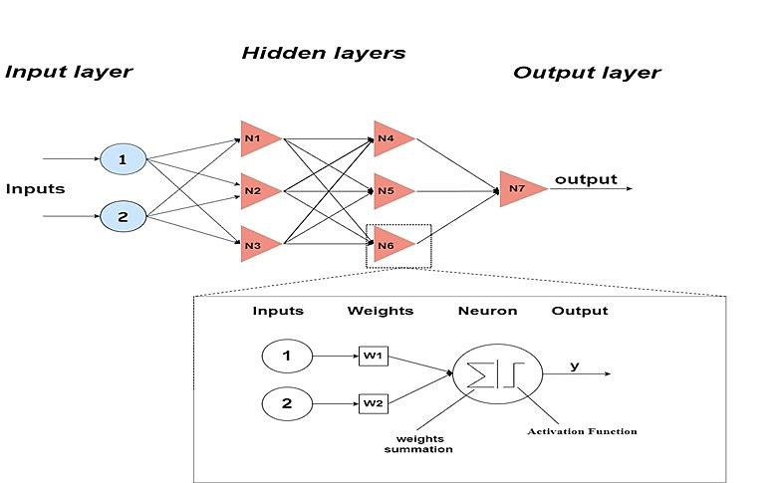
Mathematical Foundations of
Artificial Neural Networks

Slide 9

02
Data collection
and processing

Slide 10
Sampling time | Observations |  |  |  | Chocolate temperature | Weight of additive | Casting weight
 | 1 | 2 | 3 | 4
1 | 4.422 | 4.410 | 4.350 | 4.410 | 42.00 | 10.000 | 50.000
2 | 4.428 | 4.390 | 4.382 | 4.448 | 41.00 | 10.000 | 50.000
3 | 4.388 | 4.360 | 4.400 | 4.356 | 39.00 | 11.000 | 49.333
4 | 4.326 | 4.278 | 4.336 | 4.320 | 43.00 | 10.000 | 49.333
5 | 4.302 | 4.318 | 4.352 | 4.340 | 42.00 | 10.000 | 50.000
6 | 4.390 | 4.352 | 4.364 | 4.304 | 43.00 | 10.000 | 50.000
7 | 4.384 | 4.362 | 4.404 | 4.390 | 39.00 | 12.000 | 49.333
8 | 4.342 | 4.386 | 4.34 | 4.326 | 39.00 | 9.500 | 49.333
9 | 4.328 | 4.344 | 4.352 | 4.326 | 41.00 | 9.300 | 50.000
10 | 4.328 | 4.384 | 4.388 | 4.352 | 41.00 | 8.600 | 50.000
11 | 4.316 | 4.338 | 4.38 | 4.468 | 41.00 | 10.000 | 49.333
12 | 4.39 | 4.368 | 4.392 | 4.418 | 39.00 | 10.000 | 50.000
13 | 4.440 | 4.434 | 4.366 | 4.404 | 39.00 | 9.300 | 51.333
14 | 4.320 | 4.308 | 4.326 | 4.346 | 40.00 | 9.300 | 50.000
15 | 4.360 | 4.372 | 4.368 | 5.360 | 41.00 | 9.300 | 49.333
16 | 4.330 | 4.384 | 4.390 | 4.292 | 40.00 | 10.000 | 49.333
17 | 4.328 | 4.376 | 4.360 | 4.354 | 39.00 | 9.500 | 50.000
18 | 4.348 | 4.324 | 4.390 | 4.360 | 40.00 | 10.000 | 50.000
19 | 4.416 | 4.402 | 4.412 | 4.404 | 39.00 | 10.000 | 50.000
20 | 4.408 | 4.446 | 4.440 | 4.414 | 37.00 | 11.000 | 49.333
Overview of Collected data

Slide 11
Data collection and processing stages
Overview of the Production Process
Data Preprocessing
IQR rule
AL-ARZ Ice cream company
Tartufo Production quality data
Collected Data
Sampling methodology
797 datasheet
Over 4 months period
Specialized measuring devices
Data recording

Slide 12

Statistical Process Control analysis
03

Slide 13
SPC tools
Flow Diagram
Cause and effect diagram
Run chart
Pareto Chart
Histogram

Slide 14
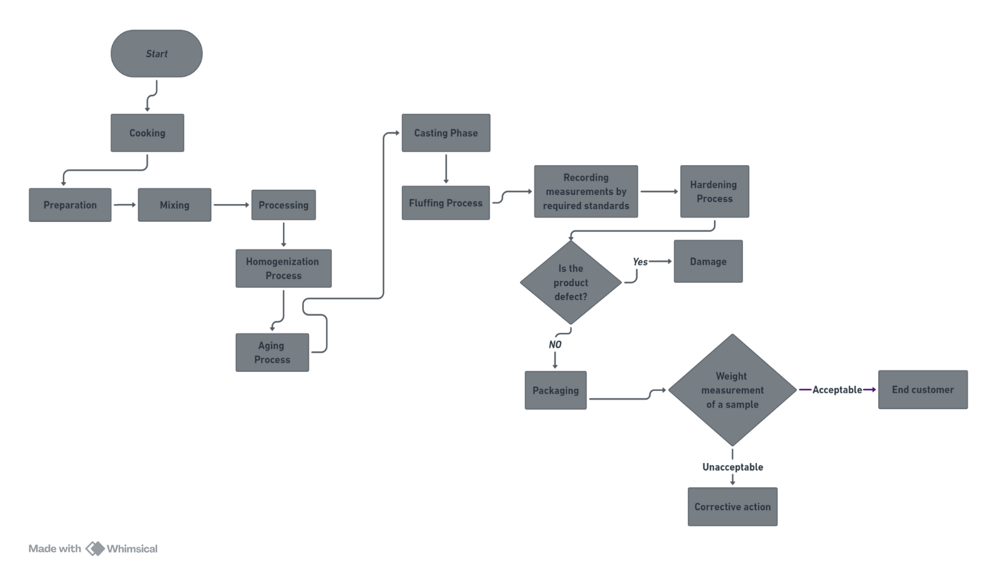
1. Process flow diagram for Tartufo production process
Notes:
© Copyright www.free-ppt-templates-download.com

Slide 15
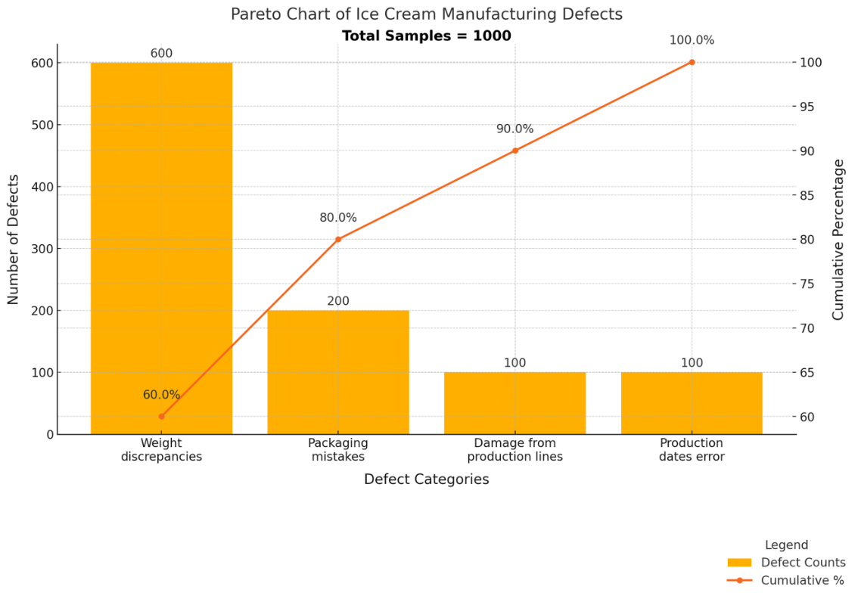
2. Pareto chart

Slide 16
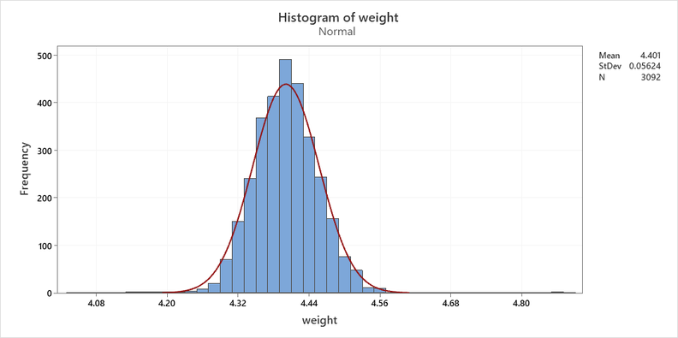
3. Histogram of weight

Slide 17
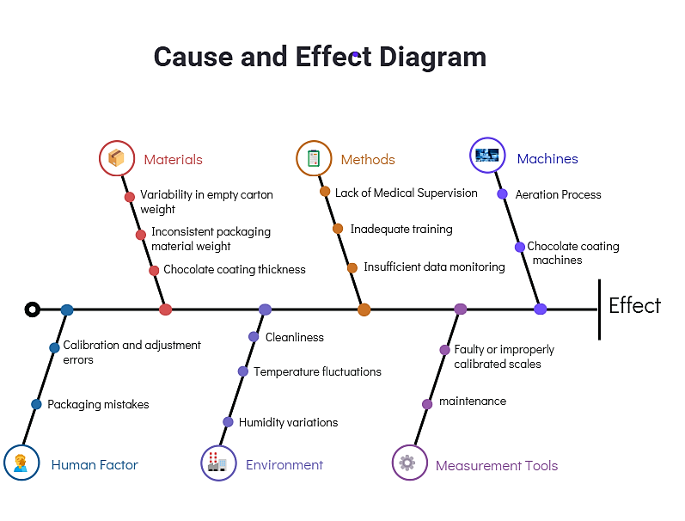
4. Cause and Effect Diagram
          for weight discrepancies defect

Slide 18
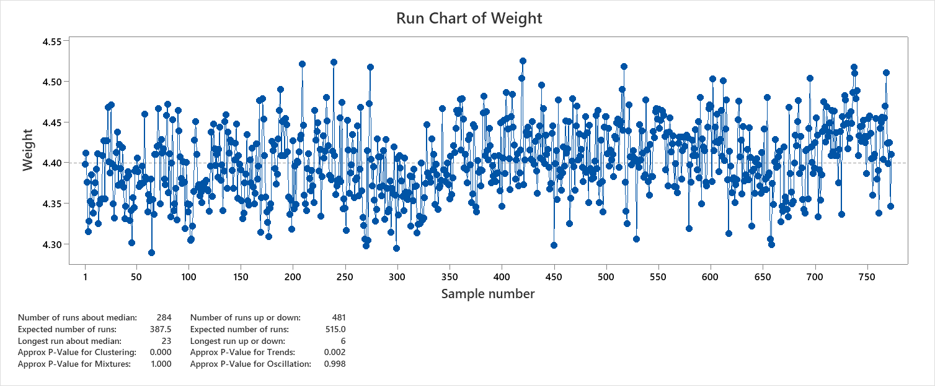
5. Run chart of weight

Slide 19
04
Results and Discussion

Slide 20

Modeling stages
Data Analysis Tool
  Spss
C
B
Data Inputs
  Independent and dependent variables
A
Methodology
  MLP,RBF
  Activation functions
  Hyperparameter tuning

Slide 21
Performance Analysis of ANN1 Model

Slide 22

Input Layer | Covariates | 1 | Sample Number
 |  | 2 | Temperature
 |  | 3 | Weight of additive
 |  | 4 | Casting weight
 | Number of Unitsª |  | 4
 | Rescaling Method for Covariates |  | Standardized
Hidden Layer(s) | Number of Hidden Layers |  | 2
 | Number of Units in Hidden Layer 1ª |  | 6
 | Number of Units in Hidden Layer 2ª |  | 6
 | Activation Function |  | Hyperbolic tangent
Output Layer | Dependent Variables | 1 | Weight box Average
 | Number of Units |  | 1
 | Rescaling Method for Scale Dependents |  | Standardized
 | Activation Function |  | Identity
a. Excluding the bias unit
Network Information
for ANN1 model

Slide 23
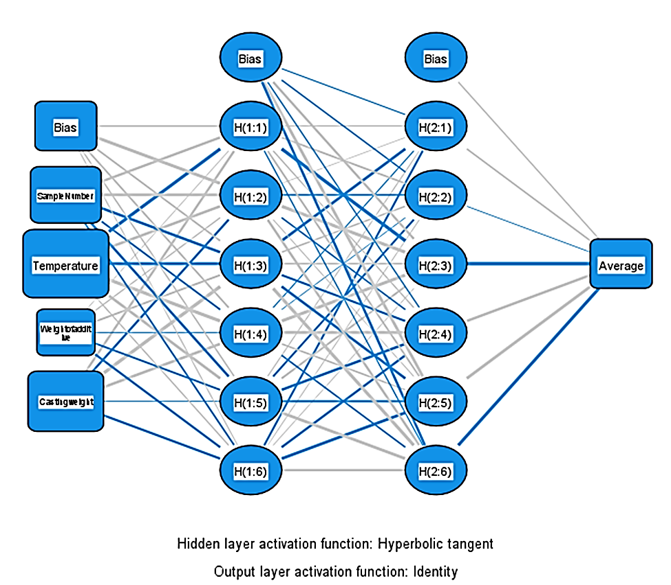
Neural Network
Diagram
for ANN1 model

Slide 24
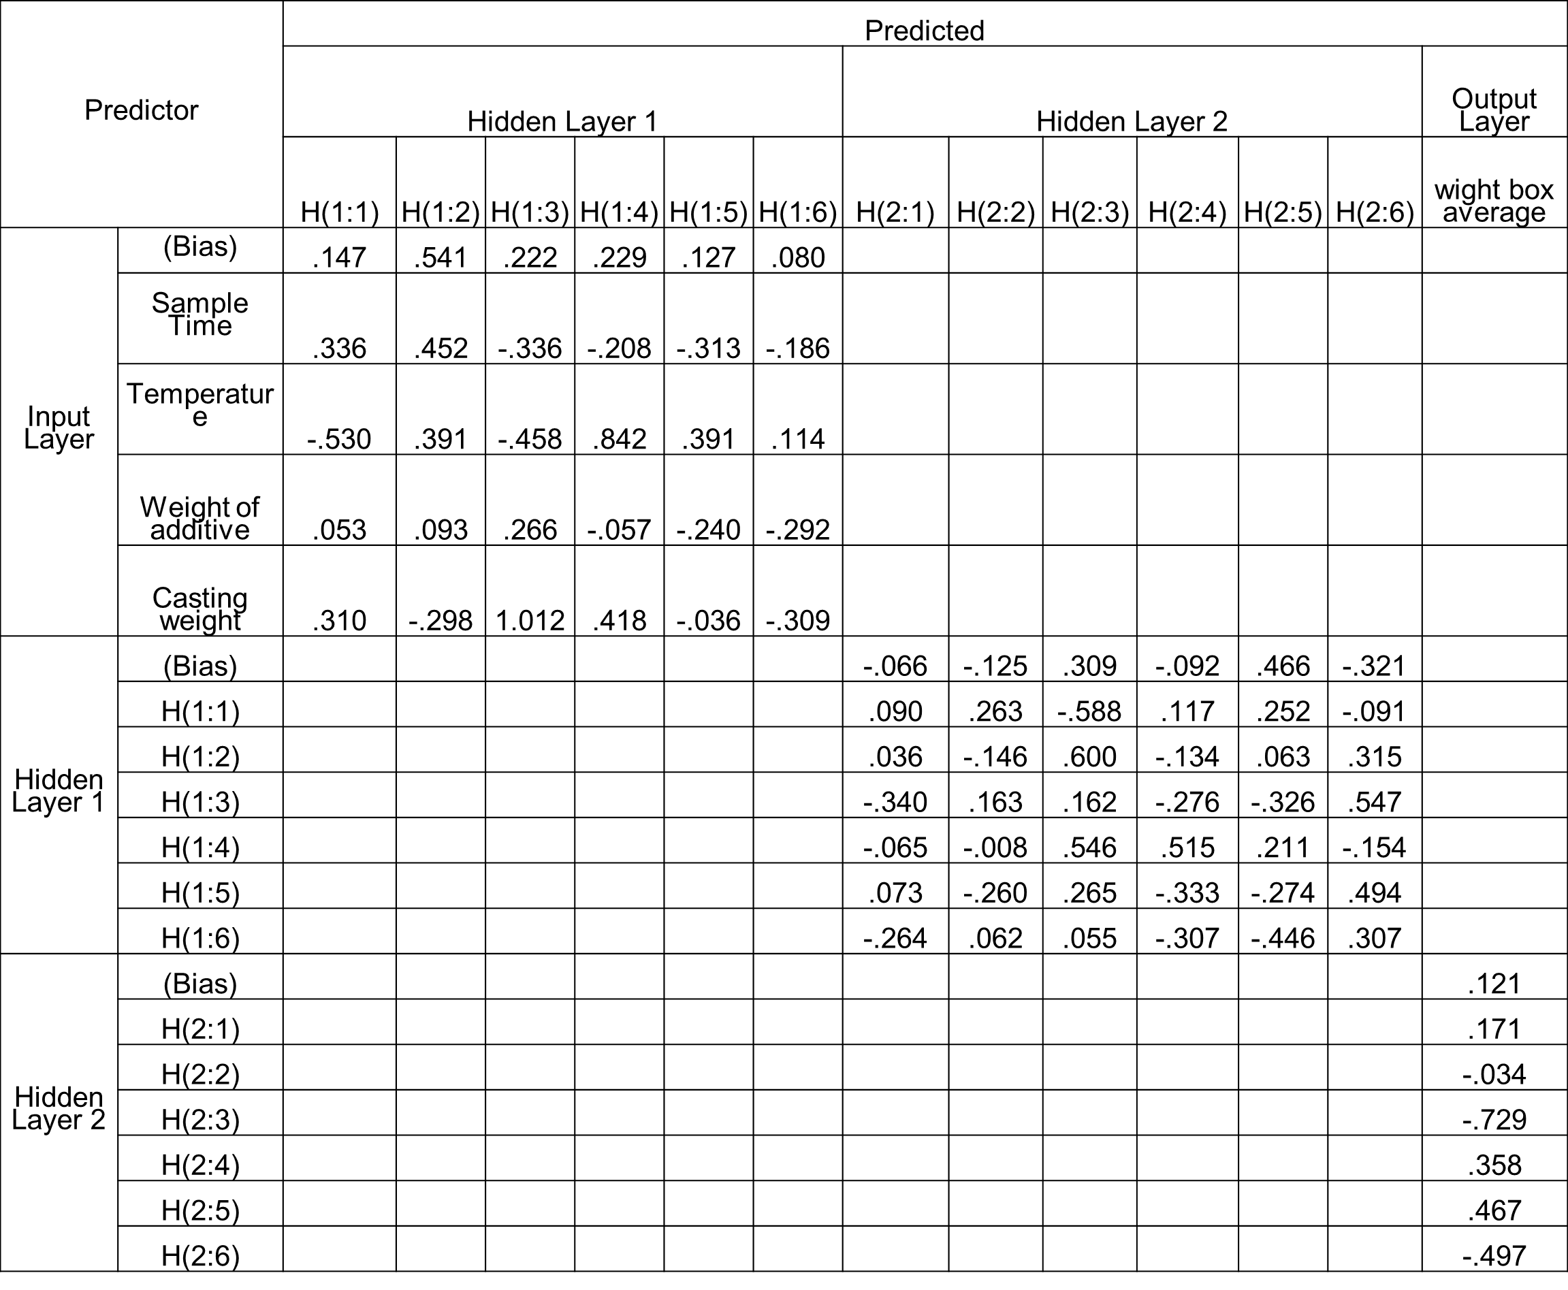
Parameter
Estimates

Slide 26
Performance Analysis of ANN2 Model

Slide 27
Network Information
Input Layer | Covariates | 1 | sampling time
 |  | 2 | Temperature
 |  | 3 | Weight of additive
 |  | 4 | Casting weight
 | Number of Unitsª |  | 4
 | Rescaling Method for Covariates |  | Standardized
Hidden Layer(s) | Number of Hidden Layers |  | 1
 | Number of Units in Hidden Layer 1ª |  | 6
 | Activation Function |  | Sigmoid
Output Layer | Dependent Variables | 1 | weight box average
 | Number of Units |  | 1
 | Rescaling Method for Scale Dependents |  | Standardized
 | Activation Function |  | Identity
a. Excluding the bias unit
Network Information
for ANN2 model

Slide 28
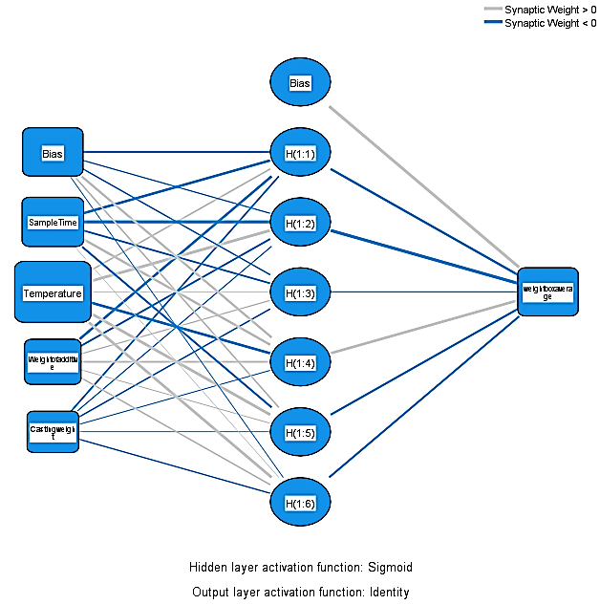
Neural Network
Diagram
for ANN2 model

Slide 29
Predictor |  | Predicted
 |  | Hidden Layer 1 |  |  |  |  |  | Output Layer
 |  | H(1:1) | H(1:2) | H(1:3) | H(1:4) | H(1:5) | H(1:6) | Weight box average
Input Layer | (Bias) | -.391 | -.097 | -.137 | .405 | .247 | -.036
 | SampleTime | -.465 | -.918 | -.315 | .443 | -.379 | .008
 | Temperature | .298 | .719 | .035 | -.494 | .612 | .610
 | Weightofadditive | -.450 | -.320 | .119 | .366 | .075 | .163
 | Castingweight | -.306 | -.086 | -.161 | -.064 | -.026 | -.120
Hidden Layer 1 | (Bias) |  |  |  |  |  |  | .736
 | H(1:1) |  |  |  |  |  |  | -.429
 | H(1:2) |  |  |  |  |  |  | -.941
 | H(1:3) |  |  |  |  |  |  | -.080
 | H(1:4) |  |  |  |  |  |  | .576
 | H(1:5) |  |  |  |  |  |  | -.381
 | H(1:6) |  |  |  |  |  |  | -.379
Parameter
Estimates

Slide 31
Comparison of MLP models
 | ANN1 | ANN2
Number of Hidden Layers | 2 | 1
Number of Neurons | H6, H6 | H6
Hidden Layers Activation Function | Hyperbolic Tangent | Sigmoid
Outputs Activation Function | Identity | Identity
Type of Training | Mini-batch | Batch
Optimization Algorithm | Gradient descent | Scaled conjugate gradient
RMSE Training | 0.03805 | 0.03879
RMSE Testing | 0.04226 | 0.04250
MAE Training | 0.03058 | 0.03108
MAE Testing | 0.0344 | 0.03533
MSE Training | 0.00144 | 0.00115
MSE Testing | 0.00178 | 0.00181
R² | 0.2354 | 0.20533

Slide 32
Performance Analysis of ANN3 Model

Slide 33
Input Layer | Covariates | 1 | Sample Number
 |  | 2 | Temperature
 |  | 3 | Weight of additive
 |  | 4 | Casting weight
 | Number of Units |  | 4
 | Rescaling Method for Covariates |  | Adjusted normalized
Hidden Layer | Number of Units |  | 12
 | Activation Function |  | Softmax
Output Layer | Dependent Variables | 1 | Average
 | Number of Units |  | 1
 | Rescaling Method for Scale Dependents |  | Adjusted normalized
 | Activation Function |  | Identity
 | Error Function |  | RMSE
Network Information
for ANN3 model

Slide 34
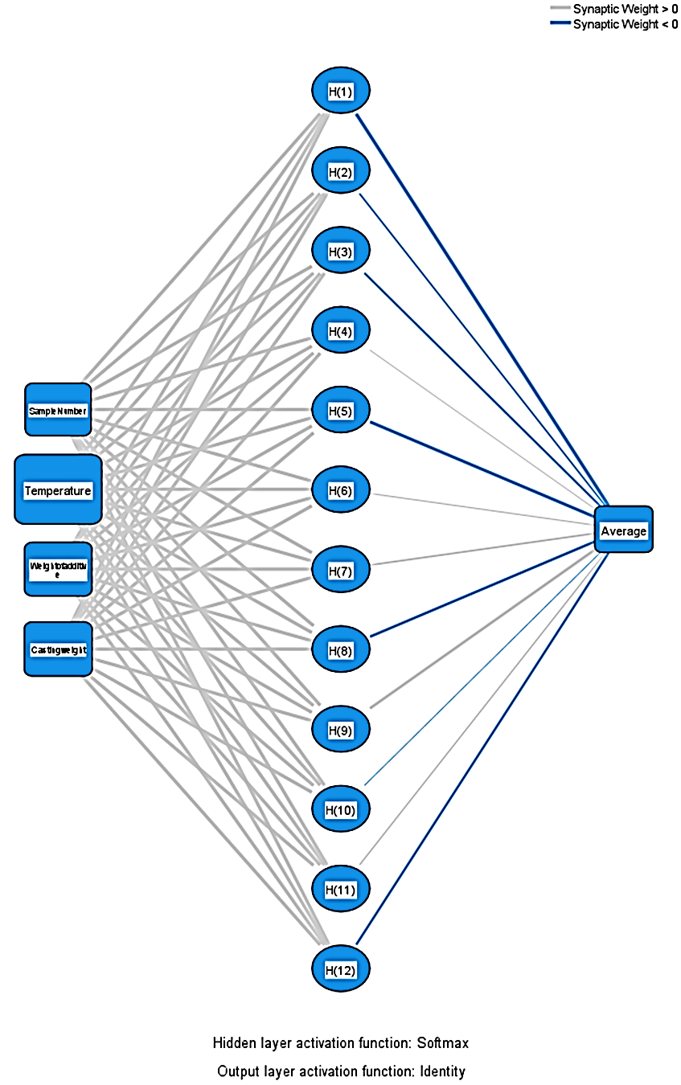
Neural Network
Diagram
for ANN3 model

Slide 35
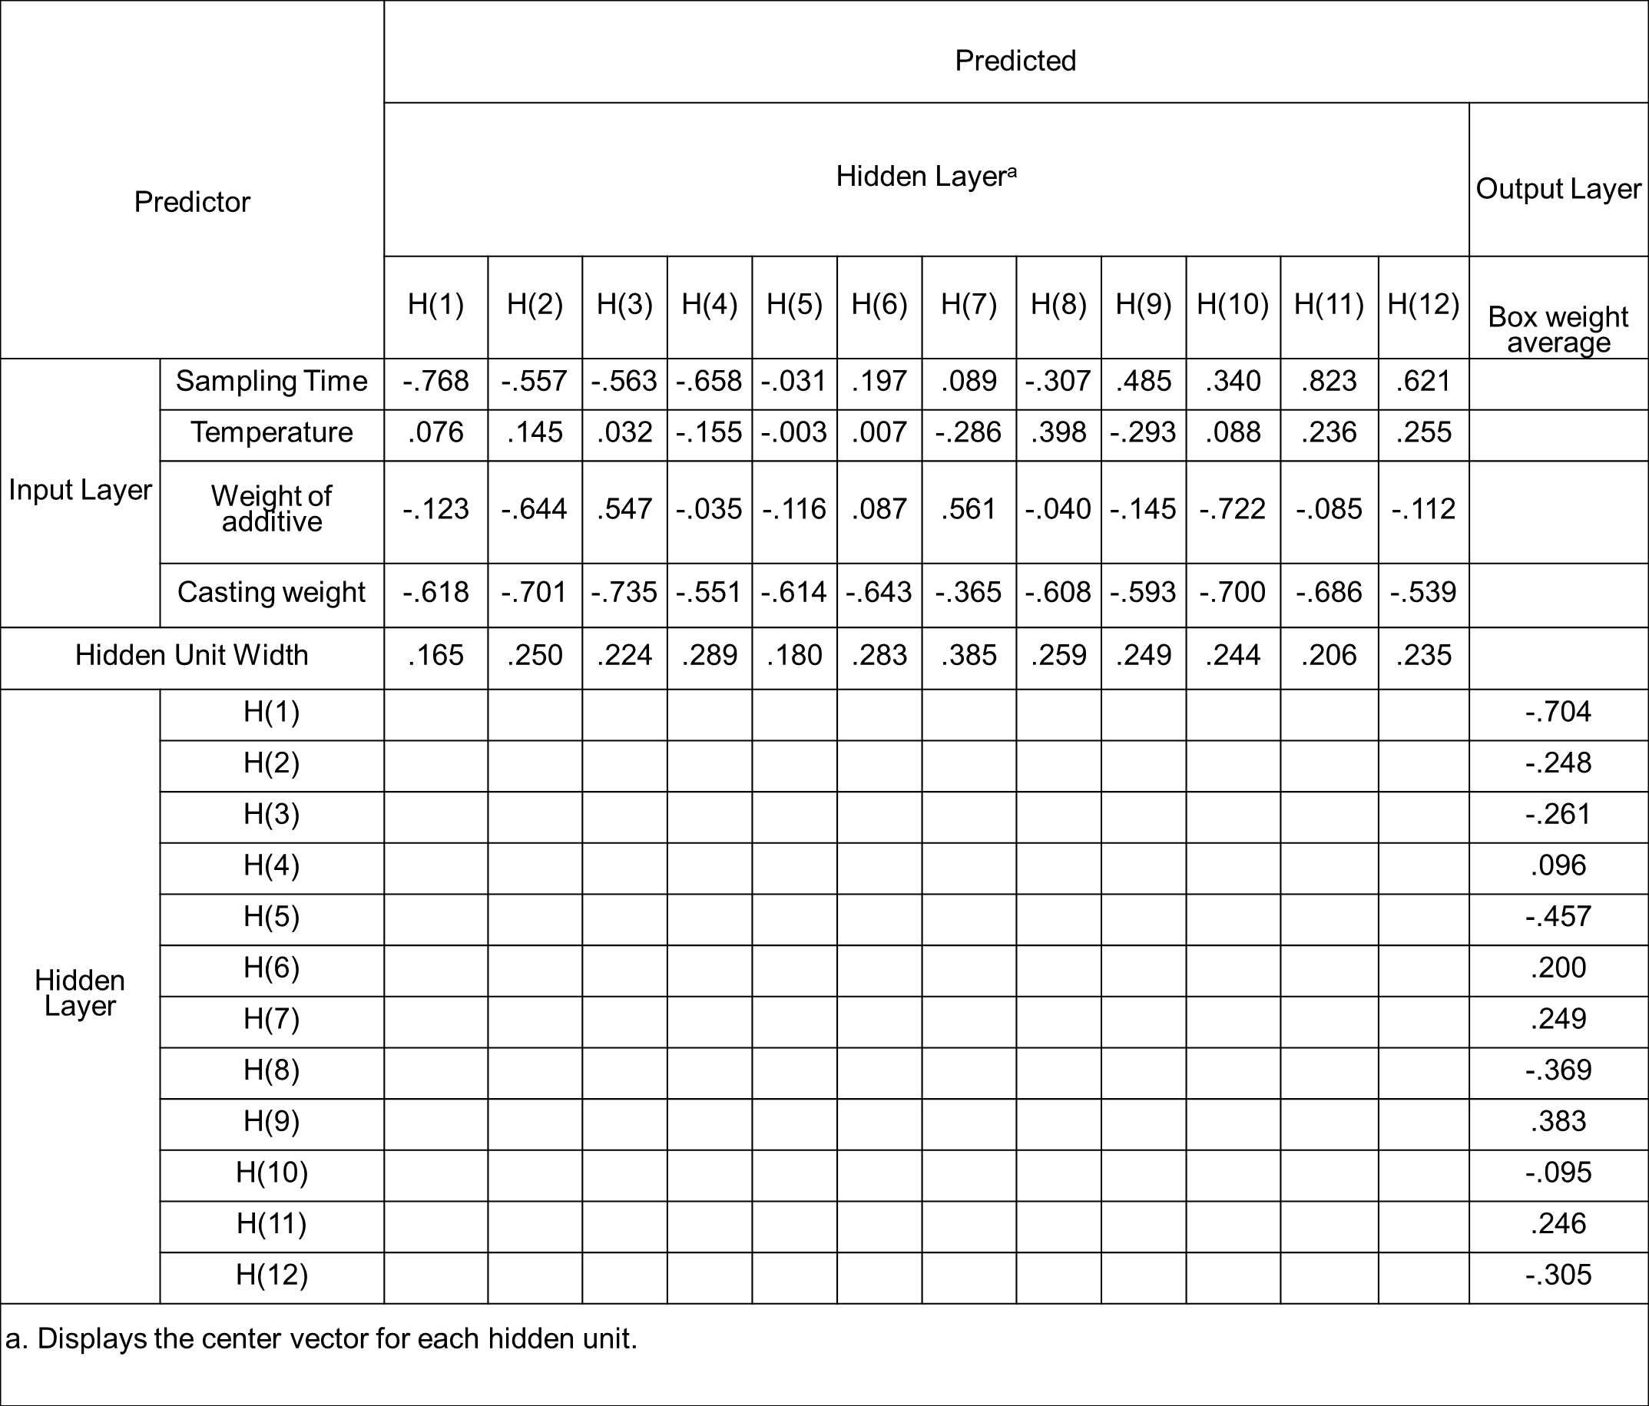
Parameter
Estimates

Slide 37
Performance Analysis of ANN4 Model

Slide 38
Input Layer | Covariates | 1 | Sample Number
 |  | 2 | Temperature
 |  | 3 | Weight of additive
 |  | 4 | Casting weight
 | Number of Units |  | 4
 | Rescaling Method for Covariates |  | Adjusted normalized
Hidden Layer | Number of Unitsª |  | 12
 | Activation Function |  | Exponential
Output Layer | Dependent Variables | 1 | Average
 | Number of Units |  | 1
 | Rescaling Method for Scale Dependents |  | Adjusted normalized
 | Activation Function |  | Identity
a. Excluding the intercept unit
Network Information
for ANN4 model

Slide 39
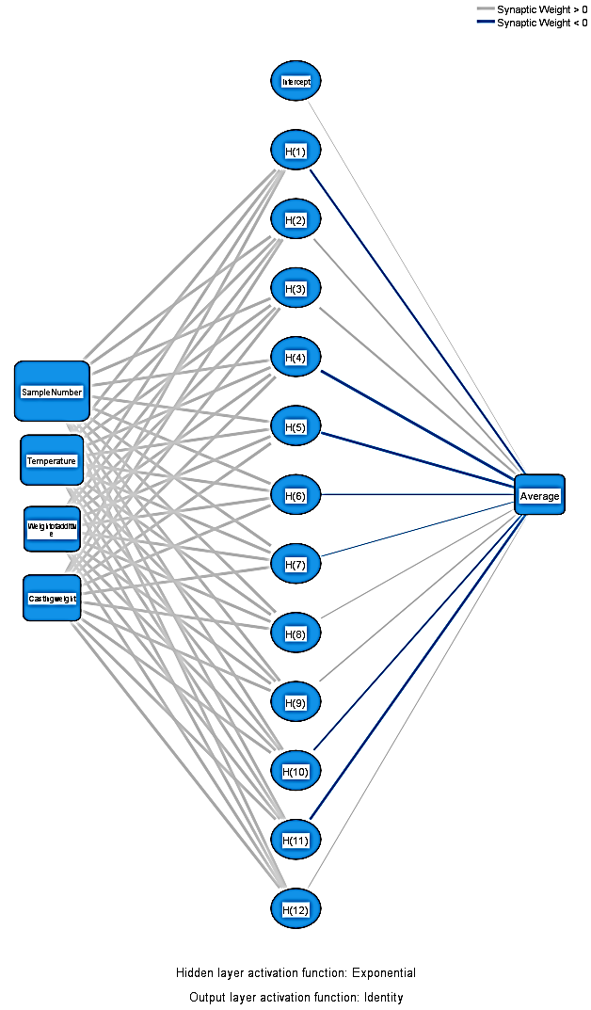
Neural Network
Diagram
for ANN4 model

Slide 40
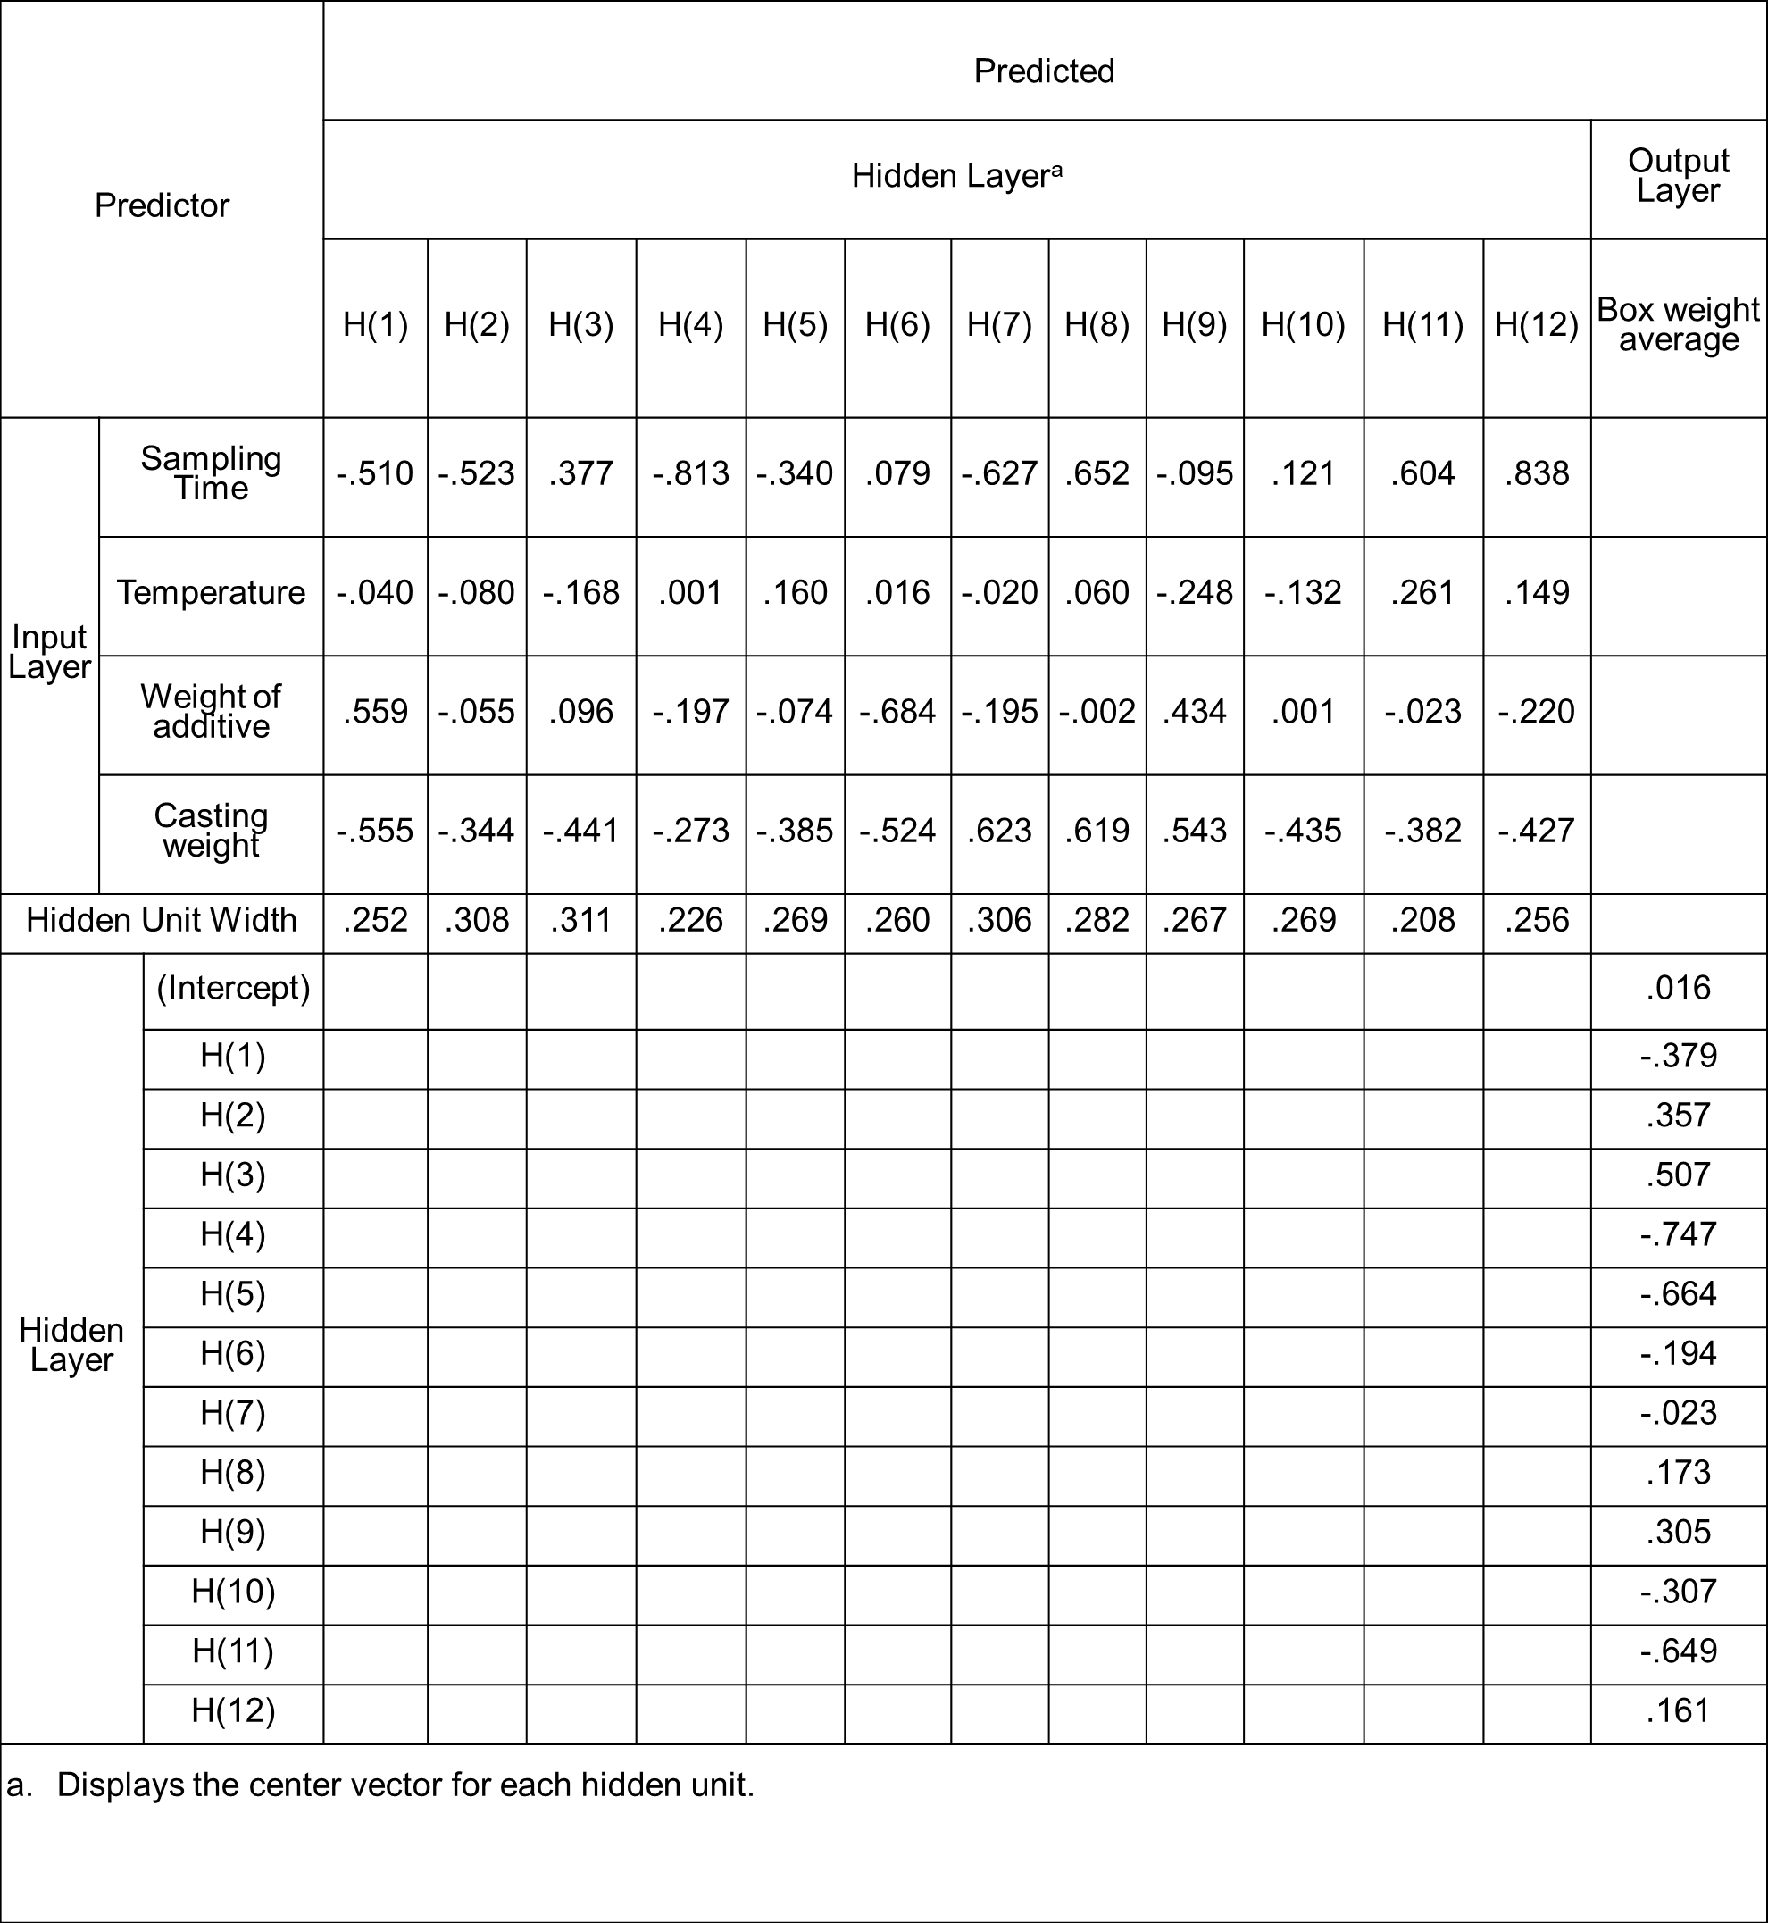
Parameter
Estimates

Slide 42
Comparison of RBF models
 | ANN 3 | ANN 4
Number of Hidden Layers | 1 | 1
Number of Neurons | H12 | H12
Hidden Layers Activation Function | Softmax | Exponential
Outputs Activation Function | Identity | Identity
RMSE Training | 0.03832 | 0.04020
RMSE Testing | 0.04291 | 0.04281
MAE Training | 0.03060 | 0.03214
MAE Testing | 0.03532 | 0.03486
MSE Training | 0.00147 | 0.00161
MSE Testing | 0.00184 | 0.00183
Training R² | 0.21598 | 0.15138

Slide 43
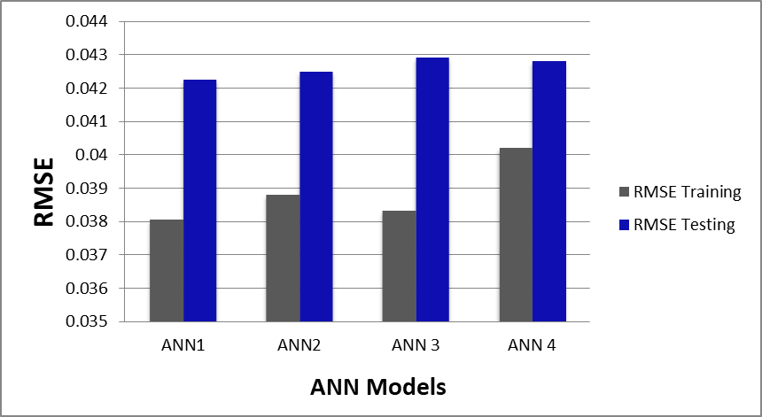
Comparison of Optimal MLP and RBF Models
 | ANN1 | ANN3
Number of Hidden Layers | 2 | 1
Number of Neurons | H6, H6 | H12
Hidden Layers Activation Function | Hyperbolic Tangent | Softmax
Outputs Activation Function | Identity | Identity
RMSE Training | 0.03805 | 0.03832
RMSE Testing | 0.04226 | 0.04291
MAE Training | 0.03058 | 0.03060
MAE Testing | 0.03440 | 0.03532
MSE Training | 0.00144 | 0.00147
MSE Testing | 0.00178 | 0.00184
Training R² | 0.2354 | 0.21598

Slide 44
Importance analysis for ANN1
100%
78.7%
 | Importance (MLP)
Sampling time | .237
Temperature | .345
Weight of additive | .146
Casting weight | .272
68.6%
42.4%

Slide 45
Importance analysis
for ANN3
 | Importance (RBF)
Sampling time | .215
Temperature | .337
Casting weight | .226
Weight of additive | .223
100%
67%
66.2%
63.8%

Slide 46

Conclusion
05

Slide 47

Conclusion
High prediction accuracy model
Real-time monitoring
Practical Applicability
Practical Applicability

Slide 48


