Slide 1
Chapter six
Dynamic loads
6.1: Design response spectrum for the structure.
6.2: The dynamic analysis method used.
6.3: Hand calculation for lateral seismic force.
6.4: SAP calculation for lateral seismic force.
6.5: Z component for earthquake.

Slide 2
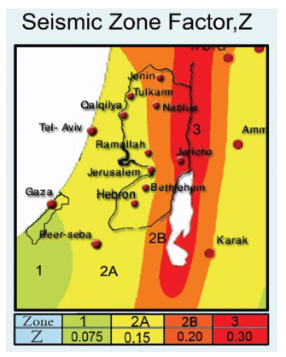
6.1: Design response spectrum for the structure:
-Z=0.2 g
-site class = B
(for rock)
-S1=1.25*Z=0.25
-Ss=2.5 Z =0.5

Slide 3
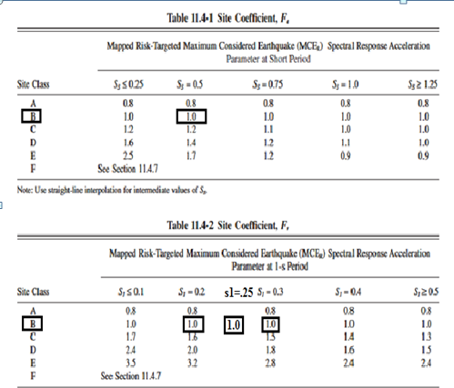
Now, Fa=1 and Fv=1 for site class B and S1 and Ss values

Slide 4
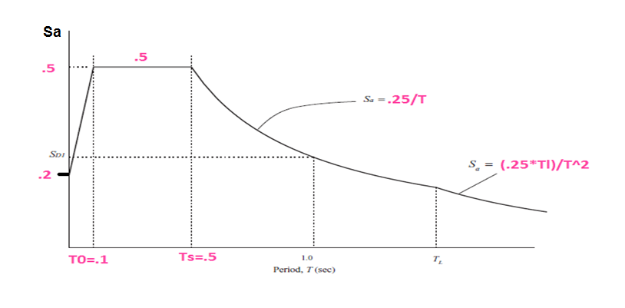
SMs=Fa*Ss=0.5…… SDs=SMs=0.5
SM1=Fv*S1=0.25.... SD1=SM1=0.25

Slide 5
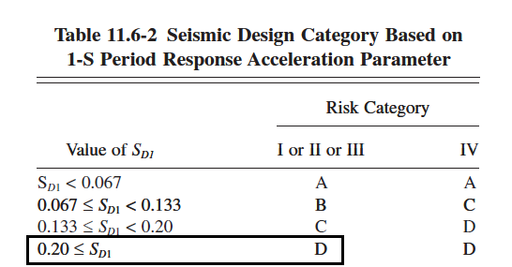
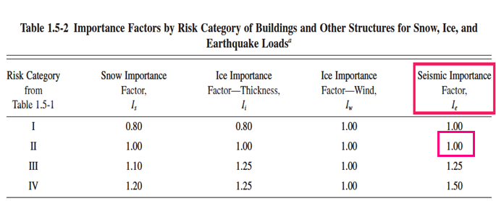

Slide 6
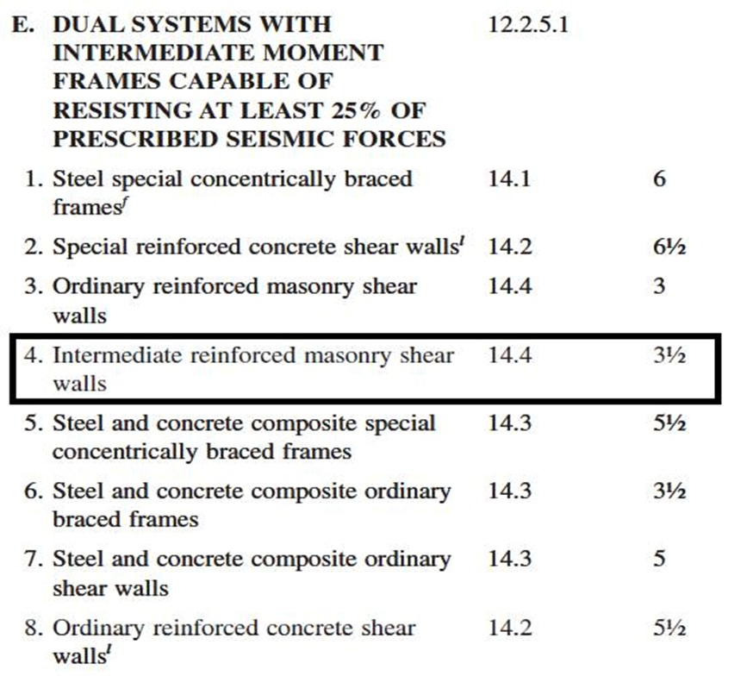

Slide 7
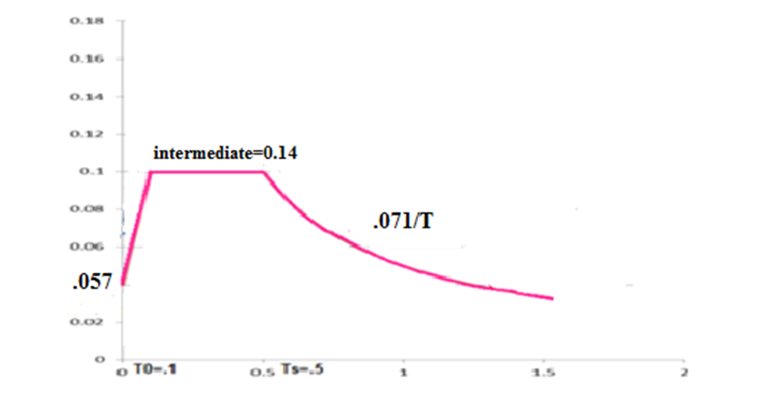
Design response spectrum for rock soil and intermediate frame

Slide 8
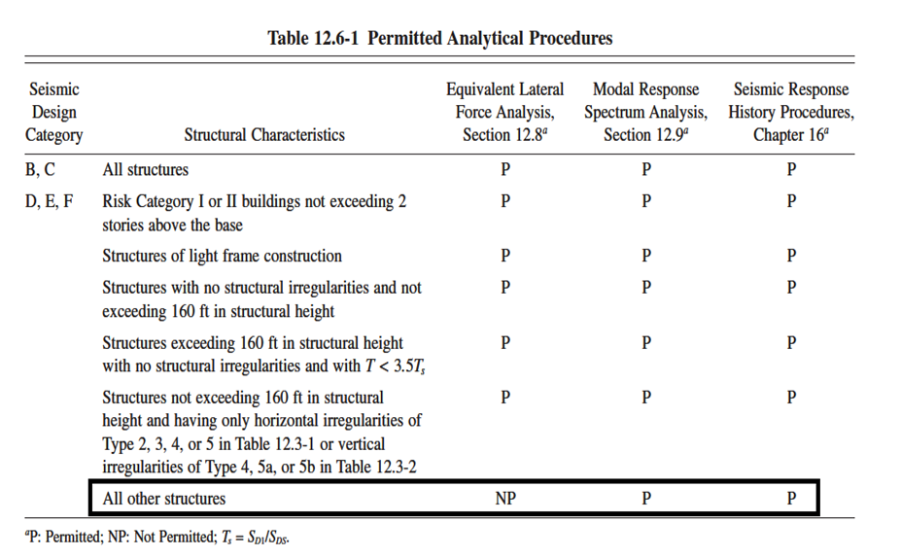
The dynamic analysis method used :

Slide 9
Hand calculation for lateral seismic force:
T=from Reyluph method=2π(ƹ(m*∆2) /ƹ(F*∆))0.5
Mass for each story =(SID+DEAD+WALL)/7*9.81=32293+13170+10000/7*9.81=807.6 TON apply 1 kN/m2 for each slab in each floor in the x direction

Slide 10

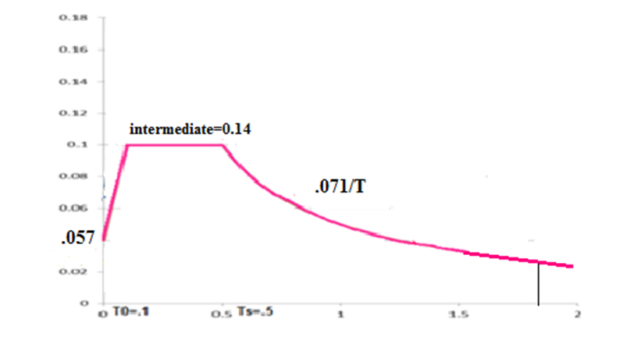
T =2π(7.74/95,4).5=1.79 sec.
Error=((1.79-1.92)/1.92)*100%
=6.7%<20% …….ok
Cs=0.071/1.79
=0.04

Slide 11
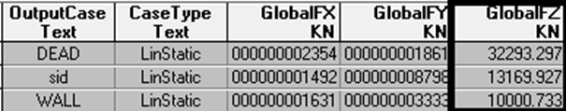
From SAP reactions we find the weights:
F=Cs*W
= 0.04 *( Dead+SID+Wall)
=0.04*(32293+13170+10000)
F x = 2218.5kN
F y = 2218.5kN

Slide 12
SAP calculation for lateral seismic force:
E=ϼEh + Ev ………….. (ϼ = 1.3)
Eh=EX+EY
EX=Ex+0.3Ey
EY=Ey+0.3Ex
Ev = 0.2* SDs *D

Slide 13
The new combination will be :
1) 1.2 D +1.6 L
2) 1.4D
3) 1.3 D + 1.0 L +1.3 EQ
4) 1.3 D + 1.0 L -1.3EQ
5) 0.8D + 1.3E Q
6) 0.8 D – 1.3 EQ

Slide 14
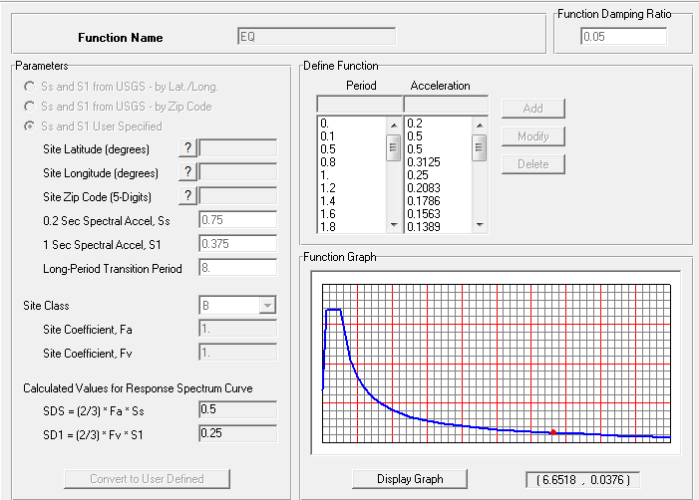

Slide 15
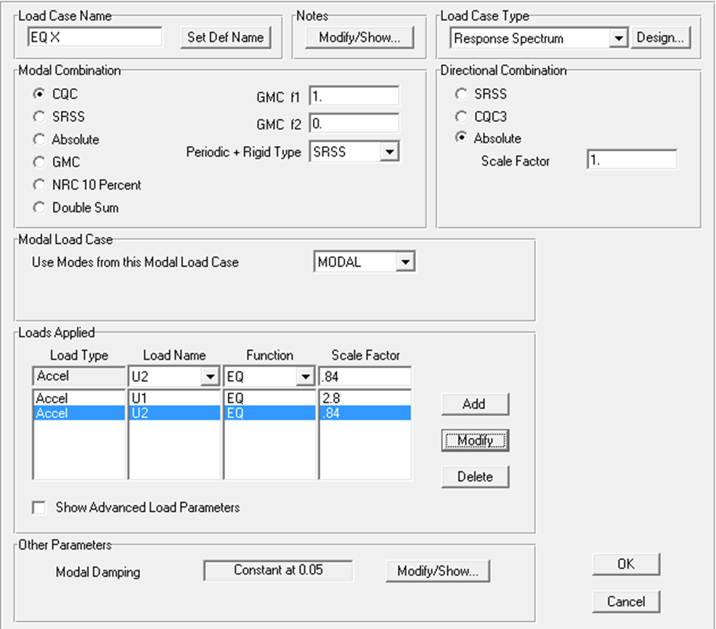

Slide 16

After modifying the scale factors the values from SAP now is ok:
Fx SAP*scale factor x=Fx manual
So :
scale factor x=(Fx manual/FxSAP)*(old scale factor=2.8).
=(2218.5*2.8)/1933.5=3.21.

Slide 17
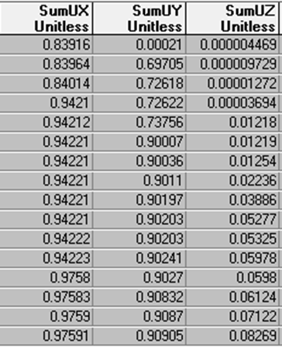
Modal mass participation ratio:

Slide 18
Chapter seven
Design and Detailing
7.1: Final sections.
7.2:check Drift.
7.3: Design of slabs.
7.4: Design of beams.
7.5: Design of columns.
7.6: Design of mat foundation.
7.7: Design of shear wall.
C_{ontents:}

Slide 19
7.1: Final Sections:

Slide 20
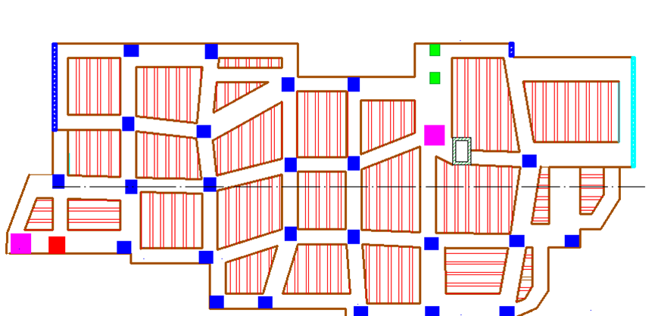
7.1.1: For slabs:

Slide 21
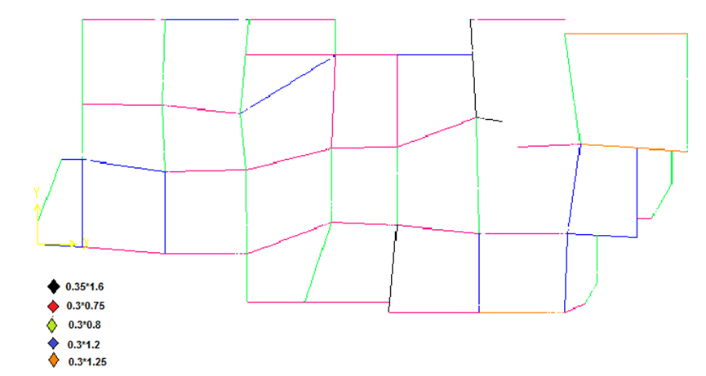
For Beams:

Slide 22
The Beam dimensions :
Beam NO | Width | Depth
B1 | 750 mm | 300 mm
B2 | 1200 mm | 300 mm
B3 | 1250 mm | 300 mm
B4 | mm | 300 mm
B5 | 1600 mm | 350 mm

Slide 23
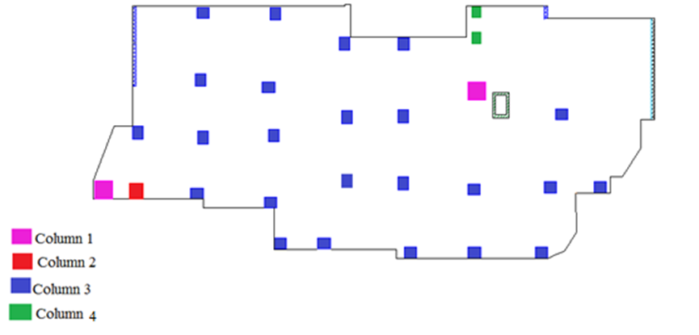
For Columns:

Slide 24
The Column dimensions :
Column NO. | Width (mm) | Depth(mm)
Column 1 | 1000 | 1000
Column2 | 850 | 800
Column3 | 700 | 600
Column4 | 600 | 500

Slide 25
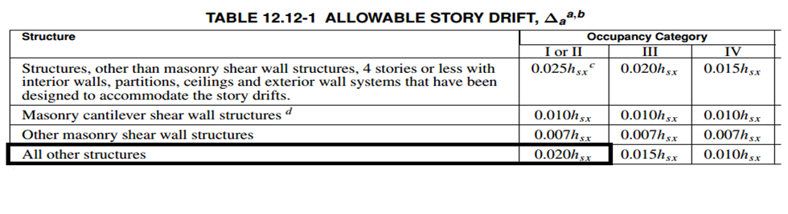
7.2 Check Drift :
∆max = 0.02*h
H for each story = 3000 mm
∆max = 0.02*3000 = 60 mm

Slide 26
Deflection of 7th floor = 6.7 mm.
Deflection of 6th floor =11 mm.
Deflection of 5th floor= 6.5mm
Deflection of 4th floor = 11 mm.
Deflection of 3rd floor = 12.1 mm.
Deflection of 2nd floor = 12.9 mm.
Deflection of 1stfloor =13.5 mm.
The critical case at the first floor.
ΔS(max) = 13.5 mm.
Maximum limitation = 0.02* 3000 = 60 mm.
13.5 mm< 60 mm ………..OK

Slide 27
7.3: Design of slabs:
ϼmin= max 1.4/Fy=(0.0033)
0.25*fc^{.5}/Fy=(0.0029)
=0.0033.
As min=0.0033*bw*d=0.0033*130*270=115.83 mm².

Slide 28
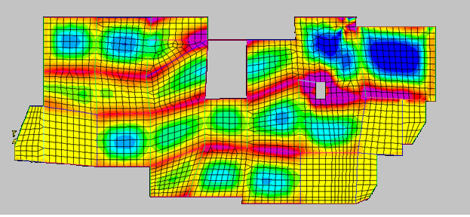
For the slabs which is in the y direction (M22):
-ve moment (kN.m/m) as shown

Slide 29
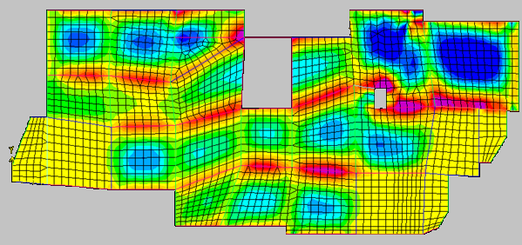
+vemoment(kN.m/m) as shown .

Slide 30
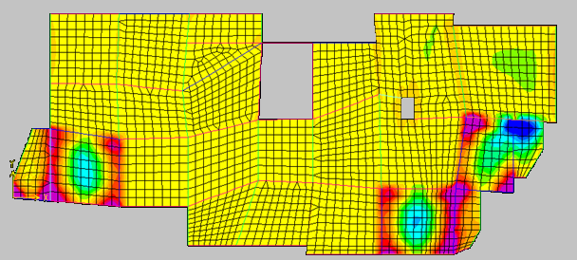
For the slabs which is in the x direction (M11)
-vemoment(kN.m/m) as shown

Slide 31
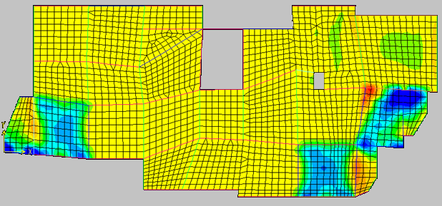
+vemoment(kN.m/m) as shown

Slide 32
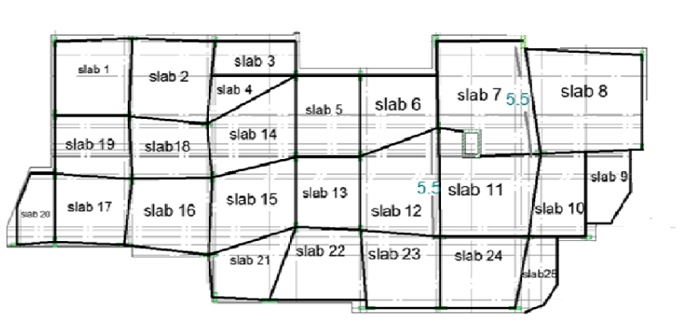

Slide 35
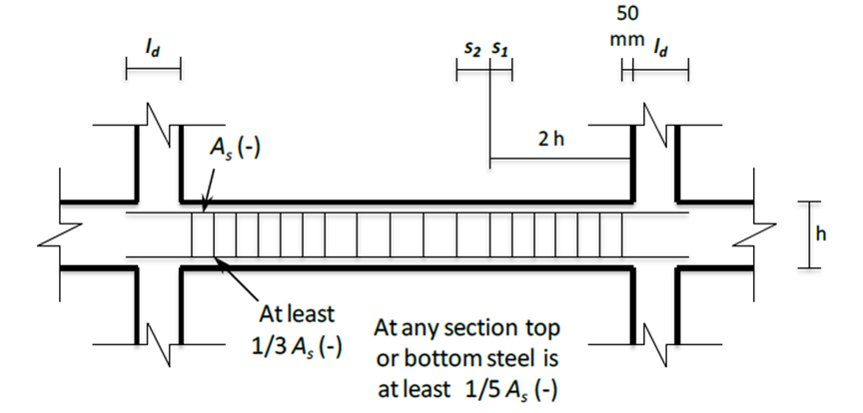
Beam Detailing:
-According to the code intermediate design detailing shall satisfy the following requirements:

Slide 36
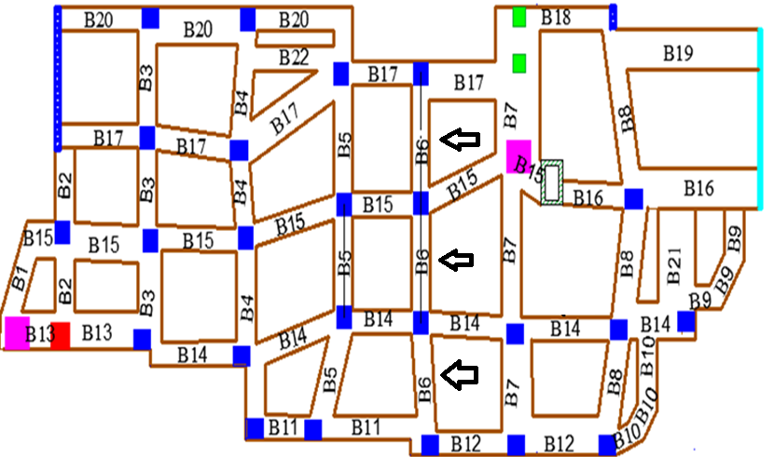
For Beam 6:

Slide 37
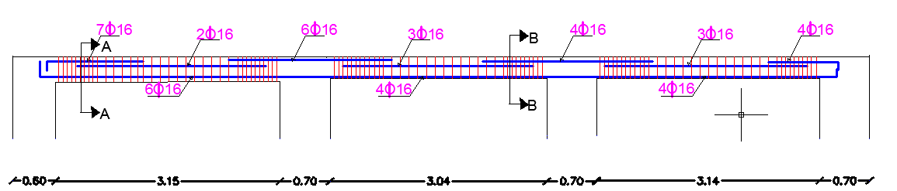
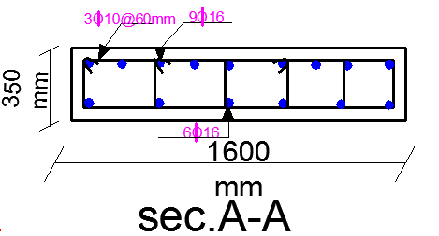
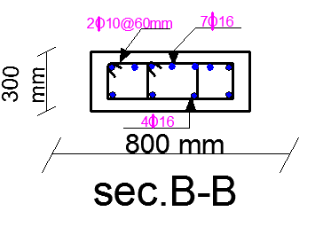
Beam 6 Detailing :

Slide 38
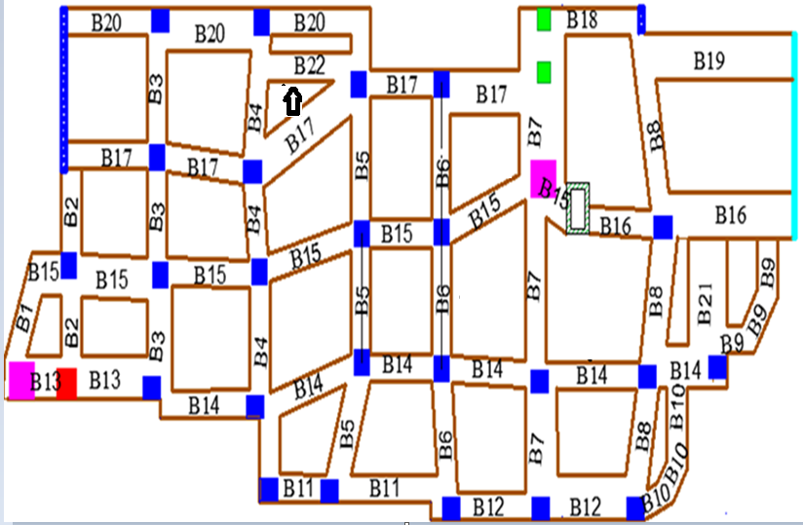
For Beam 22 :

Slide 39
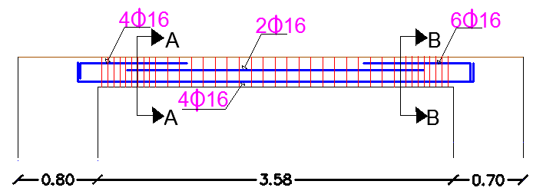
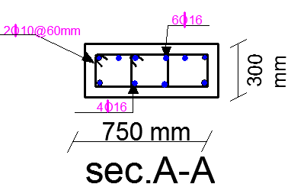
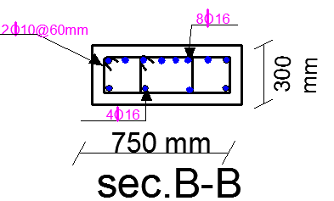
Beam 22 Detailing :

Slide 40
7.5: Design of columns:

Slide 41
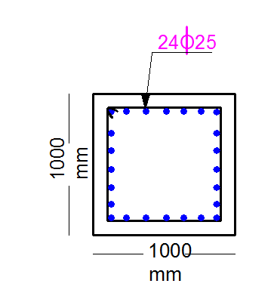
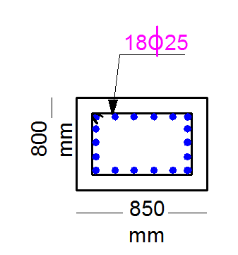
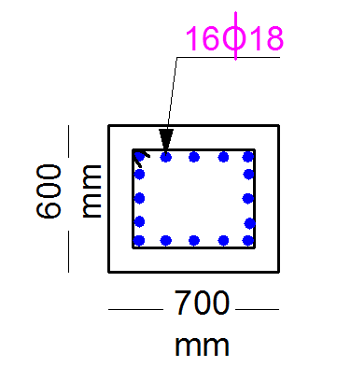
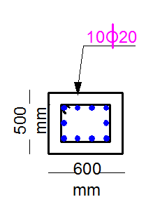
column 1 detailing
c2 section detailing
column 3 section detailing.
column 4 section detailing

Slide 42
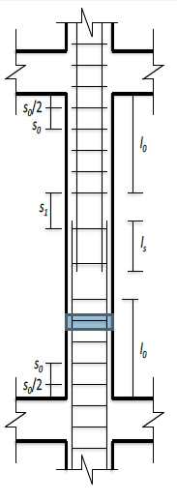
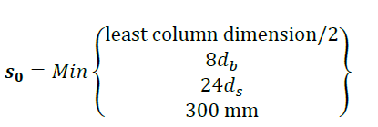
Column Detailing:
According to the code intermediate design detailing shall satisfy the following requirements:

Slide 43
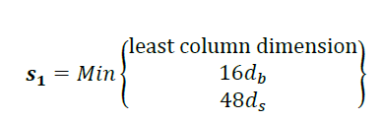

Slide 44
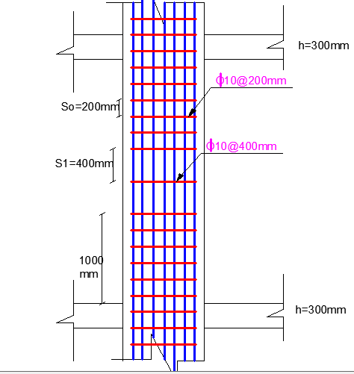
and the final longitudinal section for C1 shown

Slide 45
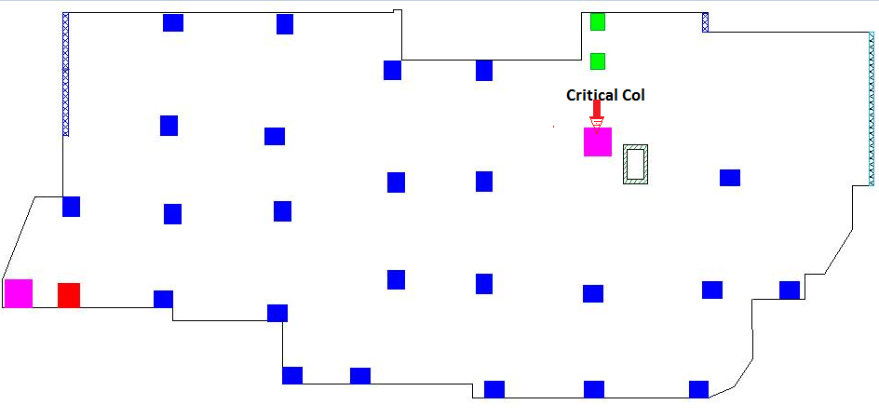


Check SAP results:
We check the sap results for the column shown below

Slide 46
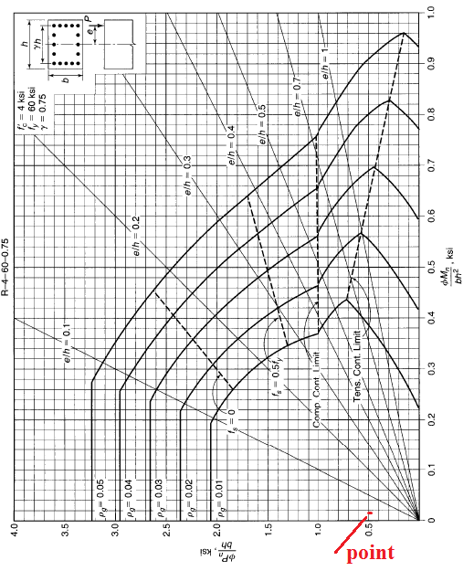

Slide 47
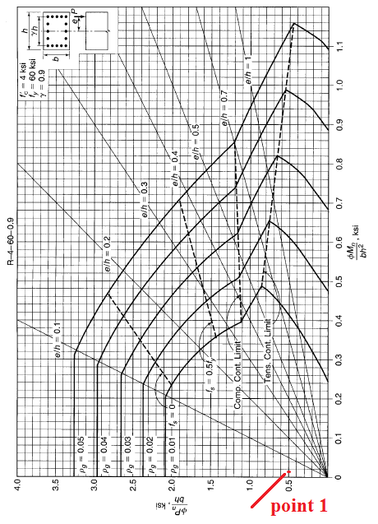

Slide 48
We notice that ϼ<1% for both values of Ɣ(.9 and.75) so its ok for
Ɣ=.88=1000-2*(cover=60)/1000.
As we notice from the previous Figure that our columns are too much below ϼ min.

Slide 49
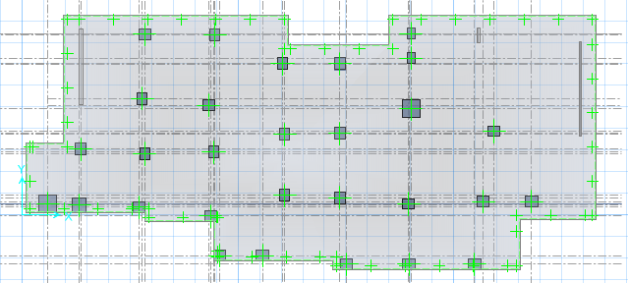
7.6: Design of mat foundation:
The plane view of mat foundation.

Slide 50
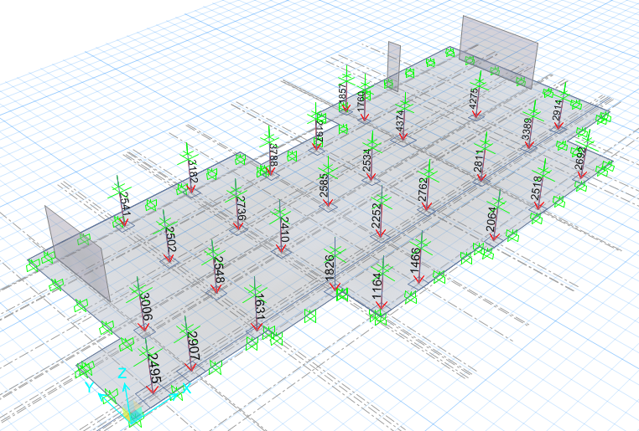
-Loads on mat foundation:

Slide 51
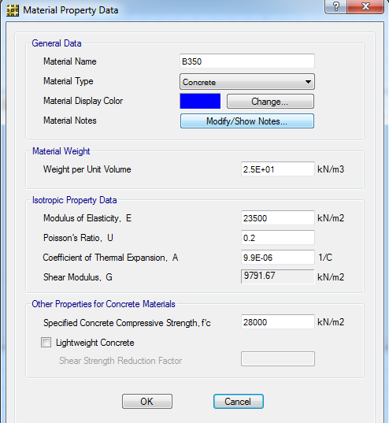
-Concrete B350 is used for mat foundation :

Slide 52
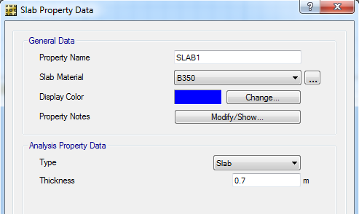
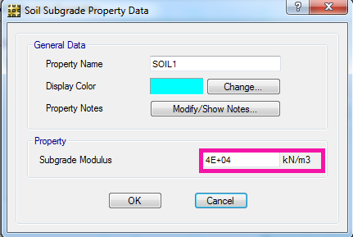
We assume thickness of mate foundation equal 700 mm
Sub grade modulus =K*Q allowable= 100*400= 40000 kN/m³

Slide 53
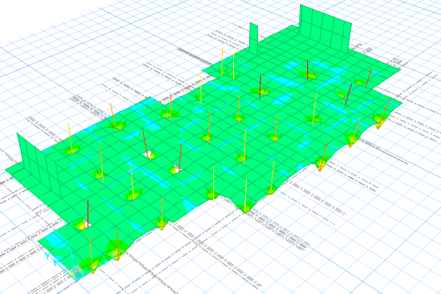
-Checks of the footing :
Compatibility:

Slide 54
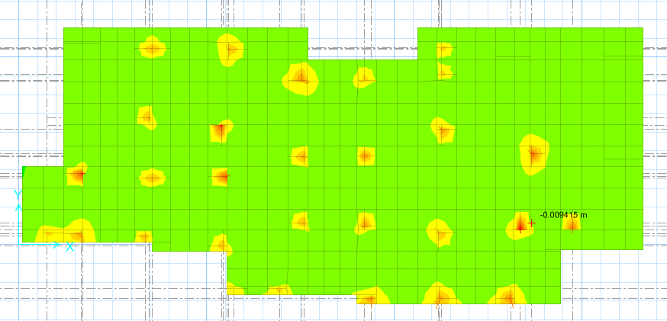
-Deflection :
By SAFE:
Max deflection from SAFE is 9.4 mm.
By hand:
Δ allowable = qall/K= 400/40000= 0.01 m= 10 mm.
Δ allowable > max deflection .............. So it's ok.

Slide 55
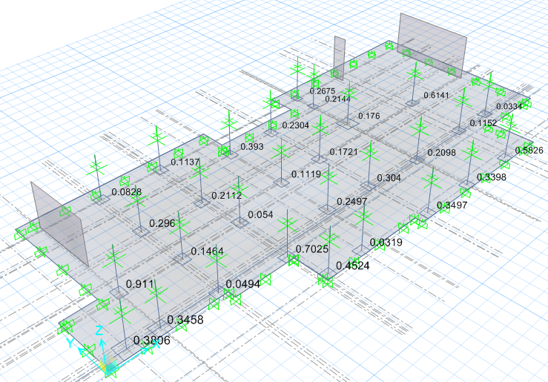
- punching shear:
By SAFE:
We notice that no punching shear occurs, because the ratio of bunching shear is less than one.

Slide 56

By hand:

Slide 57


First area: Interior column pu from sap = 4374 kN.
ΦVcp=0.75*(1/3)* *(4*1630)*630*10⁻³.
=5433.85 kN>>pu............. So it's ok.
Second area: Corner column.
pu from sap = 1164 kN.
ΦVcp=0.75*(1/3)* *(2*1015+2*915)*630*10⁻³.
=3216.97 kN>>pu ............. So it's ok.

Slide 58

Third area: Edge column pu from sap= 2907 kN
ΦVcp=0.75*(1/3)* *(2*1165+2*1430)*630*10⁻³.
=4325.4kN>>pu............. So its ok.
Reinforcement
As min=ρ*b*d.
=0.0018*1000*(700-70)=1134 mm².
So we use 8Φ14/m.
We notice that reinforcement in all region is less than Asmin so that we use Asmin.

Slide 59

7.7: Design of shear wall:

Slide 60

-Designing SW NO. 1:
Lw=4 m.
hw=3m.
h=0.2m.

Slide 61

Flexure design:
Finding the moment and force values.

Slide 62

The result :
Use 20 Ф25
Shear Design:
Vc ≤ $\frac{√fc}{6}$ A _{cr}
A_{cr} = horizontal cross-sectional area of the wall.
Vcv= $\frac{√28}{6}$ 200*4000*10⁻³ = 705.5 kN
ФVcv= 0.75*705.5 = 529.125 kN
Vu = 19.1 KN

Slide 63
Ρh = 0.002 for bars db ≤16 mm
Ρv = 0.0012 for db ≤16 mm
AS _{horizontal} = 0.002*200*1000 = 400mm ²
Use 6Ф10 / m ……… 2 Layers 3Ф10/m
AS _{vertical} = 0.0012*200*1000 = 240mm ²
Use 4Ф10 / m ……… 2 Layers 2Ф10/m

Slide 64
- Check D+L:
PD= DL+SI +shear wall weight+ wall load
Shear wall own weight = 420 kN.
1.2DL+1.6LL = 2796.5= kN.
Фpn = 0.65*0.8*(0.85*fc*Ac+fy AS)
= 11550 kN ≥ 2796.5 ………OK

Slide 65

- Check stability:

Slide 66

- Check Drift:
ΔS= 0.01 mm
Δm = Um = 0.7*R ΔS
= 0.7*3.5*0.01= 0.0245
Δ all = 0.002*h = 0.002*7*3= 0.042 mm ≥ 0.0245 …… OK

Slide 67


- Detailing for shear wall:

Slide 68
ريم : الترحيب+(1-8)
ملك(9 -15)
علا ( 16- 22)
ملك (23+24)
بنان ( 25-32)slaps
ريم (33-37)beams
بنان (38-42)
علا (43-56)
ملك (57-62)
ريم63) -65)

Slide 69
سلايد 60 مشكله
سلايد 63 مشكله
سلايد 32 في حد بدو يضيف عليه اشي ولا لا ؟؟؟؟؟؟؟؟؟؟؟؟؟؟؟

