Slide 1



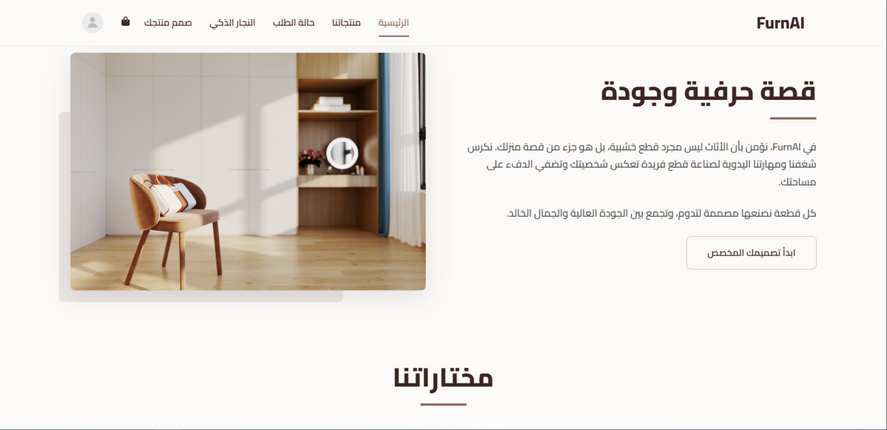


An-Najah National University
FurnAi
AI-Driven Platform for Furniture ERP, BI
By:
Helmi Tbaileh
Abdulhakeem Abuzarour
Amer Kamal
supervised by:Dr.Ahmad Shraideh

Slide 2







Table OF Content
01
Introduction & Background
02
Problem Statement
03
Proposed Solution (FurnAi Platform)
04
System Architecture & Tech Stack
05
Core Features & User Experience
06
Inventory & Supply Chain Management
AI Intelligence & Smart Analytics
07
Security, Financials & CRM
08
09
Mobile App

Slide 3



Introduction
1
Harzallah Carpentry
is a workshop that was established more than 50 years ago in Nablus. It manufactures a wide variety of wooden furniture items.

Slide 4









01
Data Silos
selling out-of-stock items because systems are disconnected
The Problem
02
Delayed Decision
Managers lack visibility until manual auditing is done
03
Random Pricing
Custom pricing relies on visual guesswork, risking loss or overpricing

Slide 5





THE SOLUTION
ERP
Intelligence
Order Tracking
Any sale instantly reflects as a "withdrawal" transaction in inventory
AI acts as a functional Accountant and Salesman
To allow customers to know their order status and time, and to enable management to count, inventory, and optimize orders.

Slide 6







TECH STACK
Frontend
Backend
HTML5, CSS3, JS
Firebase (Firestore)
artificial intelligence
Analysis
Google cloud
Python
Notes:
7

Slide 7
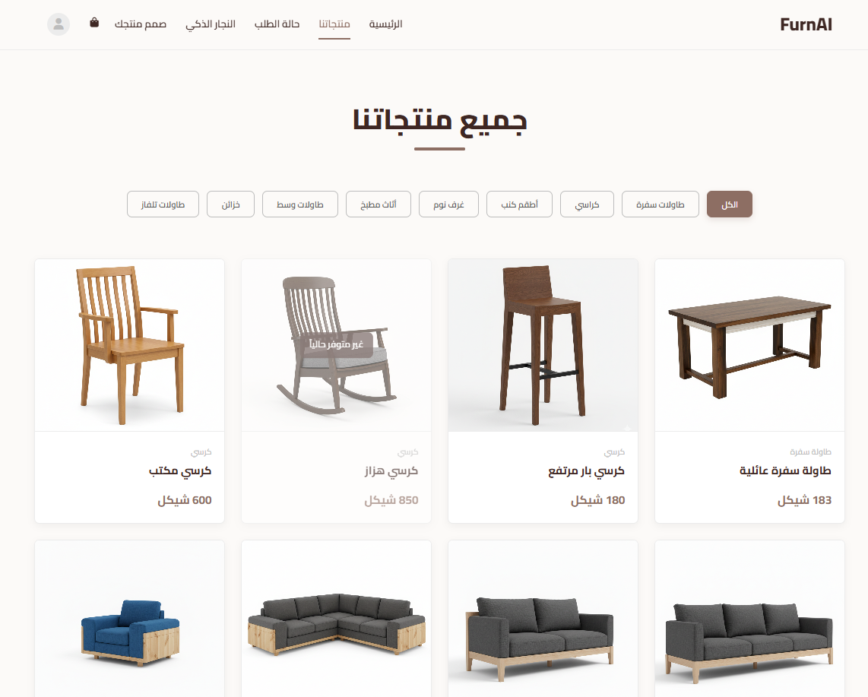


Product Browsing
Modern Shopping Experience
Visual-centric UI with seamless category filtering (Bedrooms, Tables, Chairs).

Slide 8
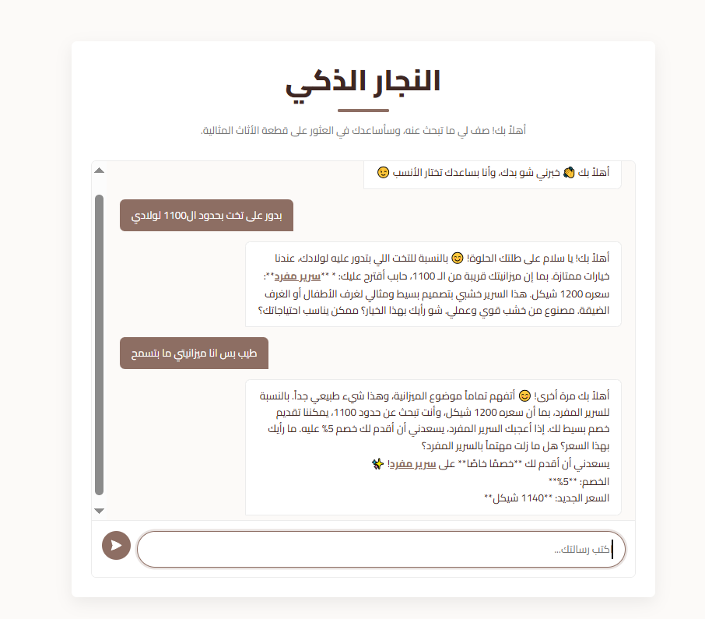


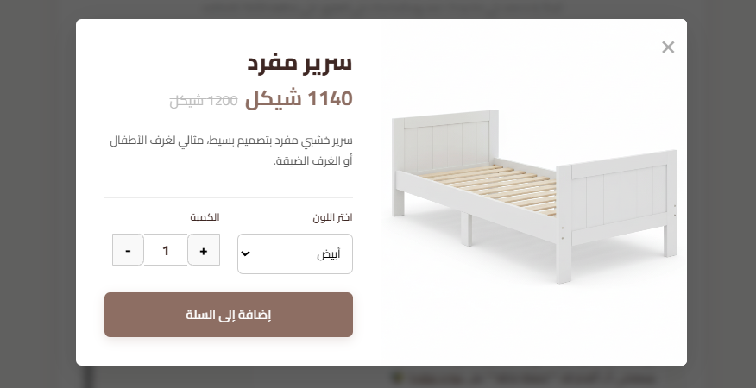
"النجار الذكي"
Smart Negotiator
Understands requests and suggests products.
Discount Logic
Authorized to offer progressive discounts to close deals.

Slide 9
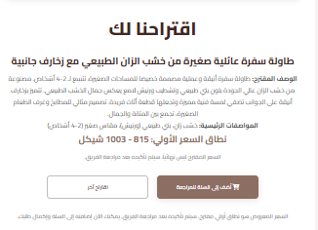
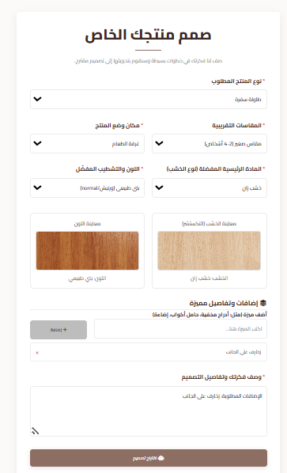



SMART CUSTOM DESIGN
Text-to-Product
AI analyzes customer descriptions.
Instant Quote
Suggests specs and price range immediately.
Interactive Input
Automatically updating dropdown menu options based on the selected product type.

Slide 10
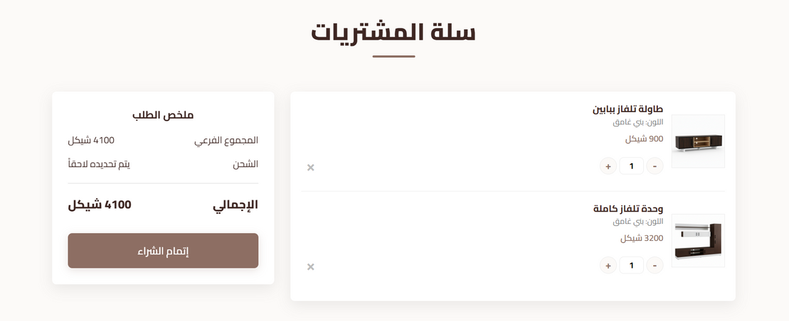

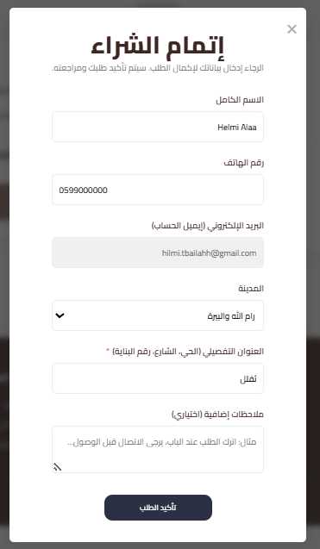
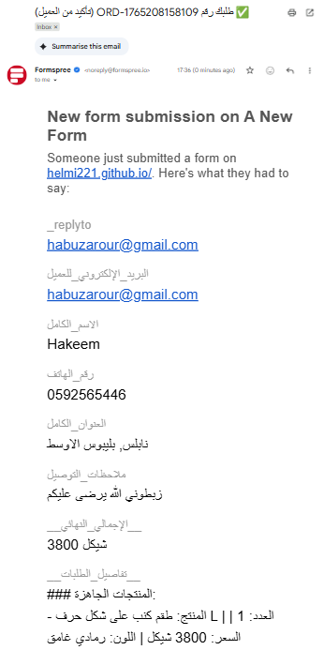


CHECKOUT & ALERTS
Checkout
Interactive cart.
Instant Alert
Email notification sent to admin via Formspree.
User Information
Saving: After the user enters their information for the first time, it is stored in the database so it does not need to be entered again.

Slide 11
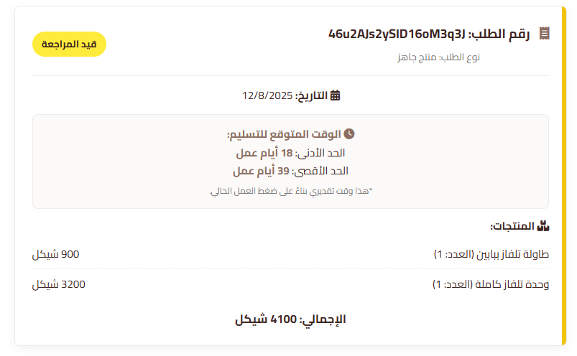











Order Tracking
Importance
The “Algorithim" allowing automated calculations.
Live Updates
Any status change made by the admin is immediately reflected on the customer's tracking page.

Slide 12

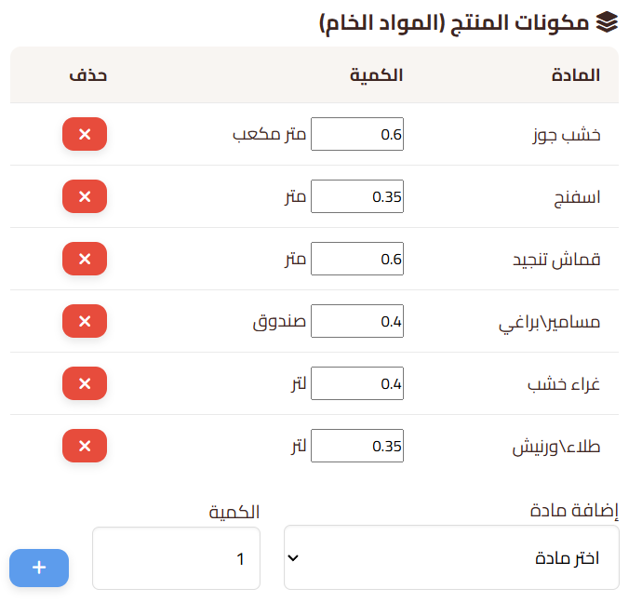



Product Engineering - BOM
Bill of Materials
Linking products to components.

Slide 13

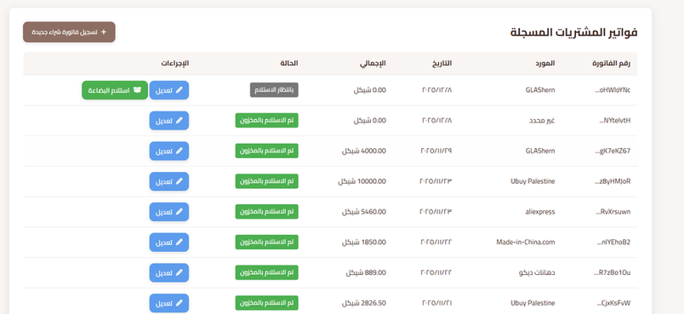


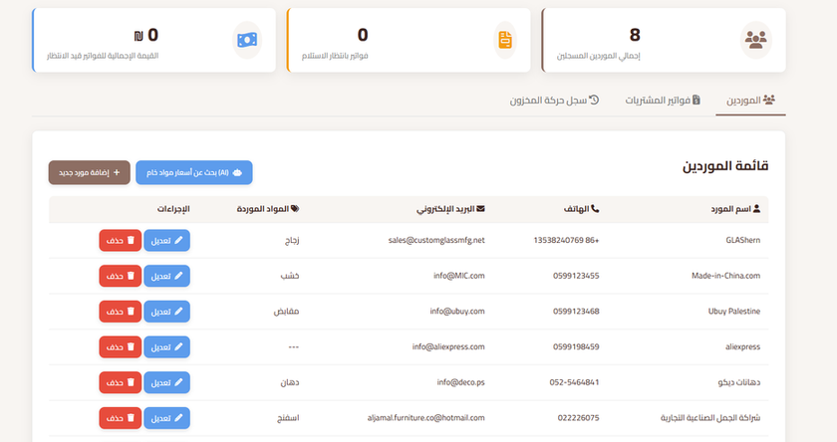
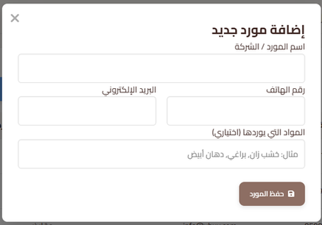
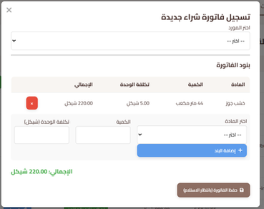
Supply Chain
Supplier Interfaceaterials
Purchase Receipt Confirmation
Ability to add the suppliers you usually work with and store their information.
Ability to confirm each supplier’s purchase invoice, receive raw materials, and store them.

Slide 14
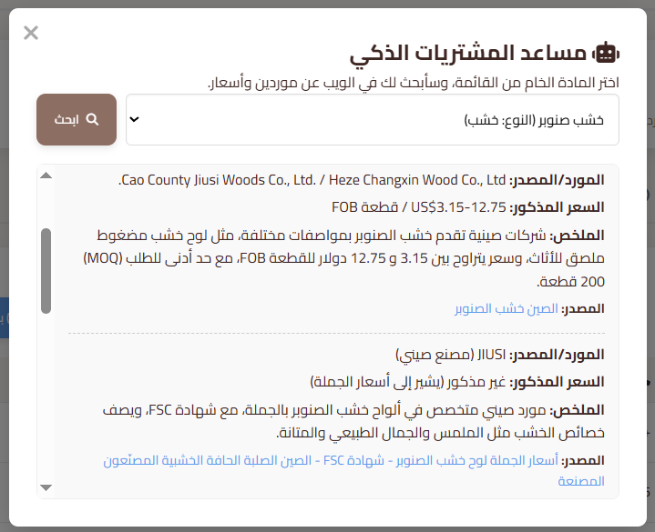





Smart Sourcing
Smart Search
Intelligent Filtering
Smart Results

Slide 15

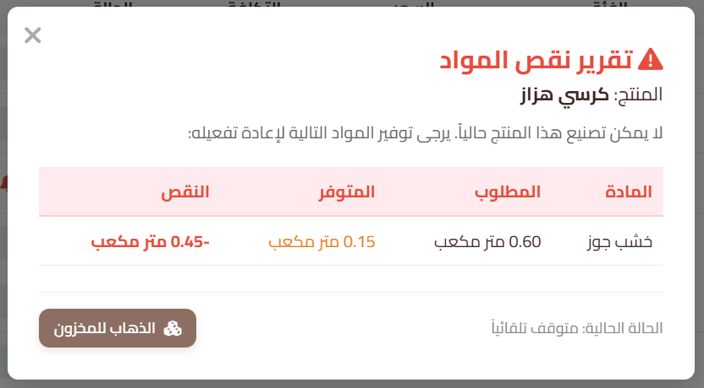


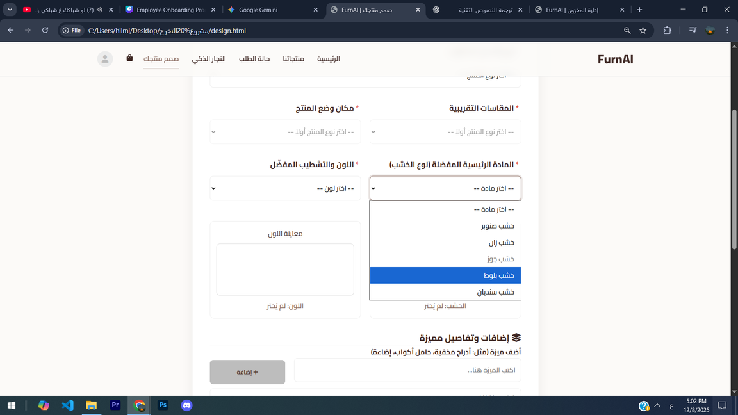



Inventory Management
Smart Guard
Constant background stock check.
Scenario
Low "Wood" -> Table becomes "Out of Stock" instantly.
Low-Stock Alerts
Saving: After the user enters their information for the first time, it is stored in the database so it does not need to be entered again.
Inventory Verification in custom design
If a specific type of wood is low in stock, it is marked as unavailable.

Slide 16


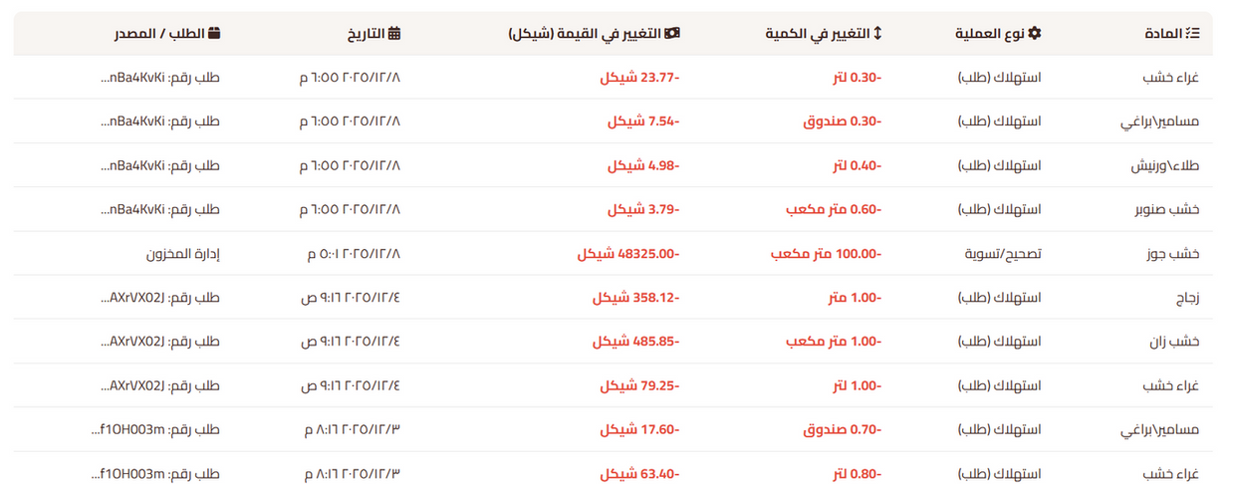
Audit Logs
Transparency
Control
Logging every stock movement with timestamp.
Preventing inventory manipulation.

Slide 17
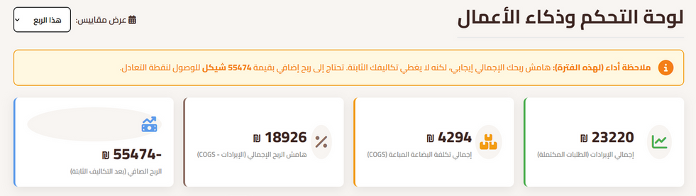

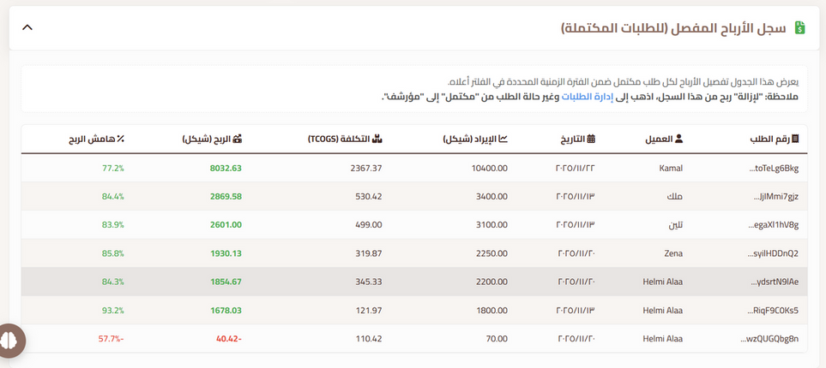


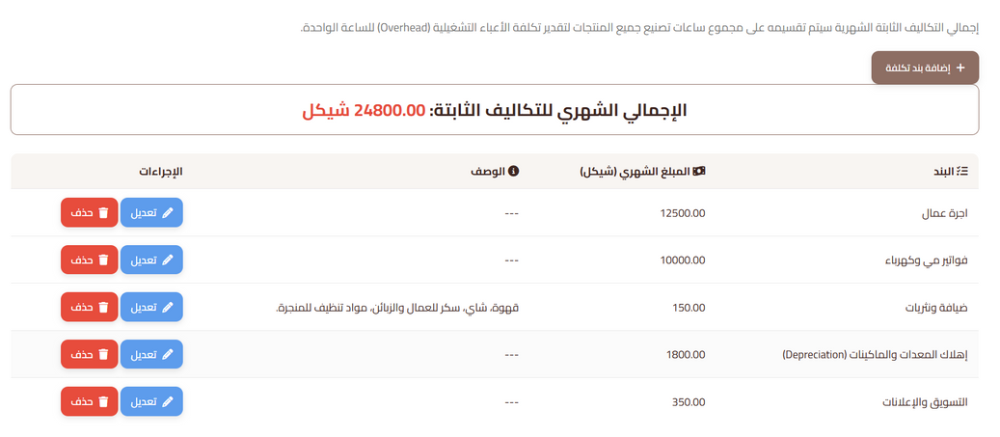

Financial Performance Overview
Sales Tracking
Real-time display of total completed order value (Revenue).
Cost Estimation
Approximate calculation of raw material costs per order.
Profit Indicator
Displaying operating profit margins to help managers track daily trends (not replacing accounting).

Slide 18
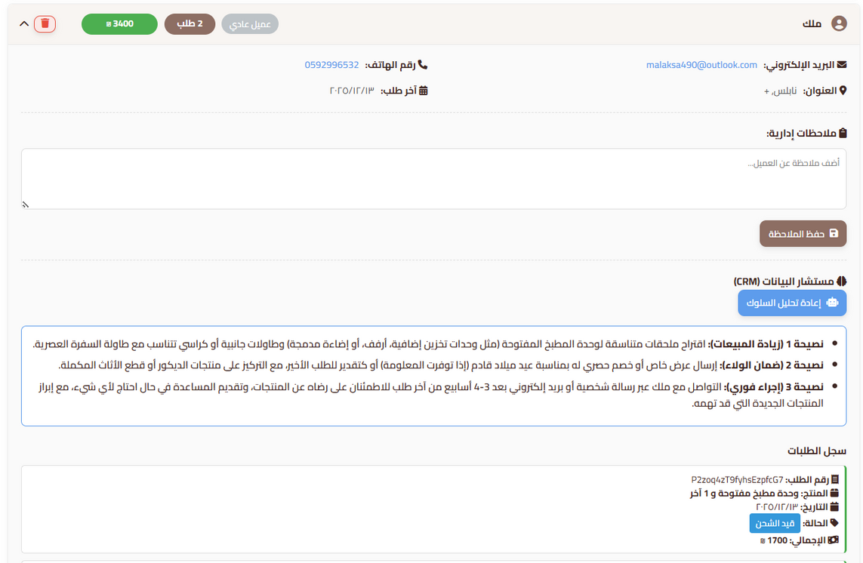



CRM
RFM Analysis
Python script segments customers.
Advice
System suggests engagement strategies.

Slide 19

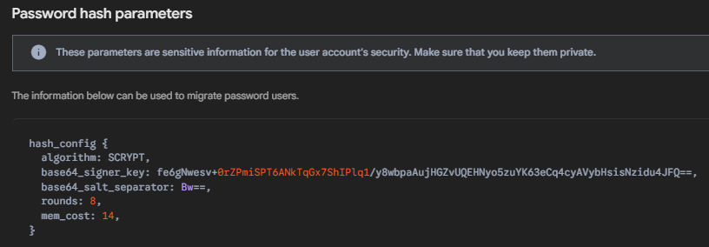






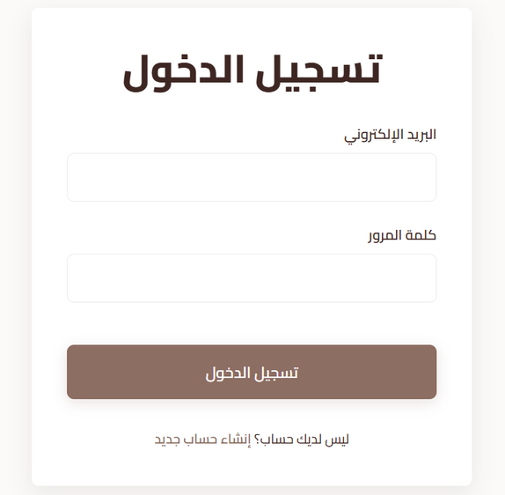
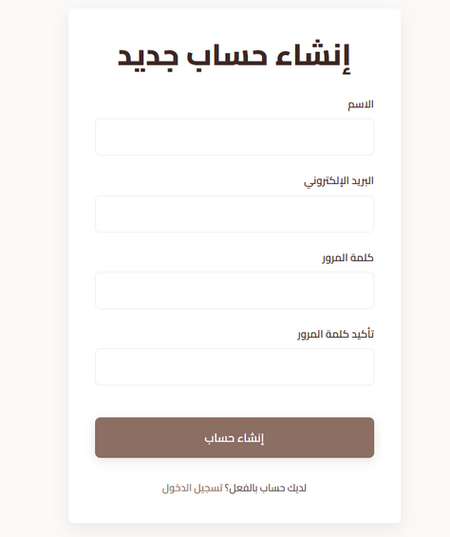






SECURITY, AUTH & VALIDATION
Auth System
01
Powered by Firebase Authentication for secure sessions
Password Hashing
02
Passwords are never stored as plain text; they are hashed/encrypted.
RBAC
03
Strict role separation; only Admins can write to Inventory
Data Quality
04
A Validation Layer blocks incorrect inputs (e.g., negative stock, invalid phone formats) to ensure report accuracy.

Slide 20

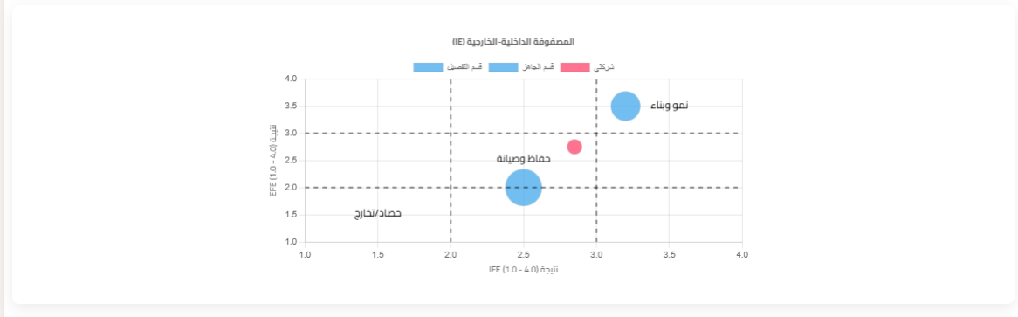
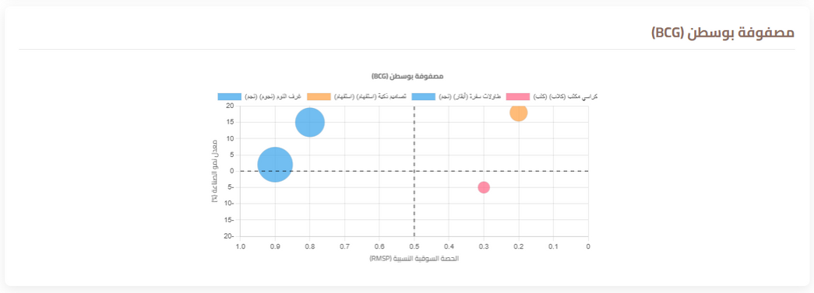

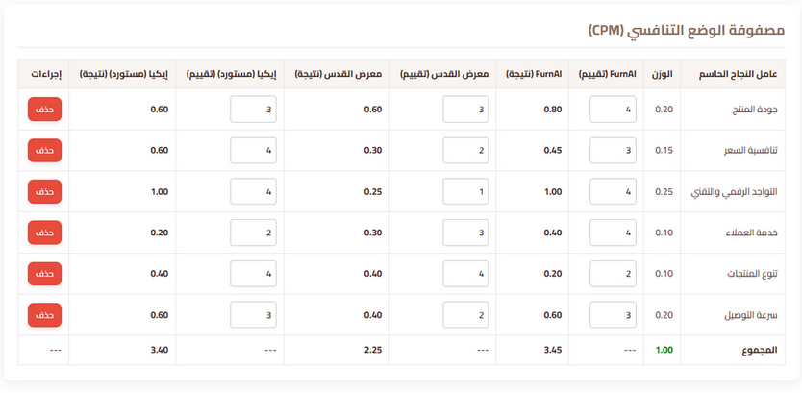
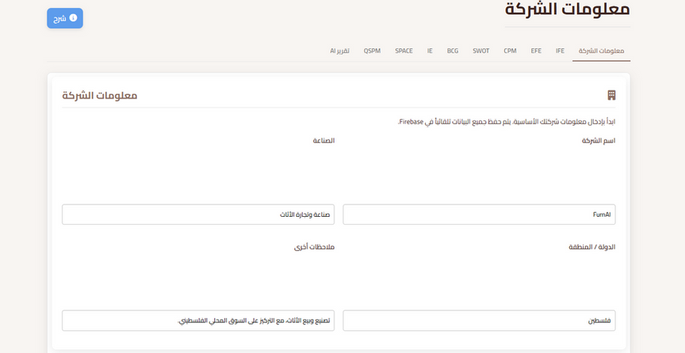

Strategic Matrices
Digital Strategy
Interactive SWOT, BCG, SPACE tools.
Live Data
Matrices pull real performance data
AI Report
Provides recommendations and analyses on the organization’s strategic situation based on inputs from matrices and tests

Slide 21

Smart Forecasting
    Digital Consultant: One-click comprehensive AI report analyzing financial and strategic status.

Slide 22
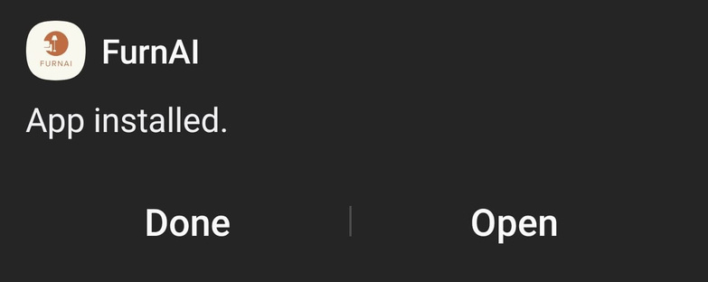






Mobile App
Accessibility
System converted to a mobile app for quick access.
Compatibility
Responsive interface working efficiently on all screens.
Unified Experience
All powerful web features available on the app anytime.

Slide 23

Thank You

