Slide 1

An-Najah National University
Faculty of Engineering & Information Technology
Mechanical Engineering Department
Graduation Project II
Preliminary Design of Low Speed Wind Tunnel
Prepared By:
Maher Na'eem Abu-Khadra.
Fawzi Sad­iq Abu-farha.
Supervisor:
Eng.Luqman Herzallah.

Slide 2
Outline
Problem definition.
Flow characteristics.
Closes circuit wind tunnel.
Fan selection.
Efficiency.
Conclusion.
Future work.

Slide 3
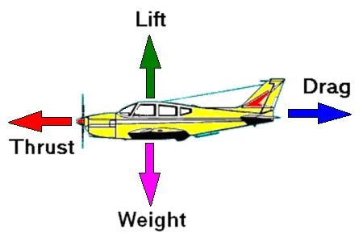
Problem definition
Aerodynamic forces.

Slide 4


Slide 5
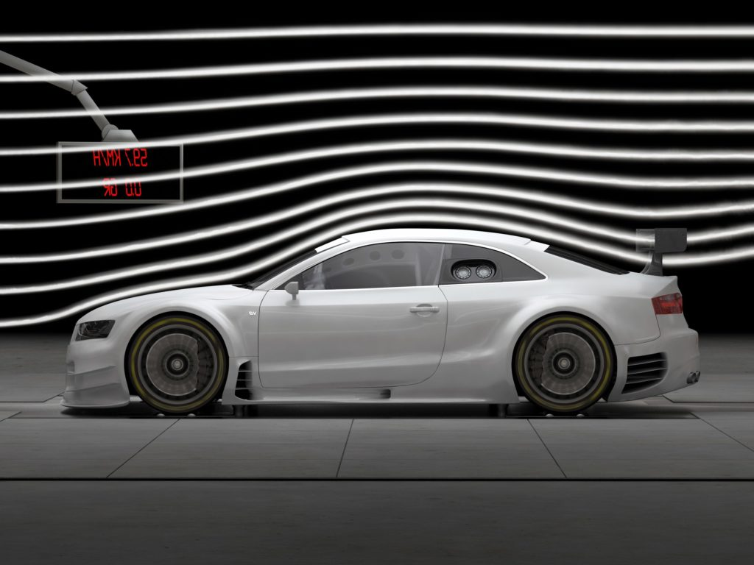
Problem definition
Flow nature.
Stability.

Slide 6
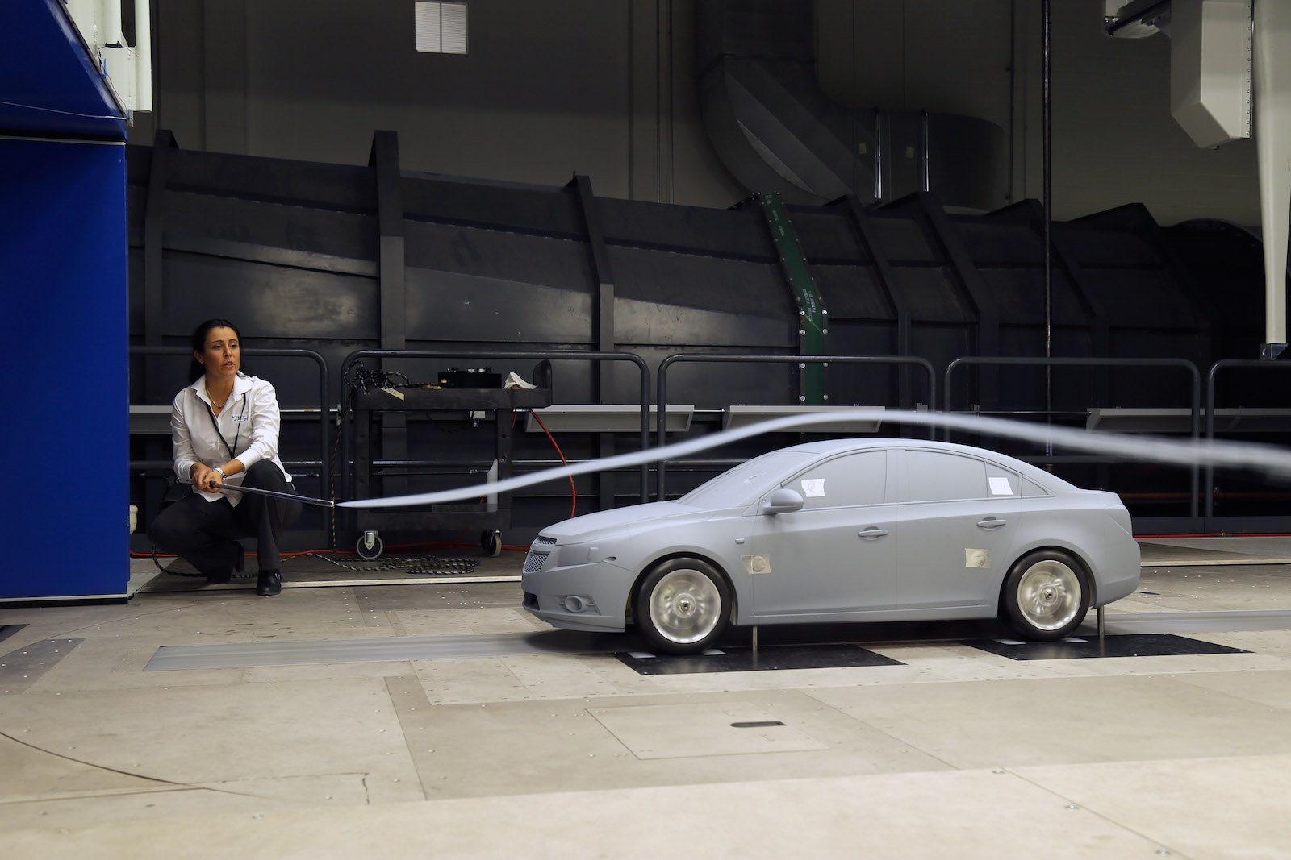
Solution: Model
Design.
Model.
Test.

Slide 7
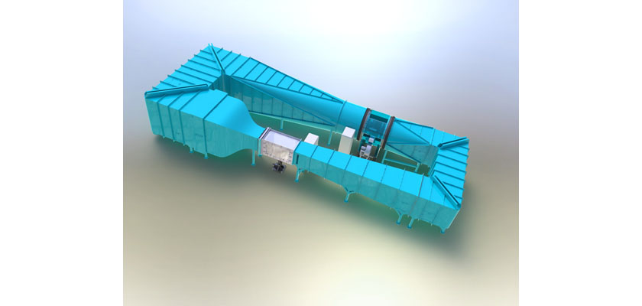
Solution: Wind tunnel
Wind tunnel.
Test section.
→ Air speed.
→ Uniform flow.
→ Size.

Slide 8
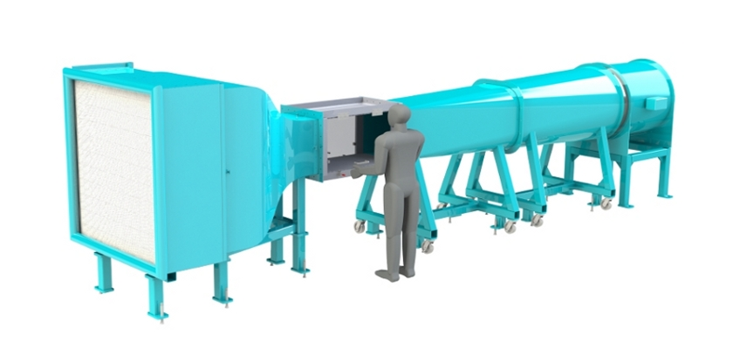
Closed wind tunnel
Open.
Closed.
Dimensions.

Slide 9
Test section
Inlet.
→Velocity= 30m/s.
→Uniform flow.
Measurement devices.

Slide 10
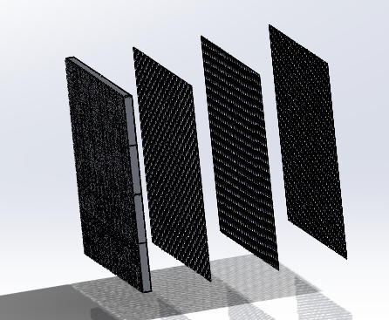
Uniform flow
Out from fan.
Settling chamber.

Slide 11
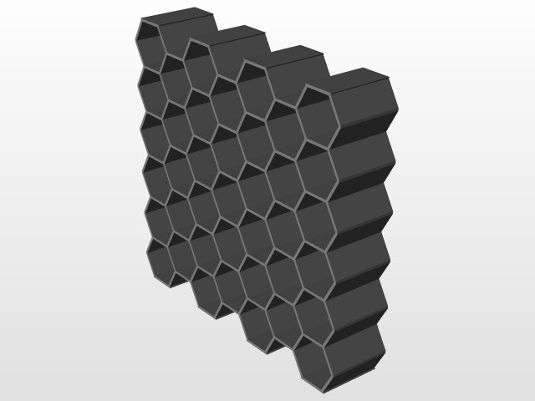
Uniform flow: Honeycomb
Aim.
Pressure losses.

Slide 12
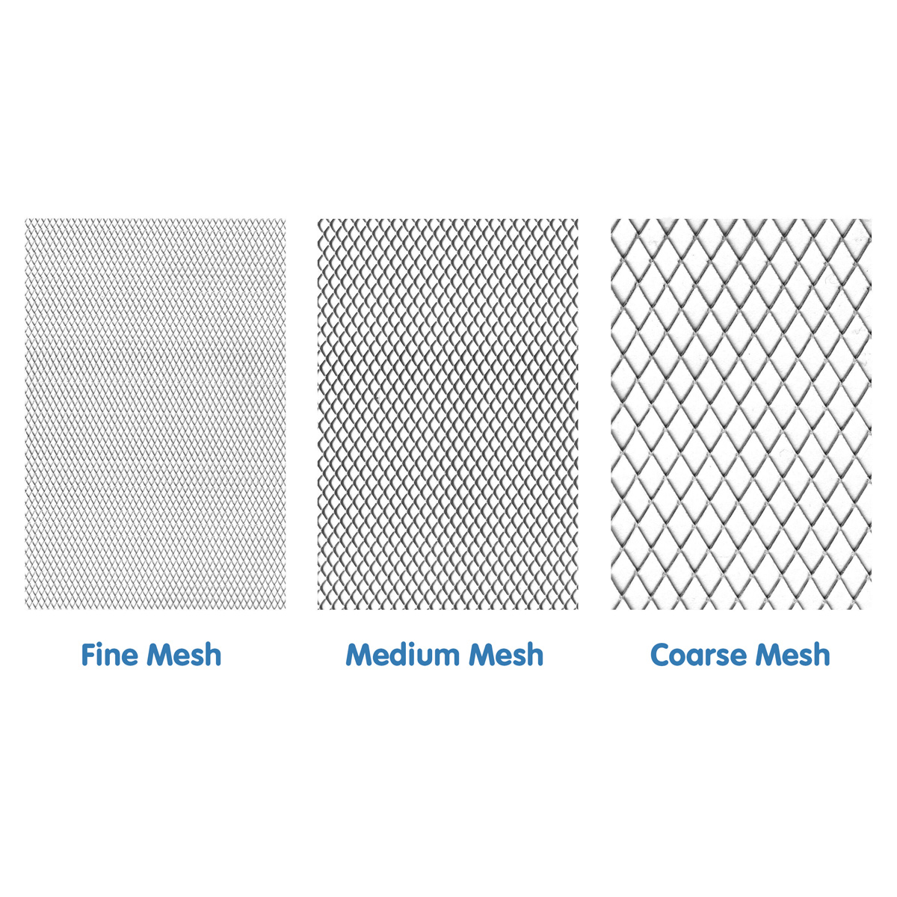
Uniform flow: Screens
Aim.
Types.

Slide 13
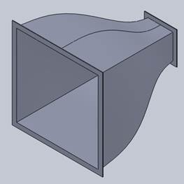
Uniform flow: Nozzle
Aim.
Description.

Slide 14
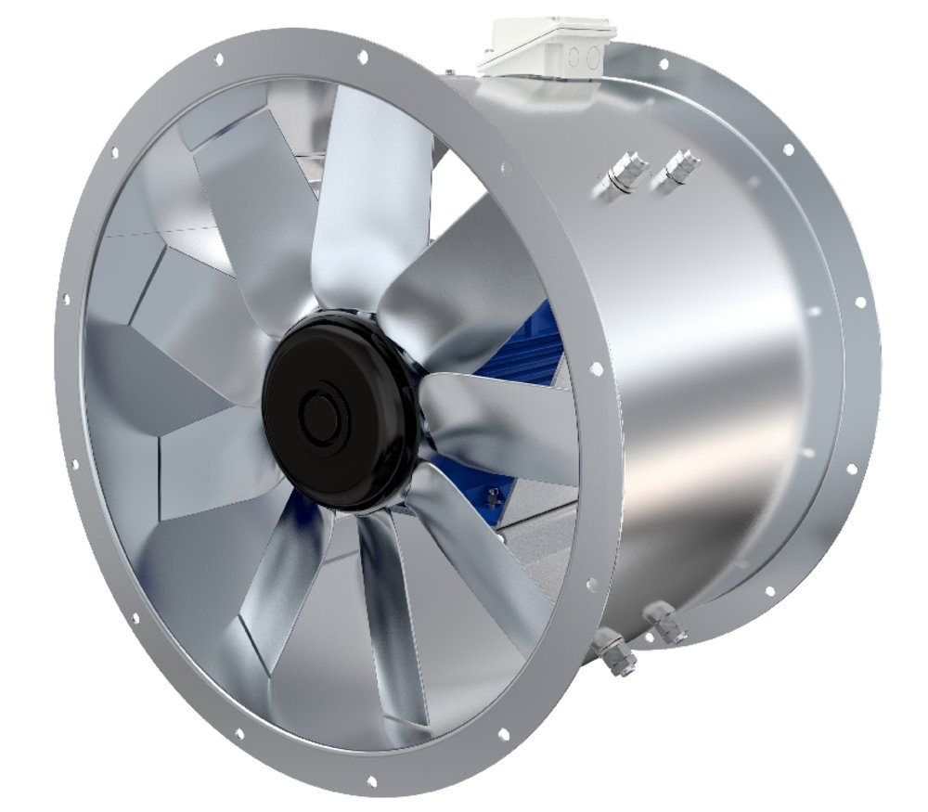
Fan selection
Aim.
Pressure drop.
Selection.

Slide 15
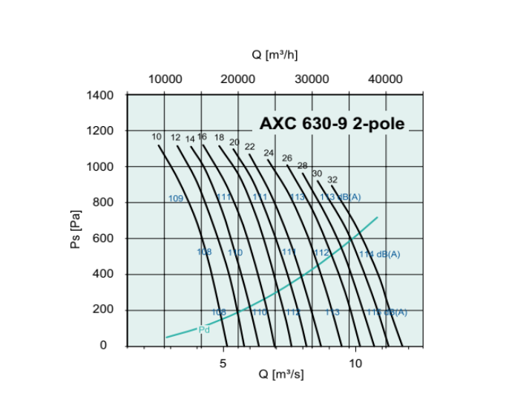
Fan selection : Characteristic curve

Slide 16
Efficiency
Energy ratio.

Slide 17
Conclusion
Design closed loop wind tunnel.
Dimensions.
Pressure losses.
Fan.
Drawing.

Slide 18
Future work
Measurement devices.
CFD.
Design fan.

Slide 19
Thank you .. ☺

