Slide 1
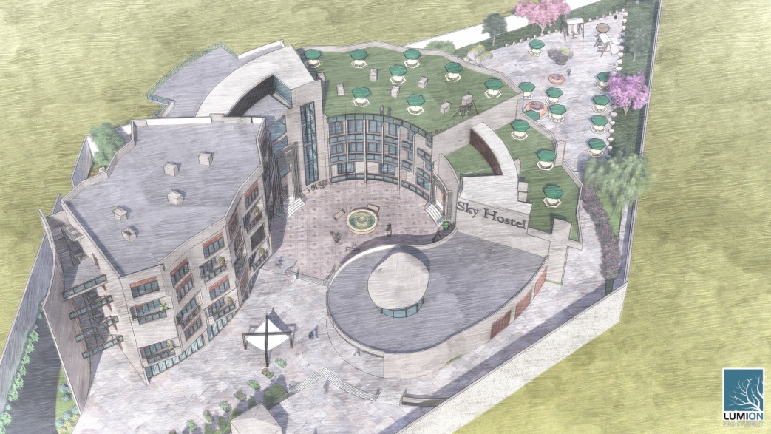

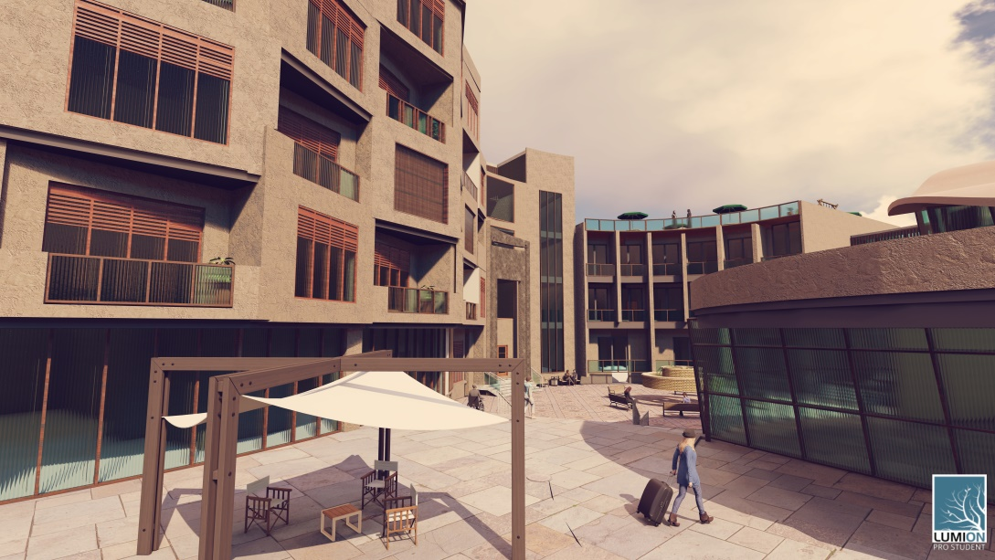
INTEGRATED HOSTEL DESIGN
An-Najah National university
Faculty Of Engineering
Building Engineering Department
Supervisor :
Moayad Salhab
Prepared by :
Lama Ahmad
Maha Hilan
Marah Awajneh

Slide 2

OUTLINES
Introduction
Site description
Architectural design
Environmental design
Structural design
mechanical design
Electrical design
Quantity surveying
Conclusion

Slide 3

Introduction

Slide 4
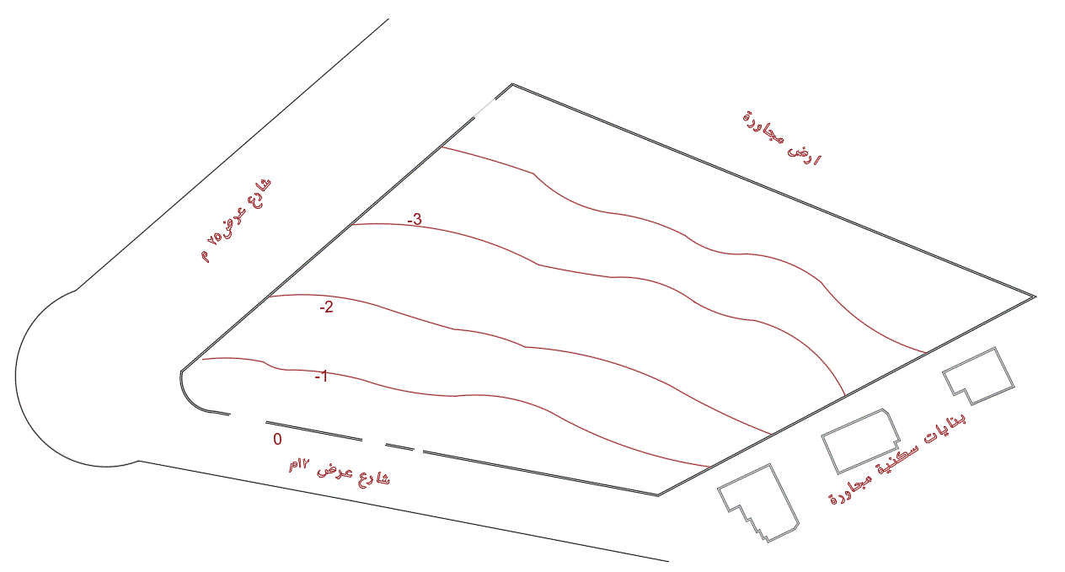
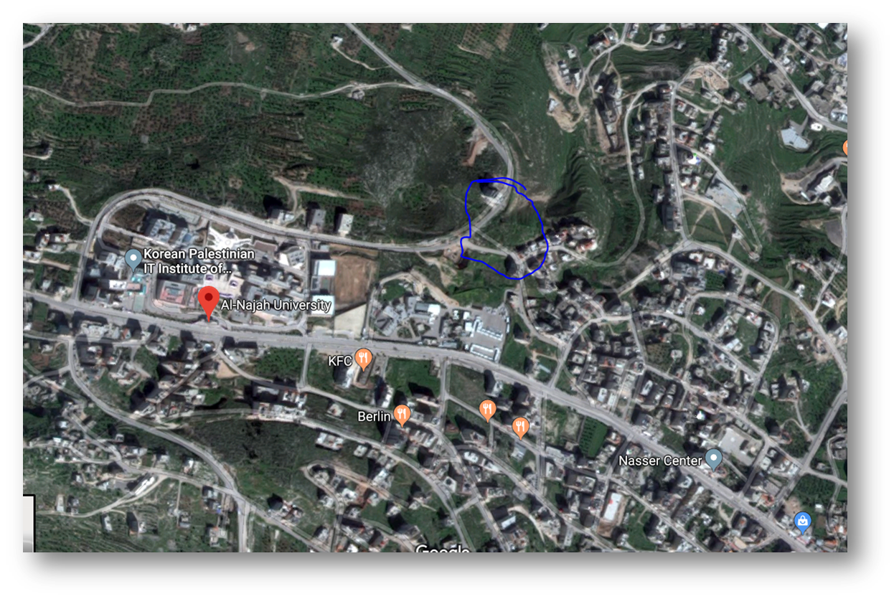
Site description
Location : Nablus city, in
Beit -Wazan town,
near An- Najah University
Area:
5583.24m2
3.2 km form city center
Surrounding
2 main streets
Residential building

Slide 5
Architectural Design

Slide 6
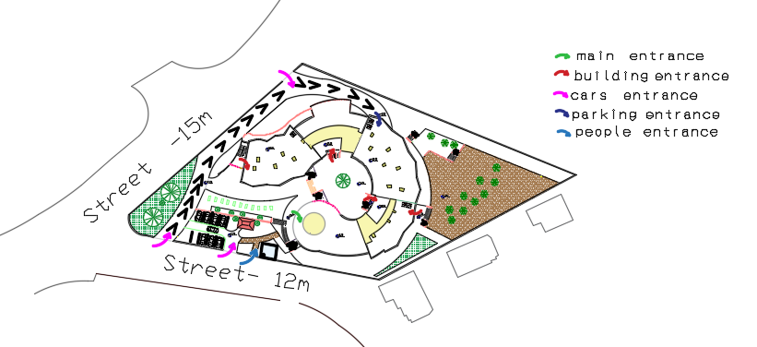
Site Accessibility

Slide 7
Project Description
4 floors, in addition to abasement as a parking .
serves 123 students
Total area of the building equals to 6155.05 m
First floor
1570.2m2
second floor area
1269.8 m2
Third floor area
783.3 m2
Forth floor floor
590.38 m2
Ground floor area
1927.7 m2
Basement
604 m2

Slide 8
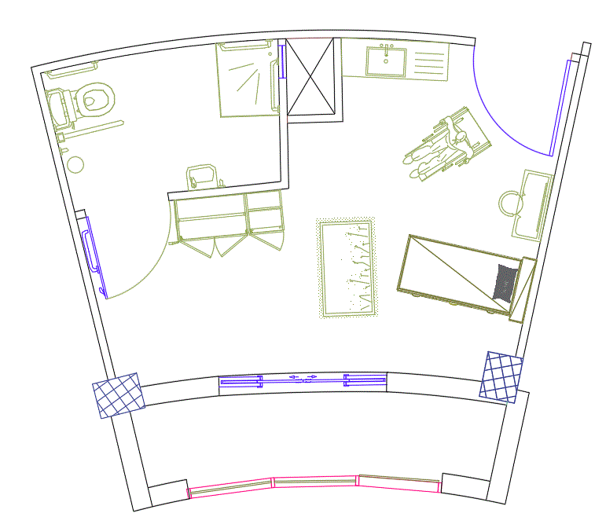
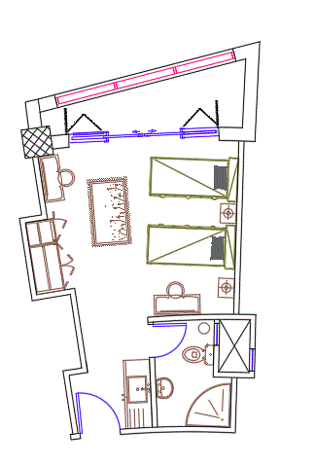
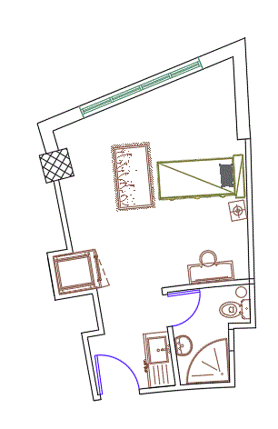
Bedrooms Forms
 | . single bedrooms | double bedrooms | Special need bedrooms
No. | 39 | 42 | 3
Area(m2) | 16-18 | 24-28 | 31-35

Slide 9
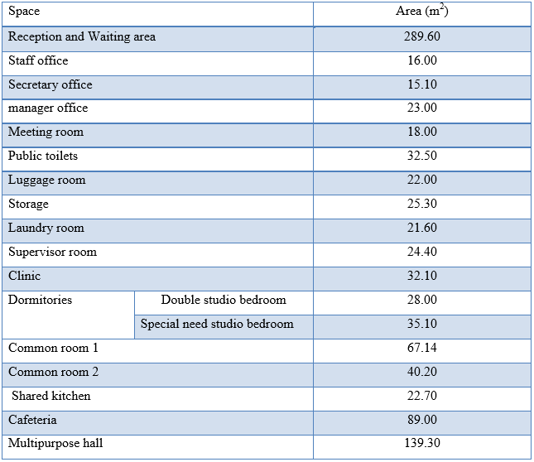
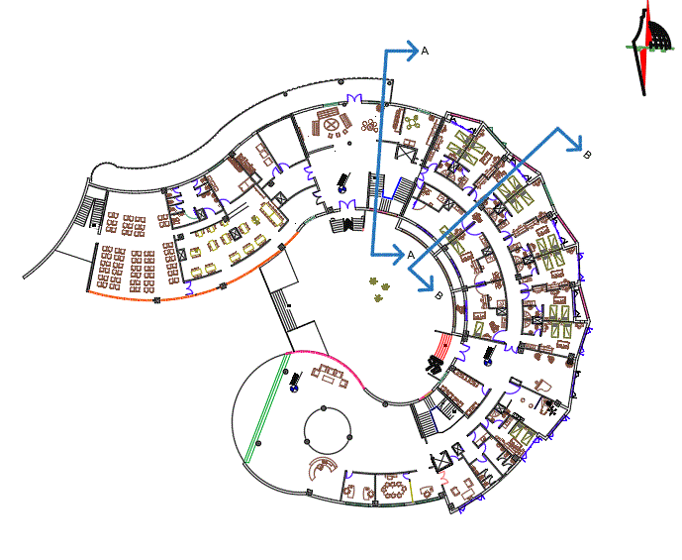
Ground Floor
Ground floor plan

Slide 10
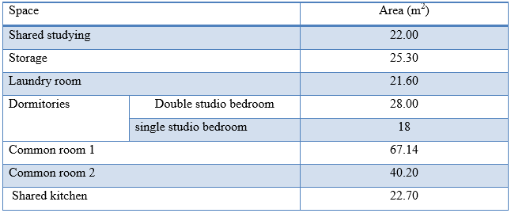
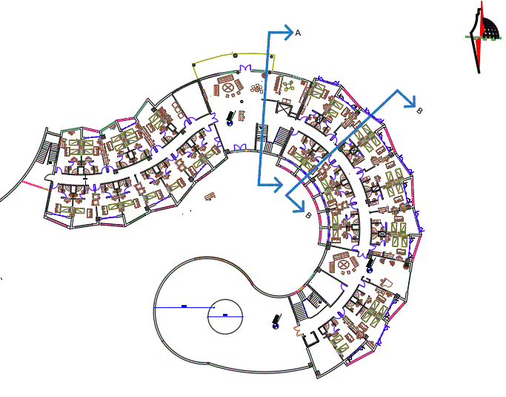
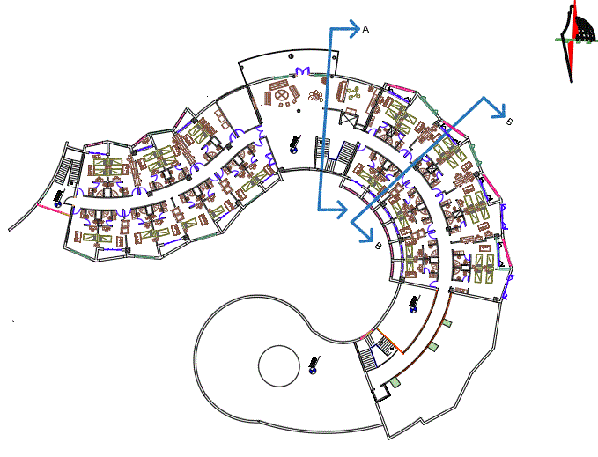
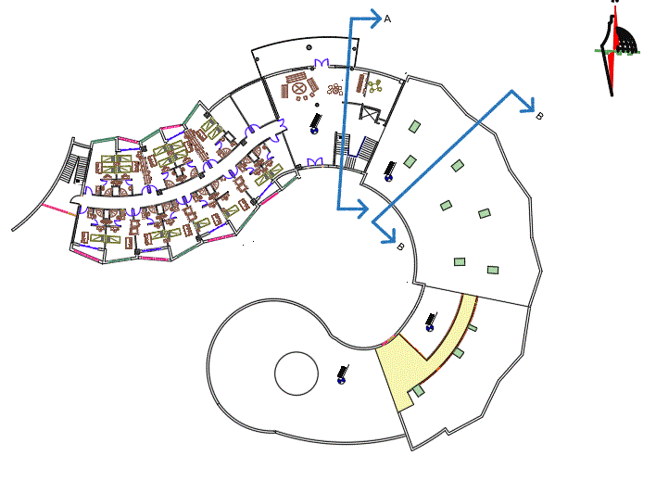
First Floor Second , And Third Floor
Plans

Slide 11
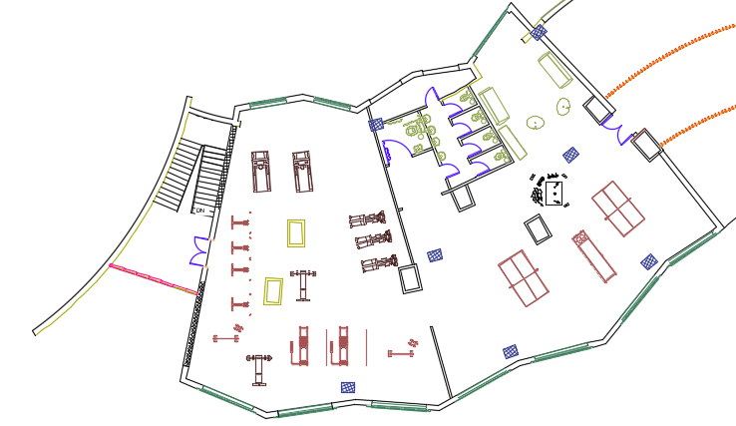
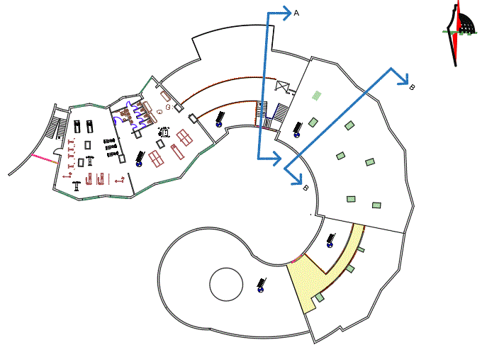
Fourth Floor
Forth floor Plan
Space | Area
Store | 7.66
Toilet | 29.10
Gymnasium | 176.4
Entertainment hall | 133.4
Common room | 34.5

Slide 12
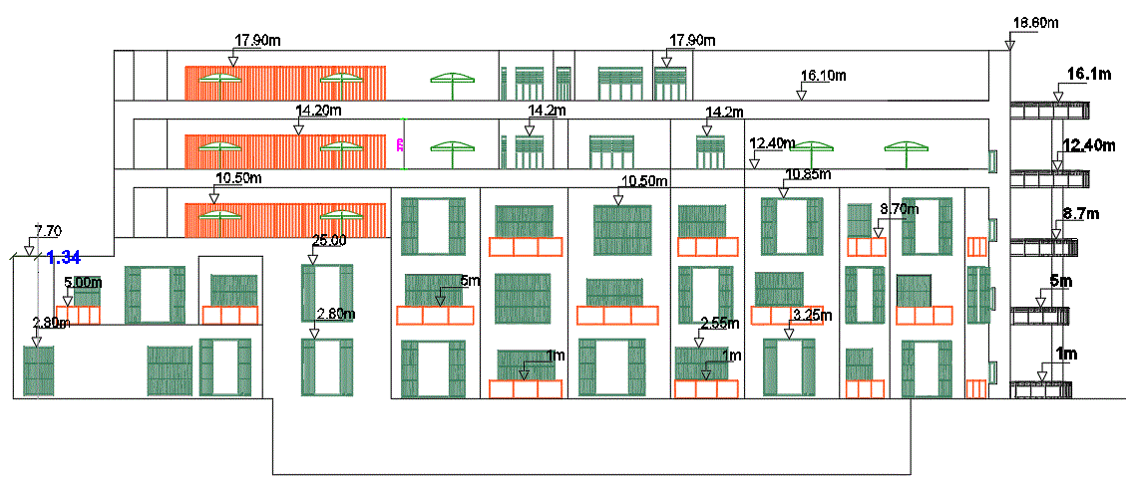
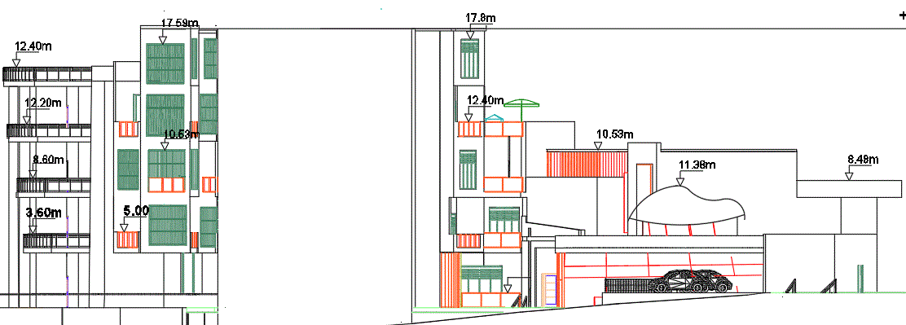
Elevations
East Elevation
West Elevation

Slide 13
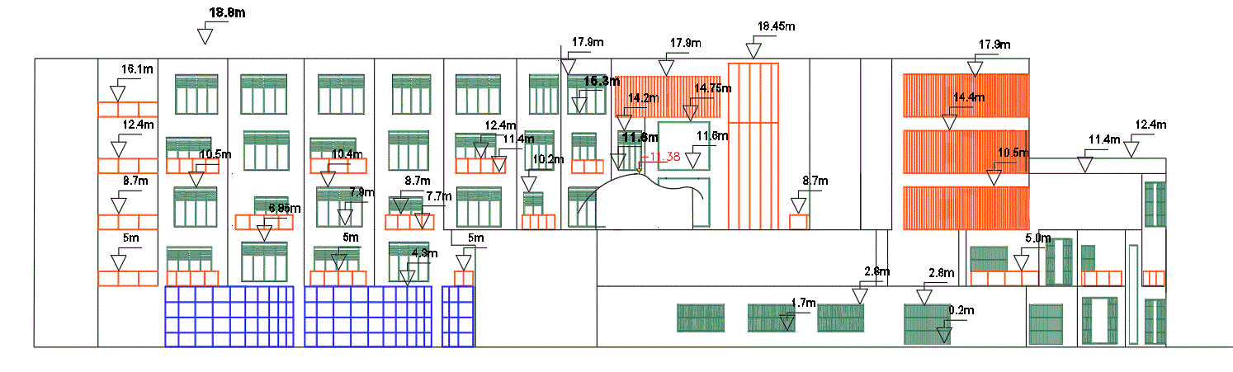
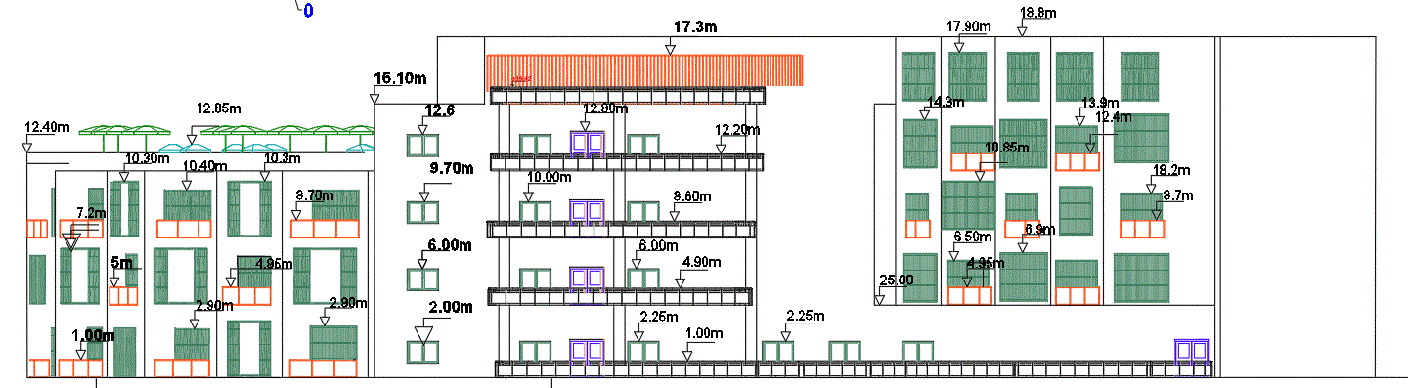
Elevations
South Elevation
North Elevation

Slide 14
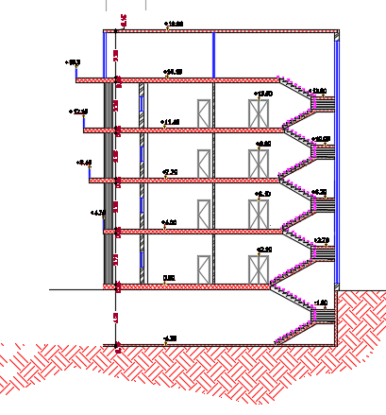
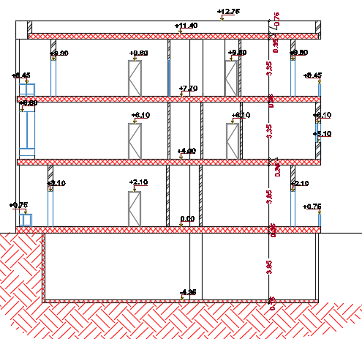
SECTIONS
A-A section
B-B section

Slide 15
Environmental design
Material properties
Thermal behavior
Acoustical design
Daylighting factor
Shading design

Slide 16
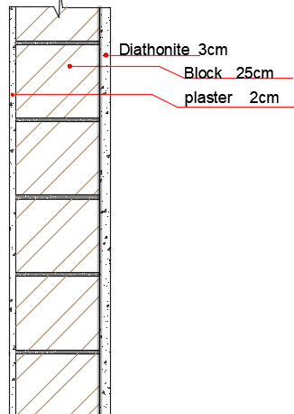
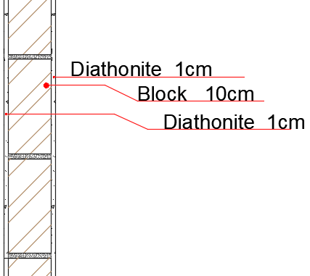
Material properties
External wall
Internal wall
Diathonite
light weight
Elasticity
Mechanical strength
Breathability
Fire resistance
Acoustic insulation
Energy saving
Humidity control
U – value
0.468 w/m².k
U – value
1.47w/m².k

Slide 17
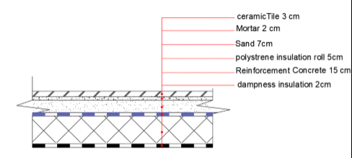
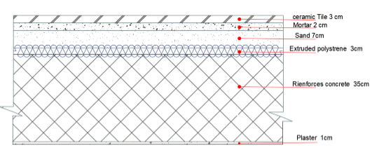
Ground floor
U – value
0.528w/m².k
Second and third floor
U – value
0.619w/m².k

Slide 18
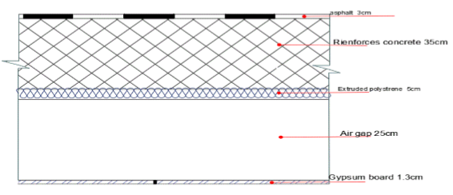
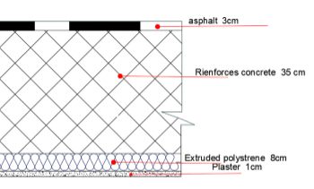
First and forth floor
U – value
0.491w/m².k
Roof
U – value
0.364w/m².k

Slide 19
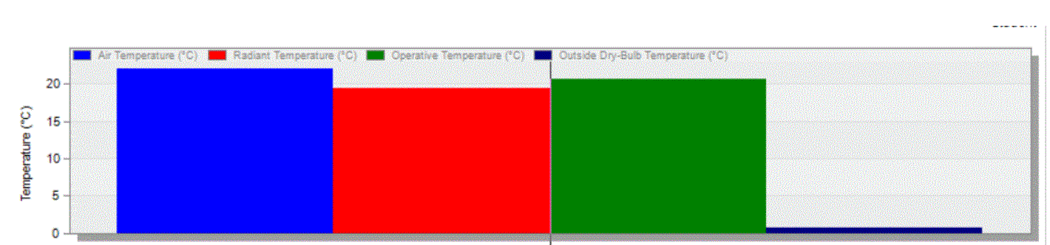
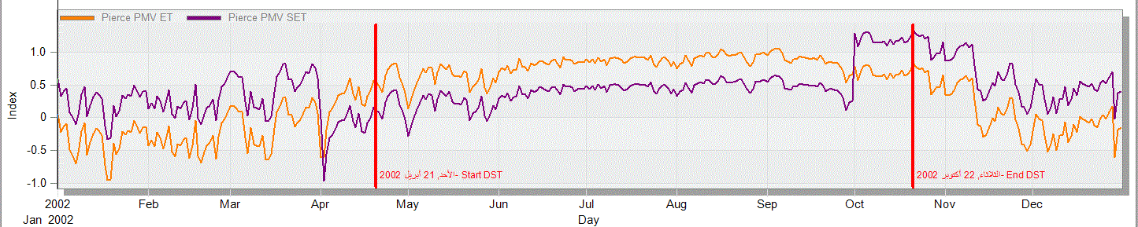
Thermal comfort Analysis
Temperature
Air Temp. =22 c˚
Radiant Temp. =19 c˚
Operative Temp. =20.48 c˚
PMV

Slide 20
Thermal Analysis
System Load
Total heating load (KW) | Total cooling load (KW)
226.59 | 388.7
Total site energy(KWh/m2)
234.59

Slide 21
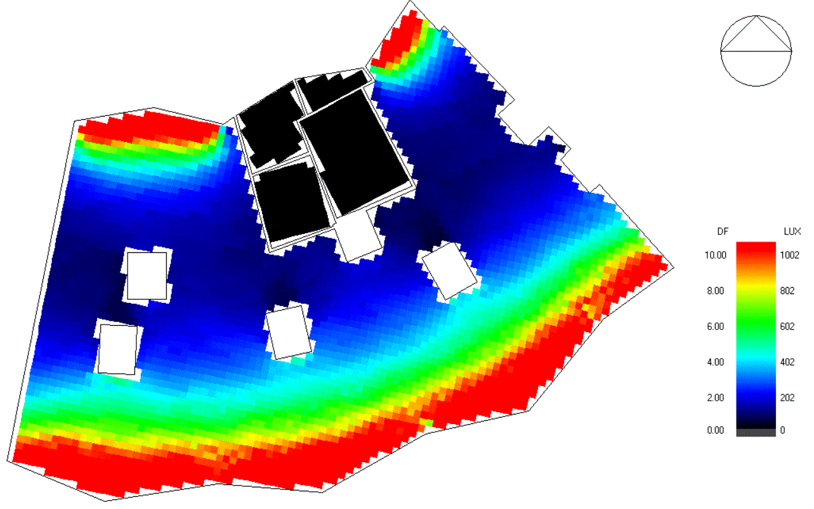
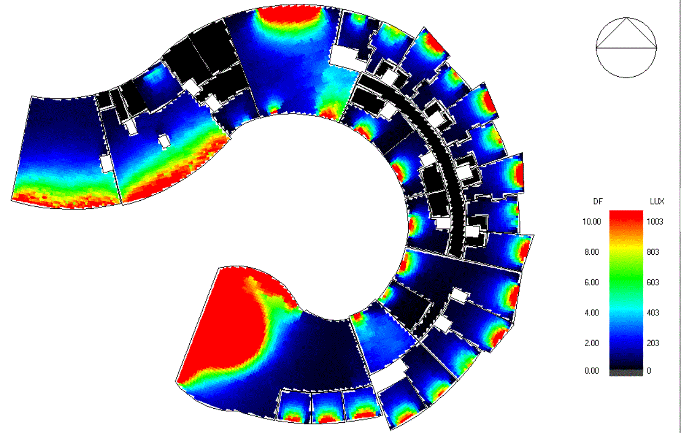
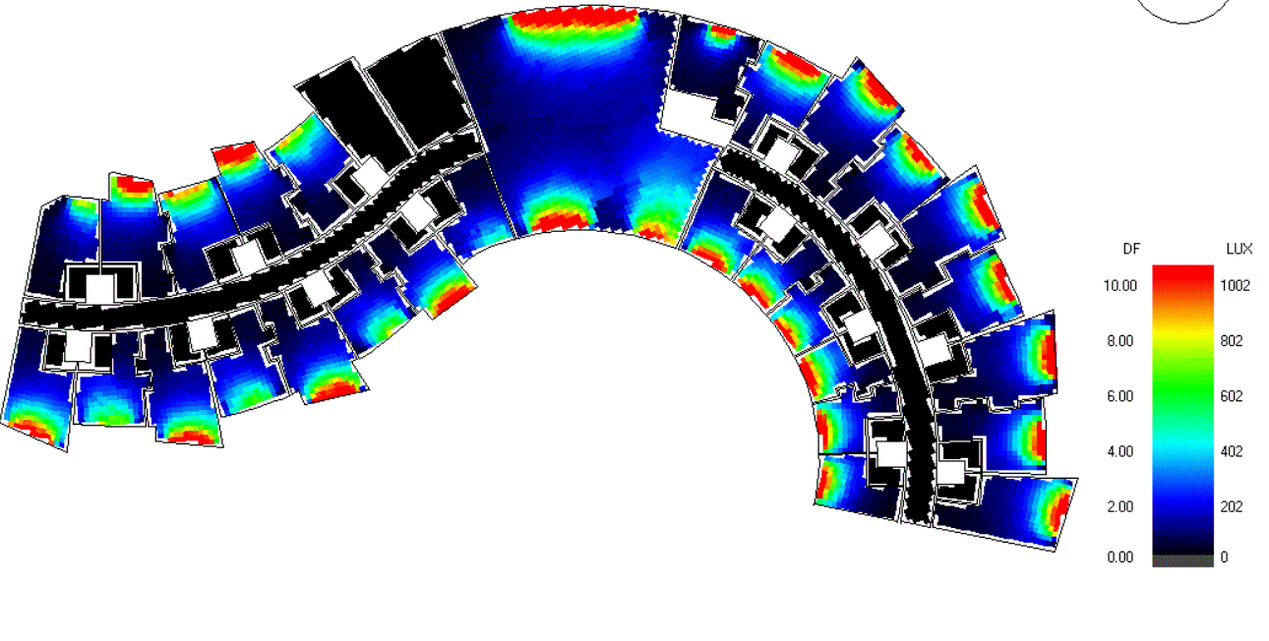
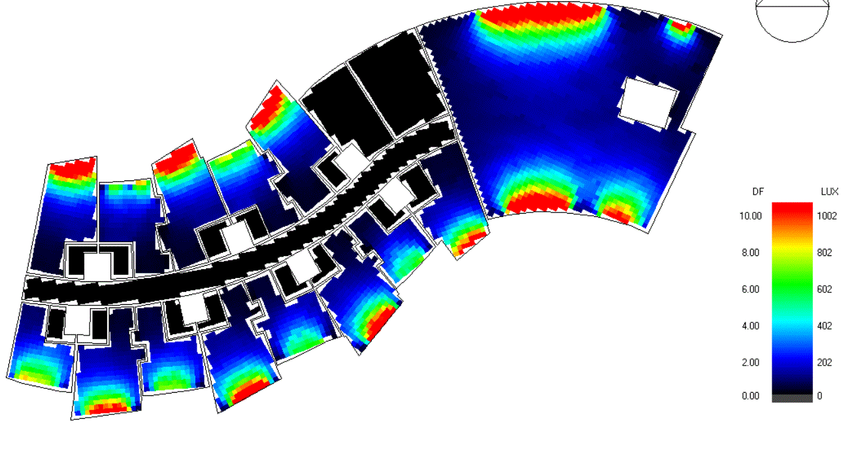
Daylighting
Function | min. Recommended Daylighting Factor
Entrance | 0.6%
Kitchens | 2%
Offices | (1.5-2.5)%
Bedrooms | 1%
Common Room | 2%
Living Entrance | 1.5%

Slide 22
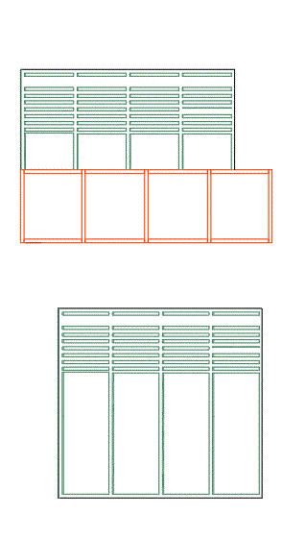
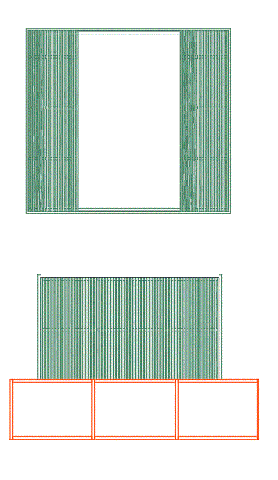
Shading
Horizontal Louvers :
Vertical Louvers :

Slide 23
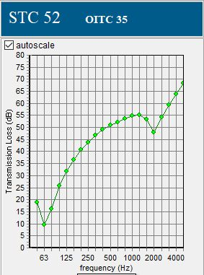
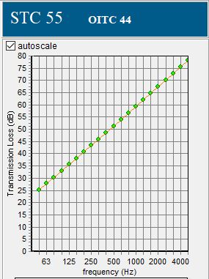
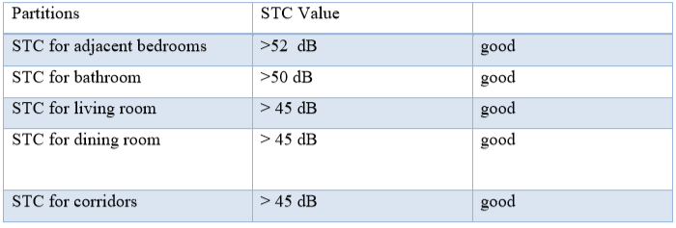
Acoustical analysis
STC (Sound Transmission Class )
External wall
Partition

Slide 24
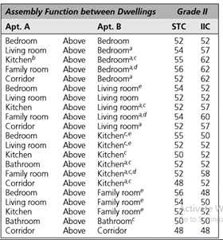
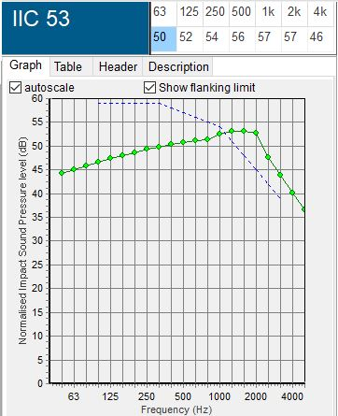
Acoustical analysis
Floors

Slide 25
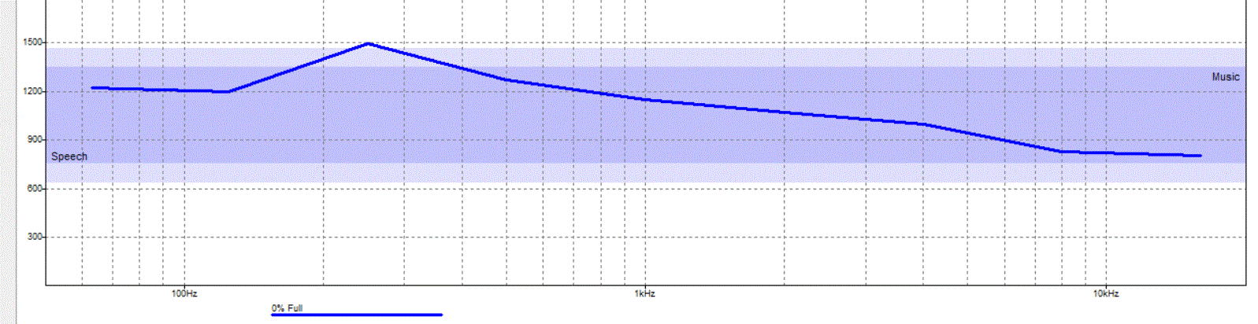
Acoustical analysis
Reverberation time
Material
Partition (acoustical Diathonite plaster
External glazing (6mm)
External wall (cement plaster on block )
Ceiling (gypsum board 1.2cm thick )
Floor (ceramic tile )
Chairs (Fabric )
Gymnasium (1.2-1.6 s)
Frequency | SABINE RT60 (sec)
125Hz | 1.23
250Hz | 1.64
500Hz | 1.38
1KHz | 1.23
2KHz | 1.14
4KHz | 1.03

Slide 26
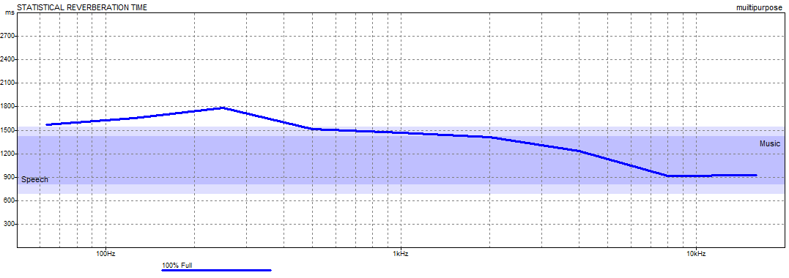
Acoustical analysis
Reverberation time
Material
Partition (acoustical Diathonite plaster
External glazing (6mm)
External wall (cement plaster on block )
Ceiling (gypsum board 1.2cm thick )
Floor (ceramic tile )
Door (aluminum )
Chairs (Fabric )
Multipurpose (1.4-1.8 s)
Frequency | SABINE RT60 (sec)
125Hz | 1.68
250Hz | 1.87
500Hz | 1.57
1KHz | 1.51
2KHz | 1.46
4KHz | 1.25

Slide 27
Structural analysis
Codes
- ACI 318-14
- UBC -97
Material
- Compressive strength ( fʹc ) = 28MPa
- Yielding strength of steel (fy) = 420 Mpa.
Bearing capacity = 250 kN /m2
Designed load
SID = 4 KN/m2
Live load = 2.5 KN/m2

Slide 28
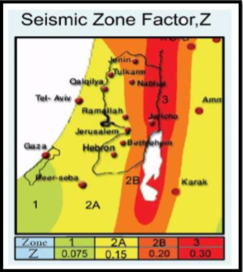
Structural analysis
seismic zone is 2B with (Z = 0.20).
( I ) = 1
Soil profiles :SD
(Ca) = 0.28
(Cv) = 0.4
(R) for Building frame with shear walls = 5.5

Slide 29
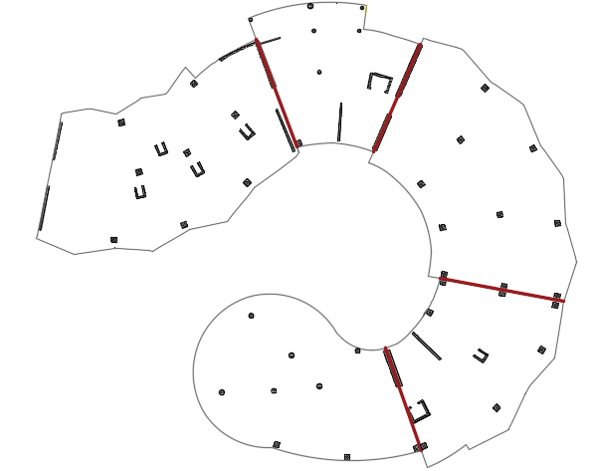
Structural analysis

Slide 30
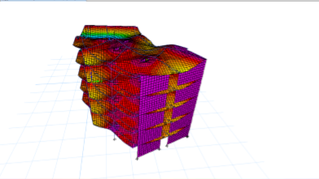
Structural analysis
Checks
Compatibility check
Equilibrium check
Internal Forces check
Deflection check
Period check
Drift check
ok
ok
ok
ok
ok
ok

Slide 31
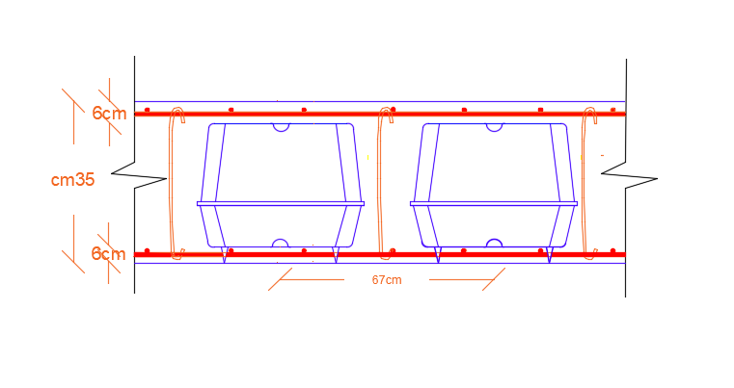
STRUCTURAL ANALASIS
Slab structural system
- Thickness =35cm
- Hidden beams
U- boot System

Slide 32
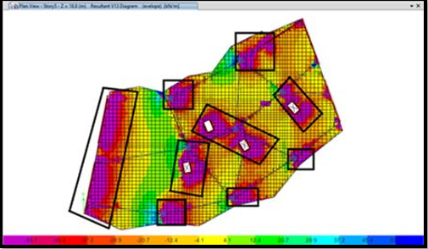
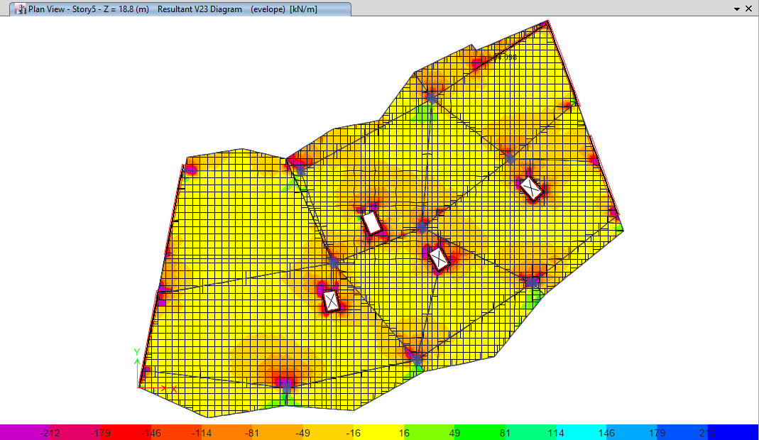
STRUCTURAL ANALASIS
Shear design
Vu >øVc

Slide 33
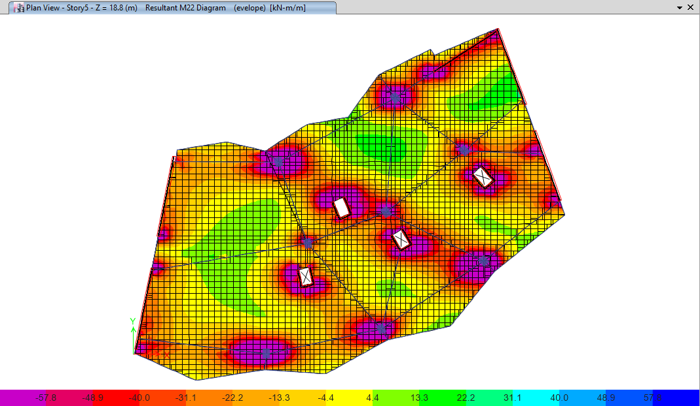

STRUCTURAL ANALASIS
Moment design
5ø10mm/m
5ø14mm/m

Slide 34


STRUCTURAL ANALASIS
Moment design
Solid slab
U-boot slab

Slide 35




STRUCTURAL ANALASIS
Beams system
Beam | Dimension(cm) | Reinforcment (mm)
B1 | 80*35 | 14Ø14
B2 | 35*35 | 8Ø14
B3 | 130*35 | 20Ø14
B4 | 110*35 | 18Ø14
Hidden beams

Slide 36


STRUCTURAL ANALASIS
Columns system
column tag | Dimension (cm) | Reinforcement | Stirrups distribution
C1 | 65*65 | 14ø20 | 3ø10@30cm
C2 | 65*65 | 12ø25 | 3ø10@30cm

Slide 37


STRUCTURAL ANALASIS
Shear wall design

Slide 38

STRUCTURAL ANALASIS
Footings type :
Single footing
Wall footing
Matt footing

Slide 39


STRUCTURAL ANALASIS
Single system

Slide 40

STRUCTURAL ANALASIS
Footing system
wall footing

Slide 41


STRUCTURAL ANALASIS
Footing system
Matt footing

Slide 42


STRUCTURAL ANALASIS
Matt footing

Slide 43



STRUCTURAL ANALASIS
Block 2
- Checks
ok
- Shear design
-Moment design

Slide 44
STRUCTURAL ANALASIS
Columns
Beams
column tag | Dimension (cm) | AS (mm2) | Bars Distribution | Stirrups distribution
C3 | D = 40 | 1257 | 8ø14 | 3ø10@30cm
C4 | D= 60 | 3850 | 8ø25 | 3ø10@30cm
C5 | 65*65 | 4225 | 12ø25 | 3ø10@30cm
Beam tag | Dimension (cm) | Reinforcement
B1 | 50*35 | 8ø14
B2 | 35*35 | 6ø14

Slide 45


STRUCTURAL ANALASIS
Shear Wall

Slide 46
STRUCTURAL ANALASIS
Footing system
- single footing
Wall footing
Combined footing

Slide 47


STRUCTURAL ANALASIS
Single footing

Slide 48

STRUCTURAL ANALASIS
wall footing

Slide 49




STRUCTURAL ANALASIS
Combined footing

Slide 50
Mechanical design
Water system
Drainage system
Fire Fighting
HVAC system
Elevators

Slide 51


Water System
underground water tank capacity = 80 m³.
Diameter Of Pipes
Vertical | Horizontal | Branch
3 '' | 2'' , 1.5'' | 0.75''

Slide 52


Drainage system

Slide 53

Drainage system
Storm water

Slide 54



HVAC System
Outdoor unit
Slot Linear diffuser
Split unit

Slide 55
Heating Ventilation and Air conditioning HVAC Design:
Total cooling load for the ground floor equals 150.5 kW
Zone | Design Capacity (kW) | Design Flow Rate (m3/s)
Multipurpose | 10.67 | 0.6977
Cafeteria | 14.29 | 1.01
Zone | Design Capacity (kW) | Design Flow Rate (m³/s) | unit
Corridor | 1.57 | 0.1011 | 1
Room11 | 2.21 | 0.1619 | 1
Room10 | 2.61 | 0.1914 | 1
Room4 | 2.96 | 0.2104 | 1
Room5 | 2.38 | 0.1689 | 1
Common Area | 12.62 | 0.7898 | 4
Zone30 | 2.84 | 0.1688 | 1
Room3 | 1.32 | 0.0885 | 1
Room6 | 3.51 | 0.2414 | 1
Room9 | 2.7 | 0.1898 | 1
Room7 | 2.62 | 0.1795 | 1
Room2 | 2.24 | 0.1569 | 1
Room1 | 1.16 | 0.0793 | 1
Room8 | 3.16 | 0.2135 | 1
Hall | 7.2 | 0.4638 | 2
Supervisor Bed Room | 3.07 | 0.2251 | 1
Clinic | 2.54 | 0.1888 | 1
Office3 | 4 | 0.291 | 1
Manager | 3.72 | 0.2685 | 1
room | 1.21 | 0.0829 | 1
Office1 | 2.68 | 0.1818 | 1
Office2 | 2.69 | 0.1949 | 1

Slide 56

Heating Ventilation and Air conditioning HVAC Design:

Slide 57


Mechanical Ventilation

Slide 58

Fire Fighting System
Heat Detector
Smoke Detector
Fire Extinguisher
(CO2)
Fire Extinguisher
(water)
Sprinkler

Slide 59

Emergency Exit
Width of corridors = 1.7-2 m
Longest bath = 17m

Slide 60

Elevators
Capacity | 630kg | 1000kg
speed | 1.00m/s

Slide 61
Electrical design
Socket distribution
Artificial lighting
Load speaker

Slide 62


Electrical design
Sockets design
 | No . Sockets
Sleeping area | 3 , 1 for hvac system
Kitchenate | 2 , 1 for refrigrator

Slide 63



Electrical design
Artificial lighting
Reception
Luminaires
Underscore Ep77
201 lm
MQ95_J005 Cup
850lm
CHAL 200
1990 lm

Slide 64





Electrical design
Artificial lighting
Bedrooms
Luminaires
QN50 Boss
4500 lm
LYRIC DECO LED
1500 lm
LOGICO TVOLO
2310 lm

Slide 65


Lighting and switches distribution

Slide 66



Loud Speaker
PRO-16RC
Frequency Range | 63hz - 23khz +/- 3db
Coverage Angle | 100
Finish | Black Baffle/Frame, White Paintable Grille
Mounting Depth | 6.15” (15.6cm)
Product Weight | 7 Ibs (3.18kg)

Slide 67
Quantity surveying
 | Cost (NIS)
Structural work | 4,625,440
Finishing | 3,719,891
Mechanical work | 481,555
Electrical work | 349,572
Total Project Cost | 9,441,253
Total Unit Cost (NIS /m2) = 1534

Slide 68

Thank you for listening
Ramadan Kareem
And You Are “Akram”

