Slide 1
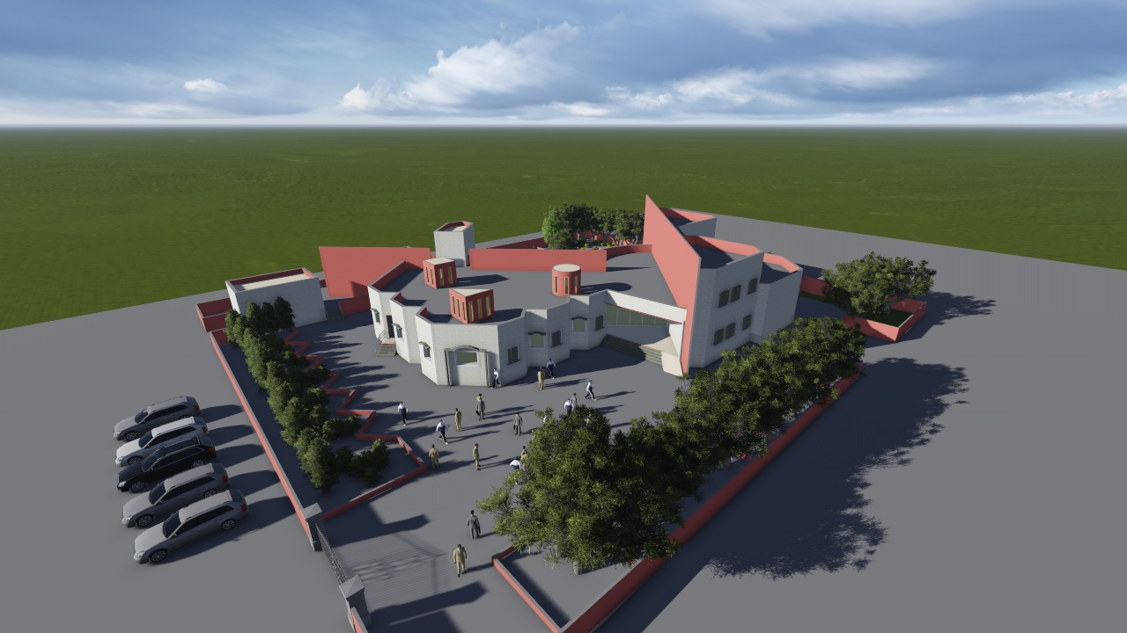

An-Najah National University
Faculty of Engineering
Building Engineering Department
Graduation Project – 2
Hamdi Manko Cultural Center
Prepared By:
Ameena Zaghal
Mohammad Taqatqa
Raneen Abo jamos
Project supervisor:
Dr. Mukkarram Abbas

Slide 2
Outline:
Project Definition
Analysis , assessment and solution for different engineering perspectives
A- architectural aspects
B- Environmental aspects
C- structural aspects
D- mechanical and HVAC design
E- safety design
Quantity and cost of the project

Slide 3
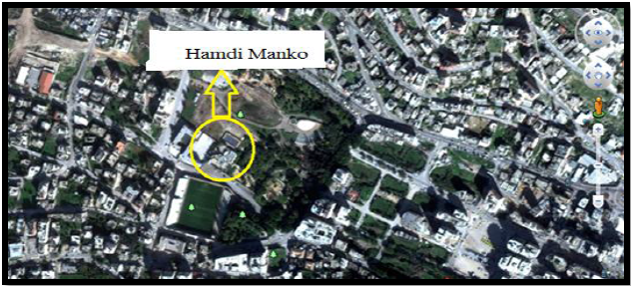
project definition:
1- Administration
2- Theater
3- Classes
4- Computer room
5- Library
6- Music room
7- Game room
8- Cafeteria
9- Conference room
10- Gallery
11- Meeting room
Total area = 1700 m²

Slide 4
Analysis of Architectural aspects

Slide 5
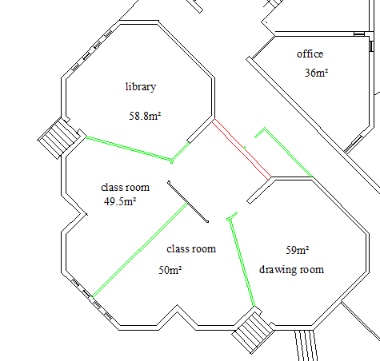
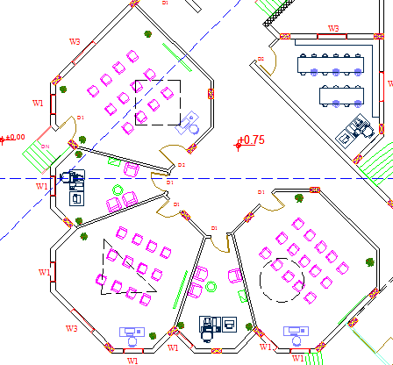
Our analysis, assessment and solutions
Classes
Before
After

Slide 6
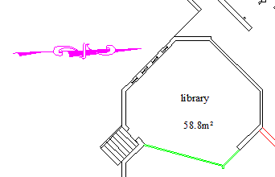
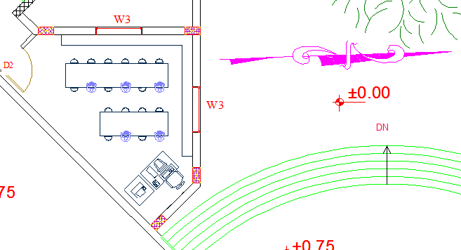
Our analysis, assessment and solutions
Library
Before
After

Slide 7
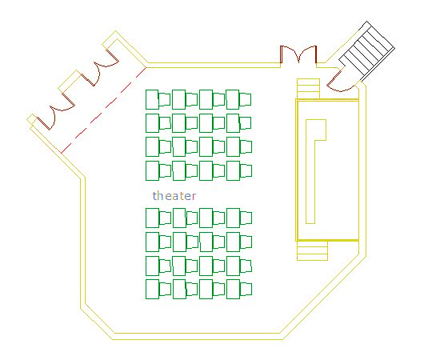
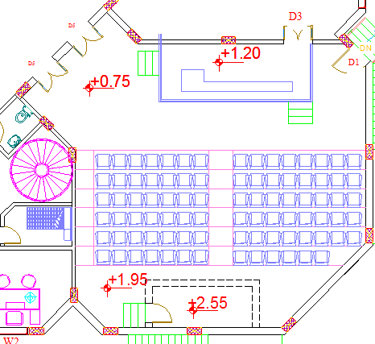
Our analysis, assessment and solutions
Theater
Before
After

Slide 8
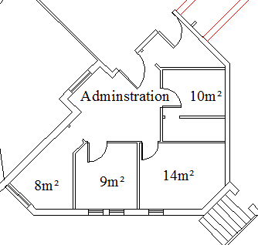
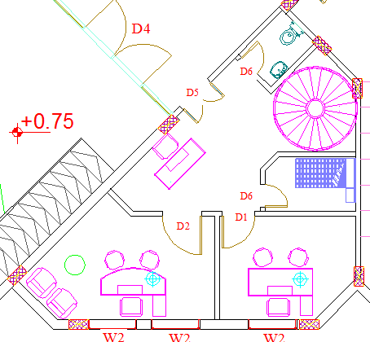
Our analysis, assessment and solutions
Administration
Before
After

Slide 9
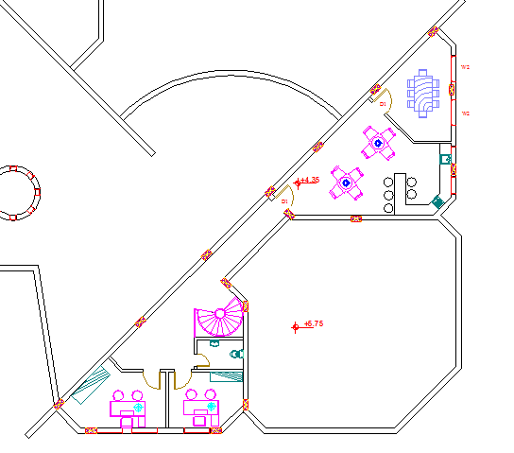
Our analysis, assessment and solutions
First floor
Meeting
room
Cafeteria
Offices

Slide 10
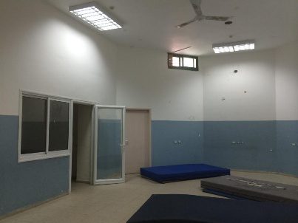
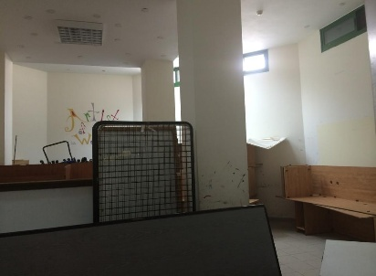
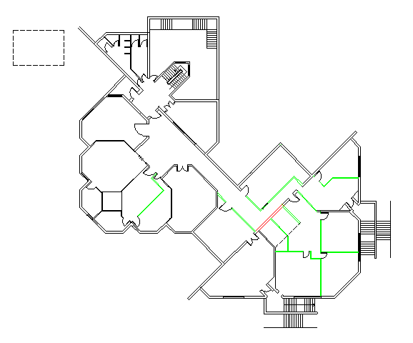
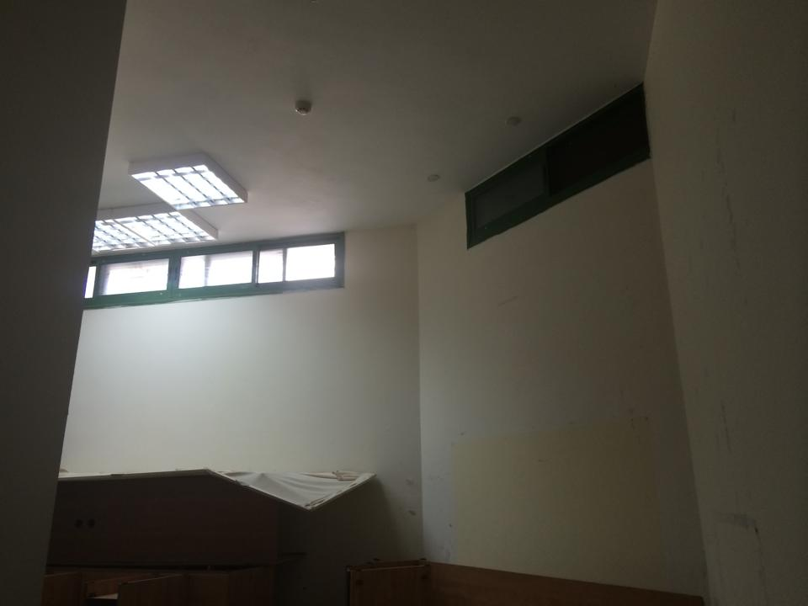
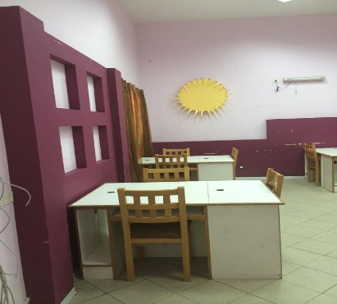
Our analysis, assessment and solutions
Basement floor before

Slide 11
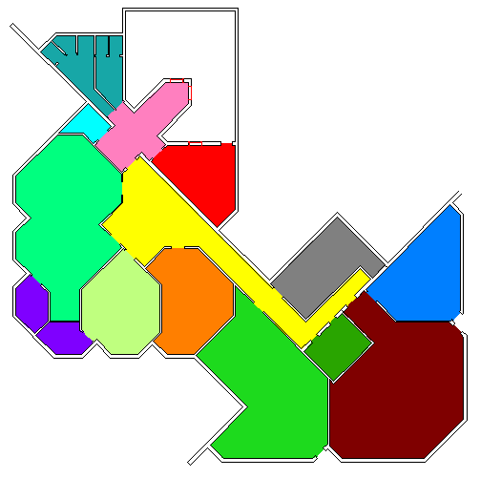
Our analysis, assessment and solutions
Bathrooms
Office
Gallery
Tennis
room
Multipurpose
room
Music
room
Art room
Game room
Conference
room
Basement floor after

Slide 12
Analysis of environmental aspects

Slide 13
Over solar gain
The best orientation figure
Orientation of the building

Slide 14
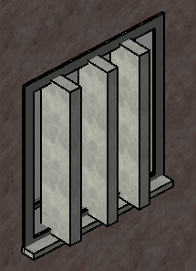
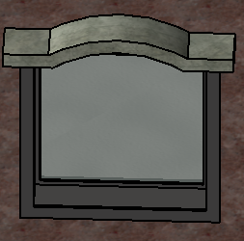
Solution :
vertical\horizontal shutters
South
West/East

Slide 15
Shadows
June 8:00 AM
June 4:00 PM
December 8:00 AM
December 4:00 PM

Slide 16
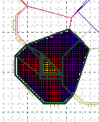
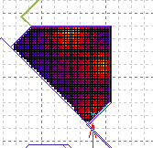
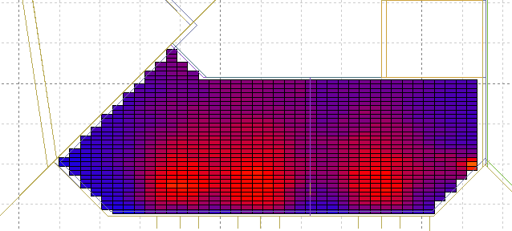
Daylight analysis
Class room
Library
Offices
DL=3.48
DL=3.54
DL=3.24

Slide 17
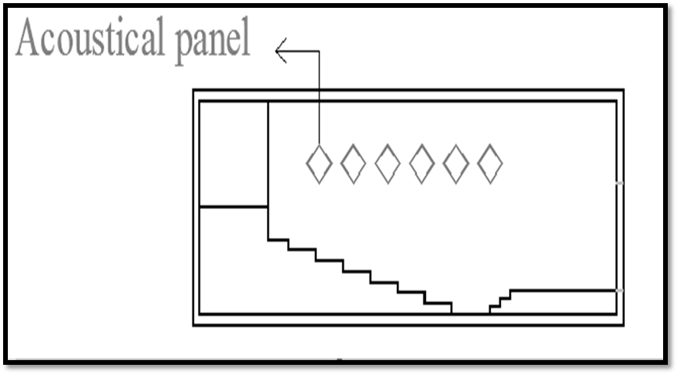
Acoustical Design:
RT60 = 1.1
Added material:
Perforated metal panels (α= 0.97)
Acoustical panels (α= 0.99)

Slide 18
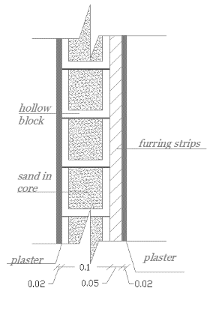
Sound transmission :
STC after improvement
STC total = 44

Slide 19
Structural
Aspects

Slide 20
Slab thickness:
The slab thickness (h) = 320 mm

Slide 21
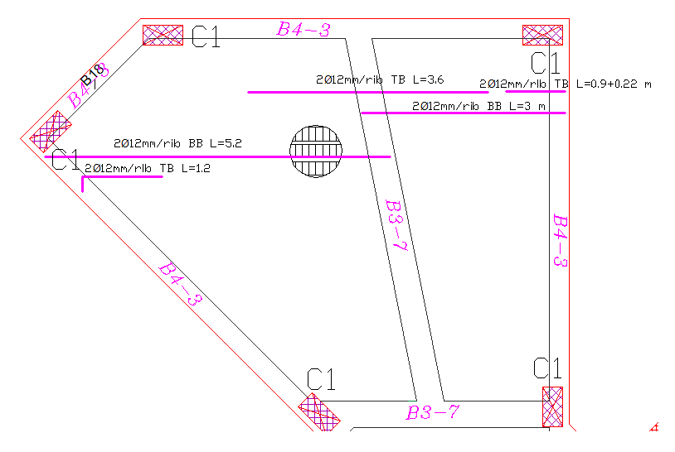
Slab reinforcement:

Slide 22
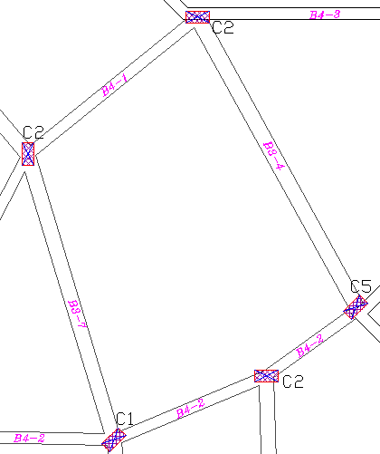
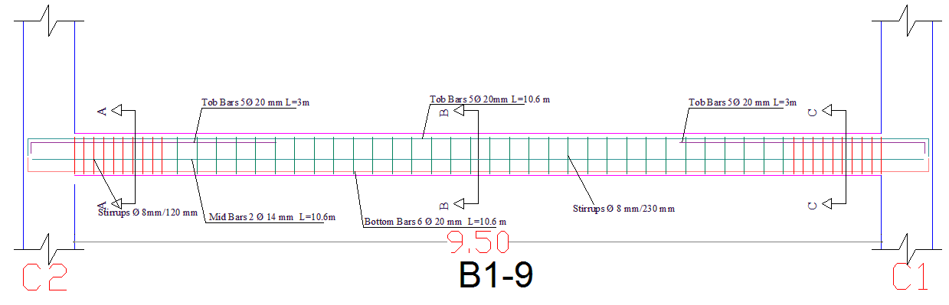
Beam design:

Slide 23
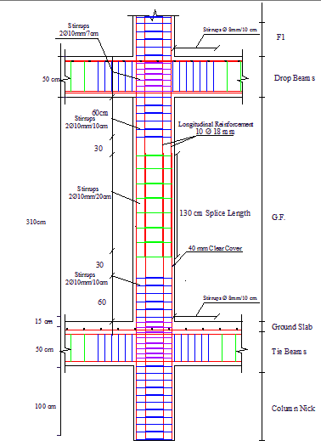
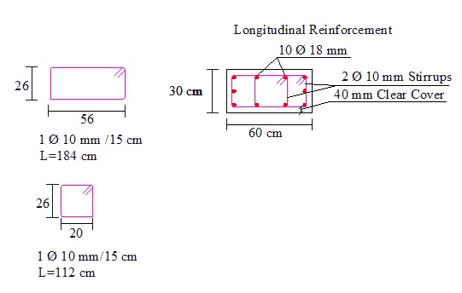
Columns Design:

Slide 24
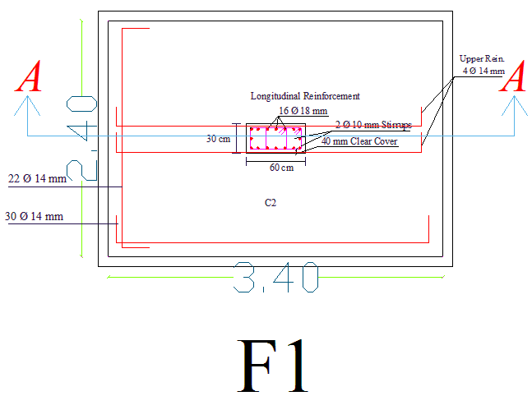
Footing design

Slide 25
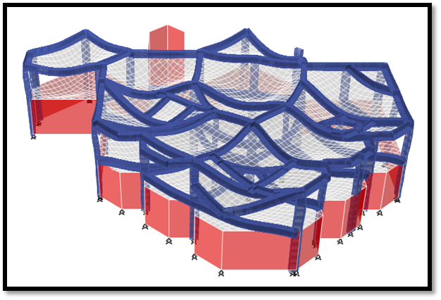
Checks:
1- Compatibility check by using Etab program

Slide 26
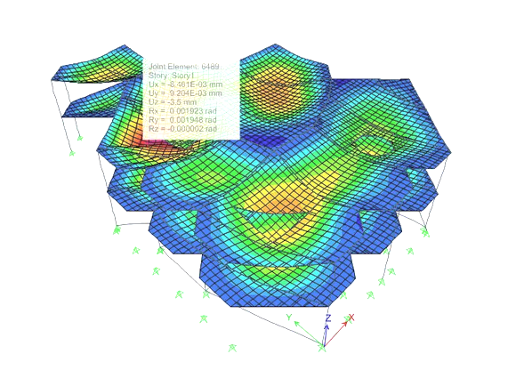
The maximum deformed shape of the model:
Max. deflection=3.5mm

Slide 27
2- Global Equilibrium:
Load | Etab | Manual | % error
Dead | 12285 | 11825 | 3.8
Live | 4192 | 4285 | 2.1
Super imposed | 5192 | 5270 | 1.4
% Error < 5%
Acceptable error

Slide 28
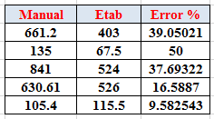
3- Internal Forces Check:
beams

Slide 29
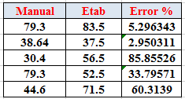
Slab

Slide 30
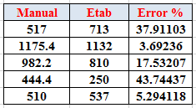
columns

Slide 31
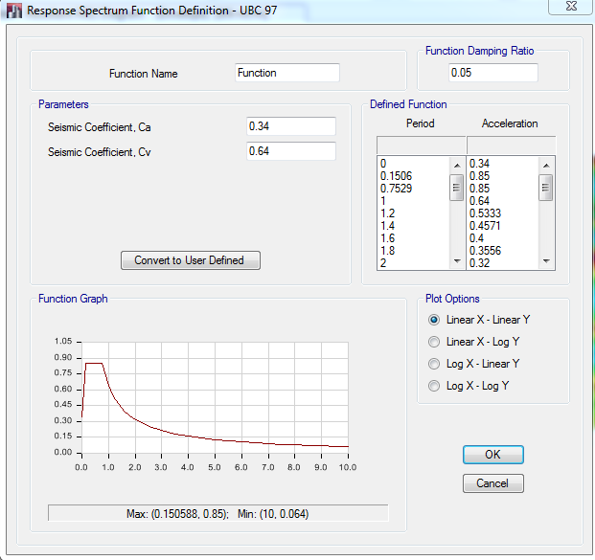
seismic desgin:
Soil Type: S_{c}
C_{a} = 0.34
C_{v} = 0.64
C_{t} = 0.0488
I = 1
R = 4.5

Slide 32
Check shear for seismic design:
V_{S (max)} = 342.7 ton
V_{S} _{(SAP)} = 478 ton

Slide 33
Natural Period (T) for the building:
T (manual)= 0.21 sec
T (etab ) = 0.215 sec
OK

Slide 34
Mechanical
Design

Slide 35
Mechanical design include:
1- Water supply system .
2- Drainage system design.
3- HVAC system design .

Slide 36
Water supply system
We compute the diameter size for main horizontal feeder, main vertical feeder and the branches for each floor.
For basement floor
Number of fixture unit = 32and water demand 21 GPM.
So,
The main vertical feeder (galvanized steel )diameter = 2” .
The main Horizontal feeder (PVC) diameter = 1.5” .
The branches (PVC) diameter = 3/4” .

Slide 37
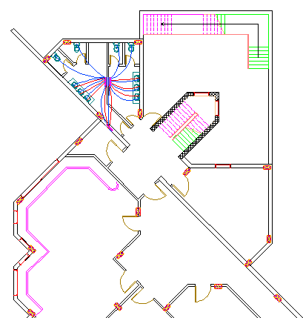
Water distribution pipes for basement floor

Slide 38
Drainage system design:
we divided the sewage system for two types:
Black water : from water closet , kitchen sink and service sink and this will go to the public sewage .
Gray water : from the lavatory and drinking fountain and this is will use again for irrigation .
**The vertical stack pipe diameter = 4”.
**The main drain pipes (under ground pipes )diameter = 6”.

Slide 39
**The next table shows the fixtures and suitable stack diameter for each one :
Fixture unit | Drainage fixture unit | Diameter size(inch)
Water closet | 4 | 4
Lavatory | 1 | 2
Kitchen sink | 2 | 2

Slide 40
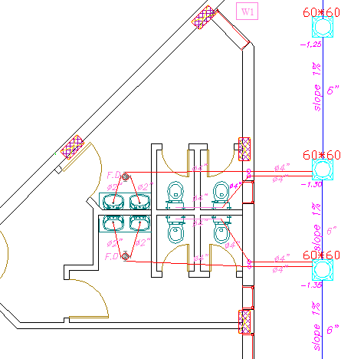
The drainage system for the bathroom :

Slide 41
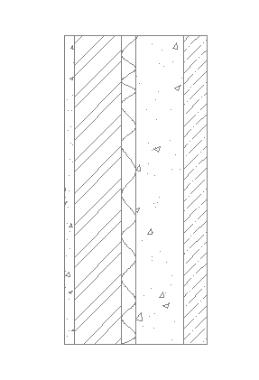
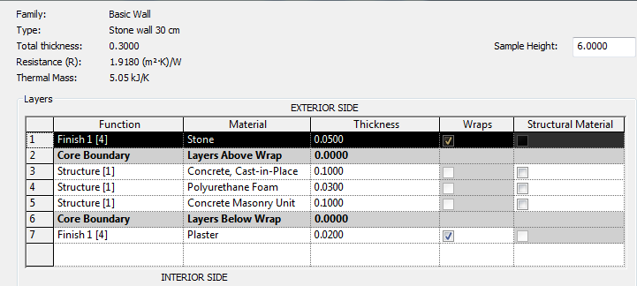
HVAC
For thermal calculation we use Revit MEP 2014 program to analyze and calculate thermal conductivity for each element in the project
External Wall layers (U=0.52 W/m^2.K)

Slide 42
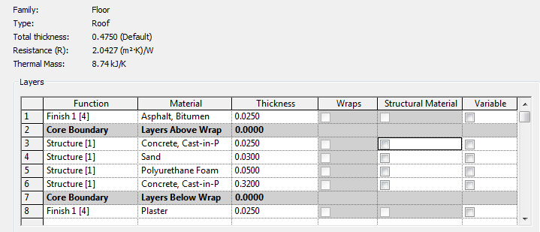
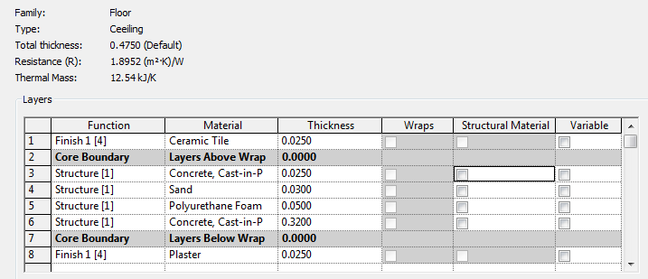
Layers of roof and ceiling
(U roof=0.49 W/m^2.K)
(U ceiling=0.53 W/m^2.K)

Slide 43
This table shows the maximum cooling and heating load calculated for all building, using Revit MEP program:
Inputs
Building Type | School or University
Area (m²) | 1,659.35
Volume (m³) | 5,207.12
Calculated Results
Peak Cooling Total Load (W) | 117,106.0
Peak Cooling Month and Hour | September 14:00
Peak Cooling Sensible Load (W) | 100,332.3
Peak Cooling Latent Load (W) | 16,773.8
Maximum Cooling Capacity (W) | 123,724.7
Peak Cooling Airflow (m³/h) | 29,491
Peak Heating Load (W) | 28,037.0
Peak Heating Airflow (m³/h) | 5,802

Slide 44
Electrical
Design

Slide 45
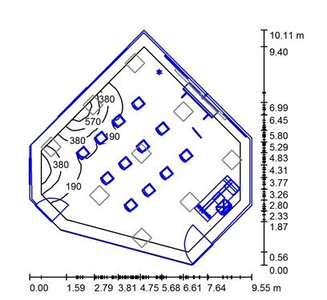
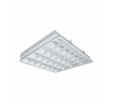
Class room:
E .avg =353 lux
Uo=0.58
#of lamps=11
Work plane =75cm
Laminar distributed

Slide 46
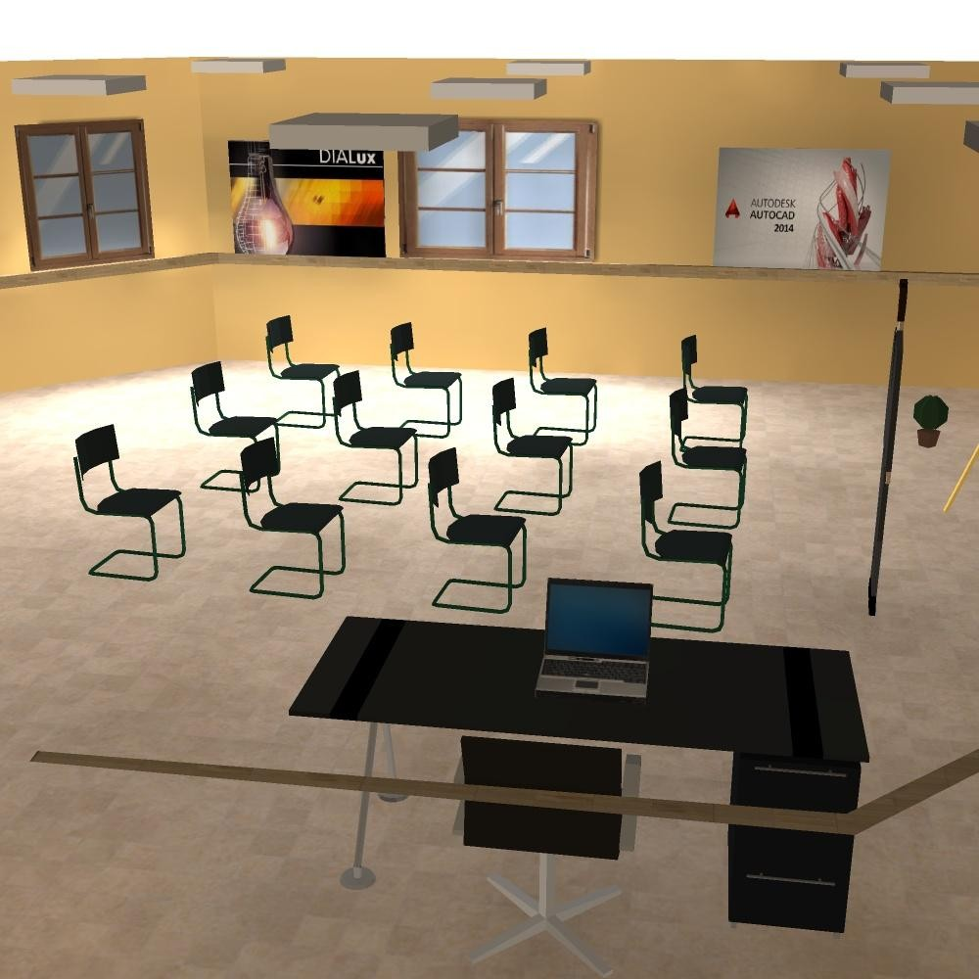

Slide 47
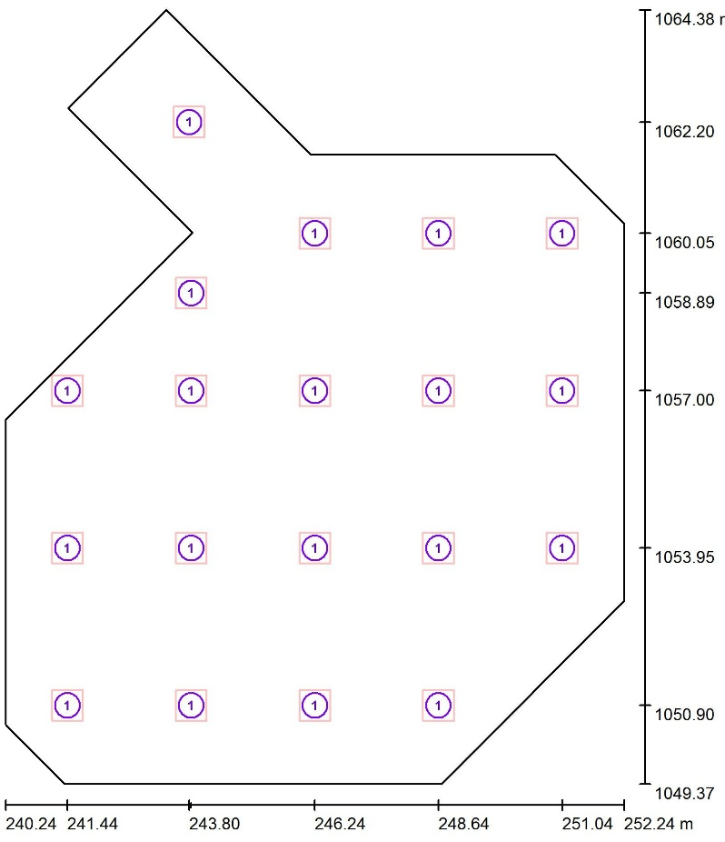
Conference room
E .avg =320 lux
Uo=0.587
#of lamps=19
Work plane =75cm
Laminar distributed

Slide 48
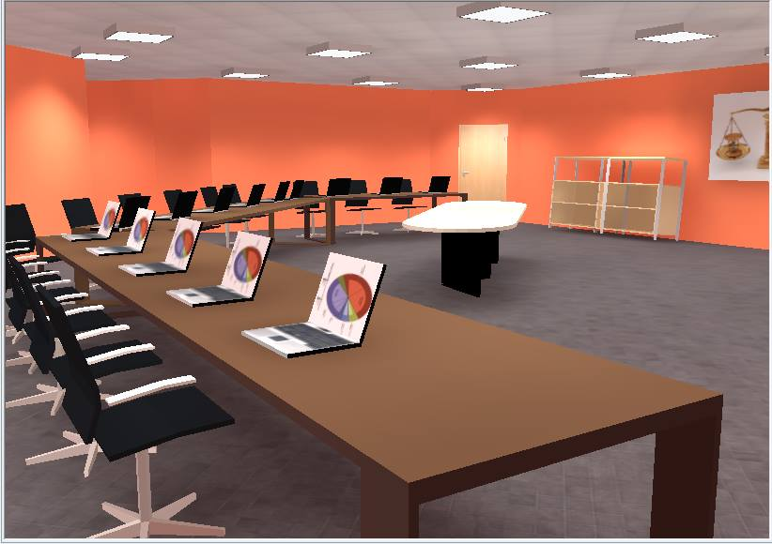

Slide 49
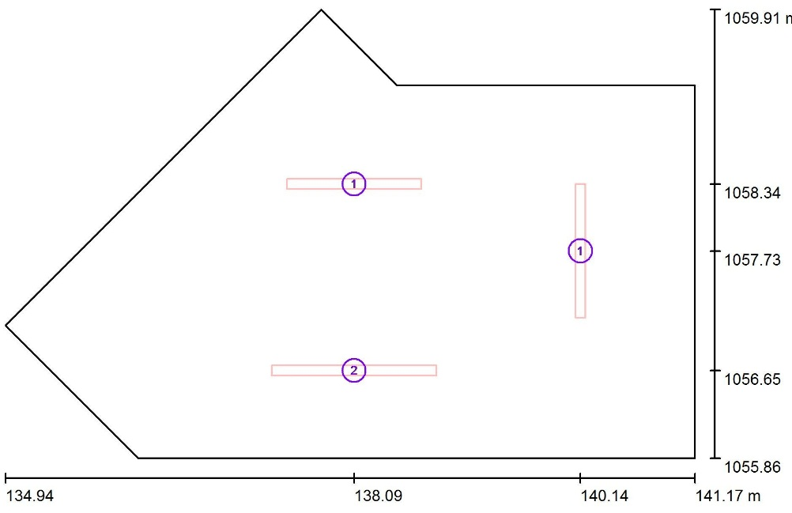

Administration
E .avg =336 lux
Uo=0 .559
#of lamps=19
Work plane =75cm
Laminar distributed

Slide 50
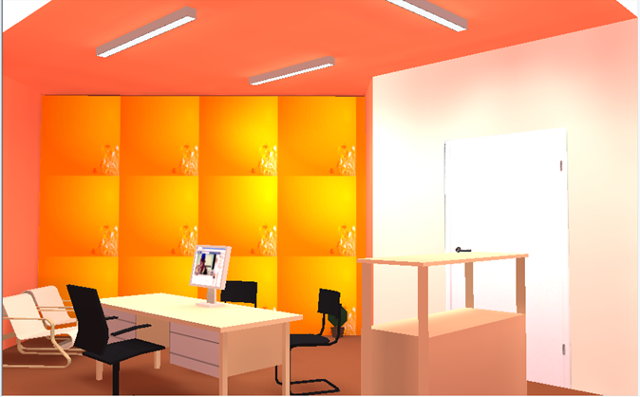

Slide 51
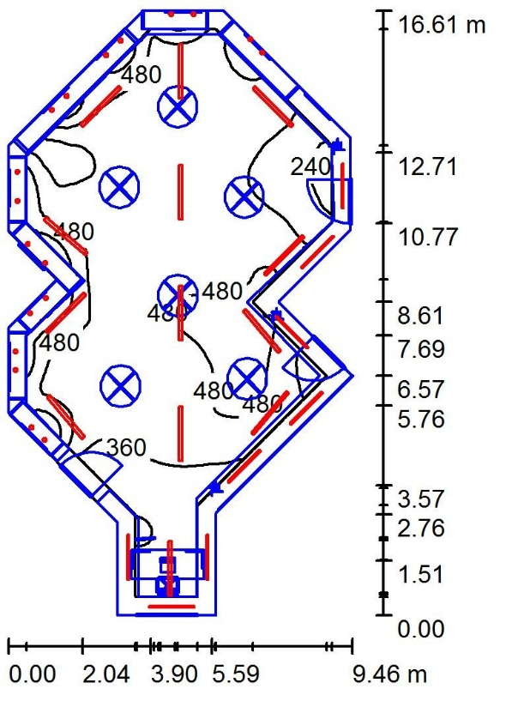
Gallary
E .avg =364 lux
Uo=0.576
#of lamps=21
#Led = 18
Work plane =75cm
Laminar distributed

Slide 52



Slide 53

Circuit breaker board
A Area of power | Ampere | MCB
6 | 30 | MCB for BF
6 | 30 | MCB for GF
4 | 20 | MCB for FF
Ground Floor

Slide 54

Basement

Slide 55

First Floor

Slide 56
Safety
Design

Slide 57





Safety signs used and distributed in the building
Left Exit
Manual fire alarm
Extinguisher
sprinkler
Output stairs

Slide 58

Distribution of Sprinklers and extinguisher in the building

Slide 59
Quantity Surveying:
The total cost of cultural center for all element with mechanical & electrical elements
Total price : 2.9 million(NIS)
= 800 NIS/m²

Slide 60
Conclusion:
In this project, we have made a redesign for the cultural center in order to have an eco-friendly cultural center.
We have achieved all the mandatory requirements of the green design in all the fields of the design such as:
Architectural Design:
By choosing the best orientation of the cultural center and be aware of all the parts of the student and take into consideration the indoor and outdoor spaces in designing the cultural center.
Structural Design:
By using one way ribbed slab for design and by taking into consideration the seismic design to have a safety construction.

Slide 61
Environmental Design:
By choosing the best orientation of the cultural center and a glass in some its parts to get solar energy on the other hand by using shutters to avoid the glare to have an eco-friendly student center.
Mechanical Design :
By designing suitable drainage system and subtract the gray water with the black water
Electrical Design:
By designing each room to achieve a satiable lighting according to the usage of the room and to safe energy as much as we can

Slide 62
Thank you

