Slide 1

Point of sale
system
Dima Shawahneh
Ayat Yassin

Slide 2

Introduction
Point Of Sale system is a commercial system used to unify accounting systems and shopping process in the market.

Slide 3
Our project
In our system
End Customers who buy the cards and use them.
Supermarkets and shopping centers who have the hardware support.
POS company which provides the users with cards and the companies with hardware and monitors transaction process.

Slide 4
Our project cont...
POS company will make a discount on each transaction done.
Each user and company can keep track to all transactions and accounts and card credits.
After each successful operation , a message will be sent to the user to ensure that success.

Slide 5
Fpga or pic
For the first month we worked on FPGA
Field Programmable Gate Array
Problem: Ethernet Interface is almost impossible using DE0 Board.
Solution: Change the project to PIC interface

Slide 6
Project components
Card Reader
GLCD-keypad system
Wiznet
Support website

Slide 7
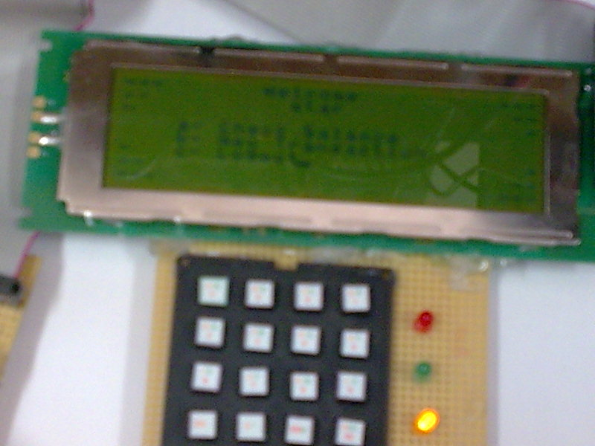
Display system
GLCD system communicating with pic2 using spi and with the internet Using wiznet

Slide 8
Ethernet Interface
Many Choices :
  ENC28J60 chip with its hardware circuit.
  Mini web server.
  Wiznet.

Slide 9
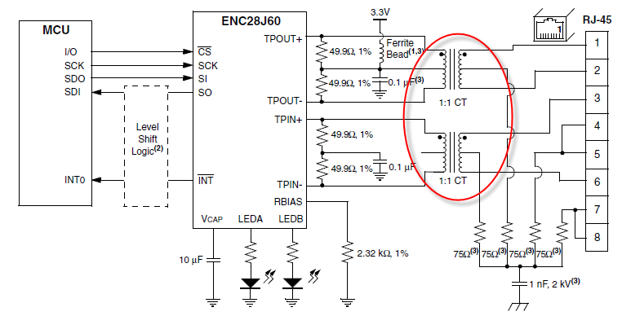
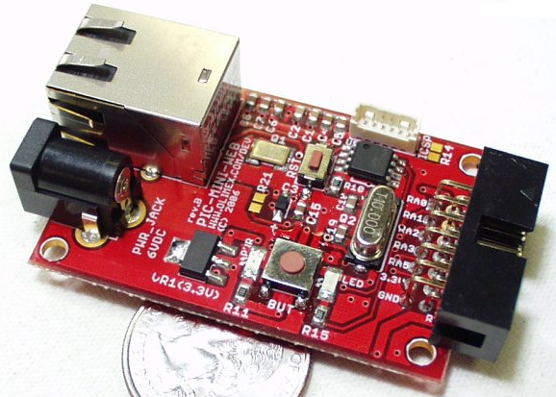
Ethernet Interface cont...
ENC28J60 hardware design
Miniweb server

Slide 10

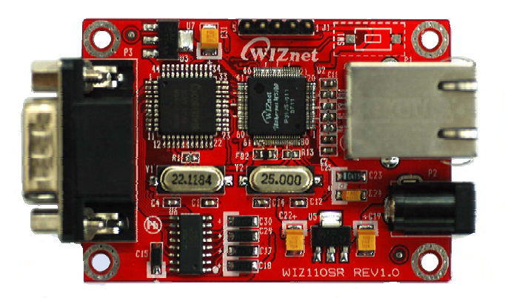
wiznet
Wiznet

Slide 11
Wiznet properties
Converts RS-232 protocol into TCP/IP protocol.
10/100 Ethernet interface and max 230kbps serial interface.
Serial baud rate up to 57600..we used 19200.
Input voltage 5v DC

Slide 12
Wiznet properties
Has an internal buffer so sending from the microcontroller to the web is easy.
Problem: sending data from the web to the microcontroller .
Solution: need to implement buffering and parsing for the required data through having our own message type.

Slide 13
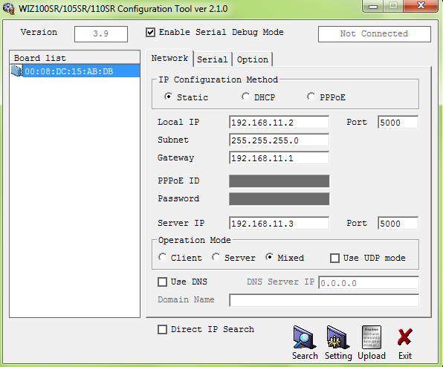
Wiznet configuration tool
Wiznet

Slide 14
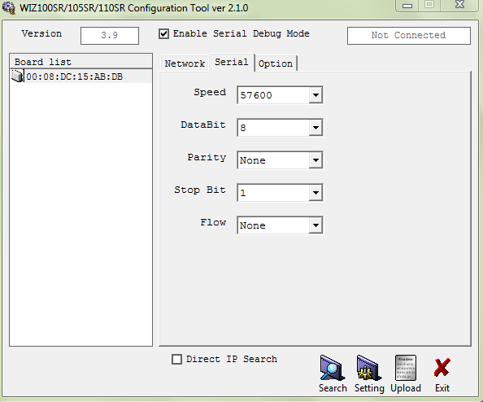
Wiznet configuration tool
Wiznet

Slide 15
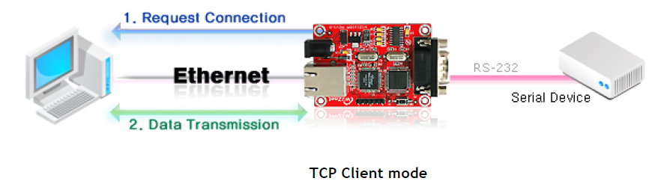
Wiznet configured as tcp-client
Wiznet
Configured as tcp-client communicating with a server programmed in java listening to the same port of the wiznet.

Slide 16
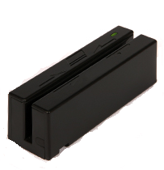
Magnetic stripe Card reader

Slide 17
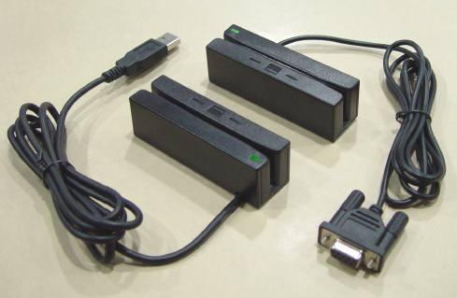
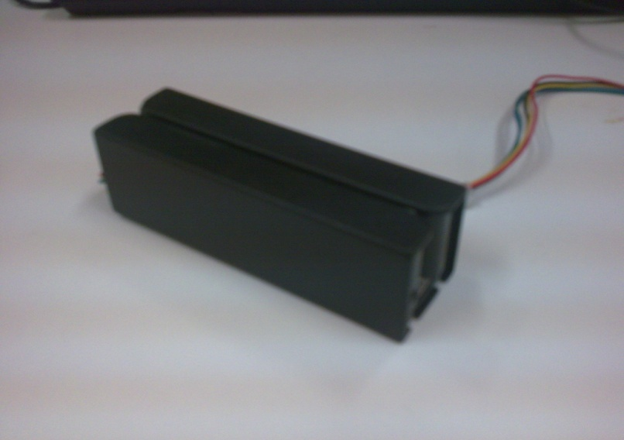

Many types

Slide 18
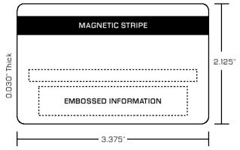
Magnetic stripe card
A magnetic stripe card is a type of card capable of storing data by modifying the magnetism of tiny iron-based magnetic particles on a band of magnetic material on the card.

Slide 19
Card Tracks
Track No. | Character Configuration | Information Content
TRACK1 | 7 bits per character | 79 alphanumeric characters
TRACK2 | 5 bits per character | 40 numeric characters
TRACK3 | 5 bits per character | 107 numeric characters

Slide 20
Interface connection
Pin No. | Signal Symbol | I/O | Color | Description
1 | GND | I | Black | Ground
2 | RDP | O | Blue | Read Data Pulse
3 | RCP | O | Green | Read Clock Pulse
4 | CLS | O | Yellow | Card Loading Signal
5 | +5V | I | Red | Supply Power

Slide 21
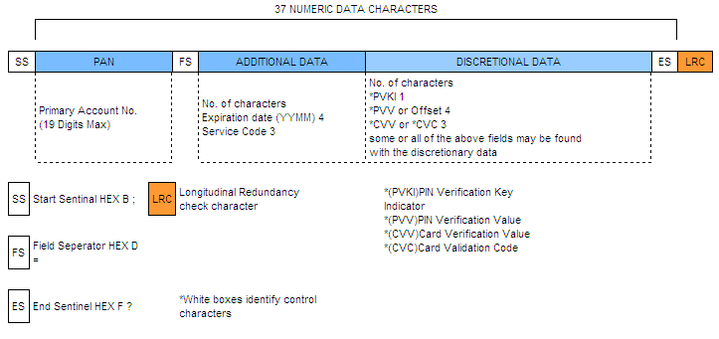
Card data format
ISO7811

Slide 22
Card data format track 2
The format for track 2 was developed by the banking industry (ABA). This track is written with a 5-bit scheme (4 data bits + 1 parity), which allows for sixteen possible characters, which are the numbers 0-9, plus the six characters : ; < = > ? .

Slide 23
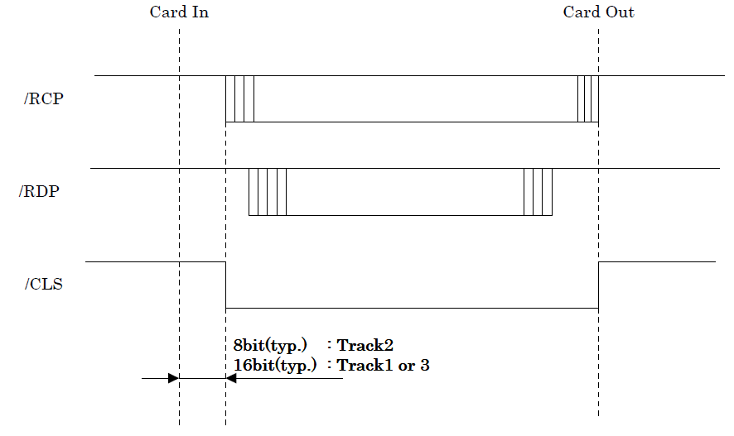
Timing chart

Slide 24
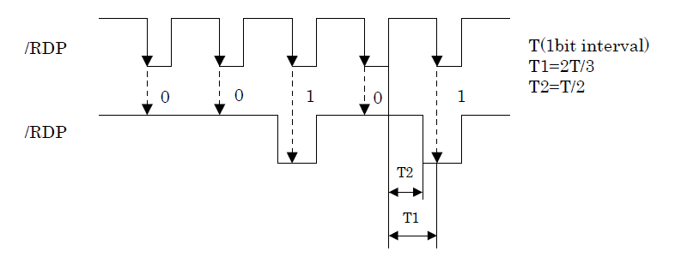
Timing chart cont...

Slide 25
Reading track 2
Read 40 characters.
Check card presence bit.
Read 4 bit data and 1 bit parity through spi.
Add 0x30 to convert to ASCII

Slide 26
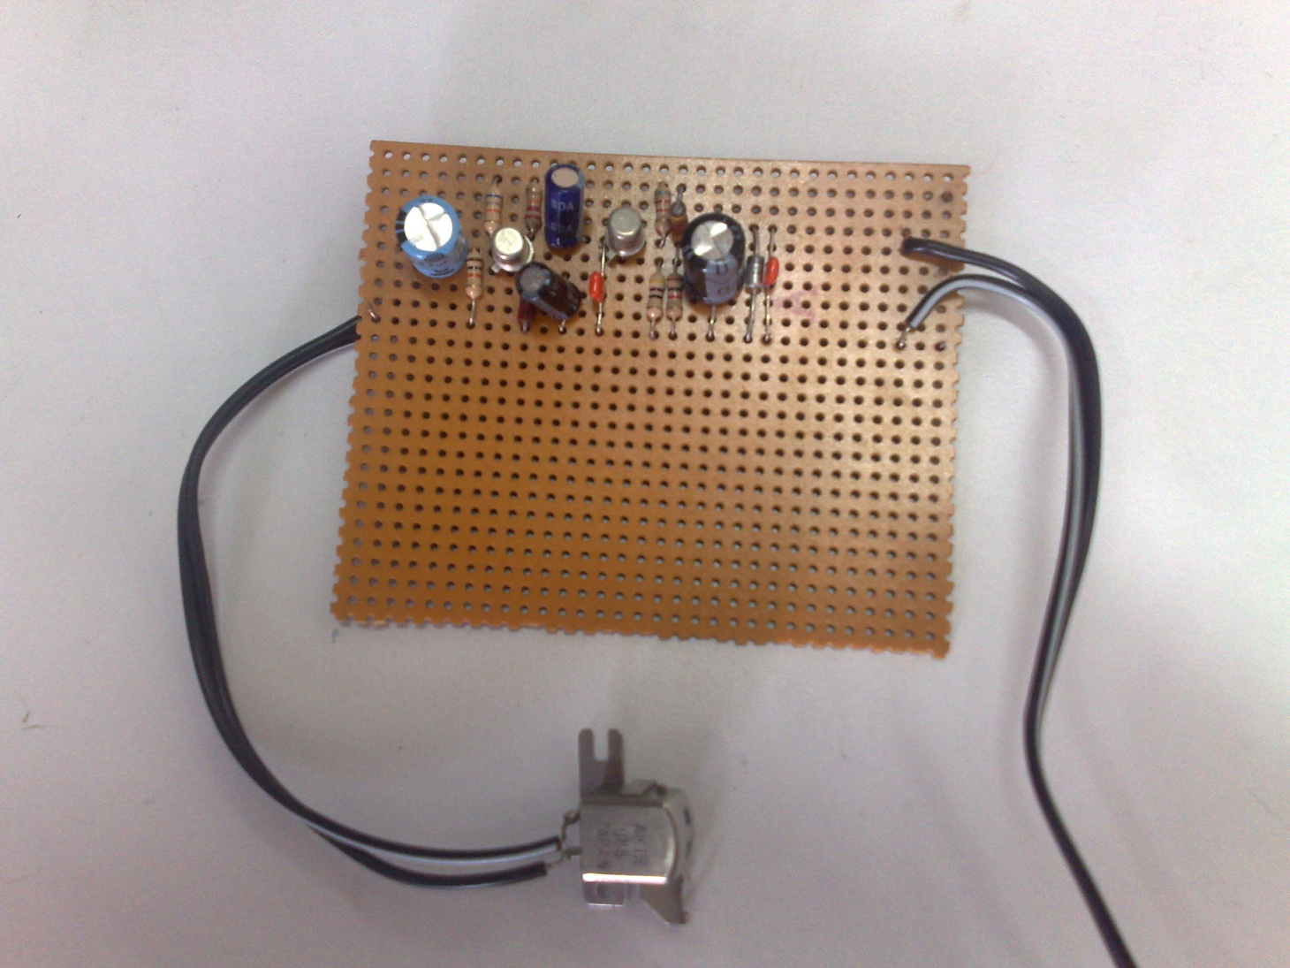
Card reader circuit

Slide 27
Spi communication
Need many ports for GLCD, keypad , card reader and wiznet so use 2 PICs.
Use SPI communication between the 2 PICs
SPI refers to Serial Peripheral Interface.
The SPI mode allows 8 bits of data to be synchronously transmitted and received simultaneously.

Slide 28
Software support
Website designed in php
Server programmed in Java to act as tcp server.
Sms system used to confirm the success of any transaction.
Use encryption for security.

Slide 29
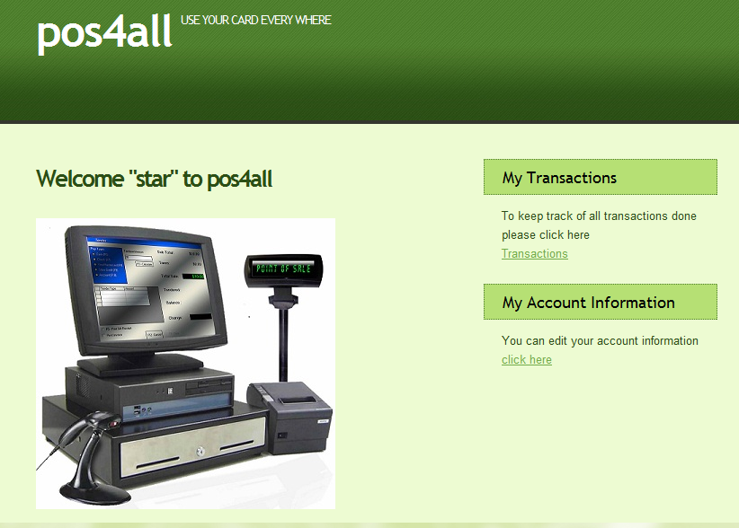
Website

Slide 30
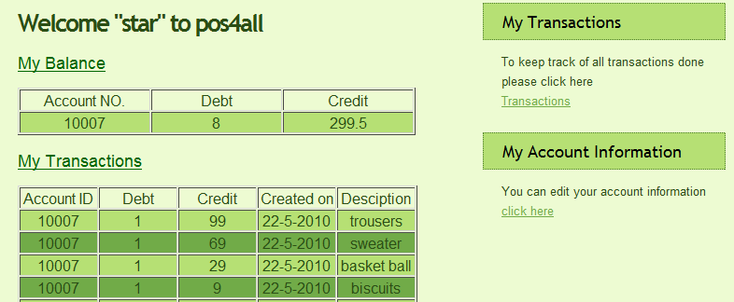
Website

Slide 31
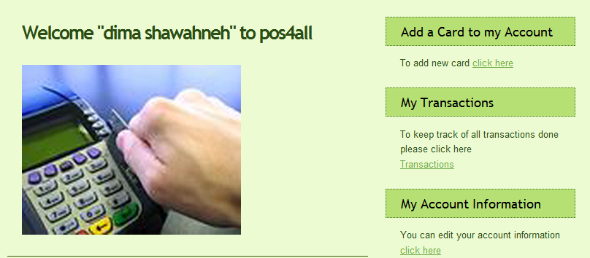
Website

Slide 32
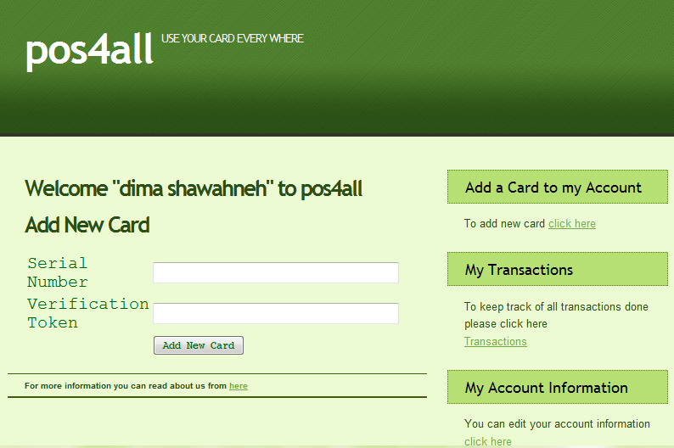
Website

Slide 33
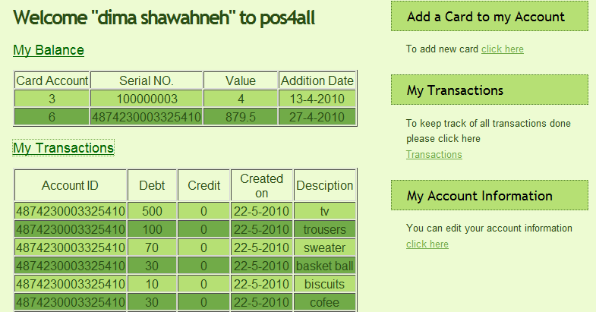
Website

Slide 34
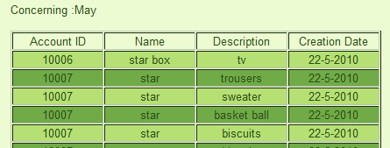
Website

Slide 35
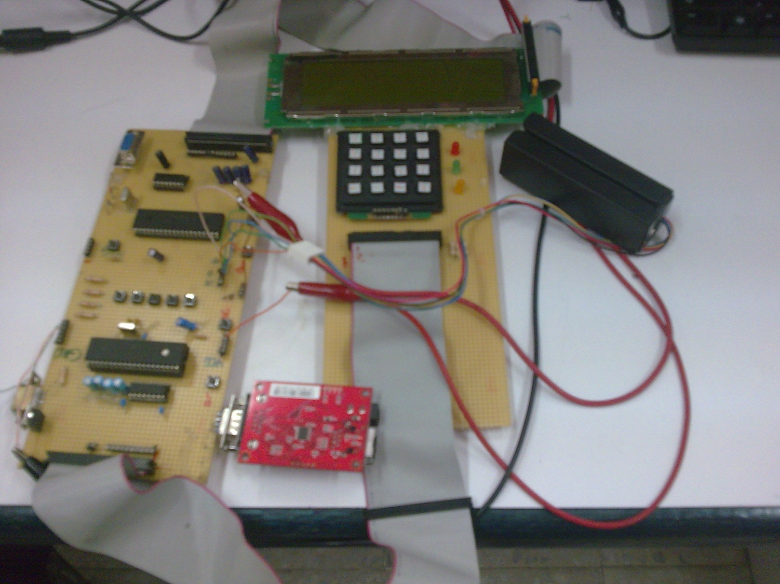
Project pictures

Slide 36

Thanks for listening
;)

