Slide 1
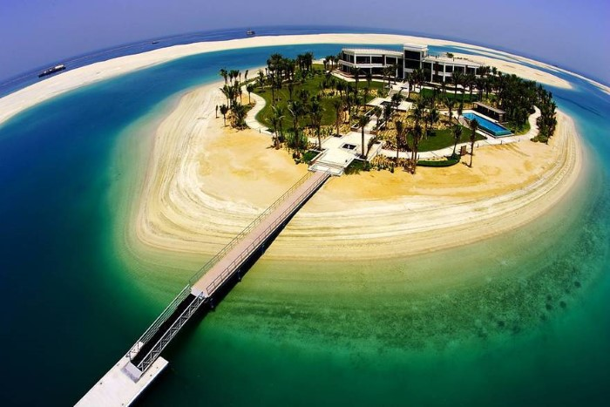
Building a seasonal artificial island by using an innovative method at
Al- Aqaba Gulf
Prepared By:
Loay Hantouli
Bara’a Bzour
Shereen Diab

Slide 2
Objectives:
Study the location of the project.
Analysis and design for Cellular steel cofferdam construction method and make the required stability checks.
Design a suitable foundation for the structures that will be built above the island.
Estimate the quantities and the total cost of building the island.

Slide 3
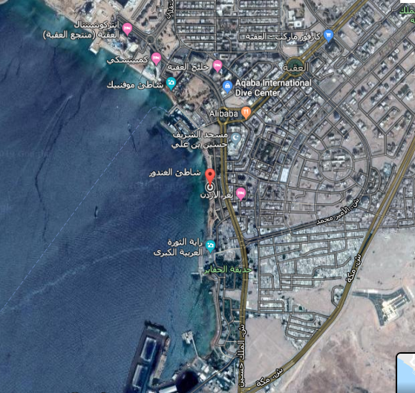
Location of the project.
The location of the project has been chosen in the south-eastern side of the Gulf of Aqaba.

Slide 4
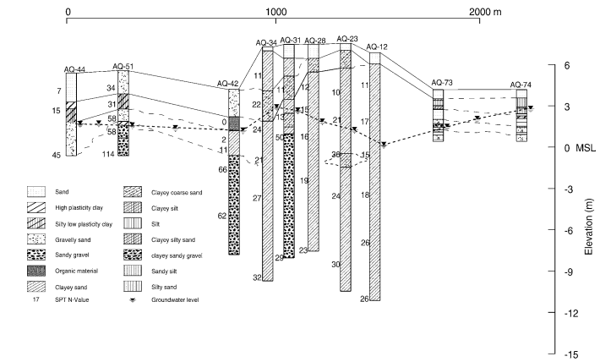
Studies.
1. Bed sea soil studies.
The type of seabed soil is clayey sand with SPT number of 32.

Slide 5
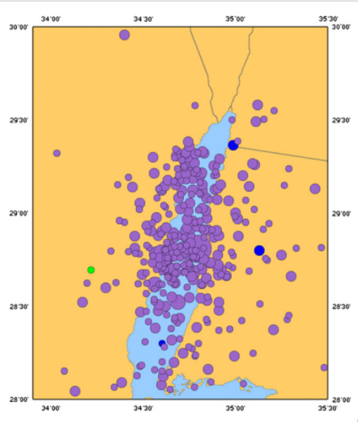
2. Seismic forces.
According to Seismic history of the Gulf of Aqaba, the impact of the seismic forces not very clear in the position of this project.

Slide 6
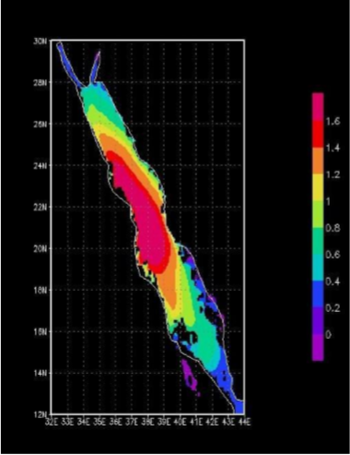
3.Waves effect.
The minimum wave height found is 0.3m. The value of 1.5 m will be used in this project as a maximum height of waves at Al-Aqaba Gulf.

Slide 7
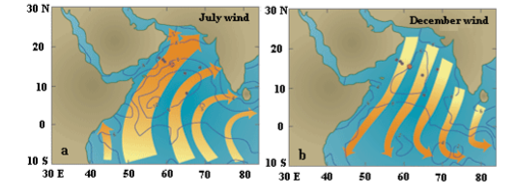
4. Wind effect.
The Gulf is considered as a confined area, where wind movement is considered relatively dull so the effect of wind movement is ignored in this project.

Slide 8
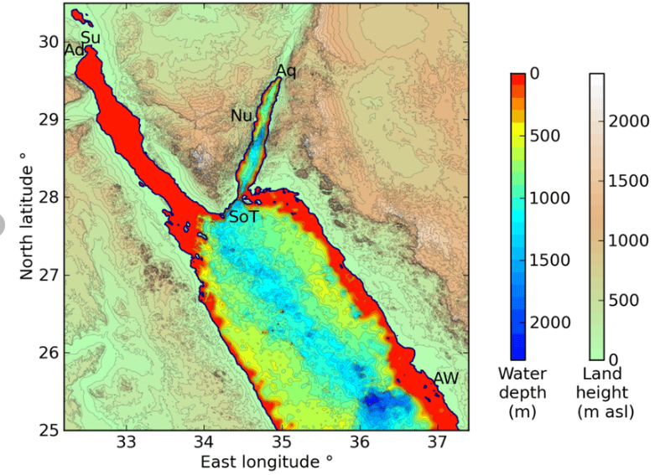
Details of the artificial island.
The area of the artificial island is 3 hectare.
The average depth of water in this project is 20 m.
The height of the island is 21.5 m

Slide 9
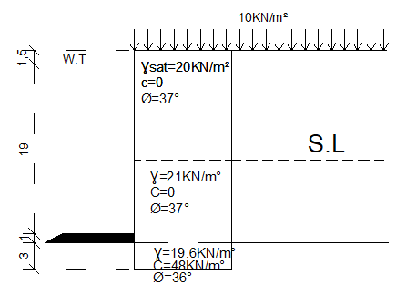

Liquefaction Analysis.
For height = 13.25 m.
σ𝑣. = 𝑍 (Ɣ𝑠𝑎𝑡) = 276 KN/m².
ớ𝑣. = 𝑍 (Ɣ𝑠𝑎𝑡− Ɣ𝑤𝑎𝑡𝑒r)
= 266.19 KN/m².
$\frac{σv. }{ớv.}$ = $\frac{276 }{266.19 }$ = 1.037

Slide 10
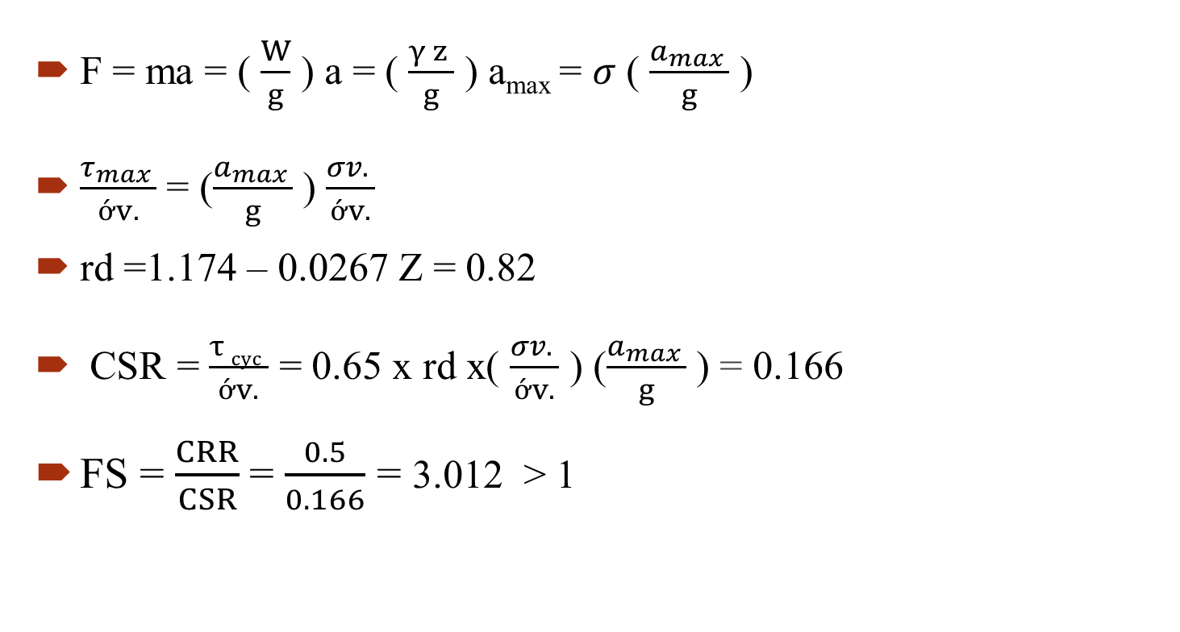
Liquefaction Analysis.
F = ma = ( $\frac{W}{g}$ ) a = ( $\frac{γ z }{g}$ ) a_{max} = $σ$ ( $\frac{a_{max} }{g}$ )
$\frac{τ_{max} }{ớv.}$ = ($\frac{a_{max} }{g}$ ) $\frac{σv. }{ớv.}$
rd =1.174 – 0.0267 Z = 0.82
CSR = $\frac{τ cyc }{ớv.}$ = 0.65 x rd x( $\frac{σv. }{ớv.}$ ) ($\frac{a_{max} }{g}$ ) = 0.166
FS = $\frac{CRR}{CSR}$= $\frac{0.5}{0.166}$ = 3.012 > 1

Slide 11
Excel sheet shows the values of factor of safety for height 21.5 m.
FS | CRR | CSR | rd | (σv.)/(ớv.) | ớ𝑣. | σ𝑣. | H2 | H1
3.014984 | 0.5 | 0.165838 | 0.820225 | 1.036853 | 266.19 | 276 | 1 | 12.25
3.017821 | 0.5 | 0.165682 | 0.793525 | 1.070733 | 277.38 | 297 | 2 | 12.25
3.034333 | 0.5 | 0.164781 | 0.766825 | 1.101986 | 288.57 | 318 | 3 | 12.25
3.063404 | 0.5 | 0.163217 | 0.740125 | 1.130905 | 299.76 | 339 | 4 | 12.25
3.104382 | 0.5 | 0.161063 | 0.713425 | 1.157742 | 310.95 | 360 | 5 | 12.25
3.156983 | 0.5 | 0.158379 | 0.686725 | 1.182716 | 322.14 | 381 | 6 | 12.25
3.221242 | 0.5 | 0.15522 | 0.660025 | 1.206012 | 333.33 | 402 | 7 | 12.25
3.297485 | 0.5 | 0.151631 | 0.633325 | 1.227795 | 344.52 | 423 | 8 | 12.25
3.386322 | 0.5 | 0.147653 | 0.606625 | 1.248208 | 355.71 | 444 | 9 | 12.25
3.410598 | 0.5 | 0.146602 | 0.59995 | 1.253112 | 358.5075 | 449.25 | 9.25 | 12.25

Slide 12
Excel sheet shows the values of factor of safety for height 24.5 m.
FS | CRR | CSR | rd | (σv.)/(ớv.) | ớ𝑣. | σ𝑣. | H3 | H2 | H1
3.46036 | 0.5 | 0.144494 | 0.5866 | 1.2632 | 363.4025 | 459.05 | 0.5 | 9.25 | 12.25
3.513631 | 0.5 | 0.142303 | 0.57325 | 1.27302 | 368.2975 | 468.85 | 1 | 9.25 | 12.25
3.570588 | 0.5 | 0.140033 | 0.5599 | 1.282582 | 373.1925 | 478.65 | 1.5 | 9.25 | 12.25
3.63143 | 0.5 | 0.137687 | 0.54655 | 1.291897 | 378.0875 | 488.45 | 2 | 9.25 | 12.25
3.696382 | 0.5 | 0.135267 | 0.5332 | 1.300973 | 382.9825 | 498.25 | 2.5 | 9.25 | 12.25
3.765698 | 0.5 | 0.132778 | 0.51985 | 1.309821 | 387.8775 | 508.05 | 3 | 9.25 | 12.25

Slide 13
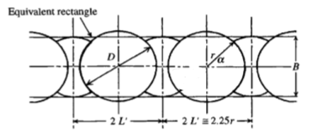
Cells Geometry.
Assume D = 13.5 m.
2 L' = 2.25 x 6.75 = 15.19 m
Perimeter of island (P) = 573.05 m
Number of systems (Ns) = 38 systems.
Numbers of main cells = 38 cells.

Slide 14

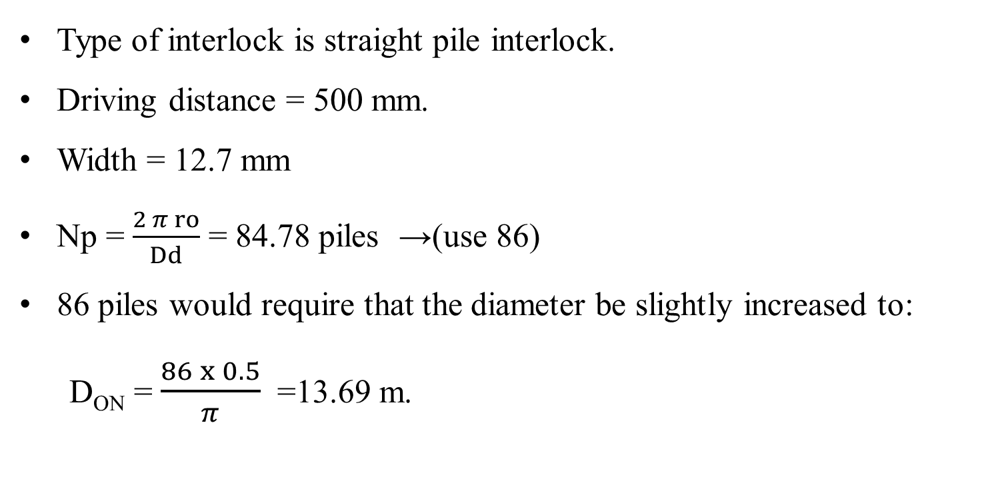
Geometry and numbers of interlock.
Type of interlock is straight pile interlock.
Driving distance = 500 mm.
Width = 12.7 mm
Np = $\frac{2 π ro}{Dd}$ = 84.78 piles →(use 86)
86 piles would require that the diameter be slightly increased to:
D_{ON} = $\frac{86 x 0.5}{π}$ =13.69 m.

Slide 15
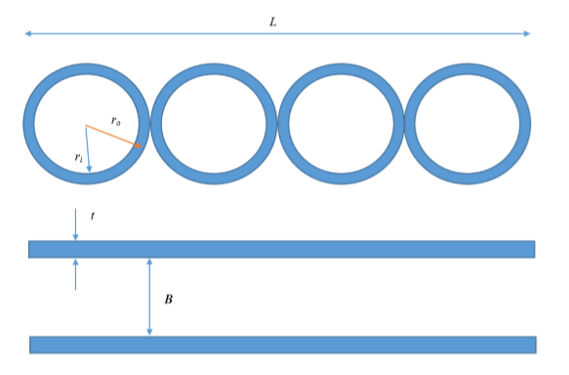

Equivalent 2D dimensions of cellular cofferdams.
A(rectangle) = N $π$ r_{o}² = B x L
B= 0.785 D_{o}
= 10.75 m < ( 0.818 D = 11.2 m)
I_{cell} = N $\frac{π}{4}$ (r_{o}⁴ – r_{i}⁴) = 764.07 m⁴
I_{cell} = L x t x 2 ${(\frac{B}{2})}^{2}$ → t = 0.025 m.

Slide 16
Cell connections.

Slide 17
Stability and design of cellular cofferdam.

Slide 18
Geotechnical and Structural Parameters.
 | Cell fill | Island fill | Berm | Seabed soil | Unit
γ sat | 20 | 20 | 19.6 | 19.6 | KN/m³
Ø | 37 | 37 | 36 | 36 | °
C | 0 | 0 | 48 | 48 | KN/m²
 | Value | Unit
Density | 7850 | Kg/ m³
Young’s modulus | 207 | GPa
Poisson’s ratio | 0.2 | -
Fy | 270 | MPa

Slide 19
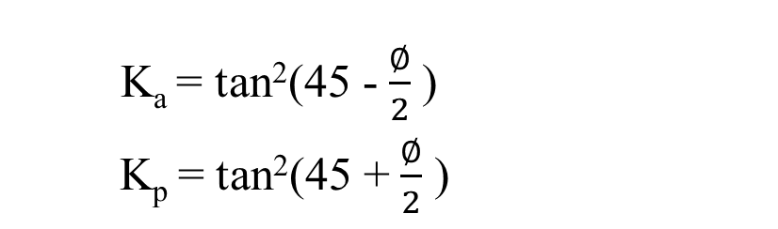
Values of Ka and Kp.
K_{a} = tan²(45 -$\frac{∅}{2}$ )
K_{p} = tan²(45 +$\frac{∅}{2}$ )
Island fill | Cell fill | Berm | Sea bed soil
0.249 | 0.249 | 0.259 | 0.259 | Ka
4.02 | 4.02 | 3.85 | 3.85 | Kp

Slide 20
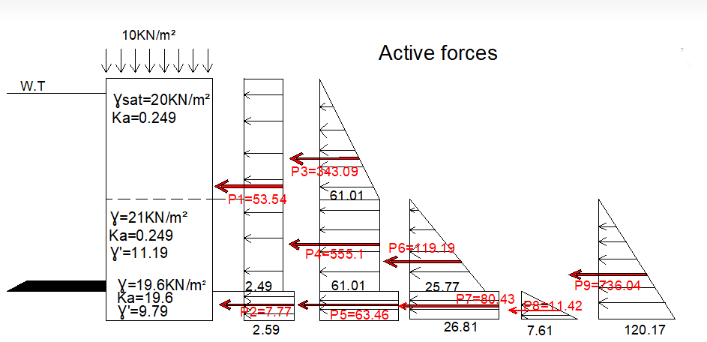
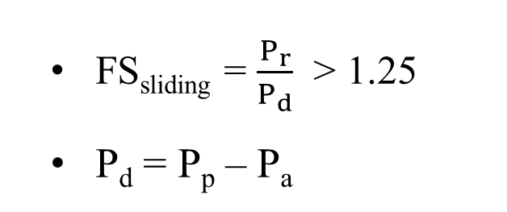
1. Sliding Stability.
FS_{sliding} = $\frac{P_{r}}{P_{d}}$ > 1.25
P_{d} = P_{p} – P_{a}
P_{a} = 2136.73 KN/m.

Slide 21
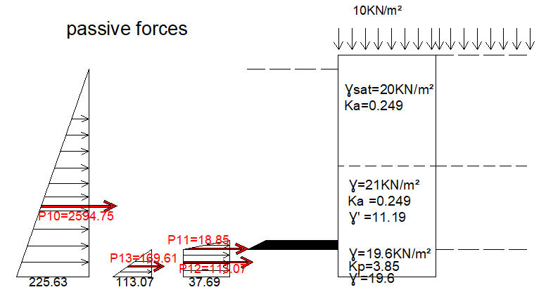
Passive Forces.
P_{p} = 2896.26 KN/m.
P_{d} = 759.53 KN/m.
P_{r} = (W+S) tanØ
= 3029.81 KN/m.
Fs_{sliding} = 3.98 >1.25

Slide 22
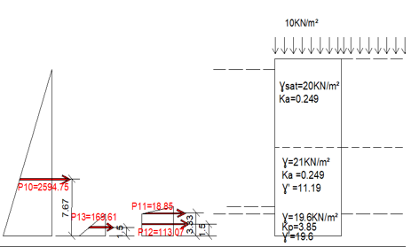

2. Overturning Stability.
FS_{overturning} = $\frac{Mresisting}{Moverturning }$
M_{resisting} =M_{P} + M_{w+s}
M_{a} = M_{overturning}
M_{P} = 20273.82 KN.m/m
(counter clockwise)

Slide 23
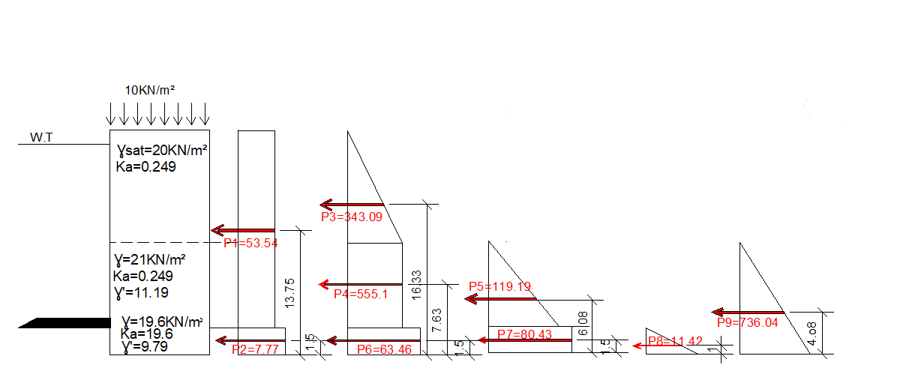

Active moment.
M_{a} = 16794.69 KN.m/m
M_{resisting} =M_{P} + M_{w+s}
= 42790.1 KN.m/m
(counter clockwise)
FS_{overturning} = $\frac{42790.1 }{16794.69}$ = 2.55
2.55 > 2 (OK)

Slide 24
Excel sheet shows the values of factor of safety.
Fs(overturning) | Fs(sliding) | Total w | H2 | H1 | Df | Hc | B
1.994978 | 3.056147 | 4017.587 | 9.75 | 11.75 | 2 | 23.5 | 10.75
2.547752 | 3.981414 | 4170.183 | 9.25 | 12.25 | 3 | 24.5 | 10.75
2.476397 | 3.199509 | 4322.779 | 8.75 | 12.75 | 4 | 25.5 | 10.75
2.41945 | 2.611899 | 4475.376 | 8.25 | 13.25 | 5 | 26.5 | 10.75
2.375421 | 2.170788 | 4627.972 | 7.75 | 13.75 | 6 | 27.5 | 10.75
2.34287 | 1.834095 | 4780.568 | 7.25 | 14.25 | 7 | 28.5 | 10.75
2.320452 | 1.572493 | 4933.164 | 6.75 | 14.75 | 8 | 29.5 | 10.75
2.306931 | 1.365702 | 5085.761 | 6.25 | 15.25 | 9 | 30.5 | 10.75
2.301195 | 1.199597 | 5238.357 | 5.75 | 15.75 | 10 | 31.5 | 10.75
2.302246 | 1.064205 | 5390.953 | 5.25 | 16.25 | 11 | 32.5 | 10.75
2.309196 | 0.952378 | 5543.549 | 4.75 | 16.75 | 12 | 33.5 | 10.75

Slide 25
Excel sheet shows the values of factor of safety.
Fs(overturning) | Fs(sliding) | Total w | H2 | H1 | Df | Hc | B
1.626727 | 2.227977 | 2327.765 | 9.25 | 12.25 | 3 | 24.5 | 6
1.777349 | 2.599227 | 2715.643 | 9.25 | 12.25 | 3 | 24.5 | 7.5
1.951052 | 2.970477 | 3103.52 | 9.25 | 12.25 | 3 | 24.5 | 8
1.147838 | 2.341727 | 3491.398 | 9.25 | 12.25 | 3 | 24.5 | 9.5
1.367704 | 2.712977 | 3879.275 | 9.25 | 12.25 | 3 | 24.5 | 10
2.547752 | 3.981414 | 4170.183 | 9.25 | 12.25 | 3 | 24.5 | 10.75
2.610653 | 4.084227 | 4267.153 | 9.25 | 12.25 | 3 | 24.5 | 11
2.876682 | 4.455476 | 4655.03 | 9.25 | 12.25 | 3 | 24.5 | 12.5
3.165794 | 4.826726 | 5042.908 | 9.25 | 12.25 | 3 | 24.5 | 13
3.477987 | 5.197976 | 5430.785 | 9.25 | 12.25 | 3 | 24.5 | 14.5
3.813261 | 5.569226 | 5818.663 | 9.25 | 12.25 | 3 | 24.5 | 15

Slide 26
3. Cell Shear check.

Slide 27
Foundation design

Slide 28
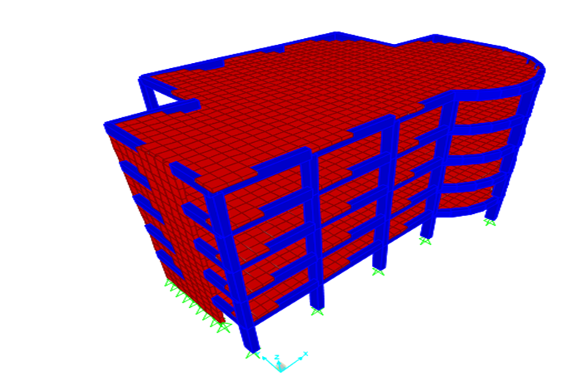
Structure details
Number of floors = 5 floors
Floor height = 4.3 m
Structure area = 558 m²
Number of columns = 17 columns
Number of shear walls = 2 walls

Slide 29
Sections of each structural elements
Slab | Beams | Columns | Shear walls | Mat foundation
Thickness = 350mm | 500mm×1000mm | 600mm×1000mm | Thickness =350mm | Thickness =1100mm

Slide 30
Loads according to ASCI 7-10 code
Dead load | Live Load | Super imposed dead load | Wall load
Structure self weight | 5 KN\m² | 4.5 KN/m² | 0.6 kN/m²

Slide 31
The values of loads for each column by using sap

Slide 32
#Column | Service Load (KN) | Dead Load (KN) | Live Load (KN) | SD Load (KN)
B6 | 1398.44 | 1462.03 | 382.84 | 344.56
C6 | 2586.45 | 2200.77 | 794.74 | 715.72
D6 | 2592.33 | 2199.68 | 794.61 | 715.15
E6 | 3334.86 | 1475.01 | 389.41 | 350.47
B5 | 3907.13 | 2808.98 | 1133.87 | 1020.49
C5 | 5268.35 | 3252.39 | 1670.47 | 1503.42
D5 | 5372.29 | 3237.36 | 1661.55 | 1495.39
E5 | 5489.09 | 2760.49 | 1108.44 | 997.60
B4 | 6182.79 | 2487.65 | 1227.36 | 1104.62
C4 | 5343.44 | 2506.97 | 1247.84 | 1123.05
D4 | 7074.04 | 2556.02 | 1281.75 | 1153.58
E4 | 7036.21 | 2886.49 | 1456.92 | 1311.22
A2 | 5194.78 | 1140.70 | 195.59 | 176.03
B2 | 2305.34 | 1624.12 | 466.97 | 420.27
C2 | 3905.39 | 1610.02 | 454.89 | 409.40
D2 | 3911.38 | 1965.32 | 657.91 | 592.12
E1 | 2386.24 | 2242.89 | 717.65 | 645.89

Slide 33
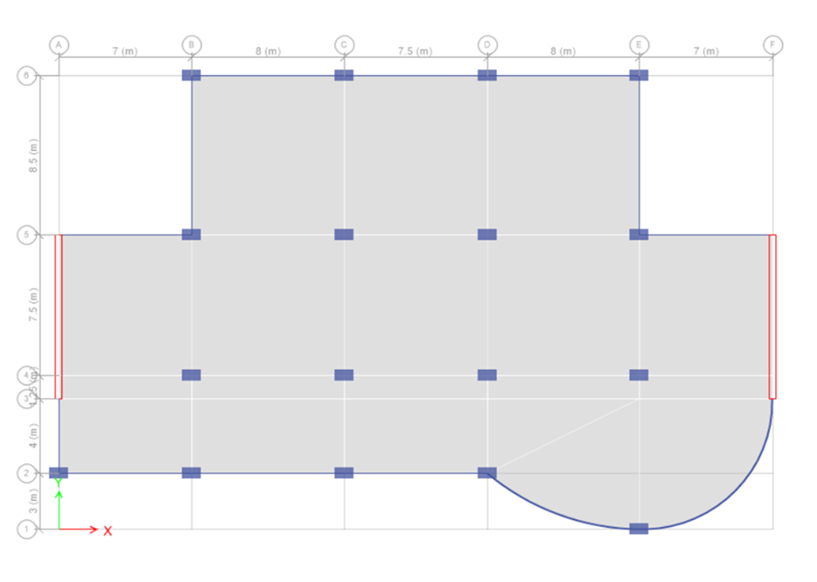
Column layout

Slide 34
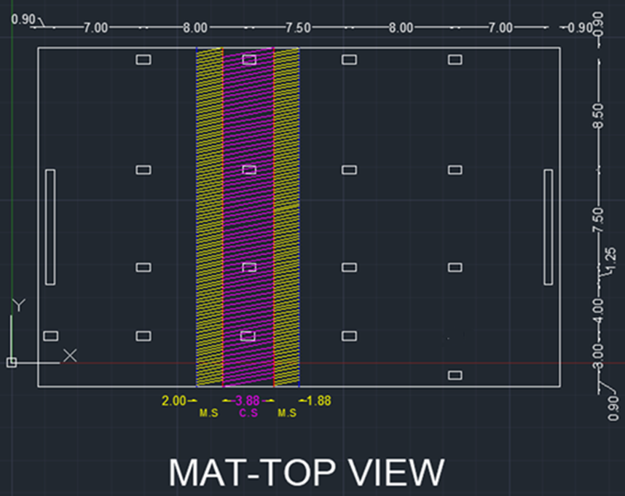
Assuming dimensions for Mat foundation

Slide 35
Manual Calculation

Slide 36
1. Mat thichness check:

Slide 37
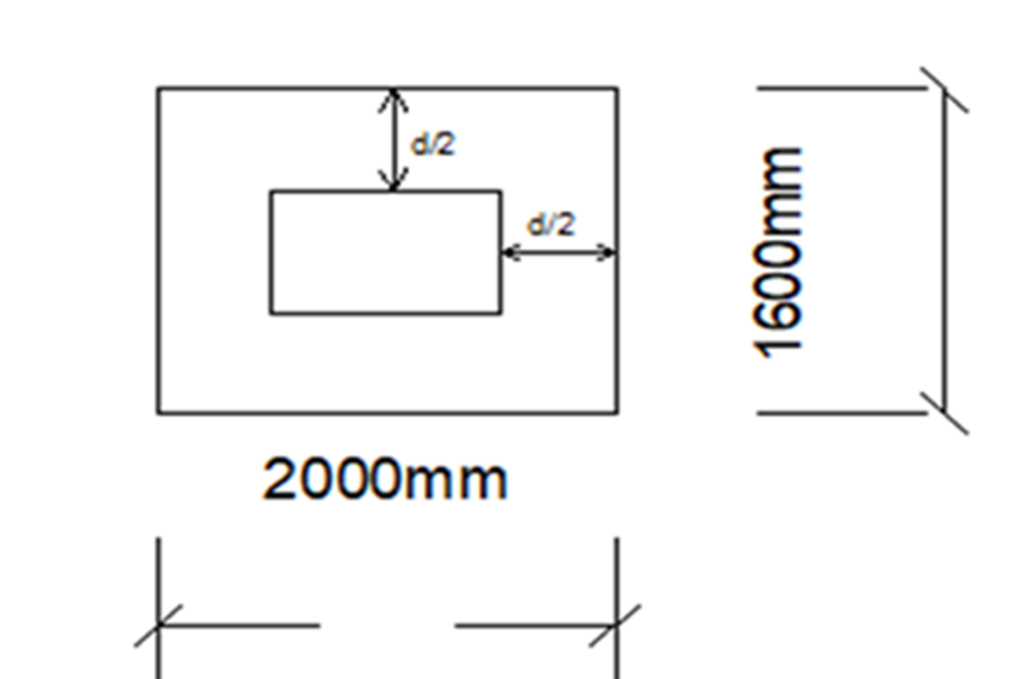
Assume t =1100mm
Take the cover =100 mm
ØVc,p = Ø x 0.333 x √fc x b0 xd =9515180 KN
Vu,p = 1.4 x 5372.29 = 7521.206 KN
Vu,p ≤ ØVc,p → Thickness ok

Slide 38
2. Flexural design :

Slide 39
Column strip |  | Middle strip
Max – negative (bottom) moment | Max – positive (top) moment | Max – negative (bottom) moment | Max – positive (top) moment
2001.02 KN.m | 2200.1 KN.m | 970.32 KN.m | 1590.46 KN.m

Slide 40
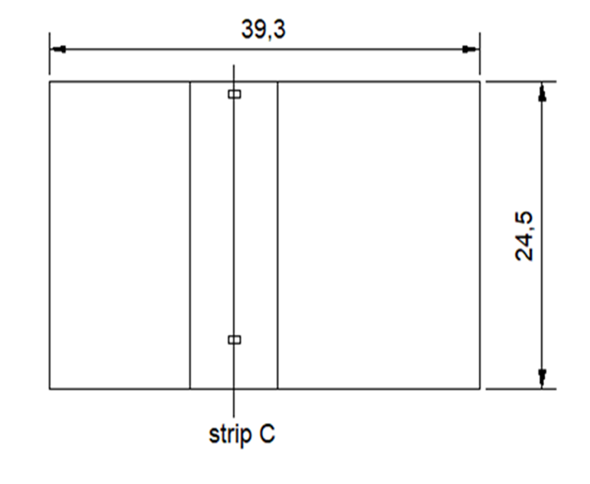

Slide 41
E-tabs modeling checks:

Slide 42
1. Soil pressure check:
It shows that qmax = 161MPa < 300 MPa → Ok

Slide 43
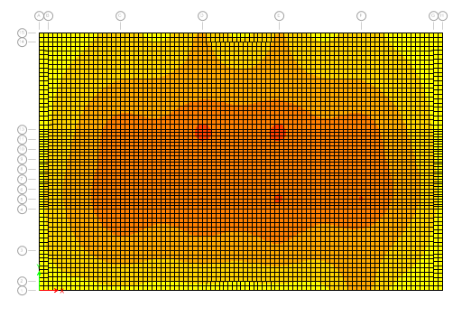

Slide 44
2. Punching check :
ØVcp=0.333 x Ø x √fc= 1.322 MPa Vumax =0.91 MPa < 1.322 Mpa → Ok

Slide 45
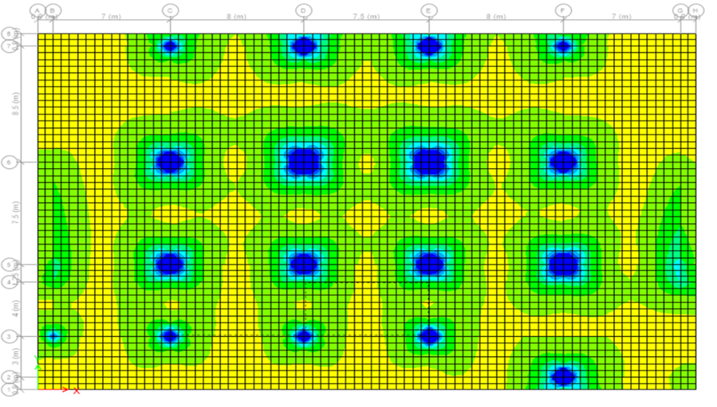

Slide 46
_For column strip:
* Max – negative (bottom) moment = 5001.02 KN.m
Error% = 2.24%
* Max – positive (top) moment = 2200.1 KN.m
Error% = 2.6%
_For middle strip:
*Max – negative (bottom) moment = 970.32 KN.m
Error% =3.11%
* Max – positive (top) moment = 1590.46 KN.m
Error% = 4%

Slide 47
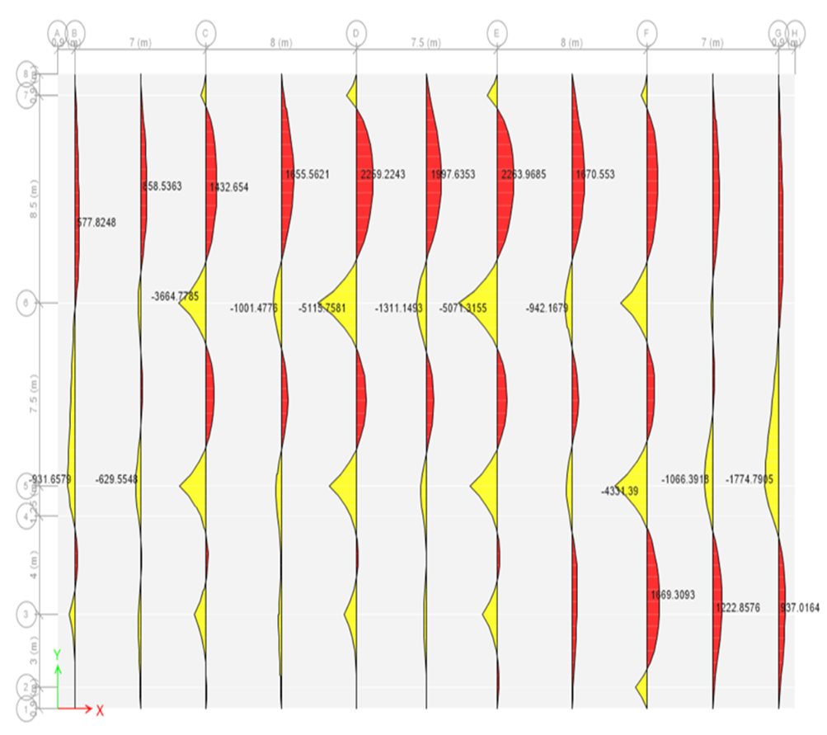

Slide 48
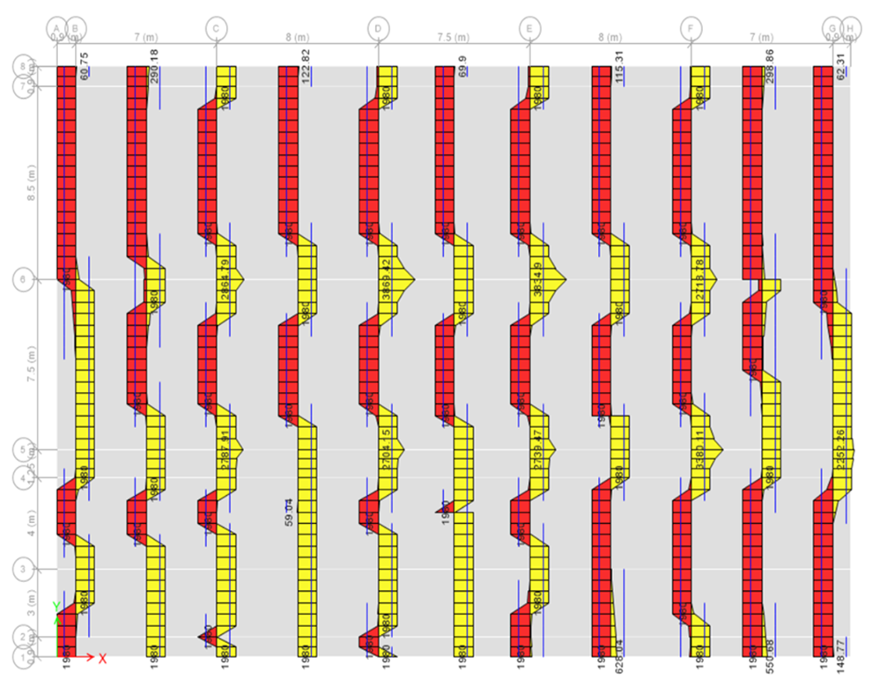

Slide 49
 | Reinforcement |  | Punching | Soil pressure
Column strip | Bottom bars | 1Ø25/12 cm | 0.90 < 1.32 (OK) | 161 < 300 (OK)
 | Top bars | 1Ø16/10 cm
Middle strip | Bottom bars | 1Ø16/10 cm
 | Top bars | 1Ø16/10 cm

Slide 50
Cost Estimation

Slide 51
Activity |  | Quantity | Cost
Filling material |  | 577527.41 m³ | 29700000 $
Steel | Piles | 5012.1 Ton | 4300000 $
 | 30° Ys | 61.3 Ton | 53000 $
Bed preparation |  | 33138.27 m² | 237000 $
 |  |  | Total = 34300000 $

