Slide 1





CraftBlend
Presented By:
Masa Lubbadeh & Raya Hindi
Supervisor:
Dr.Abdallah Rashed

Slide 2

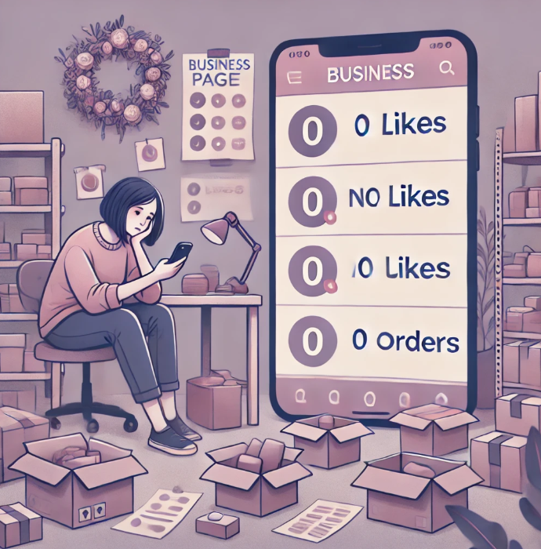


Problem
Small businesses rely heavily on social media to showcase their products, but they struggle with visibility, customer engagement, and order management.
Customers find it difficult to browse multiple Social media platforms, compare products, and place structured orders efficiently.

Slide 3


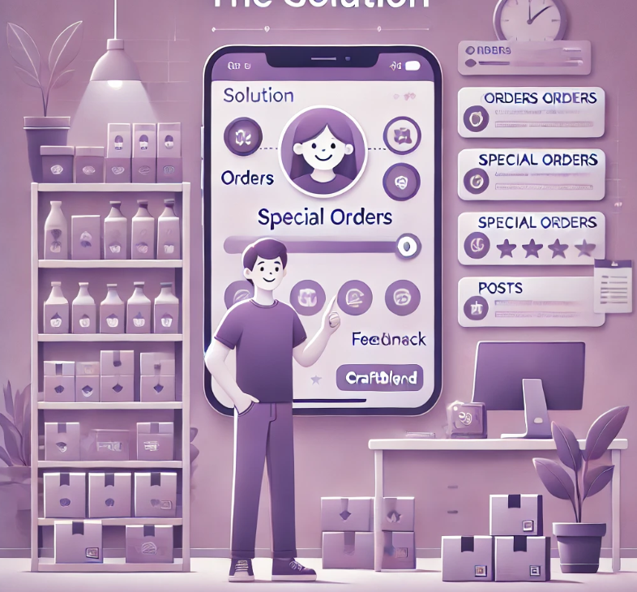
Solution
CraftBlend provides a dedicated platform where small businesses can display products, manage orders, interact with customers, and process sales seamlessly.

Slide 4









Technologies Used
Flutter & Dart
NodeJS
MongoDB
Platforms & Tools Used
Android Studio
VSCode
GitHub
Postman
Firebase

Slide 5



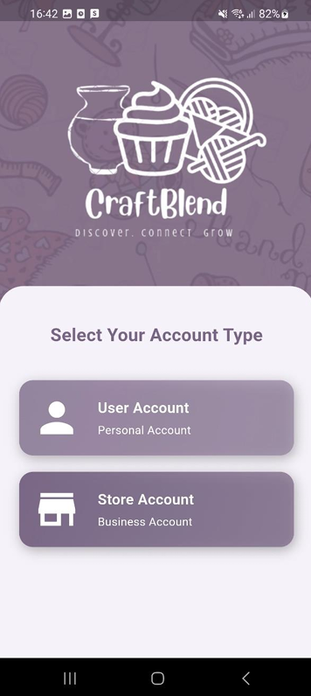

Sign Up

Slide 6

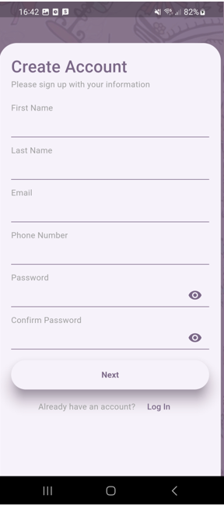
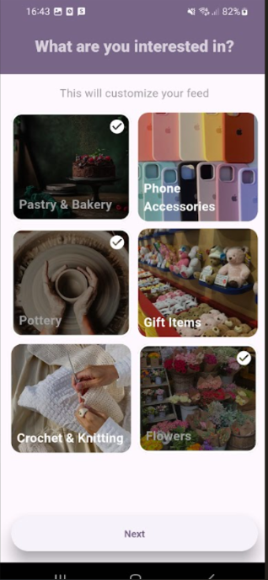


USER

Slide 7
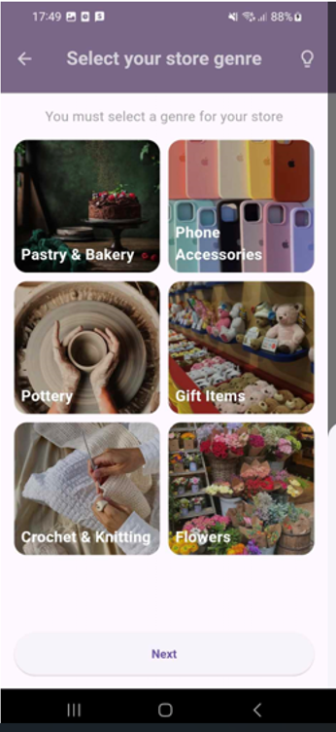
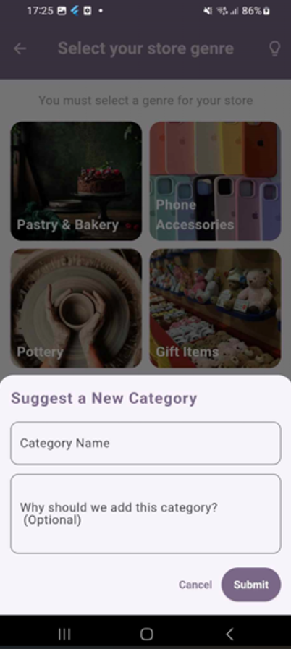
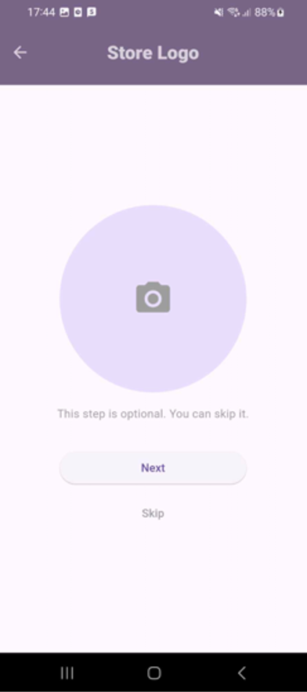
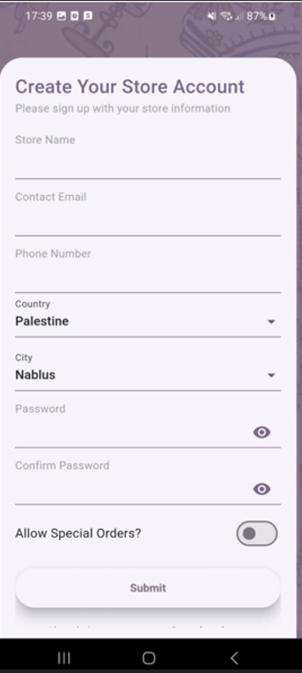
STORE

Slide 8
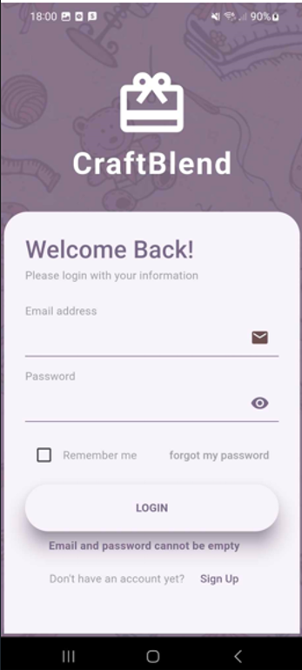
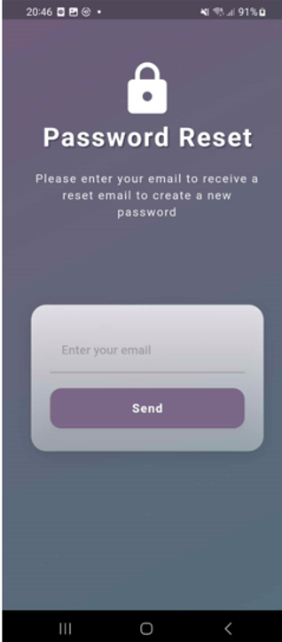
Login

Slide 9


User

Slide 10
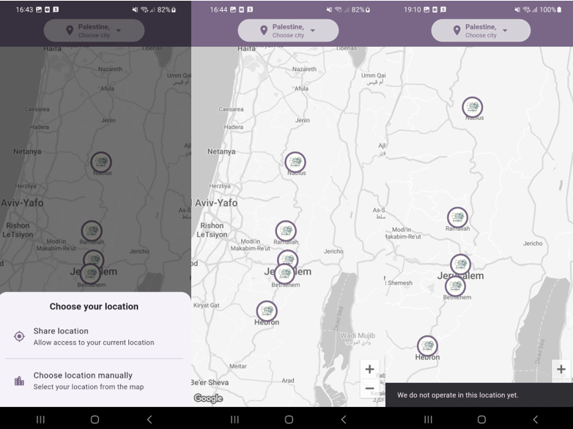
User Selects Location
Integration with google maps
Customers can see marked cities where stores offer delivery

Slide 11
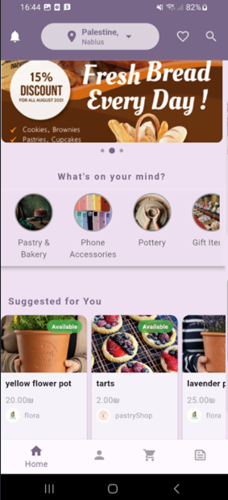
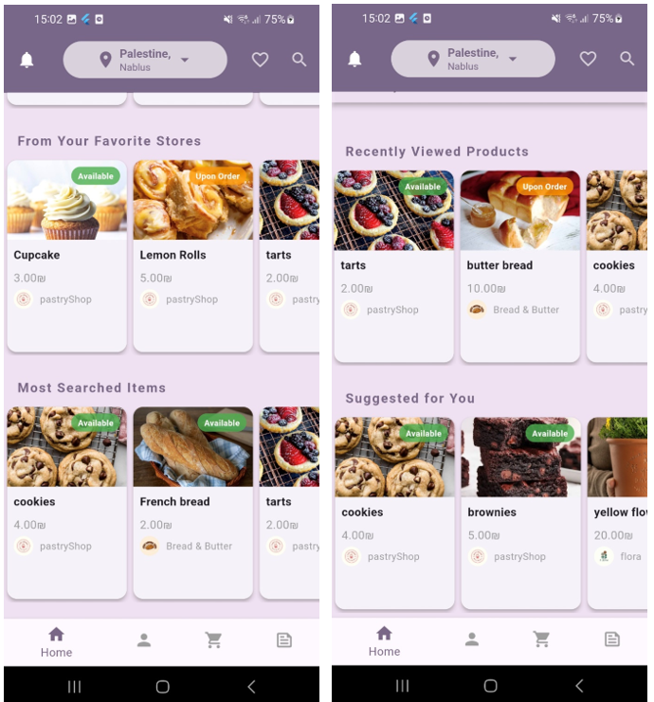
Home Page
Top-Rated products
On sale
Products
Best-Seller products

Slide 12
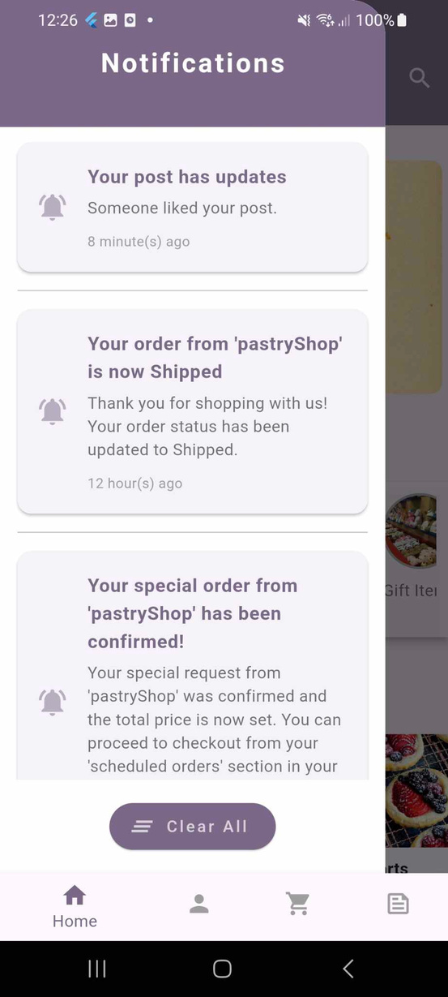
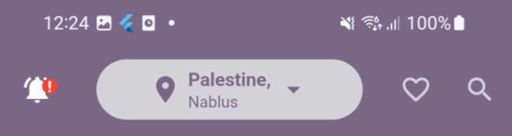
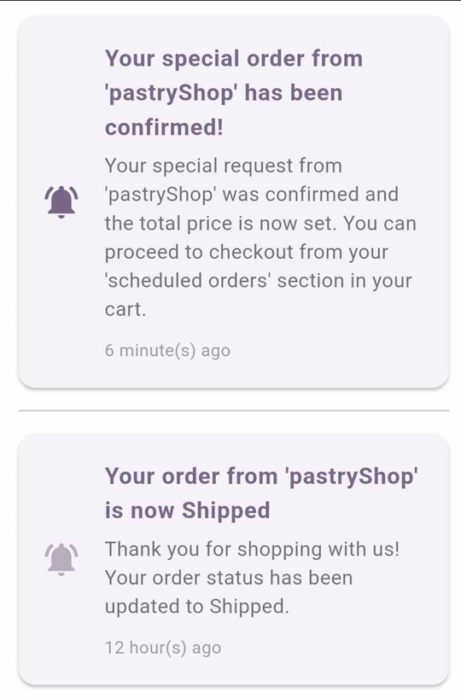
Notifications

Slide 13
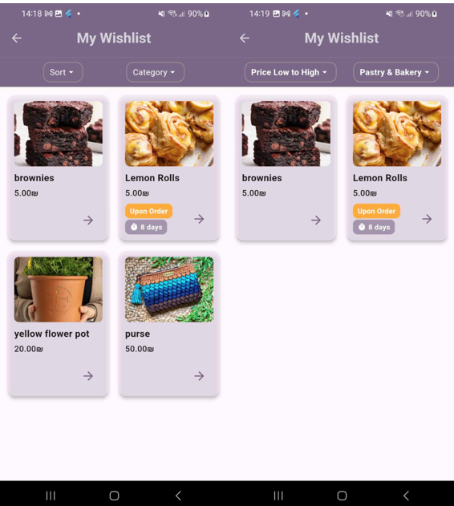
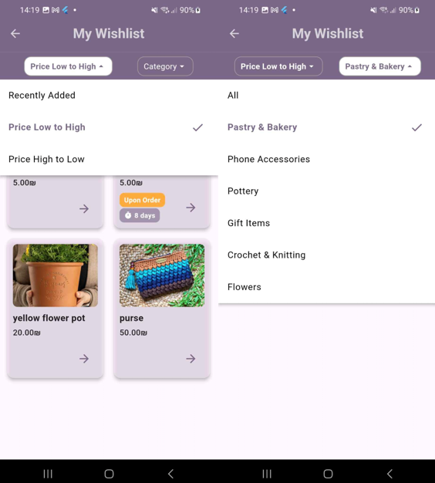
Wishlist

Slide 14
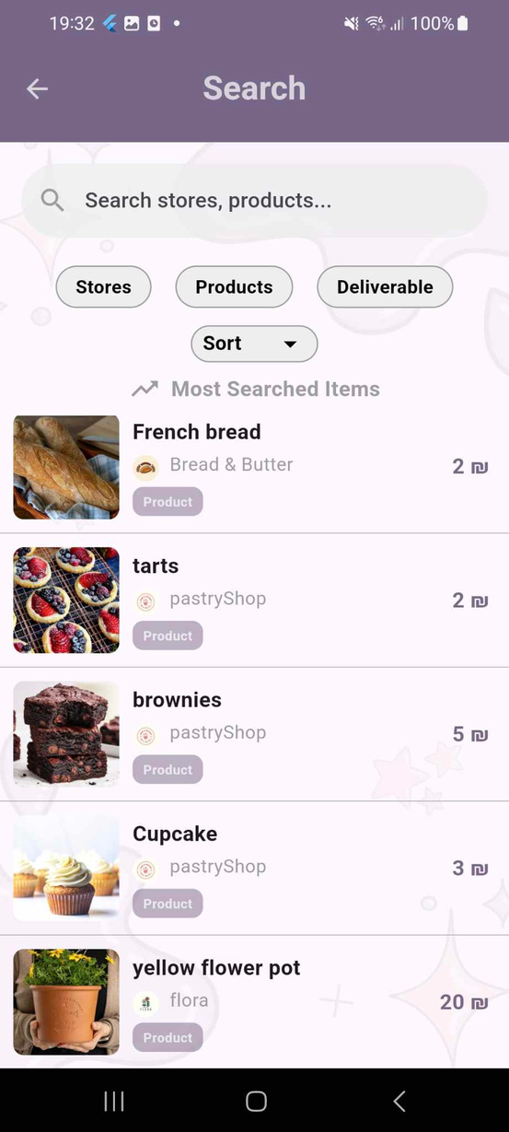
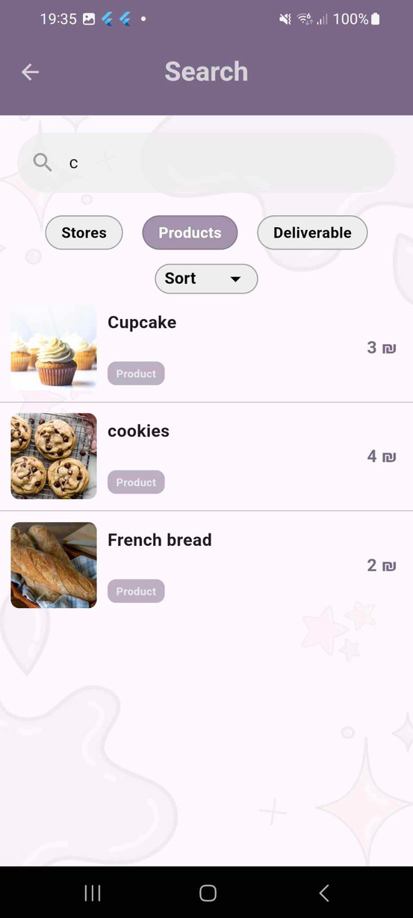
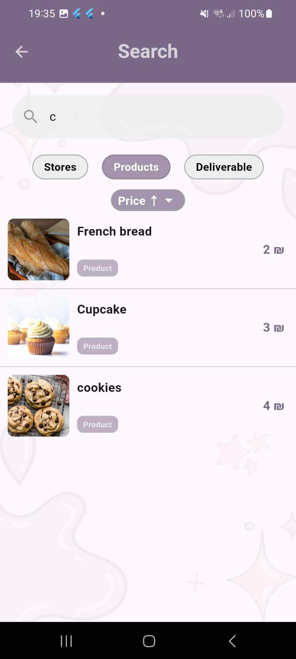
Search

Slide 15
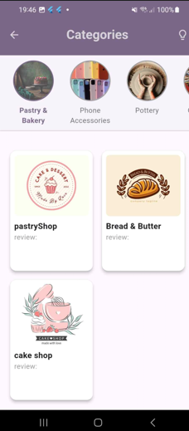
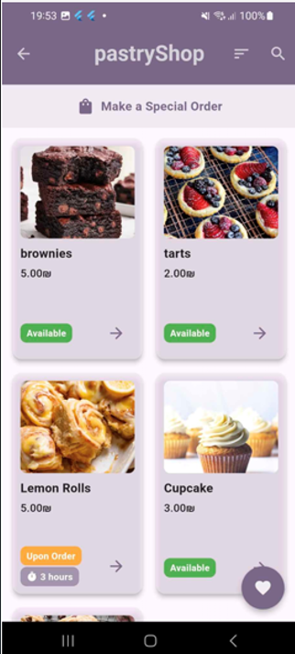
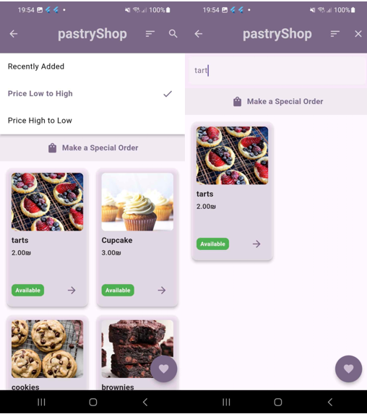
Category & Store
Pages

Slide 16
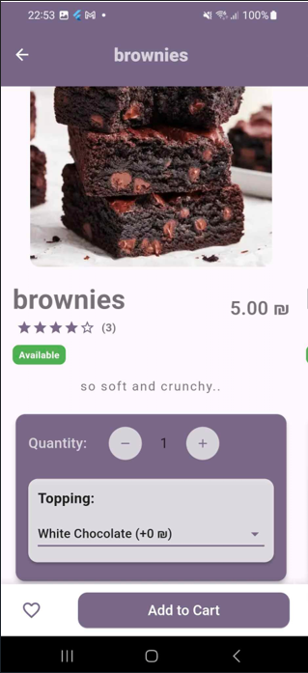
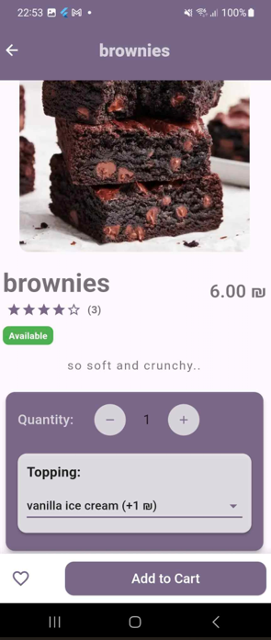
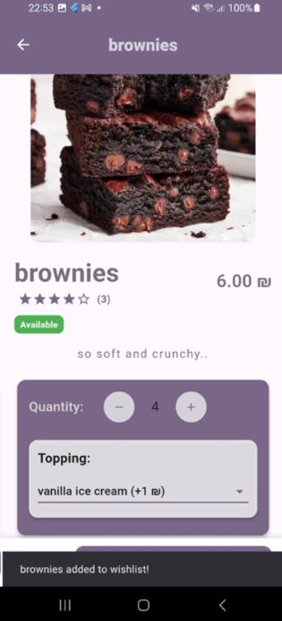
Product Details

Slide 17
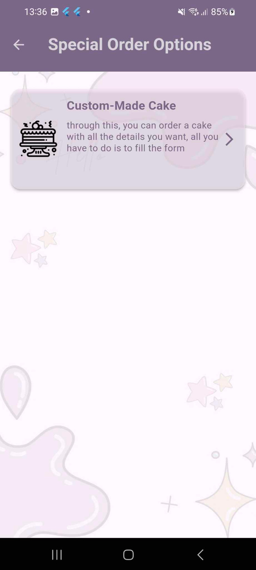
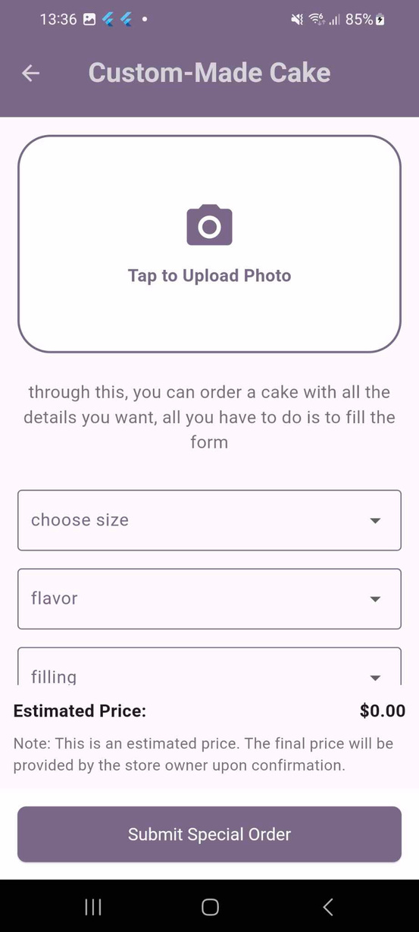
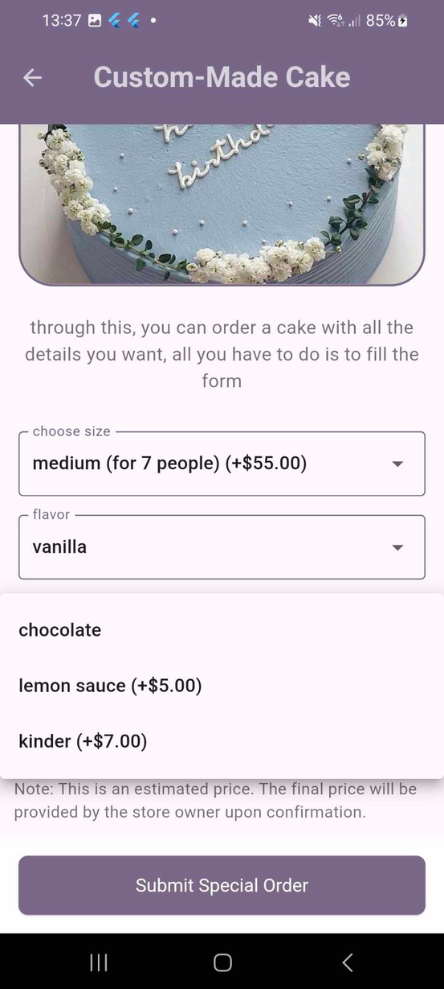
Special order

Slide 18
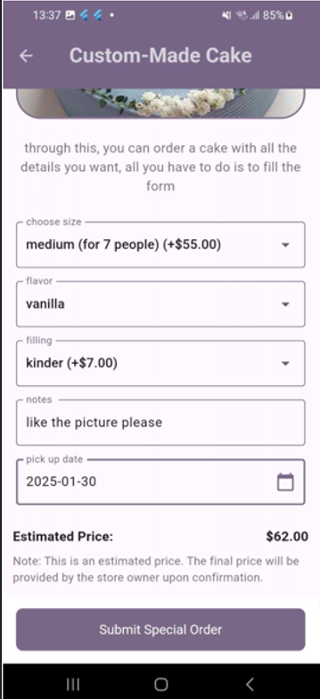
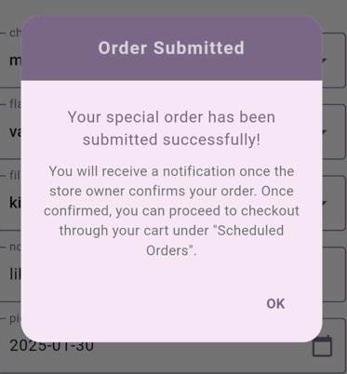
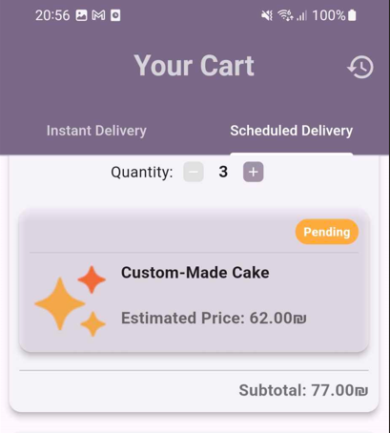
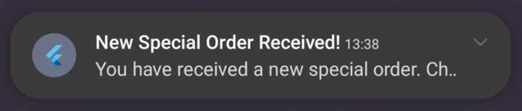
Special order

Slide 19
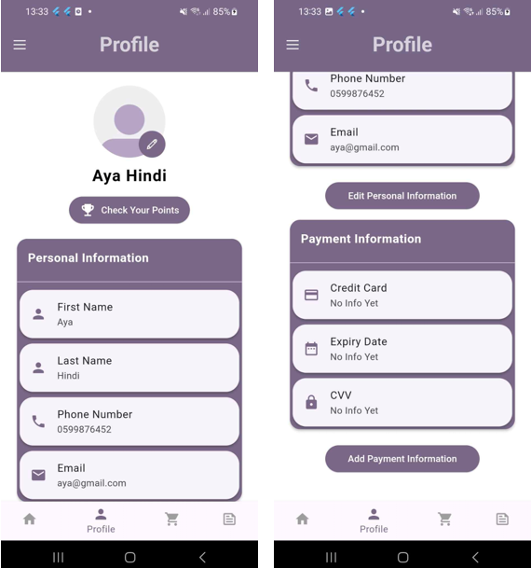
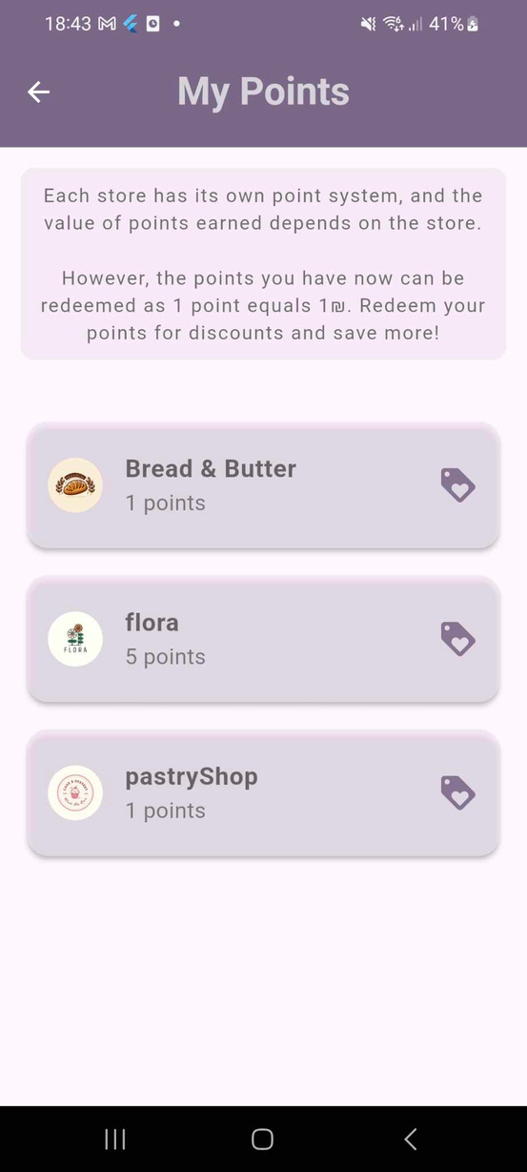
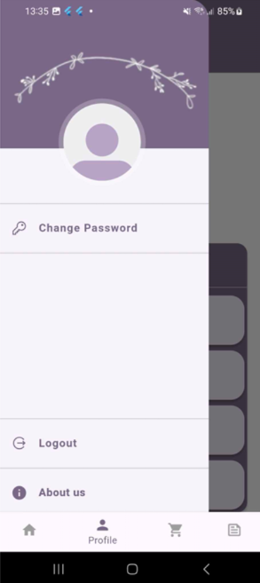
Profile

Slide 20
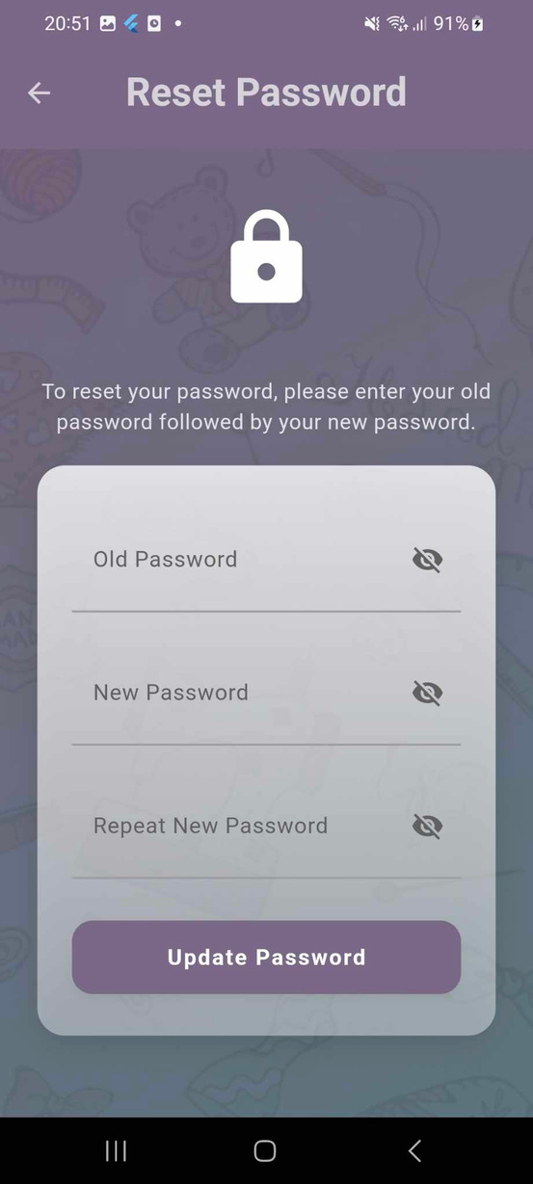
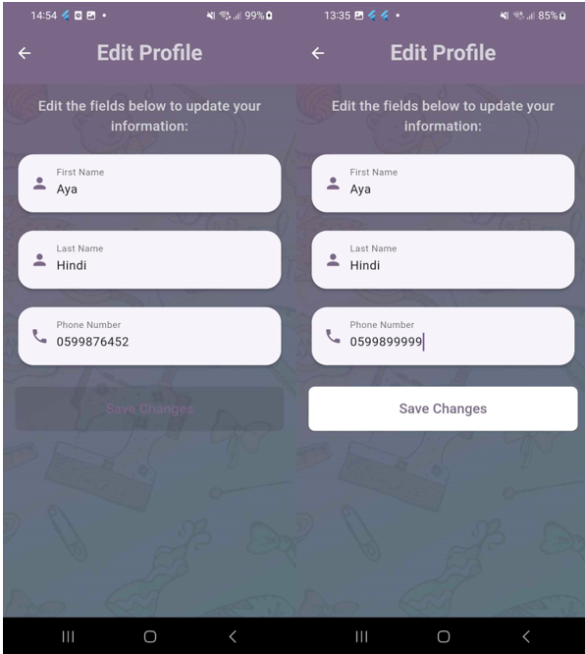
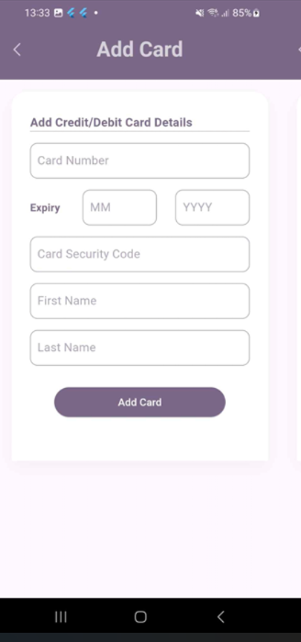
Editing Profile

Slide 21
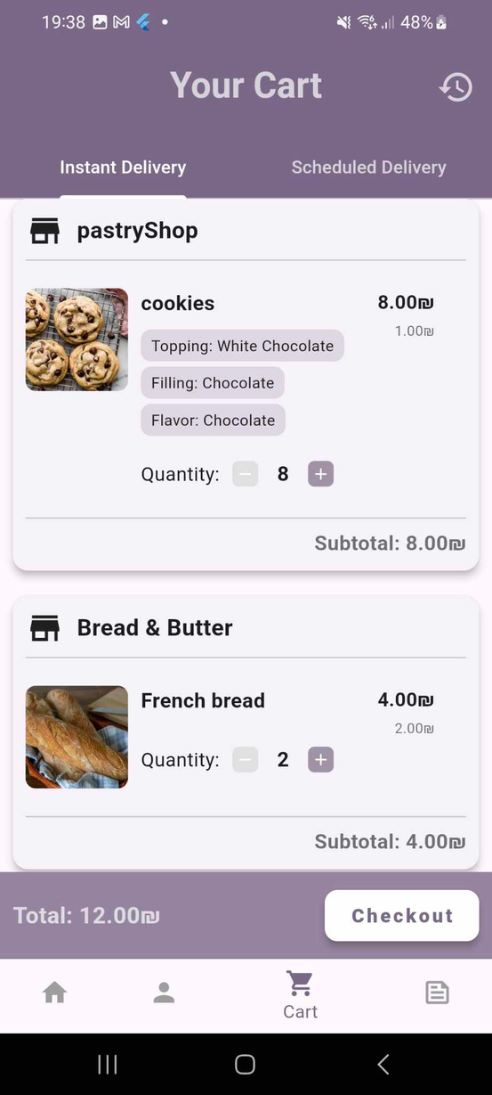
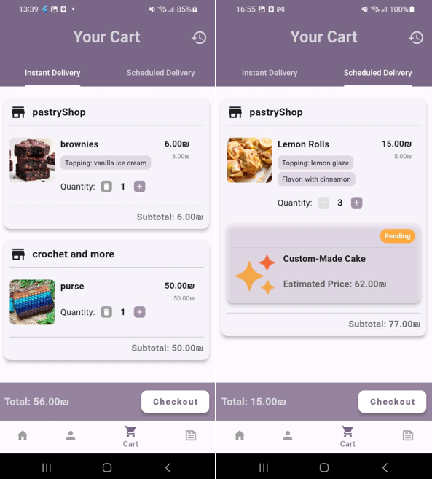
Cart
Instant Delivery
Orders that processed and delivered immediately.
Scheduled Delivery
Orders that require preparation time before being delivered at a later

Slide 22
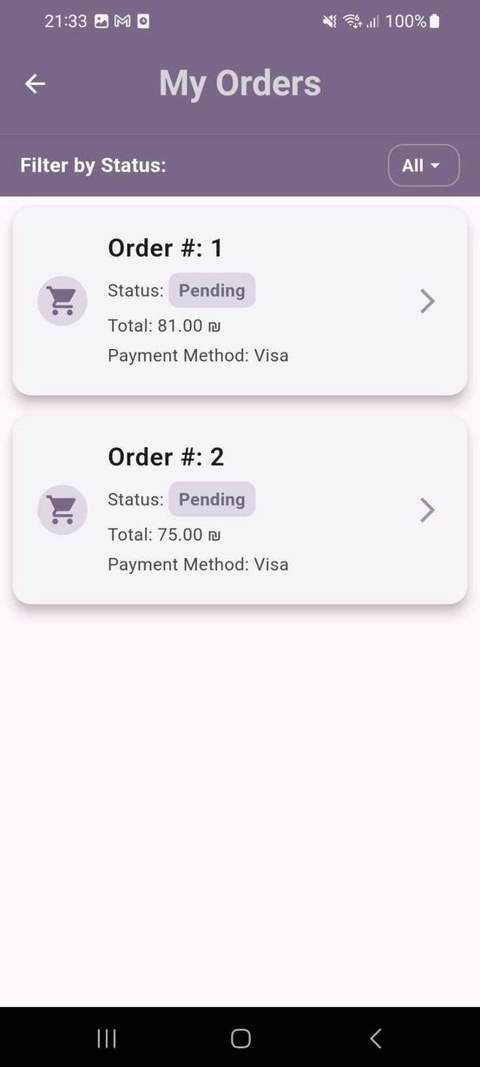
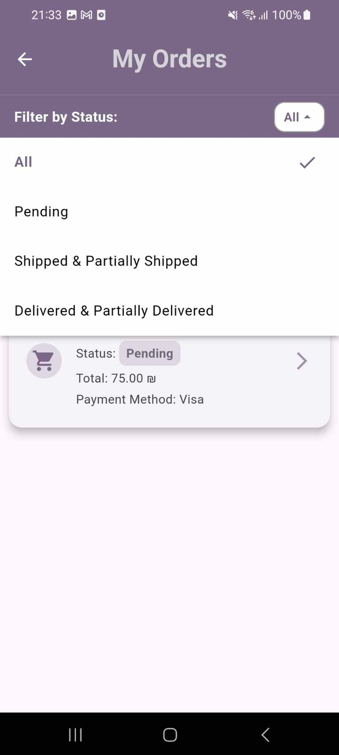
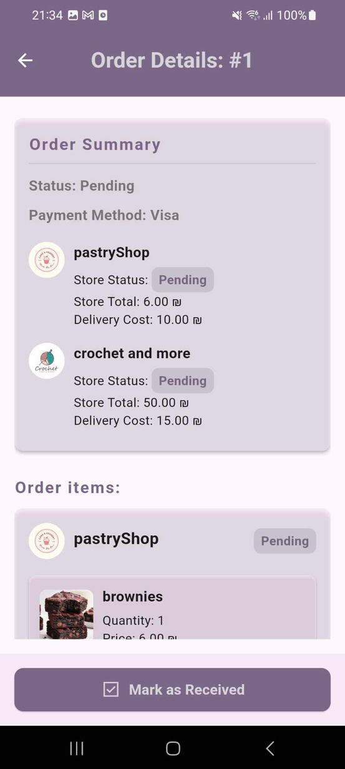
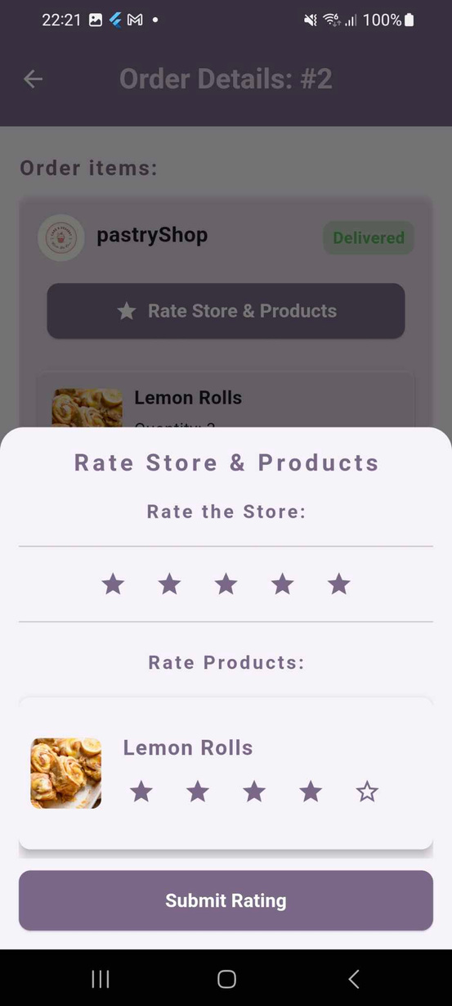
Previous Orders

Slide 23
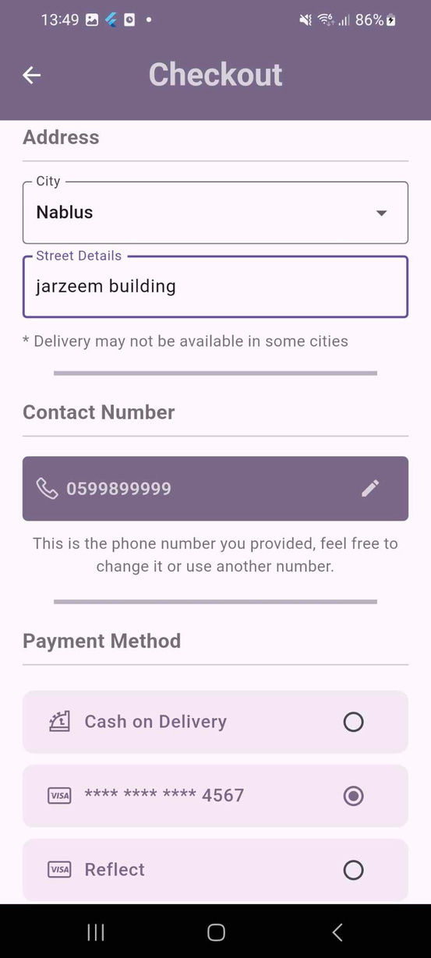
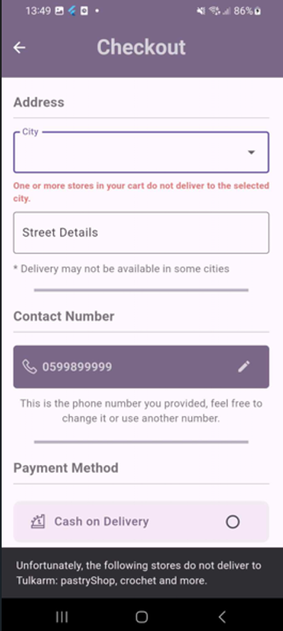
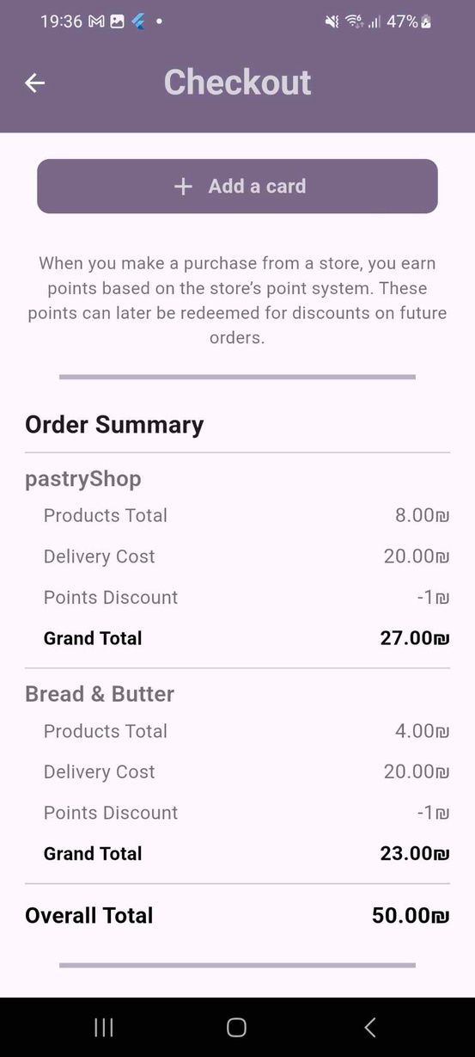


Checkout

Slide 24


Checkout- Scheduled Orders
This option appears only if the store owner enabled scheduled pickup when adding the product.
Choose whether to receive all items together after the longest prep time or get them as they’re ready.

Slide 25
Feed

Slide 26


Post Structure and Post types
Post Structure:
  User/Store
Information
  Date of the Post
  Post Content
  Image/Media
  Engagement Metrics
  Post Type Label
Store Post
<-- Post Types -->
User Feedback

Slide 27



Feed Page
User Feed
Filters
Both User and store owner
have the same Feed
Except for small differences
in avaialble filters
Another small difference
is in the app bar
User VS. Store Owner
Stores does
not have
Favorites filter

Slide 28




User Feed: Filters
Home
Popular Posts
Favorites

Slide 29

User Feed: View Store Profile
When a User clicks on a store
post or a feedback on a specific store, he gets navigated to that store profile. From there he can:
  Create Feedback on the store.
  View Store Products
  Message that store
  View Store Posts and Feedbacks about it.

Slide 30




User Feed: Creating Feedback

Slide 31




Store Feed: Creating Post

Slide 32
Store

Slide 33


Store Page After Login

Slide 34

Tutorial Videos

Slide 35




Store Home Page

Slide 36


Adding New Product
Availablity
IN STOCK
UPON ORDER
Delivery Type
INSTANT
SCHEDULED

Slide 37




Adding New Product
Default Options in another category

Slide 38




Adding New Product

Slide 39



Edit & Delete product

Slide 40
Special Order
Personalised order
Large Quantities

Slide 41




Managing Special Order Form
Default Options in a different category

Slide 42





Managing Special Order Form

Slide 43



Managing Special Order Form
Special order for a store in the flower category

Slide 44



View Received Orders

Slide 45





View Received Order Details

Slide 46






View Special Order Details

Slide 47



Store Profile
Store Profile:
  Store Information
  Insights Button
  Tab bar to navigate between the store posts and feedbacks on it.
  A drawer on the left side.

Slide 48

Store Profile : Insights Page
Insights Page:
Provides Store Owner with a report-like page to keep up with the progress of his store.

Slide 49

Store Profile : Drawer
At the left side of the store profile, the store owner can access a side menu that contains several features

Slide 50


Store Information
Manage delivery Locations

Slide 51





ads Management
Point System Management

Slide 52



Sales Mangement: Product Selection

Slide 53



Sales Management: Sale Configuration
Store Owner must provide the start date and end date of the sale. He also has the option to send a push notification to all the users

Slide 54





Sales Management: Sale Display
After the sale is created ,it’s displayed on several pages. Also, the notification is sent to the users.
How the sale appears on the product card:
Owner Home
Page
User Home
Page
Store Products
Page

Slide 55


Sales Management: Price Change
When a product is on sale, its price is changed temporarly until the sale end. However, it returns to its normal price after.
After the sale ends, a badge is shown :
Product Details
Page

Slide 56
Chatting

Slide 57




Chatting System
chatting system is to strengthen the connection between the store owners and their customers. Also to provide a way for the admin to have a connection with the stores.
To access the All Chats page:
Store Owner
User

Slide 58


Chatting System : Chat Page Structure

Slide 59

Chatting System : Chat Page
To text a Store page for the first time, the user can do this from the Store profile page using the ‘Message’ button.

Slide 60

Chatting System : Admin Chats
Admin has the same features for chatting, except in his all chats page he can view all the store accounts to chat with them

Slide 61
Admin

Slide 62



Admin Features

Slide 63


Manage stores
Manage categories

Slide 64



Admin Features

Slide 65
Web Features
Web has the same features as mobile except for small changes to all chats page and an additional feature

Slide 66

Web Features : Database Interface

Slide 67

Web Features : Chat Page Display

Slide 68


Future Work
1
3
Multi-Language Support
AI-Powered Recommendations
Regional Expansion
2

Slide 69


(وَآخِرُ دَعْوَاهُمْ أَنِ الْحَمْدُ لِلَّهِ رَبِّ الْعَالَمِينَ)
Thank You

