Slide 1

An-Najah National University
Building Engineering Department
Designing the “4 stars” Hotel
Prepared by:
Rawan Bozyah
Mohammad AbuHamma
Muath Qaradeh
Supervisor:
Eng. Moayad Salhab

Slide 2
CONTENTS:
2
Site and location
Architectural plans
Environmental design
Thermal design
structural Aspects
Artificial lighting
HVAC System design
Electrical system design
Acoustical design
Elevator system design
Supply Water design
Drainage System design
Fire Fighting System design
Quantity surveying and cost estimation

Slide 3
Site and location

Slide 4
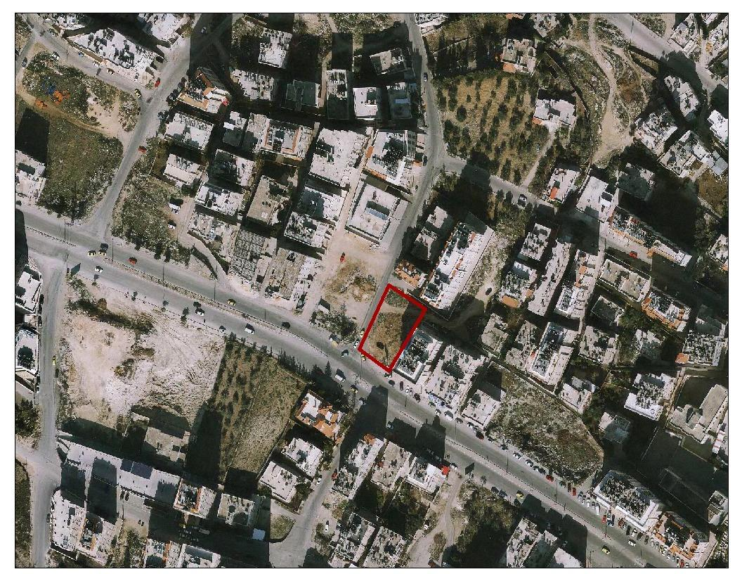
Site location
The land location in Nablus city Rafidia street AL- Junaid
Specifically in the East of An-Najah National University and it located at 32.2°N latitude and 35.2° E longitude.
And the area of land is 1080 m2 , it located in a classification area A.

Slide 5
Architectural Plans

Slide 6
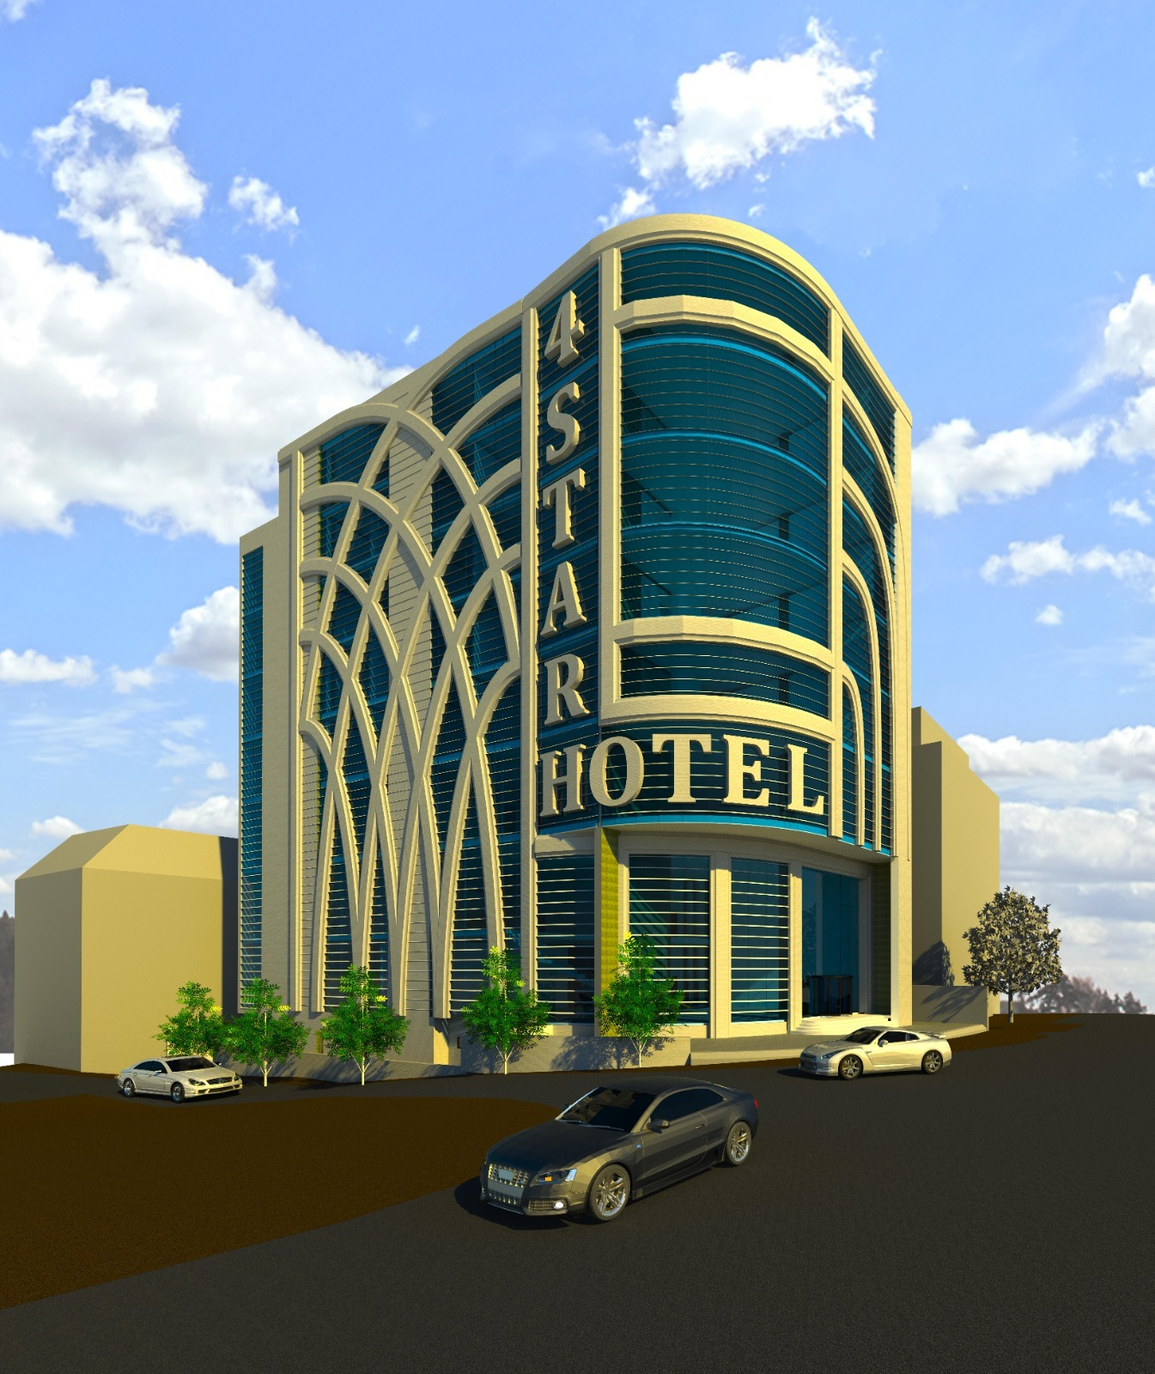
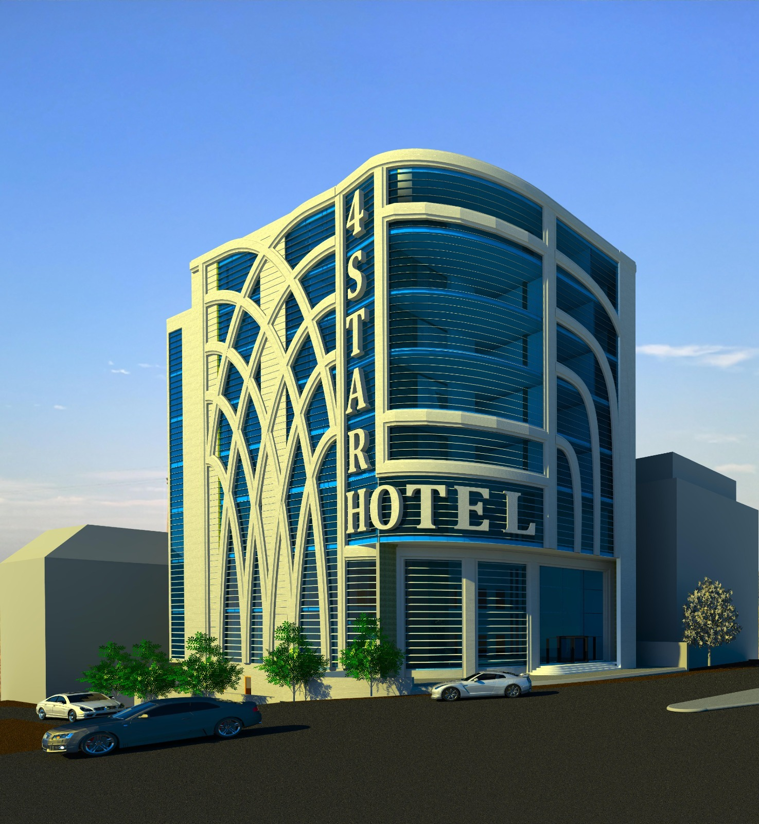
The 3D model for the existed architectural plan.

Slide 7
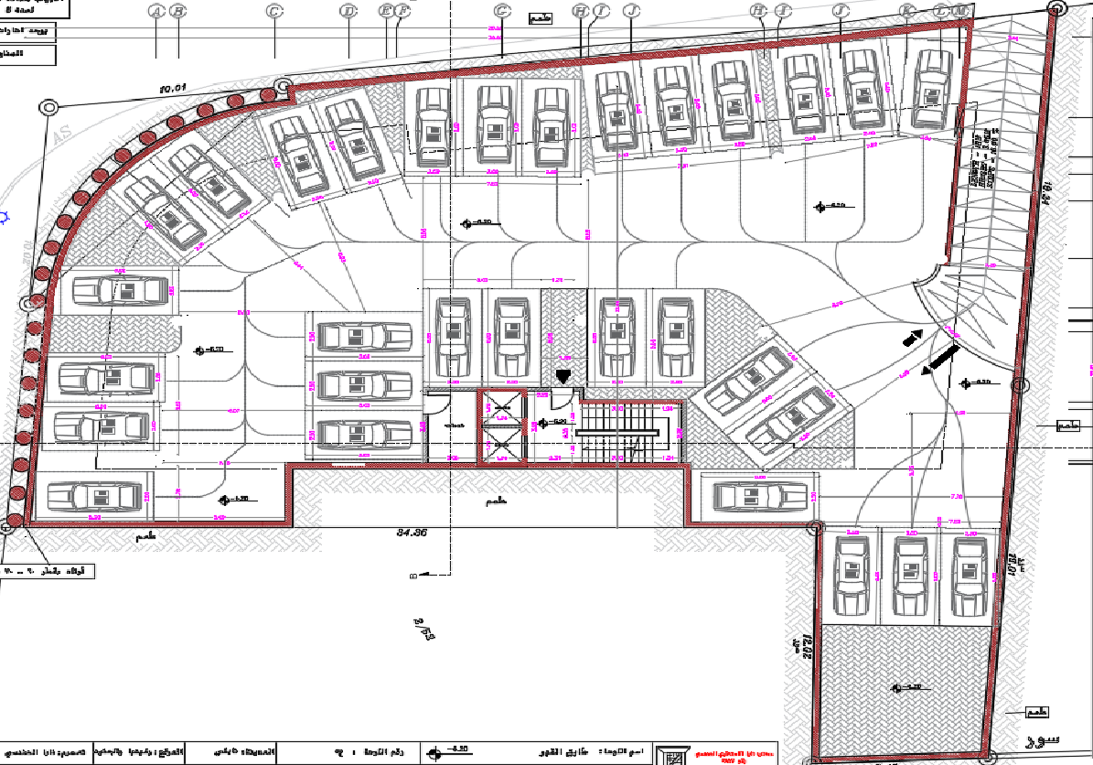
Basement floor (Parking) – Before

Slide 8
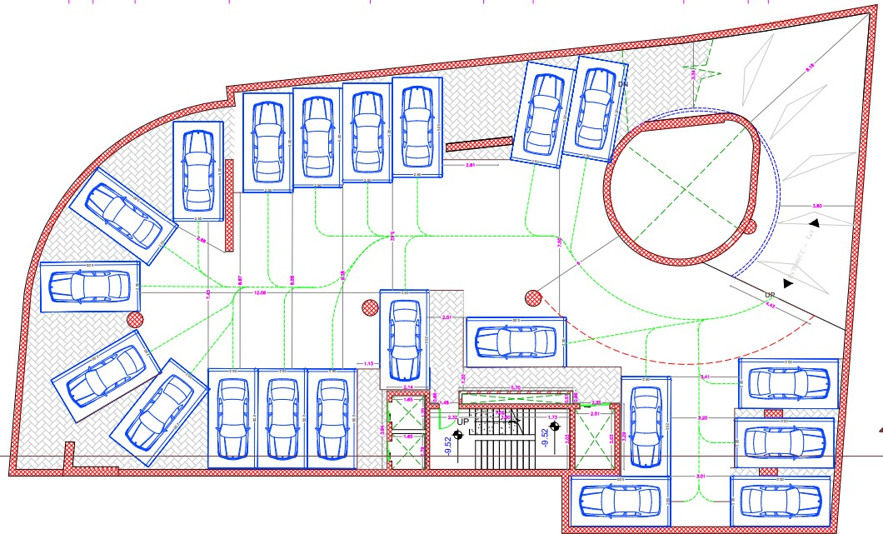
Third Basement floor (Parking) – After

Slide 9
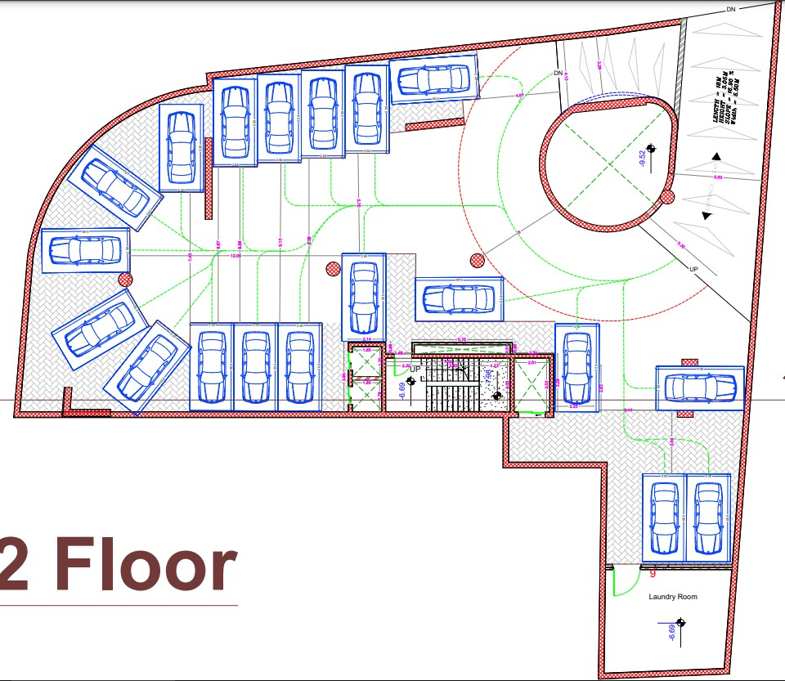
Second Basement floor (Parking)- After

Slide 10
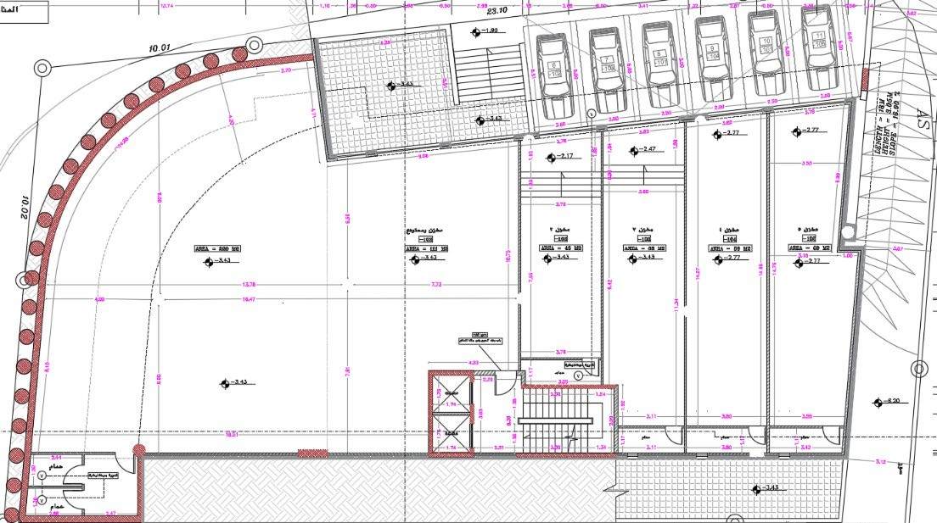
First Basement floor (Storage) – Before

Slide 11
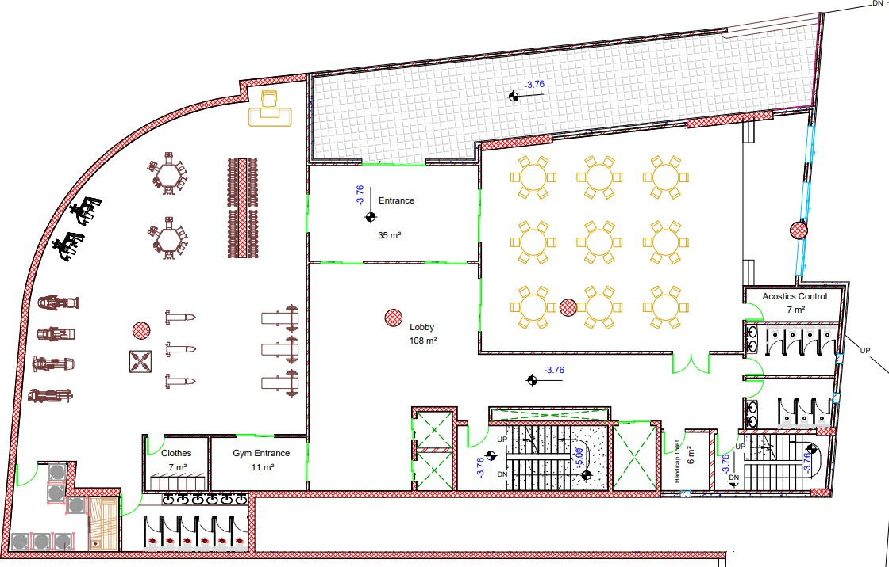
First Basement floor (Entertainment) – After

Slide 12
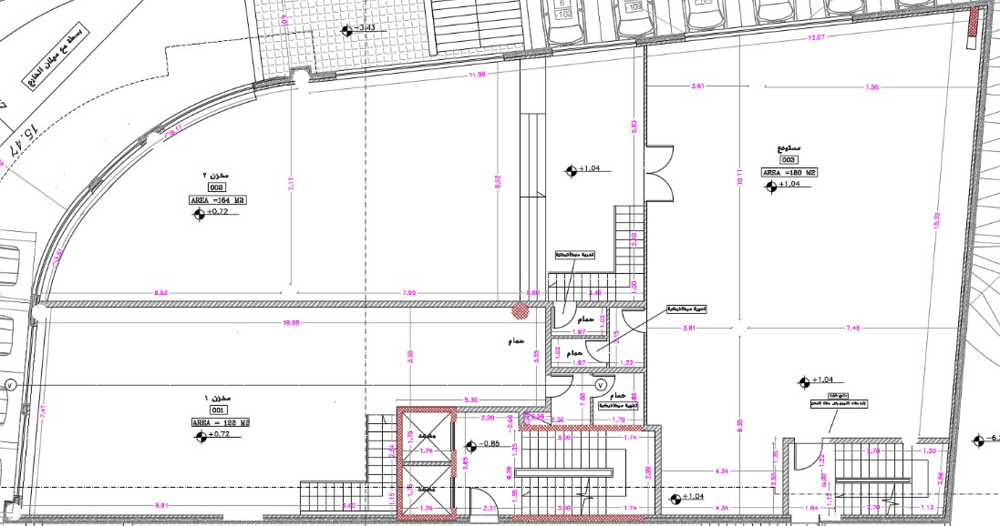
Ground floor (Storage) – Before

Slide 13
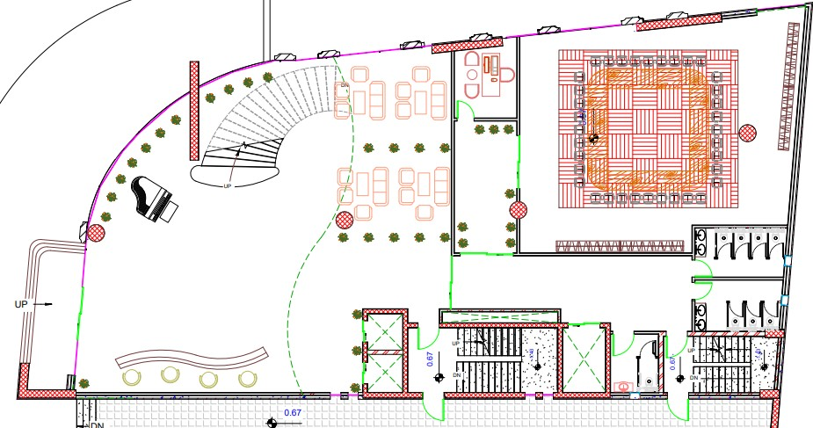
Ground floor (Reception) – After

Slide 14
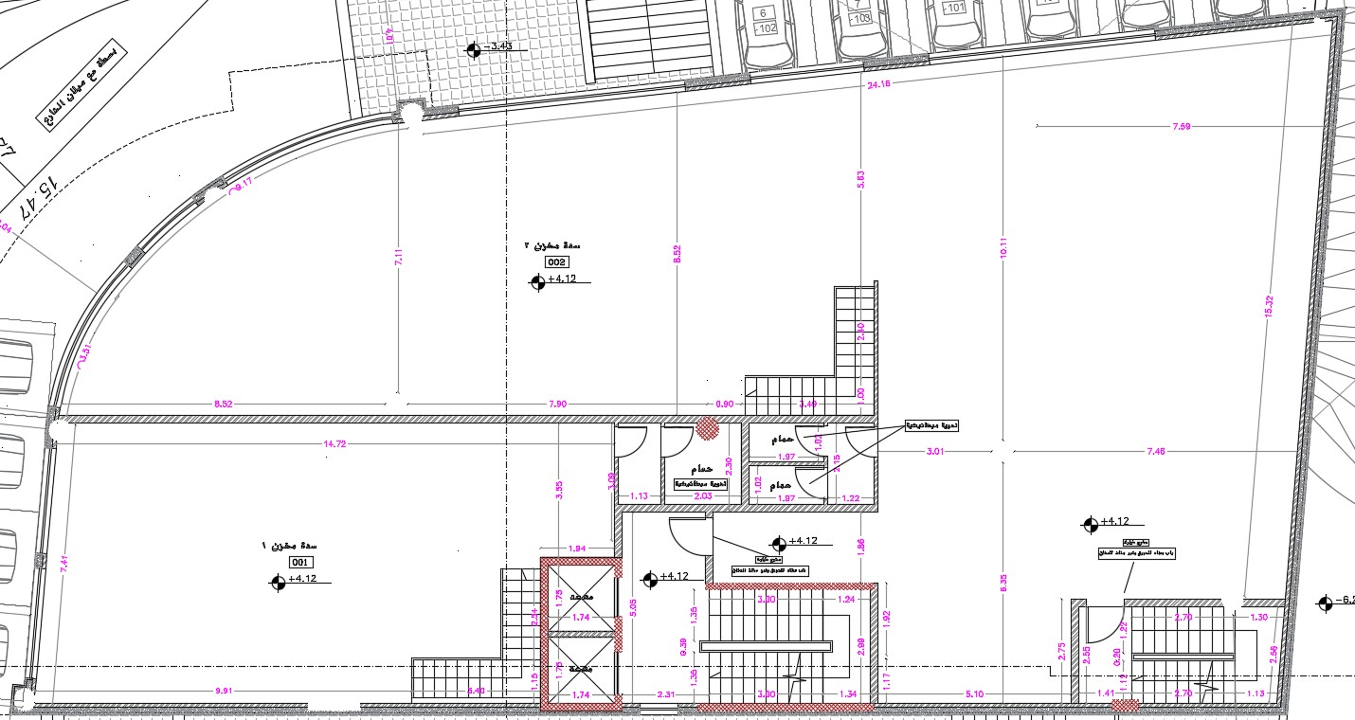
First floor (Storage) - Before

Slide 15
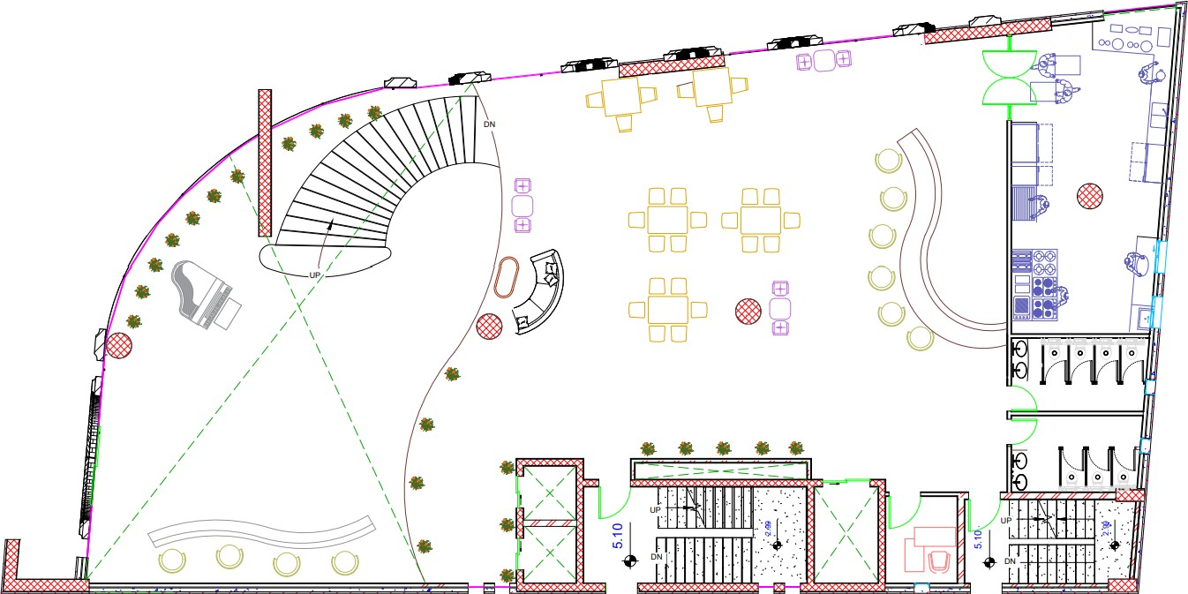
First Floor (Cafeteria) – After

Slide 16
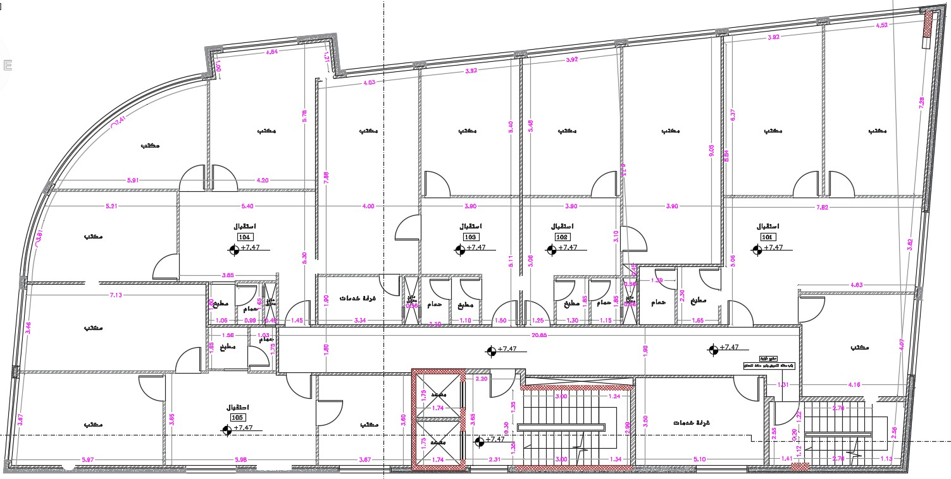
Second ,Third and Fourth Floors (Offices) - Before

Slide 17
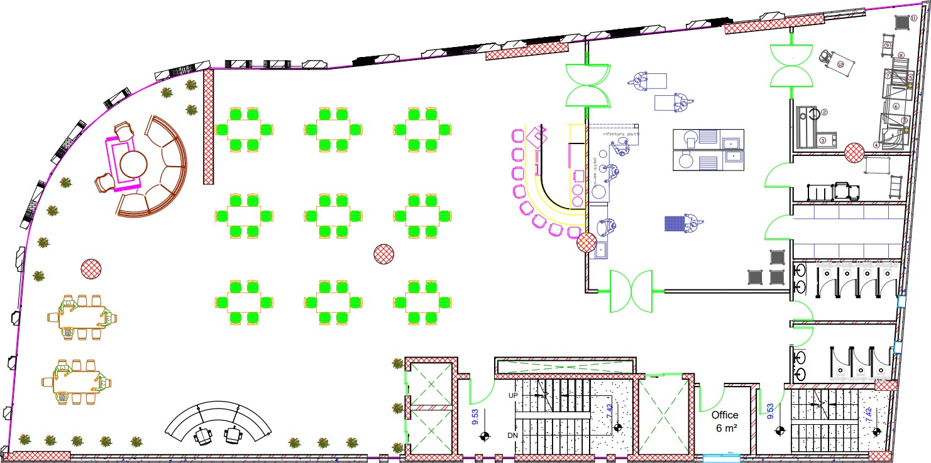
Second Floor (Restaurant) – After

Slide 18
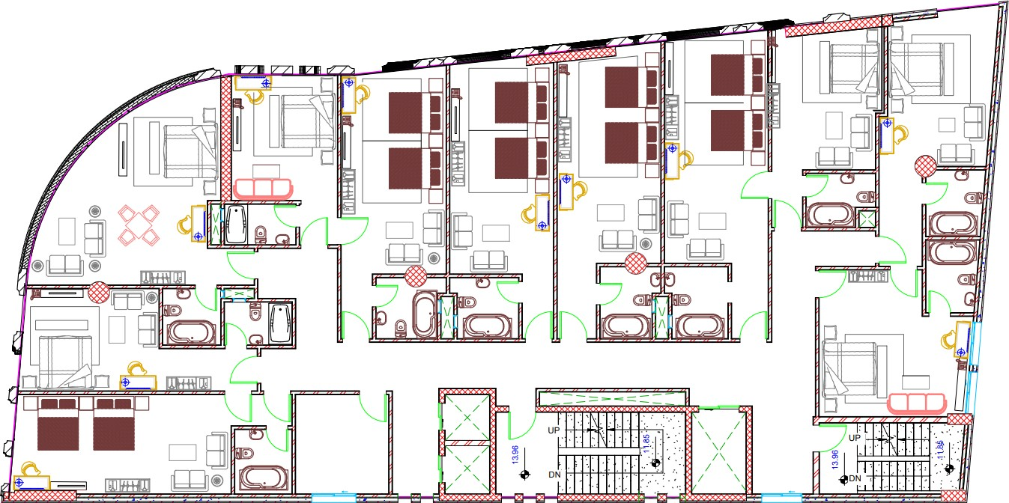
Third, Fourth and Fifth Floors (Bed rooms) – After

Slide 19
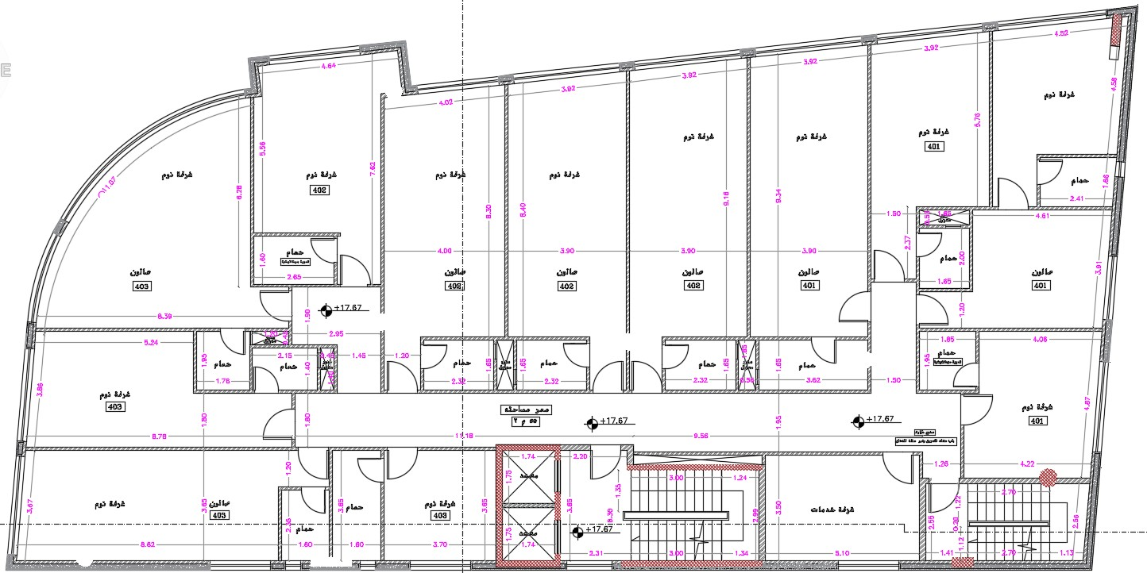
Fifth and Sixth Floors (Bed rooms) - Before

Slide 20
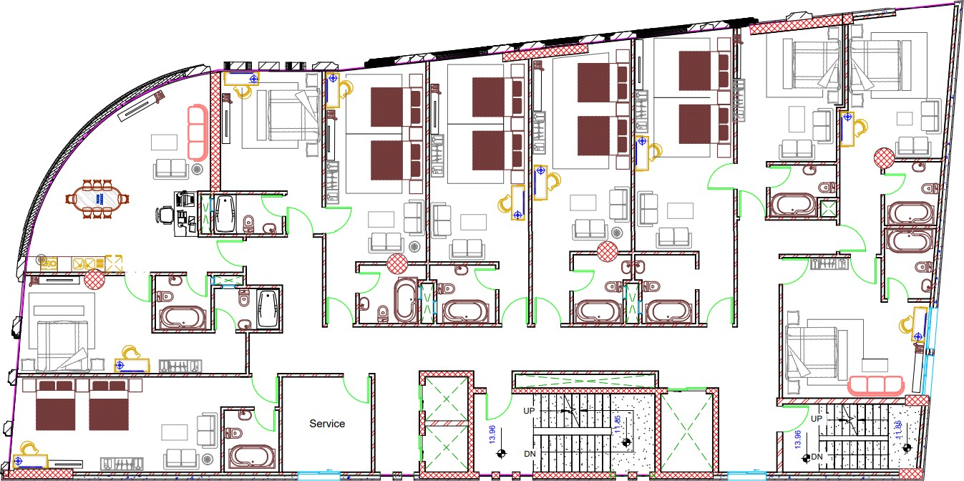
Sixth Floors (Bedrooms) – After

Slide 21
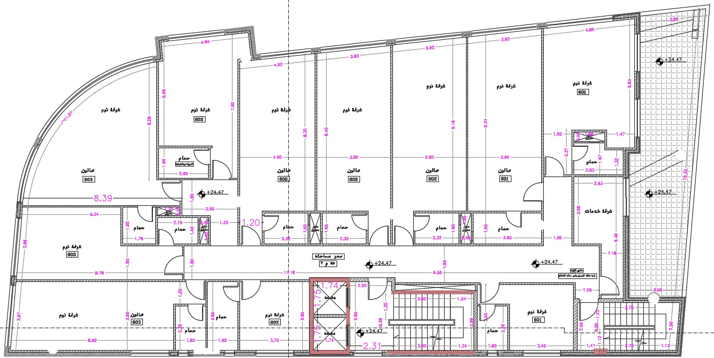
Seventh Floor (Bedrooms) – Before

Slide 22
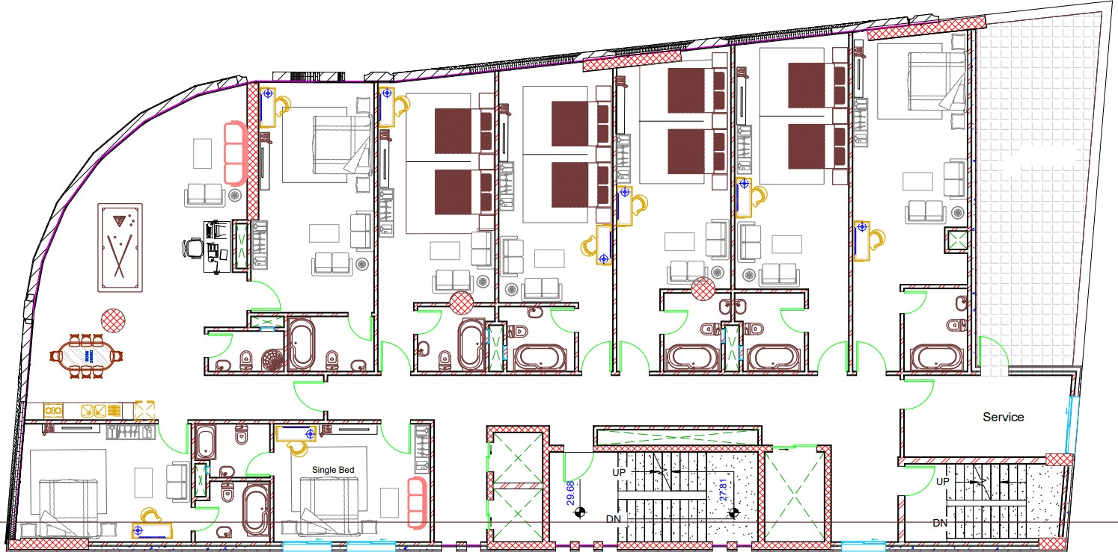
Seventh Floors (Bedrooms) – After

Slide 23
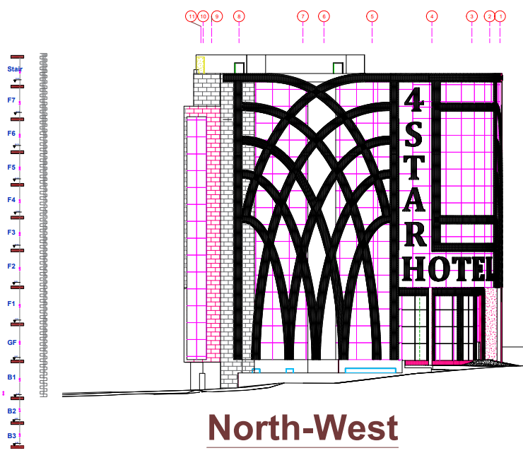
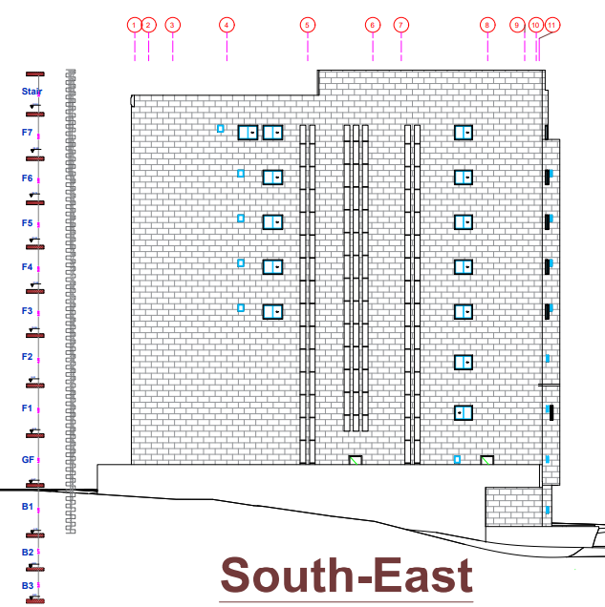
North West Elevation
North East Elevation

Slide 24
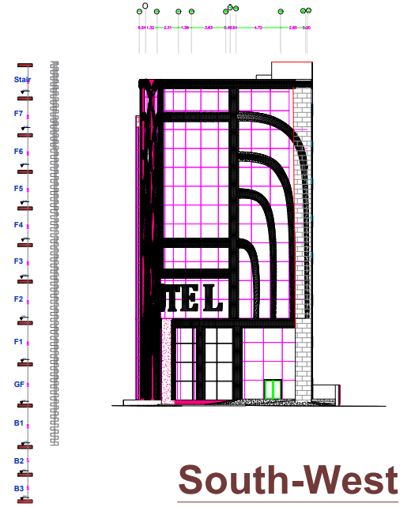
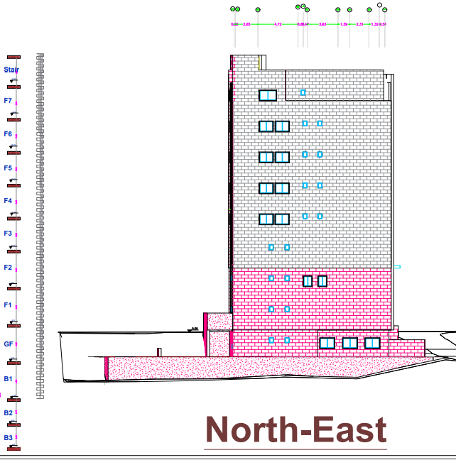
South West Elevation
South East Elevation

Slide 25
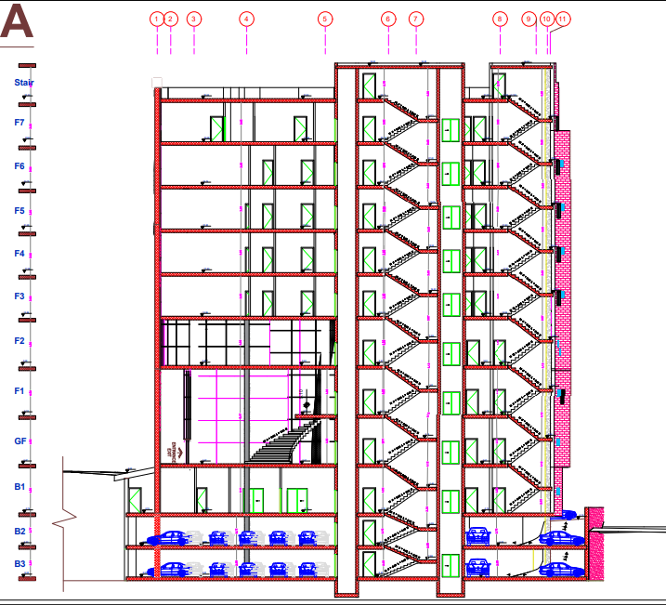
Section A-A

Slide 26
Environmental Design

Slide 27

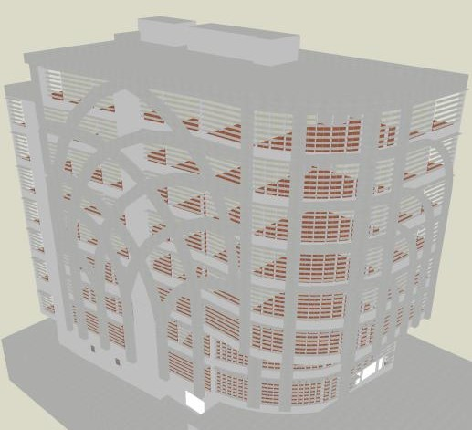
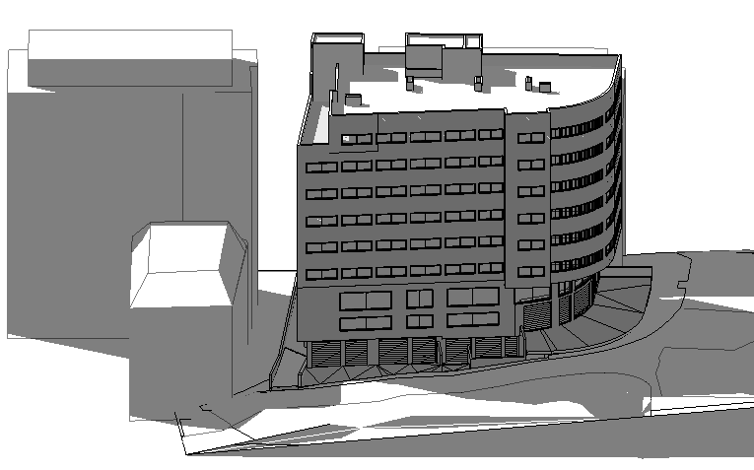
Daylighting
The model of the facility from Design Builder after modification
The model of the facility from Revit before modification
Main modification for day lighting:
Adding Louvers.
Using low transmission glass.

Slide 28
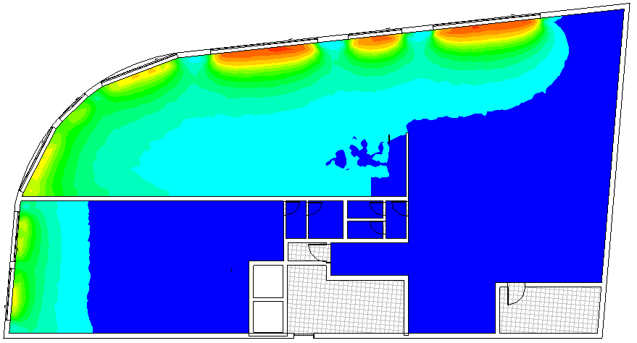

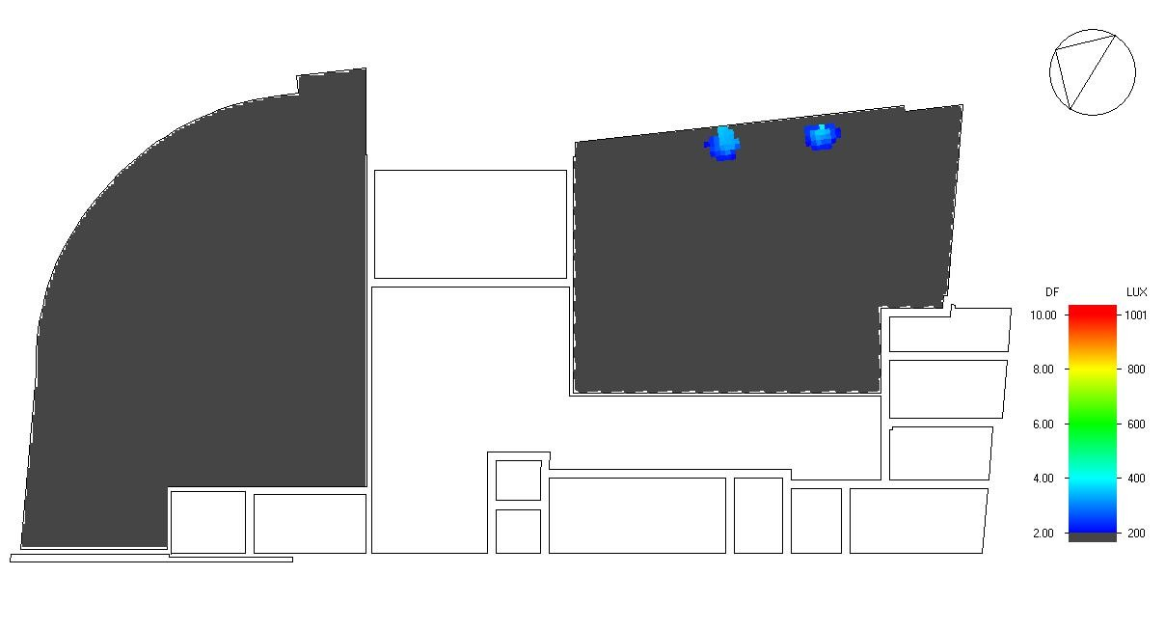
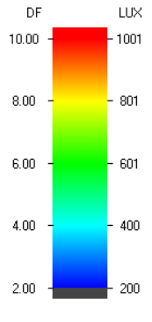
Daylight analysis for the model for the First Basement Floor and fourth floors before and after modification
Before
After

Slide 29
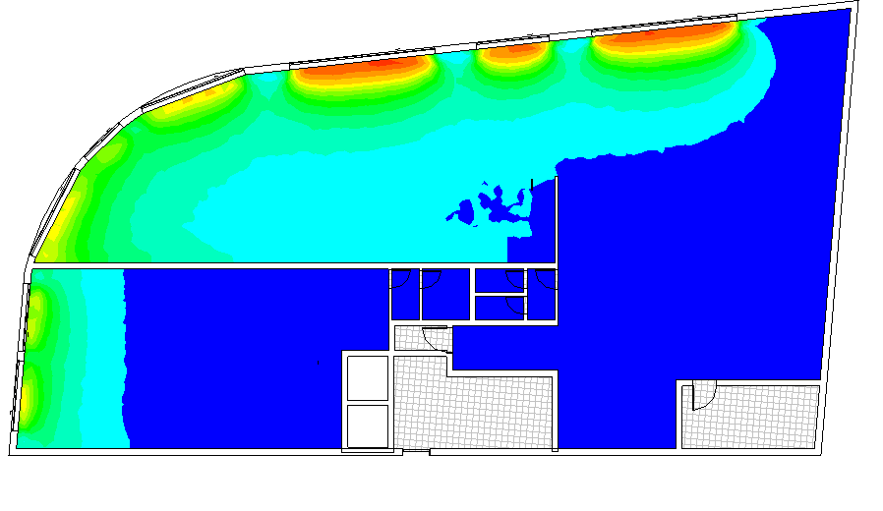

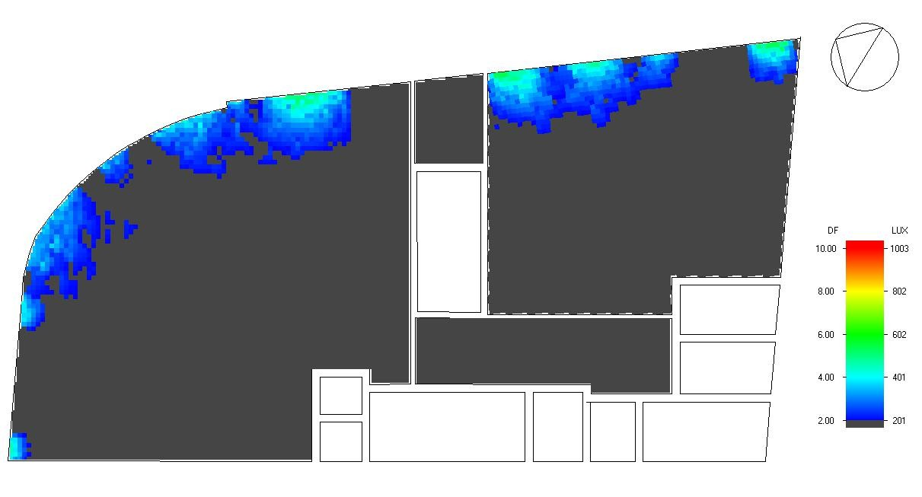
Daylight analysis for the model for the Ground Floor and fourth floors before and after modification
Before
After

Slide 30
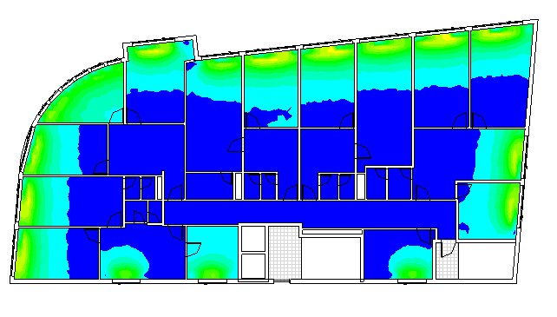

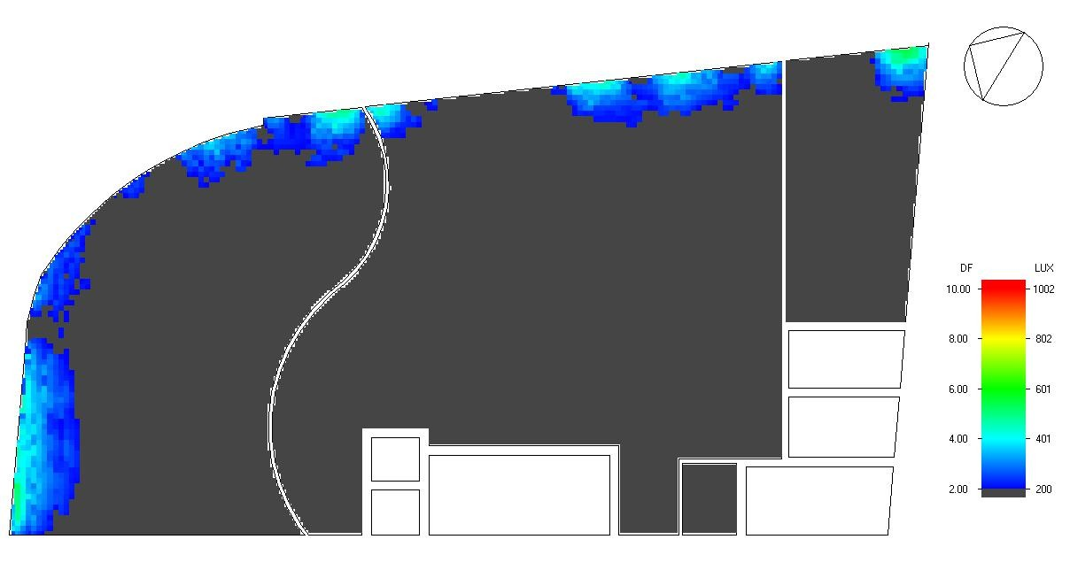
Daylight analysis for the model for the First Floor and fourth floors before and after modification
Before
After

Slide 31
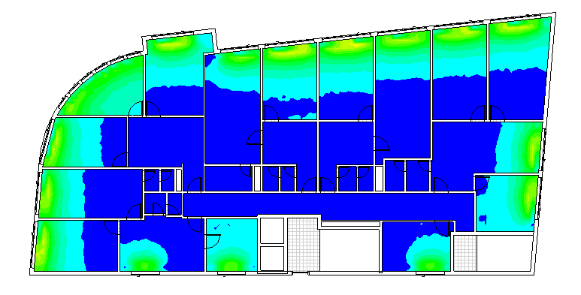

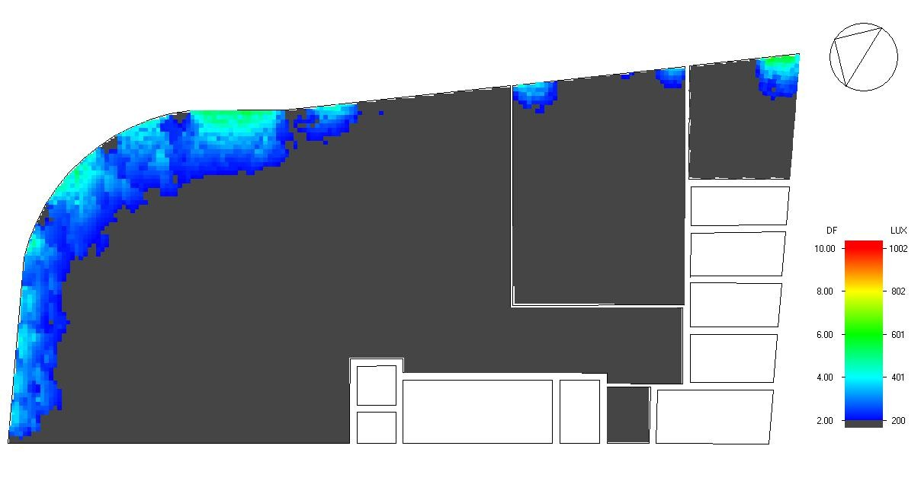
Daylight analysis for the model for the Second Floor and fourth floors before and after modification
Before
After

Slide 32

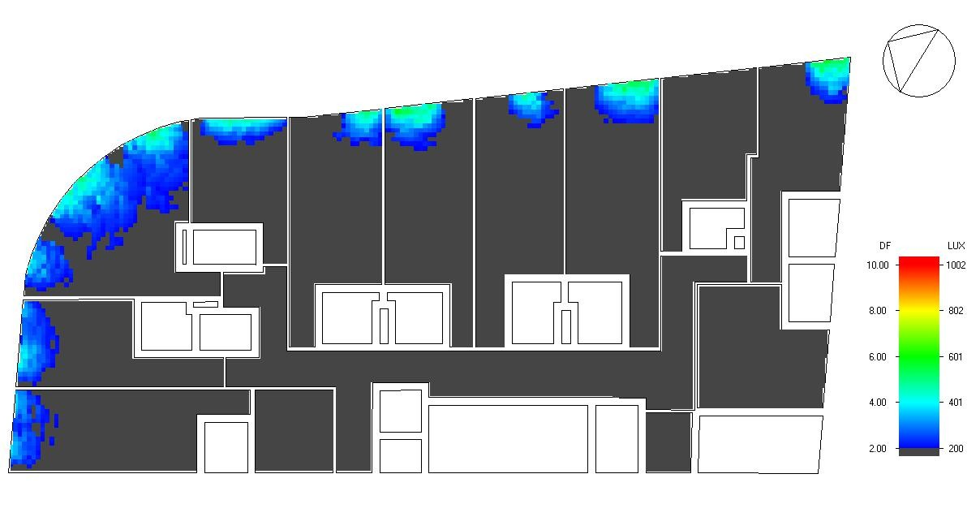
Daylight analysis for the model for the Third ,Forth , fifth and Sixth Floor and fourth floors before and after modification
Before
After

Slide 33

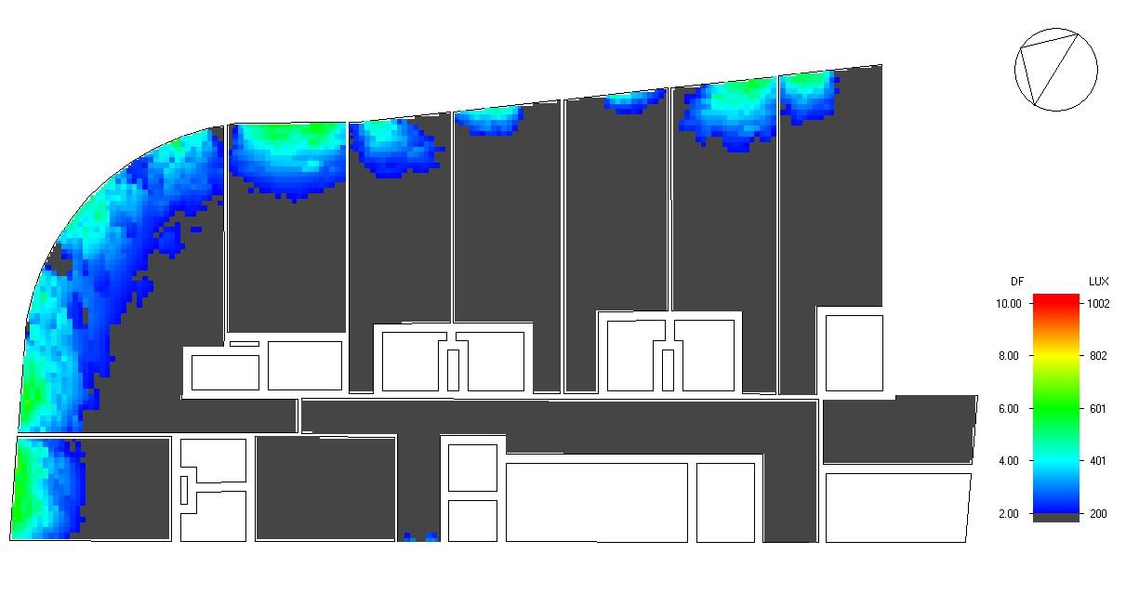
Daylight analysis for the model for the Seventh Floor and fourth floors before and after modification
Before
After

Slide 34
Thermal Design

Slide 35


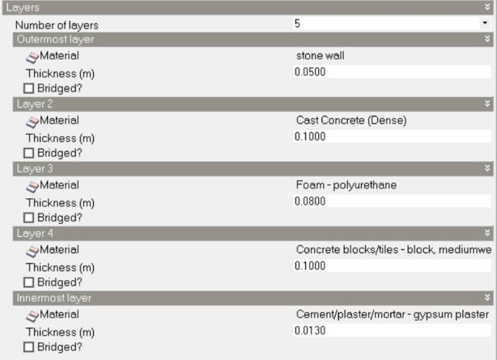
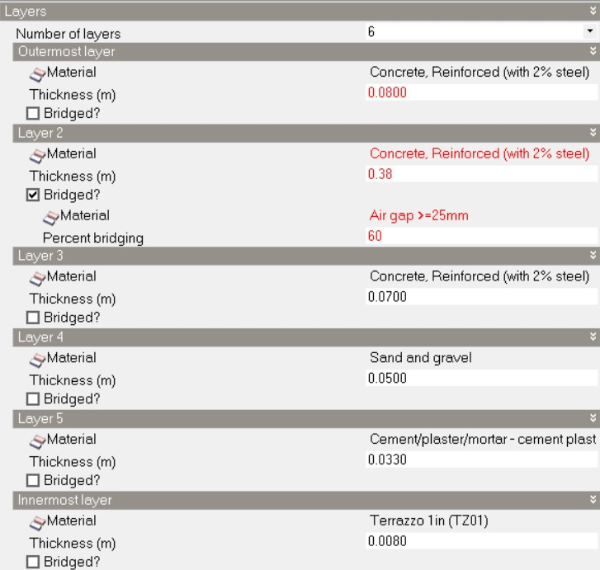

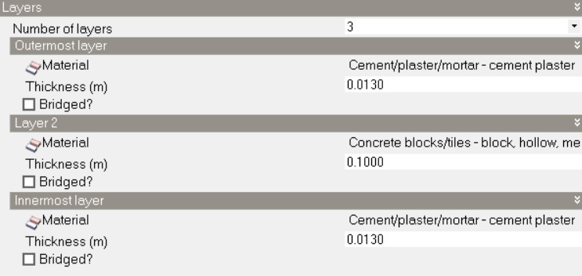

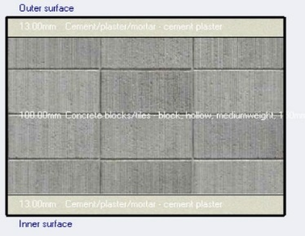


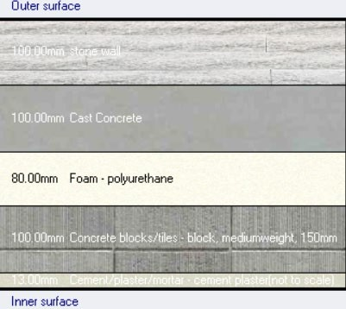
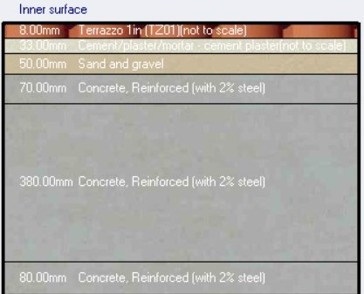
the materials that were used in the walls and slabs in the faculty
External wall
Internal slab
Internal wall
the U- value for internal wall equal 2.186 (W/m².k)
the U- value for Internal slab equal 1.746 (W/m².k )
U- value for external wall equal 0.289 (W/m².k )

Slide 36

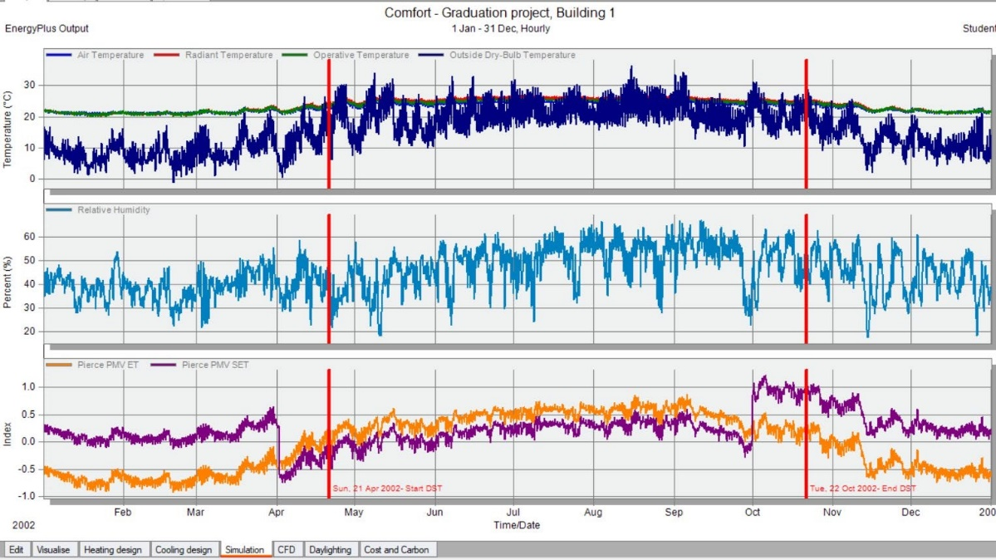
The comfort graph for the faculty from Design Builder

Slide 37

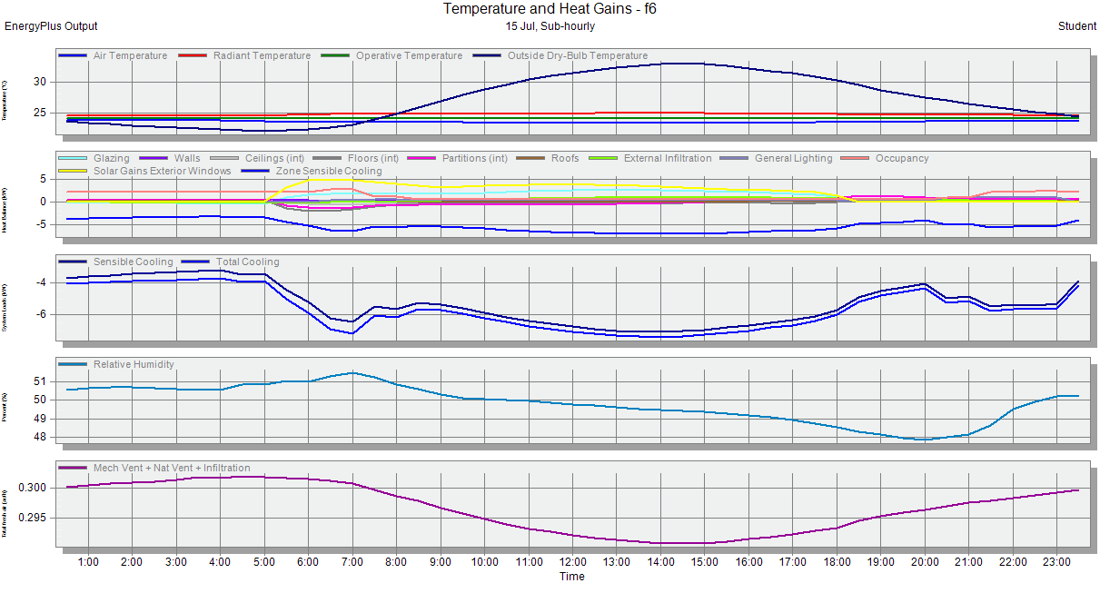

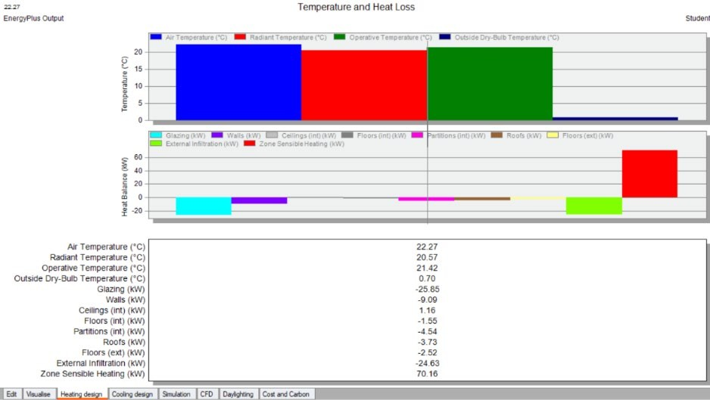
Temperature and heat gain (cooling load)
Temperature and heat loss (heating load )

Slide 38
Structural Aspect

Slide 39
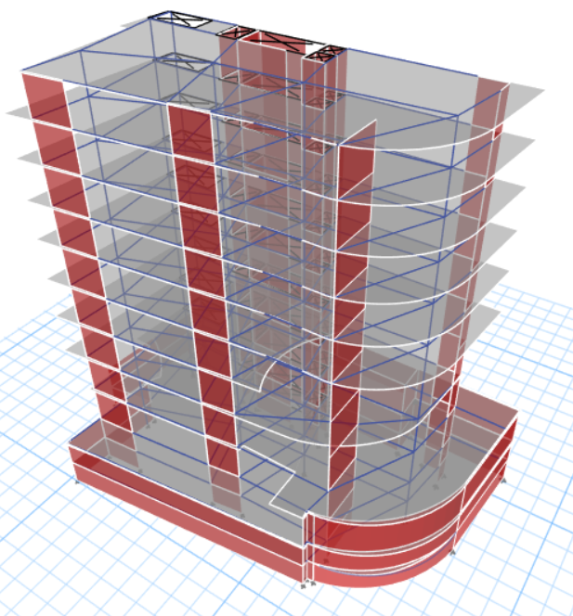
Structural Aspects
Design codes
ACI 318-14
UBC-97
Specifications
Concrete’s Compressive strength (f’c) = 28 MPa
Yielding strength of steel (Fy) = 420 MPa
Bearing capacity of soil = 250 kN/m²
Design loads
SID = 4.5 kN/m²
L.D = 5 kN/m²

Slide 40
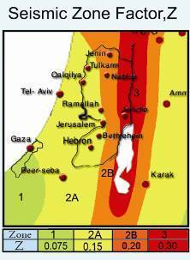
Structural Aspects
Site analysis
seismic zone : 2B (Z = 0.20).
( I ) = 1
Soil profiles : Sc
(Ca) = 0.24
(Cv) = 0.32
(R) = 5.5

Slide 41
Structural Aspects
Load combinations on Etabs (according to UBC97)
1.4D 12-1
1.2D+1.6L 12-2
1.34D+1L+1EQx+0.3EQy 12-3
1.34D+1L+1EQy+0.3EQx 12-4
0.76D+1EQx+0.3EQy 12-5
0.76D+1EQy+0.3EQx 12-6
1D 12-7
1D+1L 12-8
1D+0.71EQx+0.21EQy 12-9a
1D+0.71EQy+0.21EQx 12-9b
0.9D+0.71EQx+0.21EQy 12-10 a
0.9D+0.71EQy+0.21EQx 12-10b
1D+0.54EQx+0.16EQy+0.75L 12-11a
1D+0.54EQy+0.16EQx+0.75L 12-11b

Slide 42
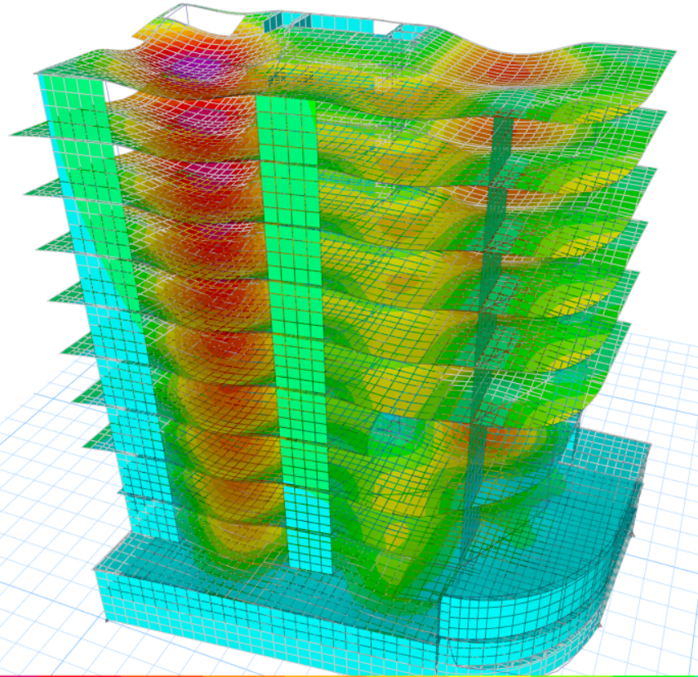
Structural Aspects
Checks
Compatibility check
Equilibrium check
Internal Forces check
Deflection check
Period check
Base shear check
Drift check
All checks are OK

Slide 43
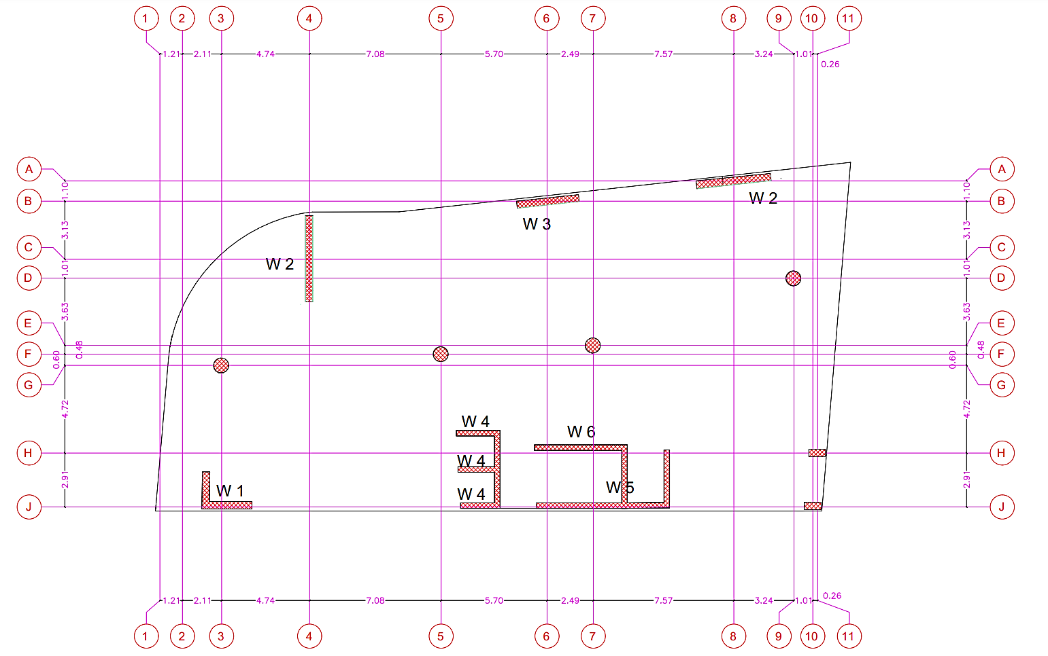
Structural Aspects
Column design
Columns Dimensions
C1/C2 : circular 120 cm diameter
C3 : rectangular 40*90 cm
C4 : circular 80 cm diameter
C4 starts from the 3rd floor
C4
C4
C4
C4
C3
C3

Slide 44




Structural Aspects
Column detailing
C2
D-D
C1
D-D
C2
C1

Slide 45




Structural Aspects
Column detailing
C4
D-D
C3
C4

Slide 46



Structural Aspects

Slide 47



Structural Aspects
Beam design
Standard beam detailing

Slide 48






Structural Aspects
Beam detailing

Slide 49




Structural Aspects
Shear wall detailing

Slide 50





Structural Aspects
Basement wall design & detailing
Ɣ for soil =18 KN/m3
ᴓ for backfilling soil = 30 degrees
F= 0.5 * 10.1 *18 = 91 KN/m
The basement wall design was done with Etabs.
(uniform reinforcement)
Wall thickness = 50 cm
As wall from Etabs = As min

Slide 51
Structural Aspects
Foundation design and checks
Safe 2016 software is used to check and design footings
The foundation is a mat footing with 100cm thickness
Bearing capacity of soil =250KN/M³
f`c=28MPa

Slide 52



Structural Aspects
Foundation design and checks
Checks
Punching shear check : All values are less than 1 , Ok
Soil pressure Check : All values are less than 250KN/M³
Deflection Check : All values are less than 10 mm , Ok

Slide 53


Structural Aspects
Foundation design and checks
Detailing
Mat footing section
Mat footing reinforcement

Slide 54

Structural Aspects
Foundation design and checks
Detailing
Mat footing additional reinforcement

Slide 55


Structural Aspects
Foundation design and checks
Wall footing detailing
This footing is used to support the Laundry room next to the building.

Slide 56


Structural Aspects
Ramp design and checks
The Ramp is 35cm thick.
M 11 and 22 on ramp slabs in Safe are checked, to find if any region on slabs has a moment larger than 67kn.m/m^2. none found. Ok

Slide 57


Structural Aspects
Ramp design and checks
Detailing

Slide 58
Electro-mechanical Aspects
Artificial lighting system
HVAC system
Electrical system
Acoustical aspects and design
Elevator system
Water supply
Drainage
Safety system

Slide 59
Lighting design

Slide 60
















Artificial lighting Design

Slide 61





3D result from DIALUX evo for the Lobby hotel

Slide 62






The result from DIALUX evo for the Multipurpose Hall

Slide 63






3D result from DIALUX evo for the Restaurant

Slide 64






3D result from DIALUX evo for the Kitchen

Slide 65





3D result from DIALUX evo for the GYM

Slide 66






3D result from DIALUX evo for the Bed room

Slide 67



3D result from DIALUX evo for the Office

Slide 68
HVAC System design

Slide 69





Electro-mechanical Aspects
HVAC system design
Variable Refrigerant Flow (VRF) system is used
VRF consists of an out-door unit feeding multiple in-door units via a BC-controller
Indoor units
Mitsubishi Ceiling concealed low static pressure units (1.2, 1.7, 2.2, 2.8 kW)
Mitsubishi Way Airflow Compact Cassette (3.6, 4.5 kW)
Outdoor unit
Mitsubishi PURY-EP200YNW-A
BC-controller
The CMB-WP108V-GA1 (8 branches)
The CMB-WP1016V-GA1 (16 branches)

Slide 70

Electro-mechanical Aspects
HVAC system design
Indoor and Outdoor unit calculations

Slide 71

Electro-mechanical Aspects
HVAC system design
HVAC units distribution in the 6th floor

Slide 72

Electro-mechanical Aspects
HVAC system design
Ducting (fresh air and exhaust) 1st floor kitchen

Slide 73
Electrical system design

Slide 74

Electro-mechanical Aspects
Electrical system design
Single line diagram

Slide 75

Electro-mechanical Aspects
Electrical system design
Socket and lighting distribution
B1

Slide 76

Electro-mechanical Aspects
Electrical system design
Socket and lighting distribution
F1

Slide 77

Electro-mechanical Aspects
Electrical system design
Socket and lighting distribution
F7

Slide 78
Acoustical Design

Slide 79
Acoustical Design
Objective: is to achieve auditory satisfaction for people within spaces
by achieving the requirements of the following Parameters:
Reverberation Time [RT60]
Noise Criteria [NC]
Sound Transmission Class [STC]
Impact Insulation Class [IIC]
Sound Pressure Level [SPL]

Slide 80

Reverberation Time Standard

Slide 81

Reverberation Time Design
We've done a treat for all spaces, but for time constraints we show you the most important Space in the hotel has designed for.
Hotel Bedroom
Construction Element | Internal Finished Material
Ceiling | Brick Plaster
Walls | Brick Plaster, Framed Plasterboard
Floor | Moquette_
Door | Plywood
Window | Generic LoE SPEC SEL CLEAR 6MM Rev
Drapes | Drapes_Absorber

Slide 82


Sound Transmission Class
For Masonry Walls:
STC Designing value was 35 dB
Layers of Masonry Walls
5 cm stone
10 cm concrete
8 cm polytherane
10 cm hollow block
13 mm plaster

Slide 83

For Curtain Walls:
STC Designing value was 35 db

Slide 84



For Partitions
Layer of Partitions
Plaster 13 mm
Hollow Block 10 cm
Plaster 13 mm

Slide 85


Impact Insulation Class
For Roof
IIC when designing the roof depends on the rate of Rainwater falling, such as the rate of rainfall in Nablus city in the last of 10 years = 253 mm
Layer of Roof Slab
4 cm lightweight concrete
8 cm polytherane
6 cm reinforcement concrete
26 cm hollowblock with reinforcemet concrete
13 mm plaster

Slide 86



For Internal Floors
We designed the internal floors based on the relationship between the space and the above, as shown in the following table, such as taking a worst-case and circular on all internal floors:
Worst case it was between the bedroom above the bedroom
Layer of Internal Floors
Terrazo tiles 2 mm
3 cm mortar
5 cm sand
8 cm reinforcement concrete
30 cm u- boots with Reinforcemet concrete
13 mm plaster

Slide 87


Speakers System Design
Objective: improve sound pressure level and intelligibility inside spaces
By using the EASE Program, we designed a speakers system for many spaces, But for lack of time we will review the design for the Multipurpose
%AL
100
-
33%
33
-
15%
15
-
7%
7
-
3%
3
-
cons
0%
appreciation
unacceptable
problem
acceptable
good
excellent

Slide 88

Total Sound Pressure Level:
this value represented direct & indirect SPL:

Slide 89
Elevator System Design

Slide 90

Elevator System Design
Elevator Specification
# of Elevator | 2 and additional one for service
Capacity | 2500lb/elevator
 | 13 person / elevator
Speed | 300 fps
Interval | 30 – 50 sec
Waiting Time | 18 – 30 sec

Slide 91
Supply Water Design

Slide 92

Supply Water Design
Use Central Tank with Pump System, as shown in the inside Section:
We need 28 CM of Water added to 15 CM for Firefighting System,
which means we need to Central Tank it has 43 CM and pumps
pumping the water to the roof tanks it has the following specification:
Pump Specification
Head | Up to 45 meter
Pressure | 72 Psi

Slide 93



Central Tank Specification
Product Type | Storage Tank
Weight (lbs) | 2800
Material | Polyethylene
Capacity (CM) | 45
Height (m) | 4.90
Width (m) | 3.60

Slide 94


Water FU`s Value
Fixture Type | Occupancy | Load Value of FU’s
 |  | Cold | Hot | Total
Lavatory | Private | 0.5 | 0.5 | 0.7
 | Public | 1.5 | 1.5 | 2
Water closet | Private | 2.2 | - | 2.2
 | Public | 5 | - | 5
Shower | Private | 1 | 1 | 1.4
 | Public | 3 | 3 | 4
Bathtub | Private | 1 | 1 | 1.4
Kitchen Sink | Hotel, Restaurant | 3 | 3 | 4
Sink Service | Various | 2.25 | 2.25 | 3
Dishwashing mash | Public | 2.25 | 2.25 | 3
Total Fus for the building |  |  |  | 454.6
Pipes of Collectors

Slide 95

Water Supply Distribution
Bedroom Floors Distribution

Slide 96


Restaurant & Cafeteria Floors Distribution

Slide 97


B1 & GF Floors Distribution

Slide 98
Drainage System Design

Slide 99

Drainage System Design
Total DFUs in the Project = 651

Slide 100
Type of Pipe | Fixture Type | Pipe Diameter (Inch)
Vertical Branch | Lavatory | 1.25"
 | Kitchen Sink
 | Sink Service
` Horizontal Branch | Lavatory
 | Kitchen Sink
 | Sink Service
 | Bathtub
 | shower
 | Dishwashing mash | 2"
 | Water closet | 4"
 | Public water closet | 4"
Sewer or Drain | Lavatory with Bathtub | 2” – 1% slope
 | Lavatory with shower
 | Bathtub with kitchen sink with Lavatory
 | Service sink with Service sink | 3” – 1% slope
 | Dishwashing mash with Dishwashing mash | 2” – 2% slope
 | kitchen sink with kitchen sink | 2” – 1% slope
 | Shower with Shower | 2” – 2% slope
 | Water Closet | 4” – 1% slope
 | Public Water Closet
Main Sewers
Stacks |  | 4" - 5 stacks
 |  | 5" - 2 stacks
 |  | 6" - 1 stacks
Vent |  | 2" inside building then convert 4" on a roof with 4 ft length
Main Sewer network in the ceiling of the Parking |  | 4" - 6 stacks – 1% slope
 |  | 5" - 6 stacks – 1% slope
 |  | 6" - 3 stacks - 1% slope
Sewer between Manholes |  | 6" - 1% slope
Size of Drainage Piping

Slide 101


Network of Drainage System

Slide 102
Fire Fighting System Design

Slide 103


Fire Fighting System Design
To Jordanian & Palestinian Safety Code, the bedrooms fall under moderate hazard, so
used to smoke & heat flame Alarms integrated sprinklers network

Slide 104

Tree configuration of Sprinklers
Each sprinklers network Consists of :
Branches line
Main cross line
Sprinkler head
Risers
Underground Supply
Fire dept connection

Slide 105


Sizing of Pipes

Slide 106



Tank & Pump Sizing
Tank Size Needed: 14.5 CM
The pressure o the Pump used: 45 Psi
We used the same Central tank for Fresh water
Fire Hose
The diameter of Supply Pipes always equals 2.5 Inches

Slide 107



Extinguishers
Number & Location determined by :
square footage
The layout of an area
proximity to people and the presence of different types of combustible material.

Slide 108


Kitchen in the Restaurant
Used Class K
Foam Generators
Flam Detectors Alarm Used

Slide 109

Escape Routs

Slide 110
Quantity surveying and Cost Estimate

Slide 111

Cost Estimation
Cost Estimation
Total Cost (NIS) | 15110000
Unit Cost (NIS)/SM | 2727
Unit Cost (JOD)/SM | 579
Unit Cost ($)/SM | 816

Slide 112
thank you all for listening

