Slide 1

An-Najah National University
Faculty of Engineering
Civil Engineering Department.
{Graduation Project}
By:
Adie Qashoua
Yazan Zubaida
Amer Qawariq
Supervisor:
Ph.D. Isam Jardaneh
2011

Slide 2
“Soil Reinforcement”
Mechanically Stabilized Retaining Wall

Slide 3
Project Outline
CHAPTER 1 Introduction
CHAPTER 2 Literature Review of Soil Reinforcement
CHAPTER 3 Mechanically Stabilized Retaining Wall
CHAPTER 4 Design of Conventional Retaining Wall
CHAPTER 5 Design of Mechanically Stabilized
Retaining Wall.
CHAPTER 6 Quantities and Cost Comparison

Slide 4
General View
Reinforced earth is an expression used by specialized soil reinforcement companies that refers to the combination of geotechnical and structural engineering principles.

Slide 5
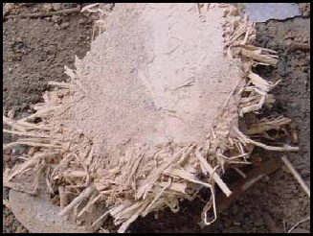
“ History of Soil Reinforcement’’

Slide 6
Modern Structures
The modern concept of the soil reinforcement and soil structure was proposed by Casagrande. The modern form of earth reinforcement was introduced by Vidal in the 1960s.

Slide 7
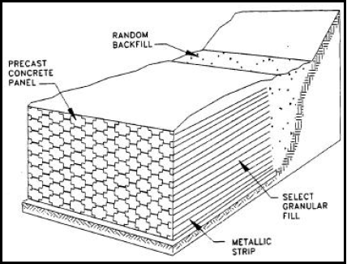
Vidal’s concept

Slide 8
“ Application of
Soil
Reinforcement “

Slide 9
There are many applications of soil reinforcement such as :
Bridge abutments.
Bridge abutments with piled bankseat.
Sloping bridge abutments.
Embankments.
Dams.

Slide 10
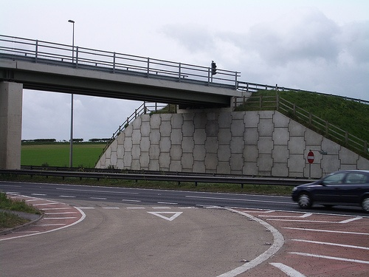
Bridge abutment

Slide 11
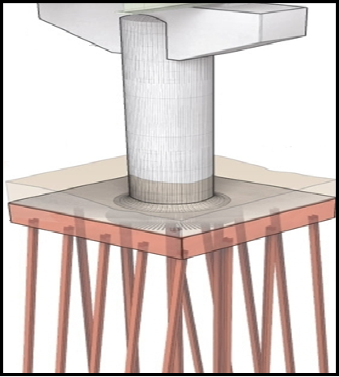
Bridge Abutment with Piled Bankseat

Slide 12
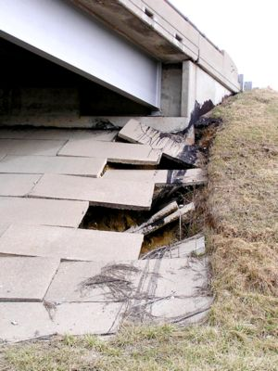
Sloping Bridge Abutment

Slide 13
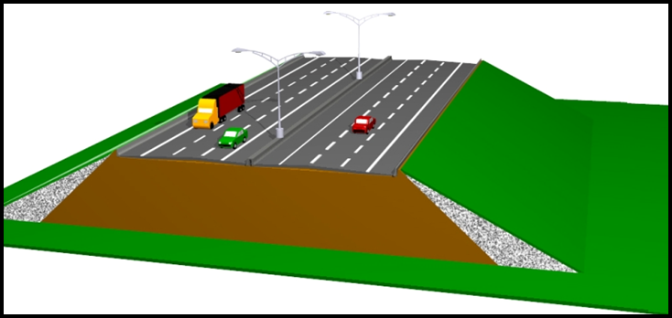
Embankment

Slide 14
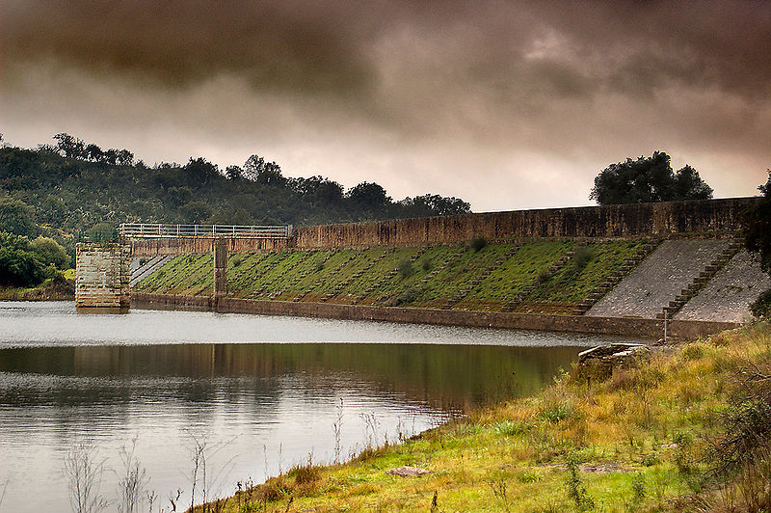
Dam

Slide 15
Advantages and
Disadvantages of
Soil Reinforcement

Slide 16
Advantages of Soil
Reinforcement
1. Allow in-situ strengthening on existing slope
surface.
2. Allow excellent working space in front of the
excavation face.
3. Avoid unnecessary temporary works.
4. Only requires light machinery and equipment.

Slide 17
Disadvantages of Soil Reinforcement
1. Less suitable for course grained soil and soft clayey soil.
2. Suitable only for excavation above groundwater.

Slide 18
Mechanically Stabilized Retaining Wall

Slide 19
General Definition
It is a new Geotechnical technology that uses reinforcement materials to reinforce the backfill of retaining walls.

Slide 20
Construction Components
Metallic Facing System.
reinforcement.
Facing Connection.
Backfill Materials.

Slide 21
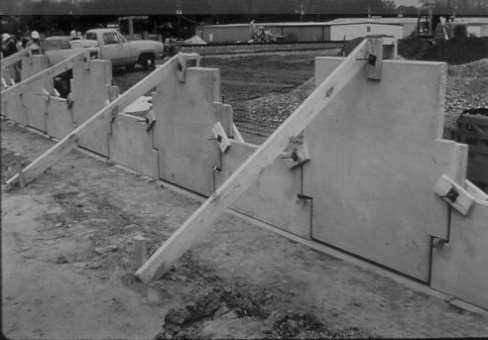
Facing System

Slide 22
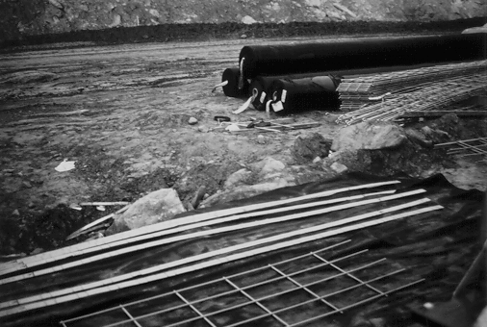
Metallic reinforcement

Slide 23
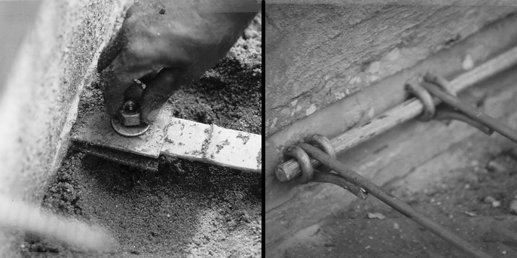
Facing Connection

Slide 24
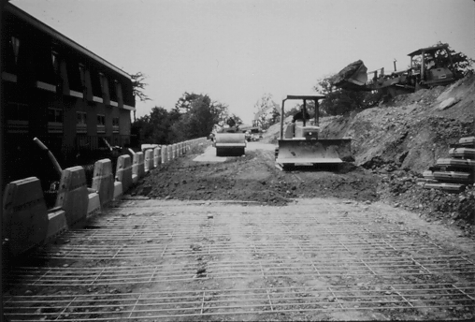
Backfill Materials

Slide 25
Design of
Mechanically Stabilized Retaining wall

Slide 26
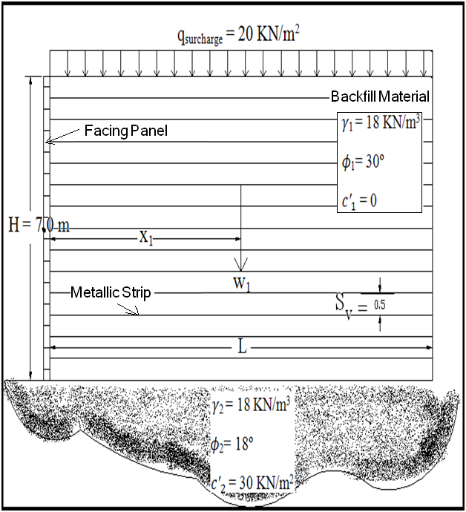
Dimensions and Soil Properties

Slide 27
Internal and External Stability
Internal Stability |  | External Stability
Horizontal Spacing | 1 m | FS (Siding) | 3.57
Vertical Spacing | 0.5 m | FS (Overturning) | 27.3
Maximum Tie Force | 24.33 KN | FS (Bearing Capacity) | 5.83
Thickness of Tie ( t ) | 6 mm
Length of Tie (L) | 13 m

Slide 28
Conventional
Retaining
Walls

Slide 29
Definition
Conventional retaining walls are classified as the earliest supporting systems used at excavation sites, soil slopes, highway beds and bridge abutments.

Slide 30
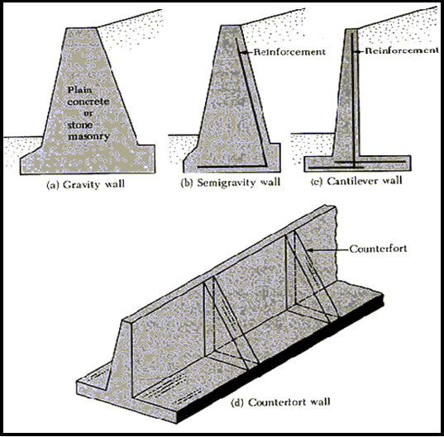
Types of Conventional Retaining Walls

Slide 31
Design of
Conventional Retaining Wall

Slide 32
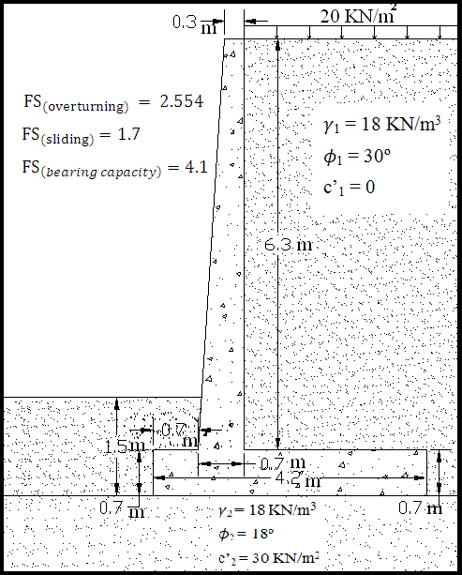
External Stability Check

Slide 33
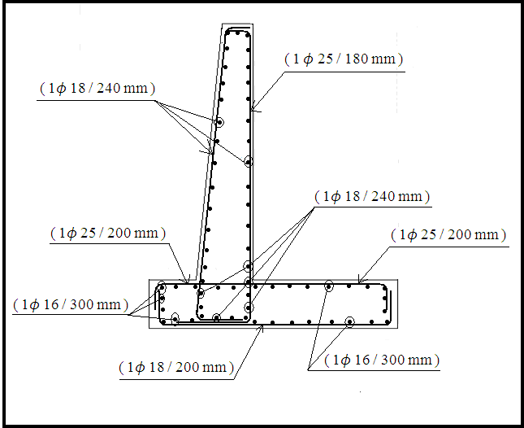
Internal Stability
(Steel Distribution)

Slide 34
Quantities and
Cost Comparison

Slide 35
 | Conventional Retaining Wall |  | Mechanically Stabilized Retaining Wall
 | Quantity | Cost | Quantity |  | Cost
Steel | 0.56 ton | 1792 NIS | 0.639 Ton |  | 2045 NIS
Concrete/Facing | Concrete | 1796 NIS | No. of Facing |  | 700 NIS
 | 6.1 Cm |  | 14
Backfill | 18.2 Cm | 145.6 NIS | Backfill material is used from the site
Total Cost |  | 3707 NIS |  | 2745 NIS

Slide 36
Thank You
For
Your Listening

