Slide 1
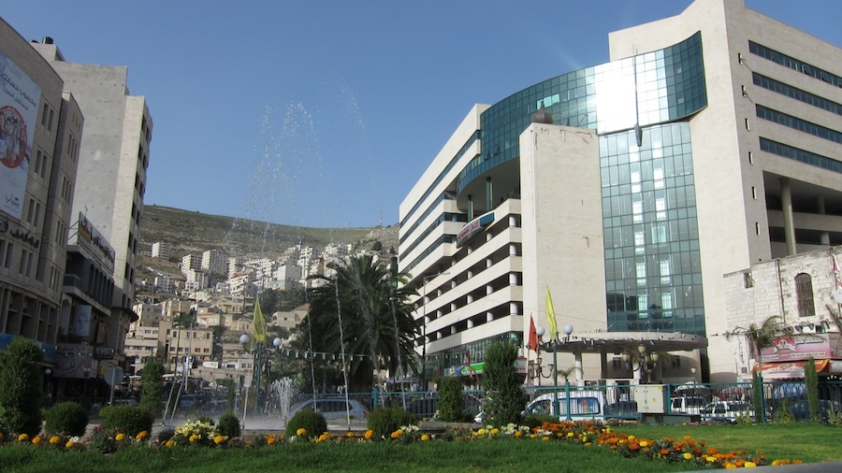

Slide 2


An-Najah National University
Mobile Wi-Max Network
In cooperation with Jawwal
Abed EL-Rahman Sholi
Mohammad Baddad
Supervisor:
Dr.saed Tarapiah
2014

Slide 3
Outline
Existence Problem.
Possible Solutions.
Wi-MAX.
Mobile Wi-Max System Architecture.
Components.
Subscriber Unit.
Planning Process.
Network Design.
Future Work.
Conclusion.

Slide 4
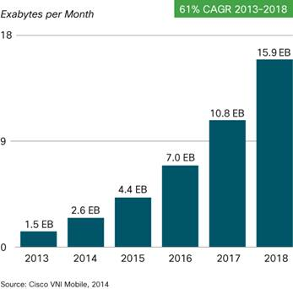
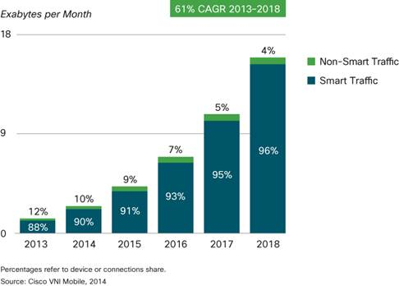
Existence Problem.
› Mobile data traffic growth
› Due to increased usage on Smartphone’s, Smartphone’s will reach 66 percent of mobile data traffic by 2018.
› In the recent years there has been a skyrocket rise in mobile data usage especially due to the large number of smartphones in use.

Slide 5
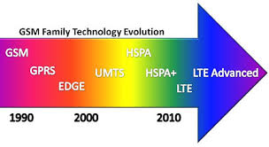


Possible Solutions
› To solve this problem; dramatic increasing in mobile data traffic; there are several solutions
› Upgrade the existence infrastructure.
› Offloading to Femto-cells
› Wi-Fi networks.
› Mobile Wi-Max.

Slide 6
Wi-MAX
IEEE 802.16d : wireless technology optimized for fixed and nomadic applications.
IEEE 802.16e : a mobile Wi-MAX standard targeted for portable, mobile application as well as fixed and nomadic applications in NLOS environments.
Feature | IEEE 802.16e | IEEE 802.16d
Used spectrum | 2.5 & 3.5 also 2.4 & 5.8 | 2.5 & 3.5 also 2.4 & 5.8
Radio Interface | OFDMA | OFDM
Duplex | TDD or FDD | TDD or FDD

Slide 7
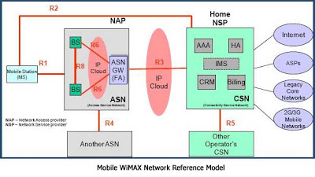
Mobile Wi-Max System Architecture
› ASN › The Network Access Provider: NAP
› CSN › The Network Service Provider: NSP
› MS

Slide 8
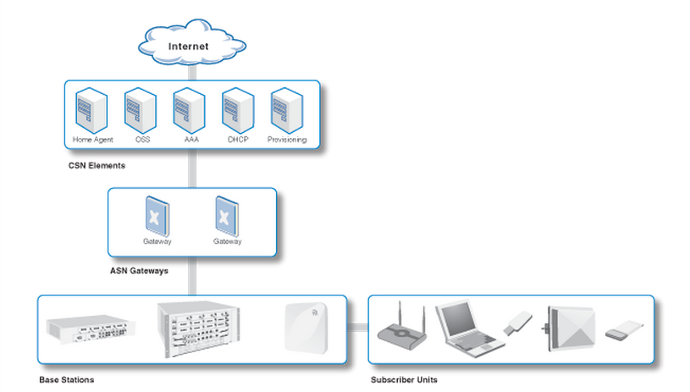
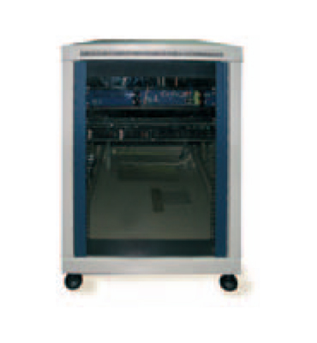
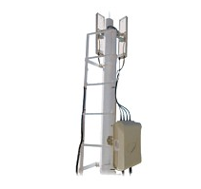
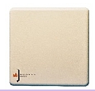
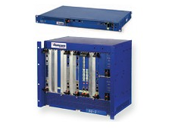
Components
Base Station: RNU4000
External Antenna: MT – 344092/NVH
ASN : RN-ASN-SG-X Runcom
CSN RN-NOC-XXX Runcom
CSN RN-NOC-XXX Runcom
External Antenna: MT – 344092/NVH
Base Station: RNU4000
ASN : RN-ASN-SG-X Runcom

Slide 9
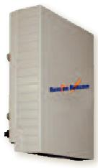
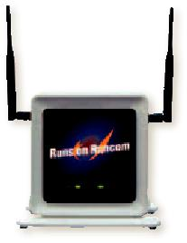
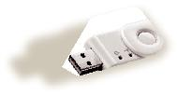
Subscriber Unit
RNU300ETH-MIMO Residential Indoor CPE
RNU303-USB USB Dongles nomadic or mobile
RNU300ODU Residential Outdoor CPE

Slide 10


Planning Process

Slide 11
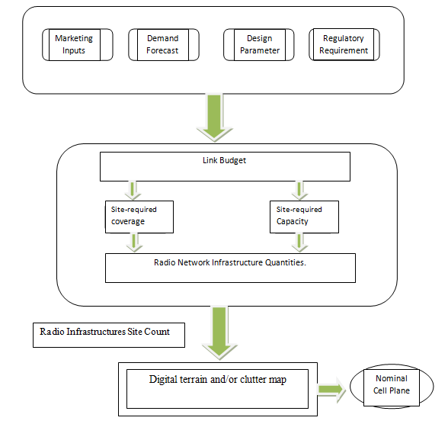
Planning Process

Slide 12
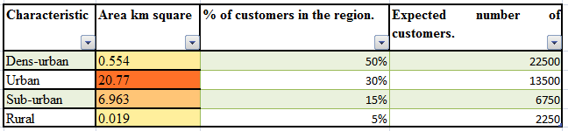
Geographical area

Slide 13
Spectrum Selection
Feature | Deployment options
Used spectrum | 2.5,GHz
Bandwidth | 10 MHz
Duplex | TDD
Sub channel/frequency reuse | 1/3, 1/4 , 1 (PUSC/FUSC)

Slide 14
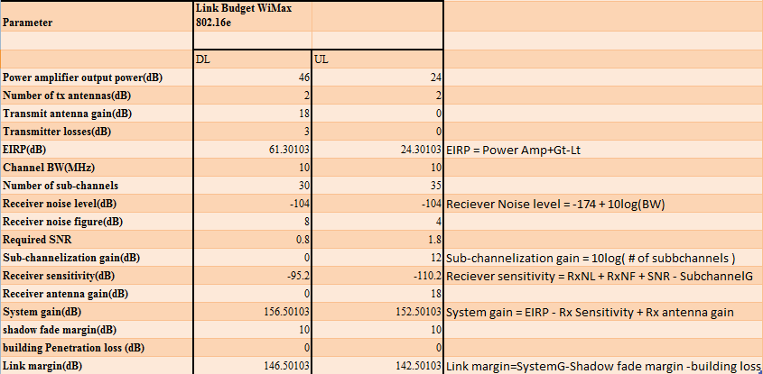
Link Budget

Slide 15
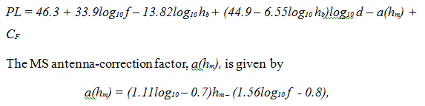
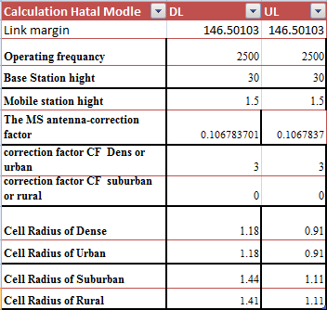
Cell Radius COST-231Hata Model

Slide 16
Coverage Deployment

Slide 17
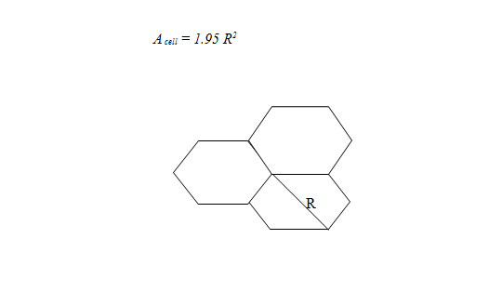
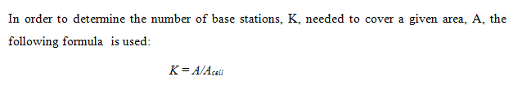
Coverage Deployment

Slide 18
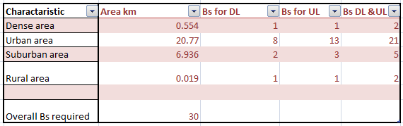
Coverage Deployment

Slide 19
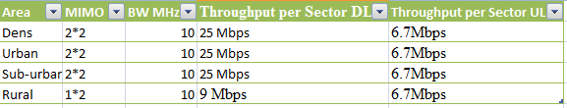
Antenna Configuration
Since mobile Wi-MAX uses shared resources, the data rate per sector is shared equally among all users currently served under the cell.
Due to the low probability that all customers are going to be served in a single base station, it is assumed that at least 10 customers can be served per sector.

Slide 20
Capacity Deployment

Slide 21
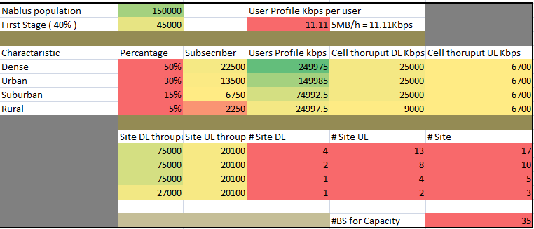
Capacity Deployment

Slide 22
Frequency Reuse Scheme

Slide 23
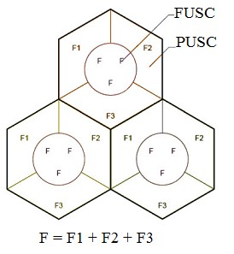
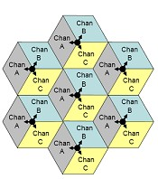
      Frequency Reuse Scheme:
Frequency reuse of 1 (universal frequency reuse), denoted as (1,1,3), where all the sectors in a base station use the same channel
Frequency reuse of 3, denoted as (1,3,3) whereby a channel is used only one of every three sectors in a base station.

Slide 24

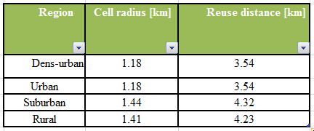
      Frequency reuse distance
Cellular network planning requires that cells using the same frequency be separated by the frequency reuse distance D in order to achieve tolerable signal to interference plus noise ratio .
Where R is the radius of the cell, and N is the number of cells per cluster

Slide 25
Network Design

Slide 26
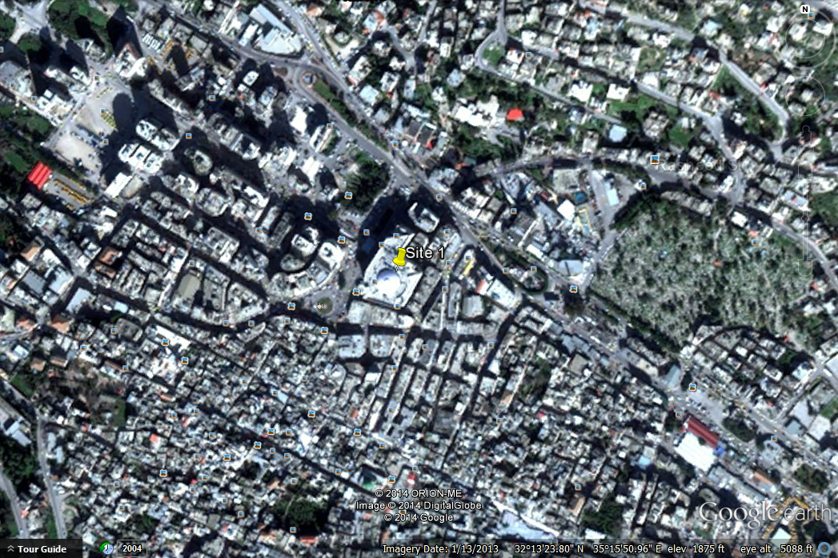
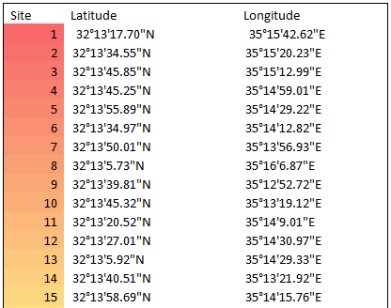
      Network Design

Slide 27
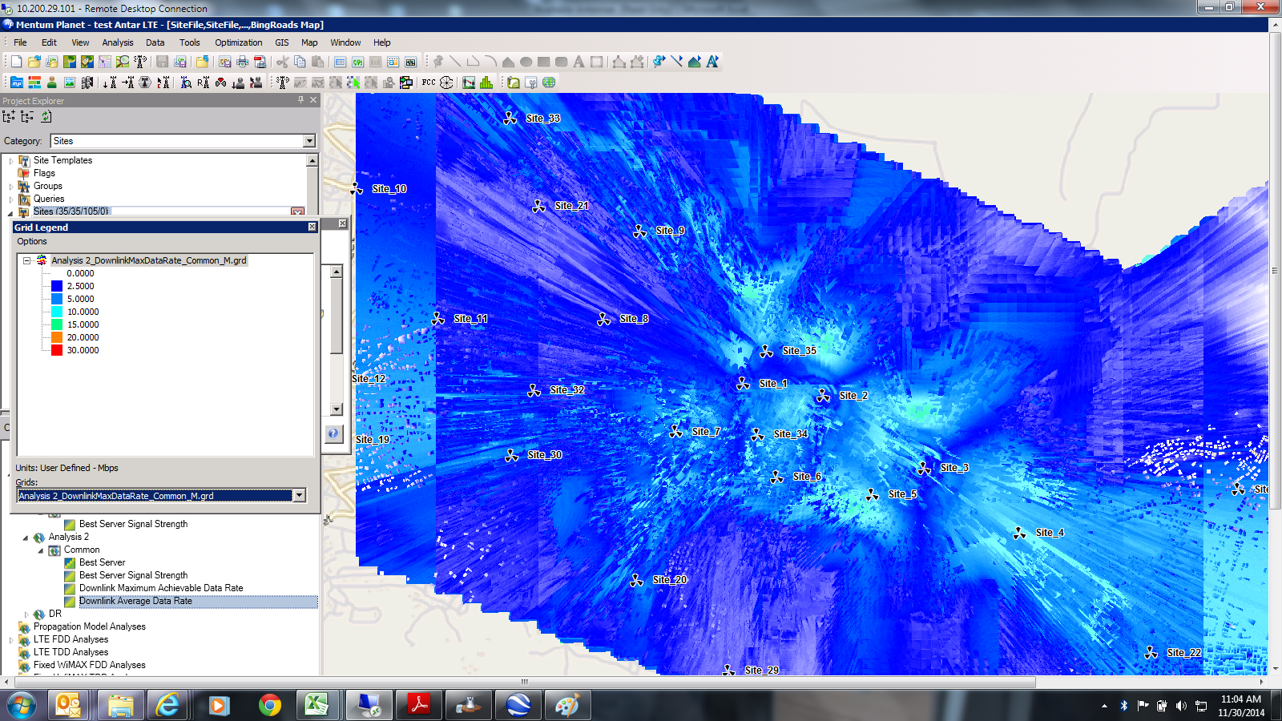

Slide 28
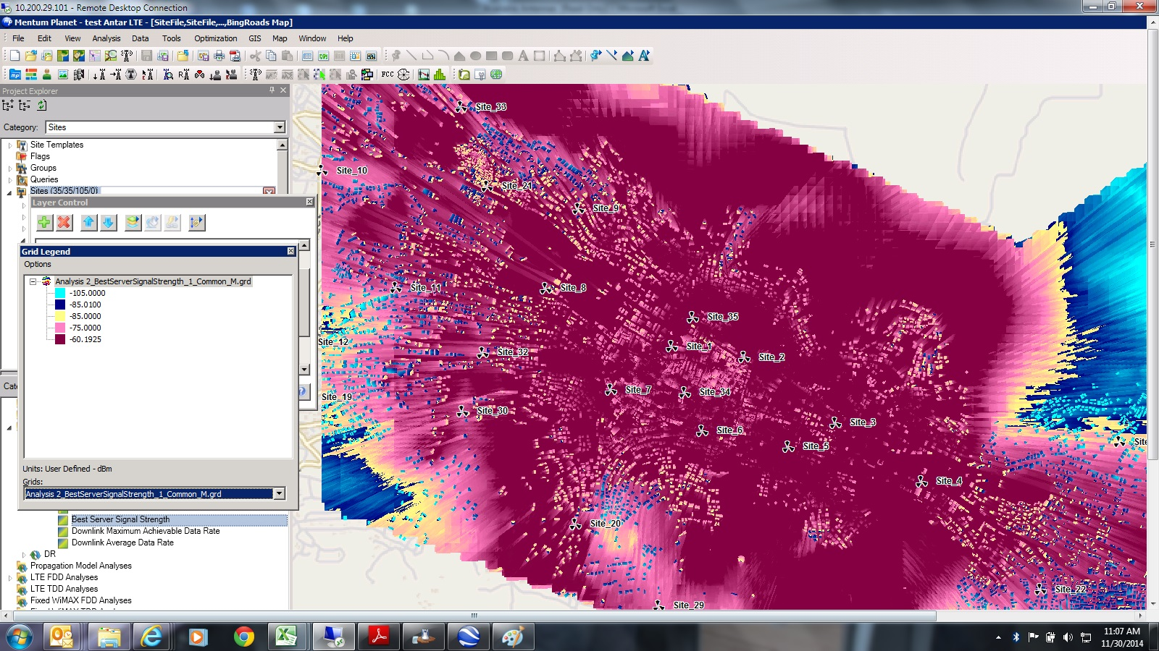

Slide 29
Visibility Study

Slide 30
Where Can be Used

Slide 31
Future Work

Slide 32
      Future Work
Backhaul Connectivity Solutions and dimensioning the transport network, which means how many ASN and CSN, needed depending upon the user experience.
IP planning so as to determine how to set up correct IP addresses to all the elements in the core service network. This will enable end-to-end IP connectivity for the user sessions.

Slide 33
Conclusion

Slide 34
Thank You
Any Questions ?

