Slide 1
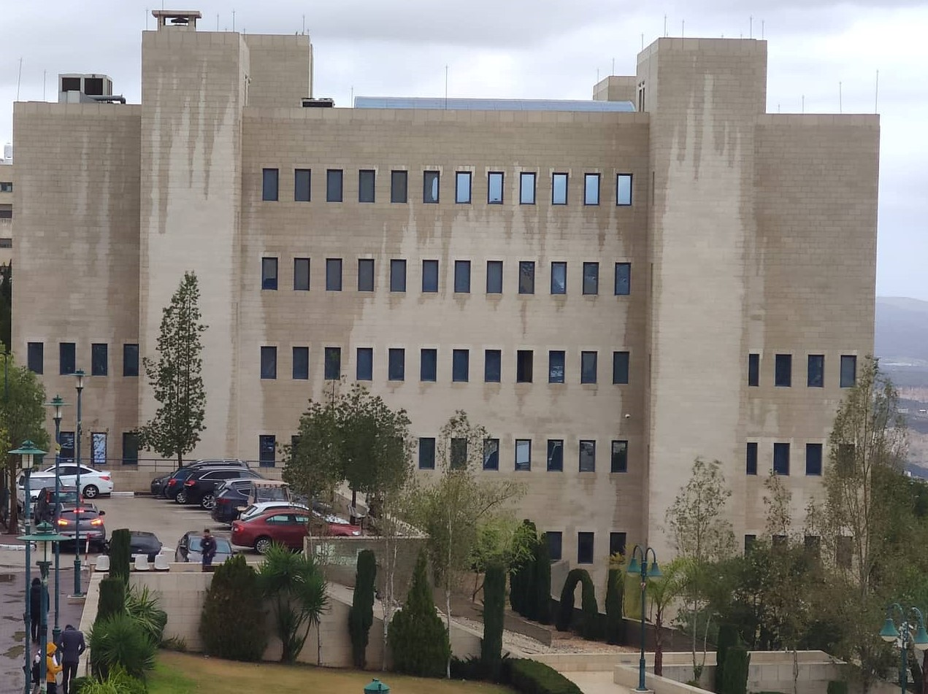
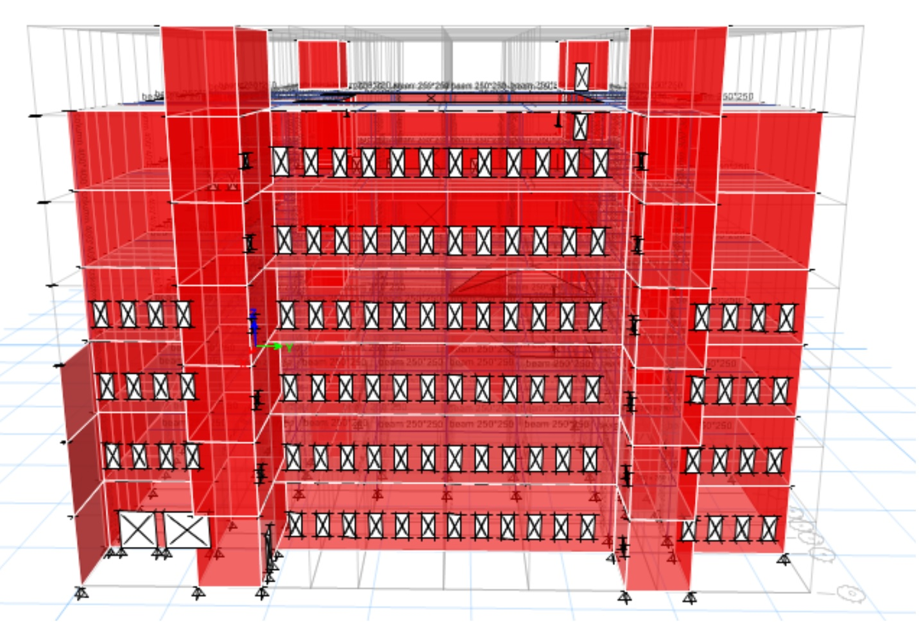
Analysis and Design of Optical and Nursing College

Slide 2

Contents
Introduction
Seismic
Analysis and Checks
Literature
Review
Design
Literature
Seismic
Checks
Methodology
Introduction
Methodology
Design
Analysis
Checks

Slide 3
2
3
1
Design
Checks
Study
Project
Soil
Investigation
Seismic
Literatur
Methodology
Introduction
Area
Location

Slide 4
Design
Drawings
Literature
Seismic
Checks
Methodology
Introduction

Slide 5
01
Analysis and design method
02
Materials
03
Load types and calculations
Design
Literature
Seismic
Checks
Methodology
Introduction
04
Load combinations
05
Codes and standards

Slide 6
01
Compatibility Check
01
02
Equilibrium Check
03
Stress-strain Check
Design
Seismic
Literature
Checks
Modeling
Introduction
04
Deflection Check

Slide 7

Drift
Check
Period check
Structural
System
Design
General
Seismic analysis
Seismic
Literature
Checks
Methodology
Introduction
P-Delta
Check
Base shear
Check
MMPR

Slide 8


Shear strength check for slab
Design check for beam
Design check for column
Design
Preliminary
Design
Checks
Modeling
Introduction
Design for shear wall
Design of the slab

Slide 9

INTRODUCTION
Study area:

Slide 10
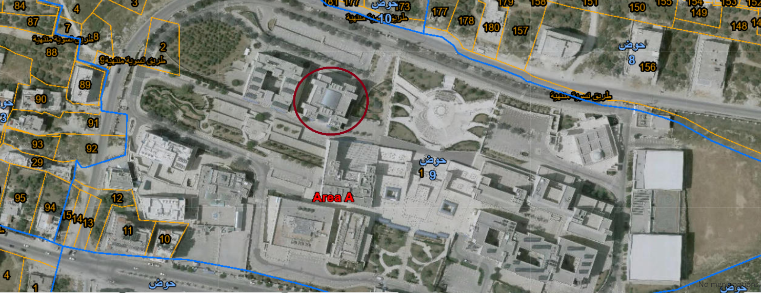
INTRODUCTION
Project location:

Slide 11
INTRODUCTION
Soil investigation:
Soil classification is “C”.
Unit weight of the soil = 20 kN/m3.

Slide 12
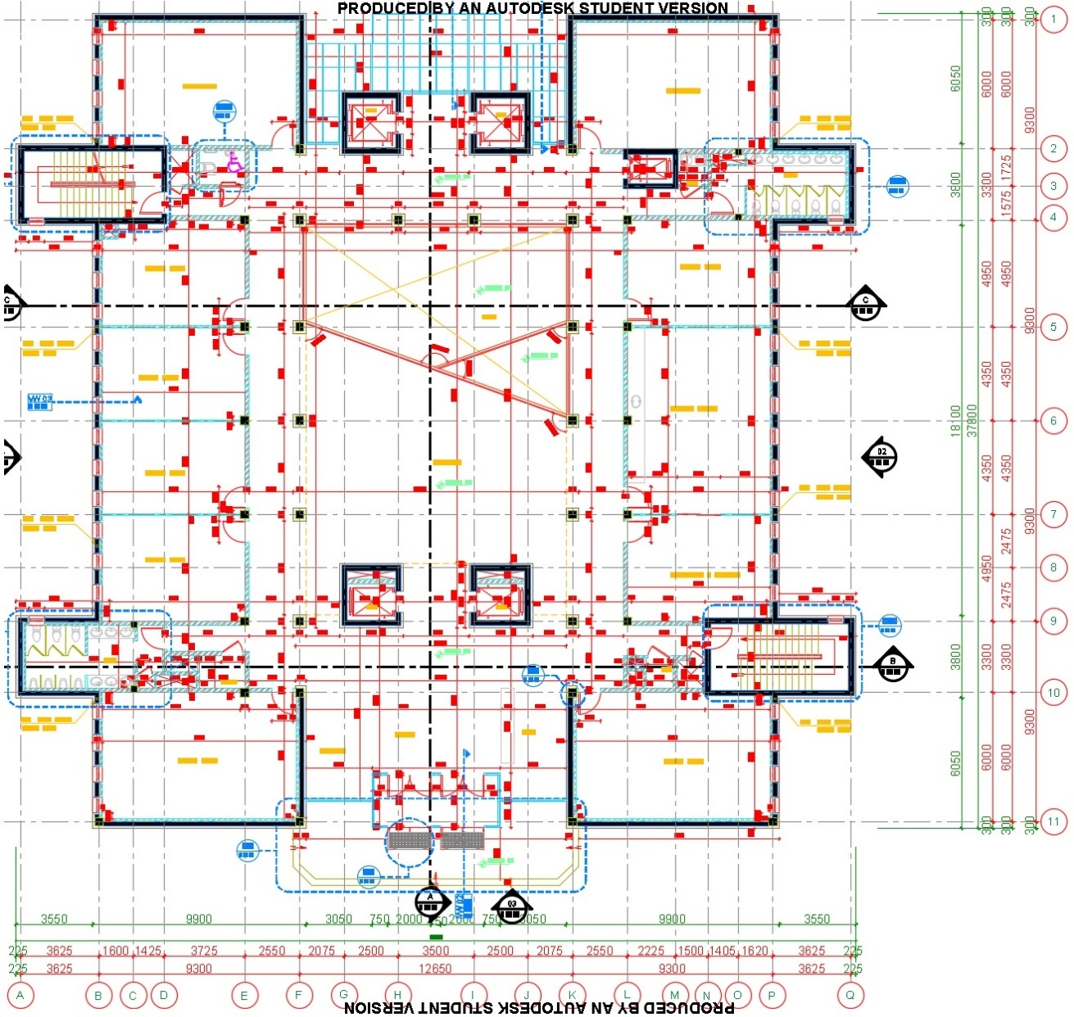
Literature review

Slide 13
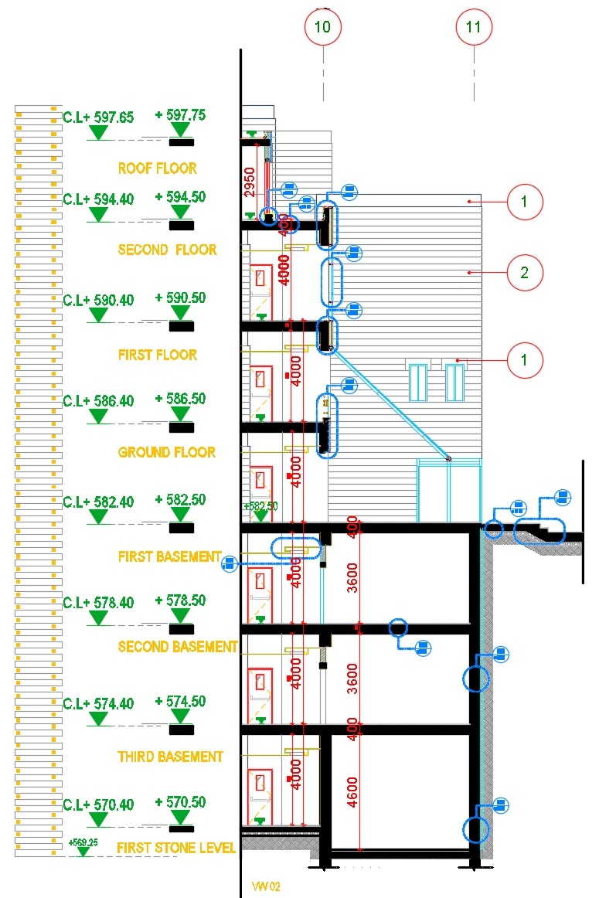

Slide 14
Methodology
Analysis and design method:
-Finite element.
-ETABS2016.
-Elements have been modeled as one and two dimensions.

Slide 15
Materials
Structural:
-Reinforced concrete:
-Steel reinforcement:
property | Value
Cylindrical Compressive strength fc (MPa) | 28
Modulus of elasticity .EC (GPa) | 25
Unit weight (kN/m³) | 25
Property | Value
Yielding strength, fy (MPa) | 420
Modulus of elasticity, Es (GPa) | 200

Slide 16
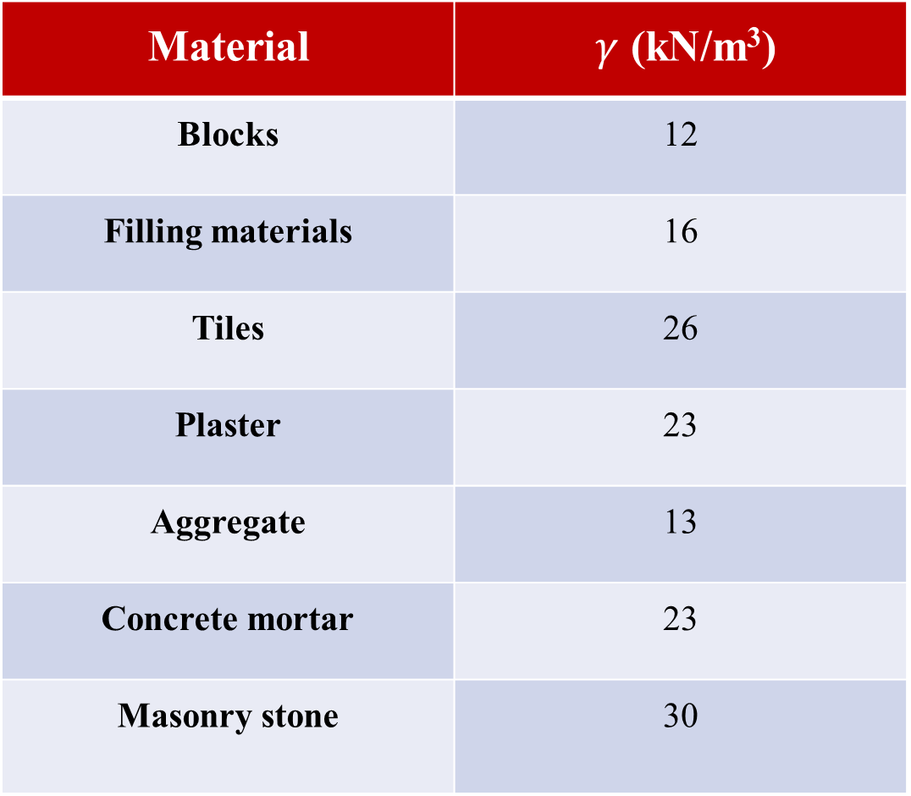
Non-Structural materials:
Material | $γ$ (kN/m³)
Blocks | 12
Filling materials | 16
Tiles | 26
Plaster | 23
Aggregate | 13
Concrete mortar | 23
Masonry stone | 30

Slide 17
Loads types and calculations:
Dead load.
Super imposed dead load:
W_{SD} = W_{Tile} + W_{Morter} +W_{Gravel} = 0.03 × 26 + 0.02 × 23 + 0.1 × 16 = 2.84 kN/m².
Take W_{SD} = 3 kN/m².
From partitions → WSD =1.66kN/m2
Total SD = 5 kN/m2

Slide 18
Super imposed dead load:
For auditoriums :
Super dead = W_{Morter} +W_{Gravel} + W_{Blocks}
SD= 0.05 x 23 + 0.2 X 16 + 1.66 = 6 KN / m²
Cladding super dead load on shear wall = 0.02x30+0.05x23=1.75 →use 2kN/m².
Live load: ASCE-10 :

Slide 19
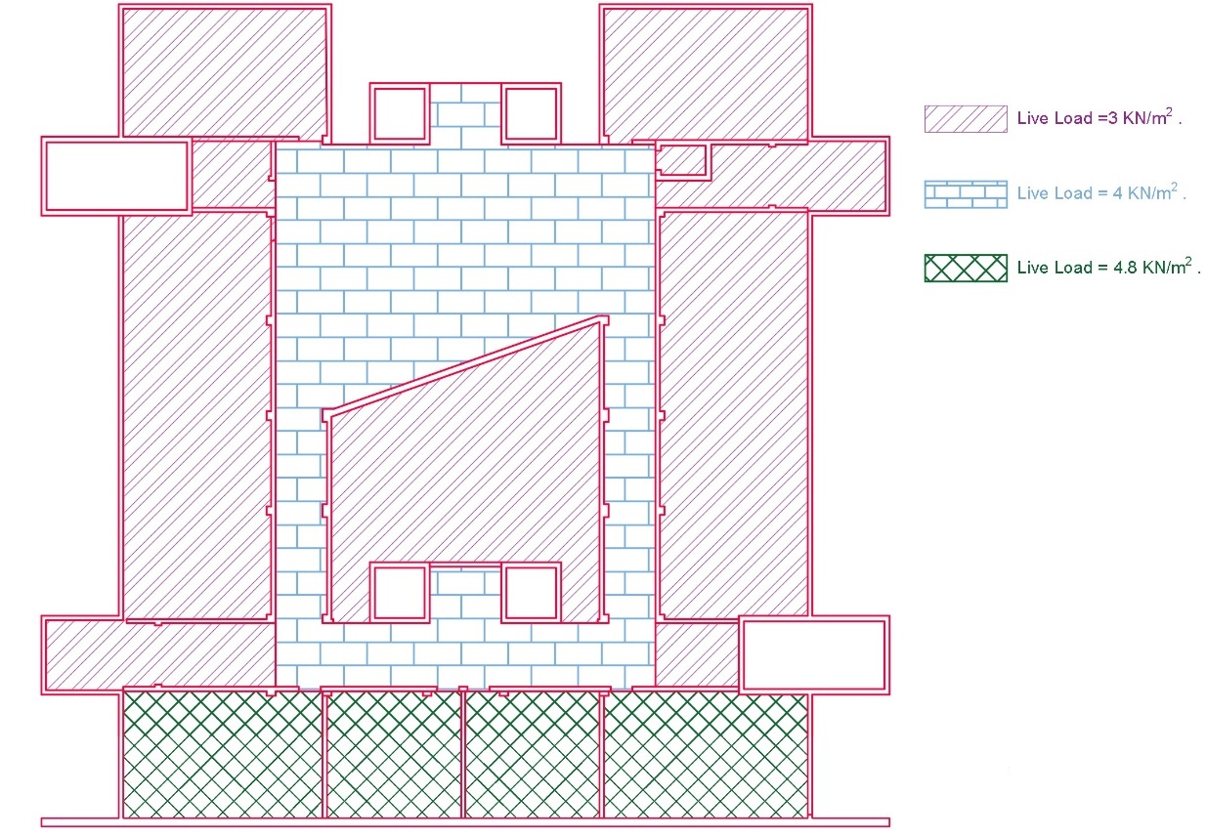
Second basement:

Slide 20
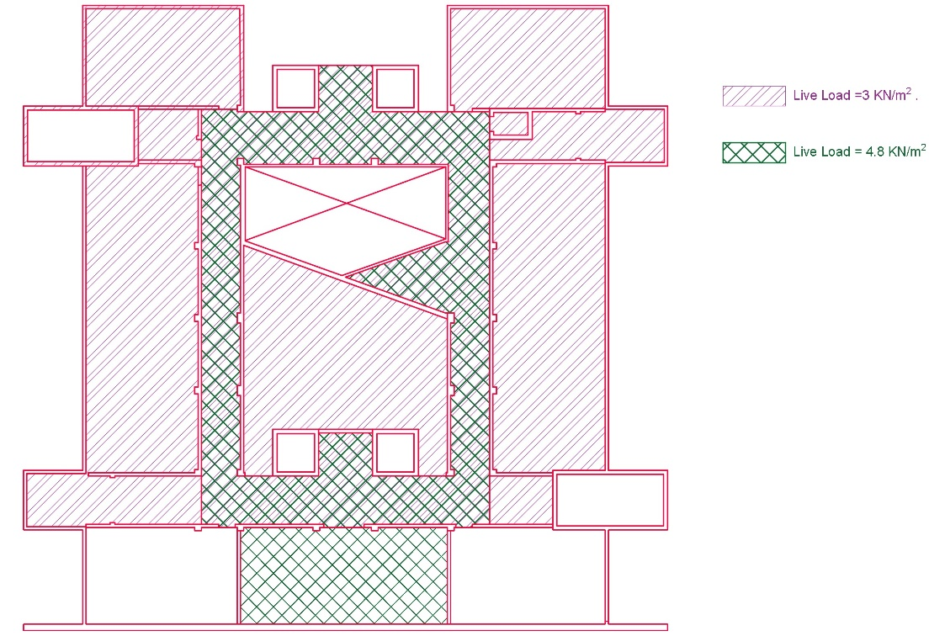
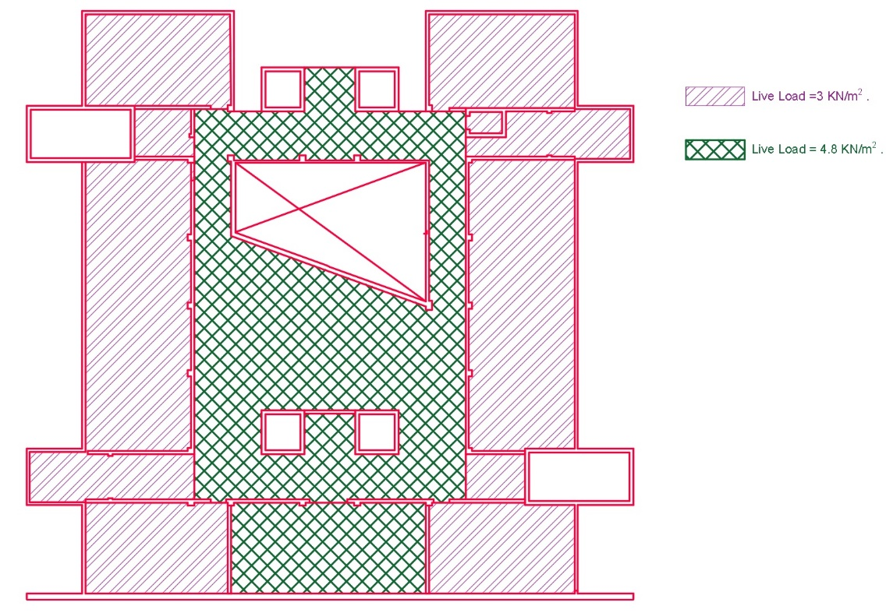
First basement Ground floor

Slide 21
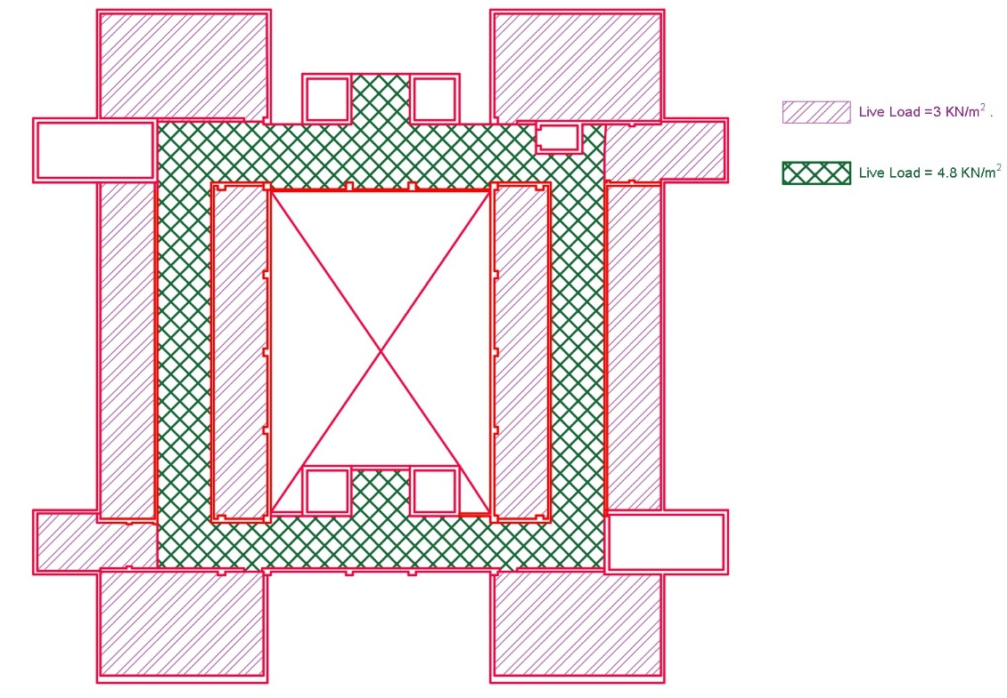
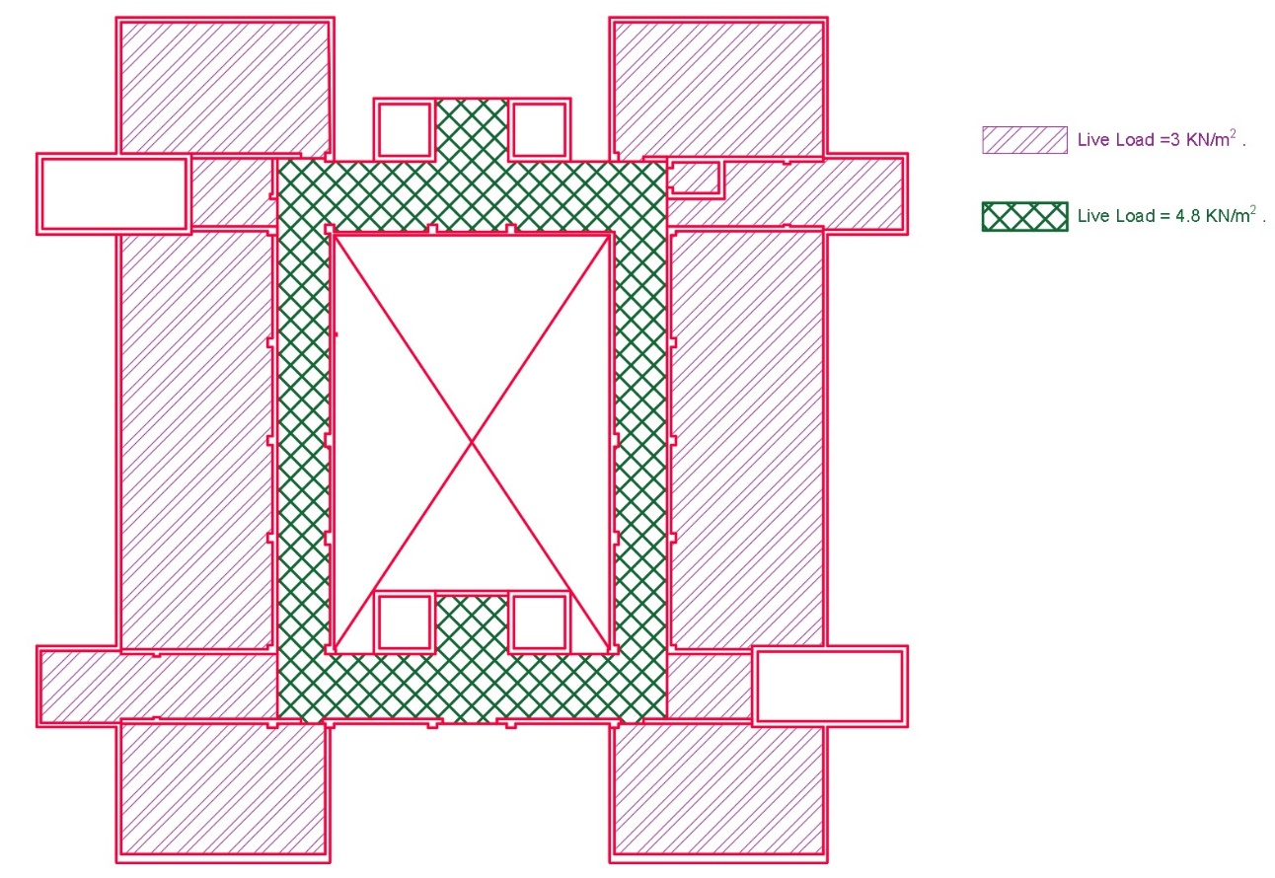
First floor second floor

Slide 22
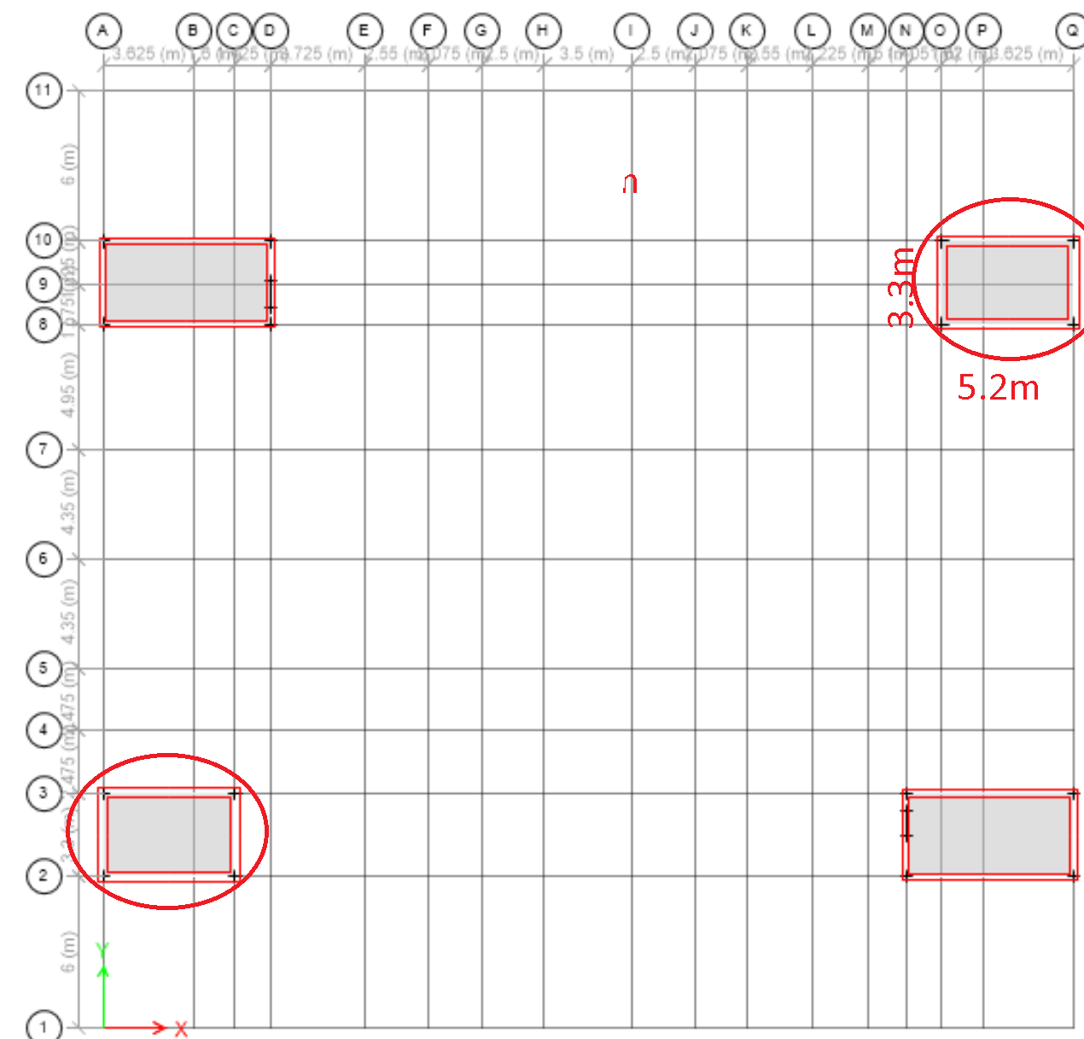

Fluid load: $γ$ = 9.81(kN/m³)

Slide 23
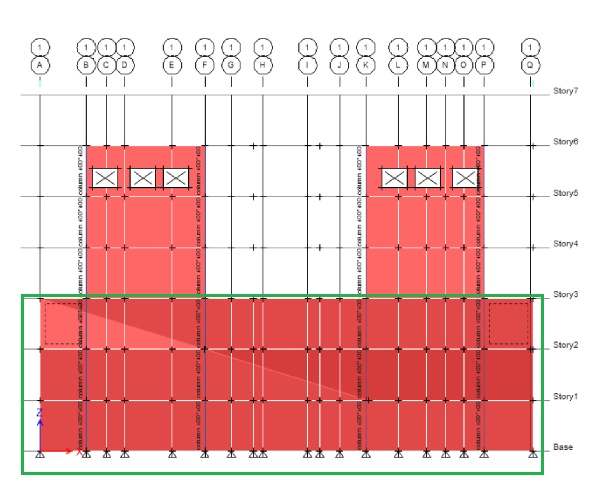

Soil load: surcharge load = 2kN/m2
$γ$ = 20(kN/m³)

Slide 24
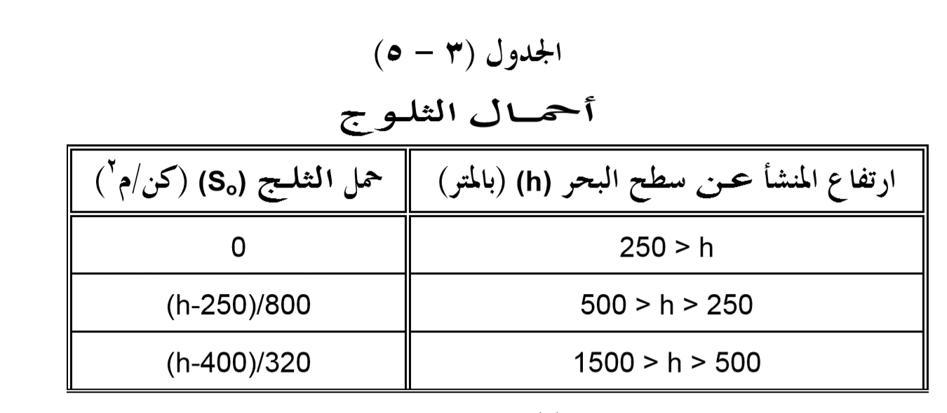
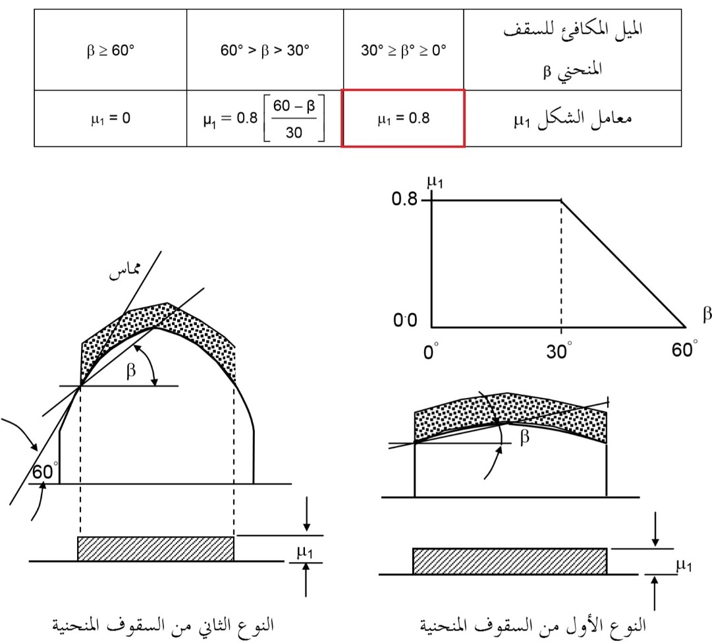
Snow load:
S_{o} = (600-400)/320 =0.625
Sd = 0.8 * 0.625 = 0.5 kN/m².
0.5 < 1 → Take 1 kN/m2.

Slide 25
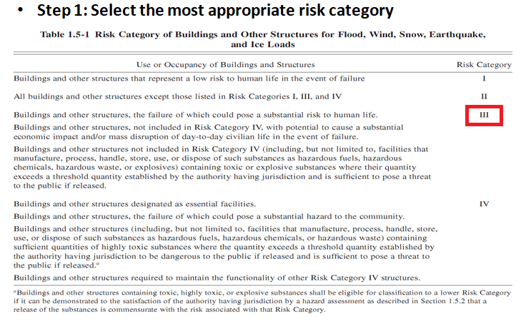
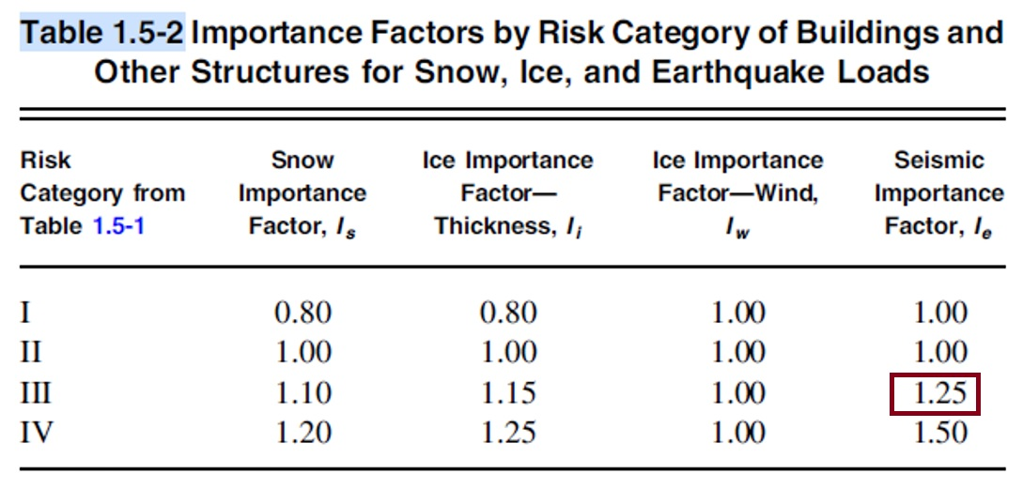
Lateral load:
1-
2-

Slide 26
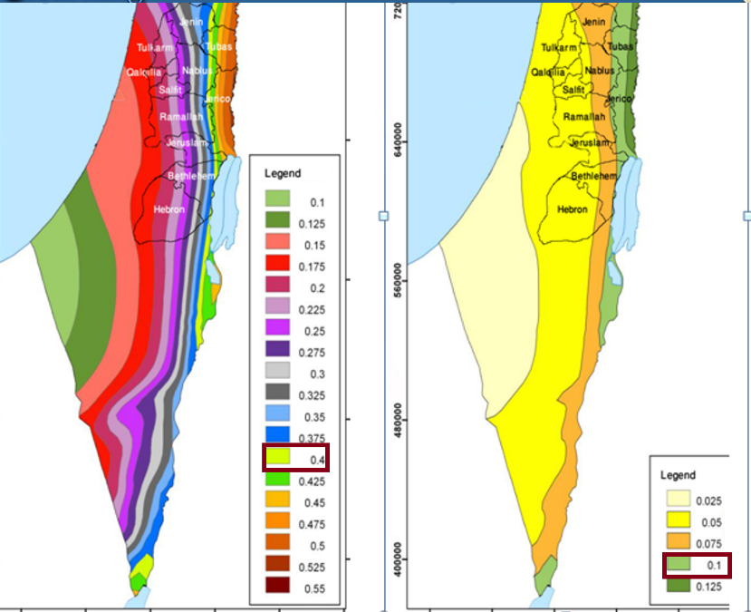
3-
S_{s} = Mapped 5% damped, spectral response acceleration parameter at 0.2 sec.
S_{s} = 0.4.
S₁ = Mapped 5% damped spectral response acceleration parameter at a period of 1 sec.
S1 = 0.1

Slide 27
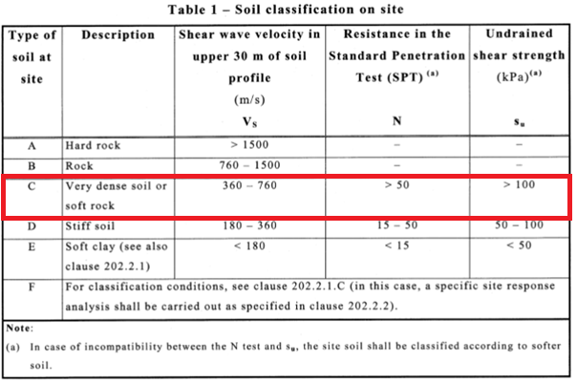
4-
5- Determine site coefficients.
Fa = short-period site coefficient (at 0.2 s-period).
Fv = long-period site coefficient (at 1.0 s-period).

Slide 28
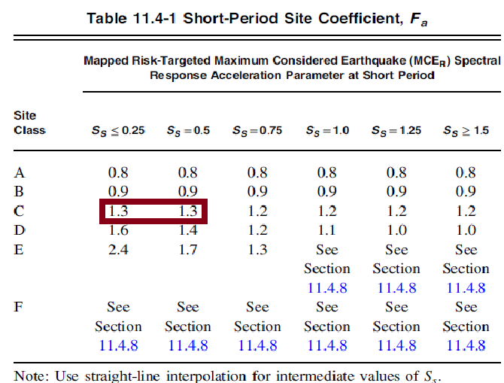
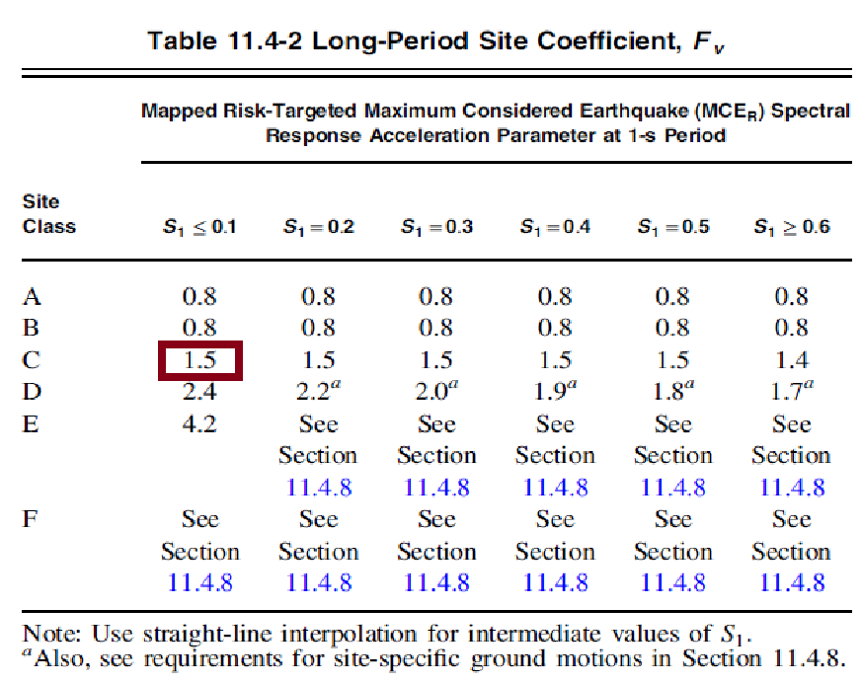
Fa Fv

Slide 29
Spectral Response Acceleration Parameters S_{MS} and S_{M1}
S_{MS}=F_{a} * S_{s} = 1.2 * 0.75 = 0.9
S_{M1}= F_{v} * S₁ = 1.5 * 0.375 = 0.563
spectral acceleration S_{DS}&S_{D1}:
S_{DS} =2 S_{MS} /3
=2*0.9 /3 = 0.6
S_{D1} = 2S_{M1} /3
=2*0.563/3 = 0.375

Slide 30
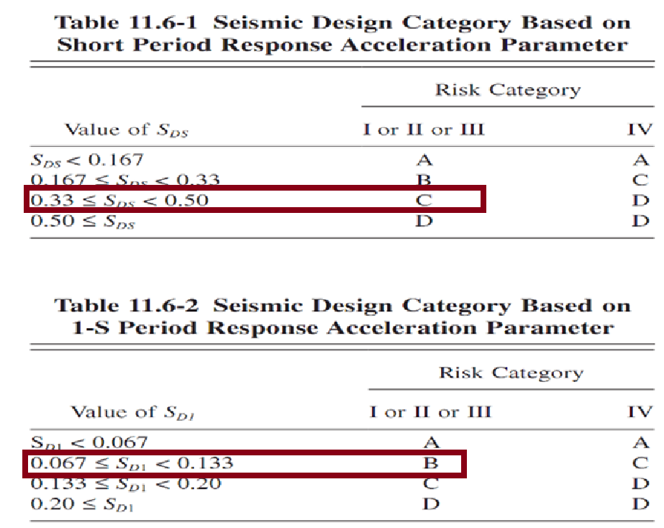
Seismic design category:

Slide 31
Load combinations:
The following load combinations are used according to ASCE_7-10 code:
-Gravity:
1.4 D
1.2 D + 1.6 L
1.2 D + 1.6 L + 0.5 S
1.2 D + 1.6 S + L
1..2 D + 1.6 L + 1.2 F
1.2 D + 1.6 L + 1.6 H

Slide 32
Load combinations:
-Lateral:
0.78 D + 0.78 SD + 0.78 F + 1.3 Ex
0.78 D + 0.78 SD + 0.78 F + 1.3 Ey
0.78 D + 0.78 SD + 0.78 F - 1.3 Ex
0.78 D + 0.78 SD + 0.78 F - 1.3 Ey
1.32 D + 1.32 SD + 1.32 F + L + S + L + 1.3 Ex
1.32 D + 1.32 SD + 1.32 F + L + S + L + 1.3 Ey
1.32 D + 1.32 SD + 1.32 F + L + S + L - 1.3 Ex
1.32 D + 1.32 SD + 1.32 F + L + S + L - 1.3 y

Slide 33
Codes and standards:
For Live load values → American Society of Civil Engineer (ASCE 7-10)
For materials → American Society for Testing and Materials (ASTM)
For design → American Concrete Institute (ACI 318-14)
For Lateral loads → International Building Code (IBC2012)
For Lateral loads → Uniform Building Code (UBC97)

Slide 34
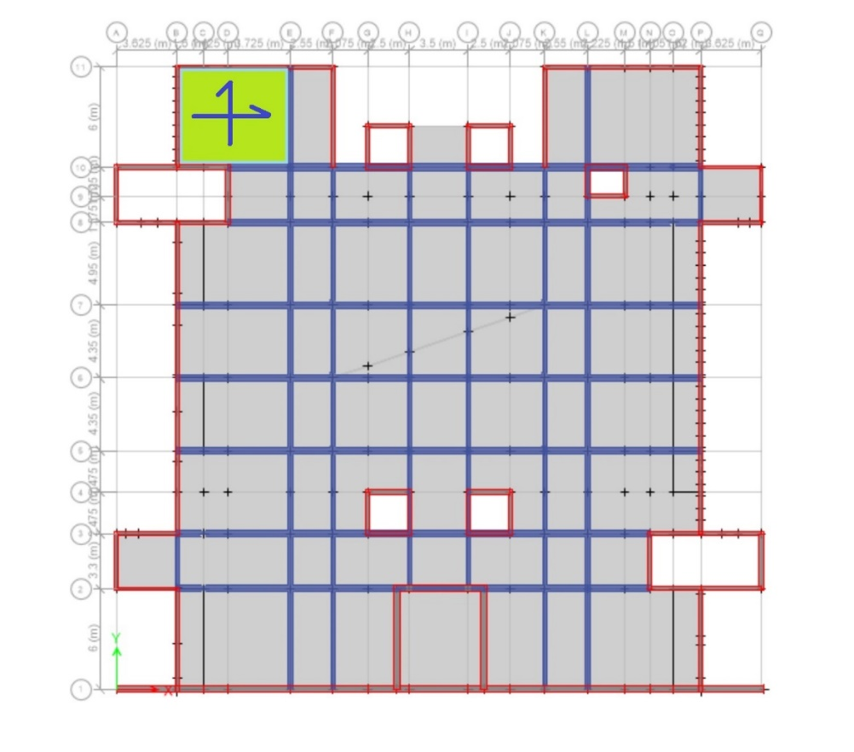

PRELIMINARY DESIGN
Slab thickness:
Thickness = $\frac{L}{36}$ = $\frac{6.75}{36}$ = 0.1875 m
Take thickness = 220 mm for all slabs.

Slide 35
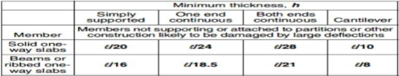
Beam thickness:
ACI code
Group name | Dimensions (mm)
Group1 (G1) | 250 x 250
Group2 (G2) | 400 x 400

Slide 36
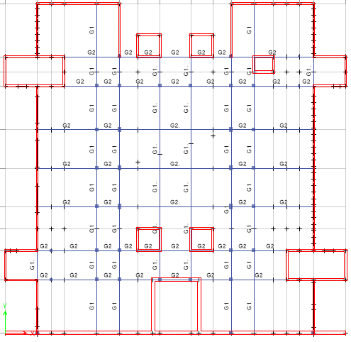

Slide 37
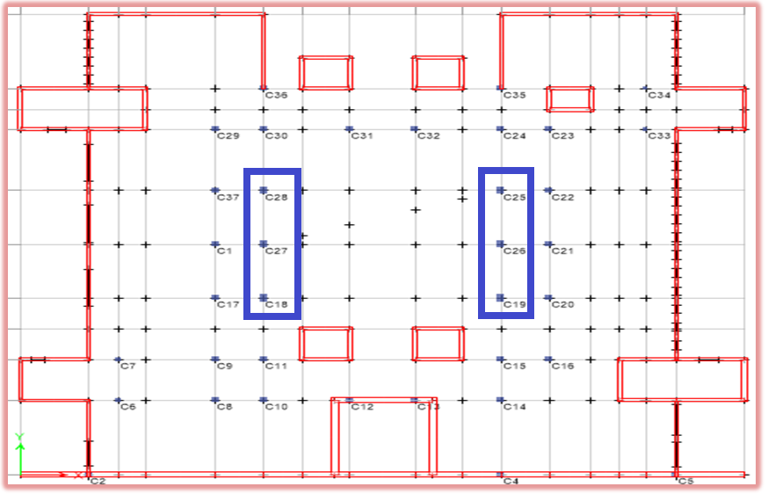
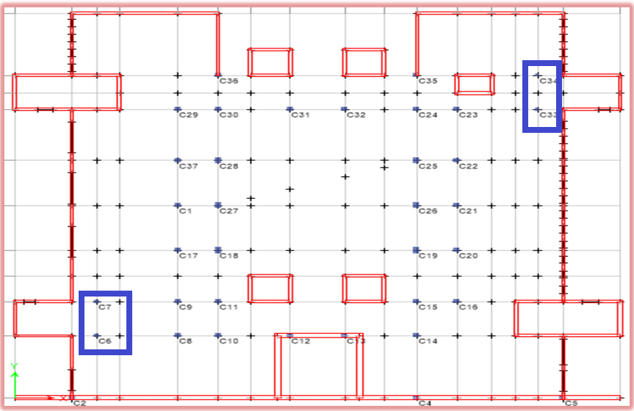
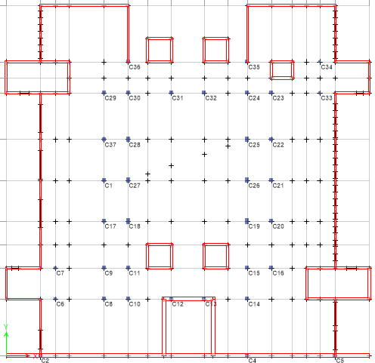
Column dimensions

Slide 38
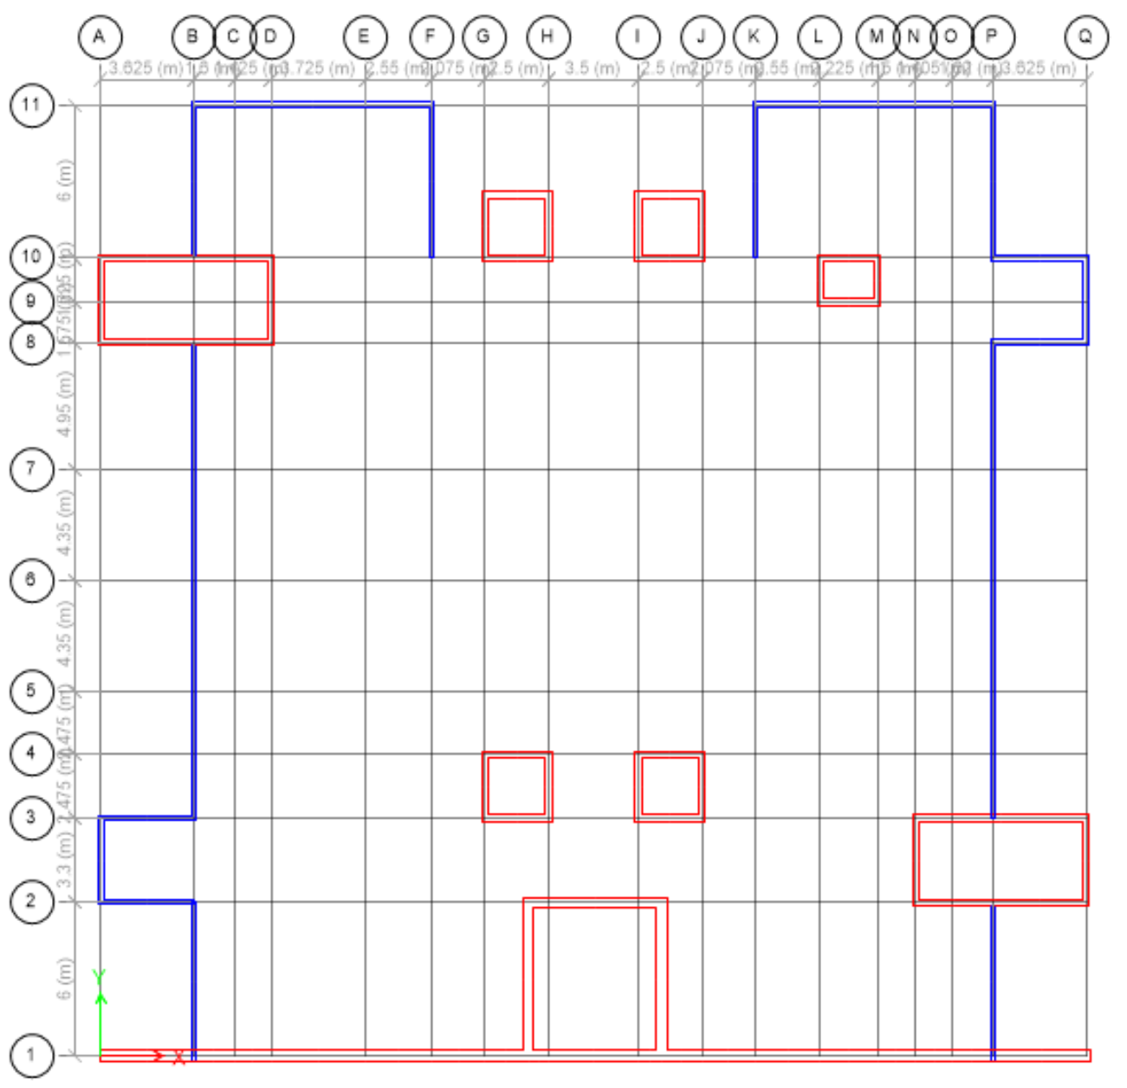
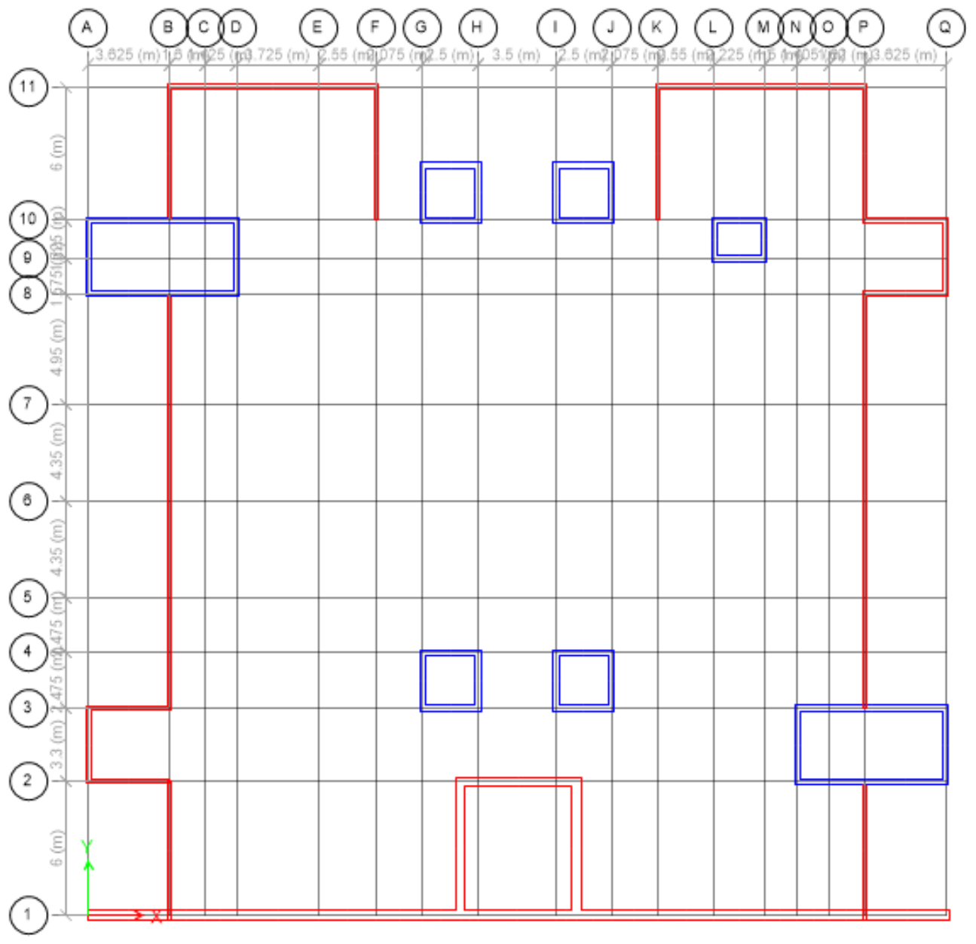
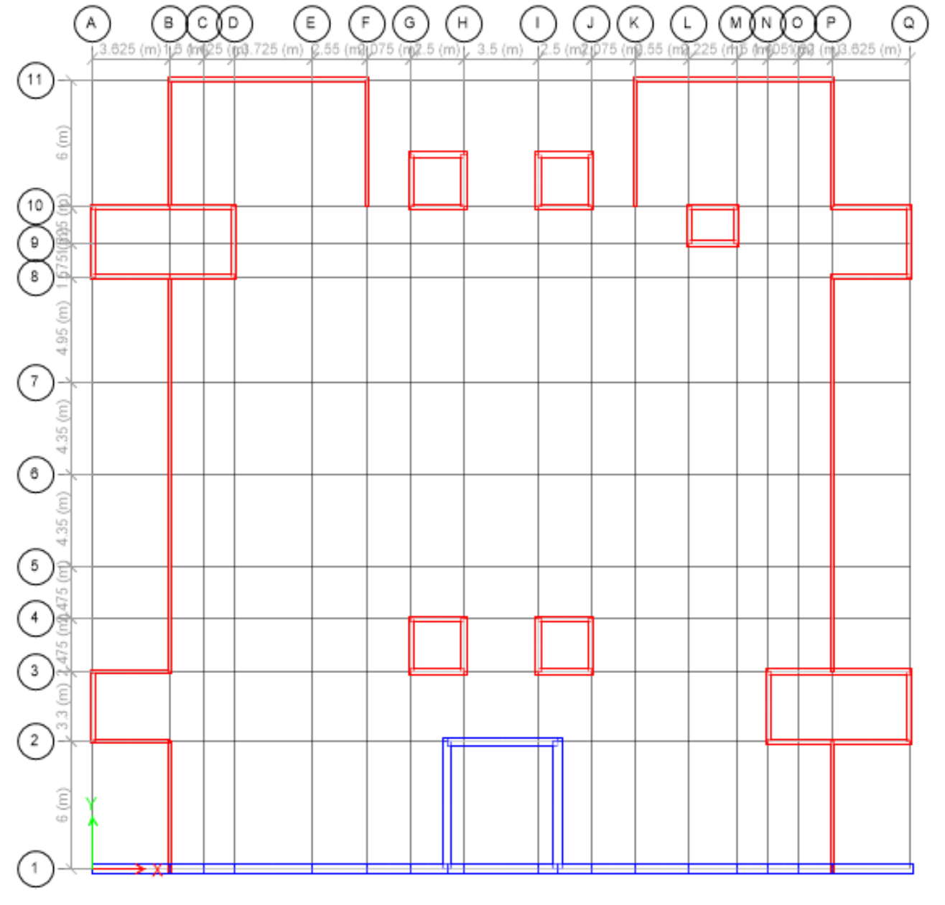
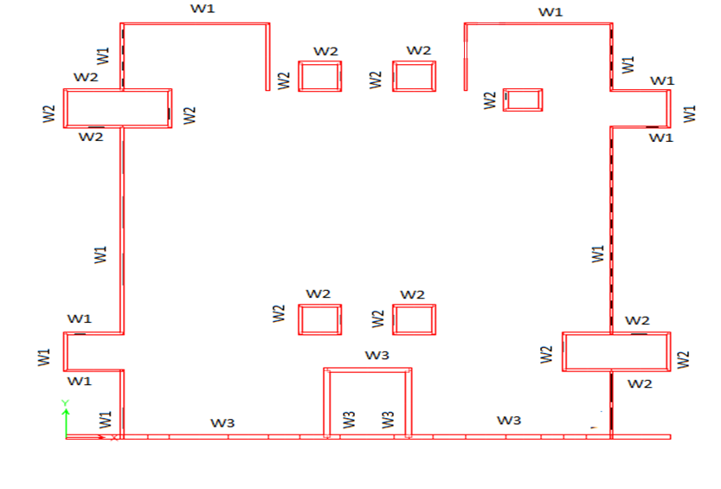
Shear walls dimensions

Slide 39
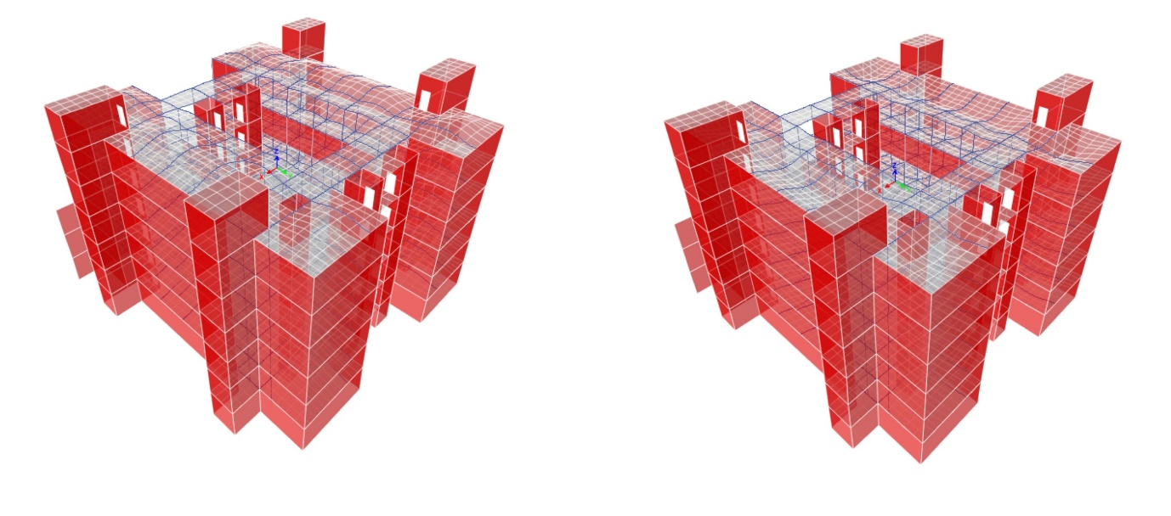
ANALYSIS CHECKS
1-Compatibility check:

Slide 40
2-Equilibrium check:
Load type | Hand calculations (kN) | ETABS value (kN) | %Error
DEAD | 72035.61 | 71001.32 | 2%
Super imposed dead | 38703.76 | 38592.8 | 0.2%
Live (3) | 1277.66 | 1277.86 | 0%
Fluid | 1353 | 1355.78 | 0.2%
Soil | 56620.2 | 56620.2 | 0%
Snow | 382.4 | 379.15 | 0.8%

Slide 41
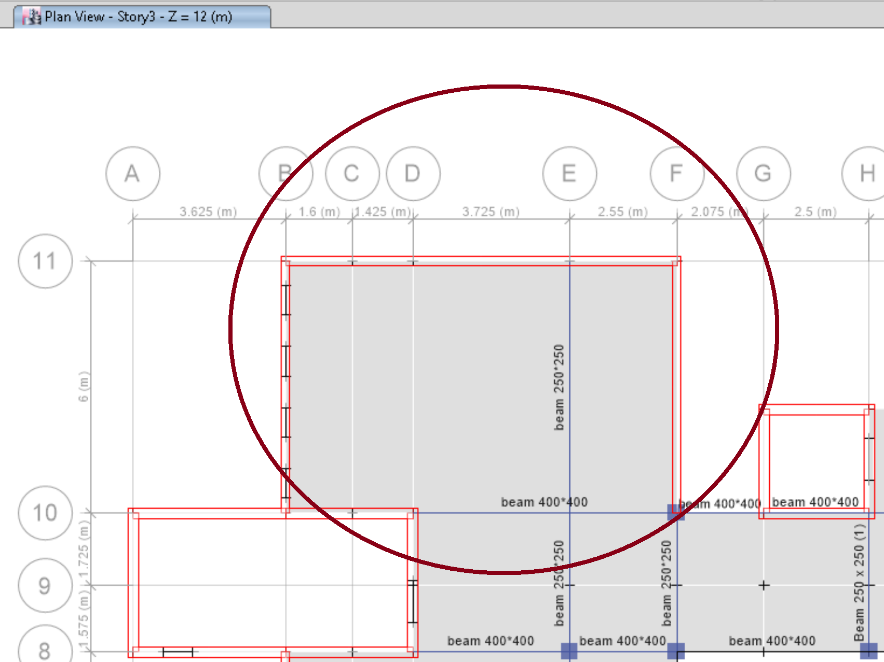

Stress-strain check
From live load =3
→M₀=$\frac{W{Ln}^{2}}{8}$ = $\frac{3∗{5.8}^{2}}{8}$ = 12.6 KN.m/m
M(ETABS)= M_{Possitive}+(M_{top}+M_{bottom})/2
=4.3+(7.9+7.9)/2 = 12.2 kN.m/m
%Error =3.1%<5% → OK

Slide 42
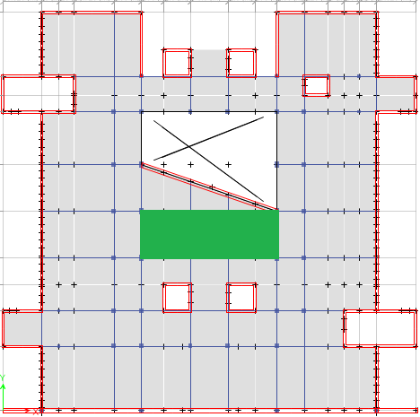
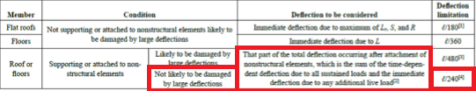
Deflection check

Slide 43

For long term deflection
→allowable deflection =L/240 = (12.65/240) *1000= 52.7mm.
 |  |  | Deflection(mm)
Load case | Middle | First corner | Second corner | Third corner | Fourth corner | Avg. of corners | Relative
Live | 7.79 | 0.23 | 0.26 | 0.24 | 0.25 | 0.245 | 7.545
Dead | 10.24 | 1.22 | 1.06 | 0.8 | 1.1 | 1.045 | 9.195
Super dead | 7.87 | 0.64 | 0.67 | 0.56 | 0.58 | 0.612 | 7.257
Long term deflection = 2*($∆D+∆SD)$+1.5($∆L)$
=2*(9.195+7.257) +1.5*(7.545) = 44.2 mm <52.7mm → OK

Slide 44
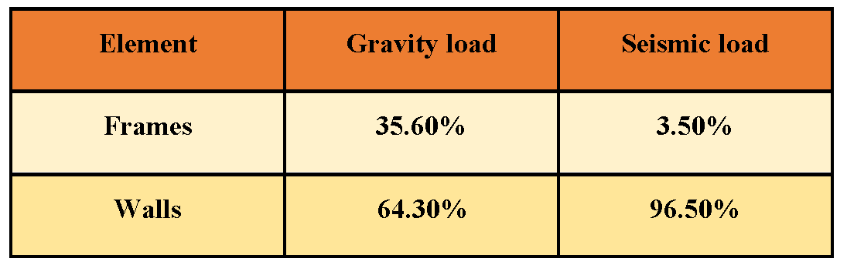
Seismic analysis and checks
Type of structural system:
The system is bearing walls.

Slide 45
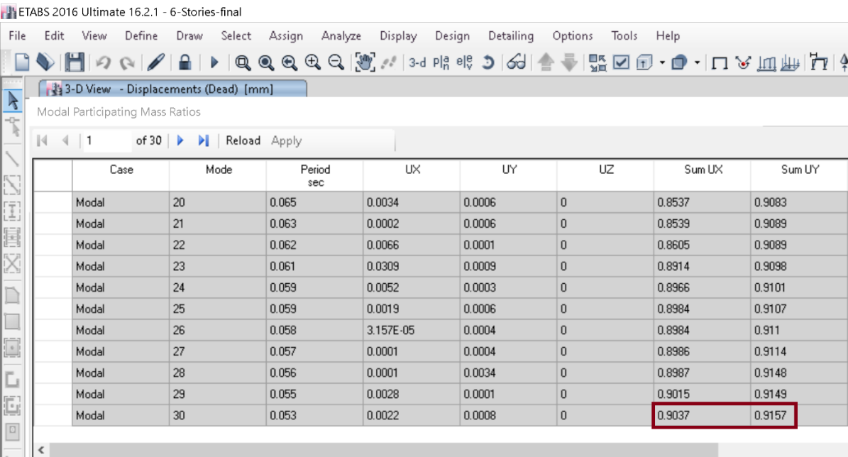
Modal mass participation ratio:

Slide 46
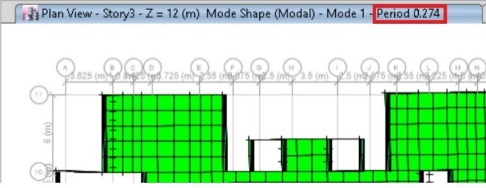
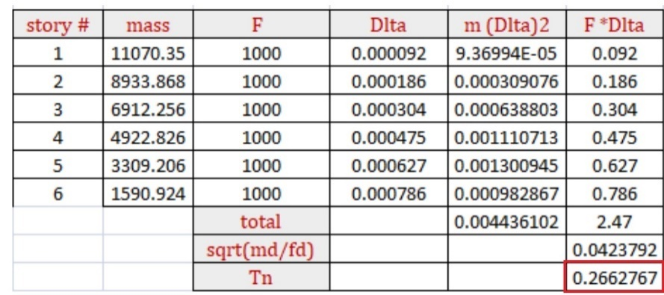
Period check
Tn = 2π * $\sqrt{ \frac{\sum{Wi (△i)^2}}{g \sum{Fi}∗△i }}$
%Difference =$\frac{0.274−0.266}{0.274}$ *100%
=3.7%<10% → OK.

Slide 47
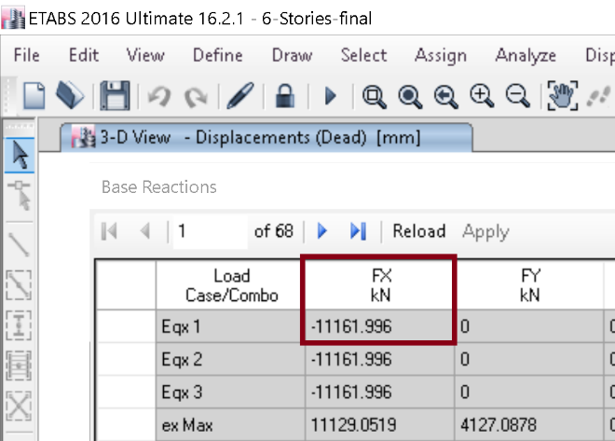
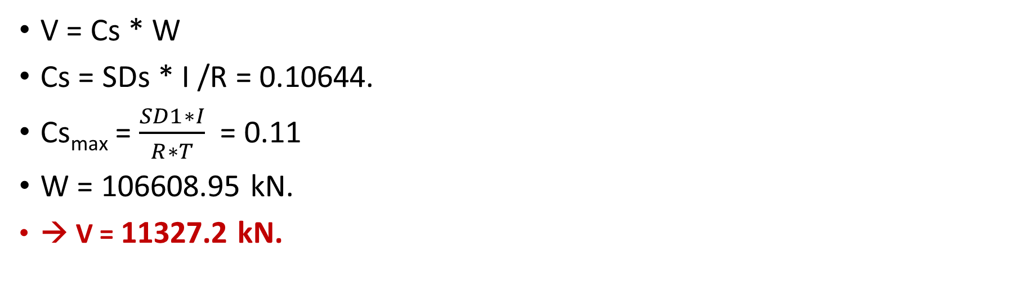
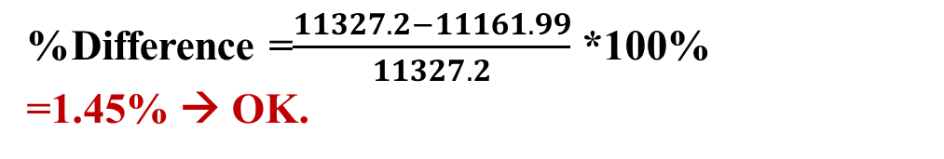
Base shear check
V = Cs * W
Cs = SDs * I /R = 0.10644.
Cs_{max} = $\frac{SD1∗I}{R∗T}$ = 0.11
W = 106608.95 kN.
→ V = 11327.2 kN.
%Difference =$\frac{11327.2−11161.99}{11327.2}$ *100%
=1.45% → OK.

Slide 48
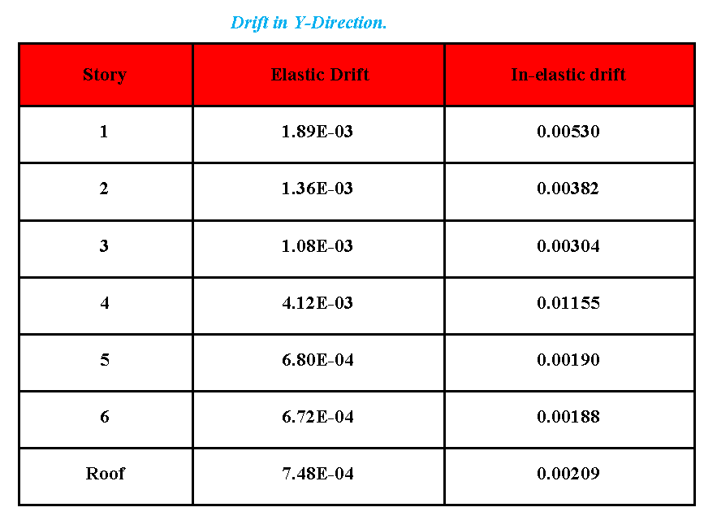
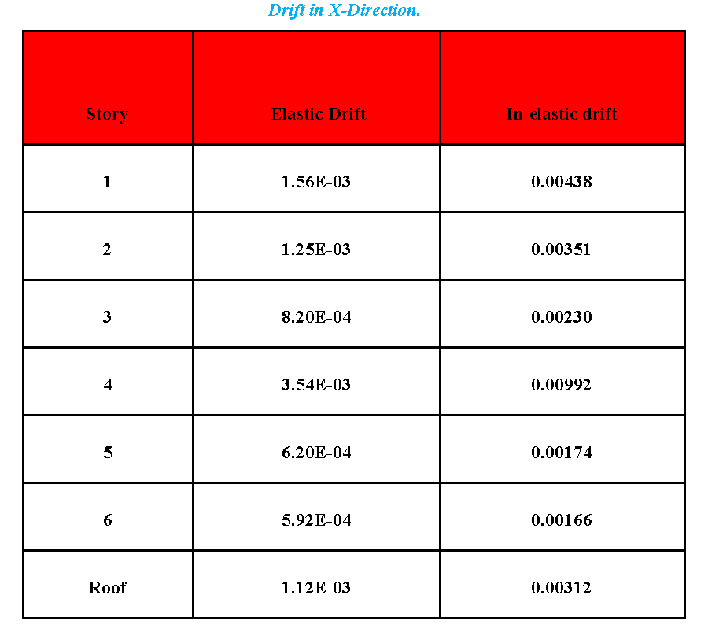

Drift check
$∂x= \frac{Cd∗ ∂xe}{Ie}$
The allowable drift = 0.015 hx = 0.06 m.

Slide 49
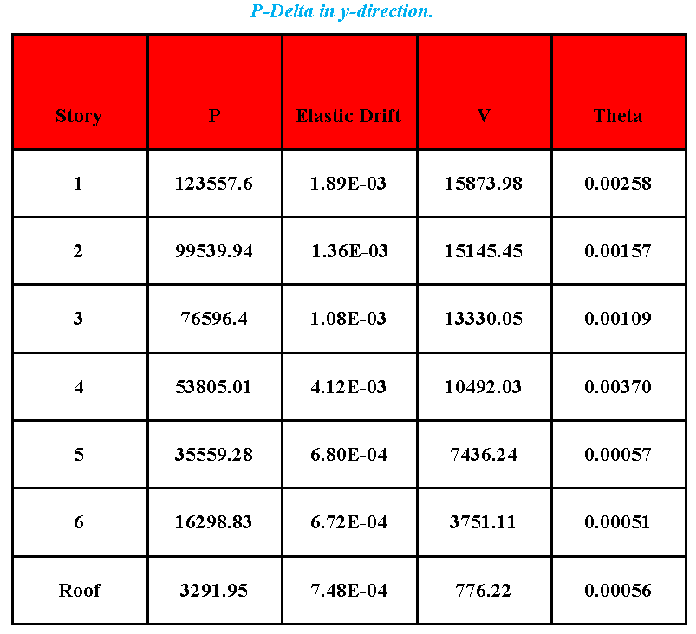


P-Delta check
$θ= \frac{Px∗ ∆∗Ie}{Vx∗hx∗Cd}$
All values are less than 0.1 → P-Delta effect can be ignored.

Slide 50
General seismic analysis
Methods to evaluate earthquake-induced forces in structures:
Equivalent lateral force procedure.
Modal response spectrum analysis.
Time history analysis.
Performance.
Seismic response coefficient (CS) = Base shear / weight

Slide 51

Equivalent lateral force procedure ELF
Methods to evaluate earthquake-induced forces in structures:
UBC:
Z= 0.075, I=1, Soil = “A”, and 3 stories of bearing wall system:
T= 0.235.

Slide 52



UBC
Seismic coefficient Ca:
Seismic coefficient Cv:
Cs = $\frac{Cv∗I}{R∗T}$ = 0.056.
Cs_{min} = 0.11 * Ca * I = 0.0066
Cs_{max} = $\frac{2.5∗Ca∗I}{R}$ = 0.033

Slide 53


UBC

Slide 54




Cs_{max} = $\frac{2.5∗Ca∗I}{R}$

Slide 55

IBC
Seismic Zone factor (Z) map:
For I=1, R=5, T=0.236, and Soil=” A”:
Zone factor (Z)
S_{s} = Mapped 5% damped, spectral response acceleration parameter at 0.2 sec.
(2.5Z) *1.5 = 0.281
S₁ = Mapped 5% damped spectral response acceleration parameter at a period of 1 sec.≈
(1.25Z) *1.5 = 0.1406

Slide 56


IBC
Site coefficients Fa and Fv:
Spectral Response Acceleration Parameters S_{MS} and S_{M1}
S_{MS}=F_{a} * S_{s} = 0.8 * 0.2813 = 0.22504
S_{M1}= F_{v} * S₁ = 0.8 * 0.140625 = 0.1125

Slide 57


IBC
Design spectral acceleration S_{DS}&S_{D1} have been found:
S_{DS} =2 S_{MS} /3 = 0.15
S_{D1} = 2S_{M1} /3 = 0.075
SD1/SDs =0.5
CS = $\frac{SDs∗I}{R}$ = 0.03.
CS_{min} = 0.01.
CS_{max} = $\frac{SD1∗I}{R∗T}$ = 0.063

Slide 58


IBC

Slide 59

IBC
Cs value = 0.15 * importance factor

Slide 60

IBC
S1, Ss maps:
For Z = 0.075 → S1 = 0.025, Ss = 0.025.
For Z = 0.15 → S1 = 0.05, Ss = 0.25.
For Z = 0.2 → S1 = 0.1, Ss = 0.4.
For Z = 0.3 → S1 = 0.125, Ss = 0.55.

Slide 61


IBC

Slide 62


IBC
Cs value = 0.1 * importance factor

Slide 63


Modal response spectrum

Slide 64


Modal response spectrum

Slide 65


Modal response spectrum
Cs values from response spectrum are always less than Cs values from ELF.

Slide 66


Time history

Slide 67

Time history

Slide 68

ELF,MRS, and TH
For Z = 0.075:
Cs value from time history always greater than that from ELF and response spectrum.

Slide 69

ELF,MRS, and TH
For Z = 0.15:
Cs value from Time history is always greater than that from response spectrum and ELF for soil types “A”. “B”, and “C”.
Cs value from ELF is always greater than that from response spectrum and time history for soil types “D” and “E”.

Slide 70


ELF,MRS, and TH

Slide 71
ELF,MRS, and TH
For Z = 0.2 and 0.3:
For stories ≤ 6, Cs value from ELF is always greater than response spectrum and time history
For stories >6, Cs value from time history is always greater than ELF and response spectrum for soil types “A” and “B”, and CS Value from always greater than response spectrum and time history for other soil types.
As the number of stories increases after 6 stories → Cs value decreases.

Slide 72

Non-symmetry
Cs values using ELF method have not been changed.

Slide 73


Modal response spectrum

Slide 74


Modal response spectrum
Cs values from response spectrum are always less than Cs values from ELF.

Slide 75

Time history

Slide 76

ELF,MRS, and TH
For Z = 0.075:
Cs value from time history always greater than that from ELF and response spectrum.

Slide 77

ELF,MRS, and TH
For number of stories ≤6, Cs value from time history is always greater than ELF and response spectrum for soil type “A” and “B”. Cs value from ELF is always greater than time history and response spectrum for other soil types.
For Z = 0.15:
For number of stories >6, Cs value from time history is always greater than ELF and response spectrum for soil type “A”, “B”, and “C”. Cs value is from ELF is always greater than time history and response spectrum for other soil types.

Slide 78


ELF,MRS, and TH
Cs value from ELF is always greater than that from time history and response spectrum.

Slide 79

Frame system
Columns dimensions are 800X600 mm.
Beams dimensions are 400X400 mm.
Slab thickness is 220 mm.
Live load = 3 kN/m².
Super imposed dead load = 4 kN/m².

Slide 80

Frame system ( non-symmetry)
Columns dimensions are 800X600 mm.
Marked columns are 600X400 mm.

Slide 81


Modal response spectrum
MRS < ELF

Slide 82

Time history
The results from frame system verify the results such that

Slide 83

Internal forces
S1 = 0.125, Ss = 0.55, and I=1,
Shear force in a column in the basement

Slide 84


Internal forces

Slide 85


Internal forces

Slide 86


Internal forces

Slide 87

Internal forces

Slide 88


Internal forces

Slide 89

Pin VS Fixed
S1 = 0.125, Ss = 0.55, and I=1

Slide 90

Pin VS Fixed

Slide 91

DESIGN
As the system is a bearing walls system and seismic design category is “C”, the design will be ordinary design

Slide 92


DESIGN
Shear strength check for the slab:
$∅$Vc=$\frac{1}{6}$*0.75*b*d*$\sqrt{F′c}$
=167.56 KN
The max shear value from ETABS
=54 kN < 167 → OK

Slide 93

Design check for beam
Beam dimensions:
400X400 (mm)
Effective depth = 340 mm

Slide 94


Flexural design
For positive moment = 57 kN.m
$ρ=\frac{0.85∗f′c}{fy}∗[1− \sqrt{(1−\frac{2.61∗Mu}{b∗d^{2}∗f′c}}$)]
$ρ=0.00289<ρmin$.
As = 480 mm².
Use 4$∅$14

Slide 95


Flexural design
For Negative moment = 95.7 kN.m
$ρ=\frac{0.85∗f′c}{fy}∗[1− \sqrt{(1−\frac{2.61∗Mu}{b∗d^{2}∗f′c}}$)]
$ρ=0.0057>ρmin$.
As = 775.2 mm².
Use 6$∅$14

Slide 96

For reinforcement from ETABS:
% Difference in bottom steel = 0%
% Difference in top steel = 5.5 %.

Slide 97


Design the beam for shear:
Vs = $\frac{Vu}{∅}−Vc$ = 28.6 kN.
$\frac{Av}{s}= \frac{Vs}{fy∗d}$
= 0.161 mm² / mm = 161 mm²/m .
($\frac{Av}{s}$)_{min} = 0.35 * $\frac{bw}{fyt}$ = 0.333.
Assume Av = 2 * 78.5 = 157 mm².
S = 471 mm.
S_{max} = d/2 = 180 mm.
Take S = 150 mm.

Slide 98

Beam details

Slide 99

Design check for column
Column dimensions :
400X400 (mm)
Axial load from ETABS = 1331.19 kN
Ultimate moment M3 from ETABS
= 21.8 kN.m
Ultimate moment M2 from ETABS
= 38.7 kN.m

Slide 100


Interaction diagram
ØP_{nx}= ØP_{ny}=2300 kN.
ØP_{no}=2309 kN.
By using preclier equation:
$\frac{1}{∅Pn}= \frac{1}{∅Pnx}+\frac{1}{∅Pny}− \frac{1}{∅Pno}$ → ØPn= 2291KN > 1331 KN OK

Slide 101




Column details:
$$ρ From ETABS=0.0125$$
As = 0.0125 * 400 * 400 = 2000 mm².
Use 8$∅$18.
S = 16 * 18 = 288 → take S = 280 mm.

Slide 102

Design of the shear wall
For shear walls with openings, there are two parts: spandrels and

Slide 103

Pier design
Pier between grids (2A-3A) has been selected
Length = 3.3 m
Thickness = 400 mm.
Design will be taken from ETABS.

Slide 104


Pier design
Flexural design:
Use 1$∅$16 /200 mm.
Shear design:
Use 1$∅$16 /200 mm.

Slide 105

Pier design
Interaction diagram
The point is inside the inter action diagram → OK.

Slide 106

Pier details

Slide 107

Spandrel design
Spandrel between grids (3H-4H) has been selected
Length = 1 m
Depth = 1.8 mm.
Design will be taken from ETABS.

Slide 108




Spandrel design
Flexural design:
Top reinforcement
Minimum steel = 0.0033 * 250 * 1800 = 1498.6 mm²
Use minimum steel → Use 6$∅$18.
Bottom reinforcement:
Use minimum steel → Use 6$∅$18.
Shear design:
Use 8$∅$10. For vertical and horizontal reinforcement.

Slide 109

Spandrel details

Slide 110


Design of the slab
A_{smin} = 0.0018*b*h = 396 mm².
As fy = 0.85 *f’c * a * b
a = 6.99 mm.
$∅Mn=0.9∗As∗fy∗\left(d−\frac{a}{2}\right)$
= 29.41 kN.m
In X-direction →
Minimum steel

Slide 111


For minimum steel →use 4$∅12$
In Y-direction → all minimum except :
Second basement First basement

Slide 112

Ground floor

Slide 113


For maximum moment = 40 kN.m/m
Reinforcement = 605 mm²/m → Take 6$∅$12

Slide 114


