Slide 1

‘أنــــا ومــامـــاProject ‘
Prepared by:
Mariam Abu-Doleh
Laila Abdallah
Supervisor:
Dr. Ashrsf Armoush

Slide 2

Outline
Motivation
objectives
Feature Highlights.
Implementation.
Future Work.
Demo

Slide 3
Outline
Motivation
objectives
Feature Highlights.
Implementation.
Future Work.
Demo

Slide 4

:Motivation
Need’s mother to know all things related to motherhood.
many of application belongs to one side.
The inability of mothers to understand a language other than Arabic.

Slide 5

Well then, here is the solution:
‘ Applicationأنــــا ومــامـــا ‘

Slide 6
Outline
Motivation
objectives
Feature Highlights.
Implementation.
Demo
Future Work.

Slide 7
Objectives:
Build a site in Arabic language for Arab women,.
Improve the knowledge of the pregnant about her fetus.
Improve the knowledge of the mother about her child.
Facilitate the contact process between doctors and women with no regard to
place, time, reservations and more extra cost.

Slide 8
Outline
Motivation
objectives
Feature Highlights.
Implementation.
Demo.
Future Work.

Slide 9
Feature Highlights(Pregnant):
pregnancy tracker
Doctor visits
Information recorder(Graph)
contact with doctors
Fetus tracker
Upload her picture

Slide 11
Outline
Motivation
objectives
Feature Highlights.
Implementation
Demo.
Future Work.

Slide 12
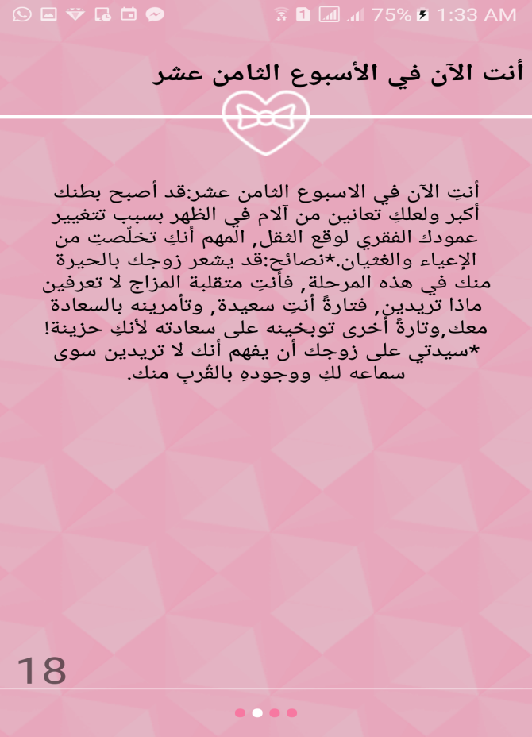
Pregnant site pregnancy tracker :

Slide 13
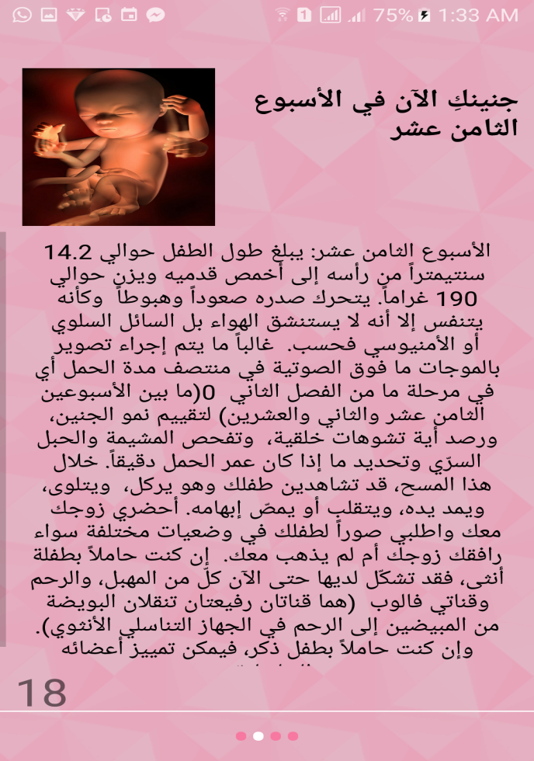
Fetus tracker:

Slide 14
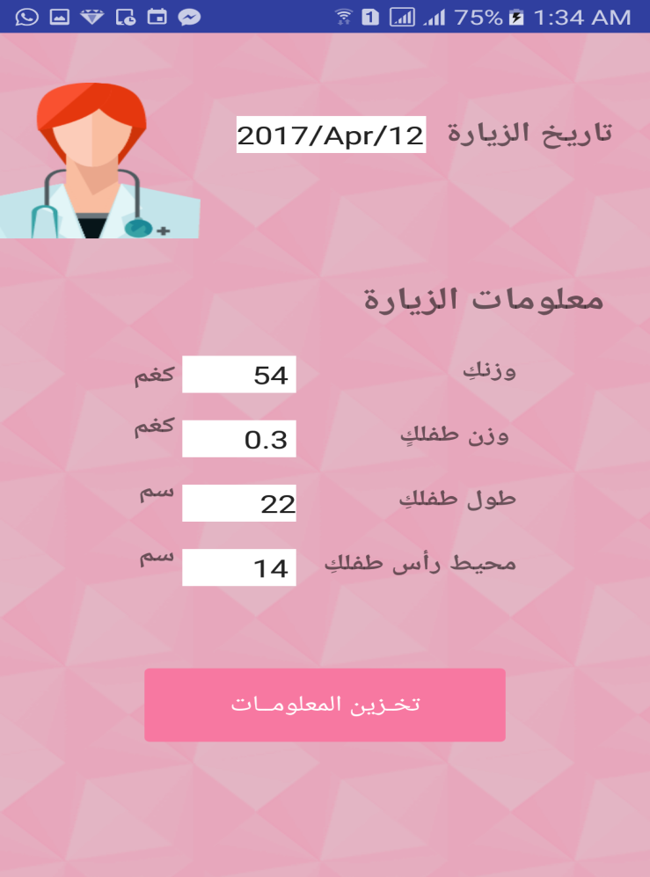
Doctor visits

Slide 15
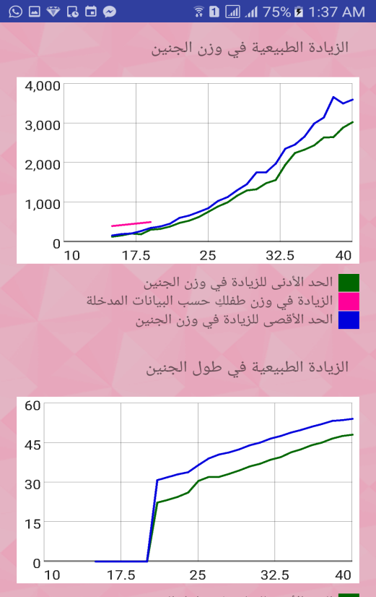
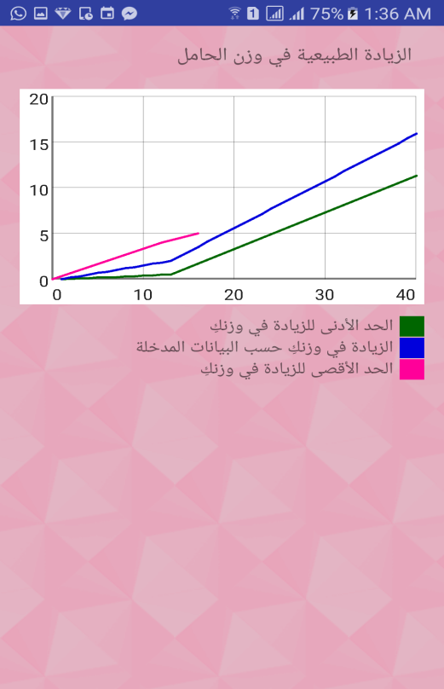
Information record
Fetus Graph
Pregnant graph

Slide 16

Upload her picture

Slide 17
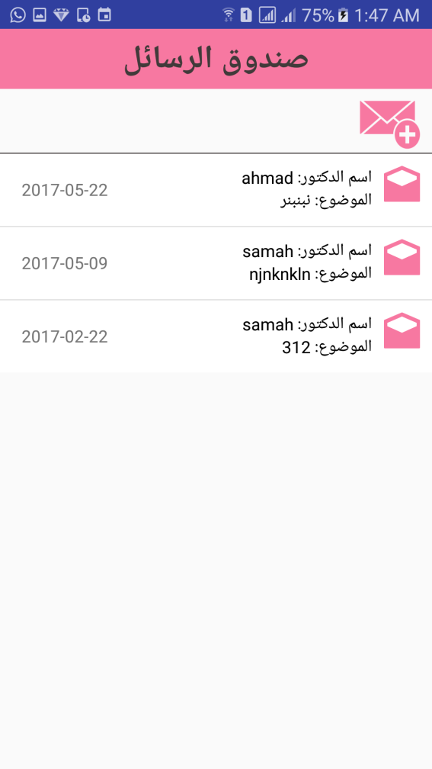
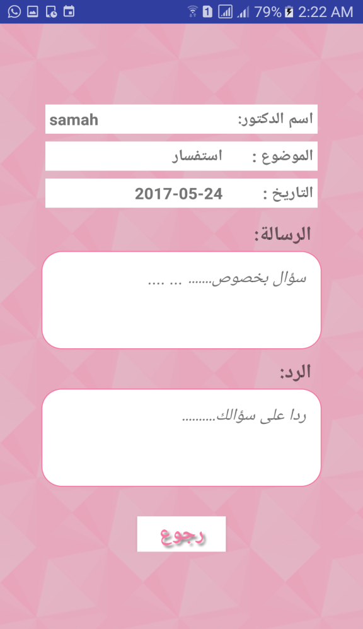
Contact with doctor

Slide 18
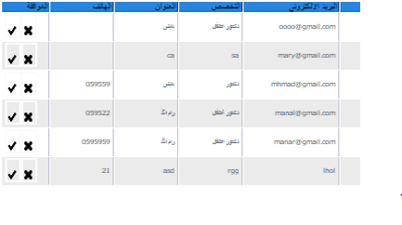
Administrator & Doctor part
Administrator controls the doctor's registration process.

Slide 19
Outline
Motivation
objectives
Feature Highlights.
Implementation
Demo.
Future Work.

Slide 20
Feature Highlights(Mother):
Tutorial
White noise system
Mother tracker
vaccination system
Baby tracker
Doctor Visits
(Information recorder(Graph

Slide 21
Outline
Motivation
objectives
Feature Highlights.
Implementation
Demo.
Future Work.

Slide 22
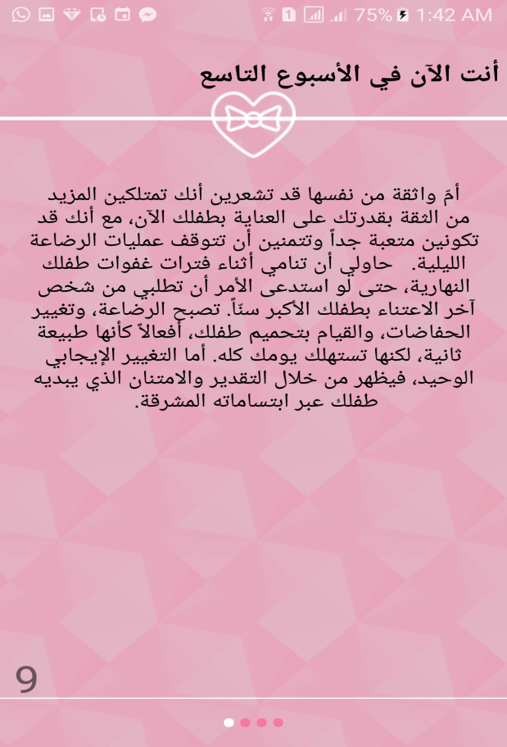
Mother site pregnancy tracker:

Slide 23
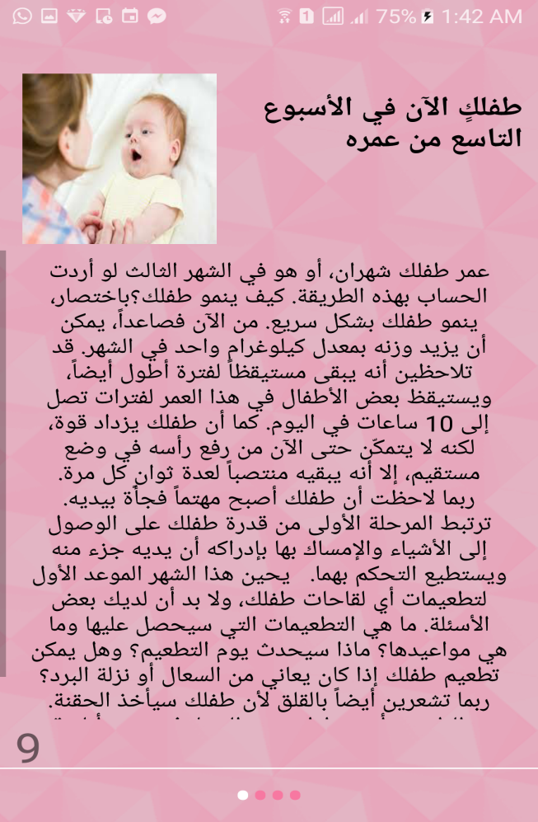
Baby tracker:

Slide 24
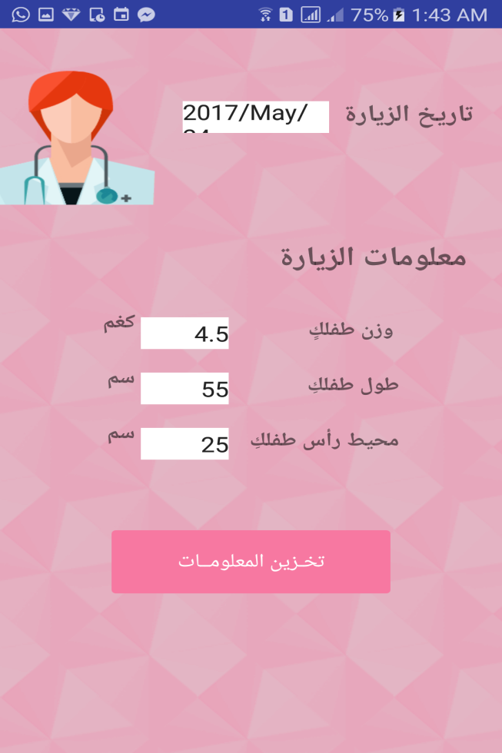
Doctor visits:

Slide 25
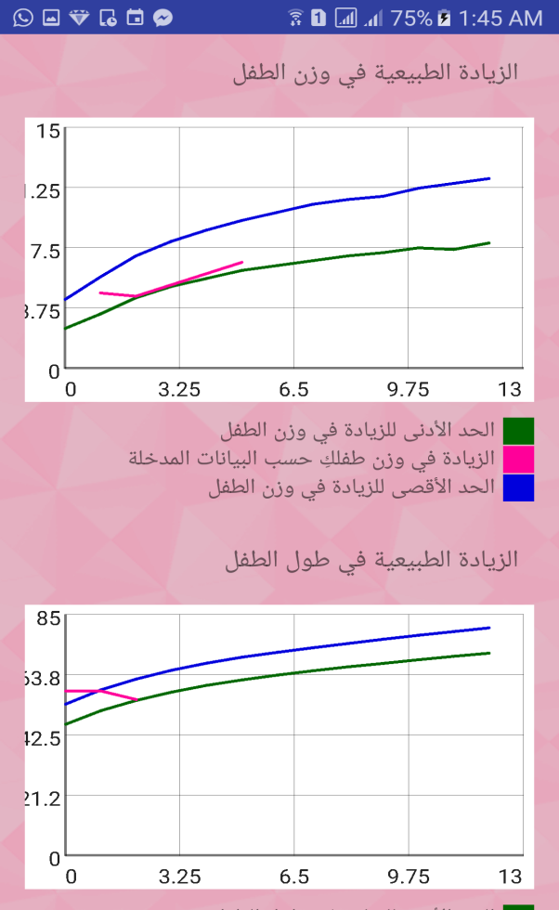
Information record:

Slide 26
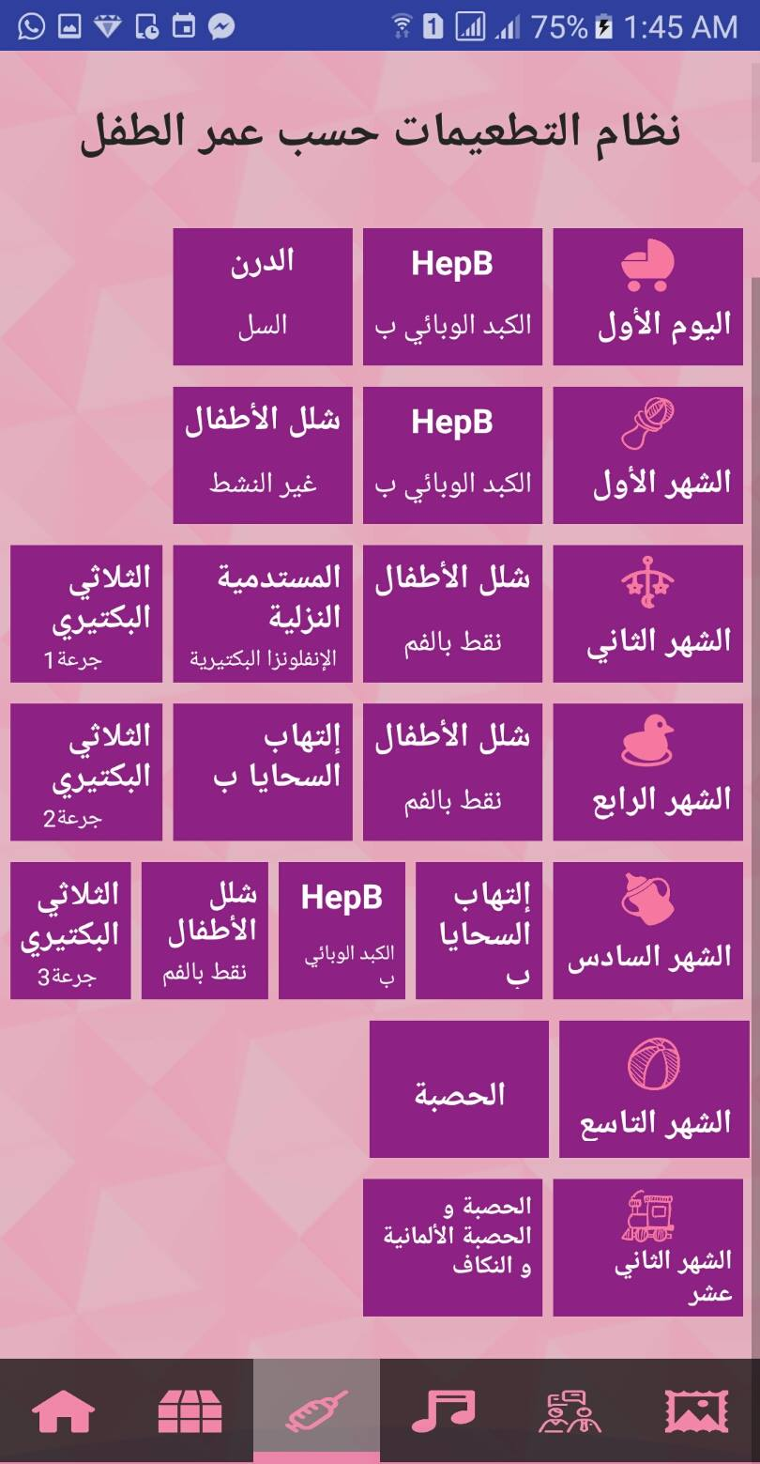
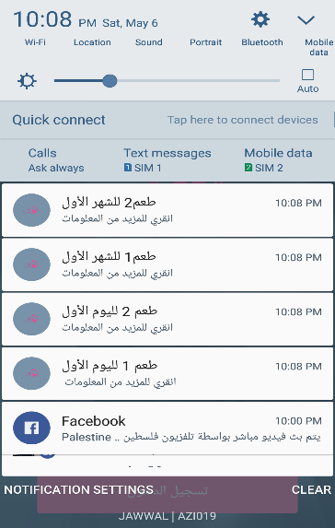
vaccination system:

Slide 27
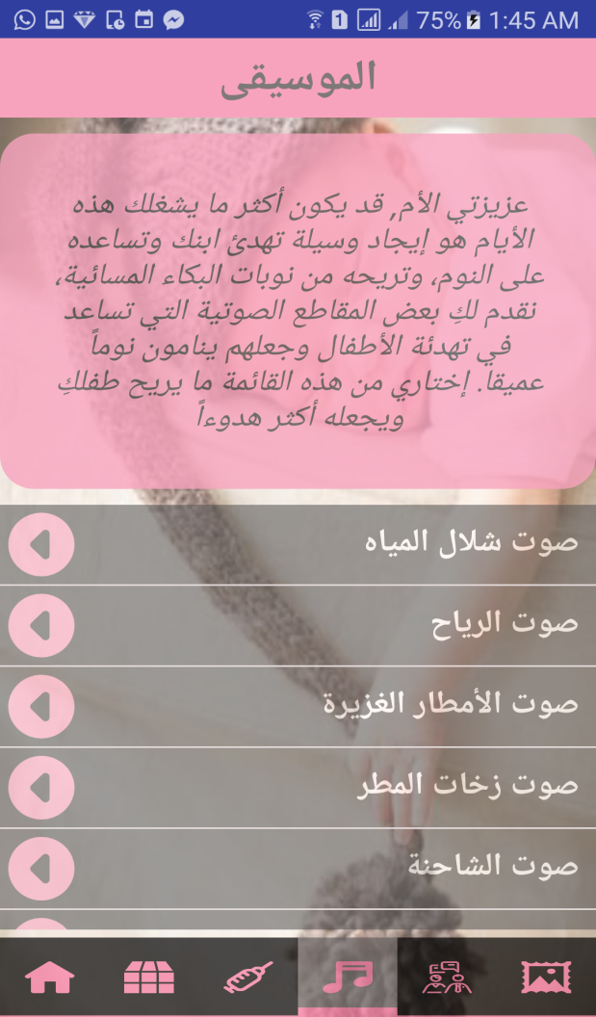
White noise system:

Slide 28
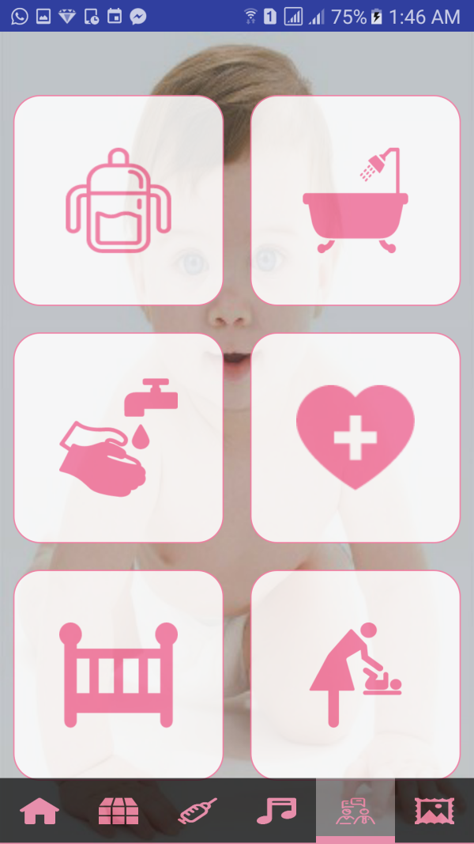
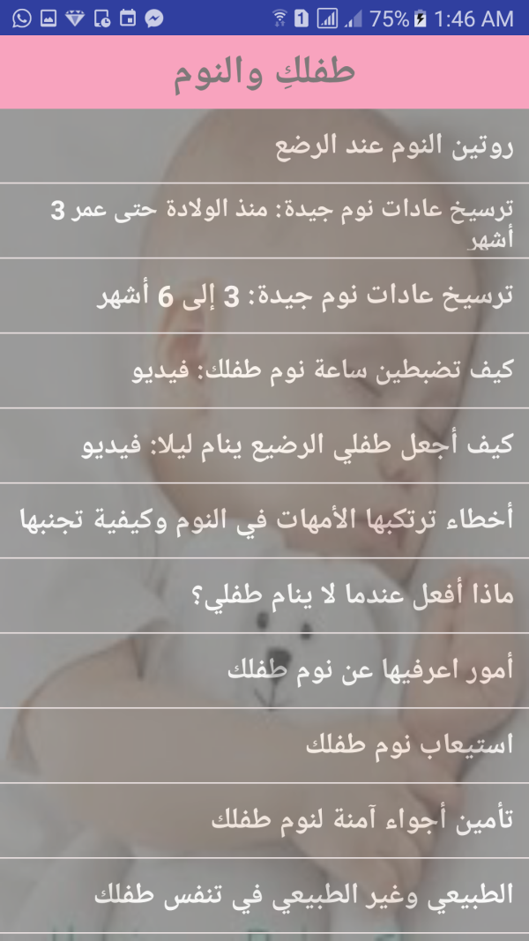
:Tutorial

Slide 29

Outline
Motivation
Introduction
Feature Highlights.
Implementation.
Demo
Future Work.

Slide 30
Outline
Motivation
objectives
Feature Highlights
Implementation
Demo
Future Work

Slide 31

Future work
Create a version that supports the IOS platform.
Make appointment with specific doctor.
Allow women to talk and negotiation with each other.
Add more functionality whether a mother or a pregnant woman can
handle it, as Shopping for example.

Slide 33


Any Questions?
Thank you

