Slide 1

An-Najah National University
Faculty of Engineering and IT
Department of Industrial Engineering
Graduation project 2
Measuring the impact of logistical management on the quality of care and patient satisfaction at An-Najah National University hospital as a case study
Prepared by: Hiba Qanaze’
Ro’ya Qeblawy
Rahaf Yadak
Sewar Ayyash
Supervisor :Eng. Walaa’ Johari

Slide 2
1
Overview
2
Problem statement
3
Objectives
Outline
4
Introduction
5
Methodology
6
Result and Analysis
7
Conclusion and Recommendation

Slide 3
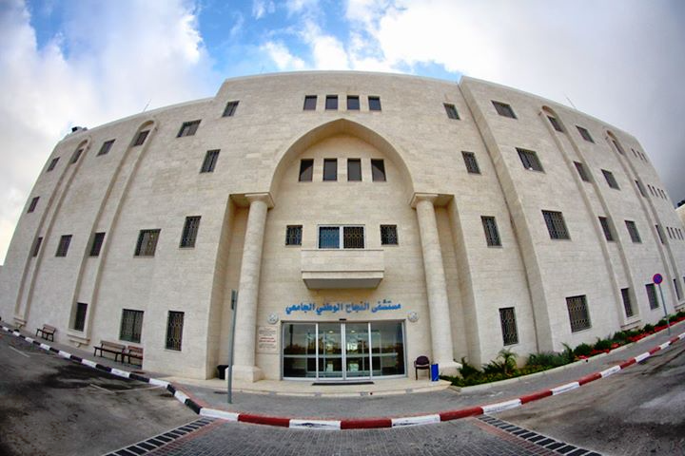



About NNUTH
Founded in 2013
17,000 m²
11 Med. Departments
135 Beds
5 Operating Rooms
5000+ Operations/year
Inpatients:
3000+ Admissions/month
Outpatients:
2000+ visits/month

Slide 4
Overview
The role of logistics in business has increased, as it affects customer selection, product design, and vendor selection.
Logistics is the part of the supply chain operations
It is considered one of the most important processes that contribute to the success or failure of the facility.

Slide 5
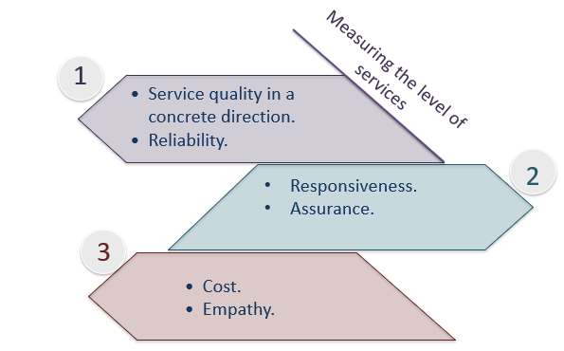
Problem Statement
This study seeks to focus on patients and measure their level of satisfaction with the services provided in the hospital affiliated with An-Najah National University according to the following guidelines:

Slide 6
Introduction
Research objectives
Measuring the level of quality of medical logistics services and determining the level of patient satisfaction with them.
Identify the most important elements and main determinants of the medical services provided.
Identify the impact of the quality of medical services.
In the end, we will come up with recommendations that will help the hospital administration in improving the quality of medical logistics services provided to the patient.

Slide 7






Stage 06
Stage 01
Data analysis
Study approach
Methodology
Stage 05
Stage 02
Data collection
Study population and sample
Stage 04
Stage 03
Study tool
Sample size

Slide 8

Stage 01:
Study approach
To reach the objectives of the study, the descriptive analytical method was used, which is based on describing a phenomenon or problem through analysis and interpretation.

Slide 9

Stage 02:
Study population ​and sample
The target group consists of An-Najah University Hospital - Nablus. As for the study sample, they are all departments in the hospital. The three departments in the hospital have been relied heavily on, namely, the ophthalmology department, the oncology department, and the nephrology department.

Slide 10

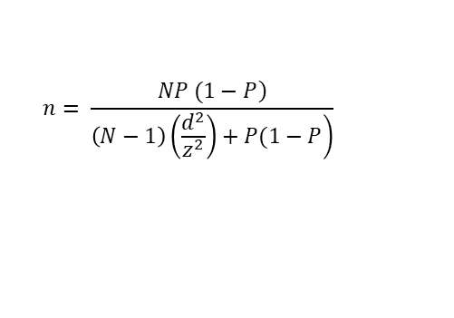
Stage 03:
Sample size
According to Thomas Simpson's equation, the sample size (n) was calculated, and the appropriate sample for the study was (351) beneficiaries as a minimum
$$n= \frac{\left.NP (1−P\right)}{\left.\left(N−1\right)\left(\frac{d^{2}}{z^{2}}\right)+P(1−P\right)}$$

Slide 11

Stage 04:
Study tool
The study tool consists of questionnaires distributed to patients to determine their satisfaction with the quality of care and services provided to them, and to test hypotheses to assess patient satisfaction.

Slide 12

Stage 05:
Data collection
Data were collected through field visits to the hospital and the distribution of questionnaires to patients, or through the electronic version.

Slide 13

Stage 06:
Data analysis
The data collected and analyzed was entered into the Statistics and Analysis Program (SPSS), and thus the necessary operations were performed on the entered data.

Slide 14
Results and Analysis

Slide 15
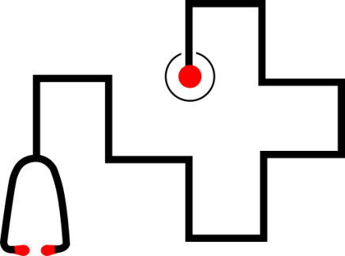
Questionnaiere directions
01
Personal Information of patients
02
Physical accessibility
03
Waiting time
04
Services provided in the departments such as food, facilities and cleanliness
05
Administrative and financial procedures

Slide 16
Questionnaiere directions
06
Quality control
07
Patients satisfaction
08
Open question for suggestions and improvements

Slide 17
Personal information consist of:
Gender: male or female.
01
Age
02
Monthly income
03
04
Duration of dealing with the hospital

Slide 18
Personal information consist of:
05
Department type:
Oncology department, Department of Ophthalmology, Dialysis department and other.
Financial transaction method: Cash, government insurance and private insurance.
06
04

Slide 19
Testing Hypothesis
An investigation was conducted about the relationship between patients' personal information, namely gender and others with the seven axes.
In order to examine these relationships.
The hypotheses were identified and tested for the directions mentioned in this study.
The hypotheses were tested By using SPSS program and analysis made by using t- test and one way ANOVA and LSD test.

Slide 20
Result related to gender
Direction 4 which is the services provided was rejected.
Females have greater number of males.
Therefore, females see that the level of services provided in the hospital is less than the required level.
43.75%
56.25%

Slide 21

Result related to age
01
Direction 2 reject age , people aged 20-40 years old, and therefore over 60 years old have a problem with physical accessibility.
Direction 3 reject age, the age of 51-60 complain about the waiting time either in waiting rooms, or for medical examinations.
02
Direction 5 reject age was rejected, the age groups less than 20 and from 51-60 suffer from administrative and financial procedures
03

Slide 22
Result related to monthly income
There is a frequent denial of the physical access axis in the hospital .
The proportion of patients with medium to low income is 74.7%.
This indicates that the greater number of patients in the hospital have low income.
Not allow to bear high treatment costs.
74.7 %

Slide 23

Result related to the duration of dealing with the hospital
While directives 3 and 7 rejected, which related to waiting and patient satisfaction, the services provided in the departments.
Patients who have treated in hospital for five years or more are also not satisfied with the waiting time .
Looking to improve the time Wait, that explains the dissatisfaction too.

Slide 24
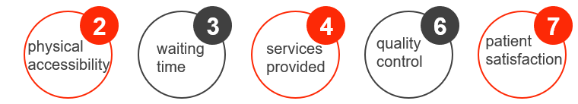
Result related to Department type
After conducting the post- hoc test and choosing the LSD test, it was found that the rejection came from other departments in the hospital.
In some cases the rejection came from the department of kidney, ophthalmology and oncology.

Slide 25
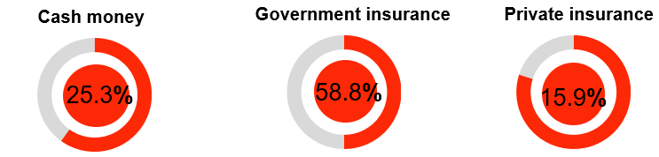
Result from the method of financial dealing
While directives 2, 5, 6 and 7 rejected which related to physical accessibility, administrative and financial procedures, quality control, and patient satisfaction.
It was found that in general people who deal with government insurance complain about money.
so the dissatisfaction comes from the largest proportion.

Slide 26
Conclusions and Recommendation

Slide 27
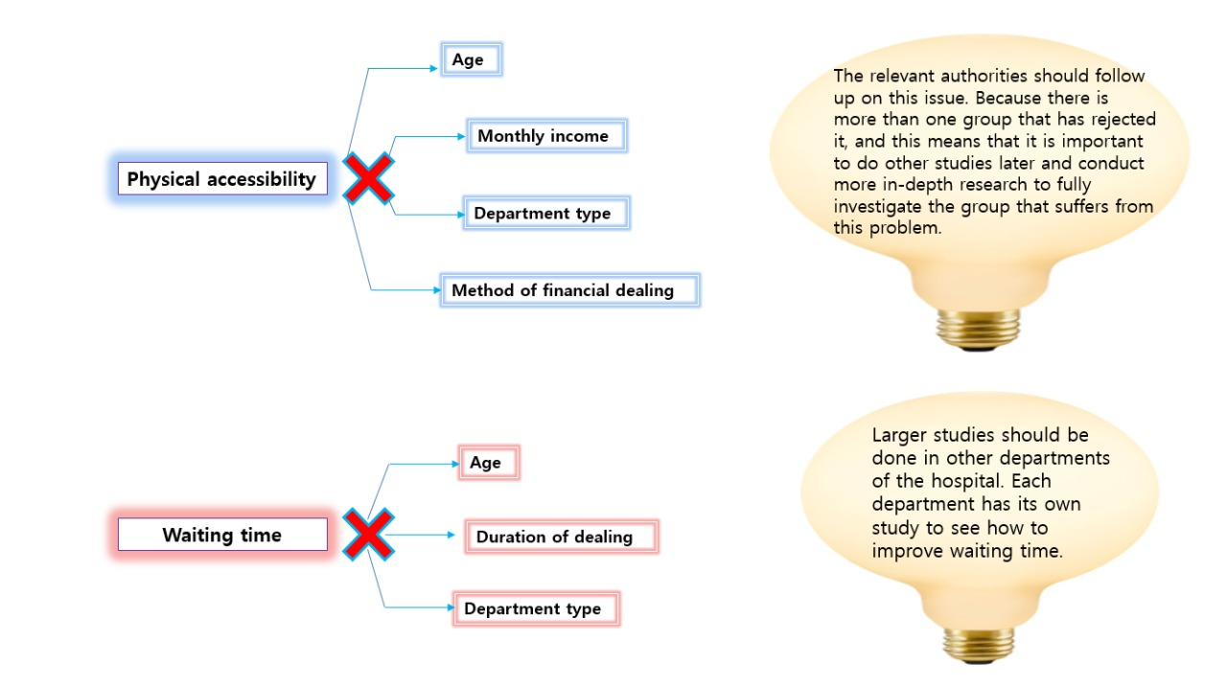

Slide 28
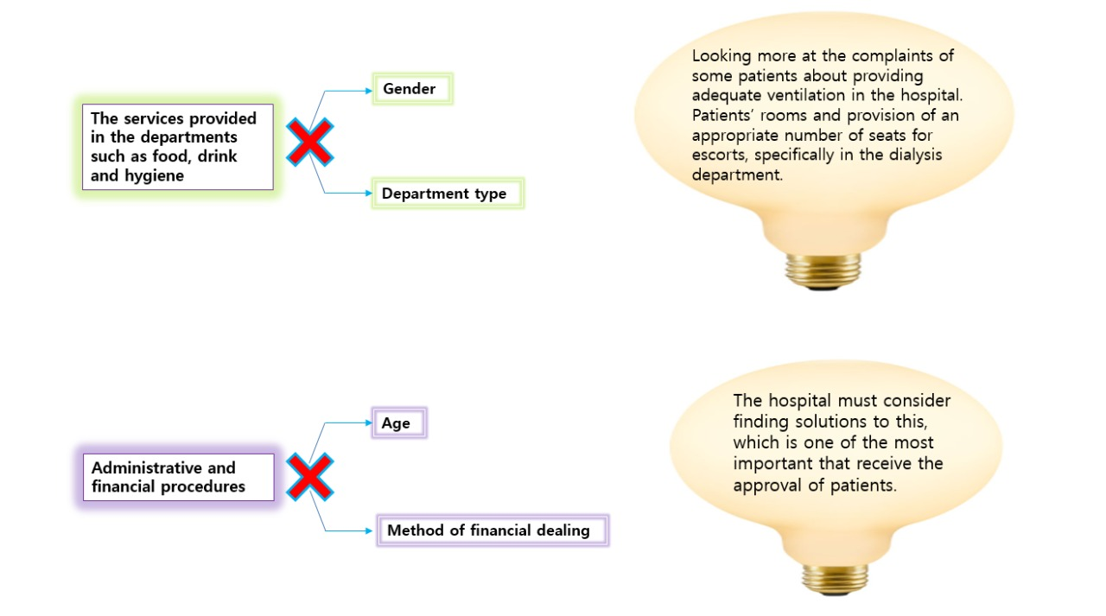

Slide 29
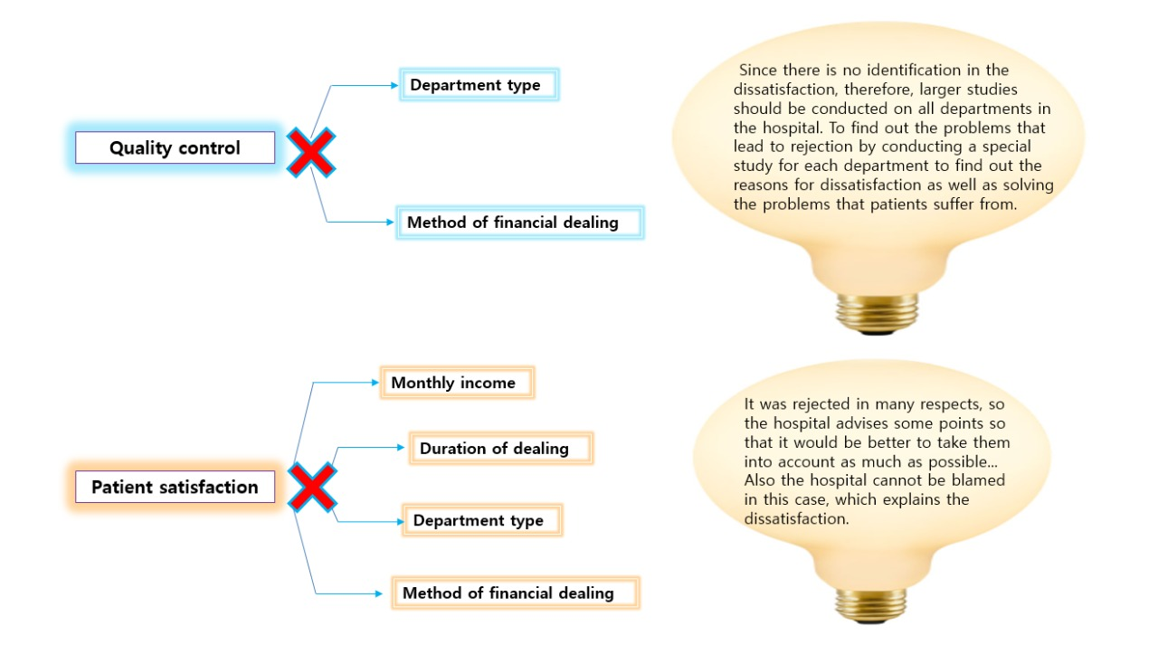

Slide 30
The aim of this study was to:
Evaluate the effect of hospital logistics on patient satisfaction and treatment quality.
Has been used a t-test model and one-way ANOVA.
A questionnaire was distributed to patients.
All axes were rejected by patients.
Focus on the physical access axis.
This study is insufficient to reveal the underlying causes of these complaints.

Slide 31
Thank you

