Slide 1

Building with Sand
An-Najah National University
Faculty of Engineering & Information Technology
Department of Civil Engineering
Graduation Project ll
Prepared by: Supervisor:
Ahmad Sarrawi Dr. Mohammad Ghazal
Ahmad Assas
Qasem Albayda

Slide 2
Contents of Presentation
Case study
Our work
Results
Conclusion
References

Slide 3
CASE STUDY
Tests conducted on mixtures consisting of loam with a specific percentage of added cement:

Slide 4
OUR WORK
Making a mixture of sand and cement and studying the mechanical properties of the resultant mix by conducting two tests:

Slide 5
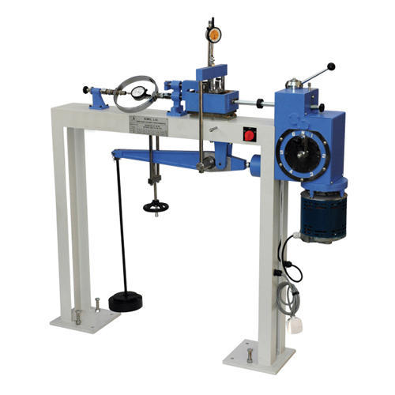
OUR WORK
1. Direct shear
Studied percentages:
Pure sand
15% cement
20% cement
25% cement

Slide 6
RESULTS
Direct Shear
Soil Description: Sand
Ф = 28.3 degrees
Load (kg) | Max H.Load (KN) | Sigma (Kpa) | Shear (Kpa)
18 | 0.22 | 49.1 | 61.1
36 | 0.287 | 98.1 | 79.7
72 | 0.5 | 196.2 | 138.9

Slide 7
RESULTS
Direct Shear
Soil Description: Sand + 15% cement
Ф = 29.45 degrees
Load (kg) | Max H.Load (KN) | Sigma (Kpa) | Shear (Kpa)
18 | 0.216 | 49.1 | 60.0
36 | 0.28 | 98.1 | 77.8
72 | 0.508 | 196.2 | 141.1

Slide 8
RESULTS
Direct Shear
Soil Description: Sand + 20% cement
Ф = 32.6 degrees
Load (kg) | Max H.Load (KN) | Sigma (Kpa) | Shear (Kpa)
18 | 0.176 | 49.1 | 48.9
36 | 0.29 | 98.1 | 80.6
72 | 0.515 | 196.2 | 143.1

Slide 9
RESULTS
Direct Shear
Soil Description: Sand + 25% cement
Ф = 34.3 degrees
Load (kg) | Max H.Load (KN) | Sigma (Kpa) | Shear (Kpa)
18 | 0.178 | 49.1 | 49.4
36 | 0.254 | 98.1 | 70.6
72 | 0.53 | 196.2 | 147.2

Slide 10
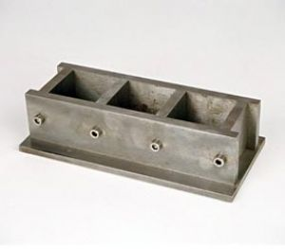
OUR WORK
2. Compressive strength test (Molds):
Studied percentages:
15% cement
20% cement
25% cement

Slide 11
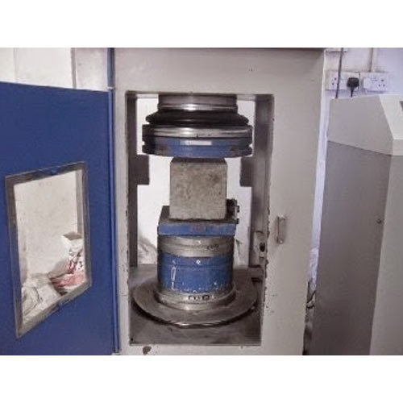
RESULTS
Compressive Strength

Slide 12
RESULTS
Compressive strength
After 7 days:
Percentage of cement in the block | Load
15% | 25KN
20% | 50KN
25% | 80KN

Slide 13
RESULTS
After 28 days:
Percentage of cement in the block | Load
15% | 33KN
20% | 91KN
25% | 98KN

Slide 14
CONCLUSION
Mixtures showed increasing angle of friction as the percentage of cement increased
Mixtures showed a considerable compressive strength:
Up to 8 Mpa after 7 days
Up to 9.8 Mpa after 28 days

Slide 15
References
Building with earth, Gernot minke
Minke, Earth Construction Handbook. Southampton, Great britian 2000.
Minke, Building with Straw.Basel, Berlin, Boston, Germany 2005.
McCann, J.: clay and cop building. Aylesbury, Great britian 1983.
Soil Mechanics,7th Edition, Braja M. Das.

Slide 16


