Slide 1
Mental Health

Slide 2
Who we are?
Adlah Faqih
Reem Abu Rajab
11941292
11924277

Slide 3
Table of contents
1
Introduction
2
Types of users
3
Technologies
4
Features
5
Constraints
6
Future work

Slide 4
1
Introduction

Slide 5
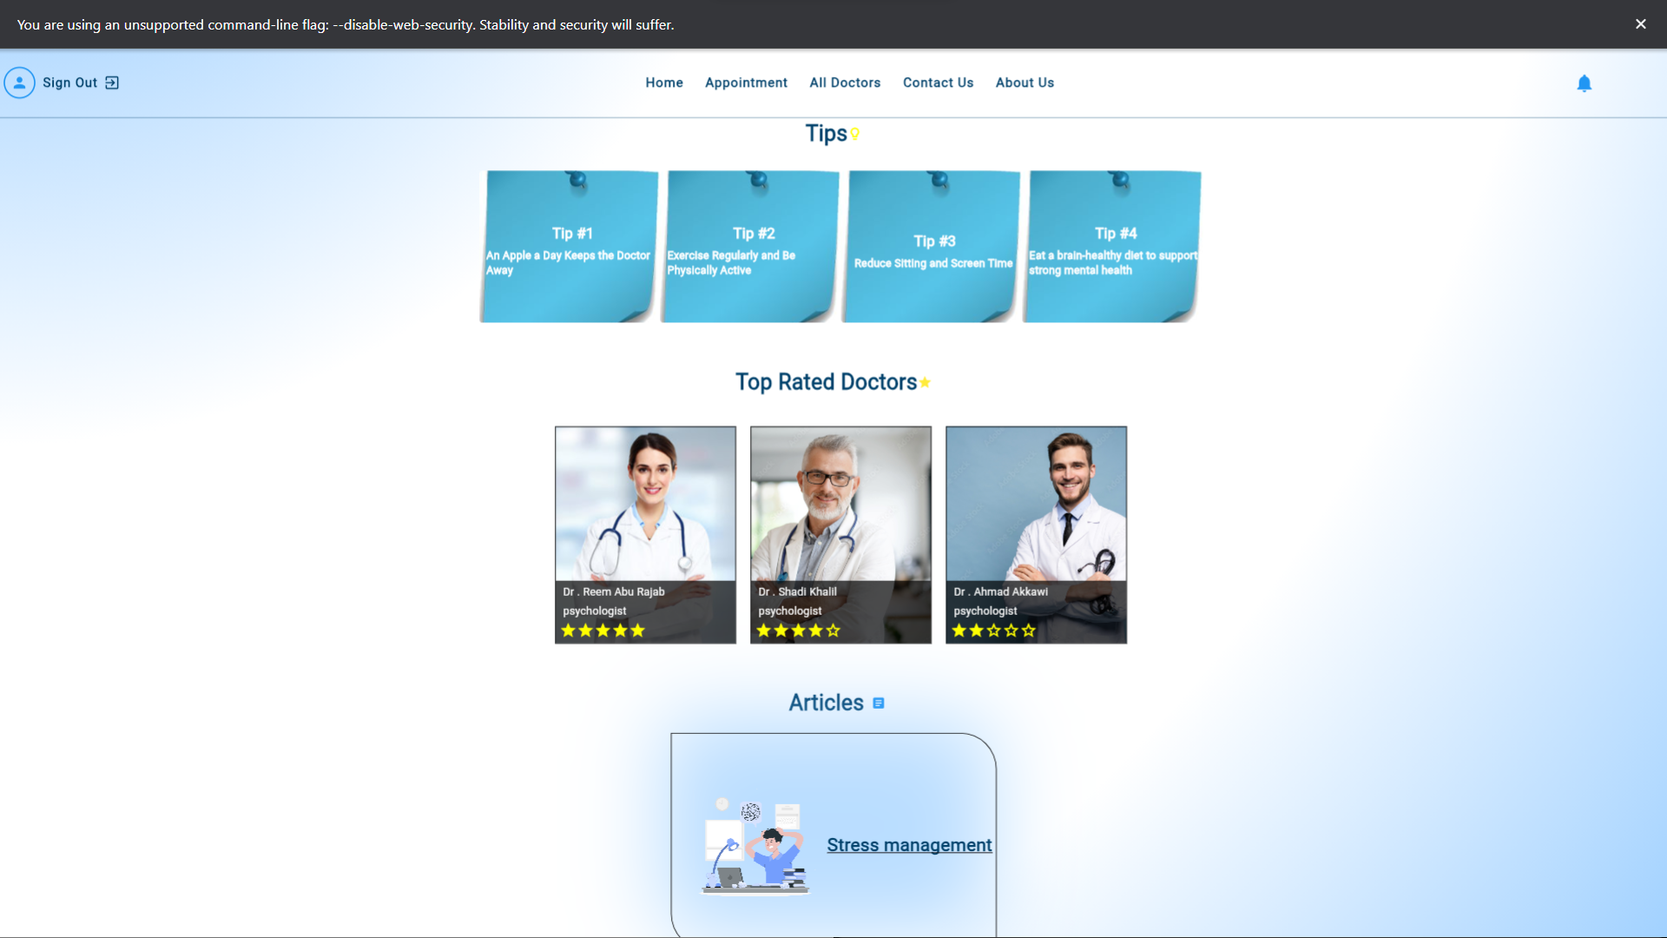
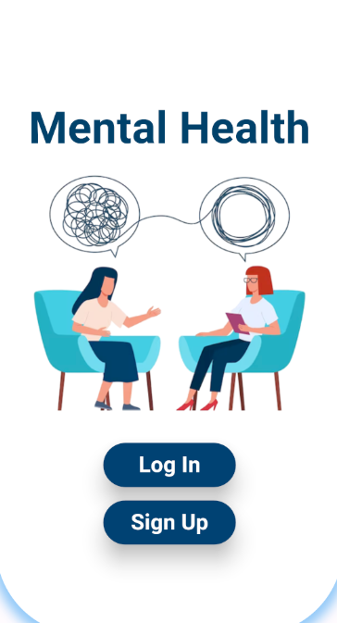
About My Application
The application aims to facilitate communication between patients and doctors easily, quickly, and privately, as the patient can communicate with the doctor without revealing his name, or number..

Slide 6
The Scope of the Application
Doctors
Patients

Slide 7
2
Types of users

Slide 8
Type of Users
Doctors
Patients
Admin

Slide 9
3
Technologies

Slide 10





What did we use?
Flutter
Node js
MongoDB
GitHub
firebase

Slide 11
4
Features
Now we will show you the Features we worked on.

Slide 12
Authentication
Profile
Home Page
Available Times
Rating
Chatting or Video Call
1
2
Login, Logout, Sign up
Doctor profile, Patient profile, admin profile
3
4
Trending Doctors, trending articles, tips…
The doctor supplies profile visitors with available times
5
6
patient can rate the doctor(⭐ and comment)
& can see all ratings and comments to the doctor
appointment can be done by chatting or video call

Slide 13
Report
Suggestions
Notifications
Contact Us
Upload Credit License
Pay
7
8
The patient can report the doctors and the admin must consider this
Patient can suggest improving the website
10
9
from Admin to the doctor for a report from a user
to the user to join the meeting
from user to admin & from doctor to admin
12
Doctors must upload a credit license to the system for approval, and if accepted, a confirmation message is sent via email.
11
The patient can pay via PayPal or credit card

Slide 14
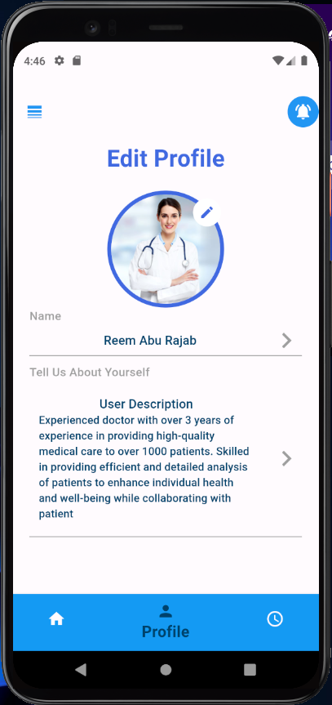
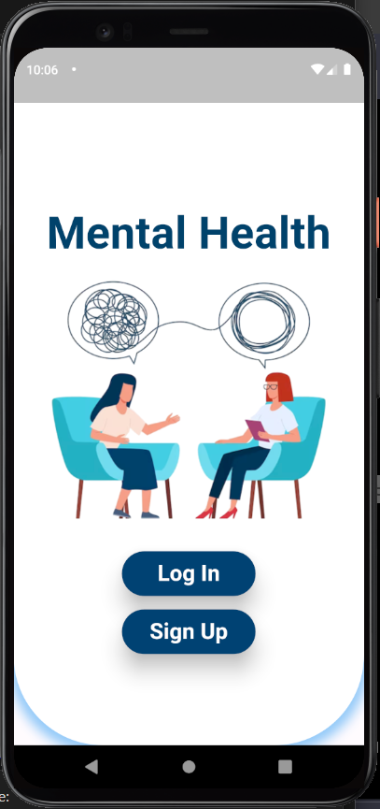
Mobile App
prohibits dispensing medications and disclaims any responsibility if the patient agrees to take it

Slide 15
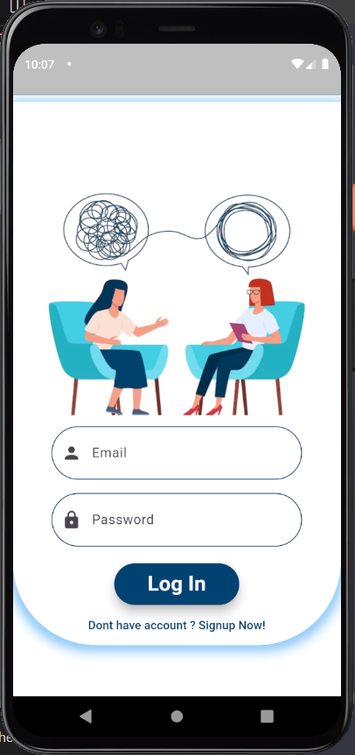
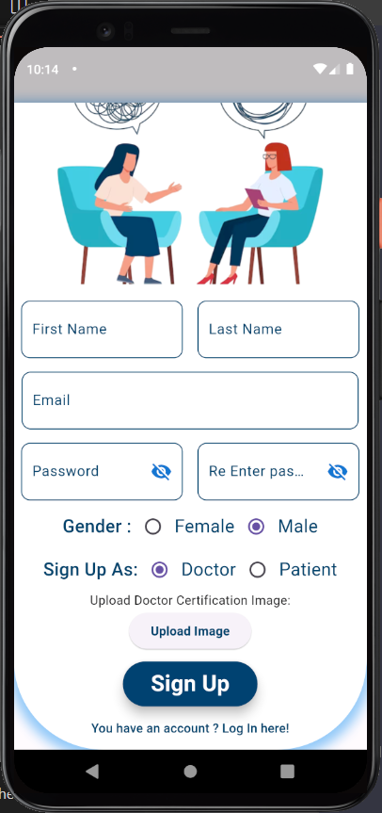
Authentication
Log In
Sign up

Slide 16
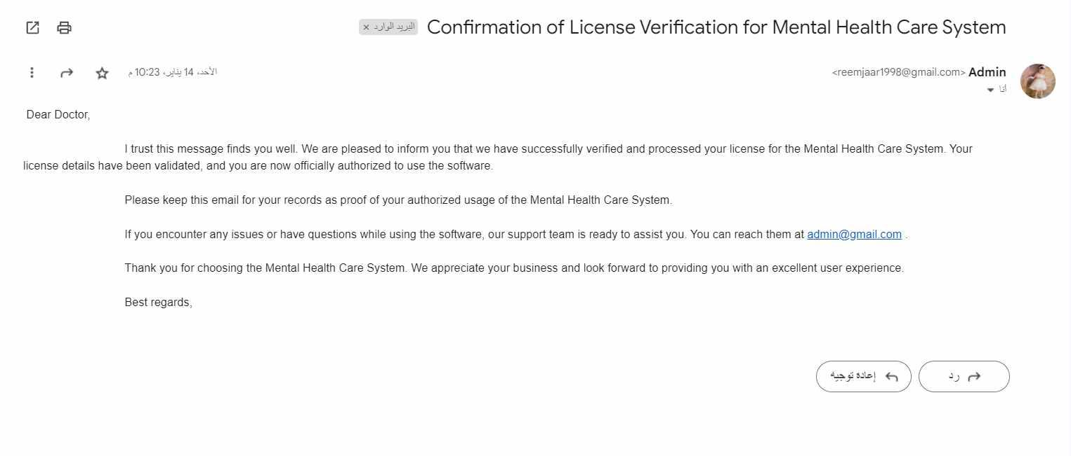
Email
Notifications

Slide 17
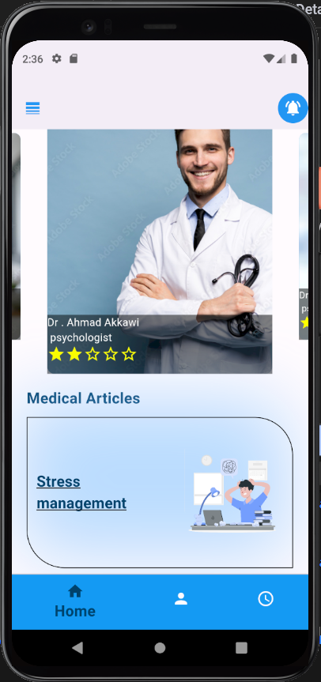
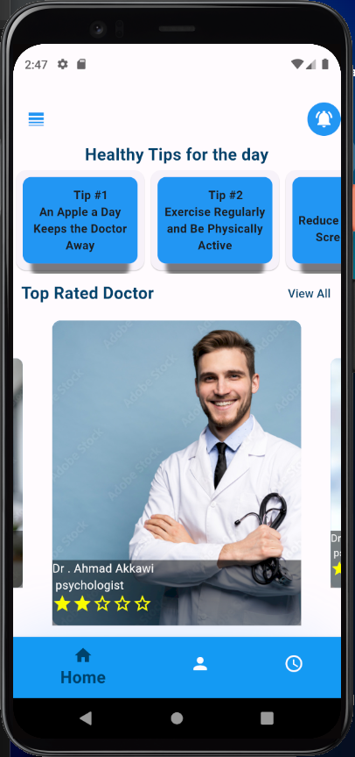
Home Page

Slide 18
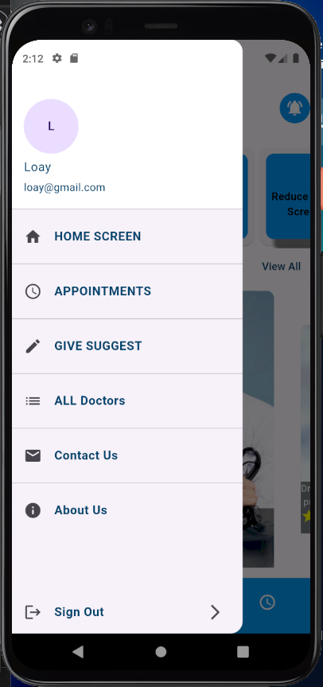
User Navbar

Slide 19
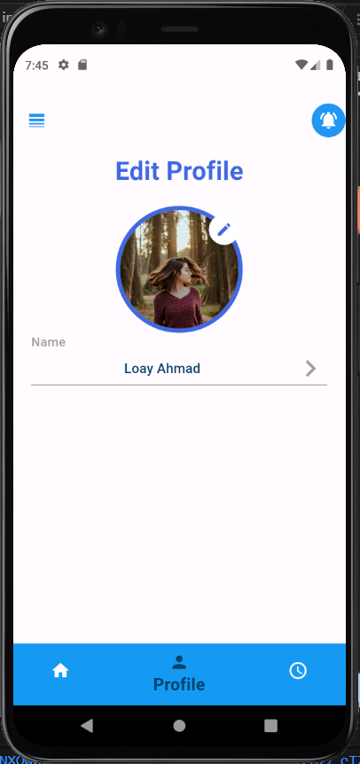
Edit Profile

Slide 20
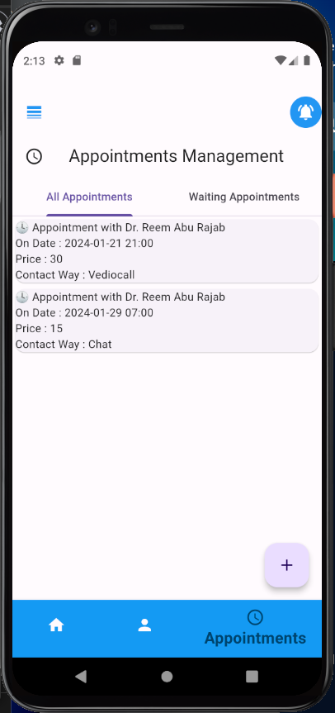
Appointment

Slide 21
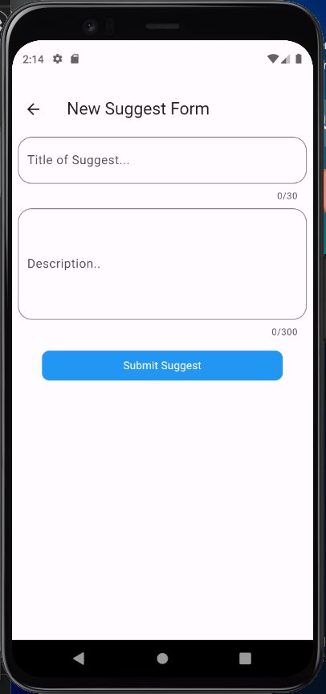
Suggestions

Slide 22
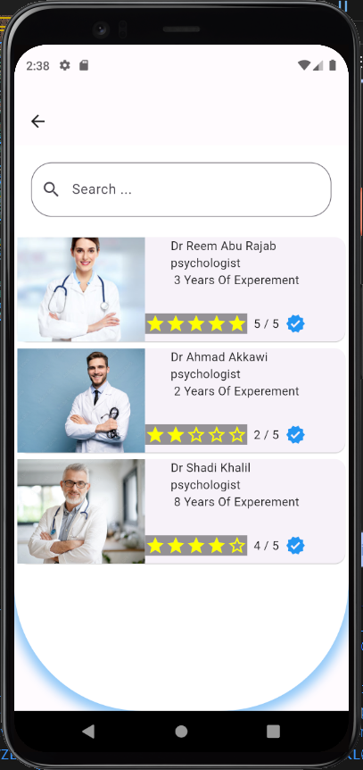
All Doctors

Slide 23
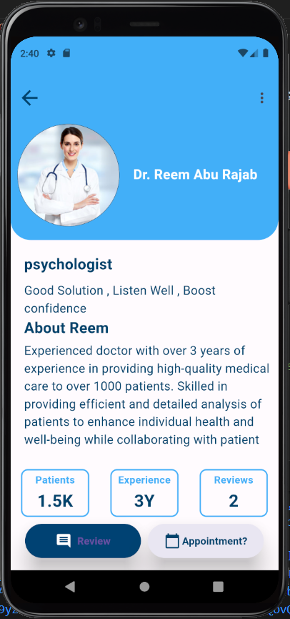
Doctor profile

Slide 24
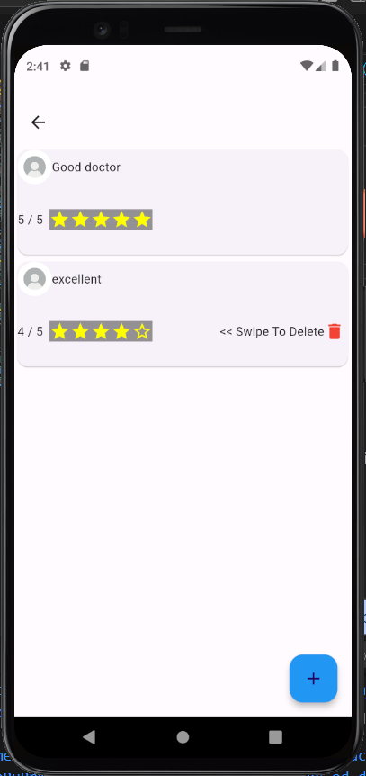
reviews

Slide 25
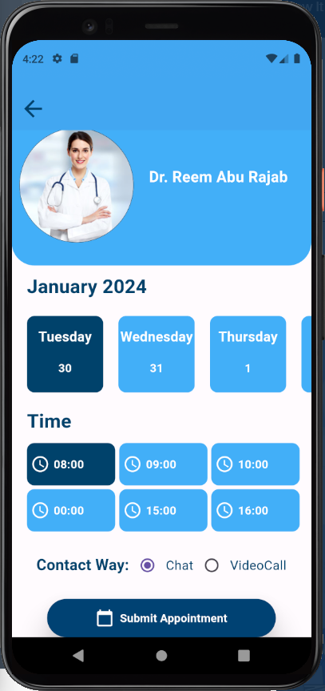
Doctor Available Times

Slide 26
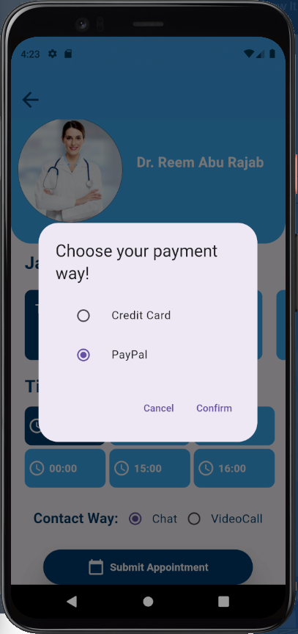
Payment

Slide 27
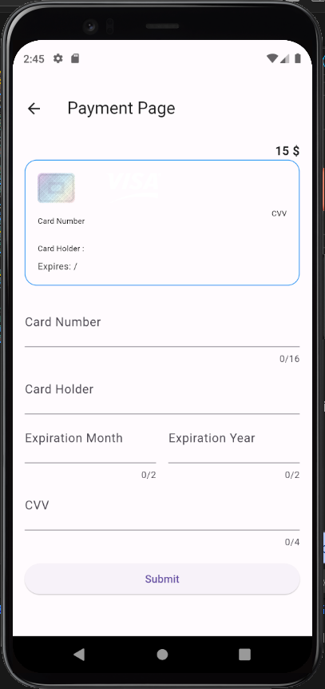
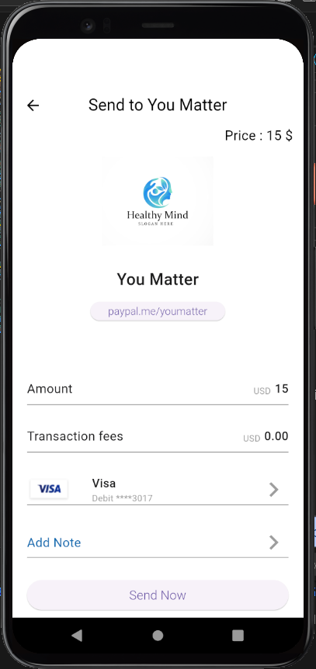
Payment
Mental Health
Mental Health

Slide 28
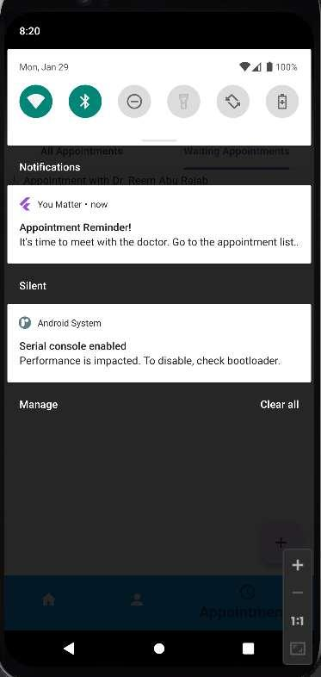
System
Notifications

Slide 29
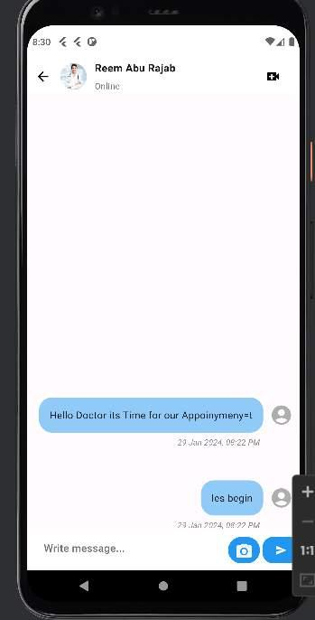
Chatting

Slide 30
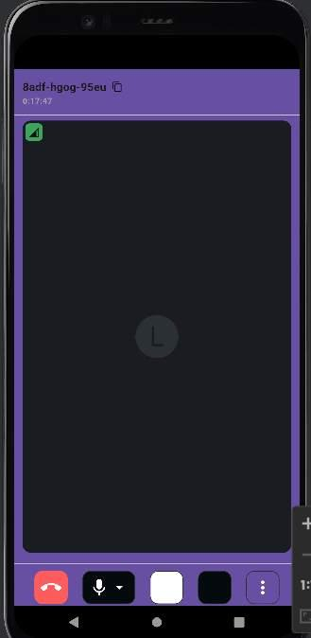
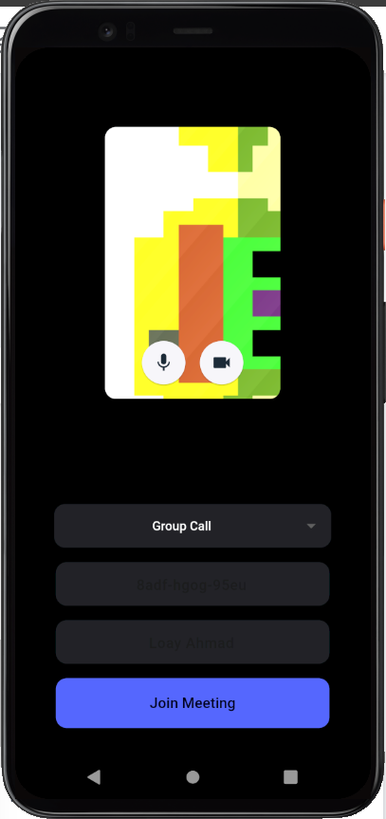
Video Call

Slide 31
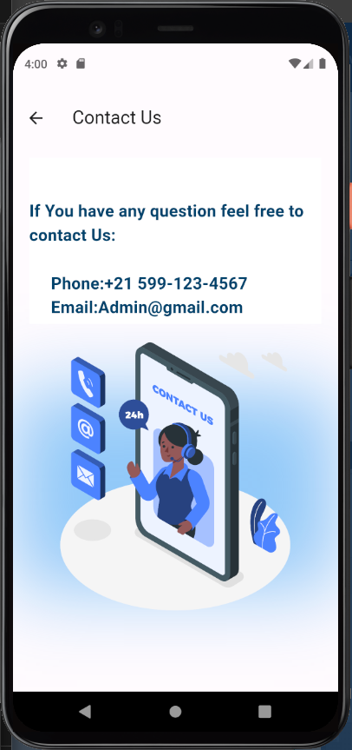
Contact Us

Slide 32
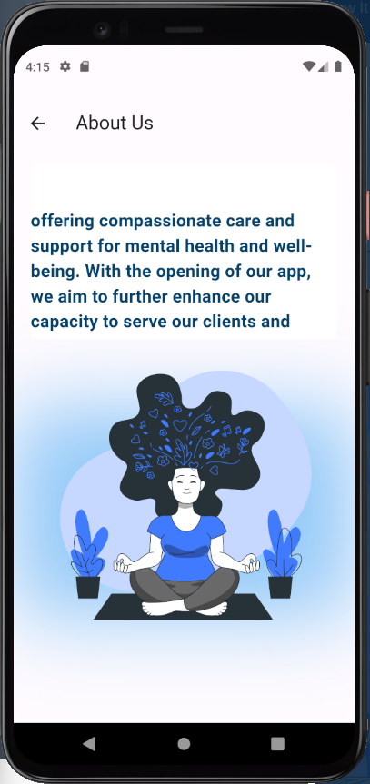
About Us

Slide 33
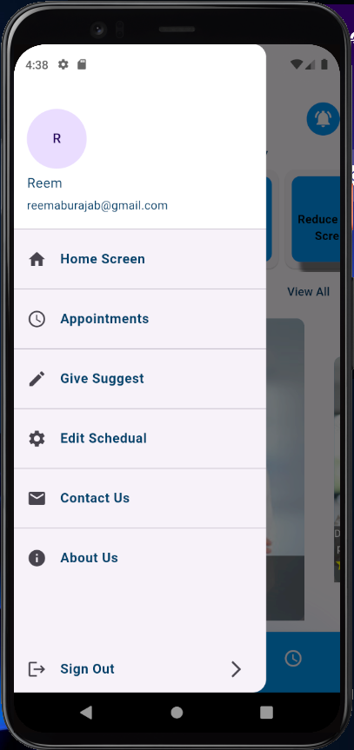
Doctor Navbar

Slide 34
Edit Doctor Profile

Slide 35
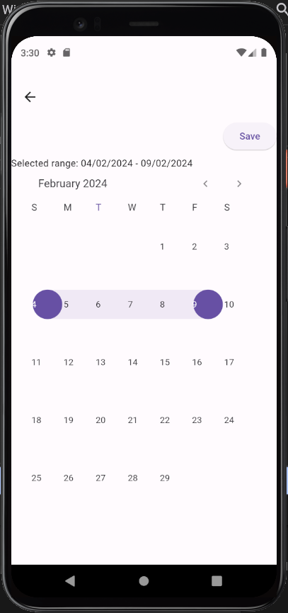
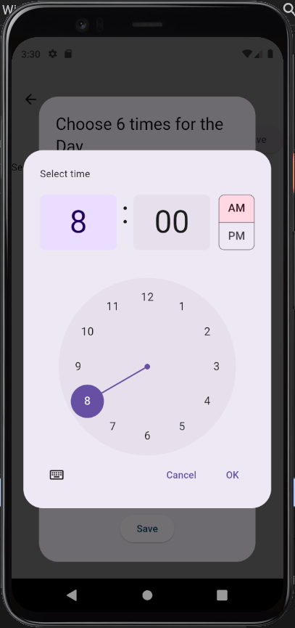
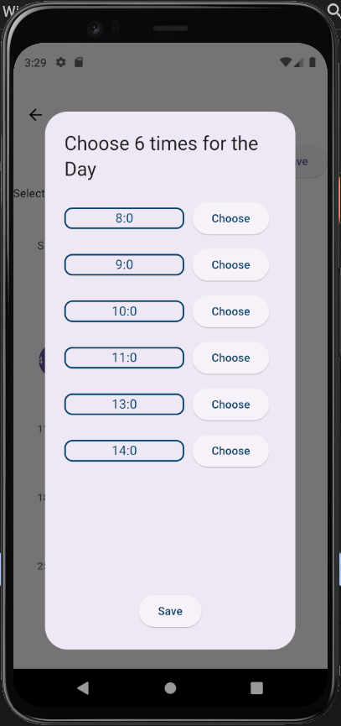
Doctor schedulaing
4
9

Slide 36
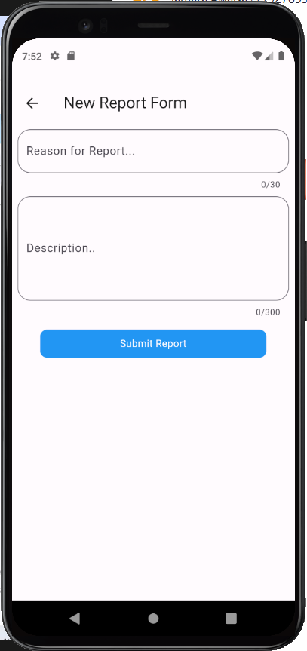
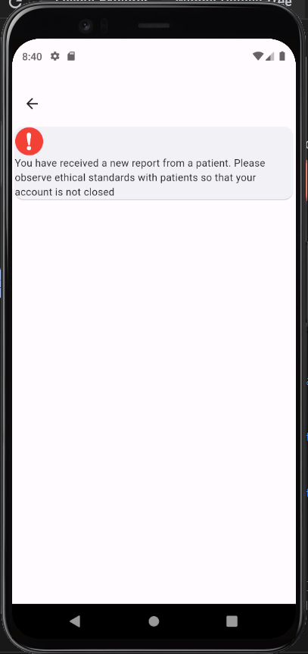
Report
Doctor Receive a Report

Slide 37
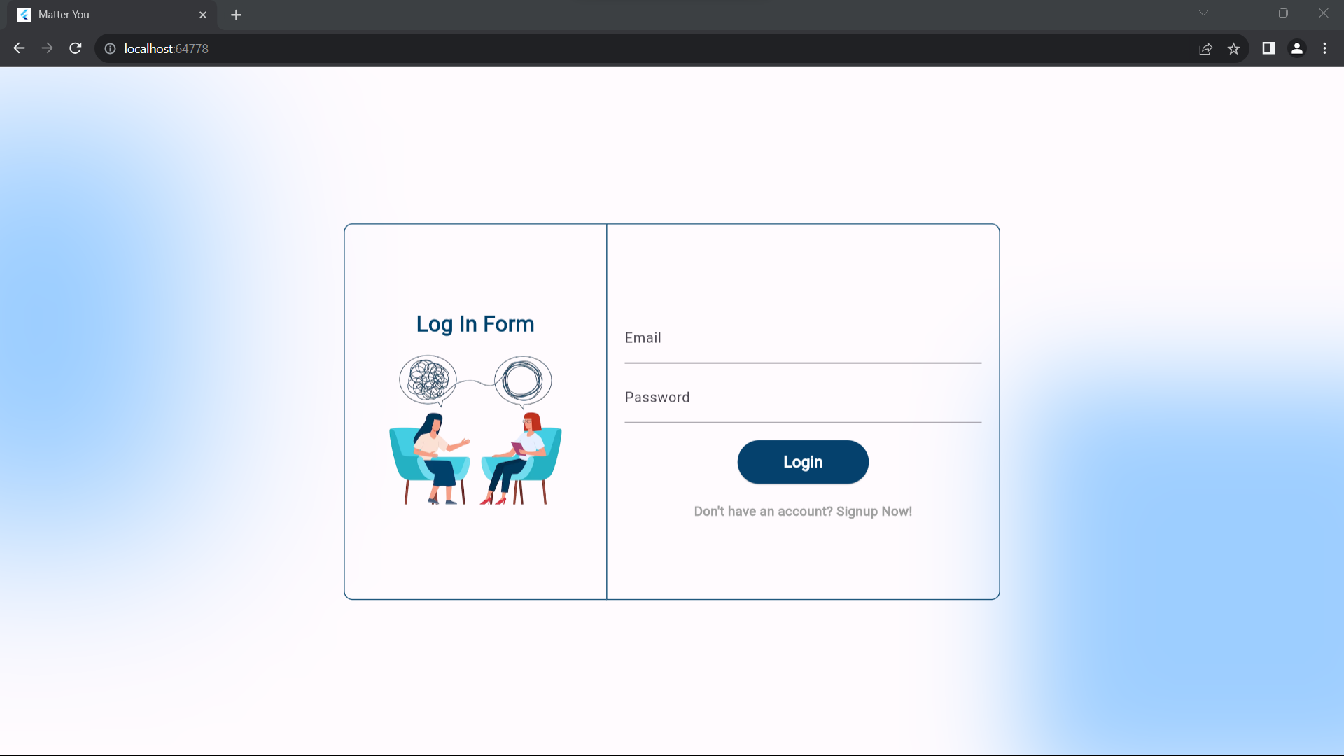
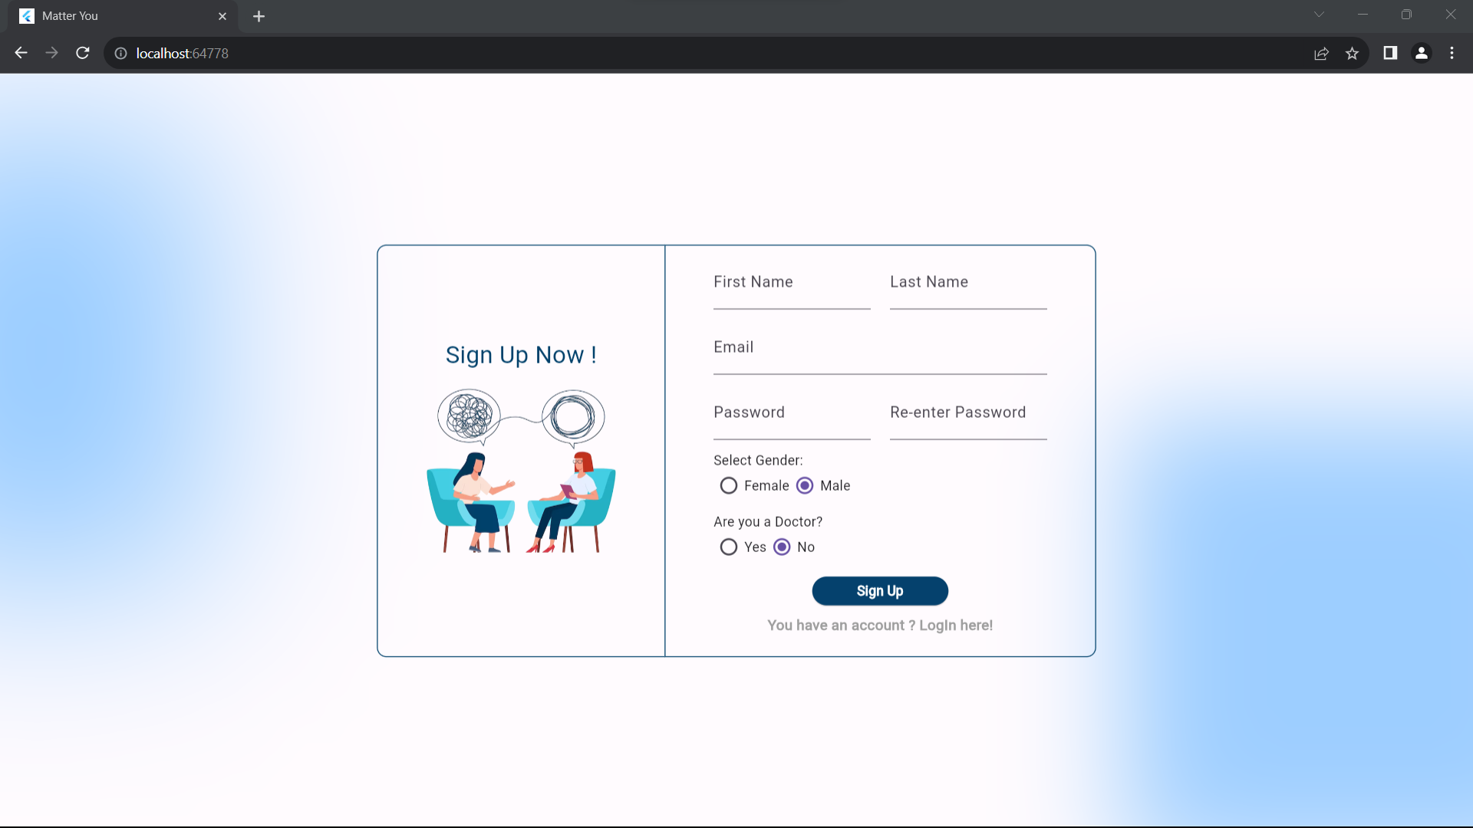
Authentication
prohibits dispensing medications and disclaims any responsibility if the patient agrees to take it

Slide 38
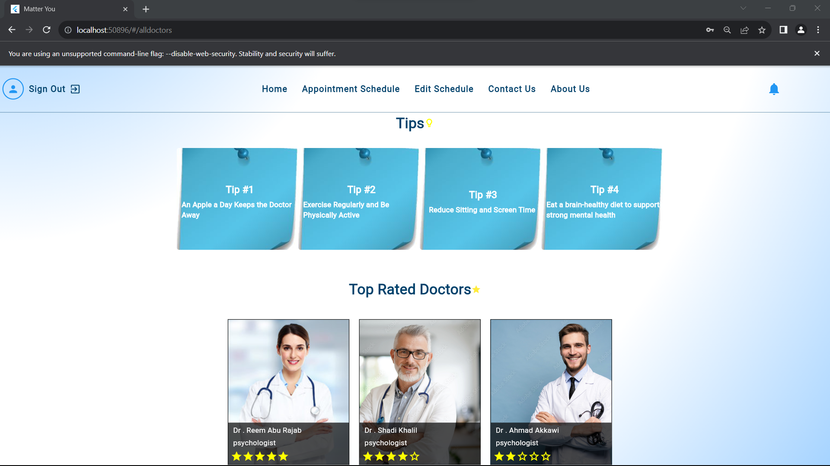
Home Page

Slide 39
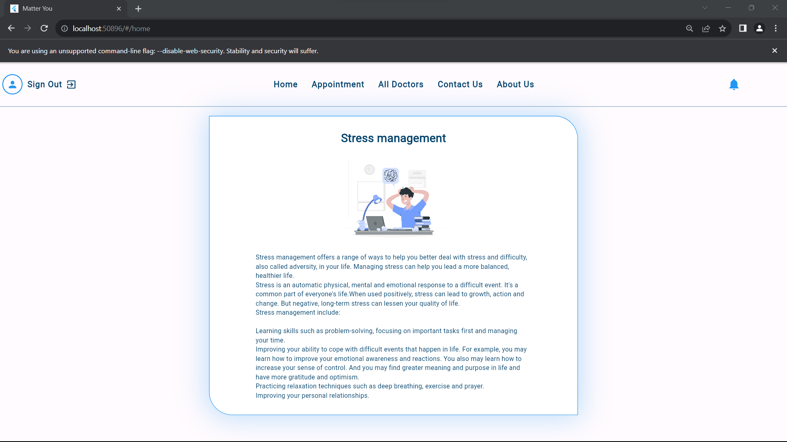
Article Page

Slide 40
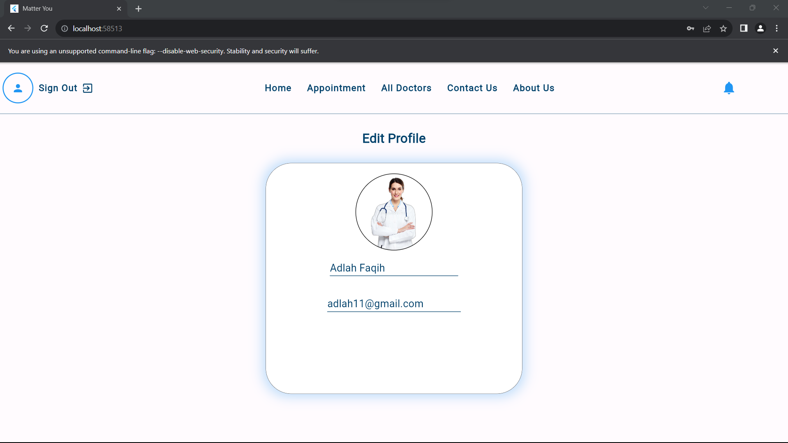
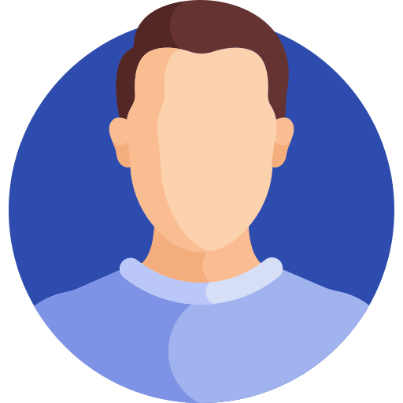
User edit profile

Slide 41
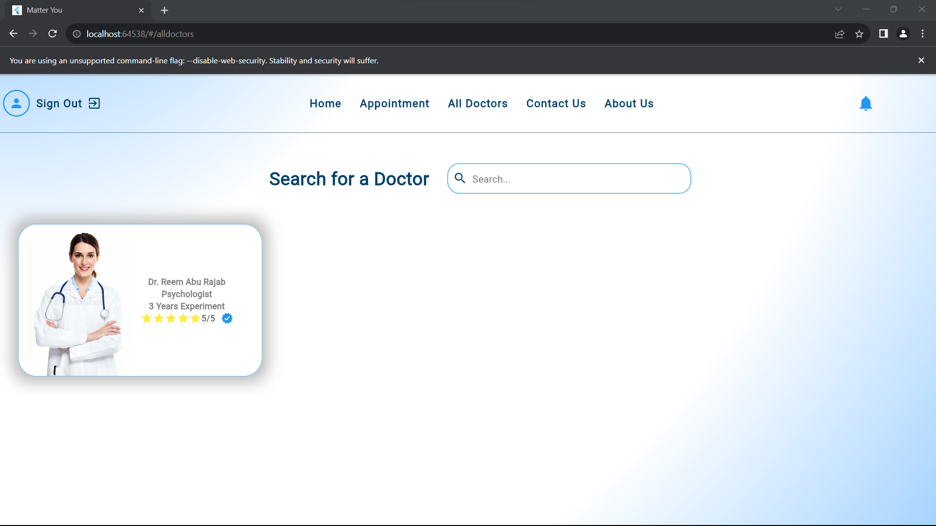
All Doctors

Slide 42
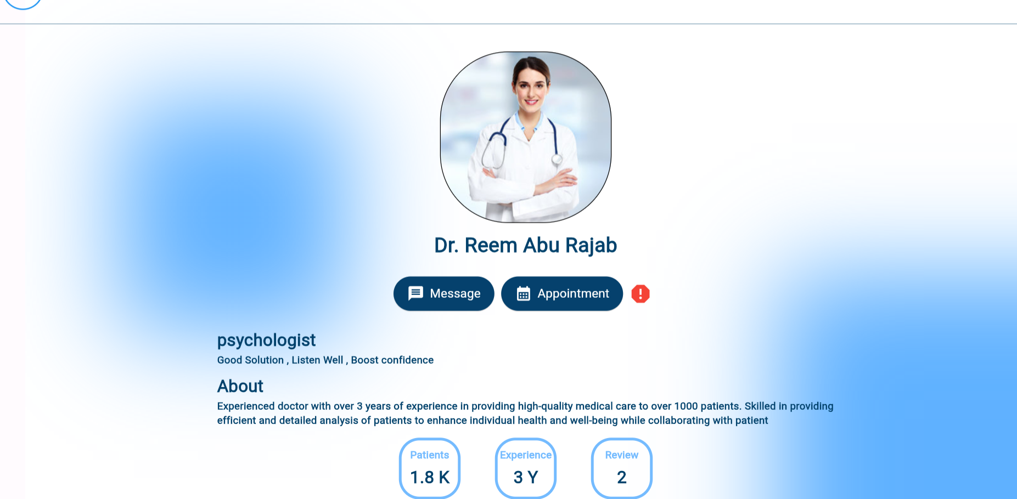
Doctor profile

Slide 43
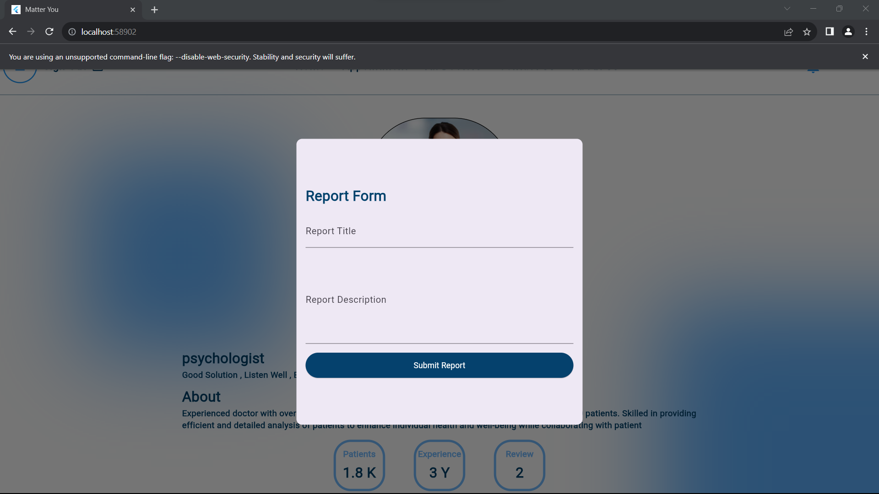
Report Form

Slide 44
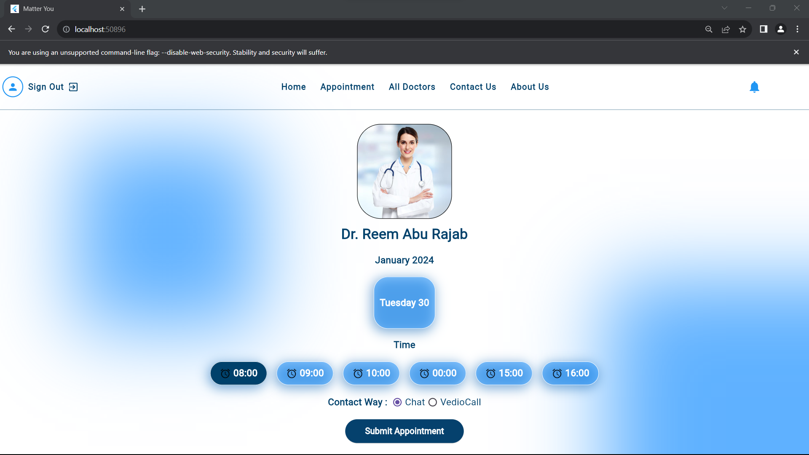
Book Appointment

Slide 45
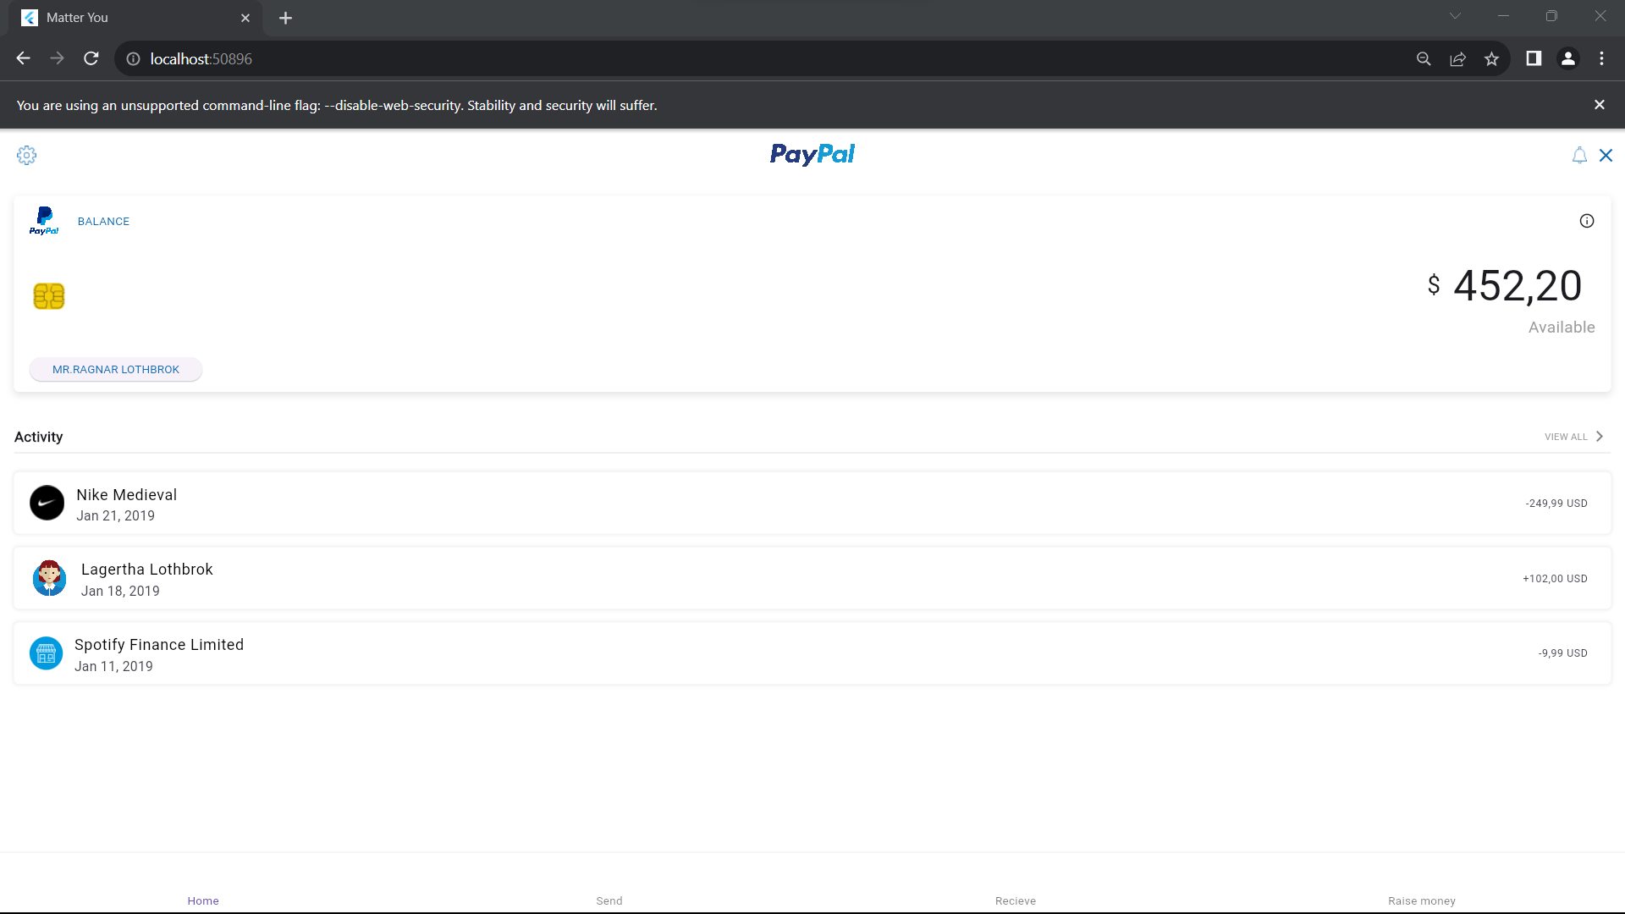
Payment

Slide 46
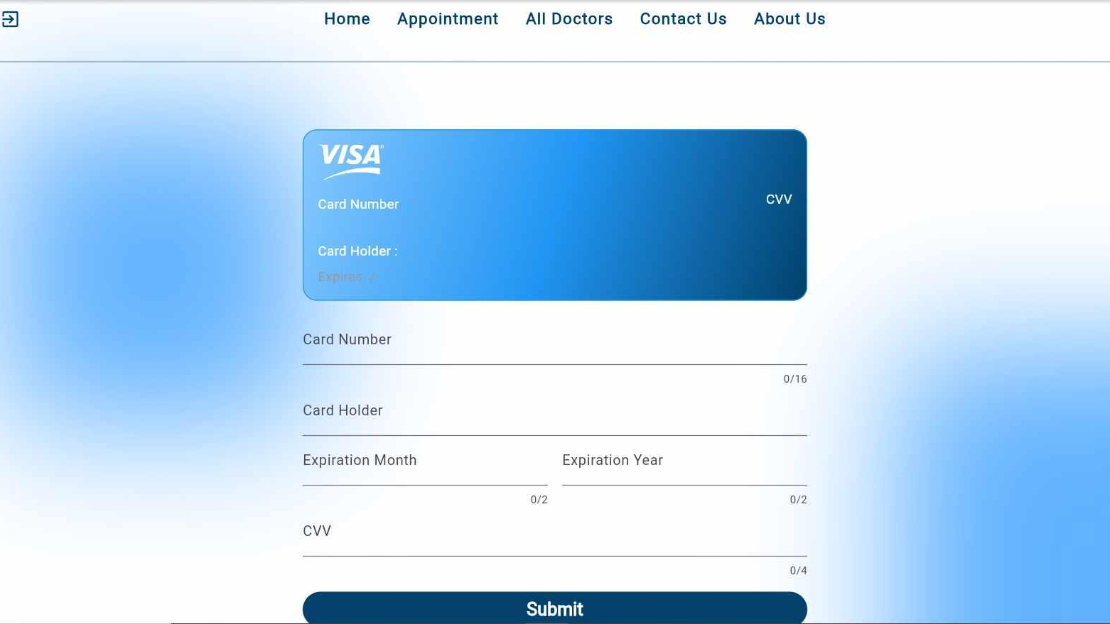
Credit card

Slide 47
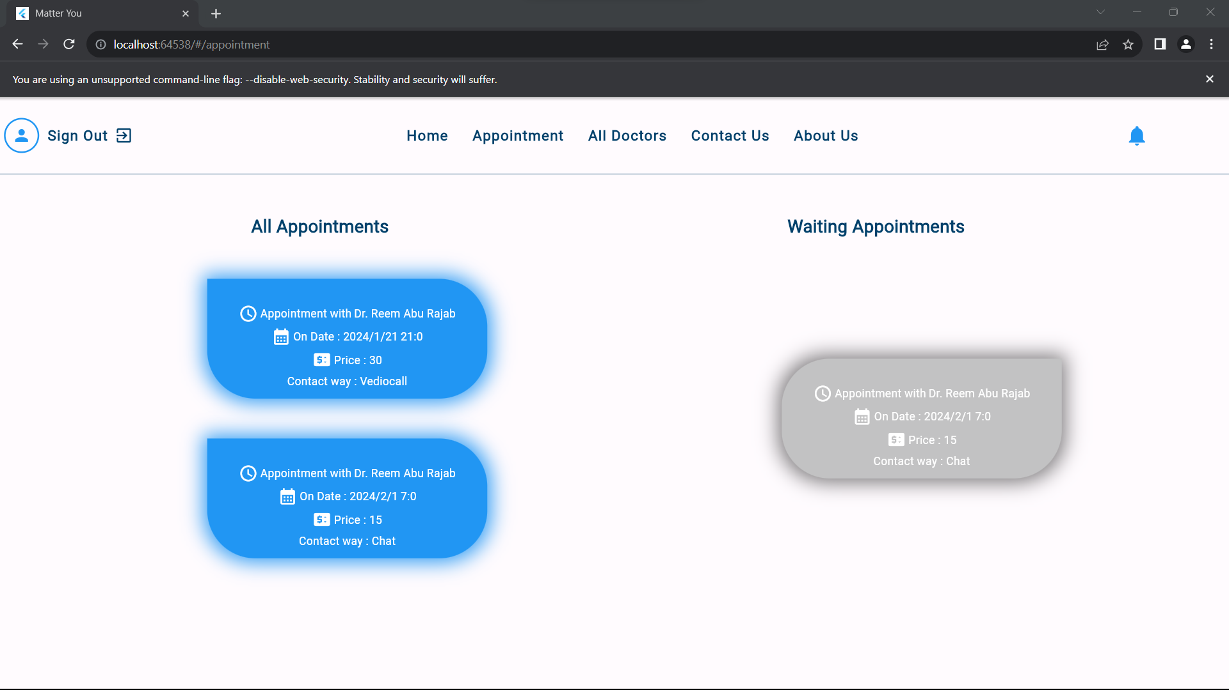
All Appointments

Slide 48
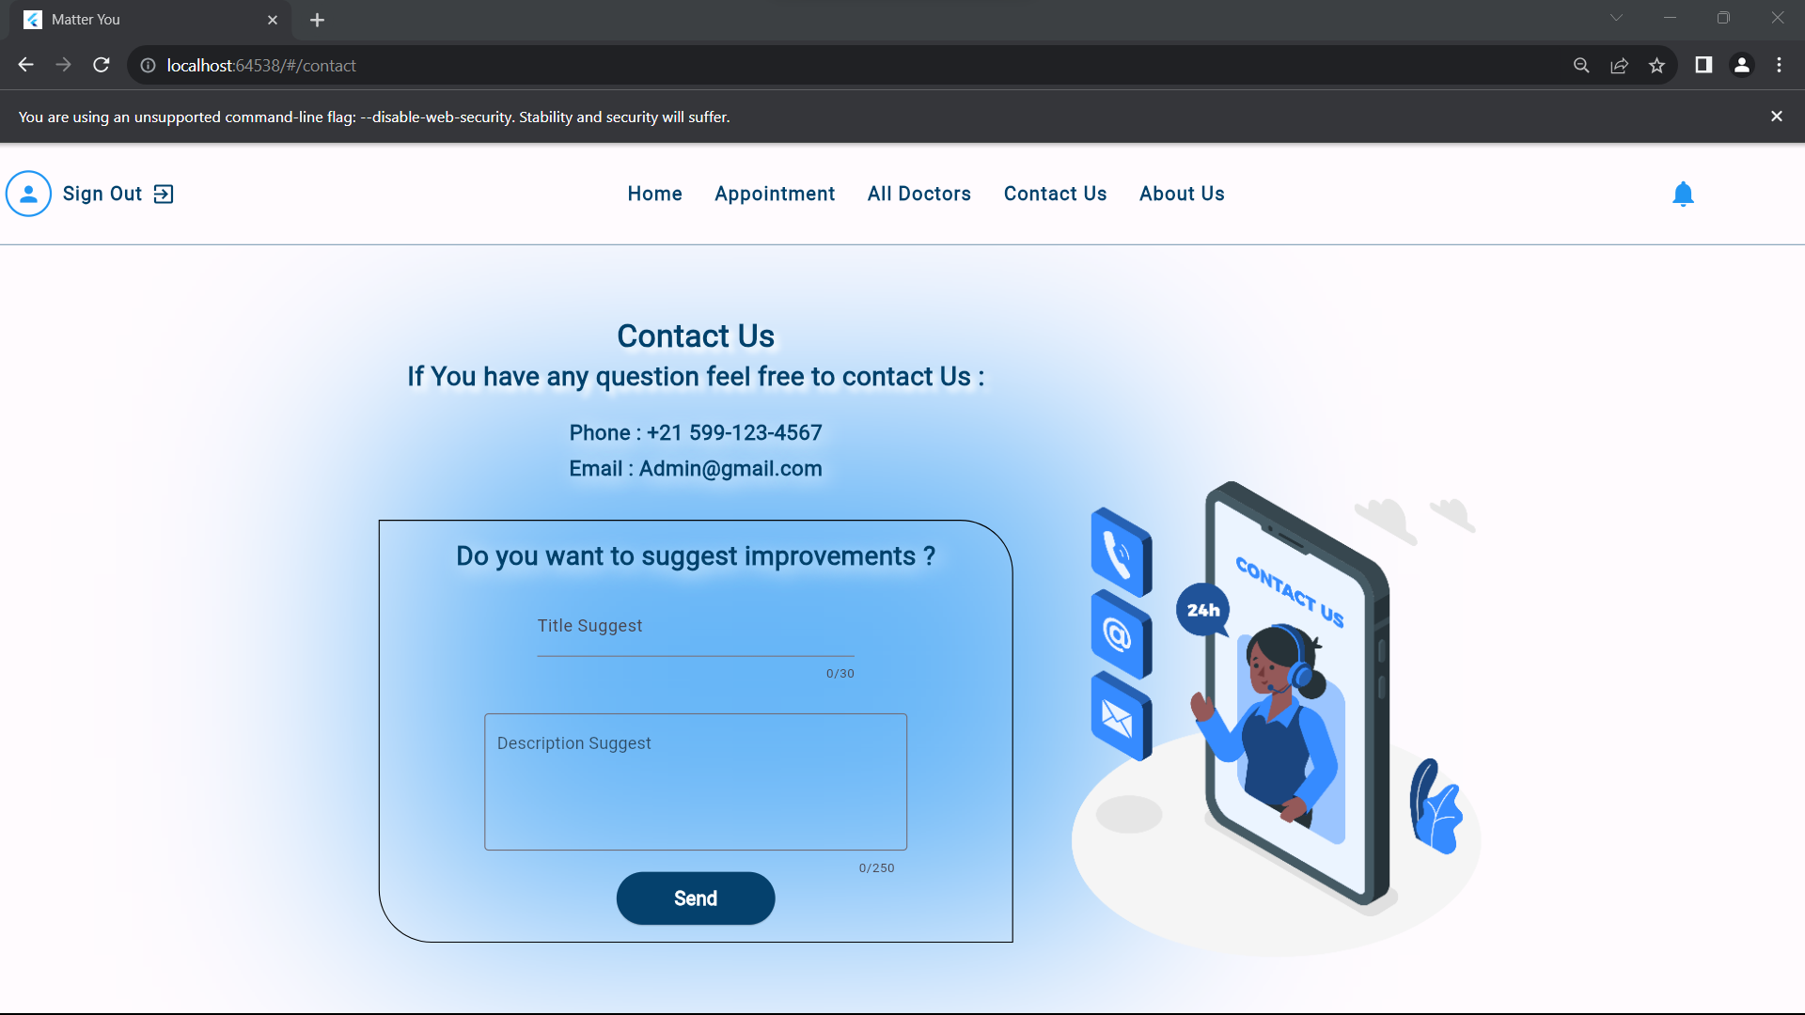
Contact Us & Suggestion

Slide 49
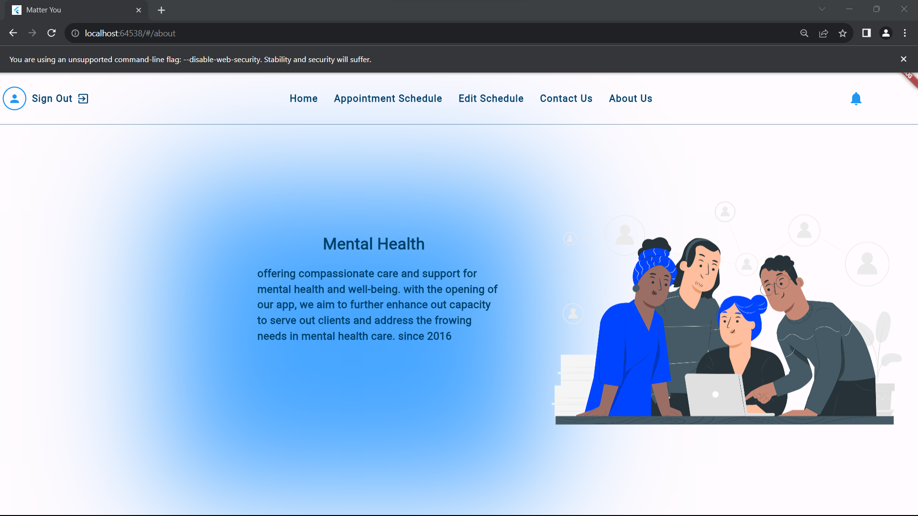
About Us

Slide 50
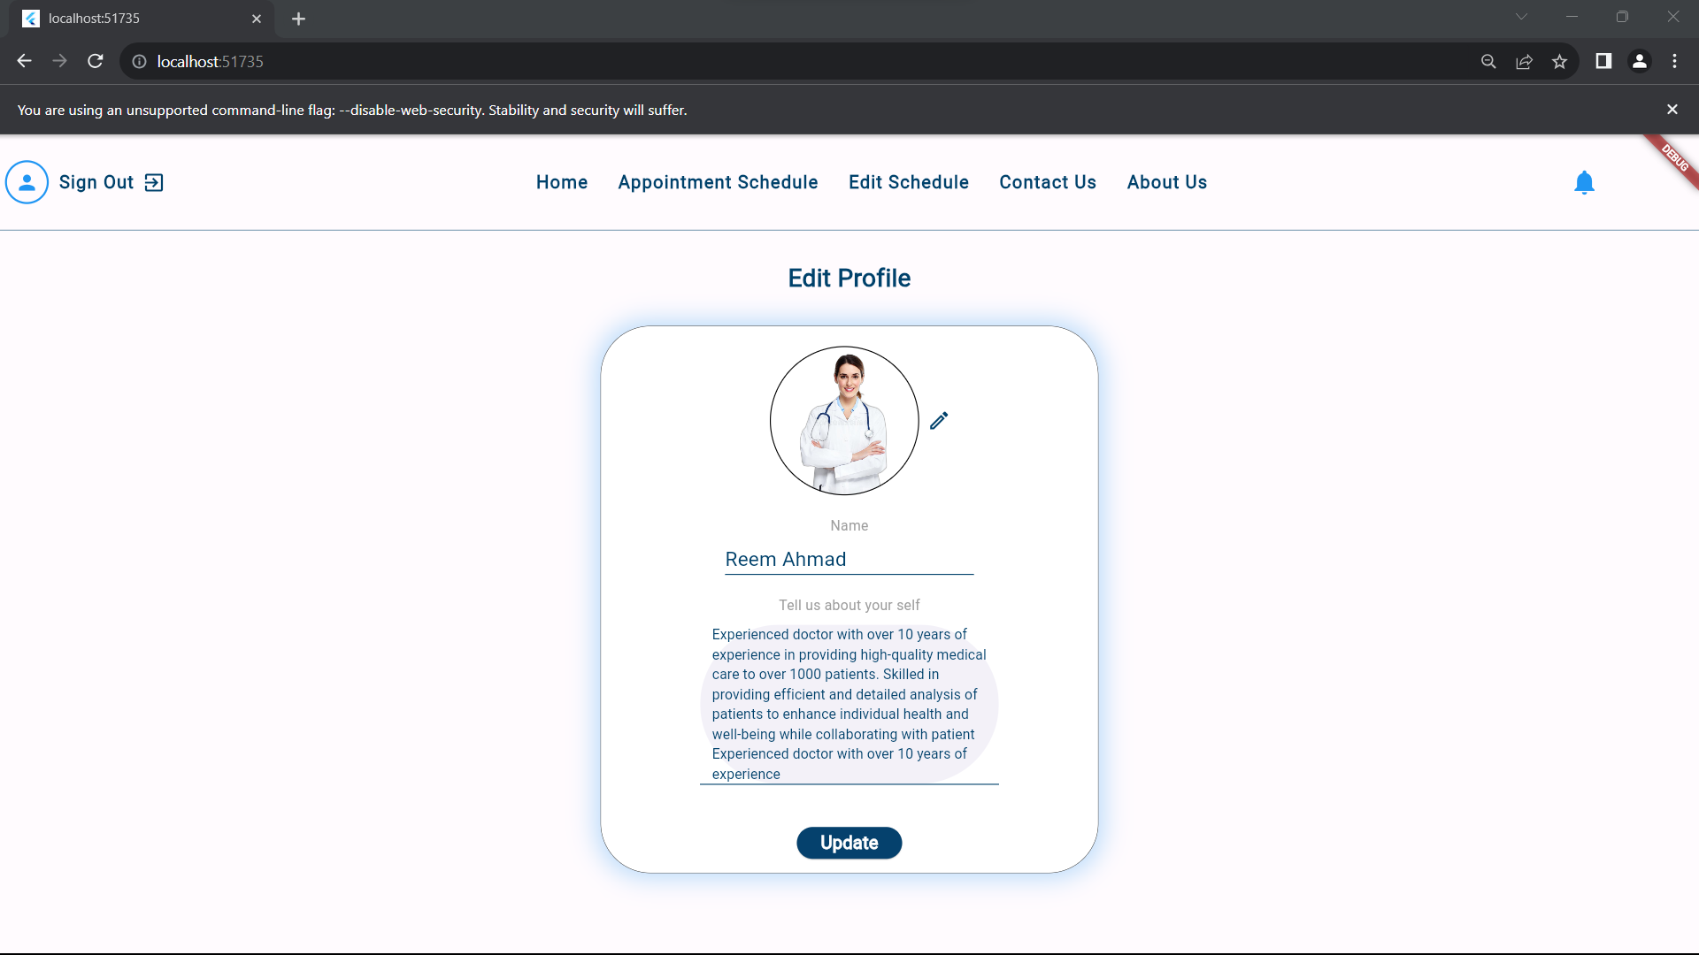
Doctor edit Profile

Slide 51
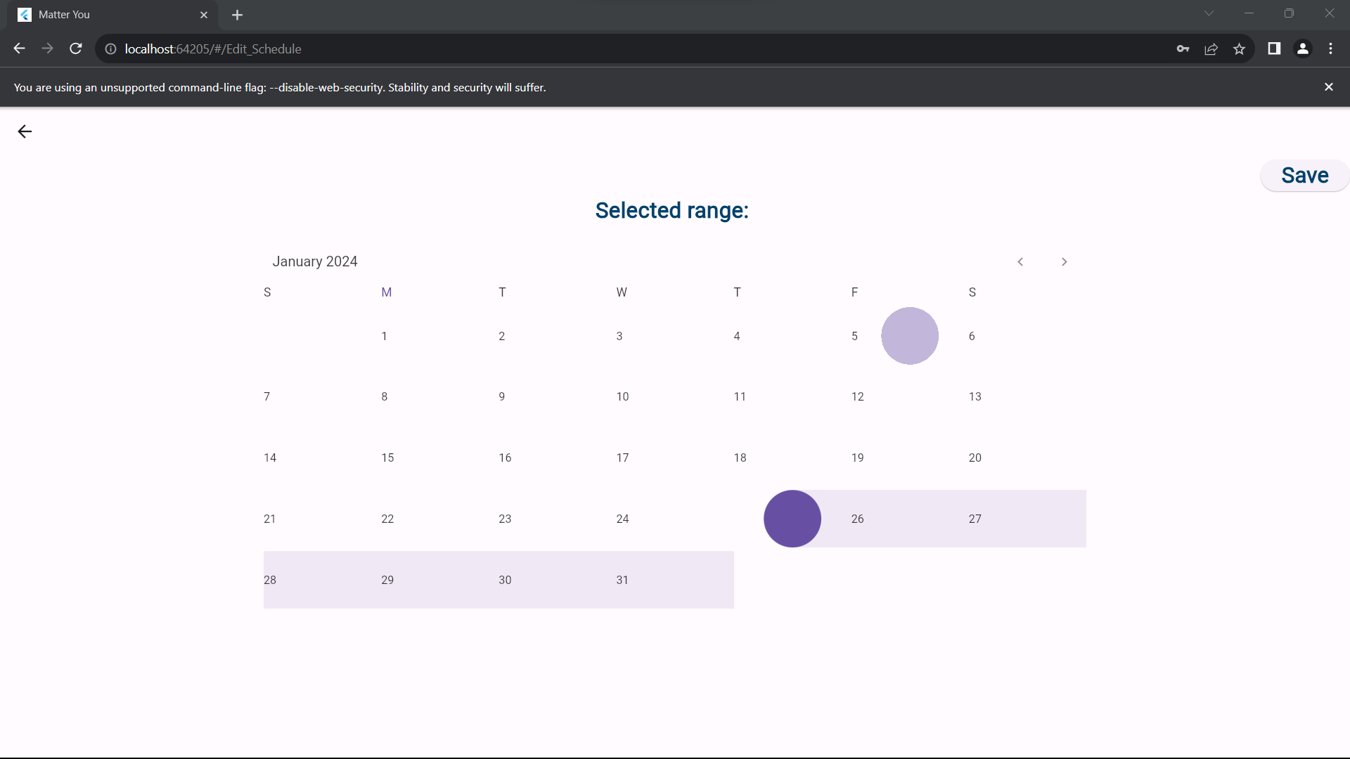
Doctor Edit Schedule

Slide 52
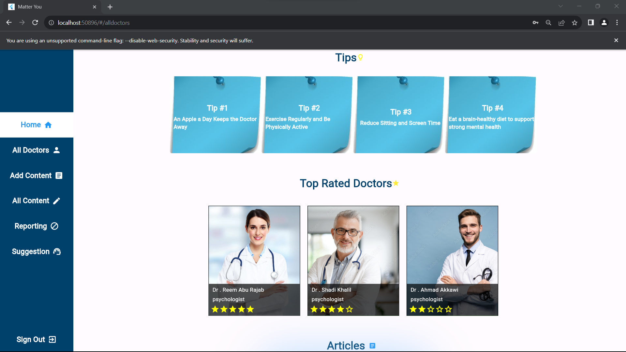
Admin Home Page

Slide 53

Admin All Doctors

Slide 54

Admin Add Content

Slide 55

Admin All Content

Slide 56

Admin Reporting

Slide 57

Admin Suggestion

Slide 58
Future work
We hope to expand our application soon to allow treatment for more than one person per session. For example, couples can conduct a session together in one chat, voice call, or video call, in addition to adding an interface for users that will enable them to add and track healthy habits in their lives, in addition to create a list Music helps relax and heal from anxiety , another suggestion is to make a community forum in the system, podcast.

Slide 59
Constraints :
Limited time .
We encountered challenges in linking the website and the mobile application with the same database, we stuck there for a while.
learning Node.js and Flutter.
Power outage.

Slide 60
Thanks!
Feel Free to ask
Mental.Health.com

