Slide 1

By: Ala’a Haj Ali & Randa Homran
Supervised by: Dr. Anas Toma

Slide 2
INTRODUCTION
DentiLija is a comprehensive web application that assists dentists in all aspects of their work including:
Teeth charting
Clinic management
Dental image enhancement

Slide 3
CURRENT WEB APPLICATIONS
Can be classified into five categories:
Clinic management only
Teeth charting only
Both categories
  Without dental image viewing
Clinic management, teeth charting with basic dental image viewing or editing
Web applications with limited clinic management
  E.g. without dental supplies management

Slide 4
CONTRIBUTION
Our web application provides:
User-friendly and interactive interface for:
  Teeth charting
  Dental image viewing
Addresses local clinics requirements
Full clinic management from adding patients to billings, appointments and dental supplies.
Advanced dental image viewing and editing

Slide 5




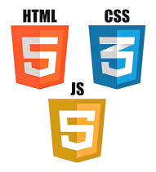


TOOLS AND LANGUAGES

Slide 6
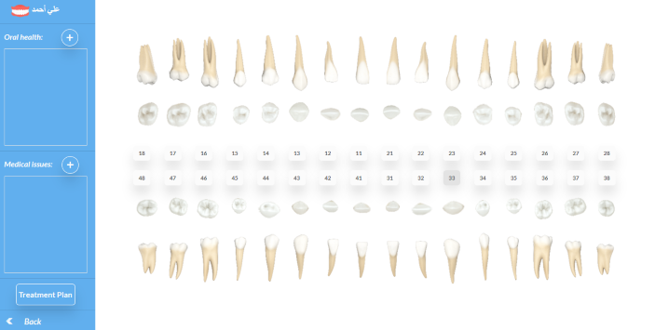
Teeth Chart
Main features:
Easy and interactive interface
Adding predefined diagnoses and treatments

Slide 7
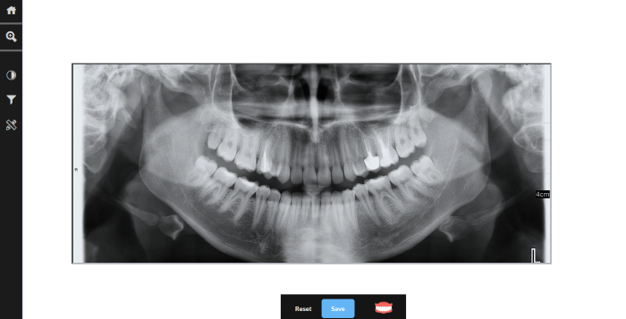
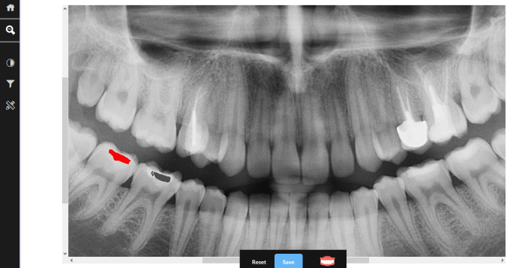
Dental Image Viewing and Enhancement
Very useful tools to analyze and enhance X-ray images
  Automatic filling detection
  Color and light enhancement
  Inverting Images to clarify some details
  Measurement
  Zooming on specific areas
Makes diagnosis and treatment easier and faster

Slide 8
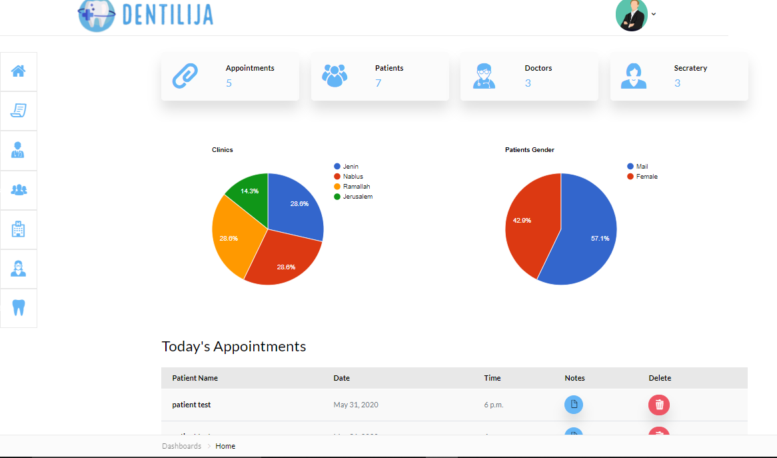
Administration
Main Features:
Different user-interfaces
  Administrator, dentist, personal assistant, patient.
Appointments scheduling
Accounting and billings
Dental supplies management.

Slide 9
Summary
Thank you 😁!
DentiLija serves dentists in all their work areas to make it easier, faster and more organized!

