Slide 1


Staffing Management Project
Presented By :
Rami Hussien
Wisam Jaddo
Supervised By :
Eng. Haya Samaneh
Dr. Manar Qamhieh

Slide 2

OutLine
Introduction.
Problem.
Solution.
Tools And Technologies.
How it works.
Future Work.
Demo.

Slide 3

Introduction
What Is Staffing Mangement Project (Hirey)?

Slide 4

Problem
Job seeking is usually a time consuming.
Finding the right job is not always possible.

Slide 5

Solution
Staffing Management ( Hirey )

Slide 6

Solution(Con’t)
Company Features :
Posting a job.
Finding the applicants that best match the job and skills requirements.
Arranging interviews.
Real-time notifications.

Slide 7

Solution(Con’t)
Applicants Features:
Confirming interview appointments.
Rejecting interview appointments.
Interviewing tips.
Latest news that are related to their major.
Real-time notifications.

Slide 8
Tool And Technologies
Android Studio.
Netbeans.
Database:
* MYSQL Database (Server).
PHP with MVC framework.
Pushbots.
Google Cloud Messaging (GCM)

Slide 9
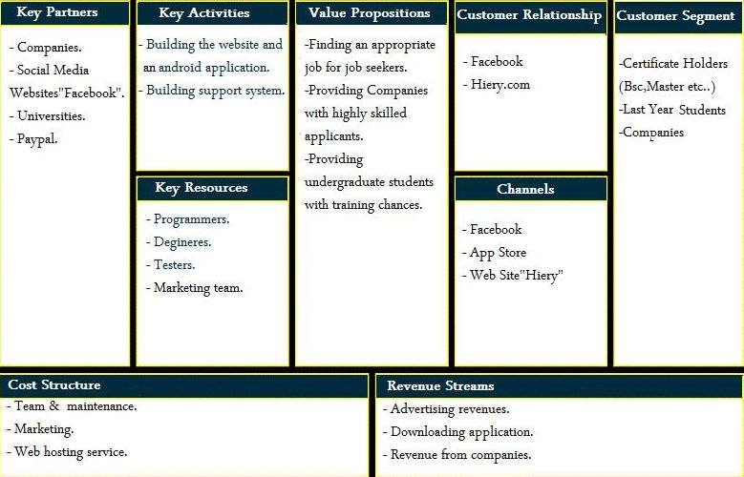
Hirey in a business view

Slide 10
How it works
Company posts a job
Sees the applicants that match the job requirements
Starts arranging interviews

Slide 11
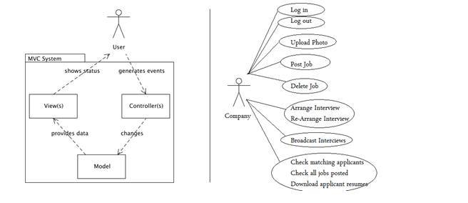
How it works
More details :
Company Side

Slide 12
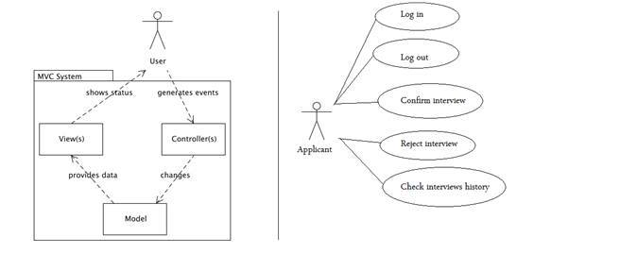
How it works
More details :
Applicant Side

Slide 13
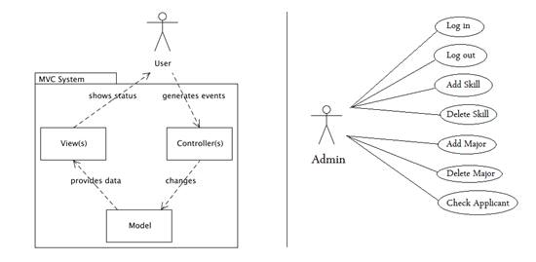
How it works
More details :
Admin Side

Slide 14
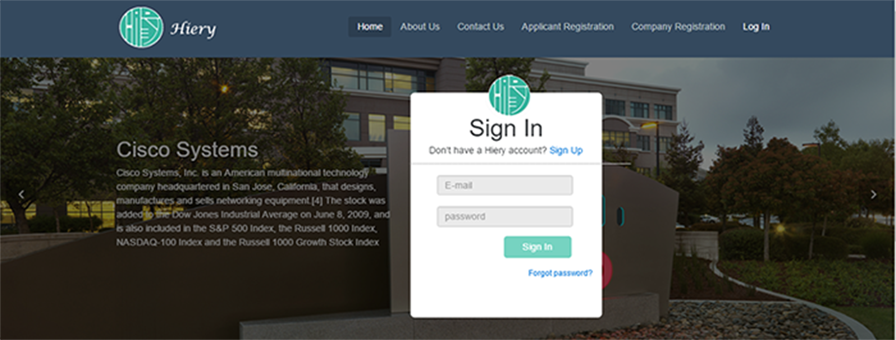
Web Application:
To start posting a job and arranging interviews the company must log in to its own profile

Slide 15
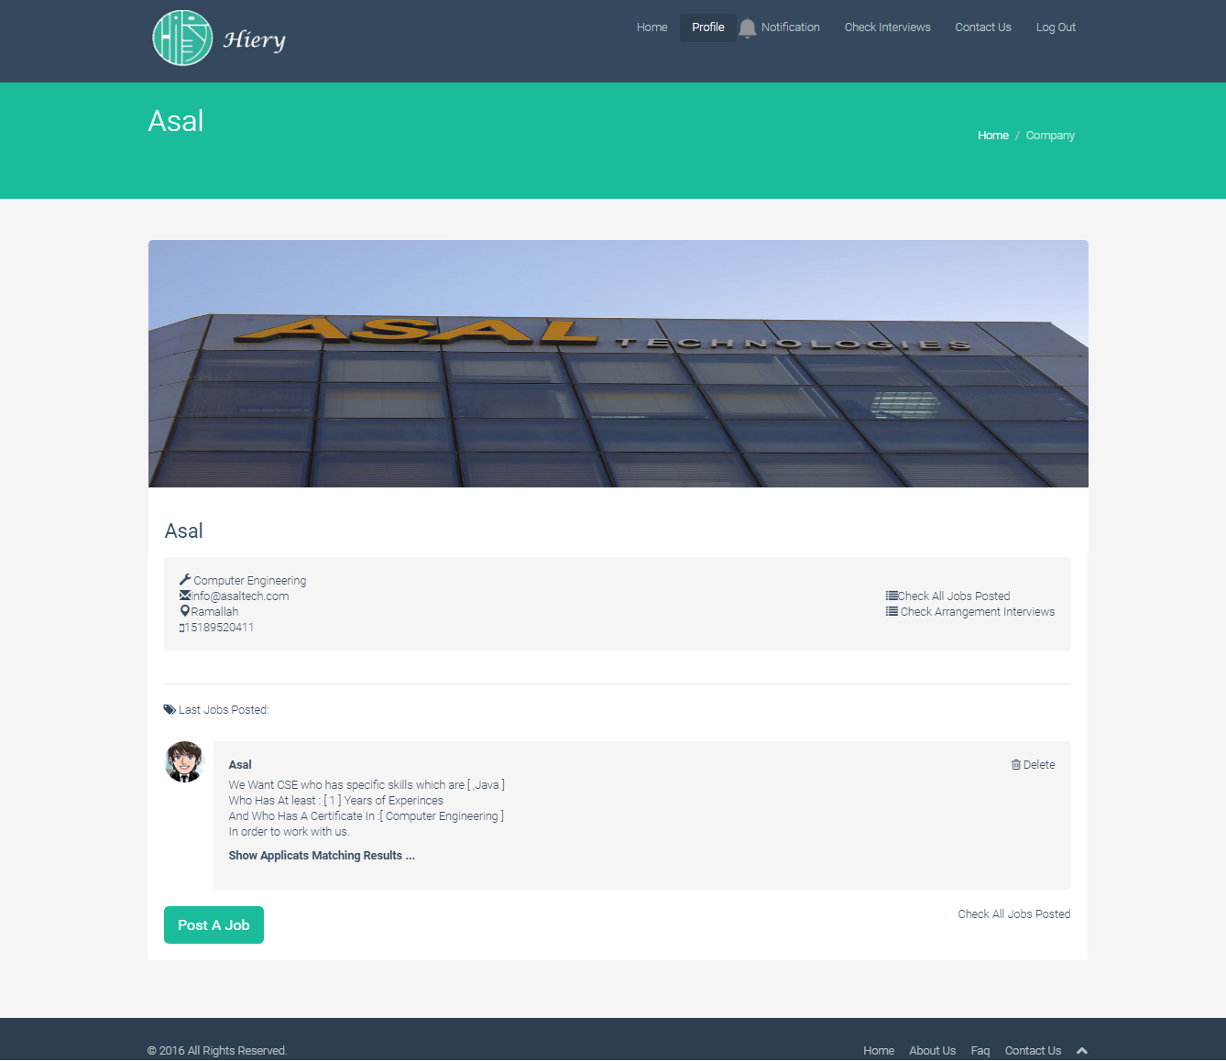
Web Application:
Company Profile Page.

Slide 16
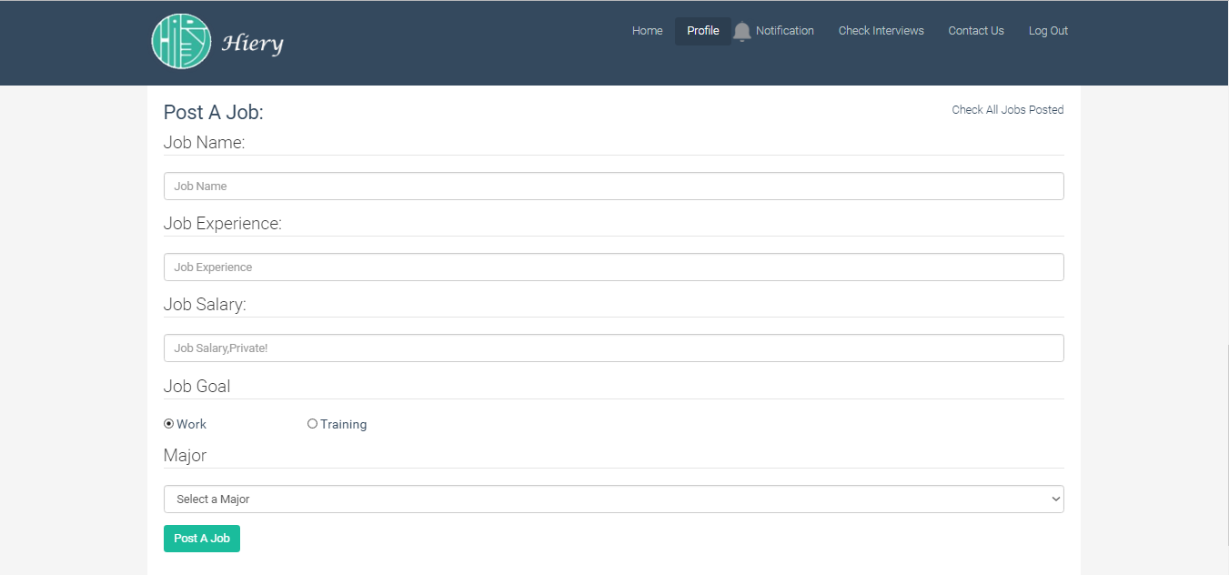
Web Application:
Posting a job

Slide 17
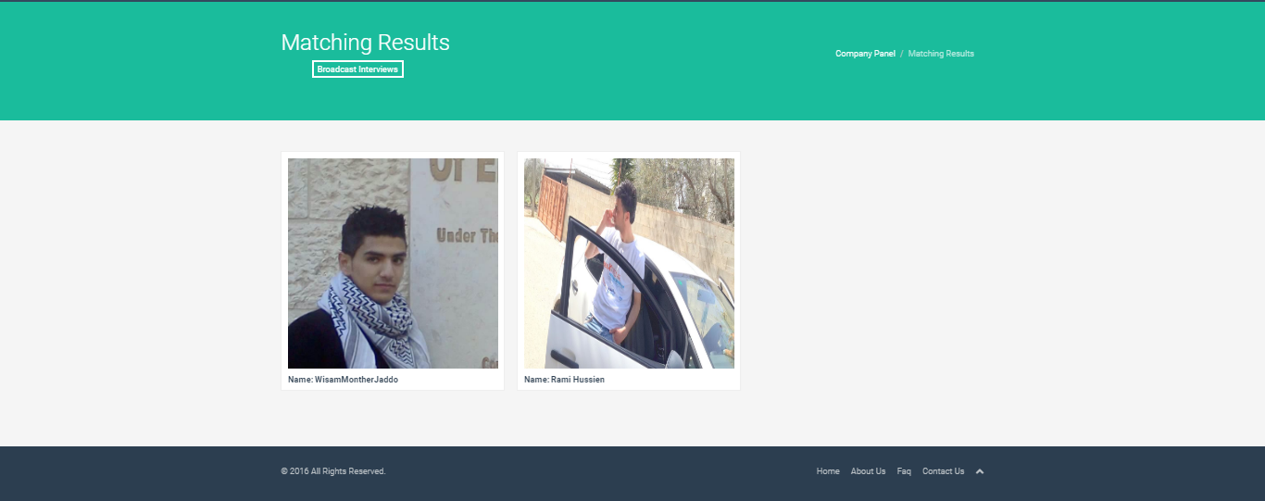
Web Application:
Matching results

Slide 18
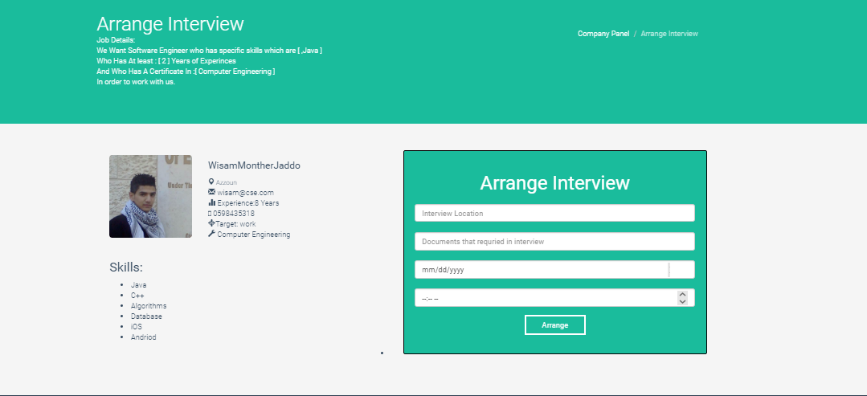
Web Application:
Arranging an interview
with a single applicant

Slide 19
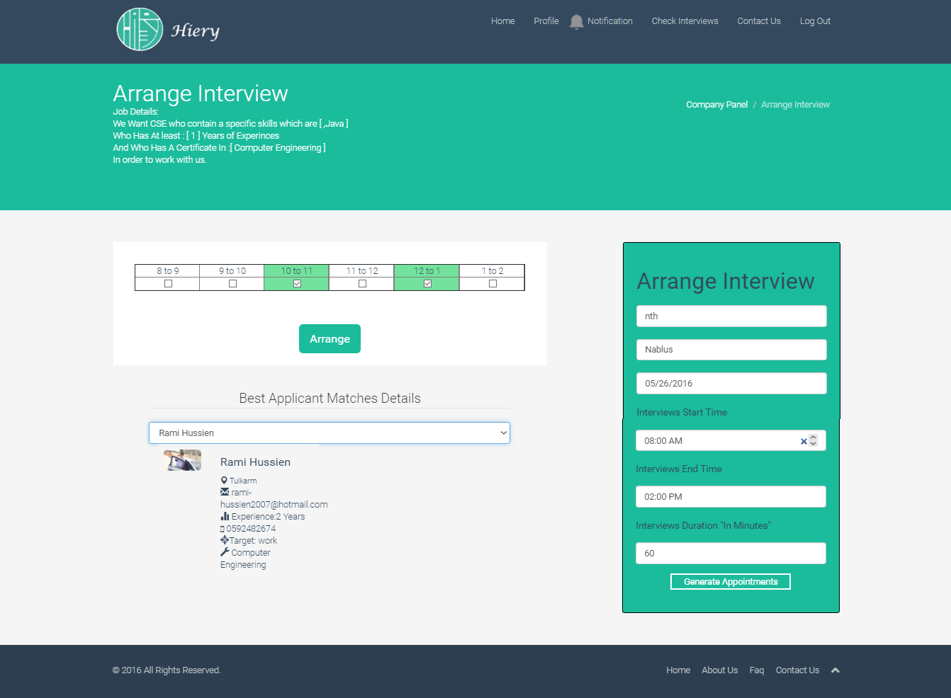
Web Application:
Arranging an interview
with multiple applicants

Slide 20

Place your screenshot here
Android Application:
The android application will be only for applicants in which it’ll let them to confirm or reject an interview appointment and keep track of latest news and jobs posted by companies.

Slide 21
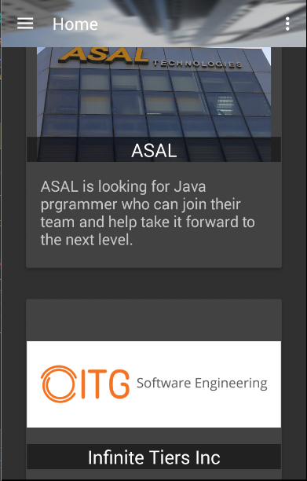
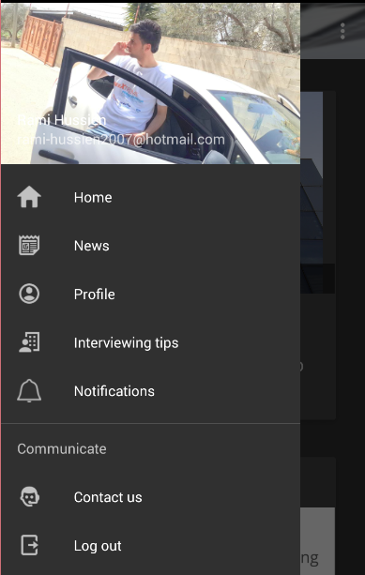
Android Application:
Home fragment which contains the latest job posted by companies

Slide 22
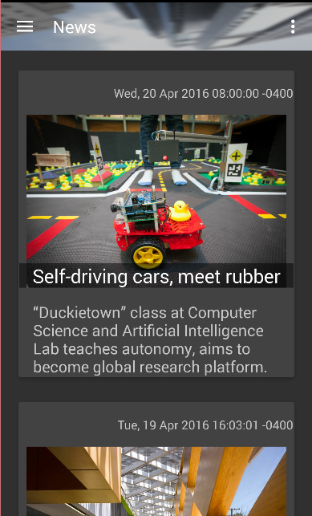
Android Application:
News fragment which contains the latest news related to the applicant major.

Slide 23
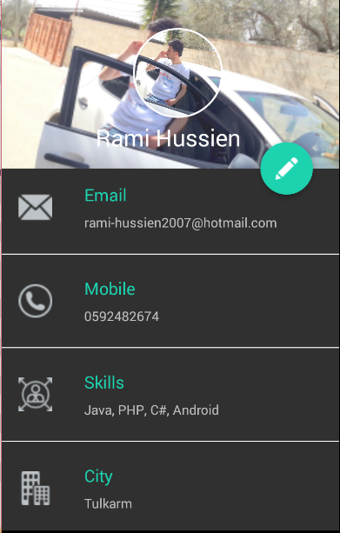
Android Application:
Applicant profile that contains
all details about the applicant
including his email, mobile, skills, city,
etc.

Slide 24
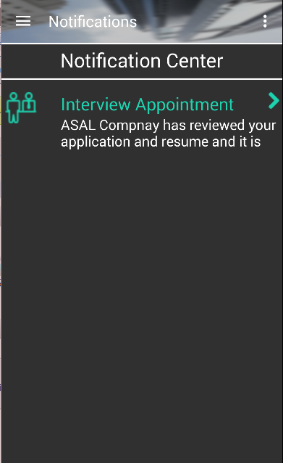
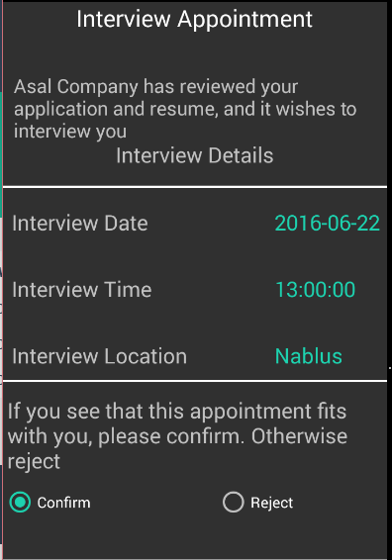
Android Application:
Notification Center which contains all notifications the applicant receives either for interview appointments or any new update in the application

Slide 25
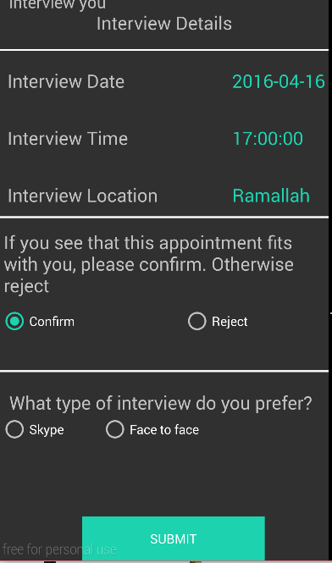
Android Application :
The applicant can either confirm the appointment or reject it. If he confirms it, he’ll be asked about the type of the interview which is either via Skype or Face to face

Slide 26
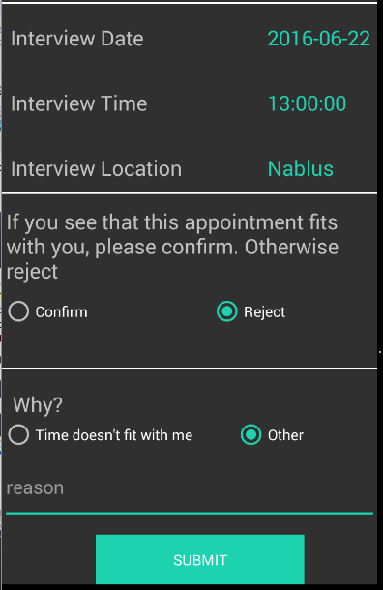
Android Application:
If the applicant rejects the
appointment, he’ll be asked about
the reason

Slide 27
Future Work :
Develop a cross platform application.
Online interview system.
Email companies about the top matching applicants according to the jobs they post.
Interview appointment remainder system.
Interview preparation system.

Slide 28

Demo Time.

Slide 29
Thanks!

