Slide 1

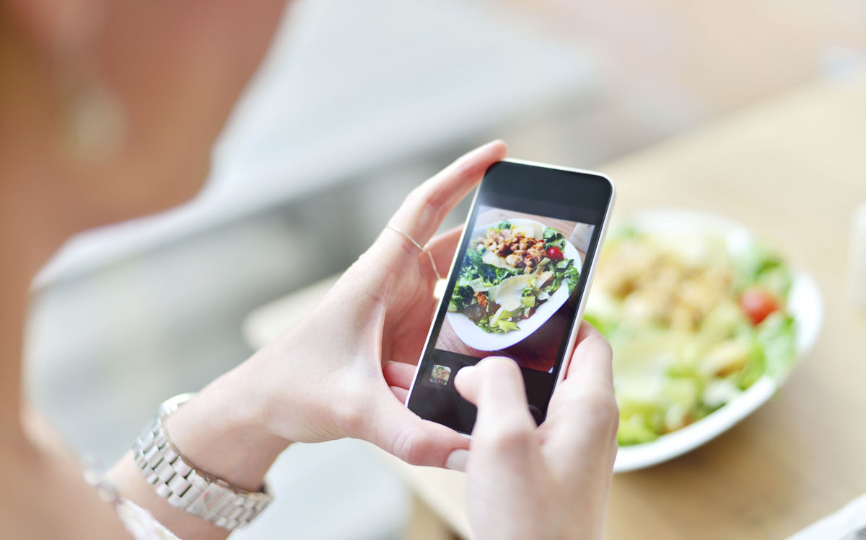

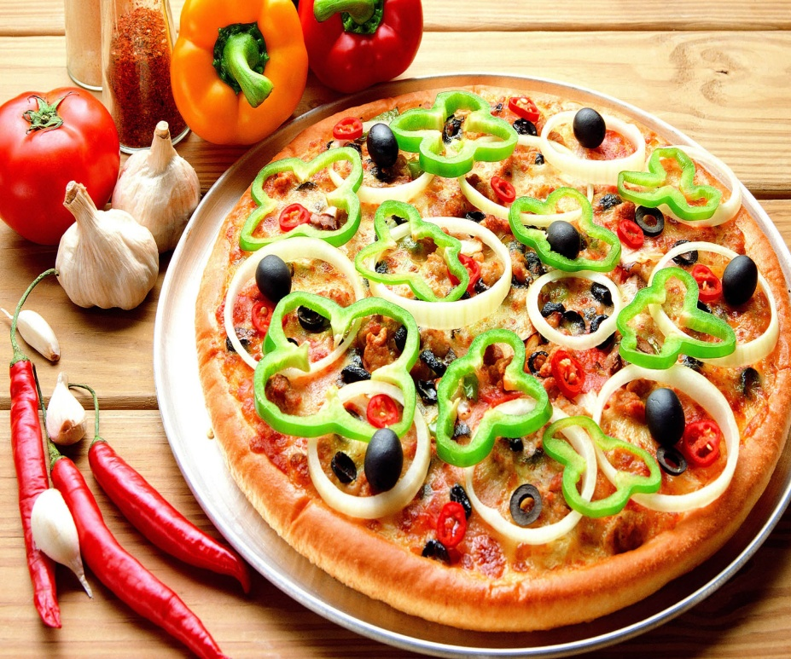
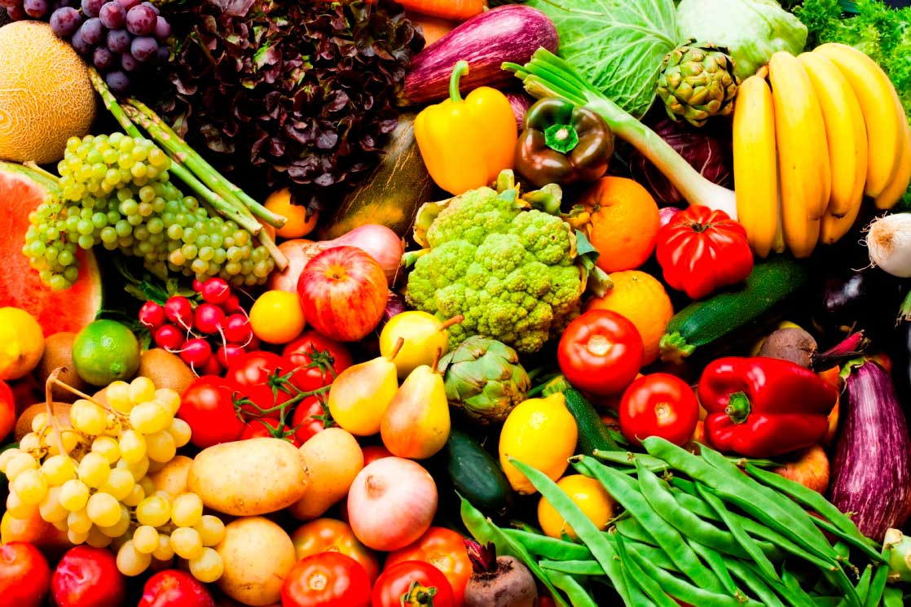
Share Recipes With Your Friends
Shayma Abu Zahra
Rabab Saleh

Slide 2

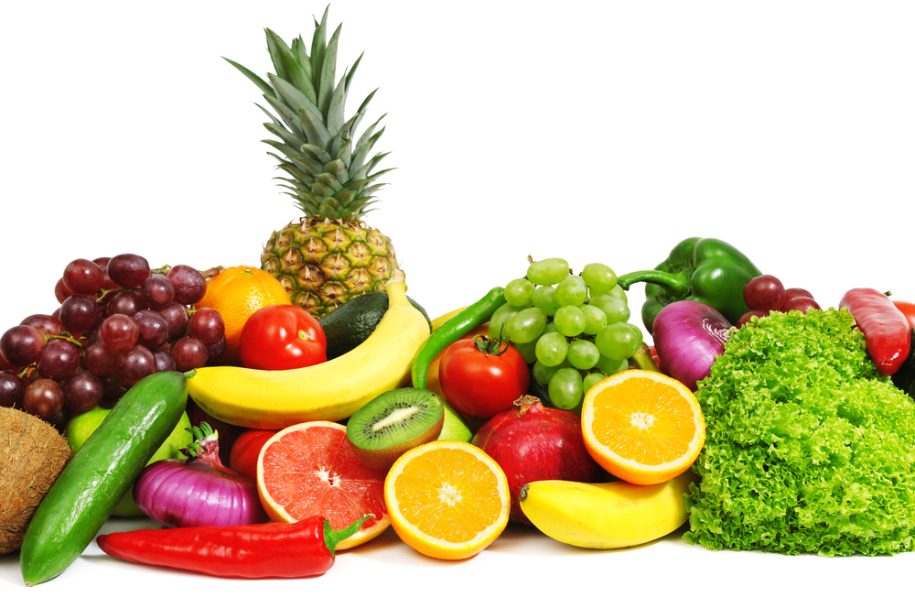
Outline
What is Cucina?
Tools used in our project
Main parts of the project
Demo
Conclusion

Slide 3
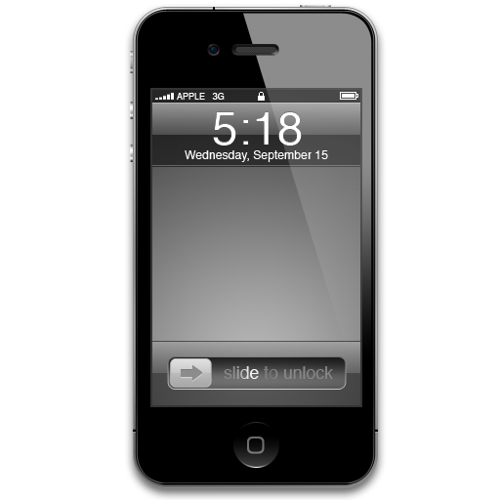
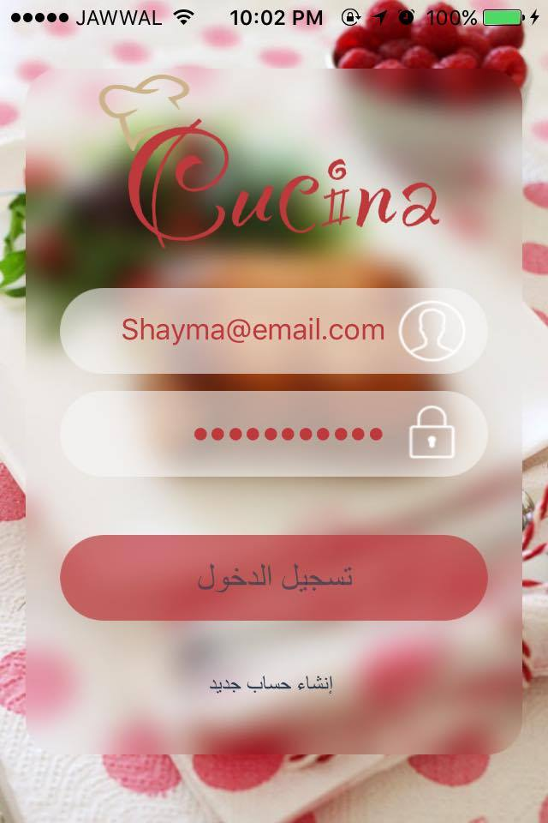
What is Cucina?
An iOS social networking application, targeting people who like cooking and learning new recipes.
This app will satisfy their interests, and may be this app can help them to ﬁnd their dream job in a big restaurant.

Slide 4
“Cucina” means
An Italian word means Kitchen, we choose it since Italy very famous of food and the art of cooking

Slide 5
Customer Segment
Cucina is targeting
People who love cooking and learning new recipes.
Restaurants who want to be close as possible as to their customer .

Slide 6
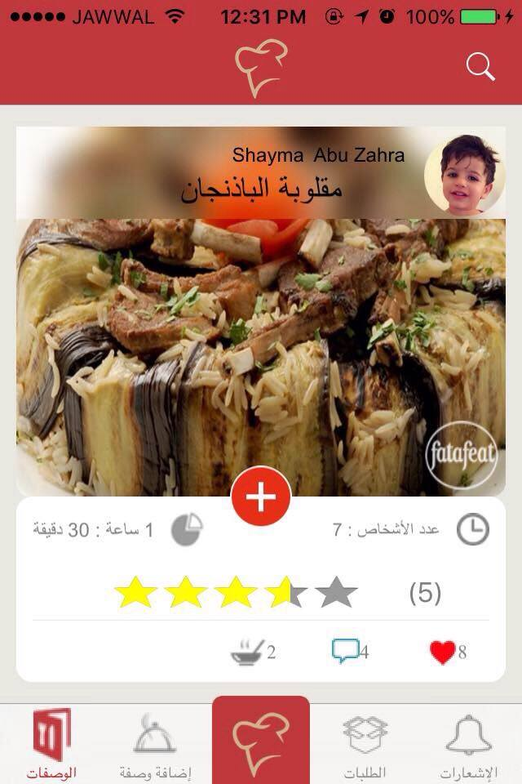
Value Proposition
Cucina enable user to :
Share his / her own recipe with friends.
Search for Recipes
Search for Restaurants
View Restaurant Menu and place an delivery order

Slide 7
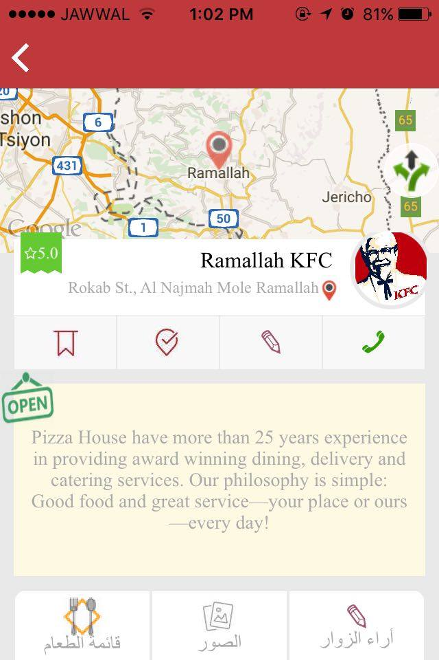
Value Proposition
In case of Restaurants :
Restaurant can share its Menu so users can ask for delivery.
Share its contact information and location so people can find it faster

Slide 8
Revenue Streams
In Cucina the source of profit is The Restaurants.
Restaurants must bay for creating an account in Cucina, and this the responsibility of the Admin

Slide 9



Tools used in our project
For Backend Part
Xampp Server
Eclipse MARS – JAVA EE
Tomcat Server
Advance REST client for testing the backend

Slide 10

For iOS Application
Tools used in our project
Xcode 7.2
iPhone 5 for testing

Slide 11



Programming Language used
For Backend
Java
For iOS Application
Swift
Objecive – c

Slide 12
The Main Parts of Cucina
Cucina App there is 3 different Account :
Free Account for ordinary people
Paid Account for Restaurants
Admin for Cucina

Slide 13
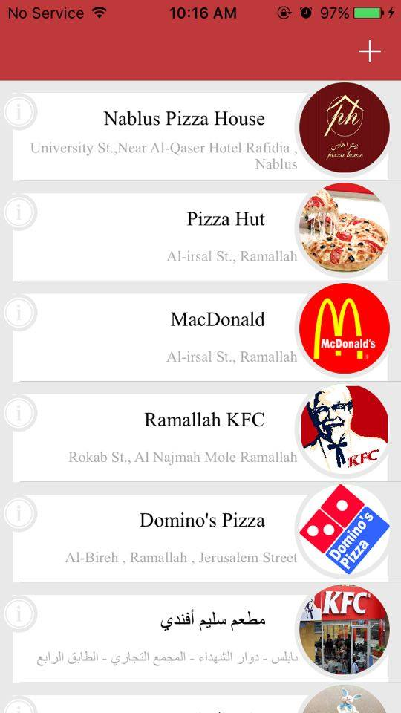
Admin
His is responsible for creating an account for Restaurant.
Adding this restaurant to the database and generate user name and password for the restaurant to use.

Slide 14
Free Account
If user interested only in sharing recipes and learning new one , this must be his / her choice.
You can create your own account by pressing The sign in button ,then start adding your information.
Welcome on board!

Slide 15
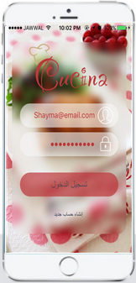
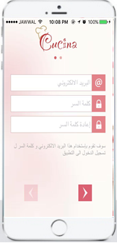
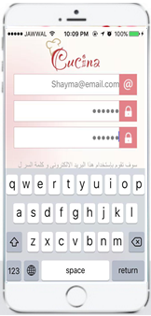
How to create a free account?
Very easy and simple way

Slide 16
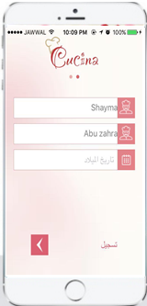
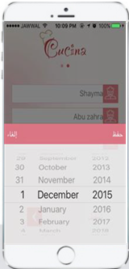
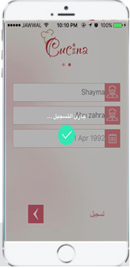
How to create a free account?

Slide 17
Paid Account
If the purpose of using Cucina is to add new restaurant that can share his menu and take orders , the Paid Account must be use.
In this case, the restaurant must communicate with the admin, and provide him with financial information in order to complete the registration.

Slide 18
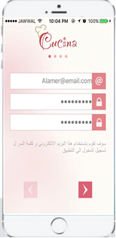
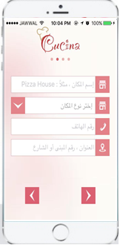
How to create a paid account?

Slide 19
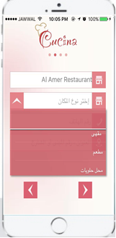
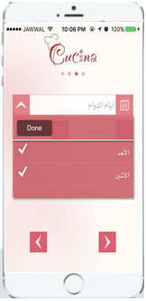
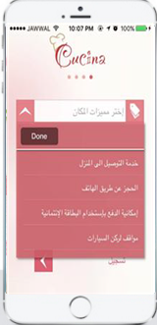
How to create a paid account?

Slide 20
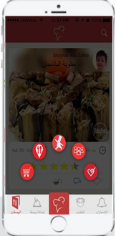
User account functionality

Slide 21
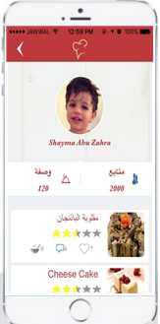
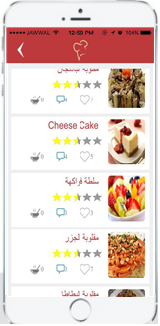
The user profile

Slide 22
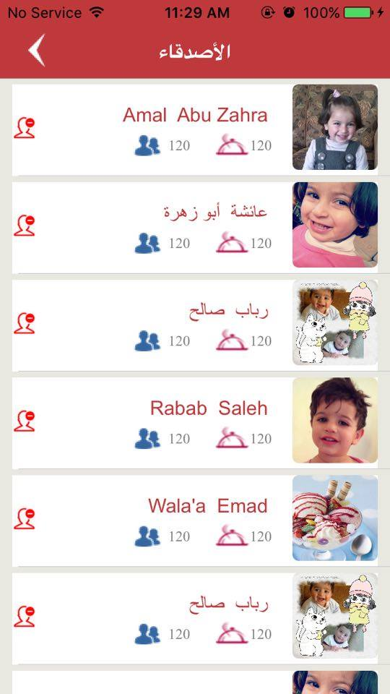
The Friends view:

Slide 23
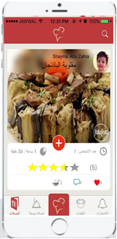
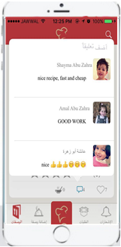
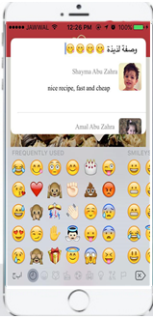
Home Page
Like and comment:

Slide 24
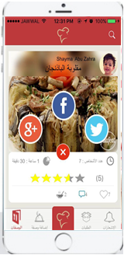
Home Page
The user can share his recipe on Twitter , Facebook and google plus.

Slide 25
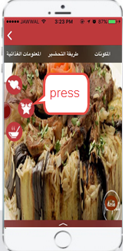
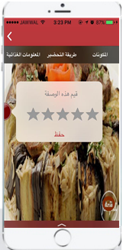
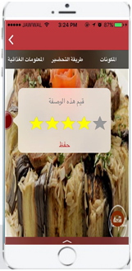
Recipe Details Page
Rating:

Slide 26
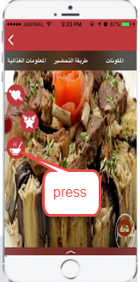
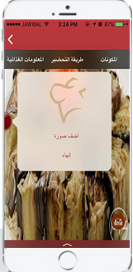
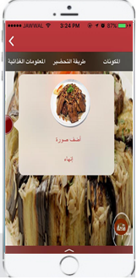
Recipe Details Page
Made it:

Slide 27
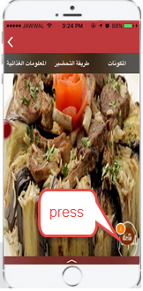
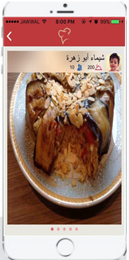
Recipe Details Page
Made it:

Slide 28
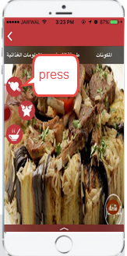
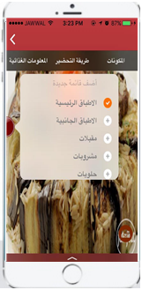
Recipe Details Page
Add to favorite:

Slide 29
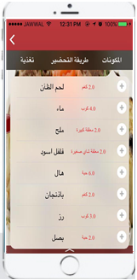
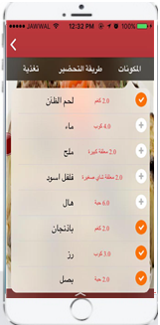
Recipe Details View
Ingredients:

Slide 30
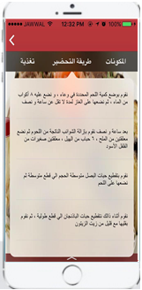
Recipe Details View
Recipe preparation :

Slide 31
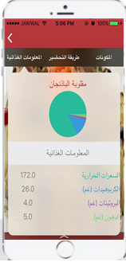
Recipe Details View
Nutritional Information:

Slide 32
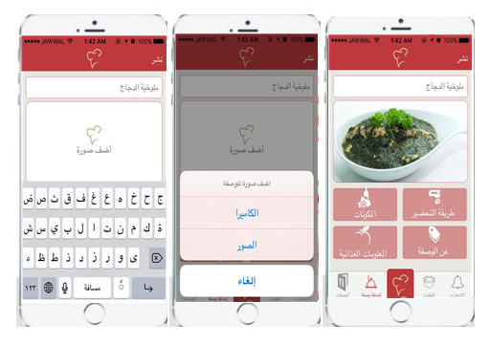
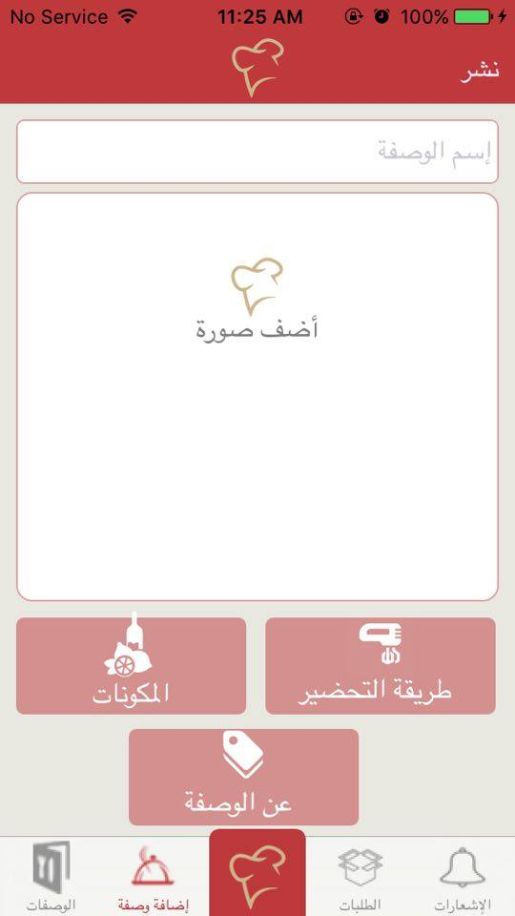
Add New Recipe
Add recipe photo:

Slide 33
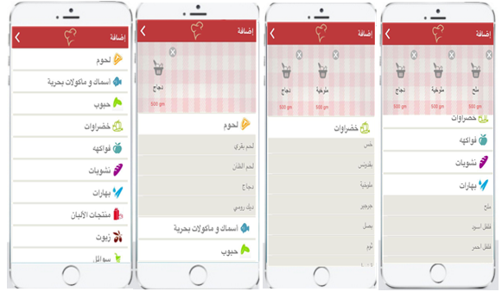
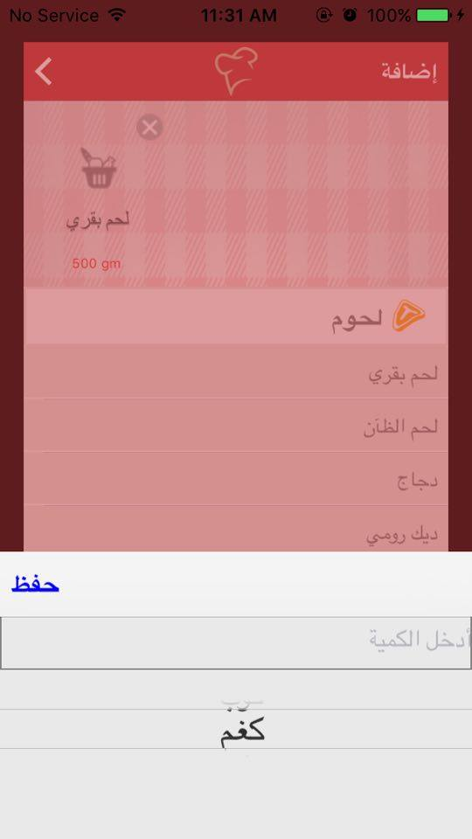
Add New Recipe
Add Recipe Ingredients:

Slide 34
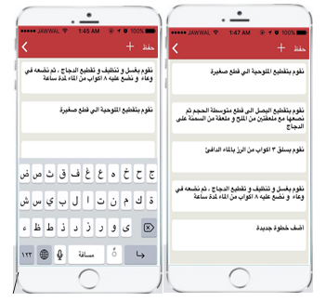
Add New Recipe
Add Recipe Preparation:

Slide 35
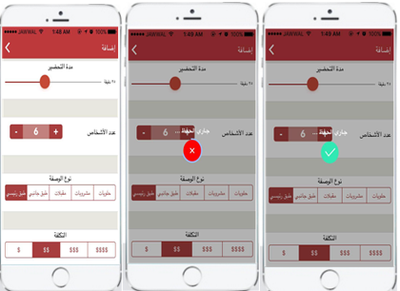
Add New Recipe
Add General Information About The Recipe :

Slide 36
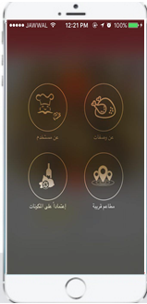
The Search
In our project we aimed to make it easy for the user to find specific recipe so we add strong search technique and but many search types

Slide 37
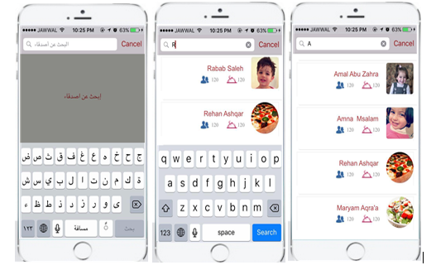
Find Recipe according to the User name.

Slide 38

Find Recipe according to the Recipe name.

Slide 39

Find Recipe according to the Recipe Ingredients.

Slide 40



Find the nearby restaurants.

Slide 41



The Restaurant Profile:

Slide 42


The Restaurant Profile:

Slide 43



The delivery order:

Slide 44
The demo

Slide 45
Thank you

