Slide 1
Design of A Sewer Network For Dair-Istiya Village
Prepared by :
Uday Fuad Arabasi.
Qosay Hamid Awad.
Mosa'b Mahmoud Qtait.
Submitted to : Dr. Abd-Alhaleem Khader

Slide 2
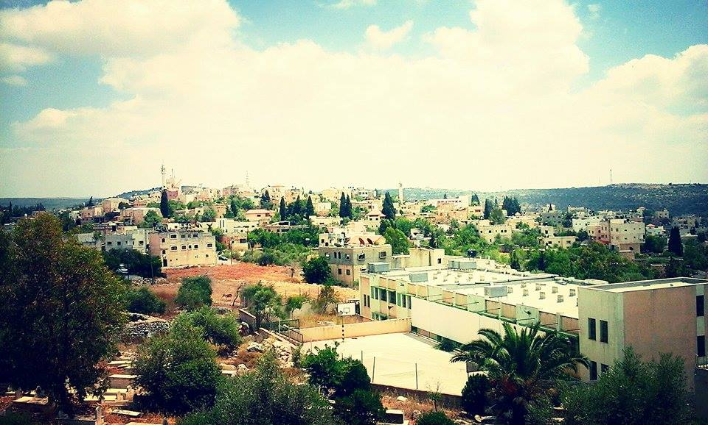
ISTIYA VILLAGE- DAIR

Slide 3
Outline
Objectives and significance of the project.
Study area.
Methodology.
Modeling, and design.
Results, Conclusions, And,
Recommendation

Slide 4
Objectives
The main objectives of this project are:
To hydraulically design a wastewater collection network for Dair-Istiya Village Area using SewarCAD program.

Slide 5
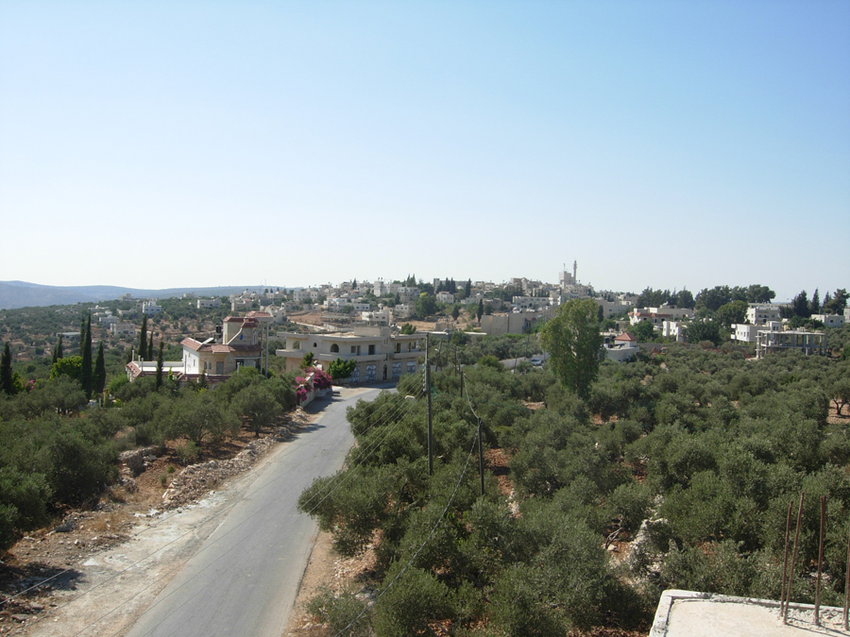
SIGNIFICANCE OF THE WORK

Slide 6
Approach
To design Sewer Collection Network.
Use SewerCAD software to design the network.

Slide 7
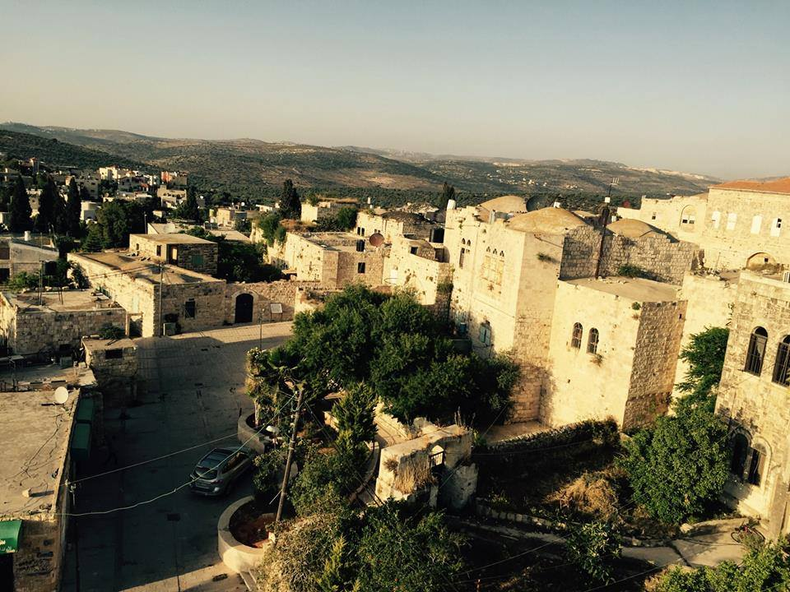
STUDY AREA

Slide 8
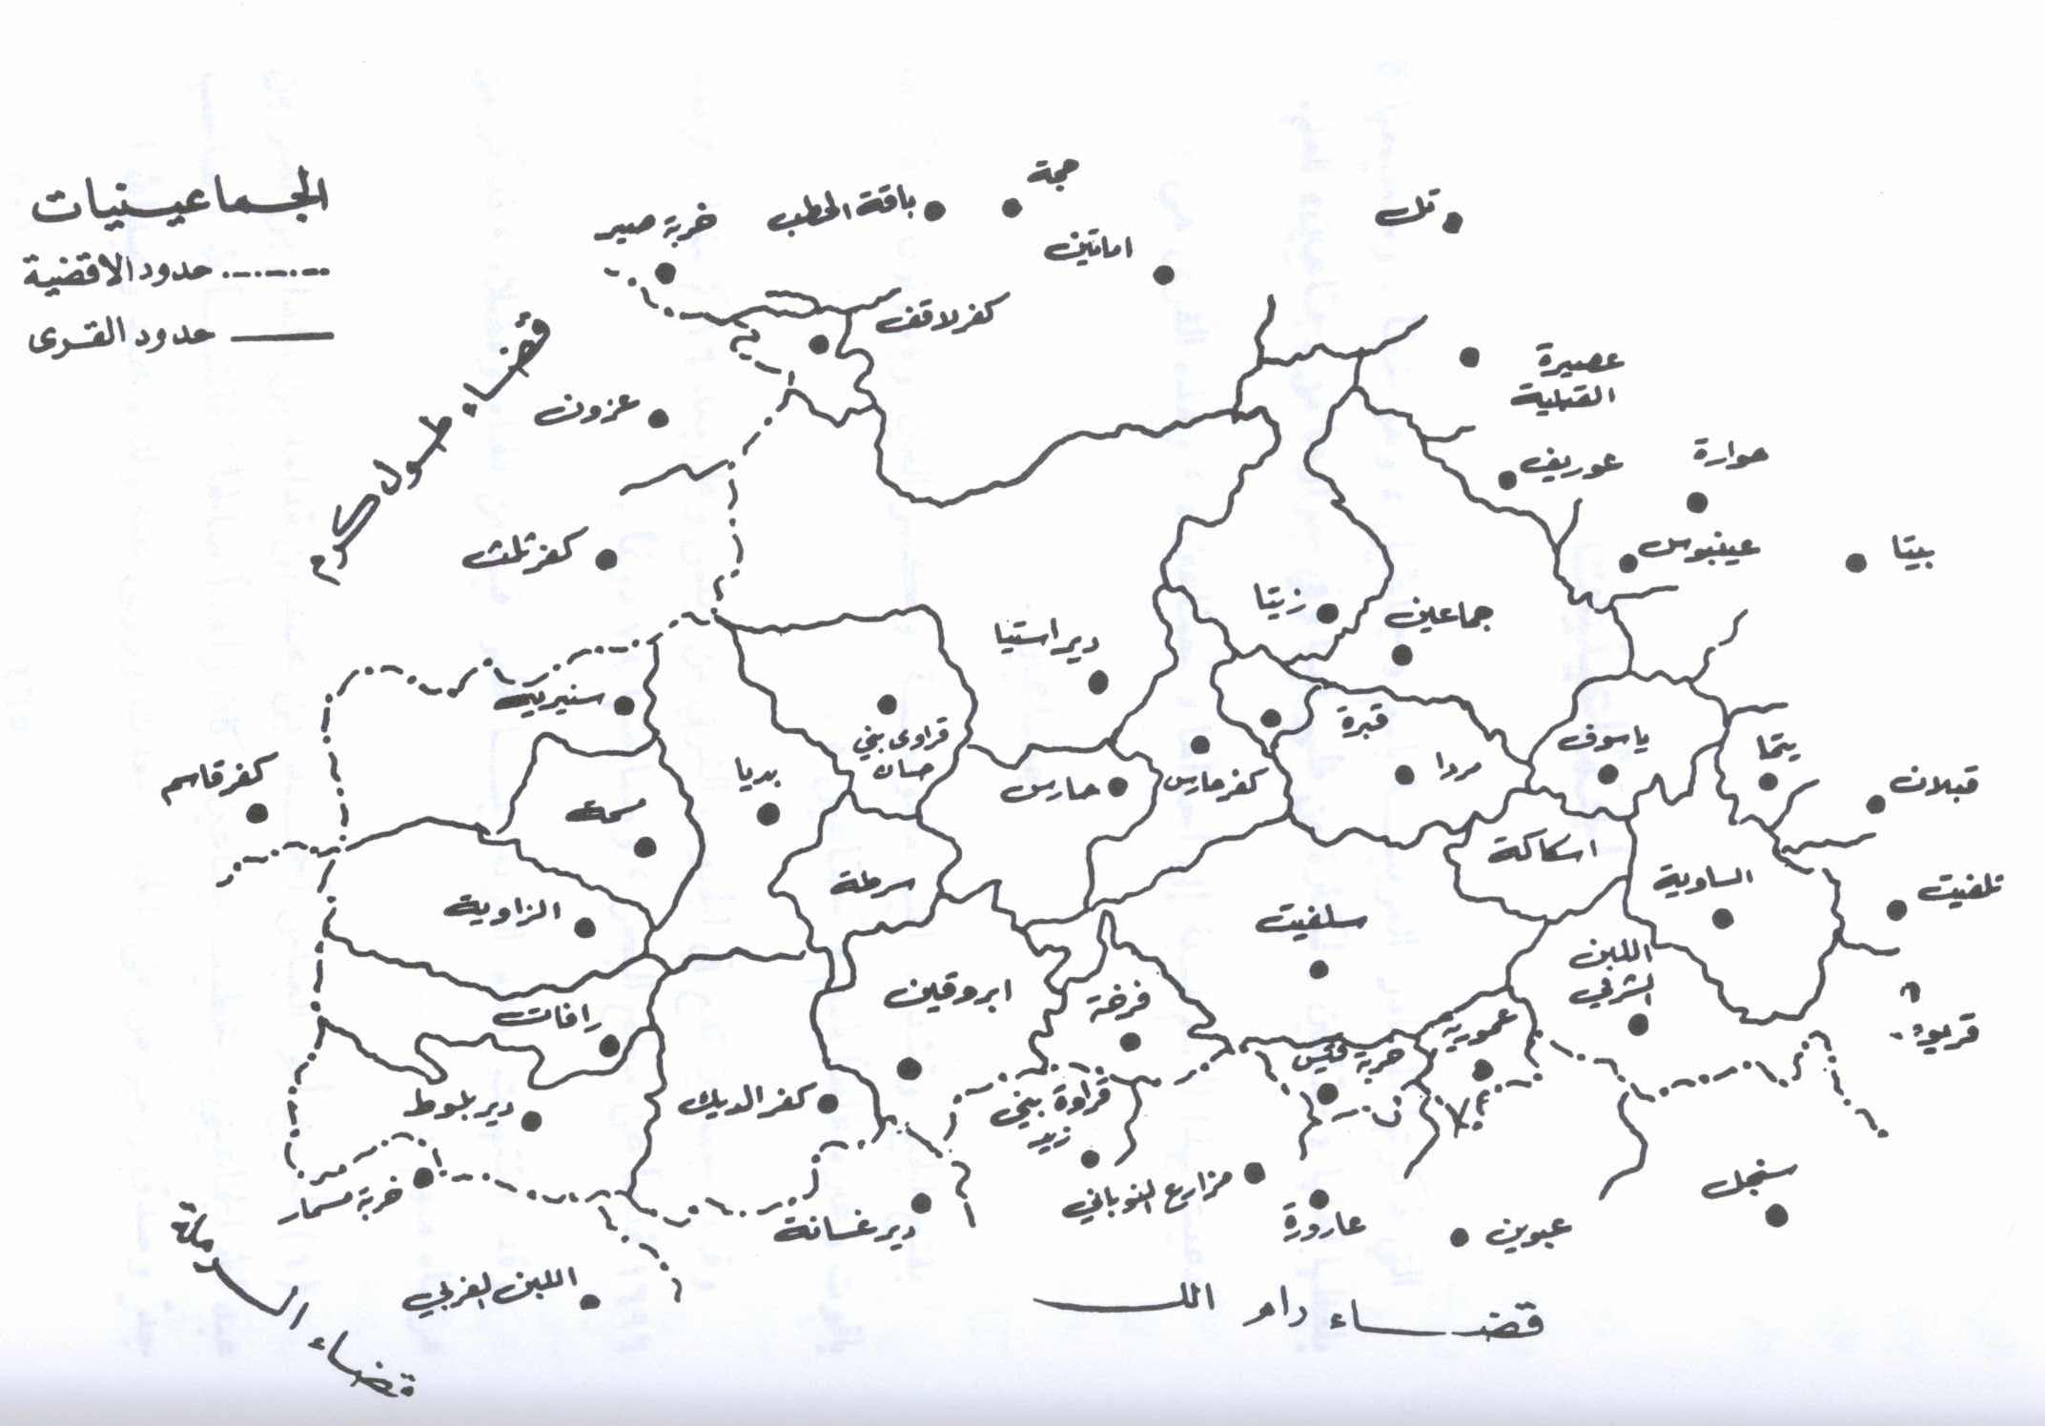
LOCATION

Slide 9
TOPOGRAPHY
Maximum elevation = 440 m above MSL
Minimum elevation = 362 m above MSL
Mean elevation = 406 m above MSL

Slide 10
AREA AND LAND USE
Total Area = 34164 donums
Built up Area = 610 donums
Agricultural land = 11000 donums
Forests and open areas = 19000 donums
The rest of the land has been confiscated by the Israeli occupation authorities

Slide 11
POPULATION
Population | Year
674 | 1922
1190 | 1945
1500 | 1967
2100 | 1987
2803 | 1997
3831 | 2007

Slide 12
Sewage Sources
Domestic Wastewater
Industrial Wastewater
Storm water
Infiltration

Slide 13
CONSTRAINTS
Velocity [ 0.6 – 3 ]m/s
Cover ( 1 – 5 )m.
Slope( 1 – 15 )%.

Slide 14
Methodology
Data Collection.
Training on SewerCAD Software.
Selection of the study area.
Designing by SewerCAD program.
Giving results and recommendations.
Preparation of data.

Slide 15
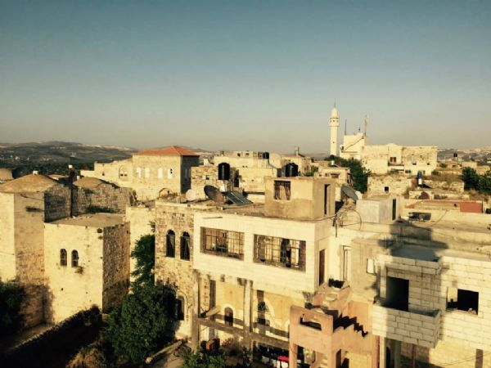
Selection of the study area

Slide 16
DATA COLLECTION
Boundary of the study area.
Contour map
Roads network
Structural plane
Population number
Outfall location

Slide 17
PREPARATION OF DATA
Population forecasting using constant growth rate equation
Pn = P0( 1 + r )^n
Population in 2016 = 4800 capita ( from council )
Future population ( 2046 ) = 8970 capita
Growth rate | Time interval
0.0305 | 1997 – 2007
0.0254 | 2007 – 2016
0.022 | 2016 – 2026
0.020 | 2026 – 2036
0.019 | 2036 - 2046

Slide 18
PREPARATION OF DATA
Demand = 120L /day / capita
Assume hourly factor = 3.5
Load calculation = Waste water generation + infiltration
Waste water generation = 0.8 * 0.12 * 8790 * 3.5 = 2953.4 CM /day
Infiltration = 0.2 * 0.8 * 0.12 * 8790 = 168.8 CM /day
Sanitary load = 3122.2 CM / day

Slide 19
Sewer Collection Network
Sewer Systems
Sewerage Elements

Slide 20
Related hydraulic concepts
Distance between manholes.
A General procedure for design flow rates quantification.
Friction Loss Methods.

Slide 21
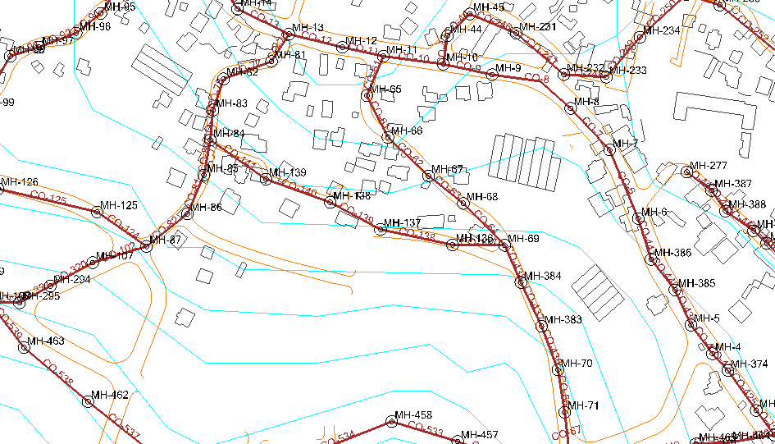
Design the Network by SewerCAD program.
Preparation of data

Slide 22
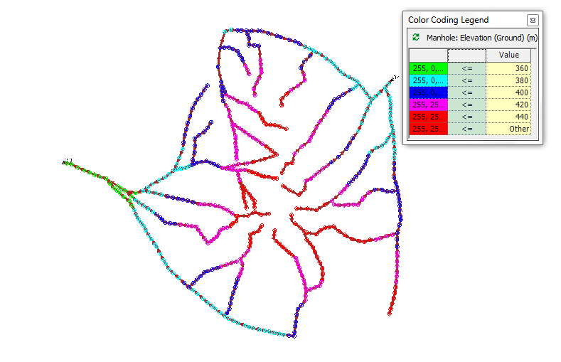
Design the Network by SewerCAD program.
and conduit. Layout of Manholes

Slide 23
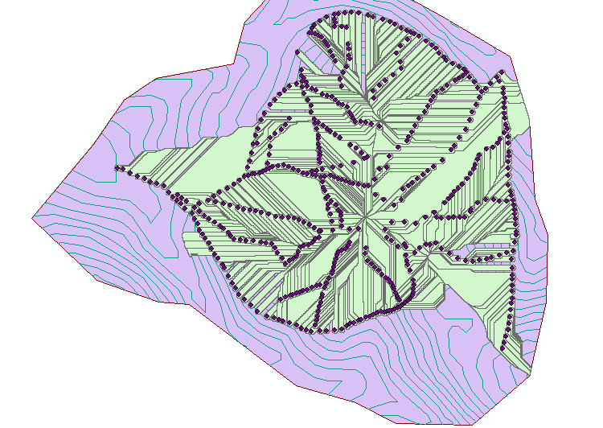
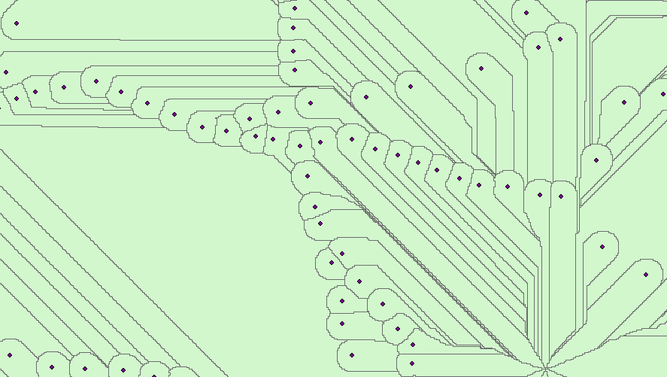
Design the Network by SewerCAD program.
Sanitary load distributed using ArchHydro.

Slide 24
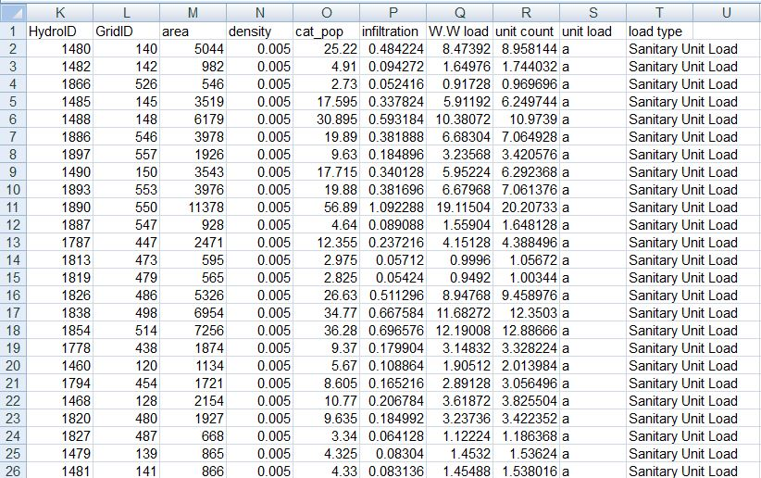
Design the Network by SewerCAD program.
Load distribution in excel sheet to make Model builder

Slide 25
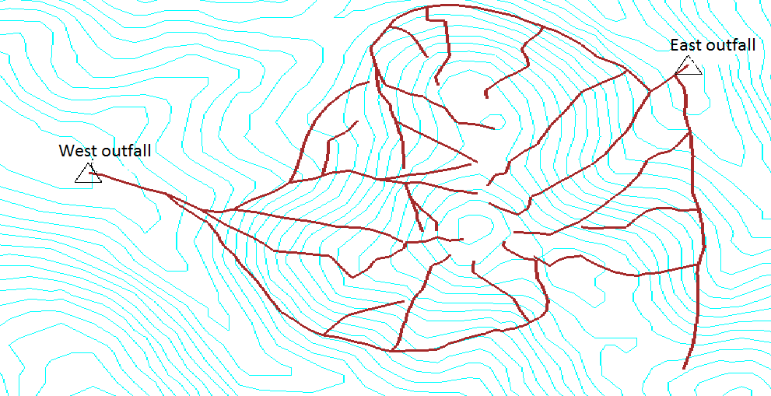
Layout the network
Layout of Outfalls
We have two outfalls in the area.

Slide 26
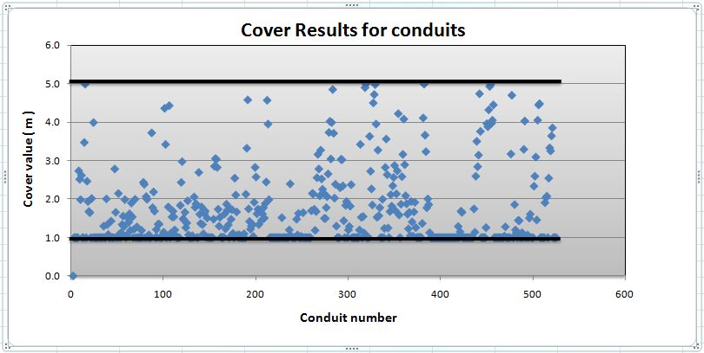
RESULTS

Slide 27
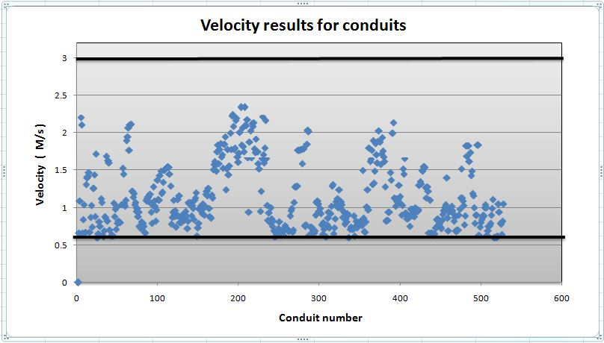
RESULTS

Slide 28
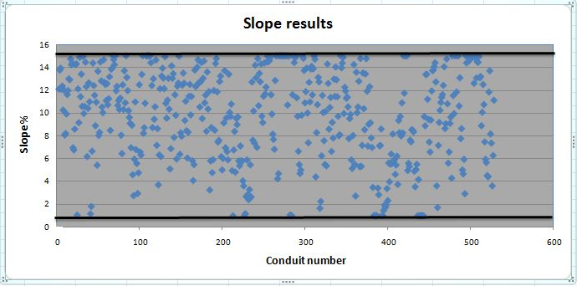
RESULTS

Slide 29
Conclosion:
We recommend constructing a sewer network because the people will be very pleased and most of their problems will be removed.
All constraints are achieved and there are no any problems in the model, and all the results are in the ranges as specifications and criteria.
We use 8 inch diameter for all conduits and PVC material.

Slide 30
THANK YOU

