Slide 1
MBRC
Mobile Based Remote Control
To : Dr. Samer Mayalah
By: Salah Aldeen Ghanim

Slide 2
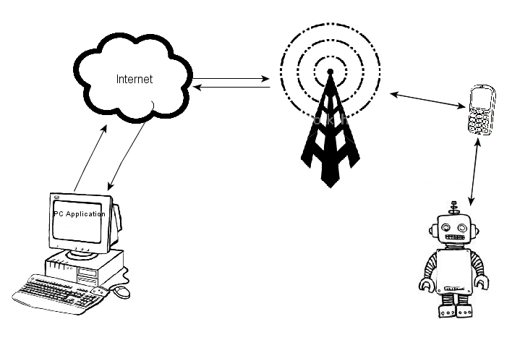
Introduction
Project idea

Slide 3
Introduction
Model advantages
  Mobility for the controller and the machine
  Availability of mobile phone technology
  Making use of the phone resources
  Low latency and high coverage

Slide 4
Project Parts
  PC application
  Mobile phone application
  Server Application
  JavaScript HTTP MAP
  MCU Code
  Robot Hardware

Slide 5
PC Application
  Handel User inputs.
  Communicate with the server application
  Show map and mobile status

Slide 6
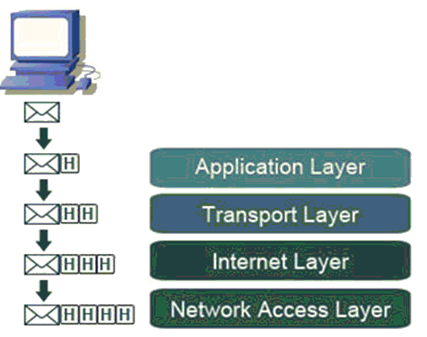
TCP/IP Socket

Slide 7
Mobile Features
  Android OS 2.2 Froyo
  Single ARM V7 1GHz 32-bit processor
  512 M.B ram
  Camera
  Wireless connectivity ( Wi-Fi , Bluetooth )
  Supports GSM & 3G Networks

Slide 8
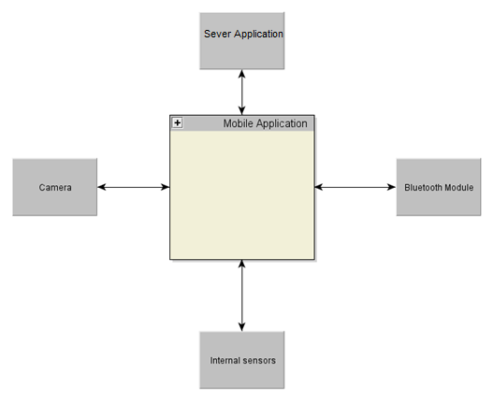
Mobile Application
  Written in JAVA

Slide 9
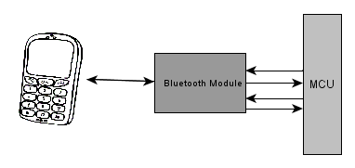
Bluetooth Module
  Supports many Bluetooth Profiles (SPP, DUN….)
  Has a UART interface

Slide 10
MCU Code
Arduino
D.C Motors
Sensors
Bluetooth Module

Slide 11
MCU & Robot Hardware
  Tow DC motors with L293
  Thermal Sensor lm35
  battery pack

Slide 12
Thank You
For
Your Time

