Slide 1


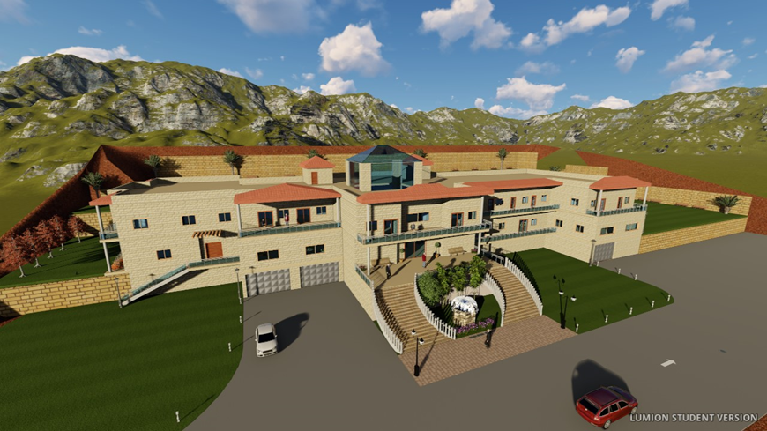
Integrated Design of An Elderly
Care Home
Prepared By: Supervisor:
Ahmad Hamdan. Eng. Haitham Sawalha.
Osaid Badran.
Wael Saleh.

Slide 2
Contents:
Introduction.
Site Analysis.
Architectural Design.
Environmental Design.
Structural design.
Electrical design.
Mechanical design .
Safety.
Quantity Survey.

Slide 3

Introduction:

Slide 4
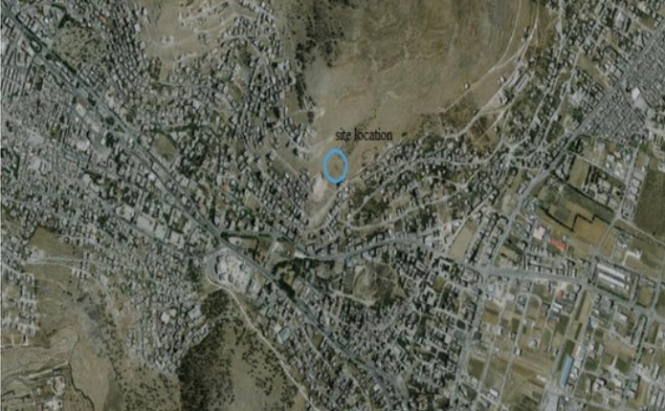
Site Analysis:

Slide 5
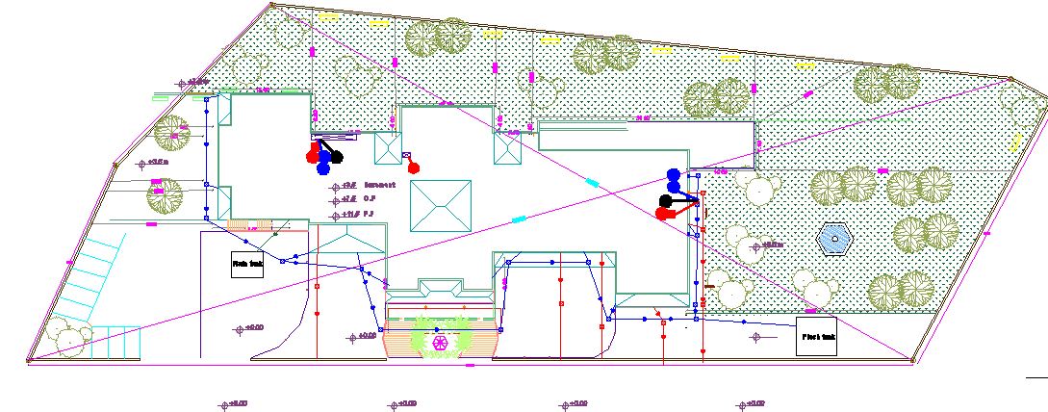
Architectural Design:
Site plan:

Slide 6
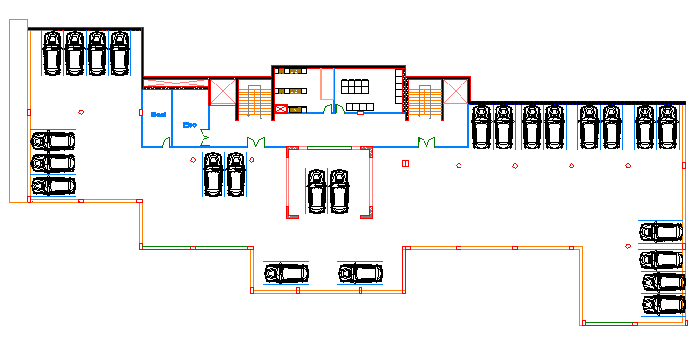
Architectural Design:
Basement Floor:
Total area of this floor it is about 1500 m²
It contains: Parking, kitchen, laundry, Mechanical, and Electrical rooms

Slide 7
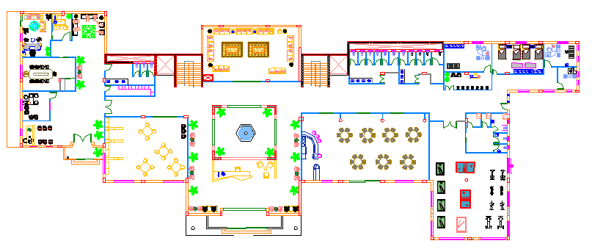
Architectural Design:
Ground Floor:
Total area of this floor it is about 1900 m²
It contains: Administration area, Library, Multipurpose room, Cafeteria, Gymnasium, Clinic, Physiotherapy, and Psychotherapy.

Slide 8
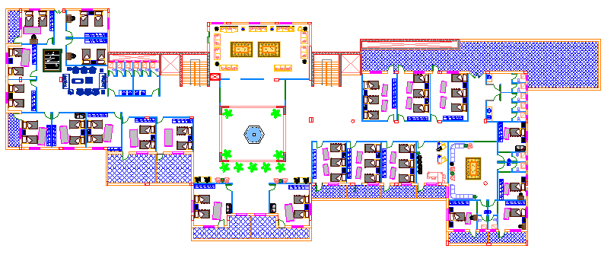
Architectural Design:
First Floor:
Total area of this floor it is about 1800 m²
It contains: Private, Double, Triple bedrooms, Living rooms, Multipurpose, and bathrooms.

Slide 9
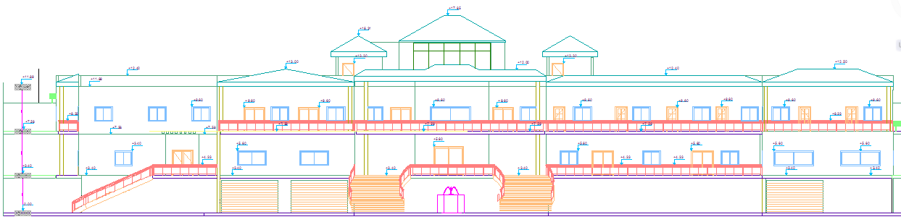
Architectural Design:
Elevations:
Southern Elevation.

Slide 10
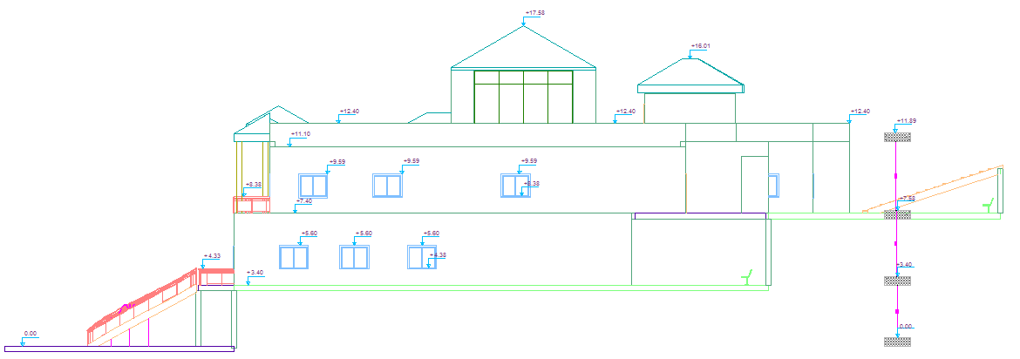
Architectural Design:
Elevations:
Eastern Elevation.

Slide 11
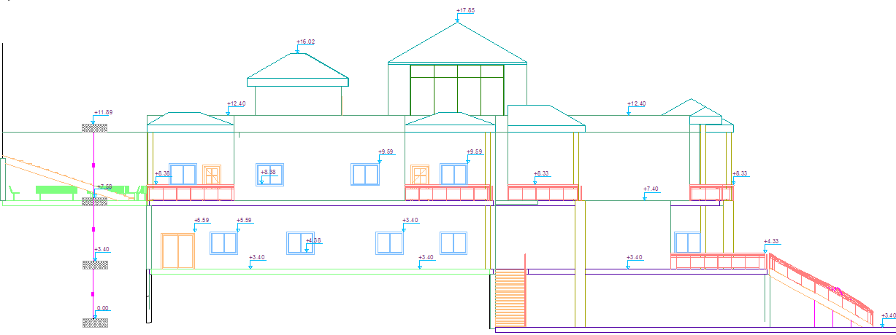
Architectural Design:
Elevations:
Western Elevation.

Slide 12
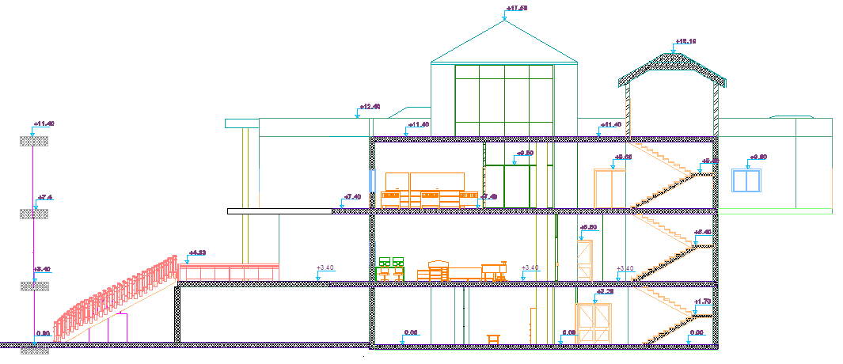
Architectural Design:
Sections:
Section 1-1

Slide 13
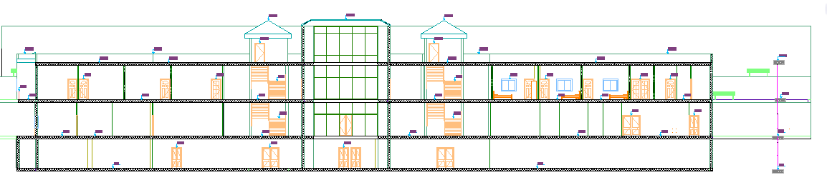
Architectural Design:
Sections:
Section 2-2

Slide 14
Environmental Design:
Thermal Design
Acoustical Design
Lighting Design
Solar Cells Design

Slide 15
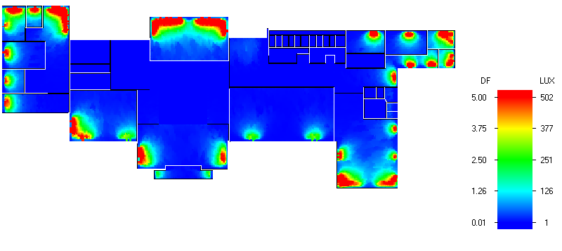
Thermal Design:
Natural daylight analysis.
D.F | Function
2.84 | Triple bedroom
3.22 | Cafeteria
6.5 | Library

Slide 16
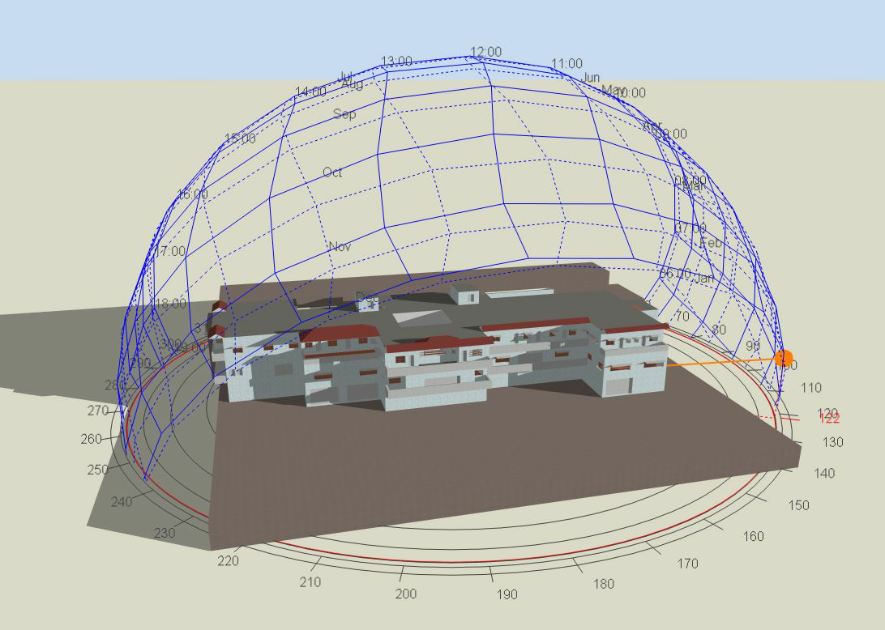
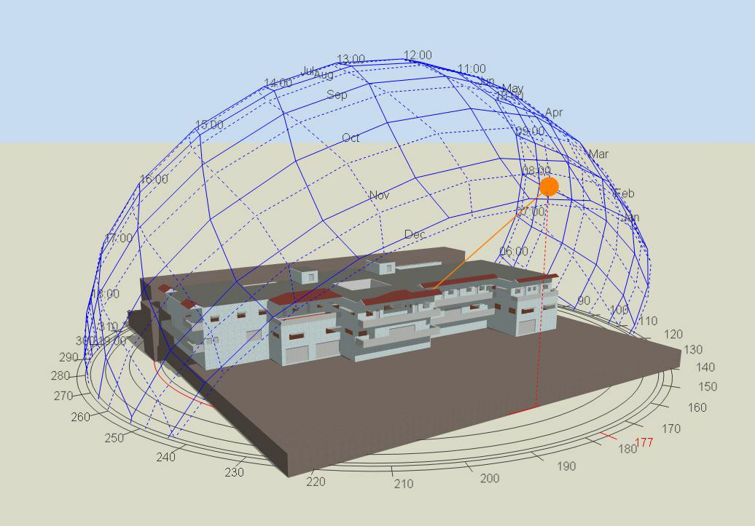
Thermal Design:
Shading:
Shading in winter (21St/January)
At 8:00 AM. At 12:00 AM.

Slide 17
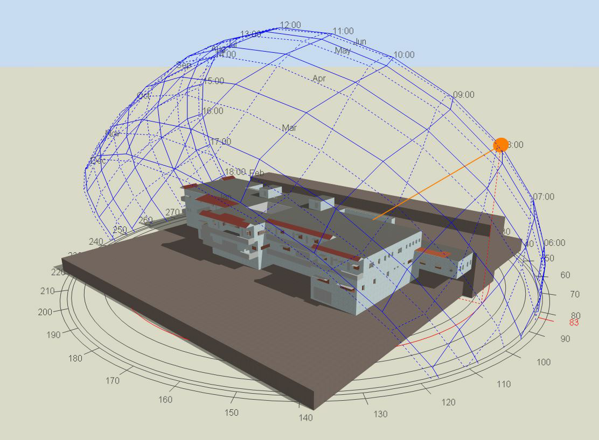
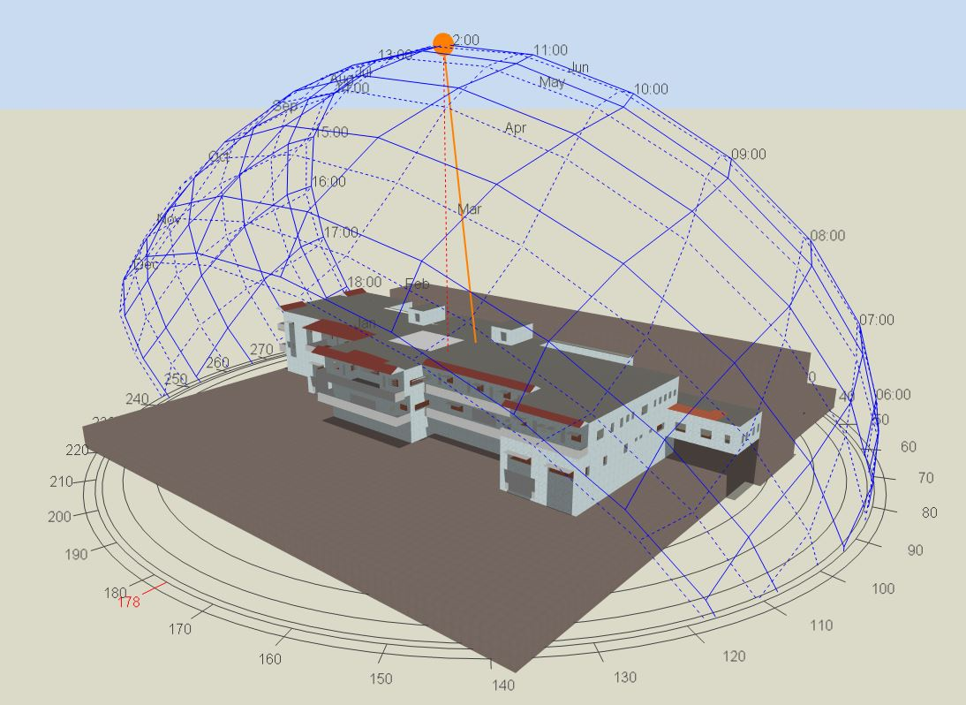
Thermal Design:
2) Shading in summer (21St/July)
At 8:00 AM At 12:00 AM

Slide 18
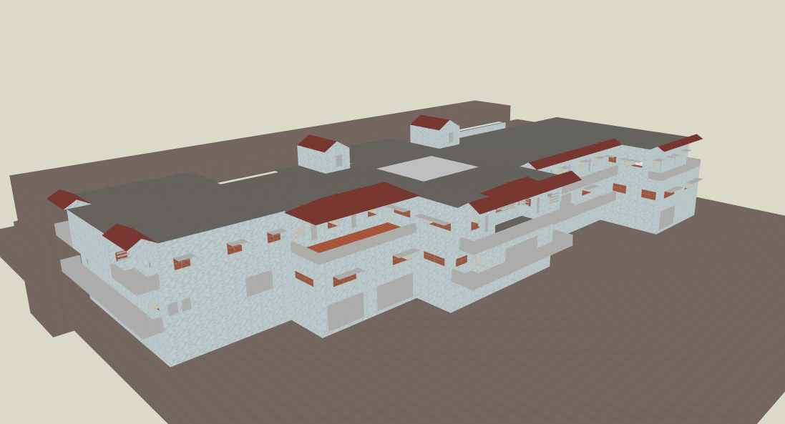
Thermal Design:
Design Builder program ( 3D Model ):

Slide 19
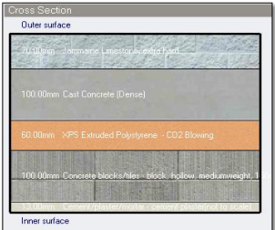
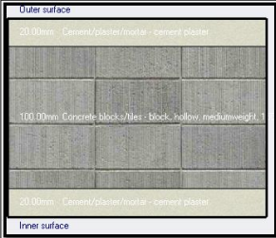

Thermal Design:
Materials:
External walls internal walls
U-value = 0.452 w/$m^{2}$.K U-value = 1.6 w/$m^{2}$.K

Slide 20
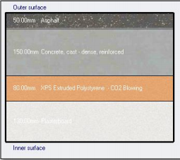
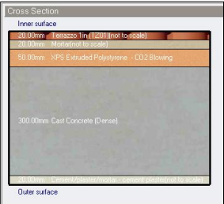

Thermal Design:
Materials:
Ceiling internal Floor
U-value = 0.452 w/$m^{2}$.K U-value = 1.6 w/$m^{2}$.K

Slide 21
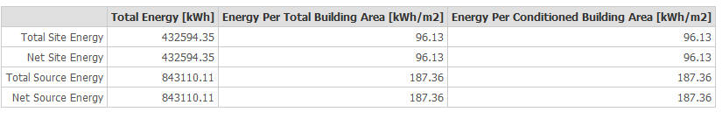
Thermal Design:
Heating and cooling Capacities.
Site energy.
233 kW | Cooling
204 kW | Heating

Slide 22
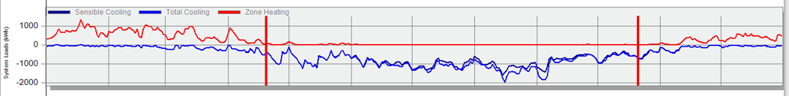
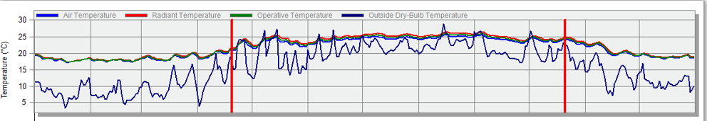
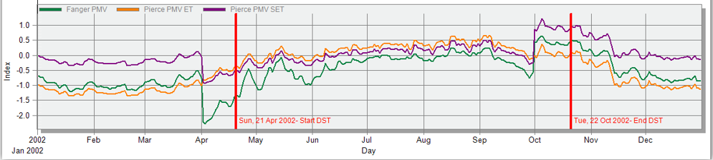
Thermal Design:
simulation:

Slide 23
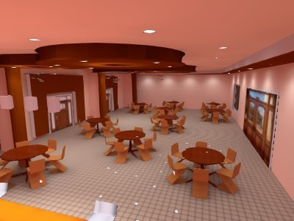
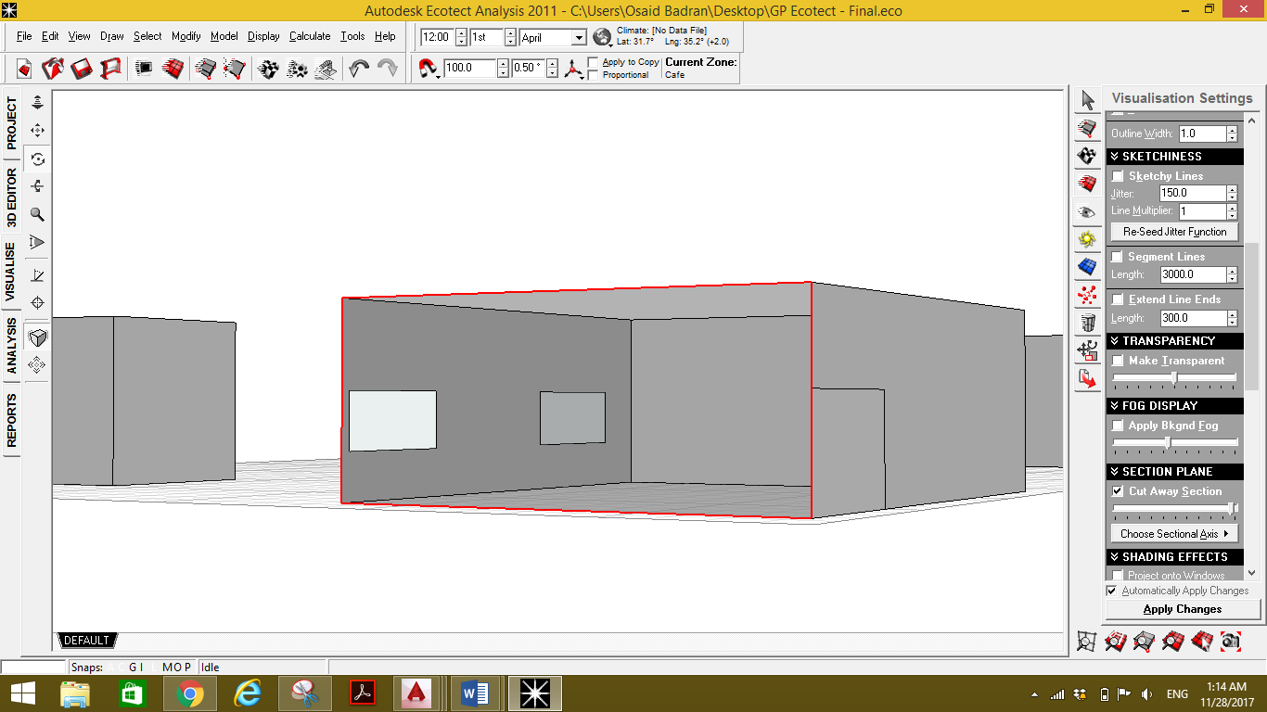
Acoustical Design:
Reverberation Time (RT60):
Ecotect Software used for calculation of RT60. Four zones were taken into consideration:
Cafeteria: The required RT60 for this zone is between (0.6 – 1.0), we used normal layers in walls, linoleum in the floor and acoustical ceiling panels to meet the requirements value.

Slide 24



Acoustical Design:
Final Layers:
Element | Final Layer
Walls | Plaster
Floor | Linoleum
Ceiling | Acoustical Panel
RT 60 values:
 | TOTAL | SABINE | NOR-ER | MIL-SE
FREQ. | ABSPT. | RT(60) | RT(60) | RT(60)
63Hz | 128.784 | 0.96 | 1.1 | 0.8
125Hz | 131.452 | 0.94 | 1.41 | 0.78
250Hz | 149.295 | 0.79 | 1.28 | 0.66
500Hz | 142.667 | 0.81 | 1.46 | 0.68
1kHz | 132.702 | 0.85 | 1.51 | 0.72
2kHz | 114.275 | 0.92 | 1.56 | 0.8
4kHz | 97.861 | 0.97 | 1.58 | 0.88
8kHz | 82.899 | 0.85 | 1.2 | 0.8

Slide 25
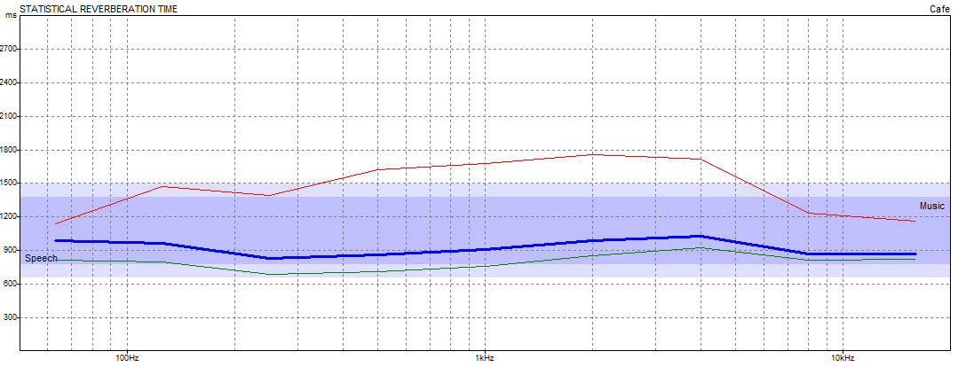
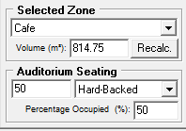
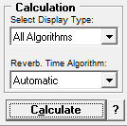
Acoustical Design:
Reverberation Time Algorithm:

Slide 26
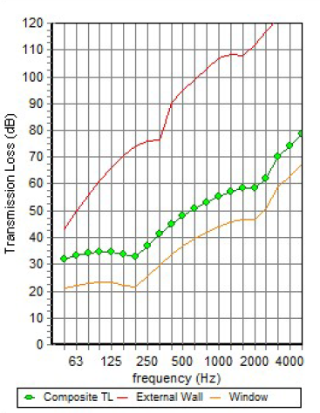
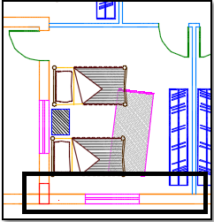
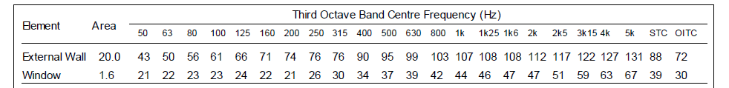
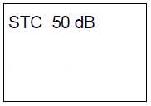
Acoustical Design:
Sound Transmission Class (STC):
We use Insul Software in order to achieve the required design.
1- External Wall: The required STC for the wall is 50, and the designed value by using Insul software is 50 dB.
Room Being Considered | Adjacent Area | Quiet | Normal
Bedrooms | Bedrooms | STC 52 | STC 50
 | Outside | STC 50 | STC 45
Library | Corridor, lobby | STC 45 | STC 42

Slide 27
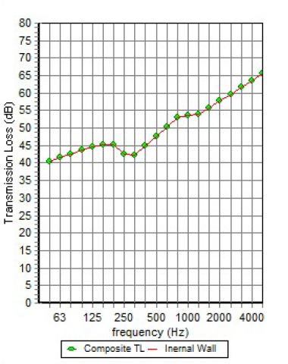
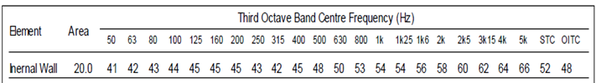
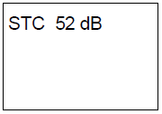
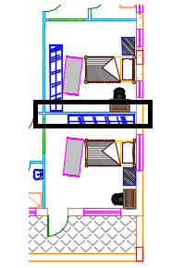
Acoustical Design:
2- Internal Wall: The required STC for the wall is 52, and the designed value by using Insul software is 52 dB.

Slide 28

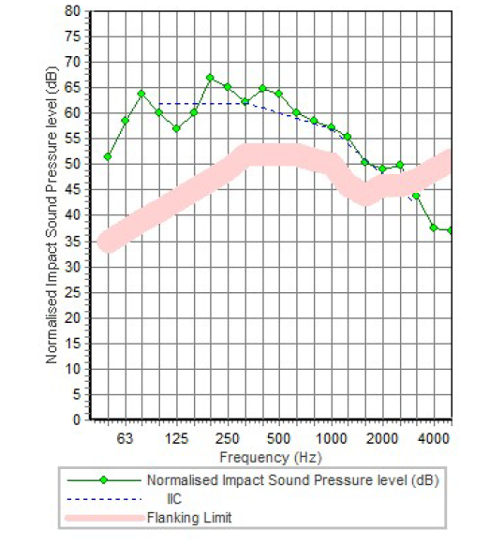
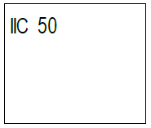
Acoustical Design:
Impact Insulation Class (IIC):
1- Ceiling: In this center, gymnasium is critical zone which is affected vertically to parking, resulted IIC for the slab is 50 dB which is good.

Slide 29
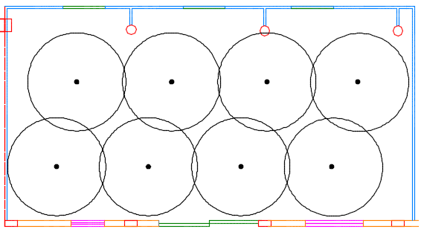
Acoustical Design:
Loud Speakers:
1- Cafeteria: We used PRO-180RPC In-ceiling speakers with 100 coverage angle.

Slide 30
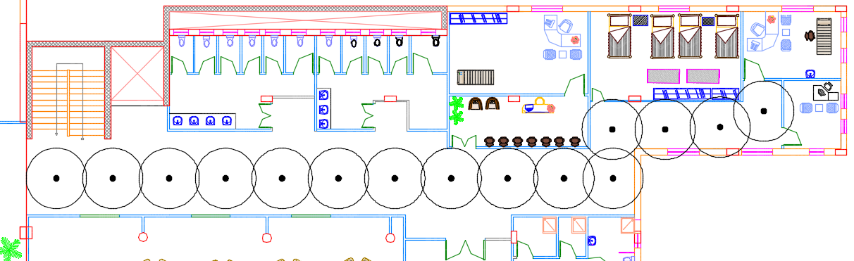
Acoustical Design:
2- Corridor: the same loud speaker was used in corridor.

Slide 31
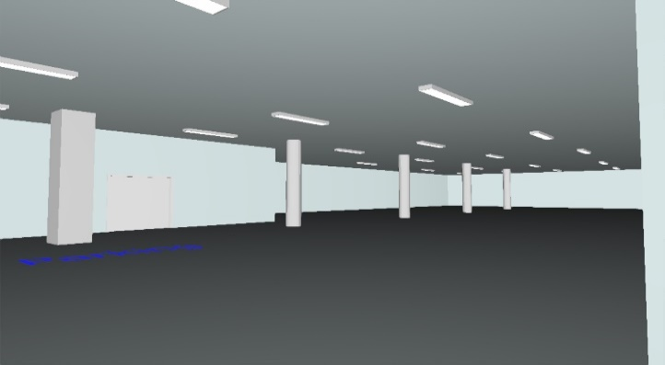
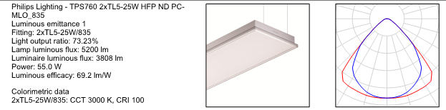
Lighting Design:
Artificial Design:
We use DIALux Software to achieve the required artificial deign, four zones were taken into consideration.
1- Parking: the required value of luminance is 150 lx, the design value was 155 lx with uniformity of 40% and UGR is 16.2 which is less than the required 25.
Surface | Finish material | Reflection factor
Ceiling | 7043(Traffic grey B) | 80%
Wall | 7043(Traffic grey B) | 70%
Floor | 7043(Traffic grey B) | 30%

Slide 32
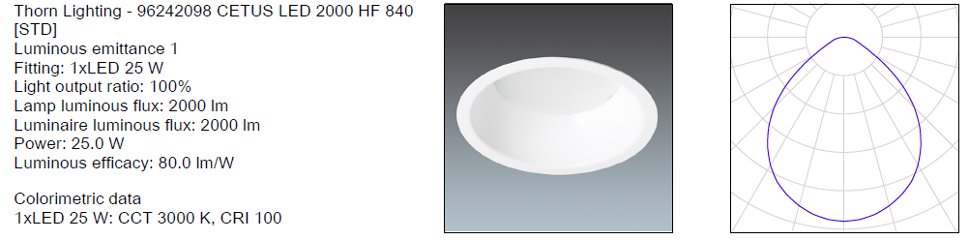
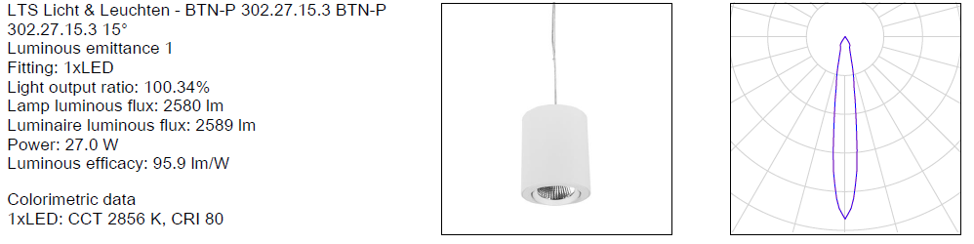
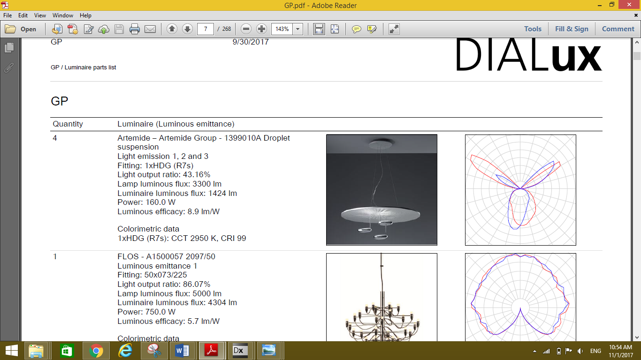
Lighting Design:
2- Cafeteria:
  E = 209 lx > 150 lx.
  U = 40% >= 40%.
Surface | Finish material | Reflection factor
Ceiling | 8012(Red brown) | 80%
Wall | 8012(Red brown) | 70%
Floor | Tiles beige | 30%

Slide 33
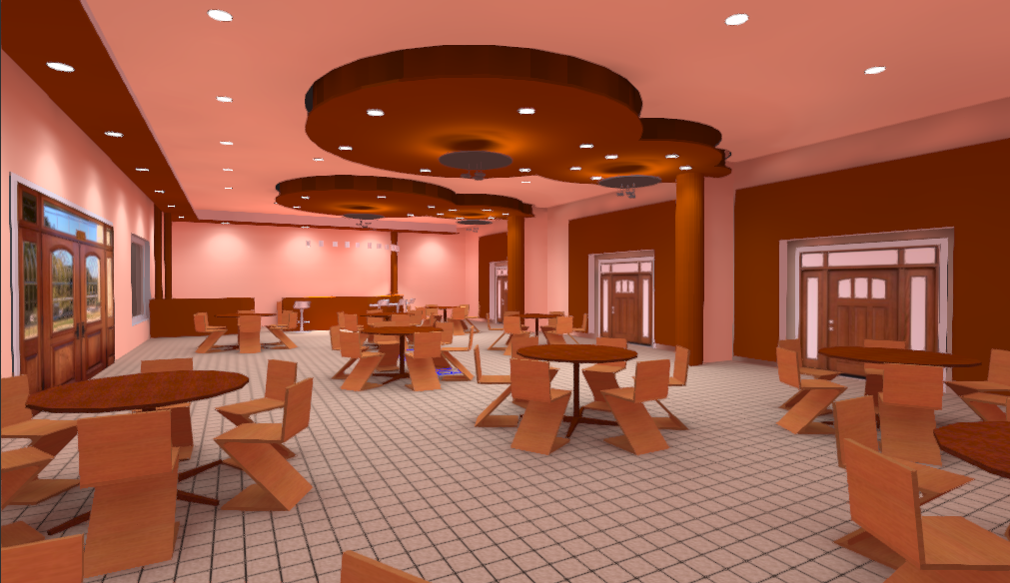

Lighting Design:
3D Views:

Slide 34

Lighting Design:
3- VIP Bedroom:
  E = 272 lx > 250 lx.
  U = 67% > 33%.
  UGR = 20.3 < 22.
Surface | Finish material | Reflection factor
Ceiling | 1014(Ivory) | 70%
Wall | 1014(Ivory) | 50%
Floor | Carpet beige | 30%

Slide 35

Lighting Design:
3D Views:

Slide 36


Lighting Design:
4- Triple Bedroom:
  E = 272 lx > 250 lx.
  U = 67% > 33%.
  UGR = 20.3 < 22.
Surface | Finish material | Reflection factor
Ceiling | 1013(Oyster white) | 70%
Wall | 1014(Ivory) | 50%
Floor | Carpet beige | 30%

Slide 37


Lighting Design:
3D Views:

Slide 38
Solar Cells Design:
We used PVsyts software in order to have appropriate solar cells design.
Mono-crystalline Cells of 250 Wp of (16.4L*9.90W*0.4D) cm were used.
216 Modules were used.
18 inverters were used.
Size of system = 54 Kwp.
Initial cost of the system = 79800 $.
Operation Cost = 1400 $/year.
Electricity Production = 96300 KWh/yr.
Annual Saving = 96300 * 0.17 = 16370 $/yr.
Payback Period = 81200/16370 = 4.96 years.

Slide 39

Solar Cells Design:
Modules Distribution:

Slide 40
Structural Design:
Codes and Standards:
ACI 318-14 for reinforced concrete design.
UBC-97 for seismic design and its load combinations.
ASCE for load combinations.

Slide 41
Structural Design:
Materials :
Concrete strength for columns, shear wall and footing f′c= 28MPa, and 24MPa for beams and slabs.
Steel yield strength Fy= 420MPa.
Bearing capacity for soil = 800 kN/m²

Slide 42

Structural Design:
Lateral loads:
Nablus City.
Seismic zone is 2B (z=0.2)
Soil profile is S_{B}
Acceleration seismic coefficients, Ca=0.2
Velocity seismic coefficients, Cv= 0.2
Importance factor, I=1
Force reduction factor, R=5.5

Slide 43
Structural Design:
Loads :
Dead load.
Super imposed dead load =4.5 kN/m² .
Live load = 5 kN/m² .

Slide 44
Structural Design:
Sections Dimensions:
Member | width | depth
Slab | 30 cm Thickness
Main Beams | 80 cm | 70 cm
Sec. Beams | 40 cm | 30 cm
Column1 | 30cm | 60cm
Column2 | 50cm | 55cm
Column3 | 55 cm diameter
Column4 | 47 cm diameter
Shear wall | 30 cm Thickness

Slide 45


Structural Design:
Model in ETABS program for block1:

Slide 46

Structural Design:
Basement beams distributions :

Slide 47

Structural Design:
G.F beams distributions :

Slide 48

Structural Design:
F.F beams distributions :

Slide 49


Structural Design:
Checks:
Compatibility check.

Slide 50
Structural Design:
Checks:
Compatibility check.
Equilibrium check.
 | Hand | ETABS | Error% | Ok?
Live load | 13432.2 | 13603.7 | 1.26% | ok
SID | 24747.6 | 25261.52 | 2.03% | ok
DL | 22855.02 | 24024.77 | 4.87% | ok

Slide 51
Structural Design:
Checks:
Compatibility check.
Equilibrium check.
Internal forces check.
All columns, beams and slab that checked, the difference between ETABS and hand calculations was been less than 10%

Slide 52

Structural Design:
Checks:
Compatibility check.
Equilibrium check.
Internal forces check.
Deflection check.
MAX. allowable deflection=26.25mm

Slide 53
Structural Design:
Checks:
Compatibility check.
Equilibrium check.
Internal forces check.
Deflection check.
Period check.
period from ETABS = 0.175 sec. , period from hand calc.= 0.381sec
T from ETABS < 40% from hand calc.
0.175 sec.< 0.534 sec.

Slide 54
Structural Design:
Checks:
Compatibility check.
Equilibrium check.
Internal forces check.
Deflection check.
Period check.
Base shear check.
V manual = 5757.12
Vx =5757.13kN > 5757.12kN
Vy= 5757.13 kN> 5757.12kN

Slide 55
Structural Design:
Checks:
Compatibility check.
Equilibrium check.
Internal forces check.
Deflection check.
Period check.
Base shear check.
Drift check.
STORY | Δmx | Δmy | .025*H*1000
B1 | 0 | 0 | 87.5
GF | 0.77 | 1.155 | 100
FF | 1.155 | 1.925 | 100

Slide 56

Structural Design:
Slab Reinforcements:

Slide 57

Structural Design:
Beams Reinforcements:

Slide 58


Structural Design:
Columns Reinforcements:

Slide 59


Structural Design:
Footing Reinforcements:

Slide 60


Structural Design:
Shear wall Reinforcements:

Slide 61

Structural Design:
Stairs Reinforcements:

Slide 62


Structural Design:
Water Tank Reinforcements:

Slide 63
Electrical Design
Lighting Arrangement.
Sockets Arrangement.
Building Control Panel.

Slide 64

Electrical Installation Design:
Lighting Arrangement:
1- Parking:

Slide 65

Electrical Installation Design:
2- Ground Floor:

Slide 66

Electrical Installation Design:
3- First Floor:

Slide 67

Electrical Installation Design:
Sockets Arrangement:
1- Parking:

Slide 68

Electrical Installation Design:
2- Ground Floor:

Slide 69

Electrical Installation Design:
3- First Floor:

Slide 70

Electrical Installation Design:
Building Control Panel:
1- Basement:

Slide 71

Electrical Installation Design:
2- Ground Floor:

Slide 72

Electrical Installation Design:
3- First Floor:

Slide 73
Mechanical Design
Water supply system.
Drainage system.
HVAC system.

Slide 74

Water supply distribution:
Diameter | Pipe
2.5 inch | Vertical
2 inch | Horizontal
1 inch | Branch

Slide 75

Drainage system:
Diameter | DFu | Fixture
4" | 4 | W.C
2" | 1 | Lavatory
2" | 2 | Kitchen sink

Slide 76

Mechanical Design:
HVAC Design:
VRF system was used
for all buildings rooms
Main component of VRF
system is:
1- Outdoor unit.
2- Controller.
3- Fan coil (indoor units).
4- Ducts.
5- Diffusers.

Slide 77

Mechanical Design:
VRF Design:
Cooling load for building = 232.36 kW
Outdoor unit was selected from Petra Company:
Model | Leaving gas temp. | Ambient Temp.
 |  | 30
 |  | Capacity | Gas flow rate( L/s) | Power input(KW)
ASPSc60-2S | 10 | 238.44 | 10.26 | 68.1

Slide 78

Mechanical Design:
VRF Design:
Balance pressure drop method was used to find duct sizing.
For library, cooling load = 8.36kW so that the volumetric flow rate =0.56m³/s
So that, the fan coil was selected from Petra Company, DC12 with volumetric flow rate = 0.57m³/s.
Kvadra diffuser was selected from Systemair Company with volumetric flow rate 0.1m³/s.
So that 6 diffusers needed in Library.

Slide 79

Mechanical Design:
VRF Design:
Ducts | ύ | V | Diameter | ΔP/El
a-b | 0.57 | 5 | 0.4 | 0.75
b-c | 0.37 | 4.5 | 0.34 | 0.75
c-h | 0.2 | 3.7 | 0.26 | 0.75
h-i | 0.1 | 3.2 | 0.2 | 0.75
Ducts | ύ | V | Diameter | ΔP/El
c-d | 0.2 | 5 | 0.24 | 1.5
d-e | 0.1 | 3.3 | 0.2 | 0.84
b-f | 0.2 | 3.5 | 0.27 | 0.55
f-g | 0.1 | 2.5 | 0.23 | 0.43

Slide 80




Safety Design:
Automatic sprinkler system.
Extinguisher.
Hose station.
Warning signs.
Heat detectors

Slide 81

Distribution of fire suppression system in ground floor:

Slide 82

Distribution of fire suppression system in first floor:

Slide 83
Quantity Survey:
Stage | Cost
Excavation work & backfilling | 190449 NIS
Structural work | 3012570 NIS
Finishing | 2829687 NIS
Mechanical work | 1440235 NIS
Electrical work | 47782 NIS
PV system | 290000 NIS
Total project cost | 7810723 NIS
Unit cost | 1523.61 NIS/m²

