Slide 1

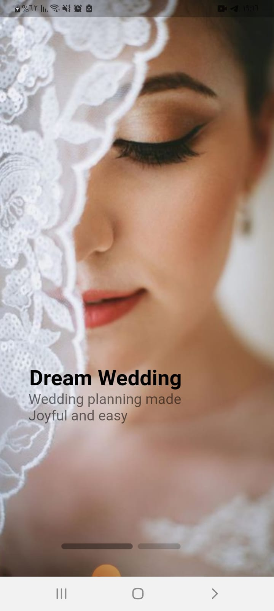
DREAM WEDDING
WEDDING PLANNING MADE JOYFUL AND EASY
Done by: Lana Atabeh, Masa Abu Odeh
Supervised by: Dr. Asmaa Afifi

Slide 2
Motivation
The couple finds it very difficult when starting to prepare for their wedding, because there are many and dispersed options, so our application aims to collect everything necessary for the wedding in one place, thus saving effort and time for the couple, in addition to benefiting entrepreneurs from introducing their project well and obtaining feedback

Slide 3
We Have 3 Level:
Client
Business Owner
Admin

Slide 4
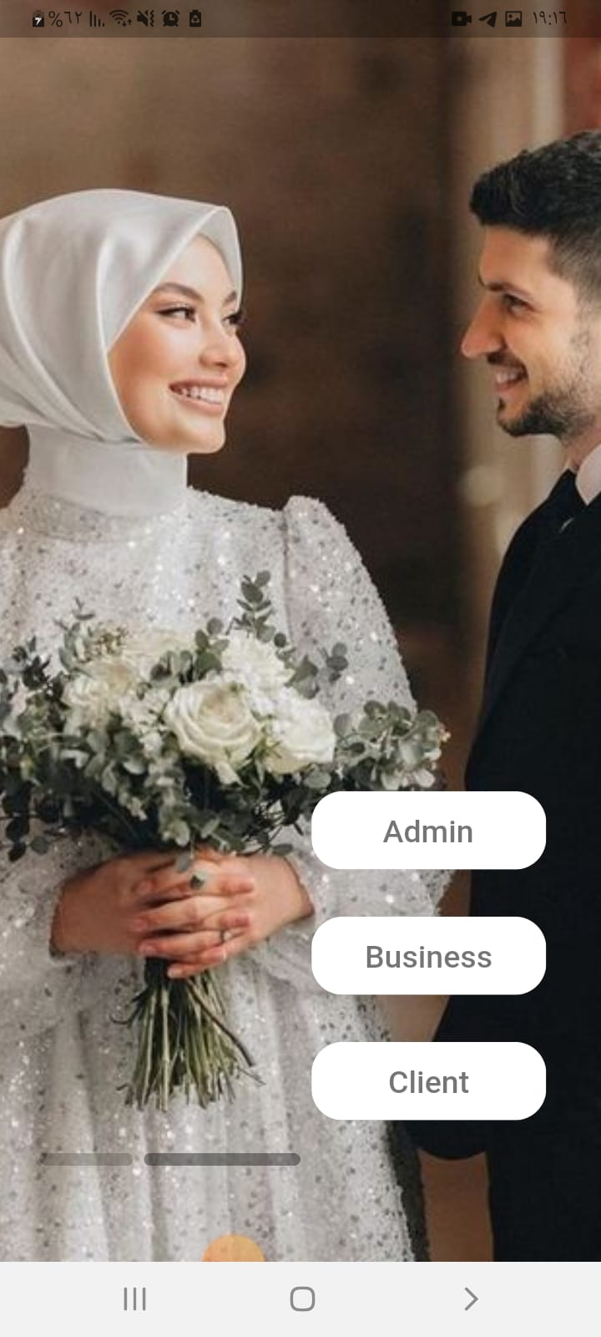

Application Levels

Slide 5

Features
Notification
Filter
Chat
Comment
Rating
Map
Booking
Search

Slide 6
User

Slide 7
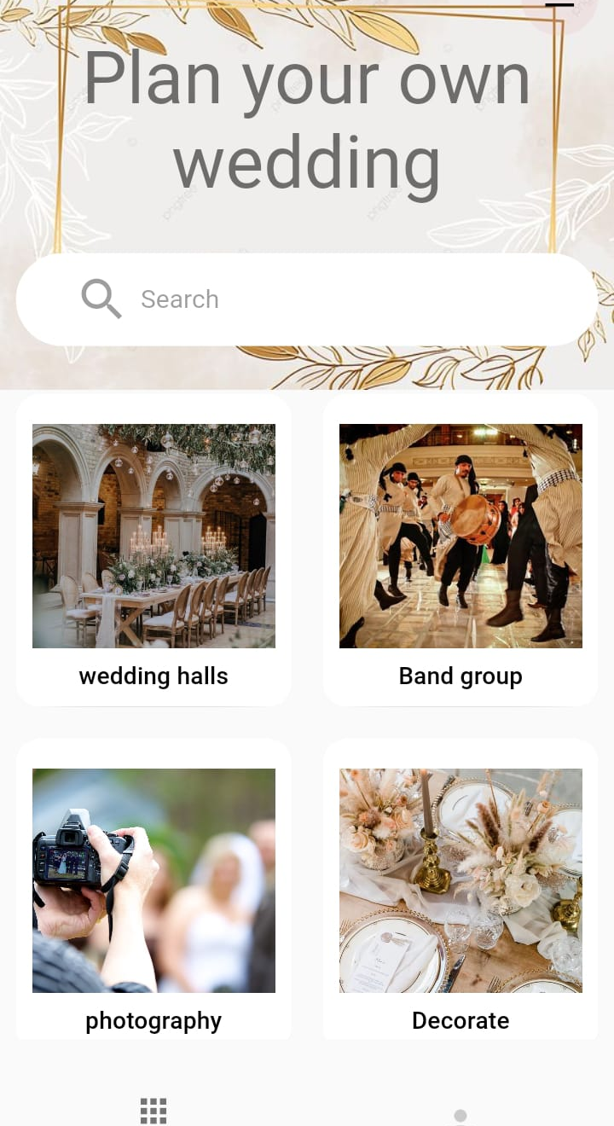
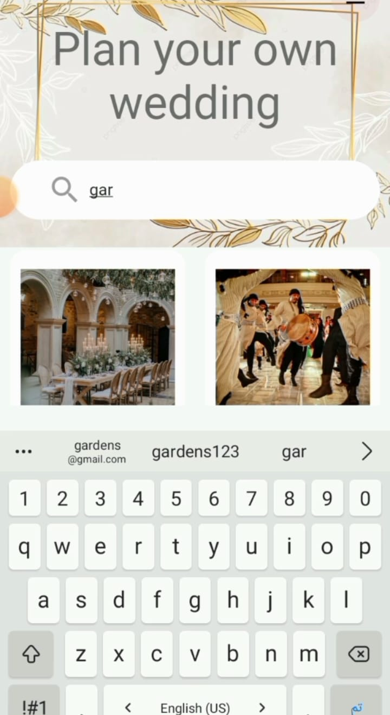
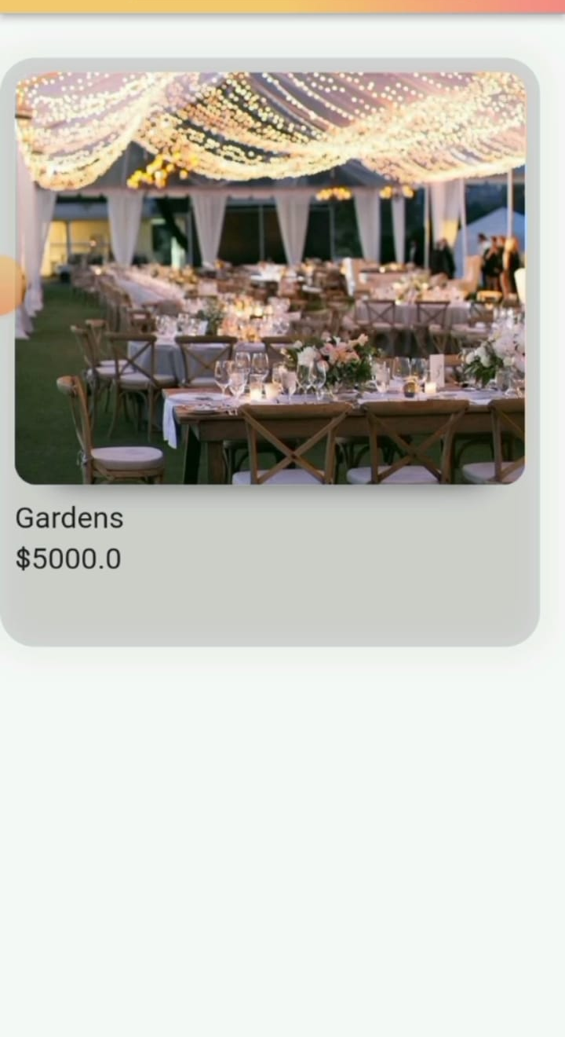
Home page and Search bar for user side

Slide 8
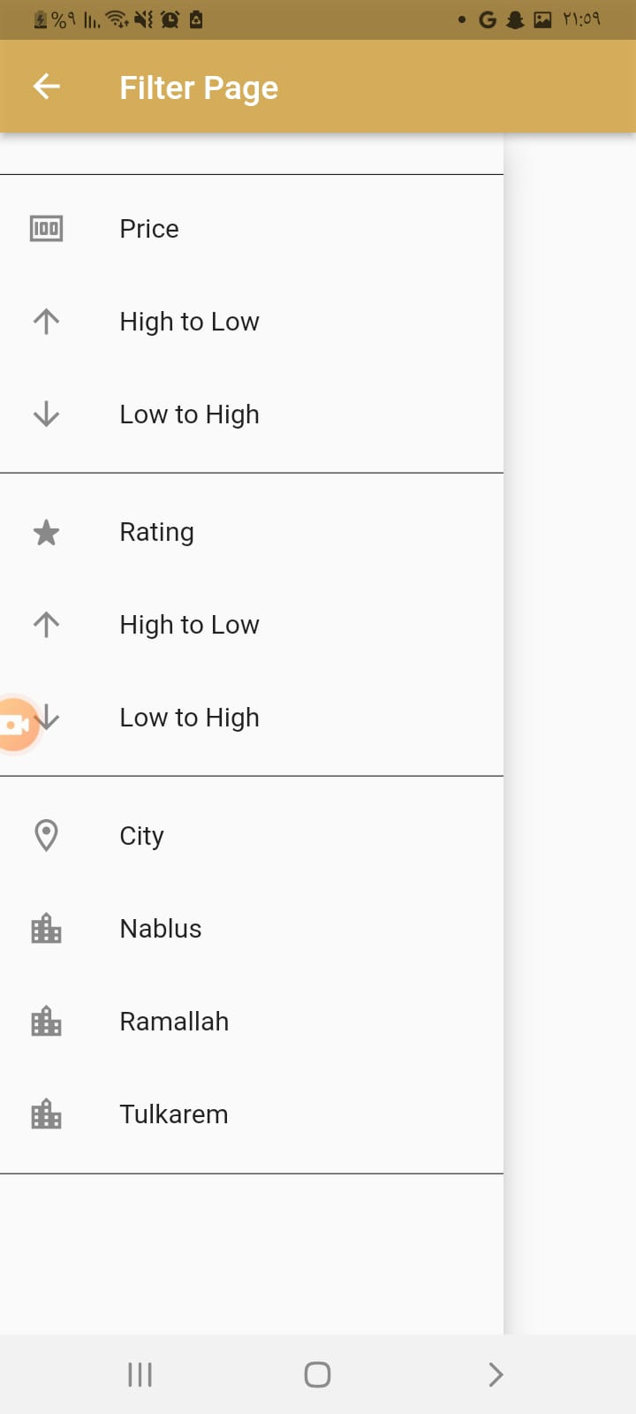
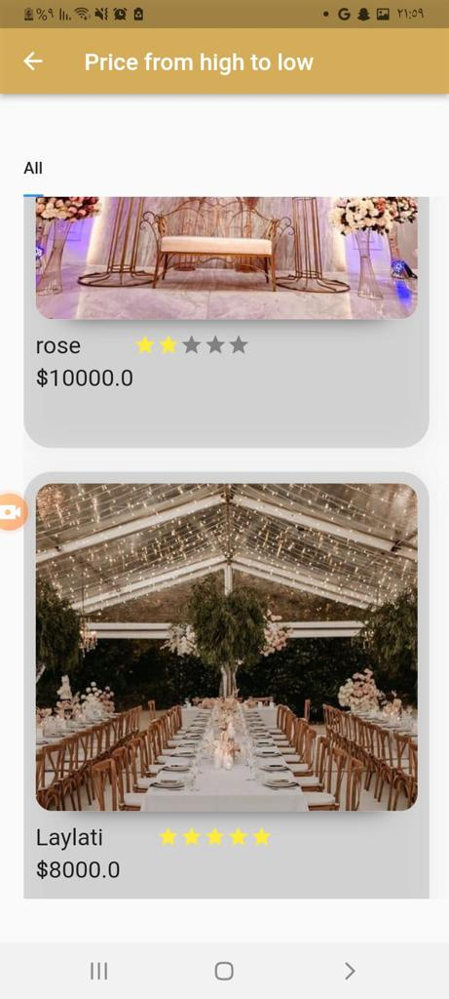
Filter

Slide 9
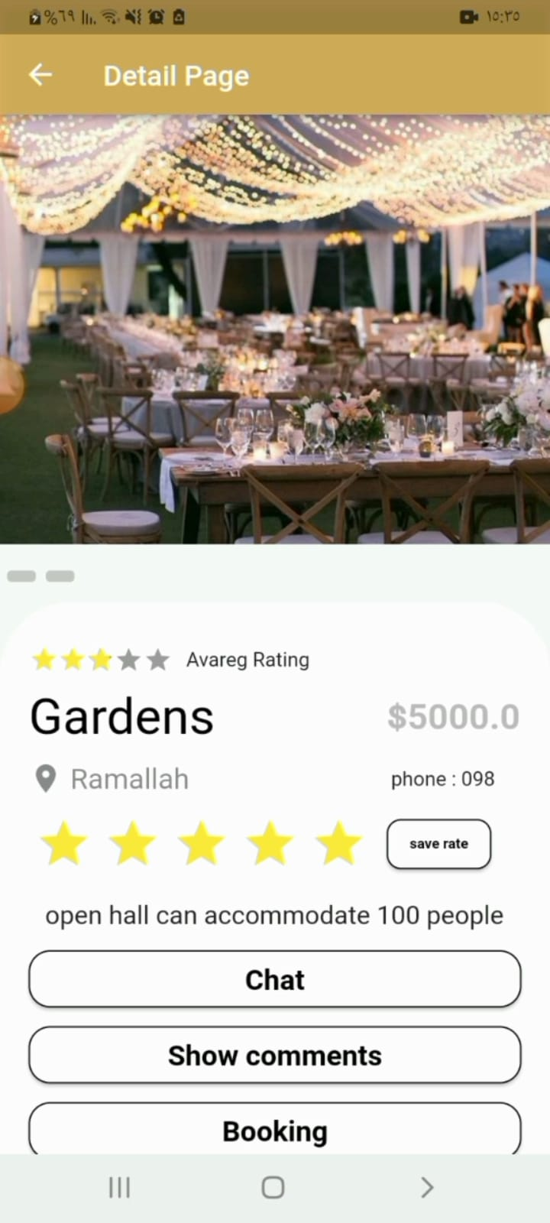
Details Page
User can see images and price, Description, Find Location on map, see Rate and Ratting, Chatting, write/see comment, and Booking.

Slide 10
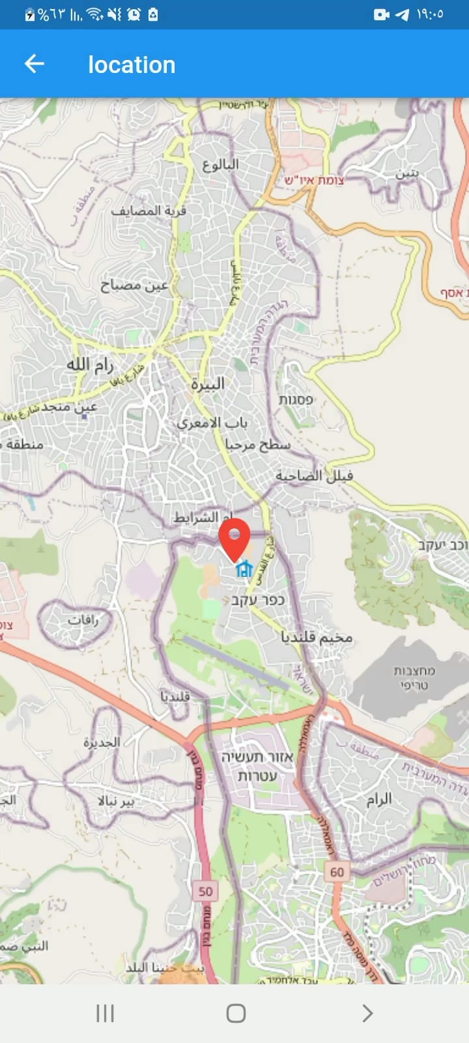
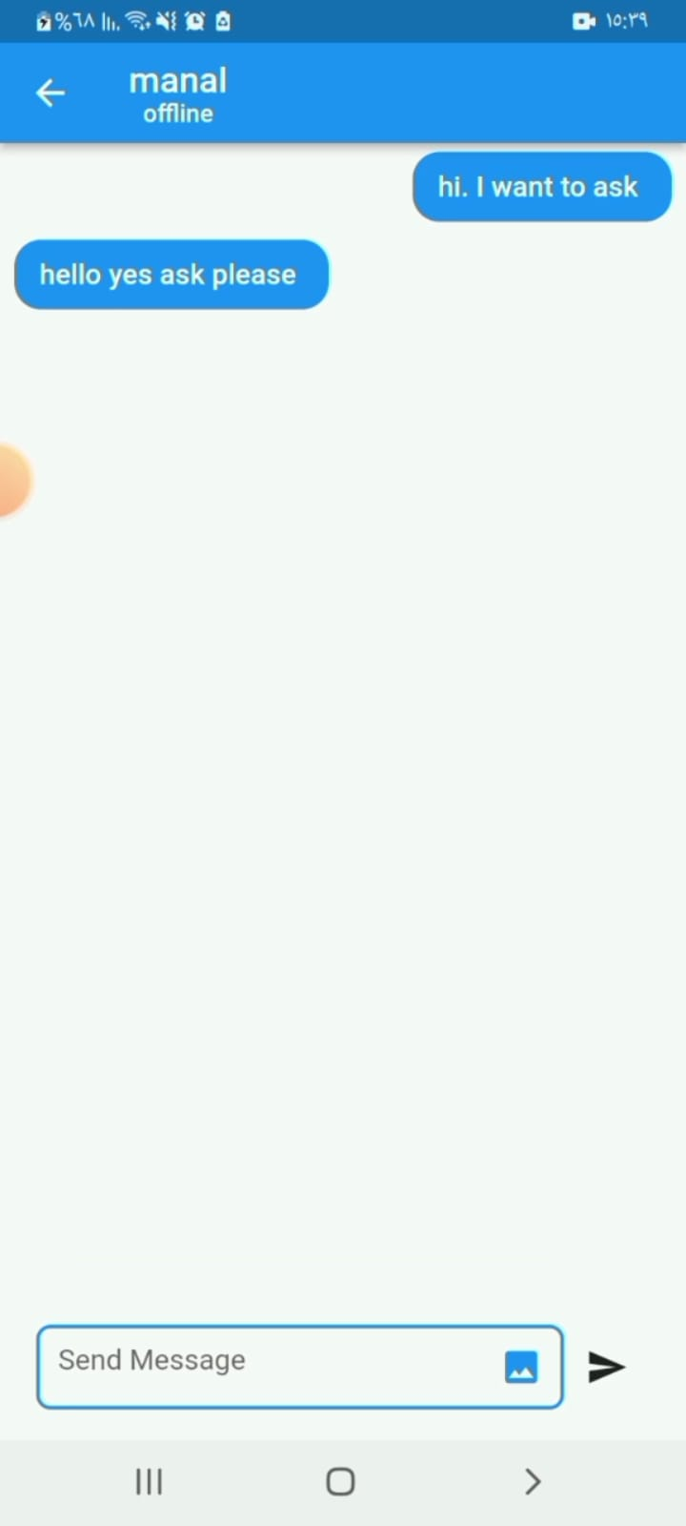
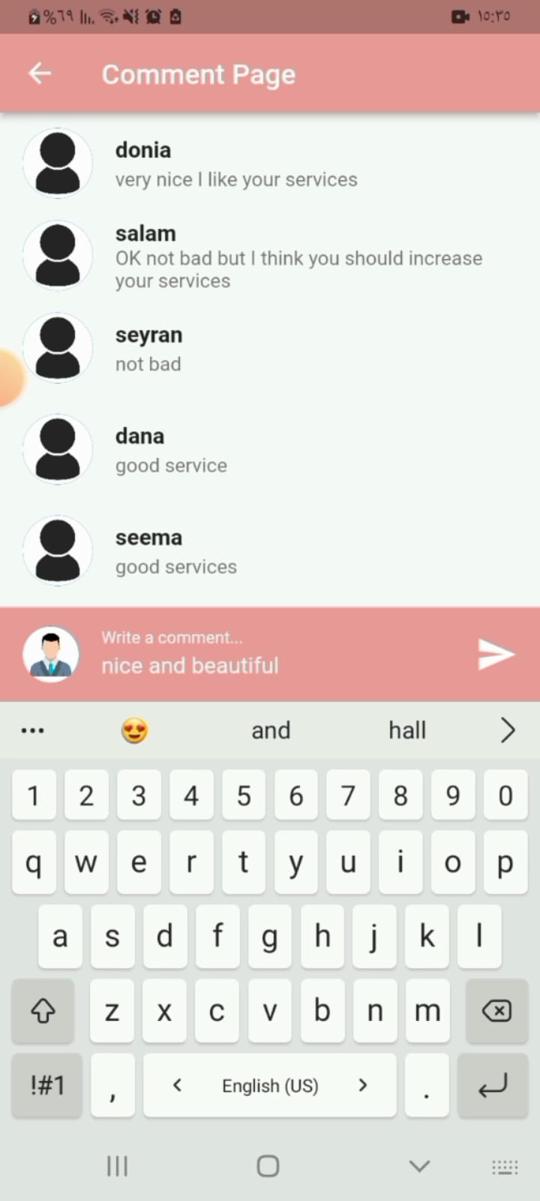
Location page, Chat page, Comment page

Slide 11
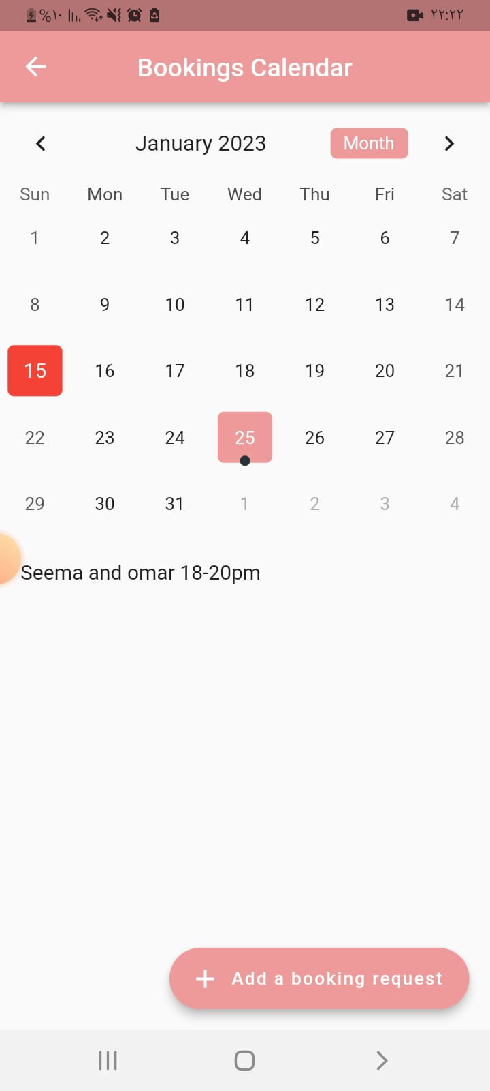
-Show all booked dates
-Add a booking request

Slide 12
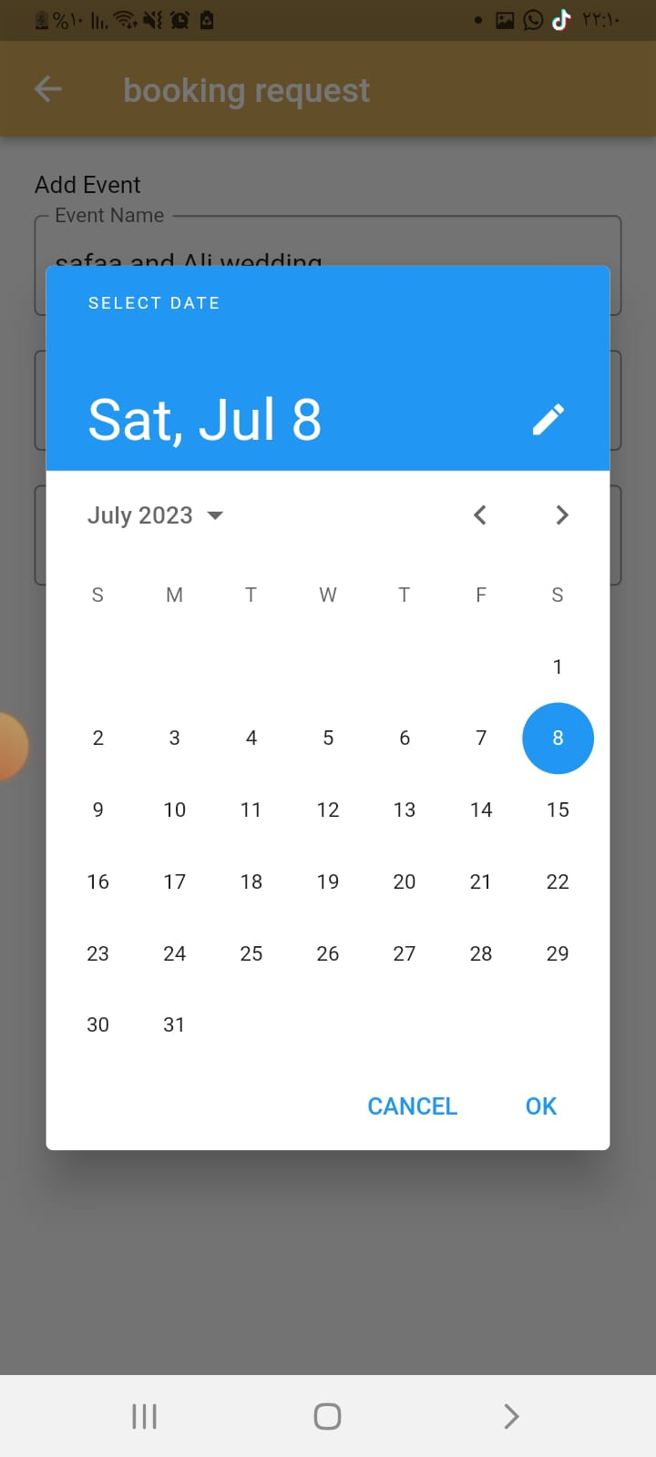
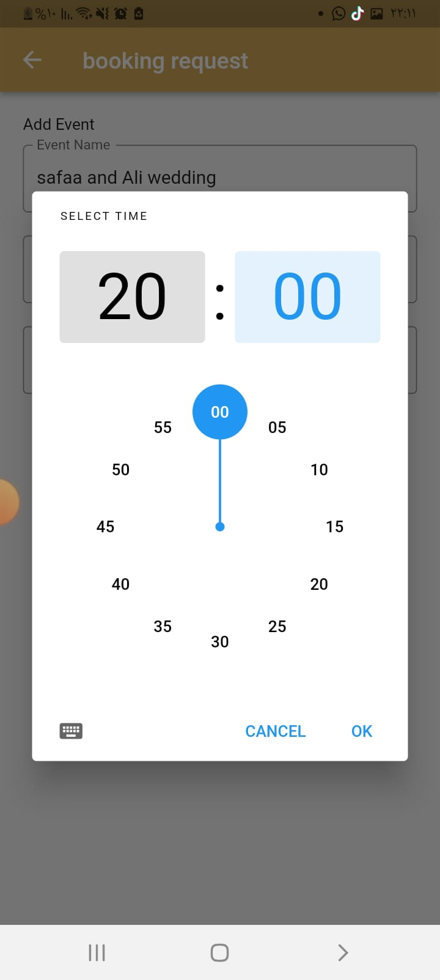

Add a booking request

Slide 13
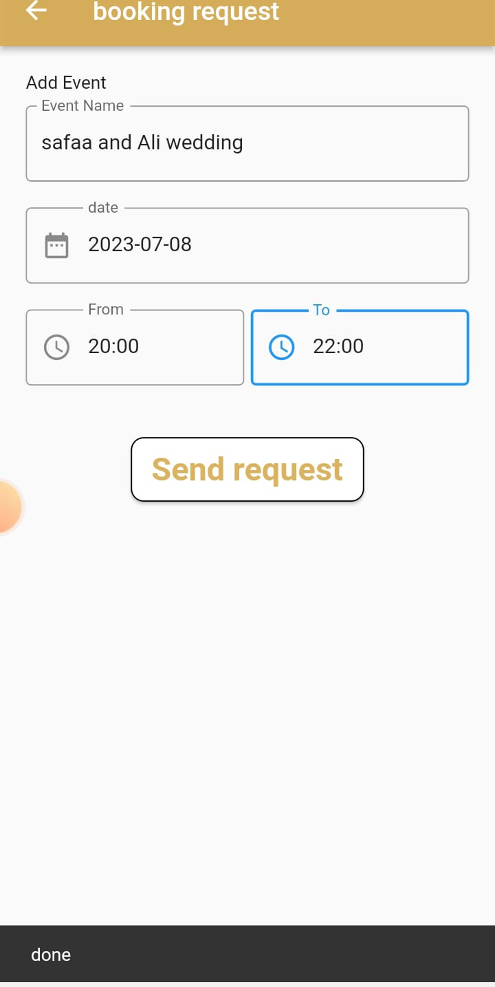
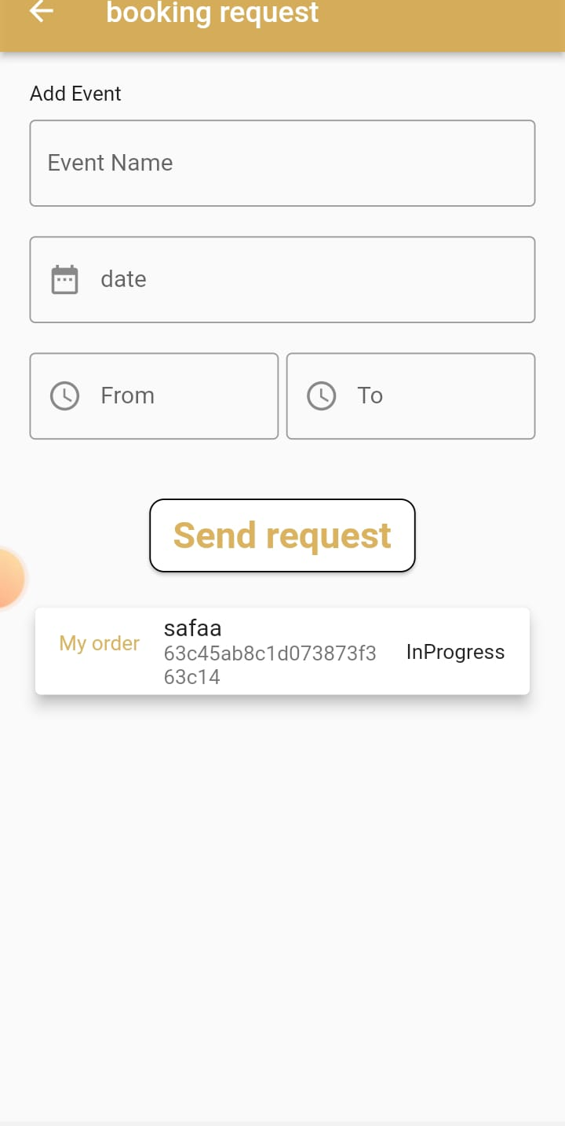
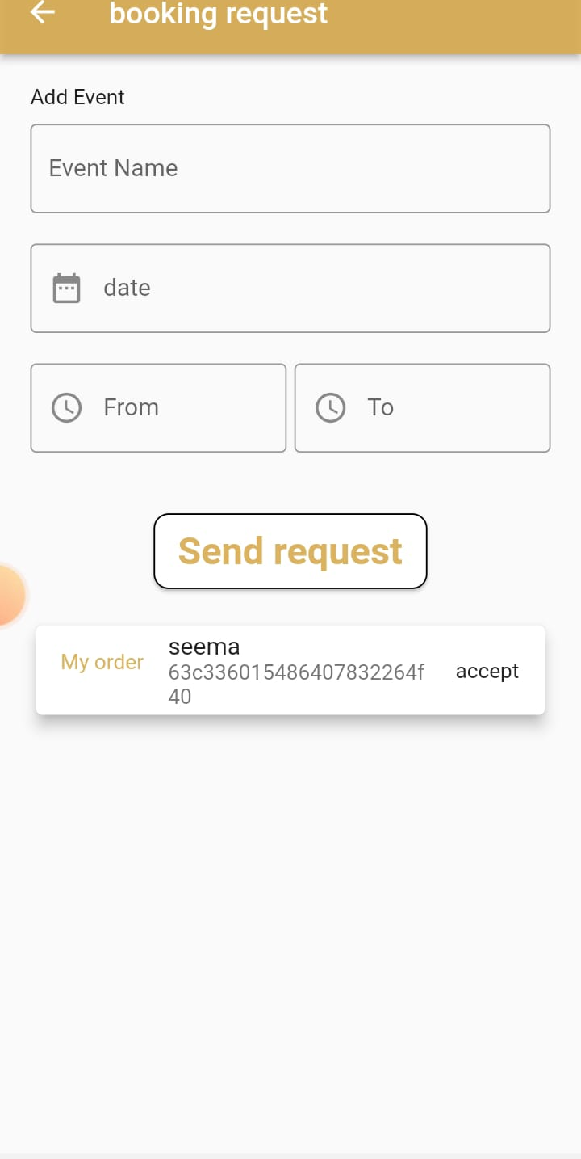
Request status

Slide 14
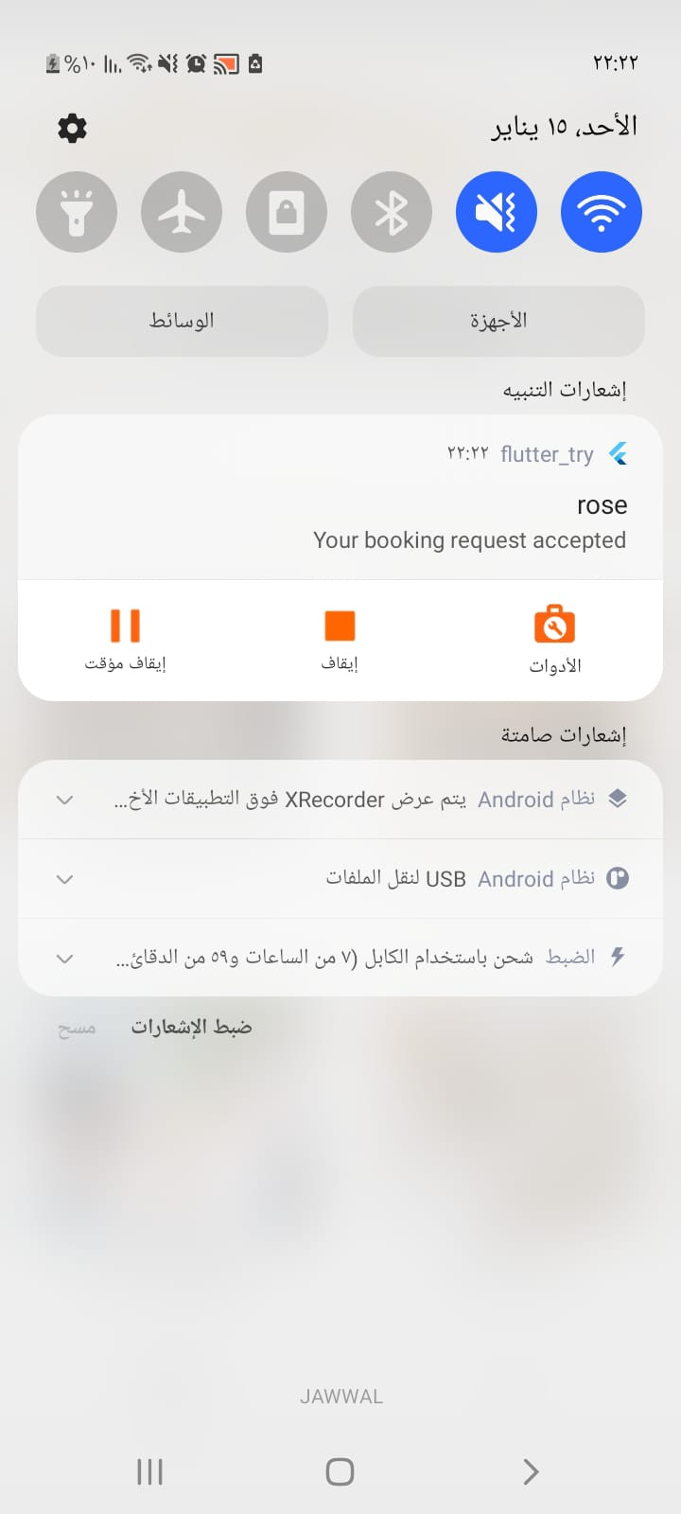
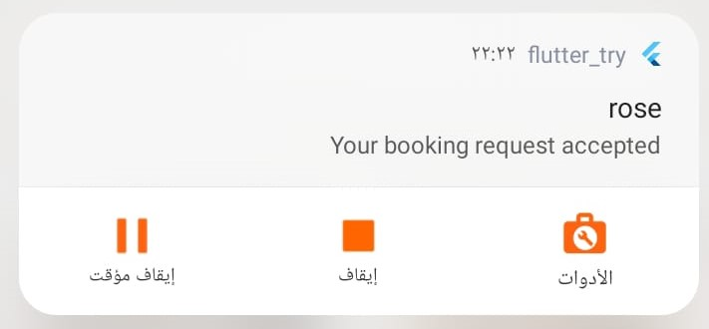
-Notification

Slide 15
Business Owner

Slide 16
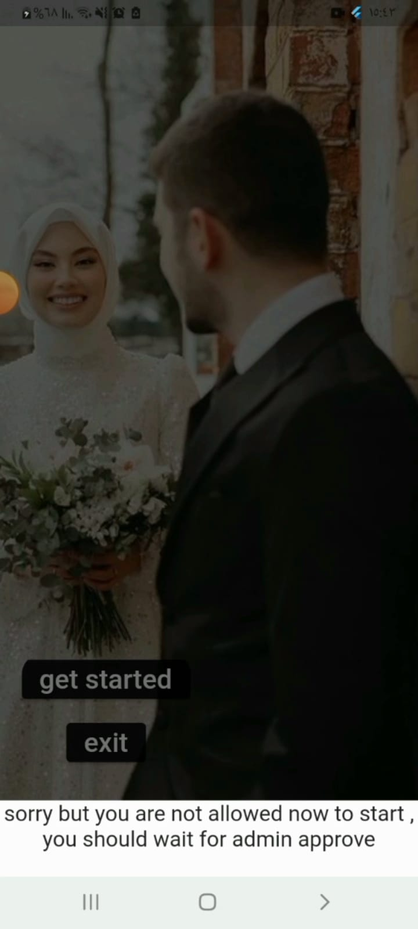
If admin did not approve

Slide 17
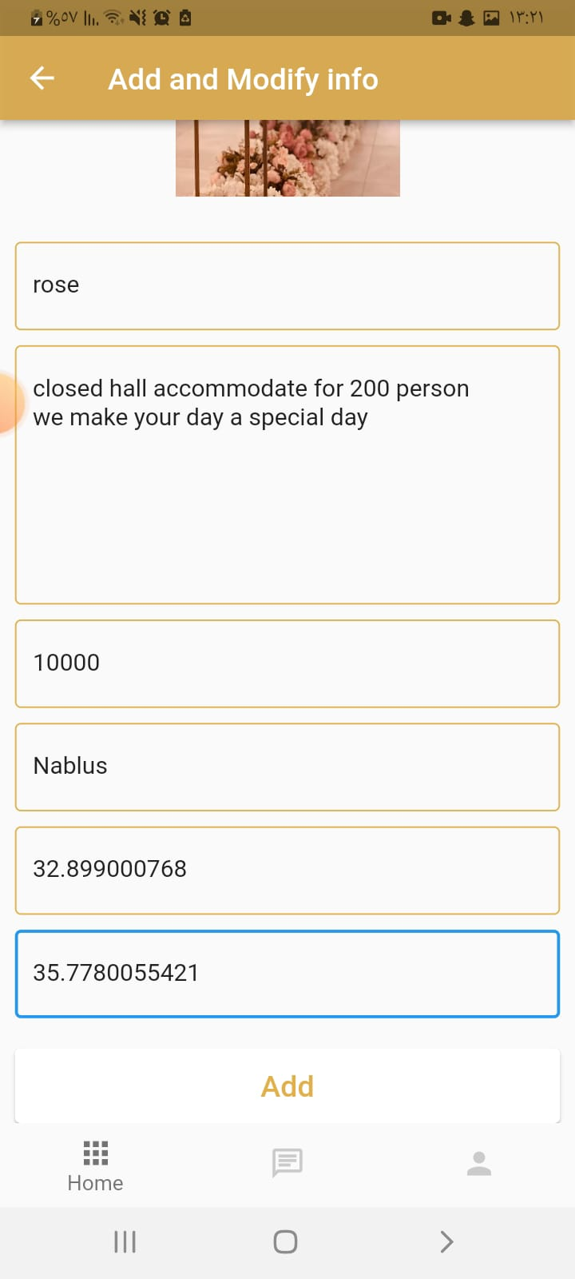
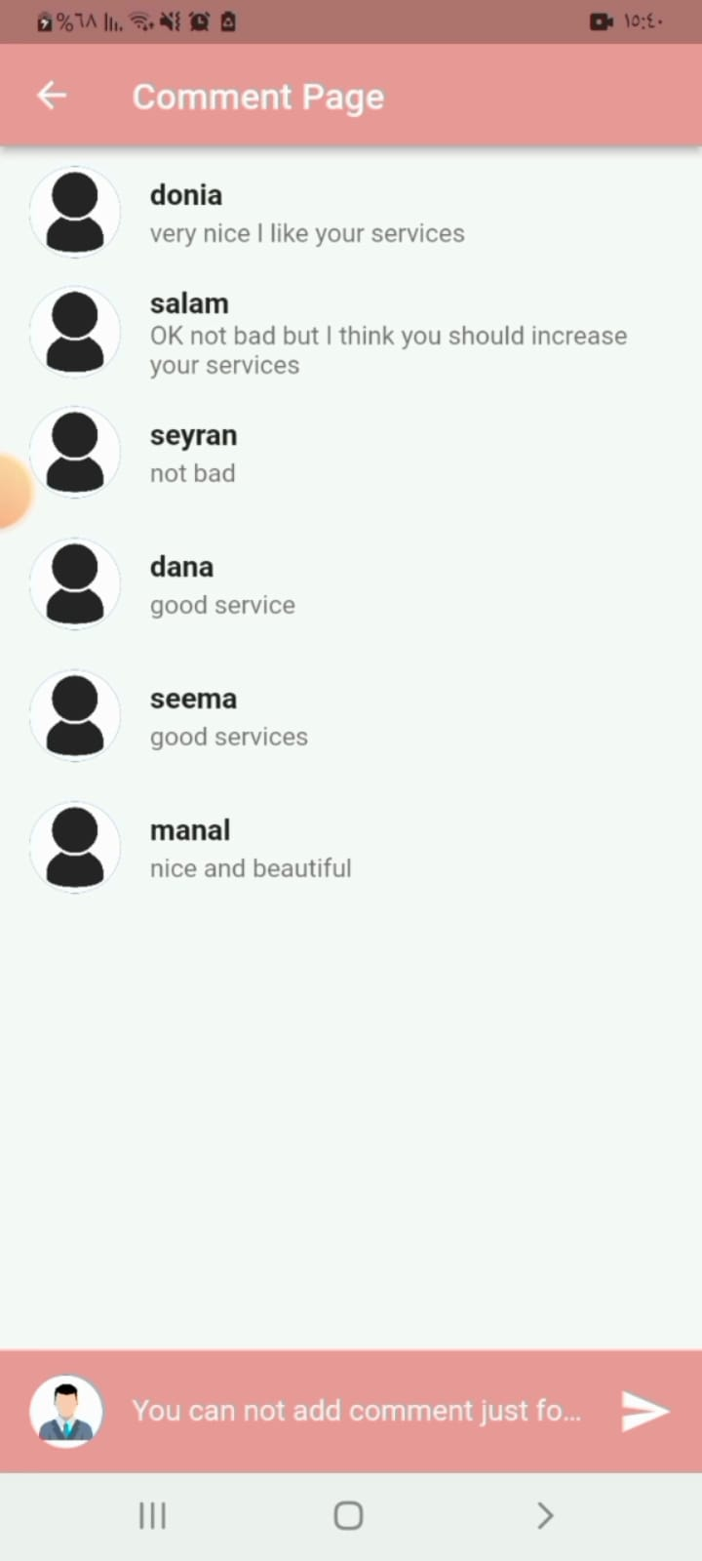
Add information and show comment

Slide 18
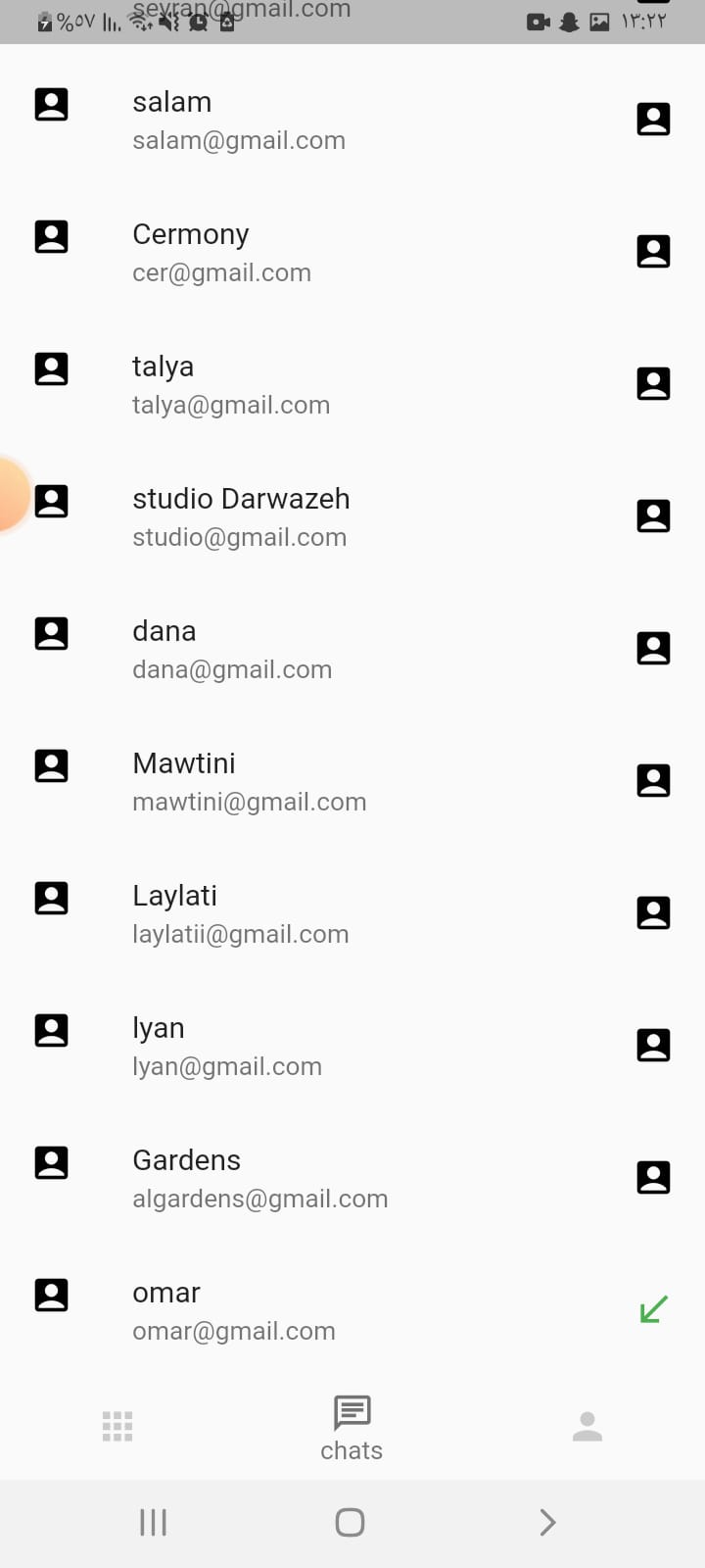
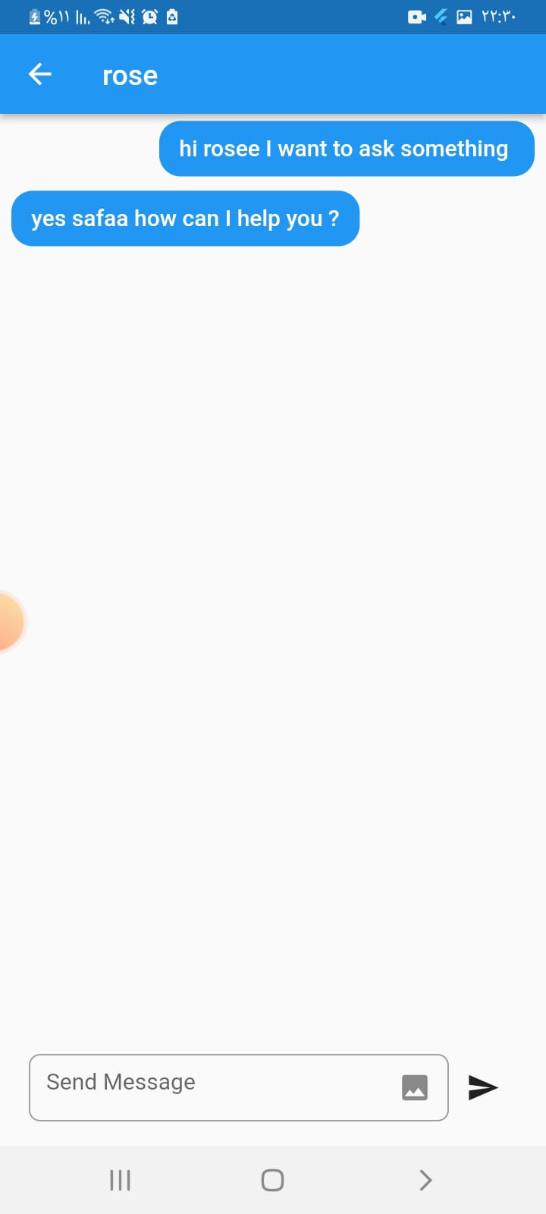
Chatting

Slide 19
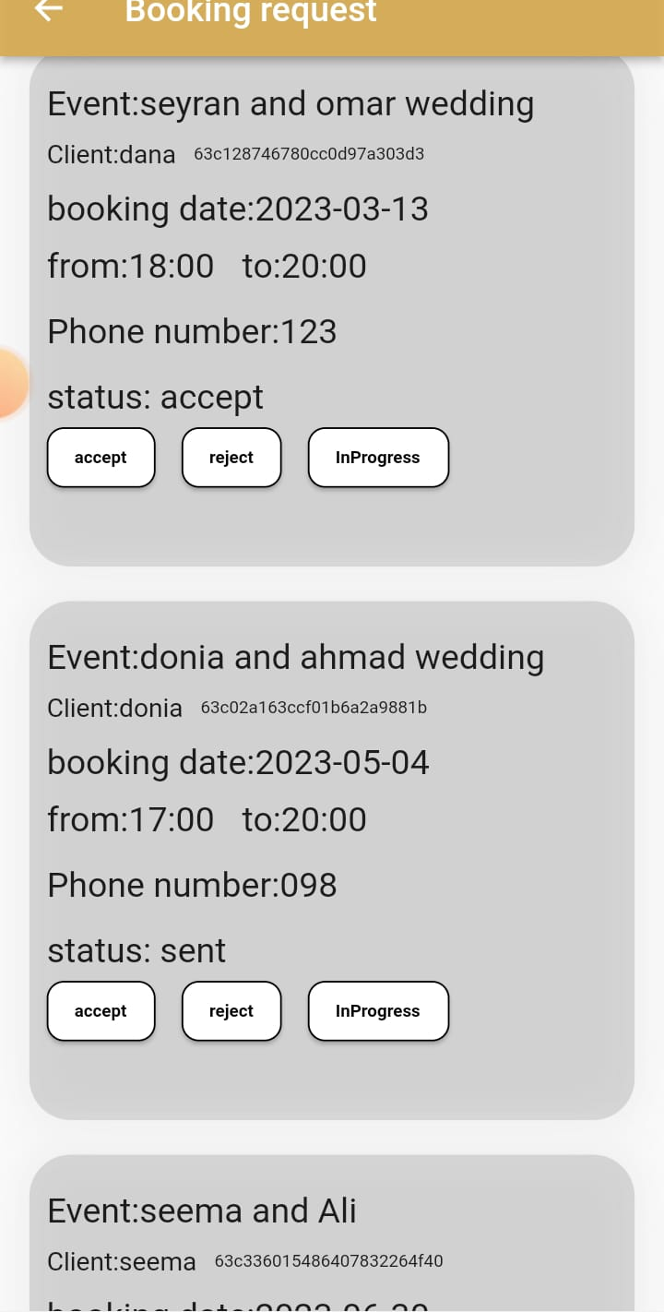
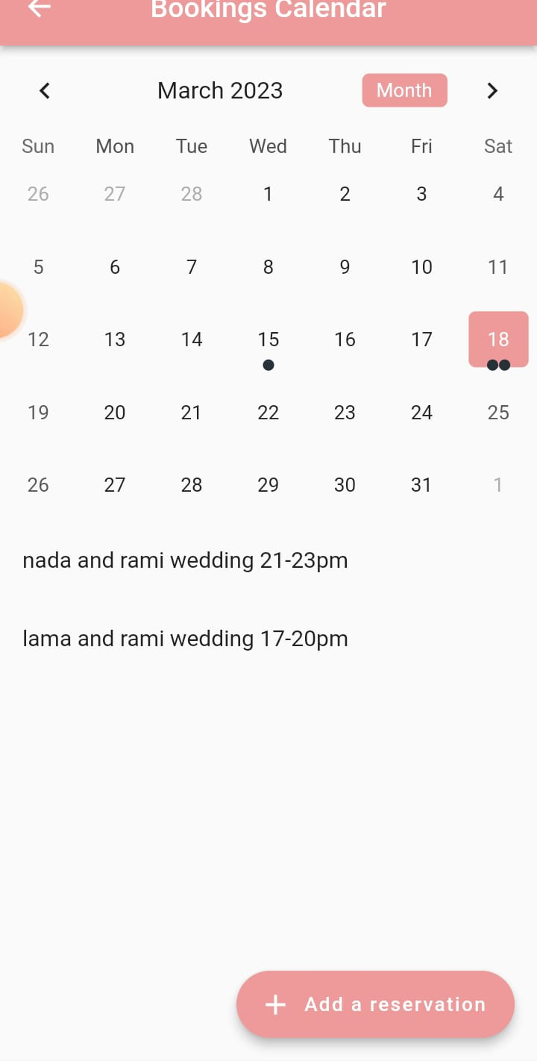
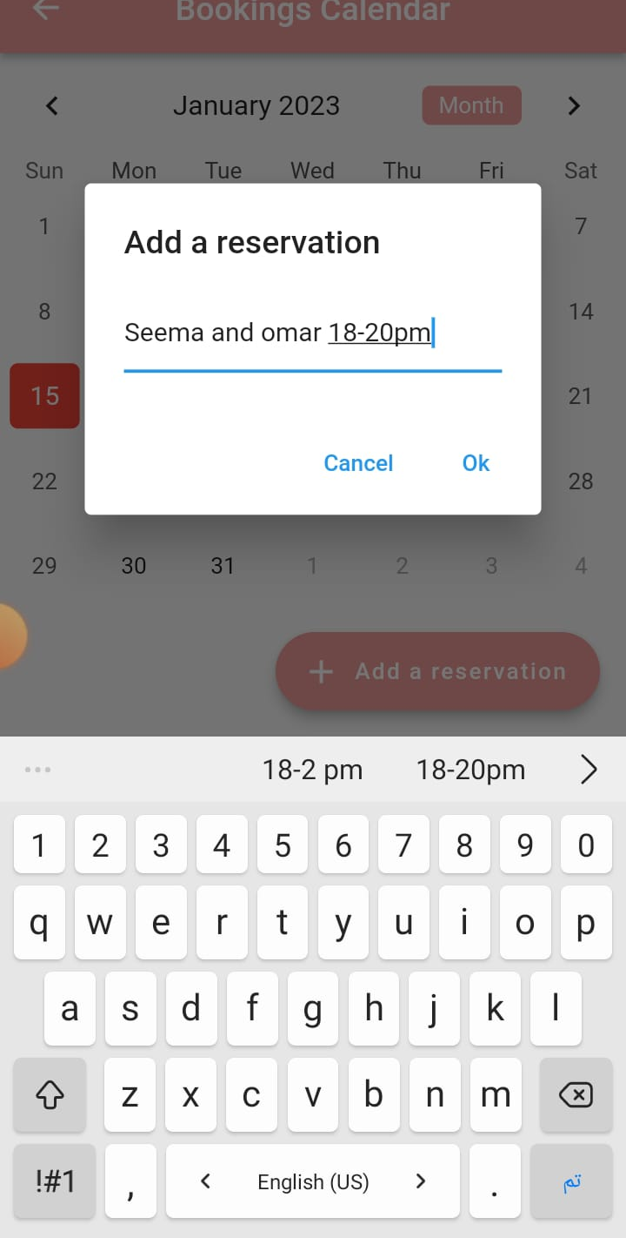
Add reservation

Slide 20
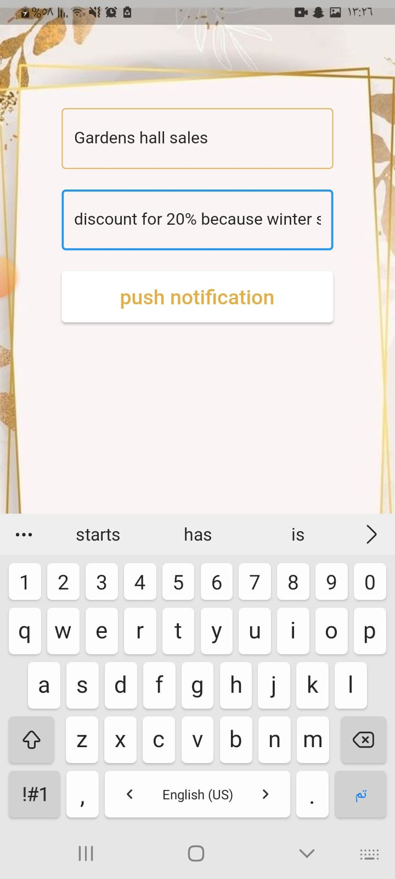

Push Notification for all user

Slide 21
Admin

Slide 22
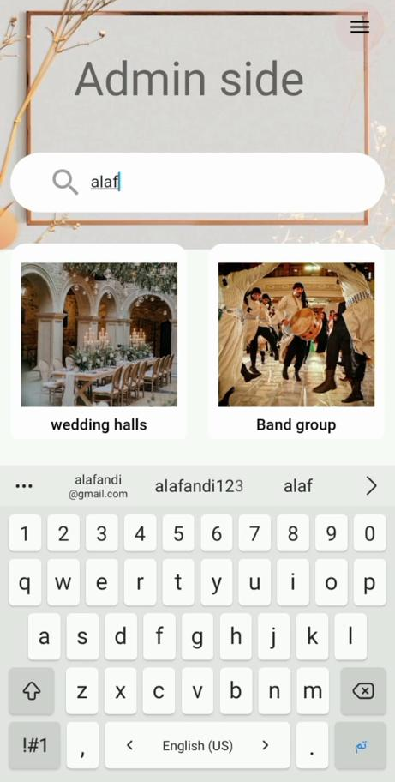
Search

Slide 23
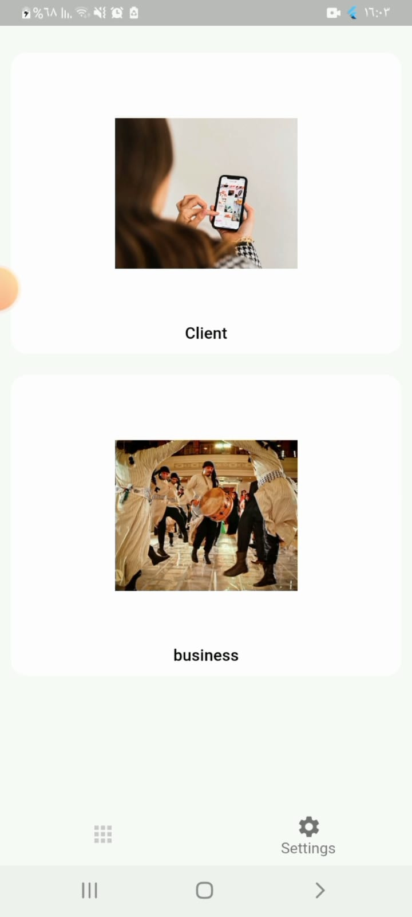
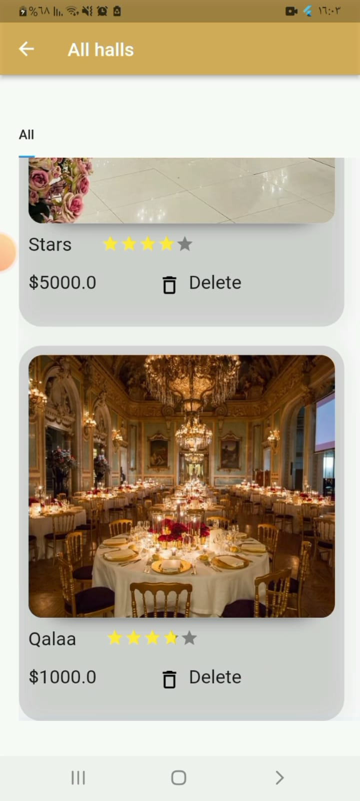
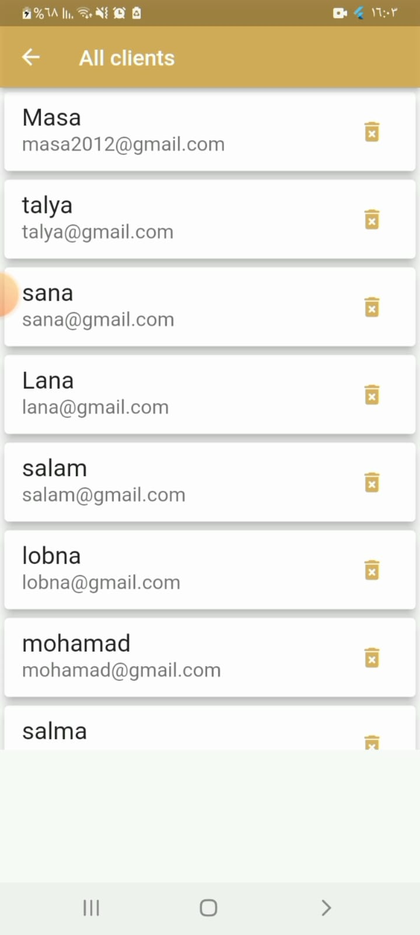
Delete user or business

Slide 24
Website

Slide 25

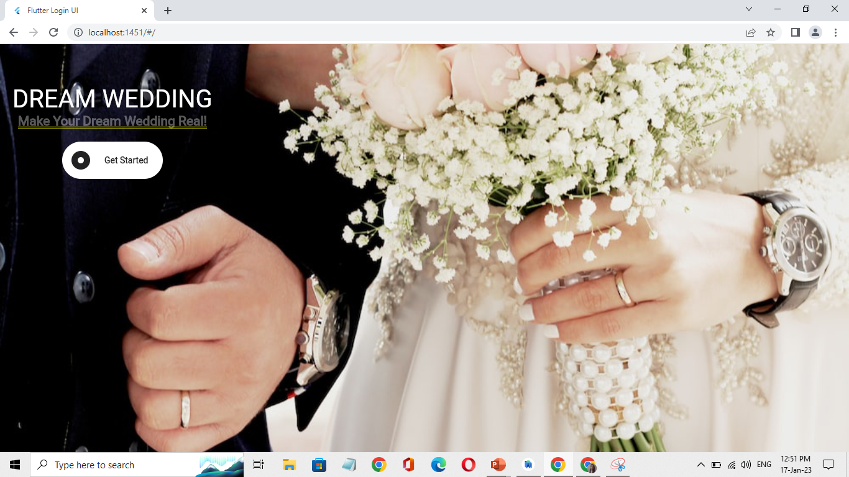
Our website for admin side

Slide 26
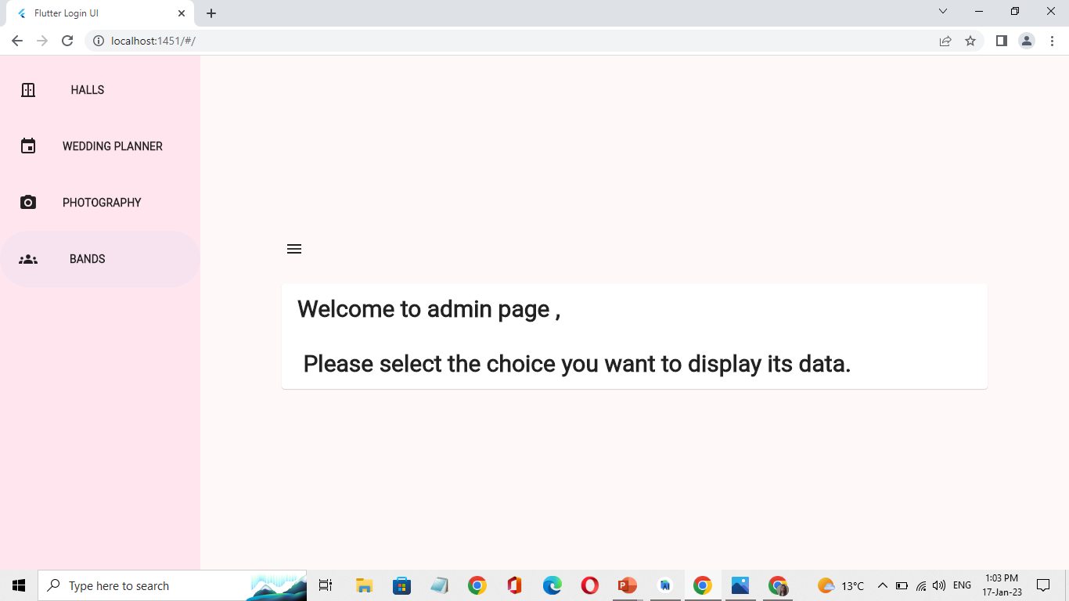
Admin can choose any field to display it table.

Slide 27

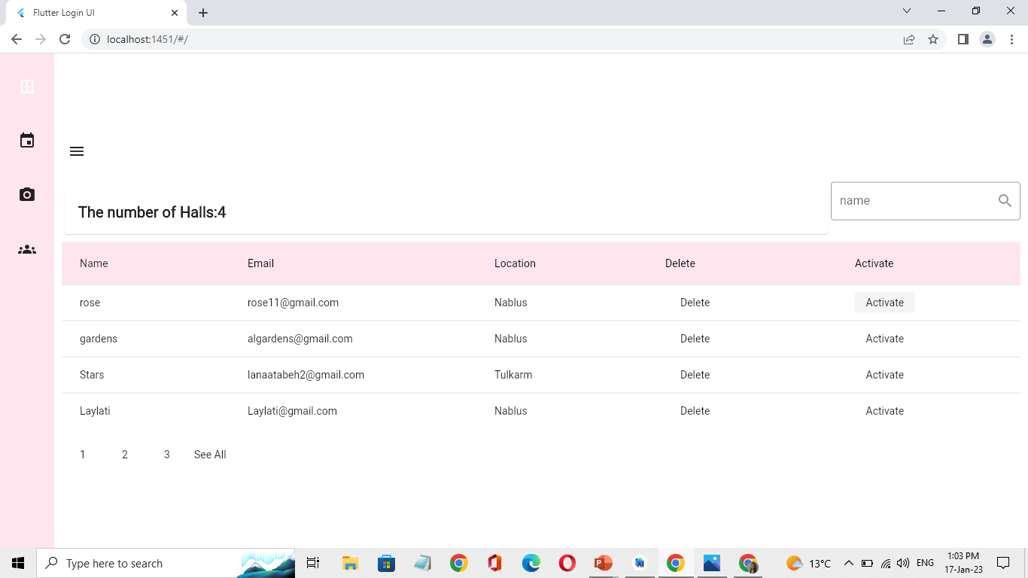
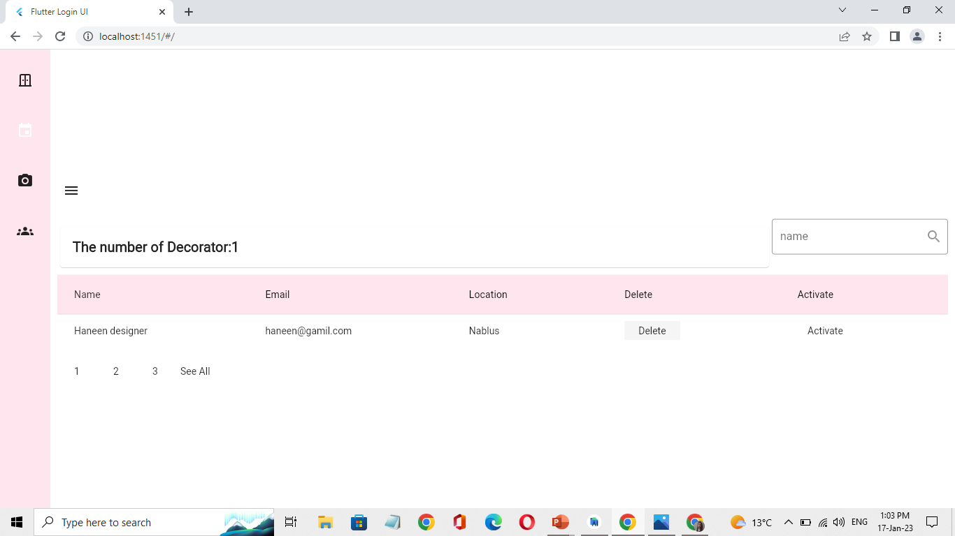
Admin can see the details of the works in addition to deleting or activating them

Slide 28
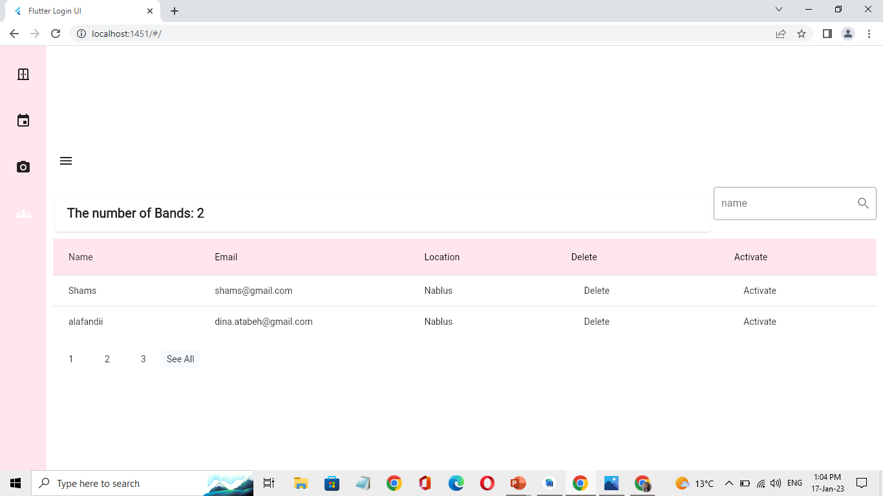
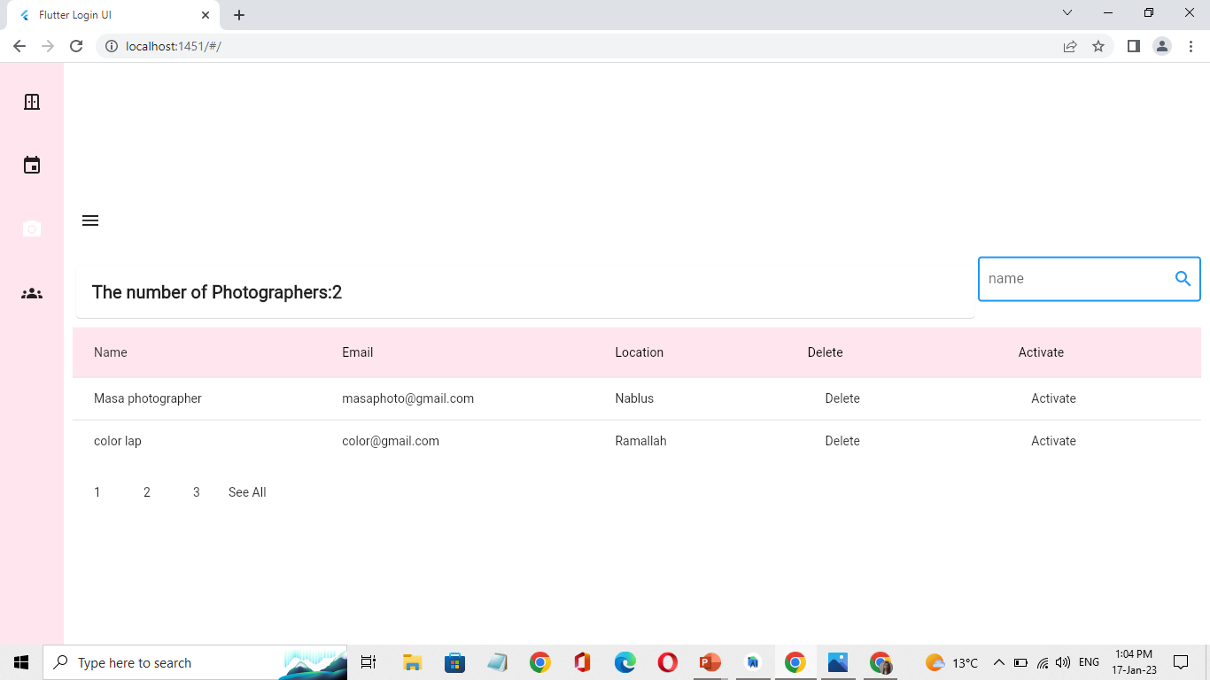
Also admin can search for name and see the whole number for each field.

Slide 29
Software Development Process
01
02
03
04
Requirements
Design
Implementation
Testing

Slide 30

Frontend:
Flutter/Dart language
Mobile App
Web
Backend:
Node js
Mongo DB
Post Man
Firebase
Database
Test Endpoitns
Firestore , messaging , notification

Slide 31
Future View
In order to improve the application, we can add online payment for services, and a website that includes all the features and services in the application, and we can add new businesses to the application such as women's salons and wedding dress boutiques.

Slide 32
Thanks !

