Slide 1
Size Reduction of Solar Water Heater by Utilizing Phase Change Material
Prepared by:
Rand Abu-Rumh
Walaa Shami
Supervisor:
Dr. Abdelrahim Abu-alsafa

Slide 2
Objectives
investigate the phase change material as a thermal energy storage method
Study the different types solar water heaters
Investigate the mathematical modeling of solar water heaters with and without PMC
Optimize the size of solar water heater with phase change material

Slide 3
outlines
Introduction
The Existed Solar Water Heater System
Comparison Between Three Sizes of Storage Tank of SWH
The Mat-lab Algorithm
The Suggested SWH system
Comparison Between The Results of The Existed System and The Suggested System
Conclusion and Recommendation

Slide 4
INTRODUCTION
In Palestine there is a large dependence on SWH to heat water. In 2001, 72% of Palestinian houses have used solar heaters but this percentage was decreasing as it reached 62% in 2014. This decrease is due to increase in the building height and decrease the space available for solar water heater (SWH).

Slide 5
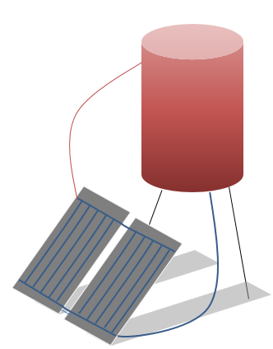
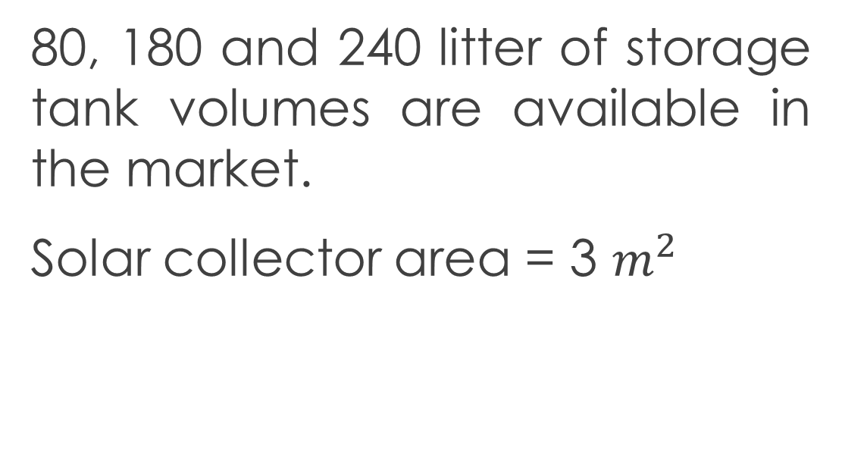
The Existed Solar Water Heater System
Thermo-siphon, flat plate SWH
80, 180 and 240 litter of storage tank volumes are available in the market.
Solar collector area = 3 $m^{2}$

Slide 6
Three Sizes of SWH Storage Tank

Slide 7
The Chosen Size of Storage Tank to be The benchmark is 180 litter

Slide 8
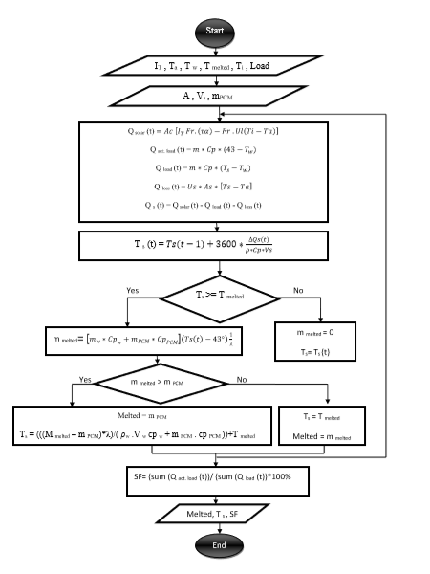
The Mat-lab Algorithm

Slide 9
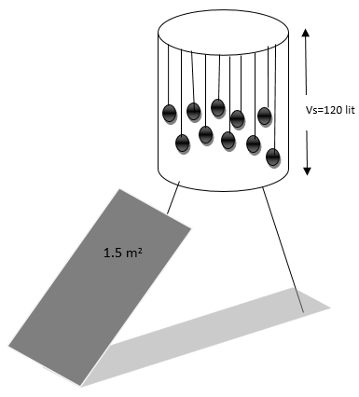
The Suggested SWH System
Thermo-siphon, flat plate SWH
The Suggested design
m2 | 1.5 | Collector Area
Litter | 120 | Storage Tank Volume
Kg | 25 | Mass of PCM
Litter | 30.5 | Volume of PCM
Litter | 80.5 | Volume of Water
Storage Tank
m3 | 0.12 | Storage Tank volume
W/m².C | 0.57 | Us
 | 2 | h/d
PCM (paraffin-wax)
°C | 52 | melting point
kJ/kg | 230 | latent heat of fusion (h)
kg/m³ | 820 | density
kJ/kg.K | ­­­­2.4 | specific heat
W/m.K | 0.25 | thermal conductivity
Kg | 25 | Mass

Slide 10
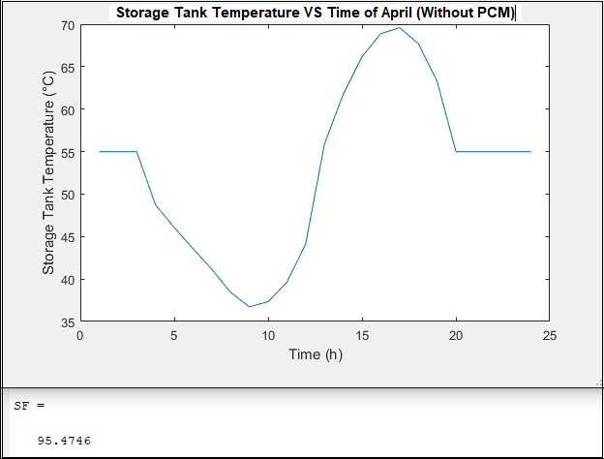
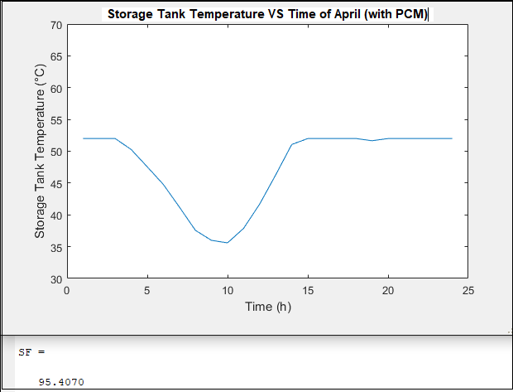
Comparison between The Results of The Existed System and The suggested system
For April
The suggested system
The existed system

Slide 11
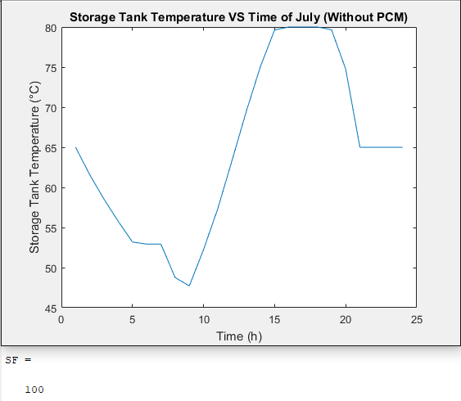
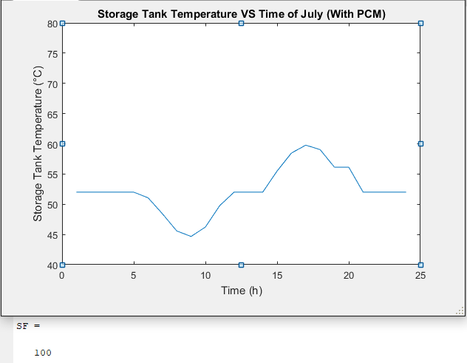
Comparison between The Results of The Existed System and The suggested system
For July
The suggested system
The existed system

Slide 12
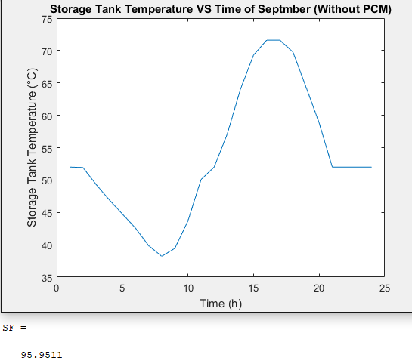
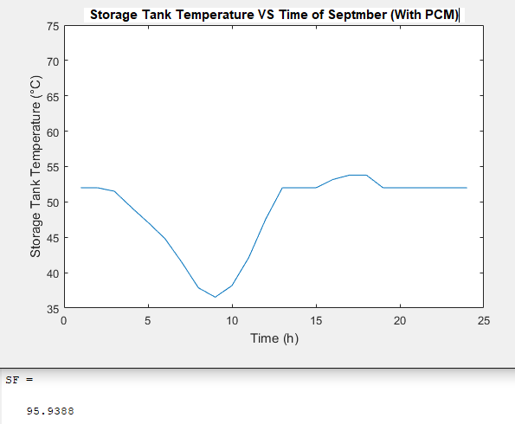
Comparison between The Results of The Existed System and The suggested system
For September
The suggested system
The existed system

Slide 13
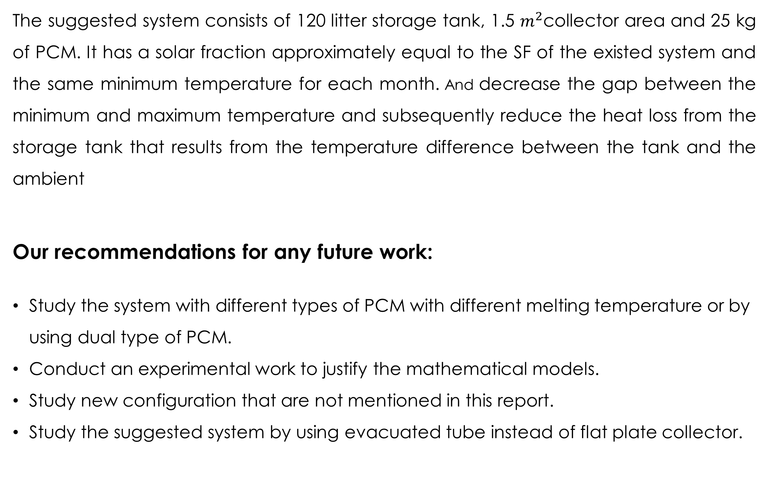
Conclusion and Recommendations
The suggested system consists of 120 litter storage tank, 1.5 $m^{2}$collector area and 25 kg of PCM. It has a solar fraction approximately equal to the SF of the existed system and the same minimum temperature for each month. And decrease the gap between the minimum and maximum temperature and subsequently reduce the heat loss from the storage tank that results from the temperature difference between the tank and the ambient
Our recommendations for any future work:
Study the system with different types of PCM with different melting temperature or by using dual type of PCM.
Conduct an experimental work to justify the mathematical models.
Study new configuration that are not mentioned in this report.
Study the suggested system by using evacuated tube instead of flat plate collector.

