Slide 1
Predicting Type 2 Diabetes Risk and Identifying its Risk Factors through a Machine
Learning Model
A Study Utilizing the 2015 BRFSS Dataset
Ghaith Maqboul
2024, February 7

Slide 2
Outline
Introduction
Dataset Overview
Data Preprocessing
Exploratory Data Analysis
PreModeling
Modeling
Discussion of Results
Conclusion

Slide 3
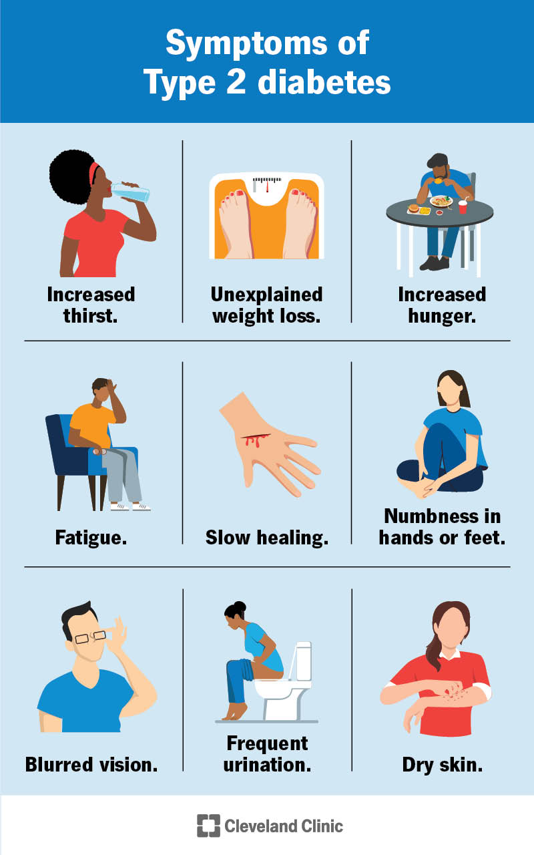
Understanding Type 2 Diabetes
Diabetes as a Global Health Concern
  Affects millions of individuals worldwide.
  Is associated with various health complications
  Has an economic burden on healthcare systems

Slide 4
Objectives of the Study
Develop predictive models for type 2 diabetes using machine learning techniques.
Identify key risk factors associated with type 2 diabetes using from the BRFSS 2015 dataset.

Slide 5
Introduction to the BRFSS Dataset
The Behavioral Risk Factor Surveillance System (BRFSS), developed by the Centers for Disease Control and Prevention (CDC), is a valuable resource for public health research.
BRFSS 2015 dataset that its used in our study it is derived from annual data surveys conducted through telephone interviews, It captures data on health-related behaviors and chronic conditions from non-institutionalized adults, providing insights into population health trends.

Slide 6
Data Preparation Process
The dataset was initially downloaded in SAS format from the BRFSS website.
It was then converted to CSV format for compatibility with Python libraries such as Pandas and NumPy.
The converted CSV dataset was uploaded to Google servers for use in the Colab environment.
Google Colab was chosen for its ability to handle large datasets efficiently.

Slide 7
Feature Selection Strategy
Initially, the dataset contained 441,456 participants and 330 features.
Acknowledging the multifaceted nature of diabetes and its intricate relationship with various factors, this project strategically selects features that span across different domains:
  Demographics: Age, Sex
  Socio-economic: Education, Income
  Health-related: WalkDifficulty, GeneralHealth, PhysicalHealth, MentalHealth
  Lifestyle and Diet: Smoker, PhysicalActivity, Fruits, Vegetables
  Medical Examinations and Body Measurements: Diabetes, HighBloodPressure, HighCholesterol, BMI
  Other Chronic Health Conditions: Stroke, HeartDiseaseorAttack

Slide 8
Overview Data Preprocessing Steps
After strategically selecting features, various preprocessing steps were undertaken to ensure data quality and suitability for analysis. These steps include:
  Convert Data Types
  Clean Data
  Change Values for ML Modeling
  Rename Features
Before preprocessing the data, the dataset contained 441,456 rows and 330 variables. After Preprocessing the data, the final shape of the dataset comprised 42,340 rows and 18 selected variables.
the final dataset features unique values and their corresponding meanings represented in this table.

Slide 9
Exploratory Data Analysis
Different exploratory data analysis techniques were employed to understand the dataset's distribution, relationships, and potential patterns such as:
Histograms.
Visualizations of diabetes cases across different categories.
Heatmap correlation matrix.

Slide 10
Pre-Modeling
Before constructing predictive models, several preparatory steps were undertaken to ensure optimal model performance including:
Partitioning the Dataset
  The dataset was partitioned into a training set and a test set using the holdout method.
  80% of the preprocessed data was randomly allocated to the training dataset, while the remaining 20% was reserved for the test dataset.
  Stratified sampling was applied to ensure a proportional representation of classes during the split.
Normalization:
  Standard scaling was employed to normalize the data.
  This normalization technique ensures that all features contribute equally to the model training process.

Slide 11
Summary of Dataset Distribution after Pre-Modeling
The final dataset consisted of 10,348 individuals, with 24.4% diagnosed with type 2 diabetes and 75.6% non-diabetic.
Stratified sampling was used during the split, ensuring a proportional representation of positive and negative cases.

Slide 12
Model Evaluation
Overview of Modeling Techniques:
  Various classifiers were explored for prediction such as: AdaBoost, Neural Network, Logistic Regression, Decision Tree, K Nearest Neighbors, Naive Bayes, and Random Forest.
  Each model was assessed for its predictive performance using metrics such as accuracy, sensitivity, specificity, and the Area Under the Receiver Operating Characteristic (ROC) curve (AUC).
Hyperparameter Tuning:
  Hyperparameter tuning was performed for each classifier to optimize their performance.
  Specific hyperparameters were tuned for each model to improve their predictive accuracy and generalization ability like presented in this table.

Slide 13
Feature Importances Evaluation
The Random Forest classifier was utilized to determine feature importances, shedding light on the associations between different variables and type 2 diabetes.
This classifier is particularly suitable for feature selection due to its ability to rank variables based on their contribution to predictive performance.

Slide 14
Modeling Results
All classifiers demonstrated high test accuracy, ranging from (71.6% - 77.8%), and exhibited elevated AUC values spanning (74.7% - 79.2%).
Notably, the AdaBoost model displayed the highest accuracy (78.2%), specificity (92.7%), and AUC (79.2%) values but with low sensitivity (33.5%).
Despite having the least highest accuracy (71.7%), specificity (71.3%), and AUC (79.1%) values, the Random Forest model presented the highest sensitivity (72.9%), making it suitable for initial screening of type 2 diabetes.
All metrics were produced to compare the performance of all models, as you will see in this table.

Slide 15
Feature Importances
The findings of Feature importances results collectively provide a comprehensive understanding of the multifaceted nature of risk factors, aiding in targeted interventions and preventive strategies for managing and mitigating the prevalence of type 2 diabetes.
Feature importance analysis identified the top contributors to type 2 diabetes risk as represented in this table.

Slide 16
Conclusion
Diabetes poses a serious threat.
Our study aimed to develop a predictive model for type 2 diabetes and identify risk factors associated with it.
The findings aligned with our objectives, as the Random Forest classifier demonstrated balanced and good overall performance across different metrics.
Random Forest, was instrumental in determining feature importances, contributing to our understanding of the disease.
By obtaining these findings, we aspire to contribute to the prevention and management of type 2 diabetes.

Slide 17
Future Work
Expanding scope: Working with 2015 BRFSS dataset and five or ten additional years, resulting in millions of instances.
Inclusive feature selection: Utilizing all cross-sectional features across different domains.
Importance assessment: Applying various techniques to assess feature importance.
Selective feature utilization: Using only features contributing the most to importance for reduction.
Hyperparameter tuning: Understanding how to tune hyperparameters for different algorithms using grid search.
Time-intensive process: Acknowledging that this process may take days or longer to execute.
Resource development: Planning to develop resources and learn parallelization techniques.

Slide 18
Thanks!
Do you Have any Questions?

Slide 19
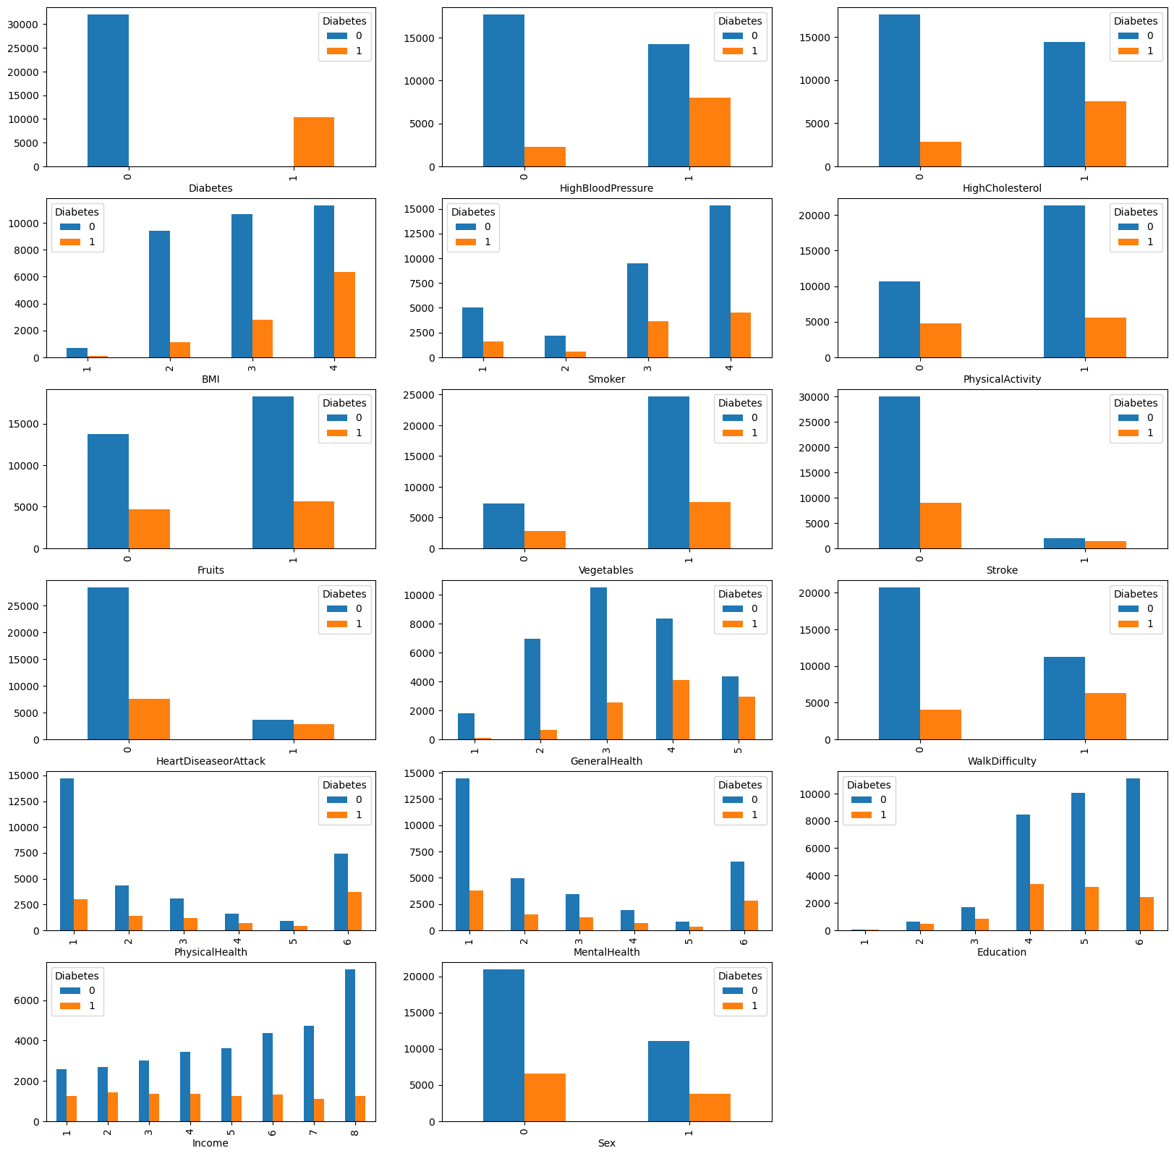

Slide 20
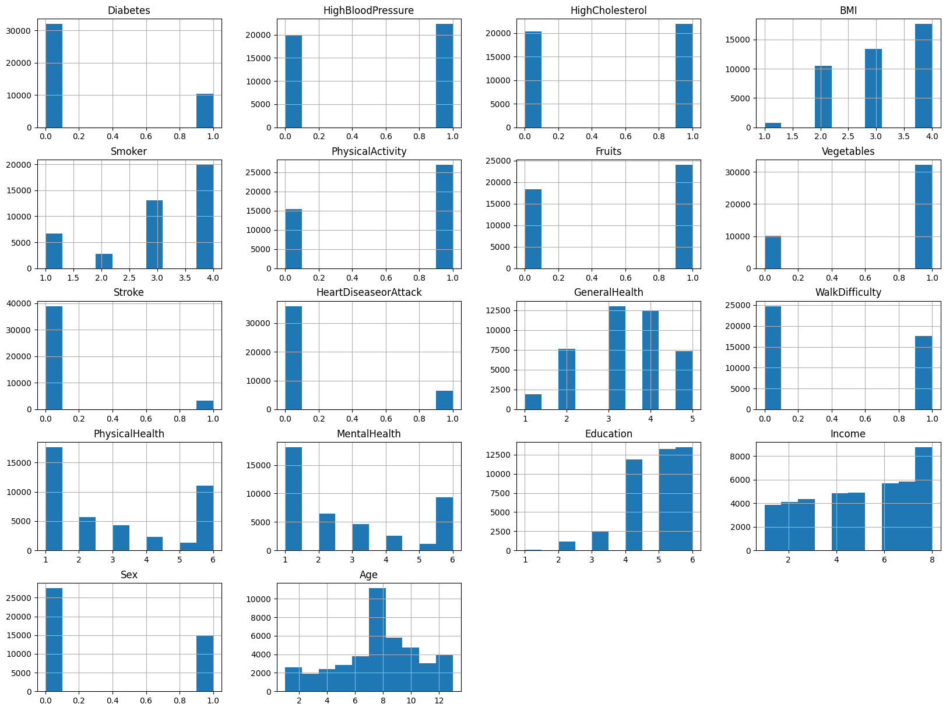

Slide 21
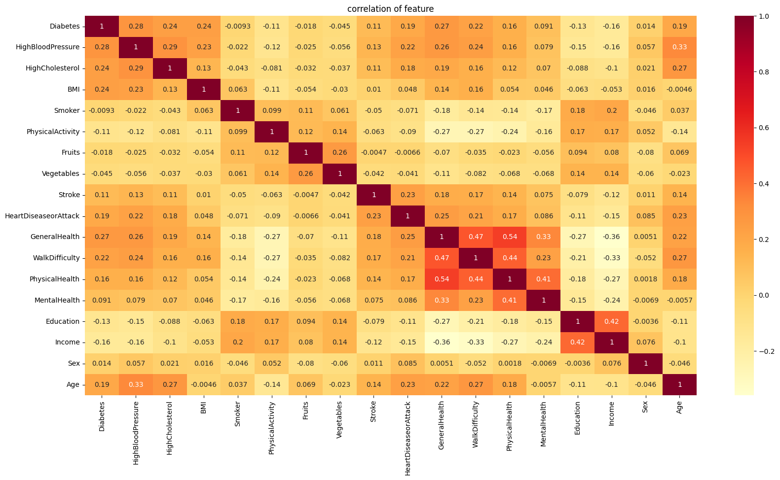

Slide 22
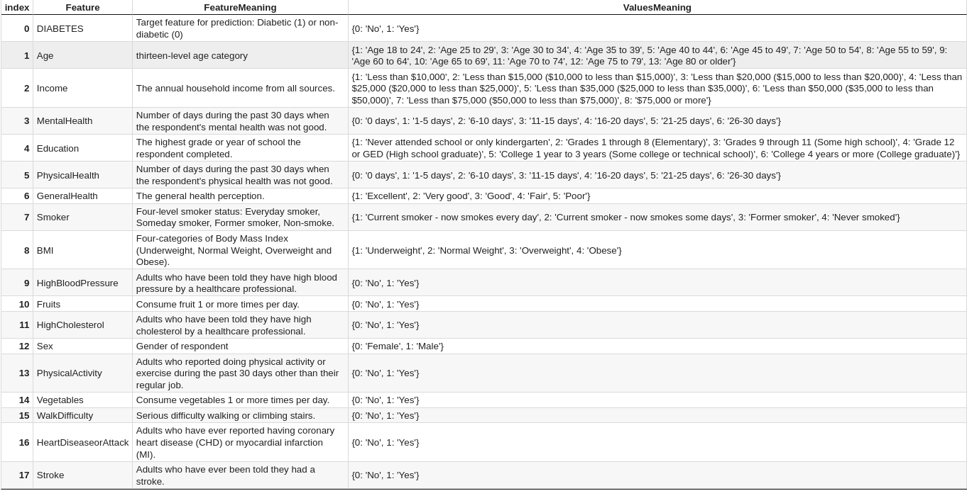

Slide 23
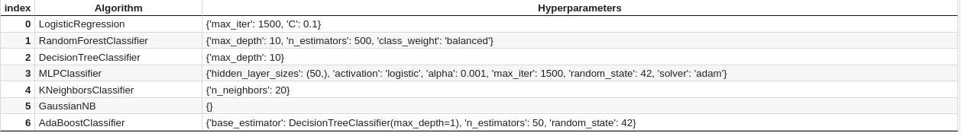

Slide 24
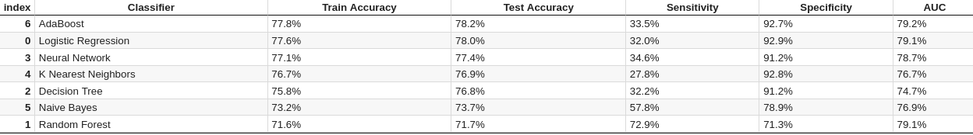

Slide 25
