Slide 1

An-Najah National University
Faculty Of Engineering
Mechanical Engineering Department
Design and Analysis of Biogas Register
By : Khaled Zaid Ahmed Khader
Taqi-Adyn Atili Aanas Malik
Supervised By : Dr. Basheer Nouri

Slide 2
RENEWABLE ENERGY

Slide 3
Renewable Energy
History
Biomass
Sources
Definition
Geothermal
Water Energy
Solar Energy
Wind Energy

Slide 4
Definition
Production
Biomass
Composition
Benefits

Slide 5

History
Europe

Slide 6

History
China

Slide 7

History
India

Slide 8
BIOLOGICAL PROCESS

Slide 9
Complex organic matter
Carbohydrates, proteins, fats
Hydrolysis
1
Soluble organic molecules
Sugars, amino acids, fatty acids
Acidogenesis (Fermentation)
2
Acetogenesis
Volatile fatty
acids
3
Acetic acid
H₂CO₂
Methanogenesis
4
4
CH₄ + CO₂

Slide 10
Factors effecting on the process
pH Value
Temperature
Retention time
Loading rate
Toxicity
C/N ratio
Slurry

Slide 11
SAMPLE TEST

Slide 12
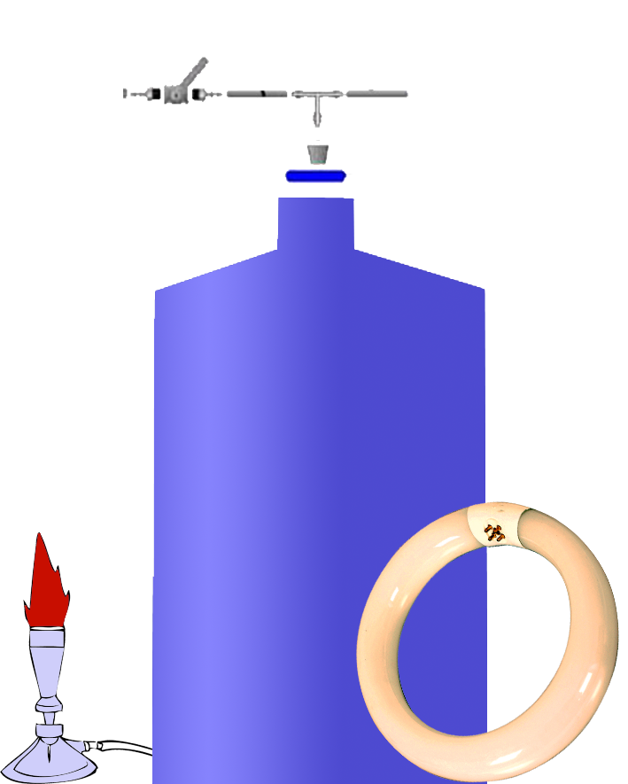
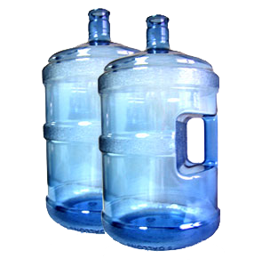
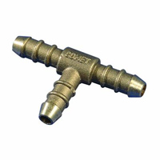
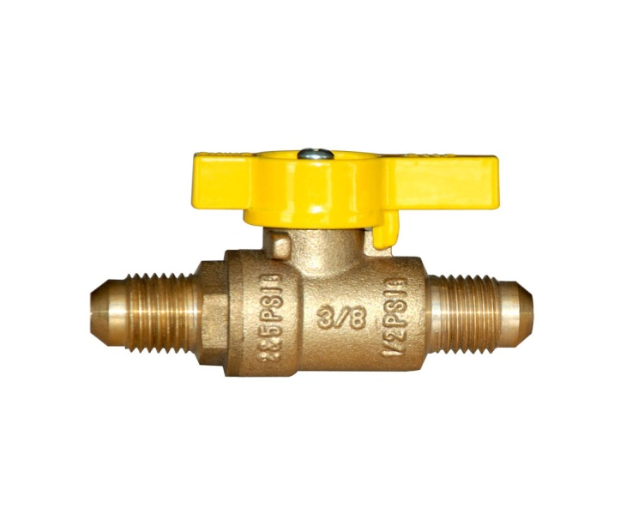
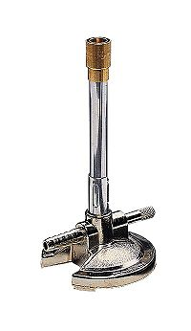
T-Connection
Gas valve
Plastic water bottle
Car tire
Bunsen Burner

Slide 13
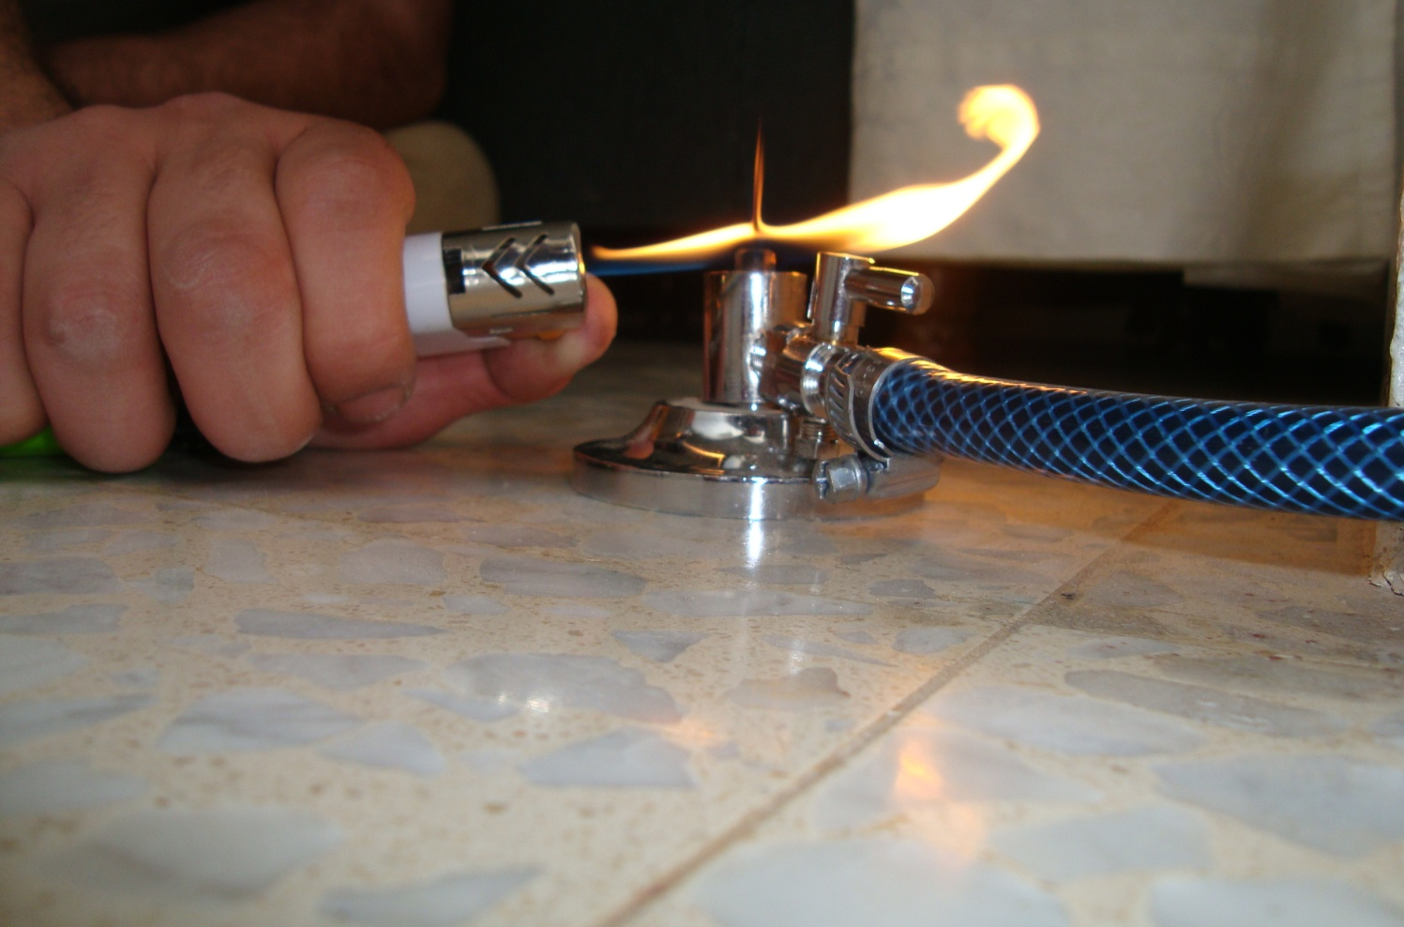
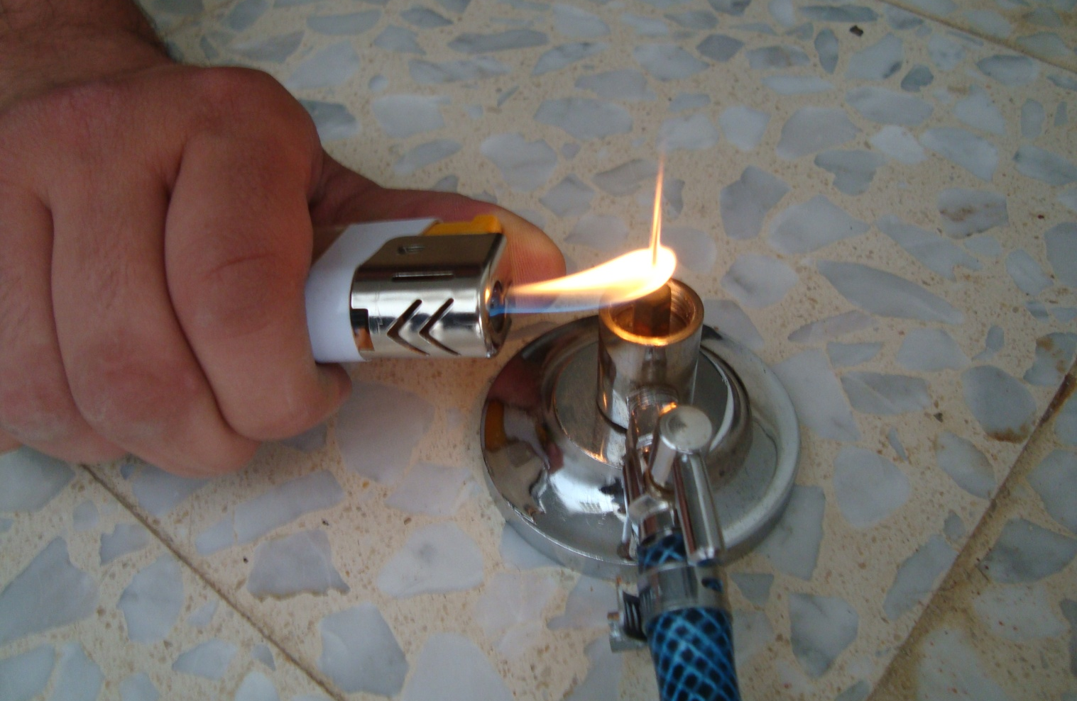
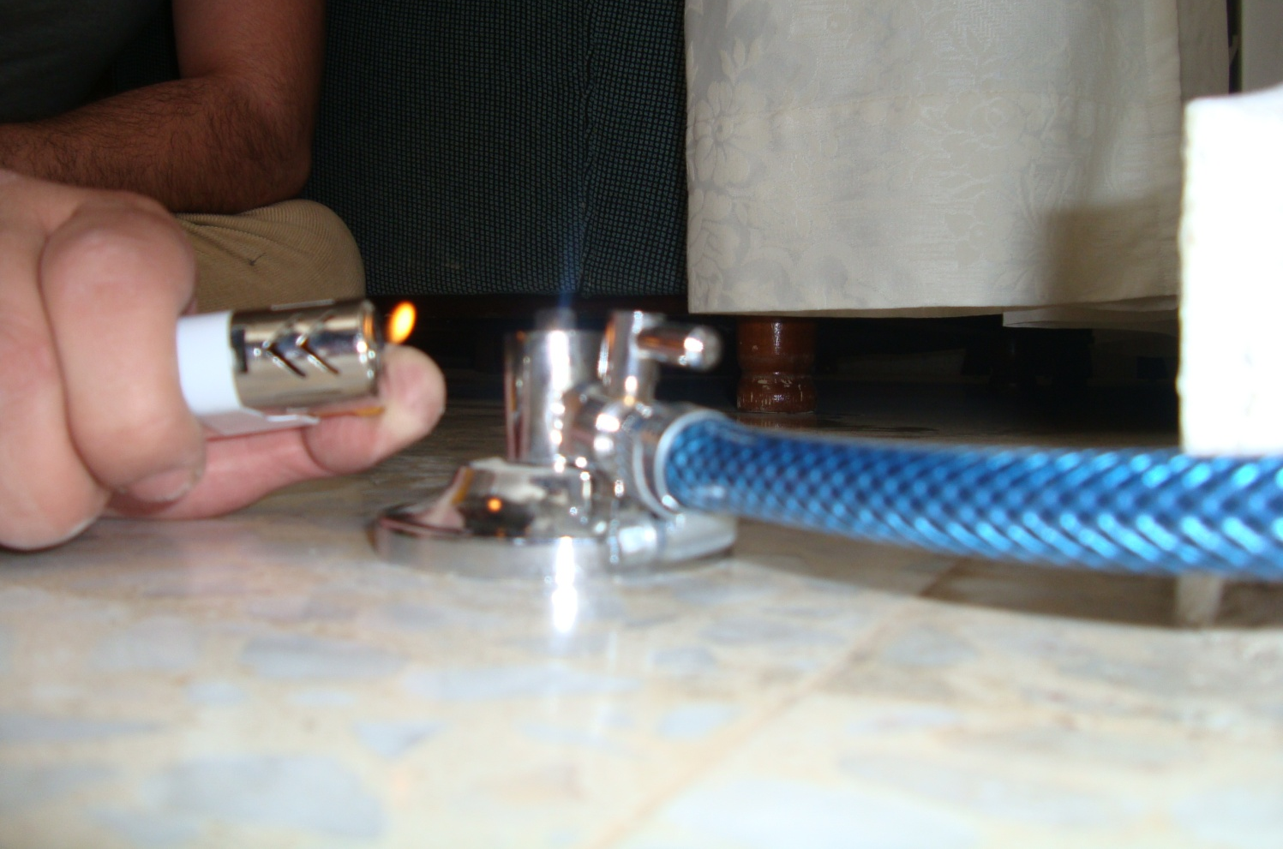
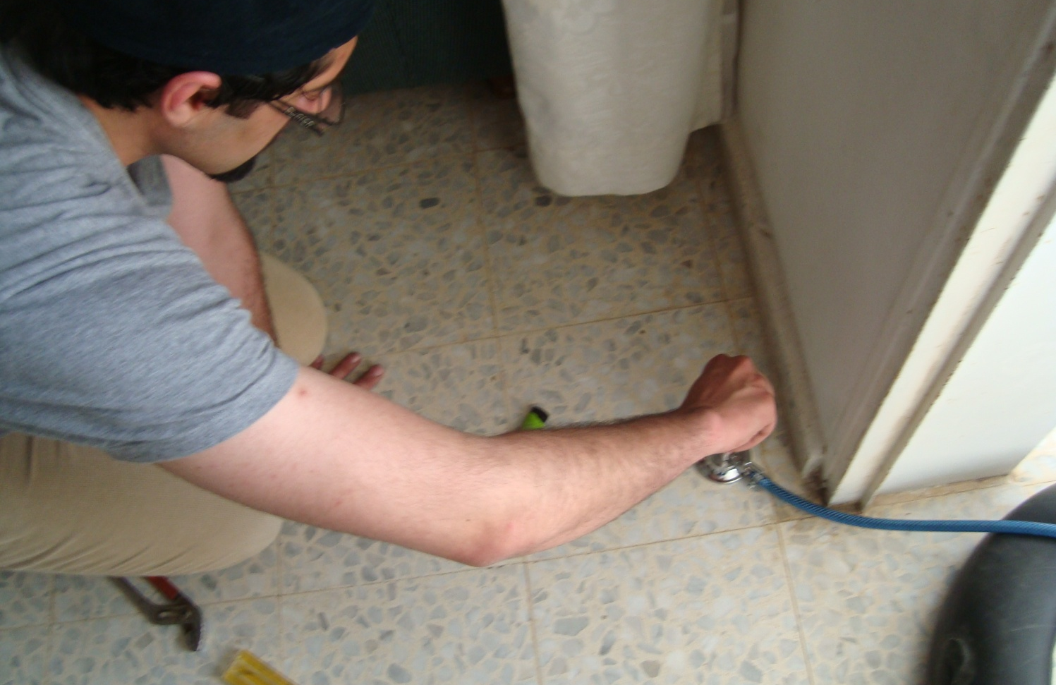
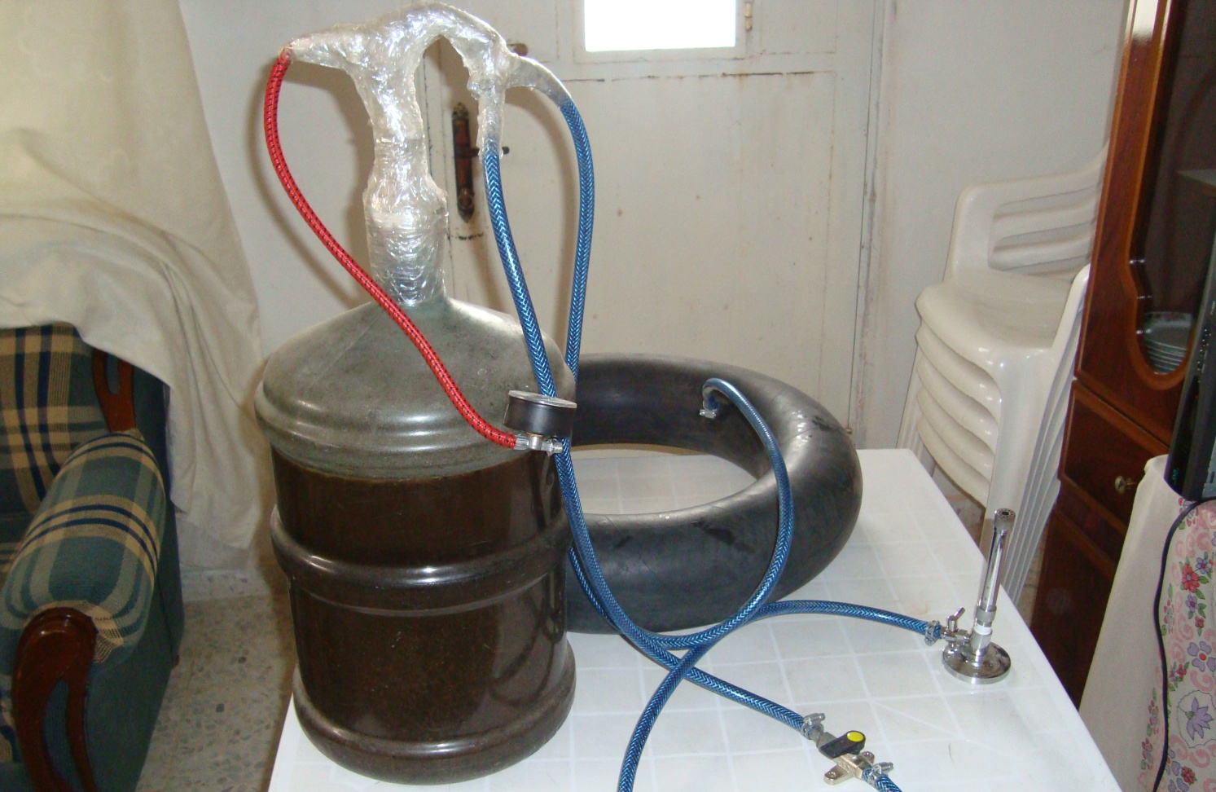
Analyze

Slide 14
Results and conclusions
Days | Mass of gas (g)\Day | Days | Mass of gas (g)\Day
1 | 0 | 26 | 25
2 | 0 | 27 | 27
3 | 0 | 28 | 27
4 | 0 | 29 | 34
5 | 1 | 30 | 35
6 | 1 | 31 | 36
7 | 2 | 32 | 34
8 | 2 | 33 | 39
9 | 2 | 34 | 35
10 | 3 | 35 | 38
11 | 4 | 36 | 38
12 | 5 | 37 | 39
13 | 8 | 38 | 35
14 | 8 | 39 | 37
15 | 9 | 40 | 39
16 | 8 | 41 | 32
17 | 9 | 42 | 36
18 | 11 | 43 | 28
19 | 10 | 44 | 15
20 | 13 | 45 | 9
21 | 15 | 46 | 8
22 | 16 | 47 | 4
23 | 17 | 48 | 0
24 | 16 | 49 | 0
25 | 20 | 50 | 0

Slide 15
Results and conclusions

Slide 16
Results and conclusions
Theoretically, 1 kg of solid poultry manure will produce 100 liter of biogas
Experimentally, the weight of biogas produced is 0.830 kg for 9 kg of manure
That leads to an error of 20.49%

Slide 17
MECHANISM OF THE OPERATION

Slide 18
Mechanism of the operation
Waste collection
Dry matter tank
Screw pump
The digester
Gas holder
Filtration unit
Gas tank
Cogeneration
unit

Slide 19
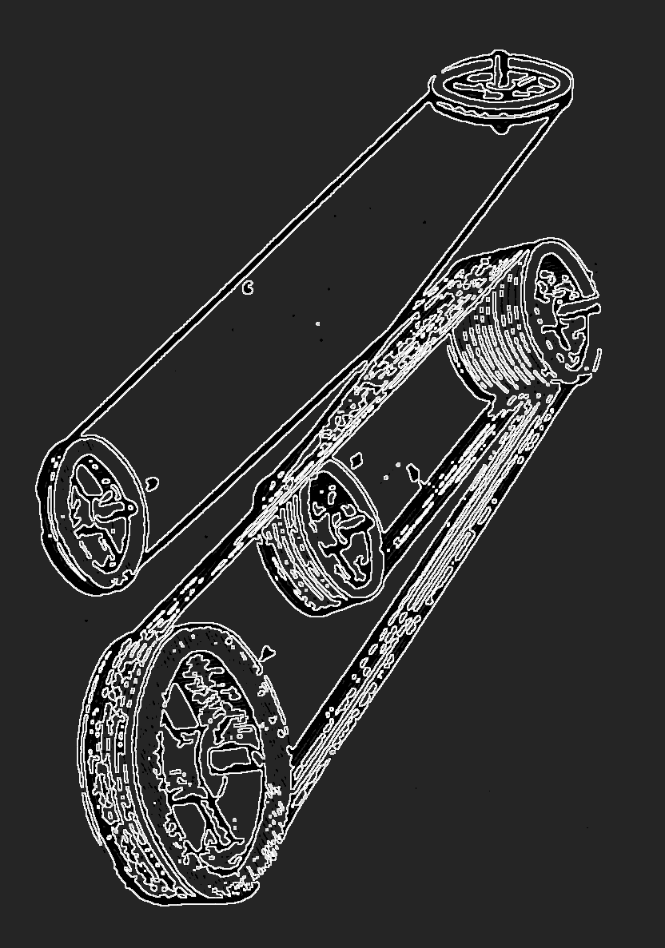
Waste collection
Easy visual control for daily feeding input
Or using inclined surface

Slide 20
Dry matter tank
Can be constructed from concrete or galvanized steel plate

Slide 21
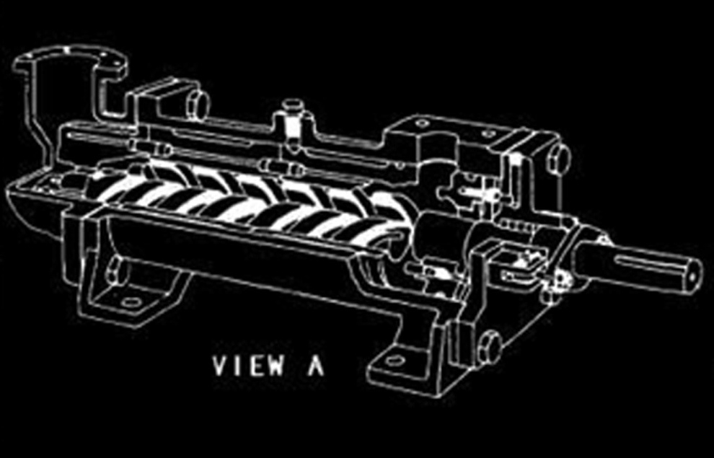
Screw pump
Diameter >= 12”
Length = 50’
Used for handling liquids containing solid in suspension with horizontal transport
Speed 30-60 rpm
Capacity 15 L/s -11 m³ /s

Slide 22
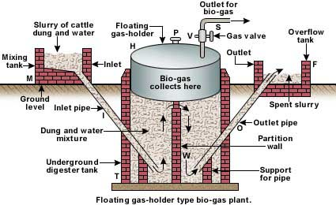
The digester
Floating drum planet

Slide 23
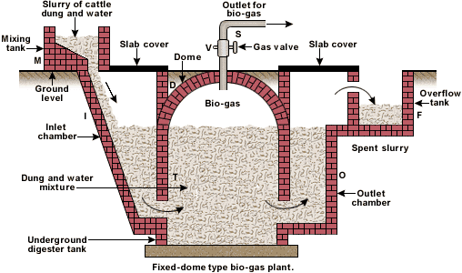
The digester
Fixed dome planet

Slide 24
Gas holder
Floating drum gasholder
Fixed dome gasholder
Plastic gasholder
Separate gasholder

Slide 25
Filtration unit
Chemical absorption
High pressure water scrubbing
Pressure swing absorption
Cryogenic separation
Membrane separation

Slide 26
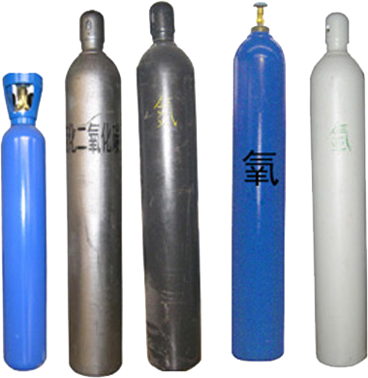
Gas tank
Using propane gas cylinders

Slide 27
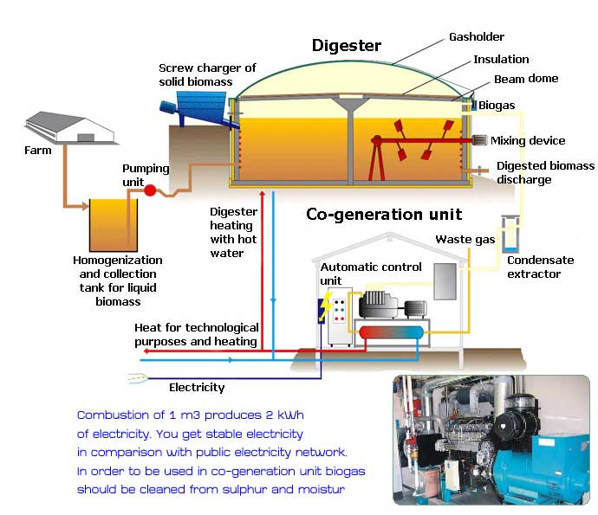
Cogeneration
unit
Two type of cogeneration:
Topping cycle
Bottoming cycle

Slide 28
CASE STUDY
CHICKEN FARM

Slide 29



Slide 30
Demand Production method
Energy demand for lamps
Cogeneration unit
Heating and cooling loads
Biogas demand
D
P > D
Gasholder volume
P
Biogas production
Plant parameters
Type and quantity of available biomass
Digester temperature
Digester volume – size of plant

Slide 31
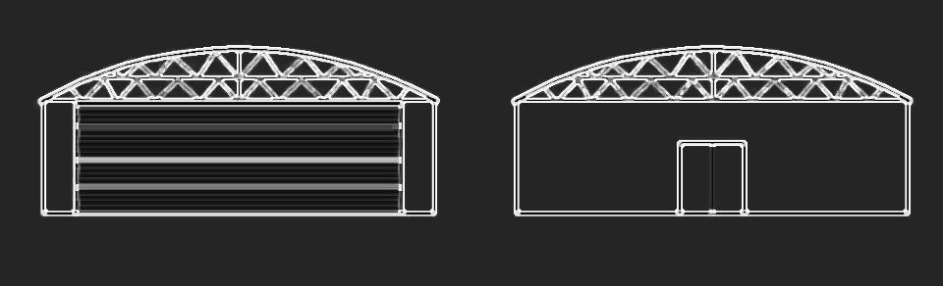
Chicken farm specifications
Length = 110 m
Width = 12 m
Height = 3.5 m
Front door
Back door

Slide 32
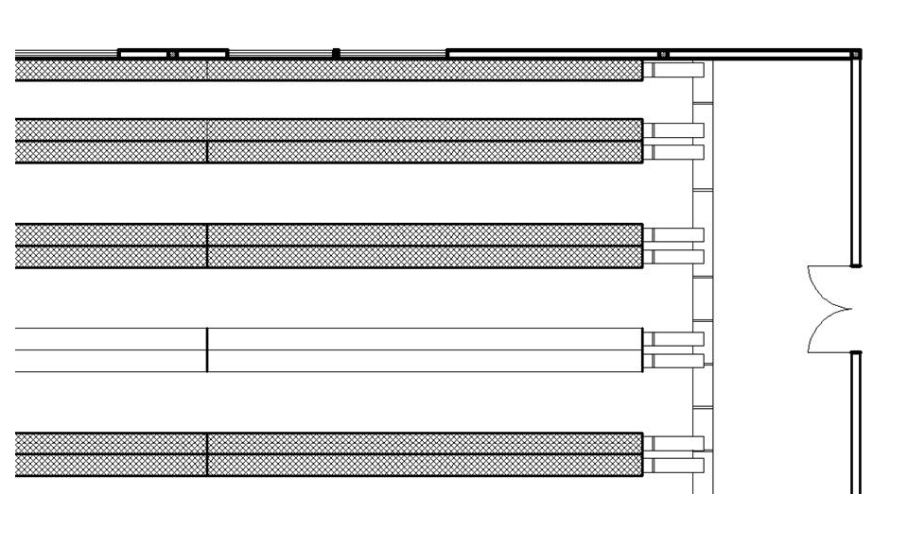
Chicken farm specifications
20,000 chicken head
Consist of ten rows
Each row contain 1000 chicken head

Slide 33
Demand calculations
Lighting
  53 lamps are used.
  Each lamp uses 400 watts to cover 25 m² of floor area.
  Operated for 18 hours
Heating
  Q_{tot} = 255 Kwatt
  Operates with an electrical motor having 80 hp.
  Consumes 60 Kwatts electricity
Total biogas demand equals 280 m³ daily.

Slide 34
Production calculations
Each chicken gives 150 – 200 gm of dung daily.
Dung production equals to 3200 Kg daily
Each 1 Kg of dry matter produces 100 liter of biogas.
Gas yield production equals 320 m³ .

Slide 35
Design of digester
Motors for collectors operate every three hours and has a power of 1 Kwatt.
Dry mass tank construct from galvanized steel plate, has a dimension of 1.5 X 1.5 X 2 .
Screw pump feeding once a day , has a velocity of 1 m/s, flow rate 50 L/s.
Digester size is calculated depending on the equation :
V_{d} (m³) = S_{d} (m³/day) * RT (days)
Substrate input (S_{d}) = biomass (B) + water (W) (m³/d)
Digester size equals to 320 m³ , for factor of safety it assumed to be 430 m³ .
Gasholder size is calculated depending on the equation :
V_{g1} = G_{c max}* T_{c max}
Gasholder size equals to 240 m³ .

Slide 36
PAYBACK

Slide 37
Estimated system components cost
Item | Cost
Collecting waste | 250 $
Dry mater tank | 100$
Screw pump | 650 $
Digester | 4000 $
Gas holder | 200 $
Filtration unit | 1000 $
Gas tank | 300 $
Cogeneration unit | 3000 $
Piping | 300 $
Total | 9800 $

Slide 38
Estimating Payback point
One labor is needed to run the system, works for 30 hours per month and get 300 $ per month.
Maintenance is assumed to be 10% of the system cost and equals to 980 $ per year.
Electricity cost due to heating and lighting ( 1 Kwatt = 0.143 $ ) equals to 2220 $ per month.
Total cost per month equals to 2600 $.
Payback point = system cost / monthly cost
Payback point = 9800 / 2600
Payback point = 3.7 months

Slide 39
RECOMMENDATIONS

Slide 40
recommendations
Palestine is a rich country of plants and animals, which can give a large amount of manures, which in result can be the fuel of biogas digesters that can provide the Palestinian farms the needed energy for its various operations.
Authorities must concentrate more on the renewable energy sources, especially the biogas and biomass sources, in which Palestine is rich with. This alternative energy sources can help us to become independent in consuming gas from other sides, it helped the farm to become alive, so it definitely will help Palestinians too.

Slide 41
THANK YOU !!

