Slide 1
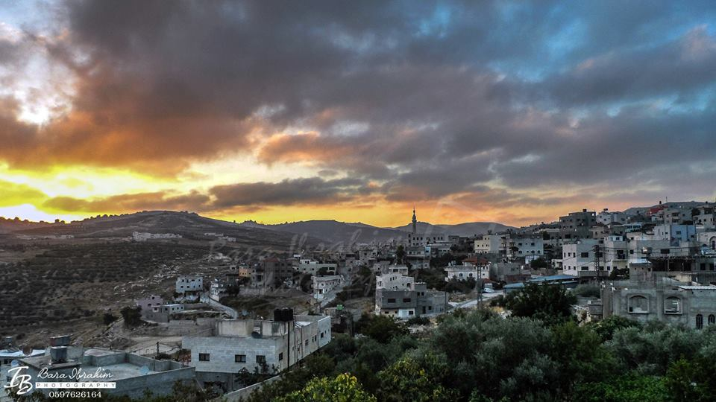
Improvements of Sarra Treatment Plant
Prepared by :
Doa’a Jawabri
Asma Turabi
Ruba Mansour

Slide 2
Wastewater disposal
Wastewater collection systems.
Cesspools.

Slide 3
Constructed Wetlands
Artificial lands.
Wastewater sources.
Use natural processes.
Low cost.
Slow rate of operation.

Slide 4
Location & Pop
Climate
SARRA
Land use
Water Resources
Sewer Network
Wastewater Disposal

Slide 5
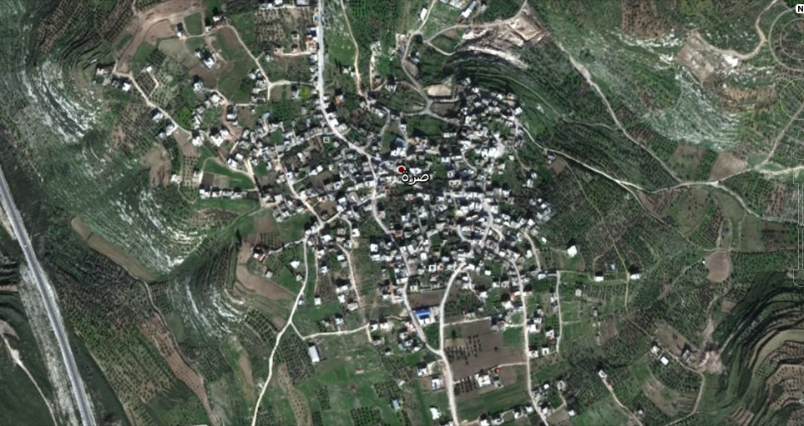
Southwest of Nablus.
Population 3042 capita.
Entrance
N
Exit
back

Slide 6
Climate
Average annual rainfall 451 mm.
Average Temperature 18˚C.
Average Humidity 59%.
Wind 10 km/hr.
back

Slide 7
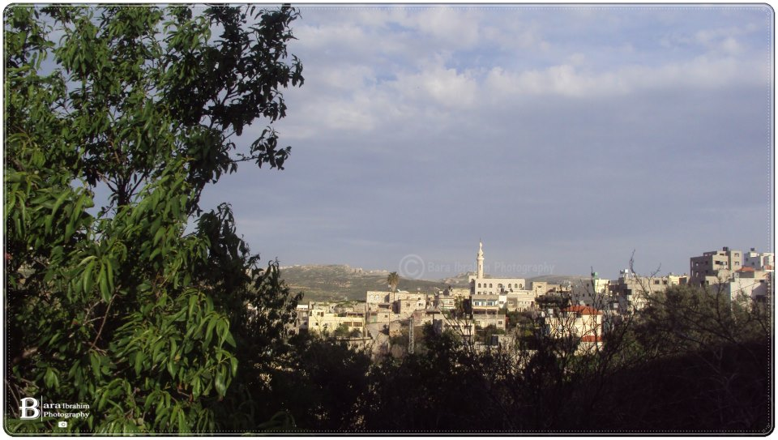
Land use
Total area : 50000 donums .
4000 donums agricultural area :
permanent crops
Range lands
Arable lands
back

Slide 8
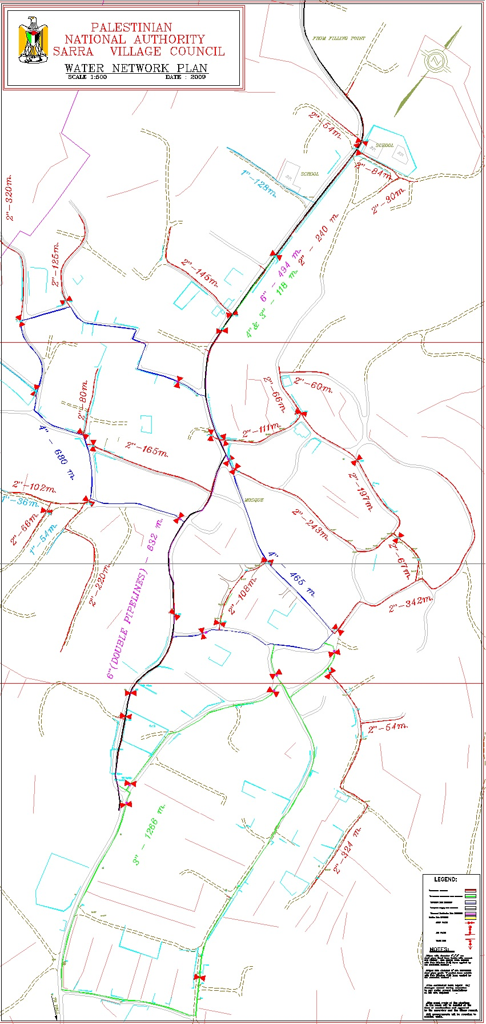
Water Resources
Water Network
Established in 2009.
Covers 90% of houses.
back

Slide 9
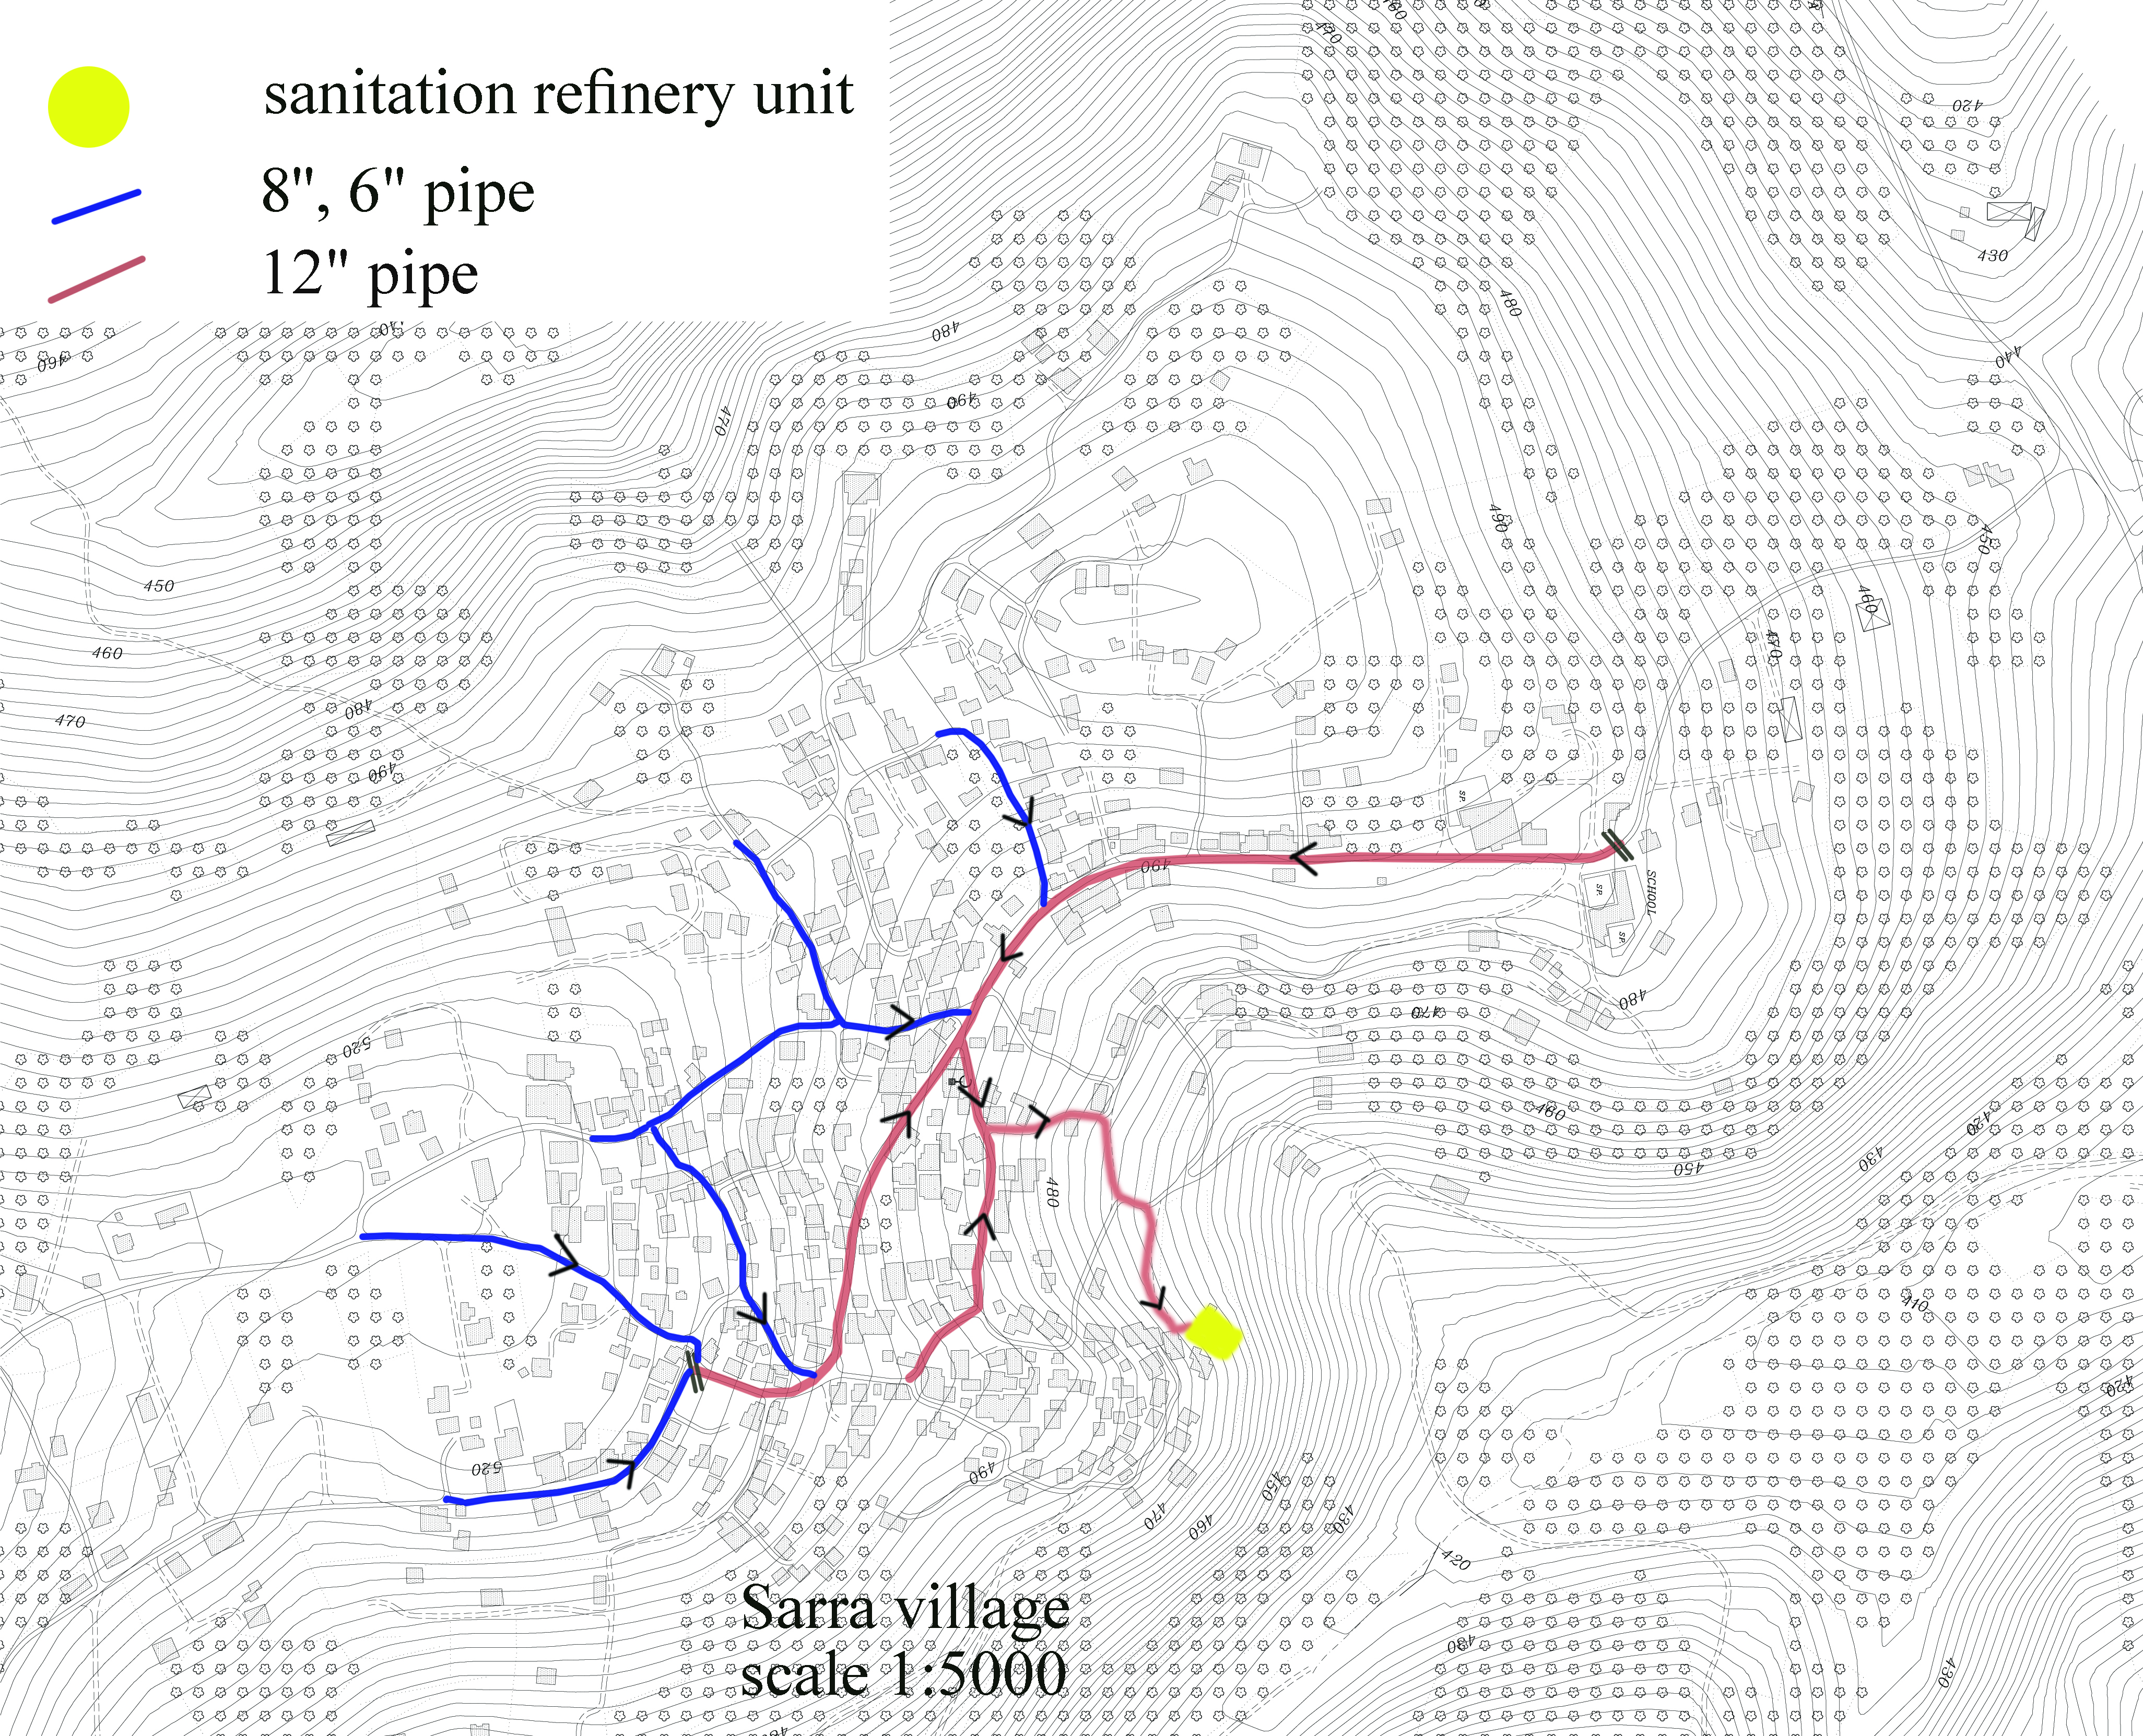
Sewer Network
Established in 2004 and run in 2014.
Covers 96% of Sarra
back

Slide 10
WW Treatment Plant
Established in 2013.
Functioning as subsurface Wetlands.
After primary settling.
Area 10 donums.
Australian Qossaip plants is used.
With two stages of treatment.

Slide 11
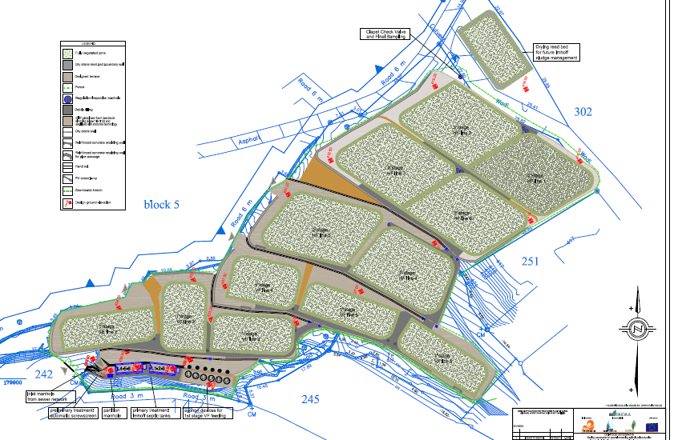
Plan of Treatment Plant

Slide 12
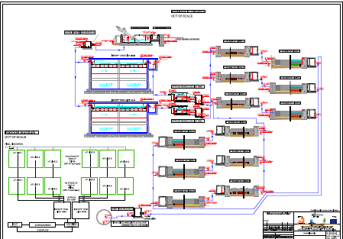
Stages of Treatment
Hydraulic profile

Slide 13
Objectives
To know if treatment plant is working well.
Fix problems.

Slide 14
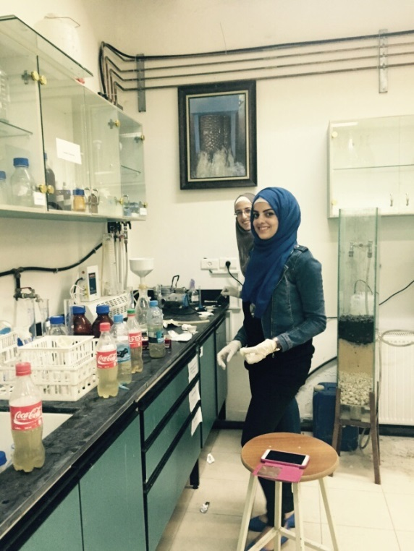
Methodology
Nine samples were taken and experiments were done including:
BOD
COD

Slide 15
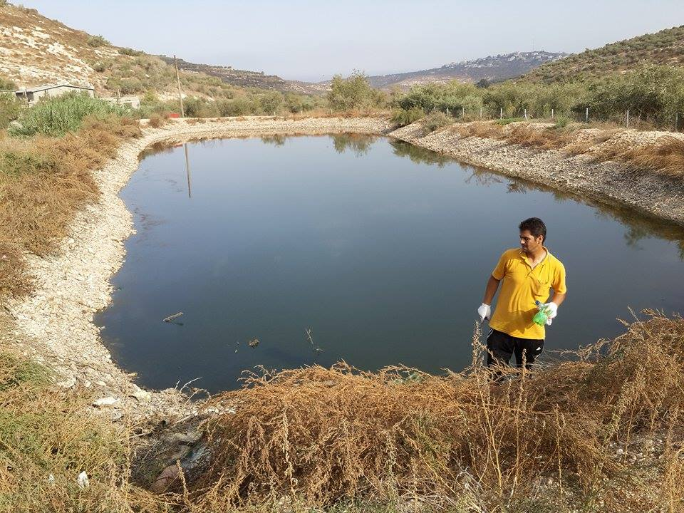
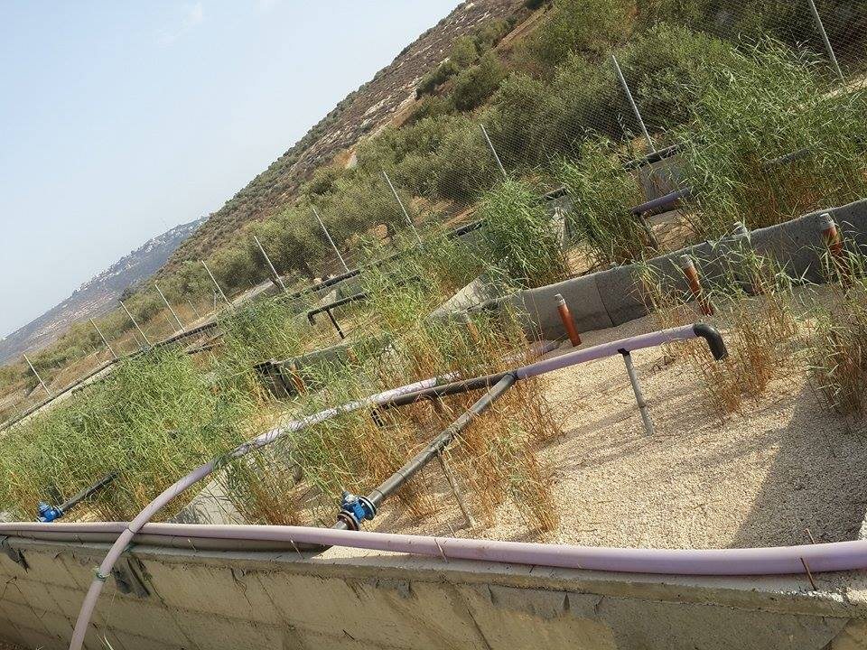
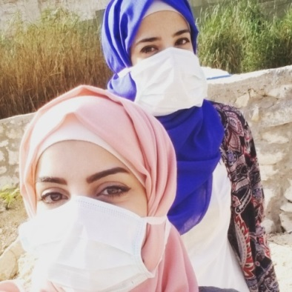
Site visit and samples collection

Slide 16
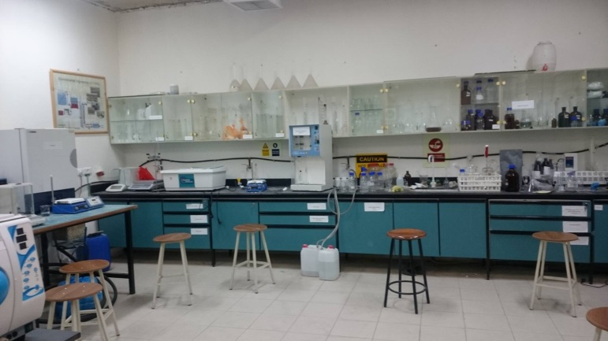
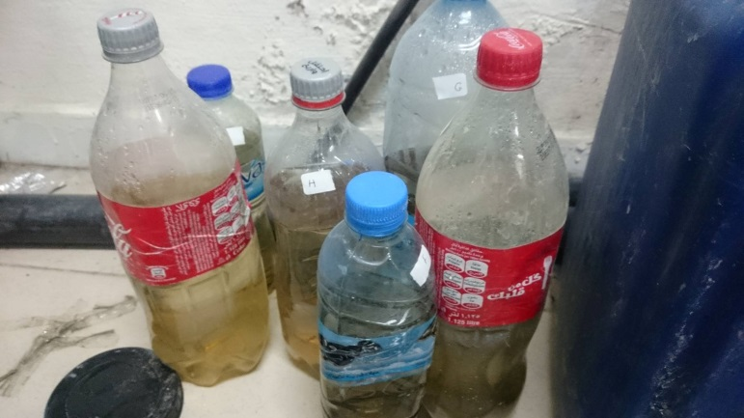
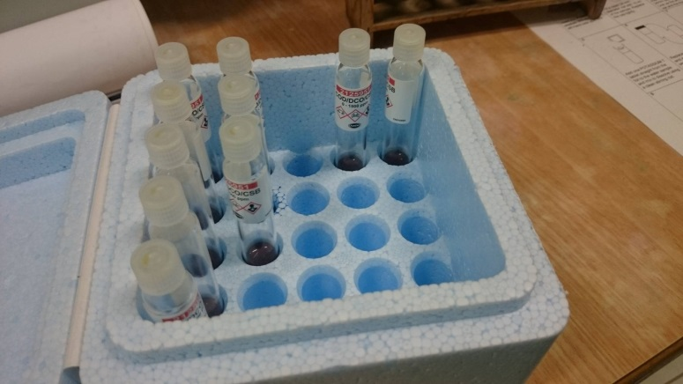
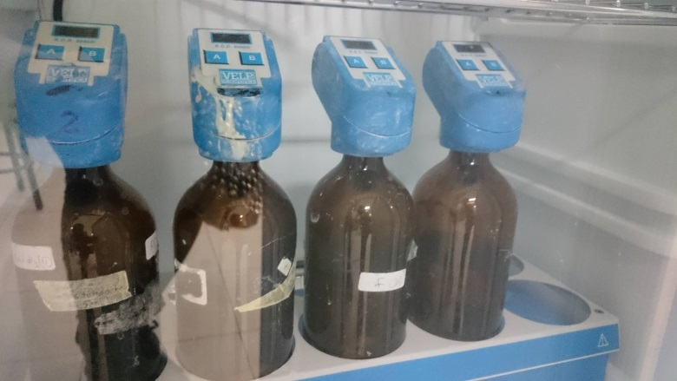
Experiments

Slide 17
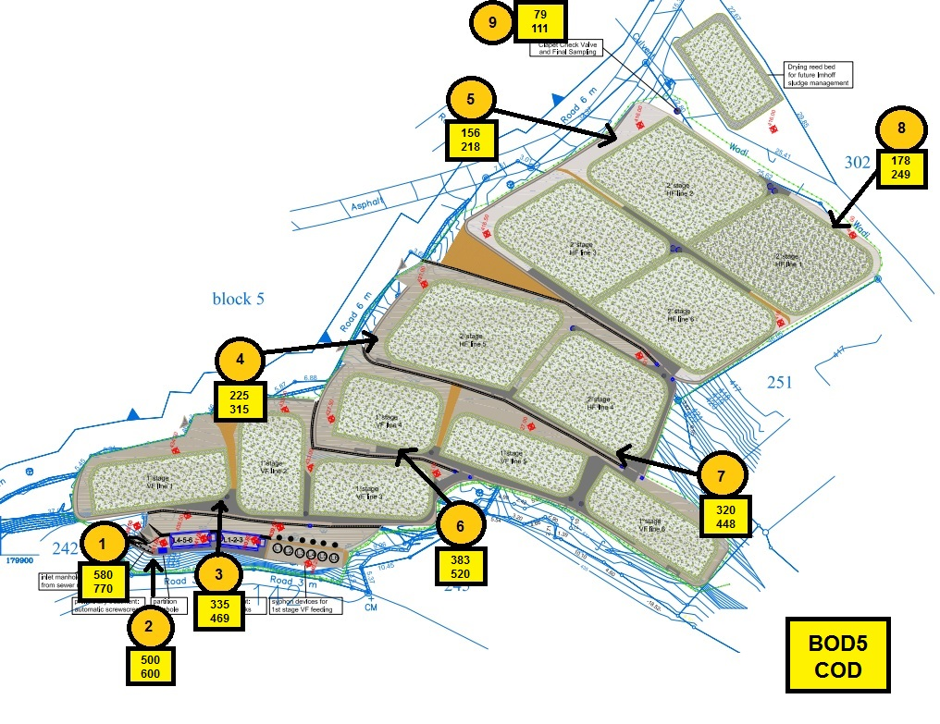
Results of
Experiments

Slide 18

Standards used for checks
TR34 Palestinian Standards.

Slide 19
BOD & COD Checks
Meets standard or not | Palestinian Specifications |  |  |  | Sarra | Chemical Properties (mg/L)
 | D | C | B | A
❒ | 60 | 40 | 20 | 20 | 79 | BOD
✓ | 150 | 100 | 50 | 50 | 111 | COD

Slide 20
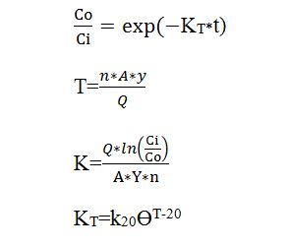
Reed Model
Reed model was used to find k20 for two stages.
KT : is a rate constant at the wetland temperature .
The flow entered the inlet of treatment plant is 238.7 m3/day.

Slide 21
K20 and Efficiencies were found for the two stages.
 | BODi | BODo | ln(BODi/BODo) | Area(m²) | Y(m) | N | Q | K_{T} | K₂₀ | Efficiency
VS | 335 | 225 | 0.398 | 250 | 0.6 | 0.85 | 39.66 | 0.123 | 0.098 | 32.835
HS | 225 | 156 | 0.366 | 500 | 0.6 | 0.85 | 39.66 | 0.0569 | 0.045 | 30.666

Slide 22
Comparison between VS & HS
 | K_{T} at t = 24° C | K₂₀ | Reference value | Comment
Vertical stage | 0.742 | 0.588 | 1.104 | ❒
Horizontal stage | 0.341 | 0.270 | 1.104 | ❒

Slide 23
Design Alternative
UASB tank:
  Upflow Anaerobic Sludge Blanket Reactors.
  In Primary treatment.
  After Screw screens.
  hydraulic retention time 6-12 hrs.

Slide 24
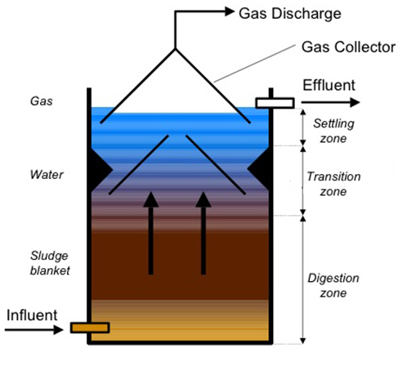
UASB tank
Anaerobic
conditions.
Sludge blanket.
GLS (gas liquid
separators).

Slide 25
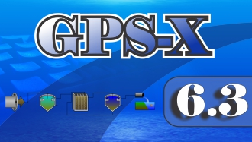
Analysis and Design
Wastewater simulation Program was used : GPS-x.

Slide 26
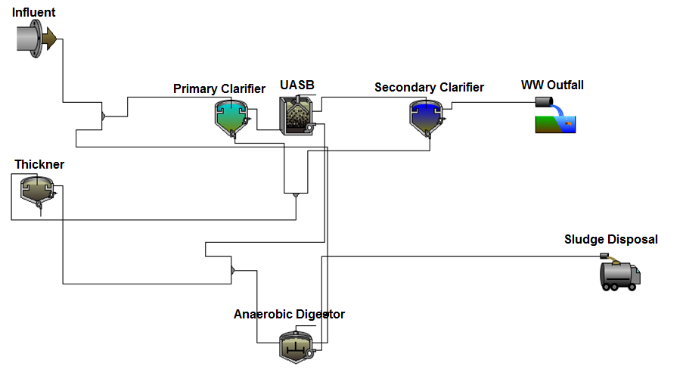
Case 1
UASB

Slide 27
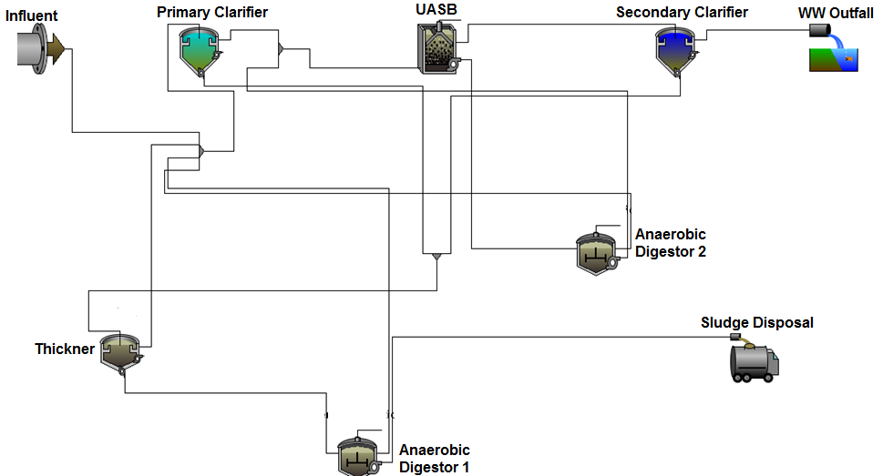
Case 2
UASB- Digester.

Slide 28
Manual Design
Primal design was made to enter approximate values to each tank in GPS-x including:
Volumes
Areas
Depths

Slide 29
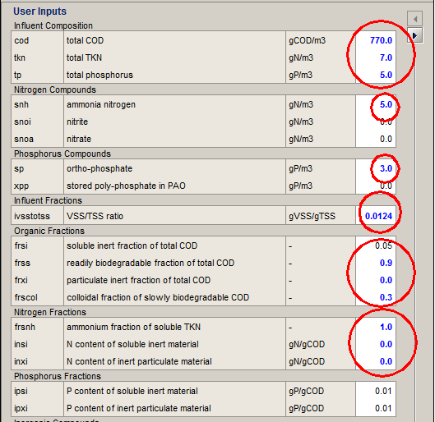
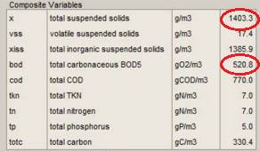
Data entered
Influent composition

Slide 30
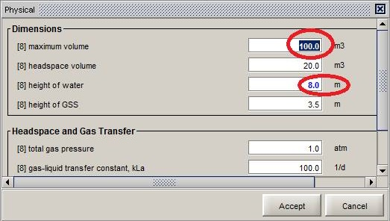
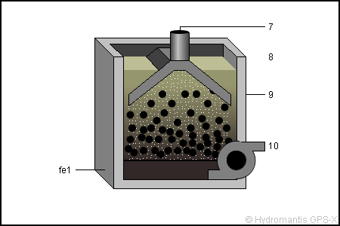
UASB data

Slide 31
Outfall results for the two cases :
Physical and Chemical Properties (mg/L) | Simulation results(mg/l) |  | Palestinian Standards (mg/L) |  |  |  | Meet standards or not?
 | Case1 | Case2 | A | B | C | D | Case1 | Case2
TSS | 5.52 | 91 | 30 | 30 | 50 | 90 | ✓ | ✓
BOD | 280 | 24.2 | 20 | 20 | 40 | 60 | ❒ | ✓
COD | 430 | 74 | 50 | 50 | 100 | 150 | ❒ | ✓
Ammonia N | 0.99 | 1.27 | 5 | 5 | 10 | 15 | ✓ | ✓
Soluble PO₄-P | 0.8 | 2.7 | 30 | 30 | 30 | 30 | ✓ | ✓

Slide 32
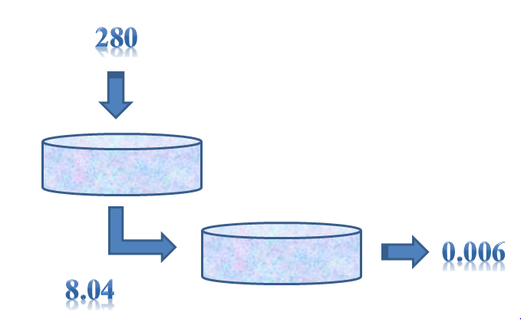
Case 1 needs wetlands after it but case 2 doesn’t.
The concentration of BOD when using wetland after case1

Slide 33
Checks for HRT
Tank Type | HRT (from simulation results) | Typical value for HRT
Primary clarifier | 1.64 hr | (1-2) hr ✓
Secondary clarifier | 3.13 hr | (2-4) hr ✓
UASB | 7.77 hr | (8-10) hr ✓
Anaerobic digestion 1 | 1.2 days | (1-2)day ✓
Anaerobic digestion 2 | 2.33 days | (1-2) day ✓
Thickener | 2.28 days | Min T=0.35 day✓

Slide 34
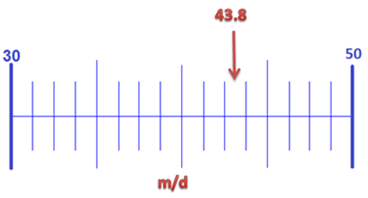
Check for V_{o}(Primary Clarifier)

Slide 35
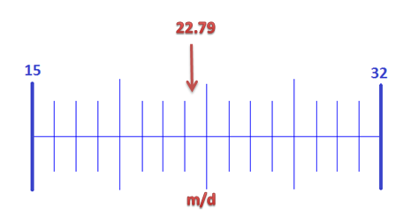
Check for V_{o}(Secondary Clarifier)

Slide 36
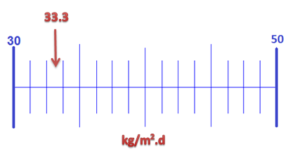
Check (SLR) for Thickener

Slide 37
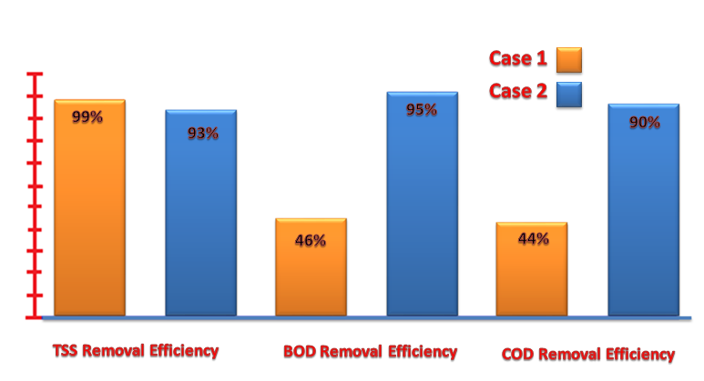
The two cases efficiencies

Slide 38
Conclusions
Original case: overloaded.
First case : improve efficiency.
Second case : higher efficiency and no need for wetlands.

Slide 39
Recommendations
Provide area for the project.
Cost Analysis.
Maintenance of TP.
Use water for irrigation.
Good pipes for treated water.

Slide 40
Thank you
For
listening!

