Slide 1
Maktabi
SW Project
Done by: Rami Abuseir & Khaled Abulibdeh
Supervised by: Dr Ashraf Armoush & Dr Mona Dmaidi

Slide 2
TABLE OF CONTENT
01
02
03
04
05
Introduction
Main Features
Used Technologies
Web Pages & Application
Future Work

Slide 3
01
Introduction

Slide 4
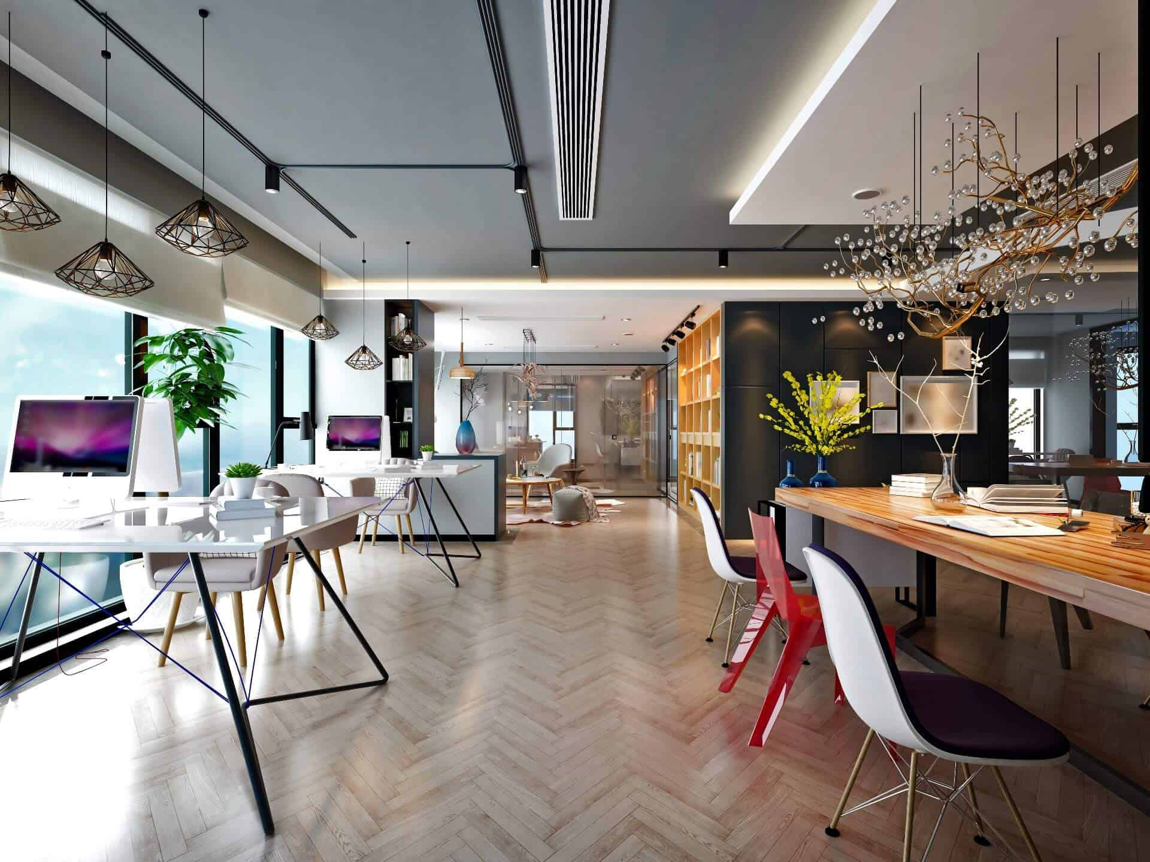
INTRODUCTION

Slide 5
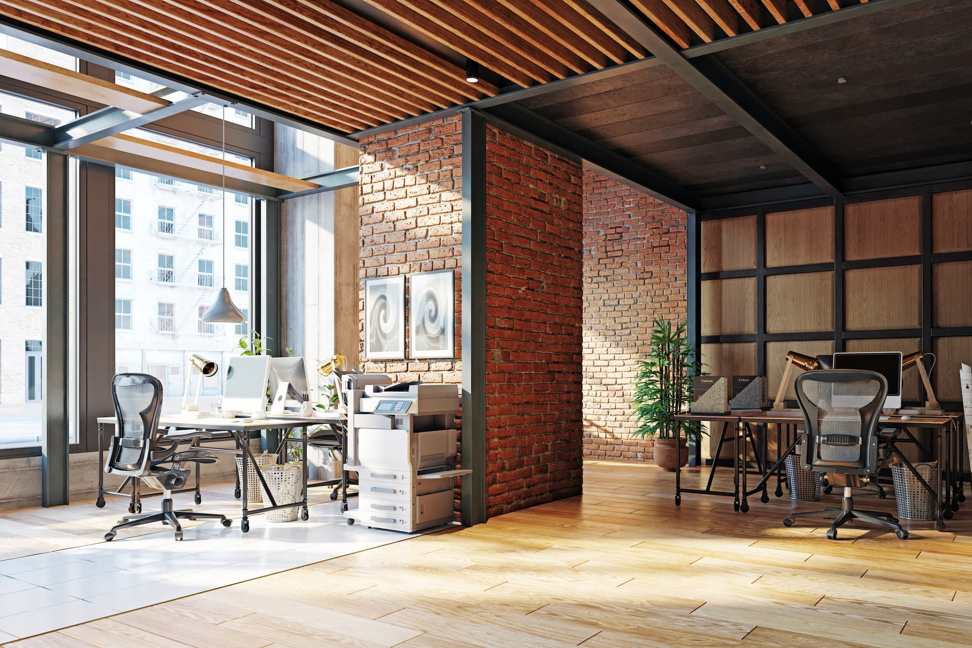
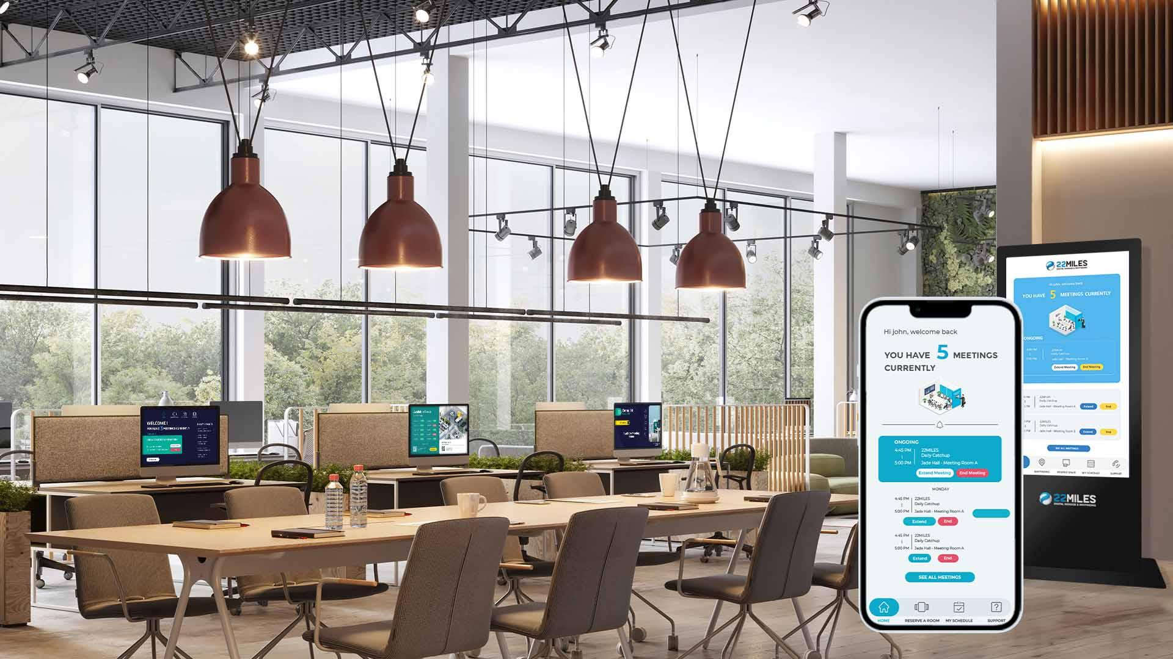
INTRODUCTION
● Workspaces are becoming more demanded
● We decided to create a service that helps people find their preferred workspaces to book them from home or mobiles

Slide 6
Main Features
02

Slide 7
Main Features
Browsing Workspaces and Subscribing
Public and Private Workspaces
Admin Control Over Workspaces
Mobile Application
Customizable Workspaces
For Users To book workspaces from anywhere
With customizable desks
(single desks, meeting rooms)

Slide 8
Used Technologies
03

Slide 9



Front-End
React/ React Native
CSS
Bootstrap

Slide 10



Back-End
Node JS
MongoDB
Mongoose

Slide 11
Web Pages & Application
04

Slide 12
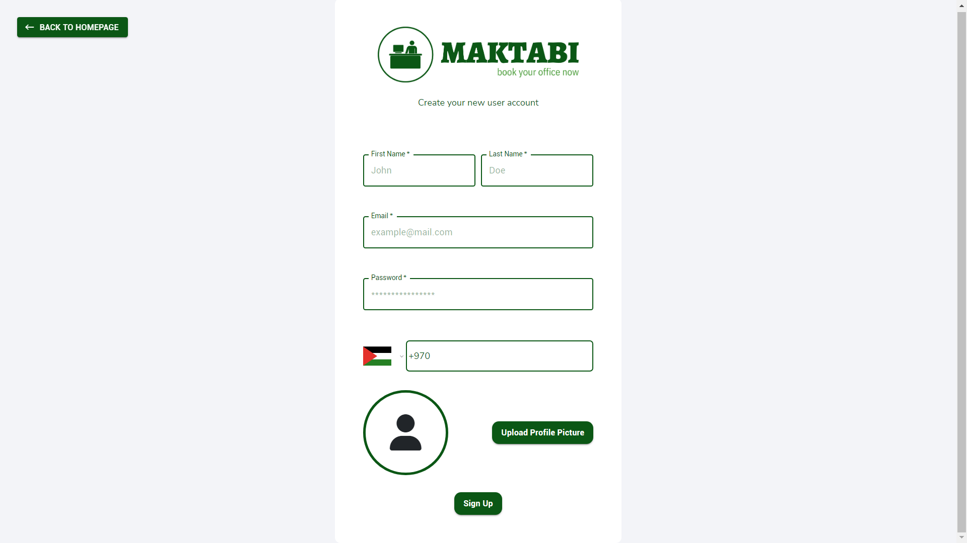
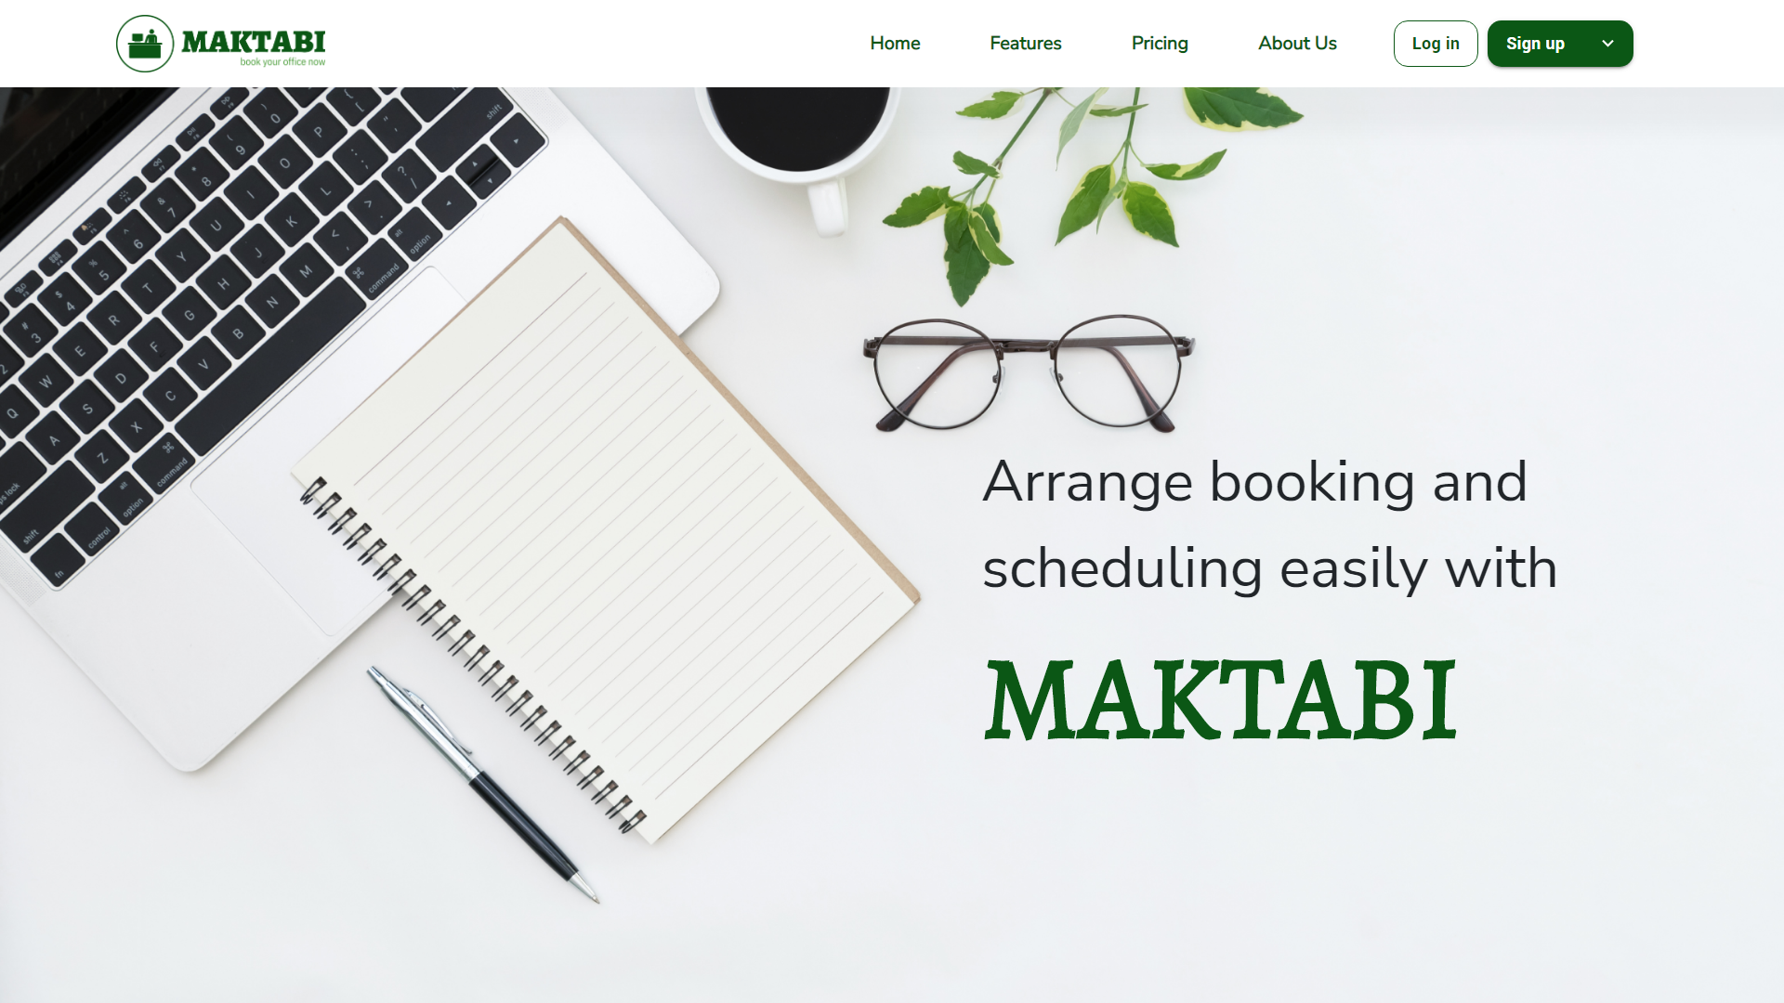
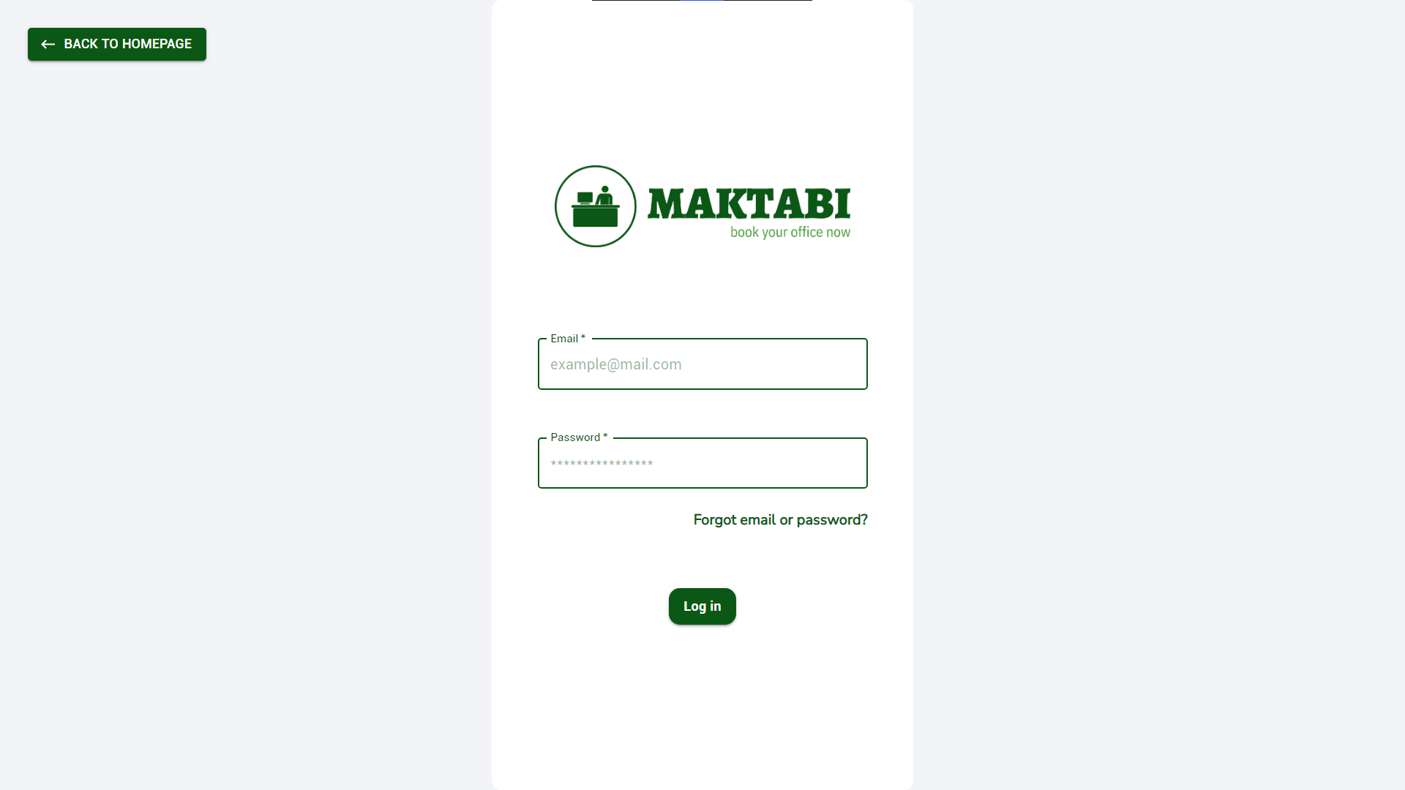
General Pages

Slide 13
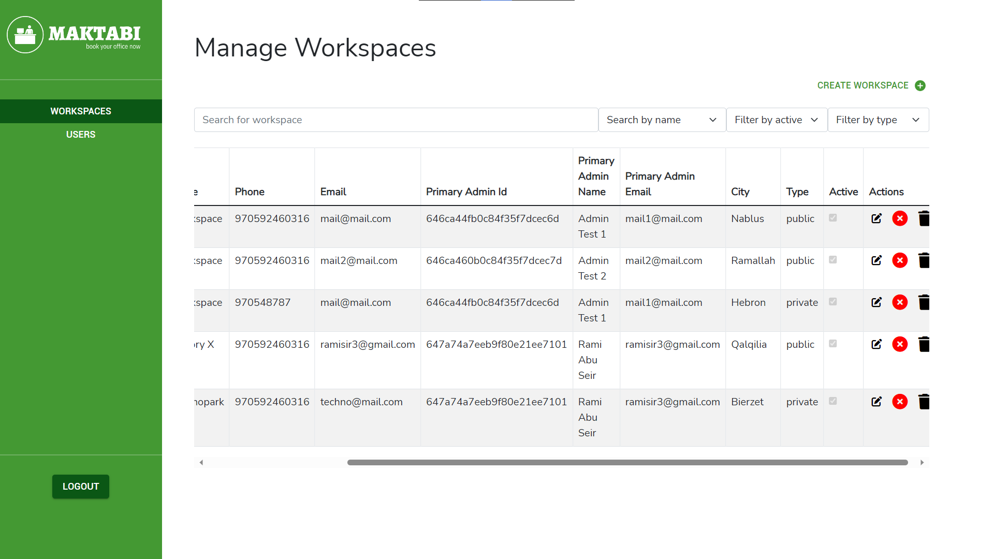
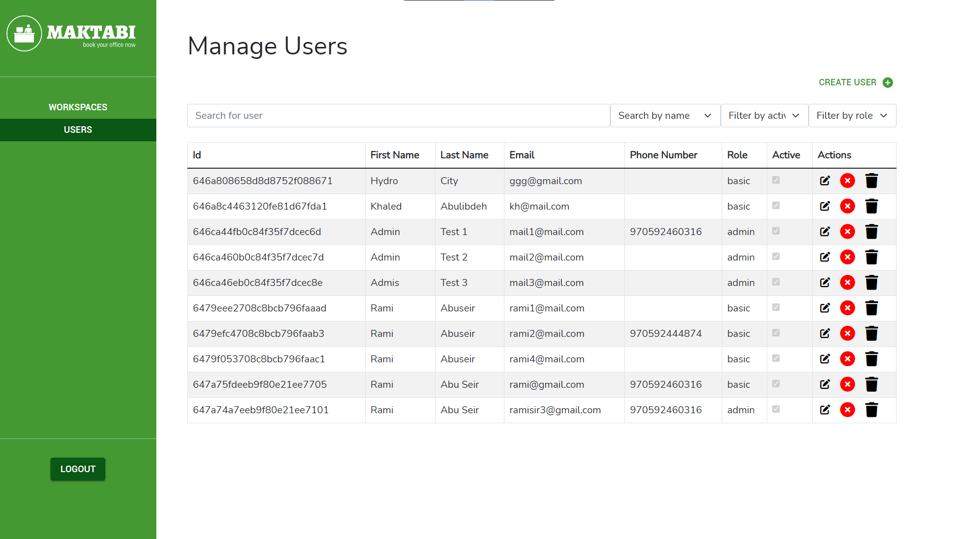
Maktabi Admin

Slide 14
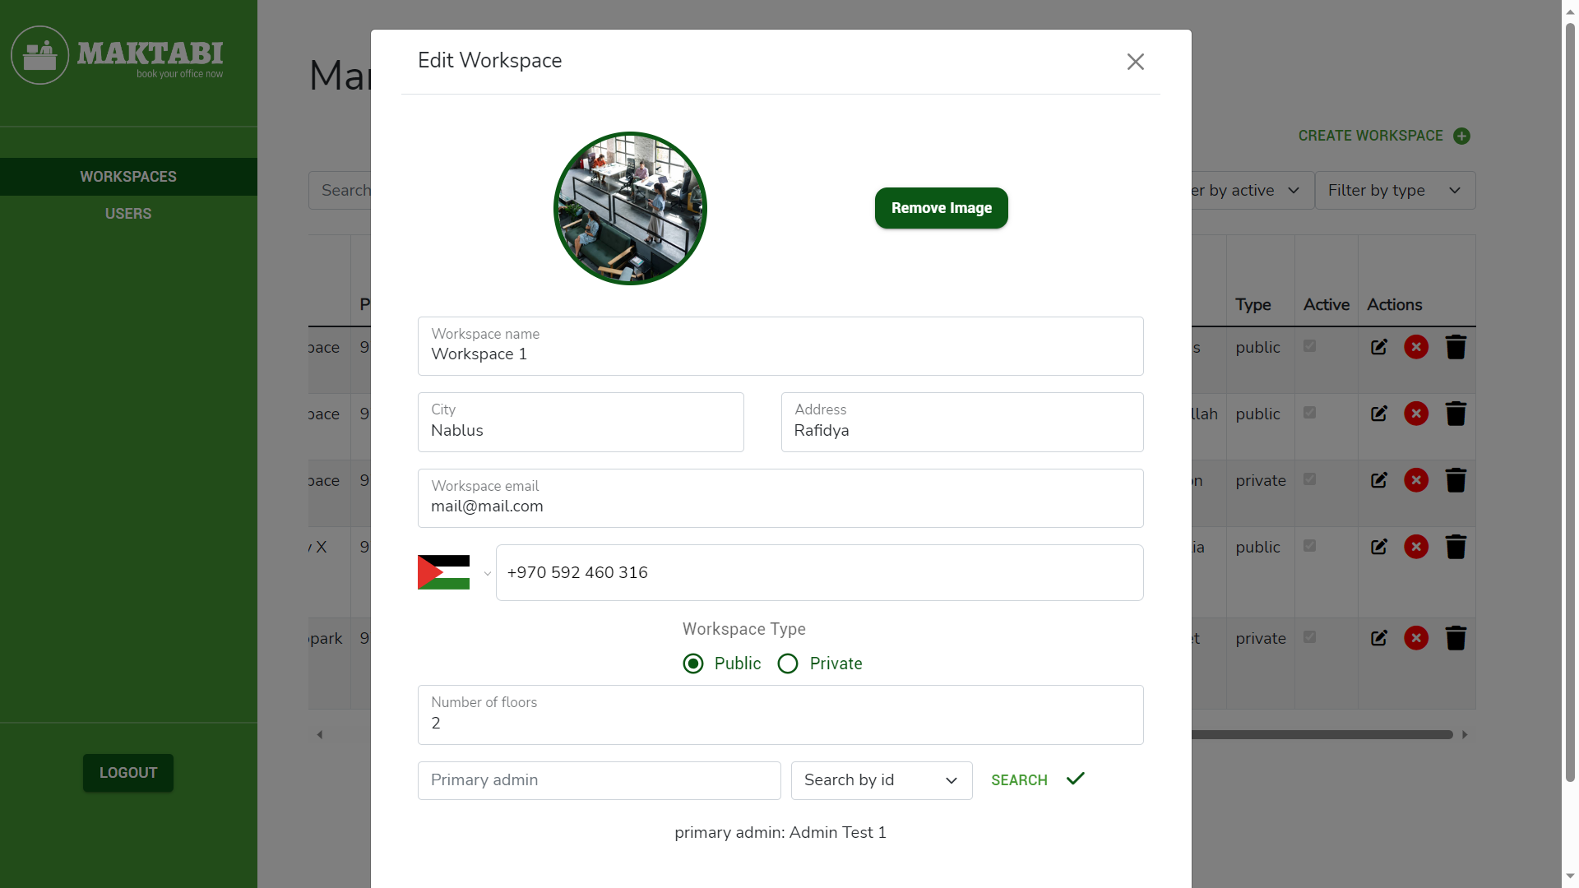
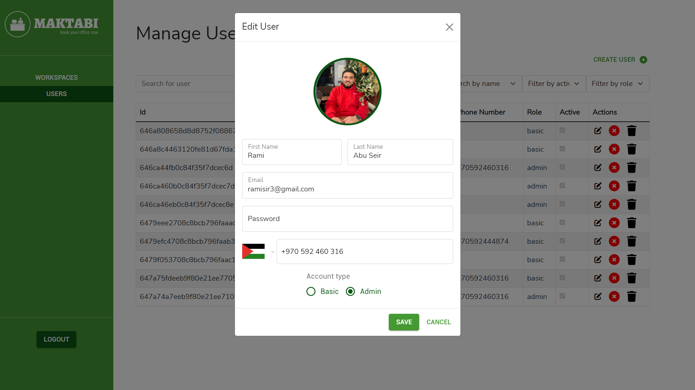
Maktabi Admin

Slide 15
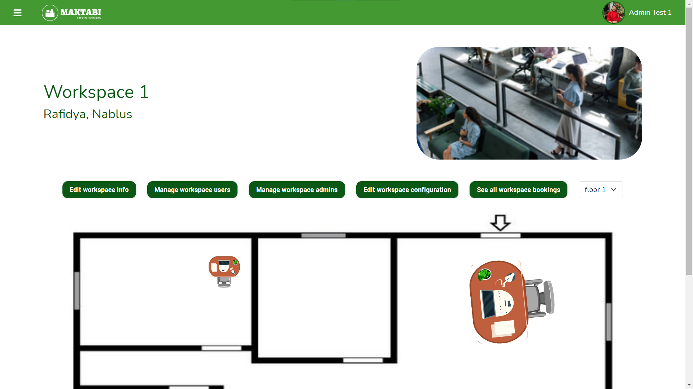
Workspace Admin

Slide 16
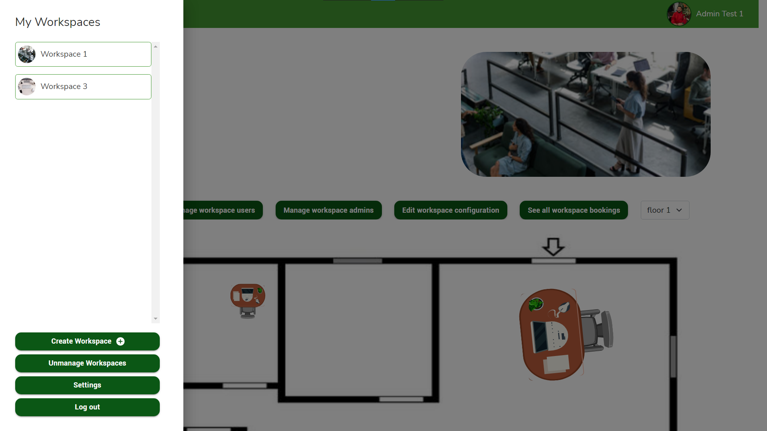
Workspace Admin

Slide 17
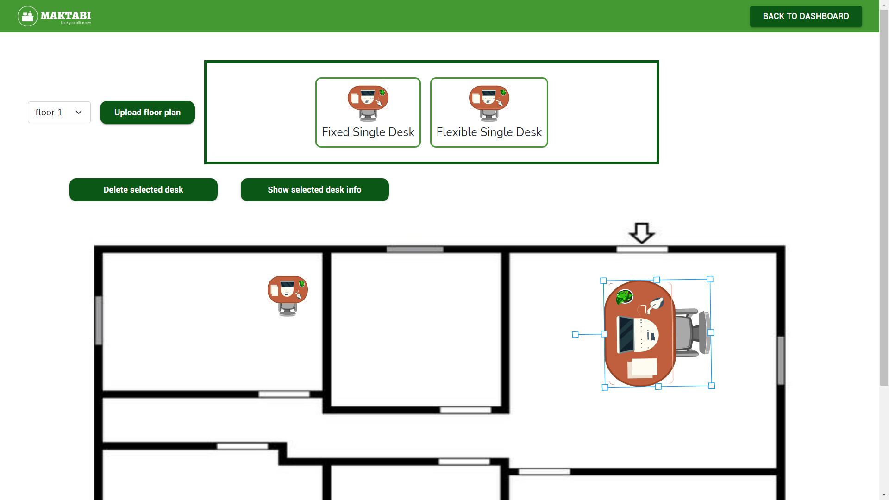
Workspace Admin

Slide 18
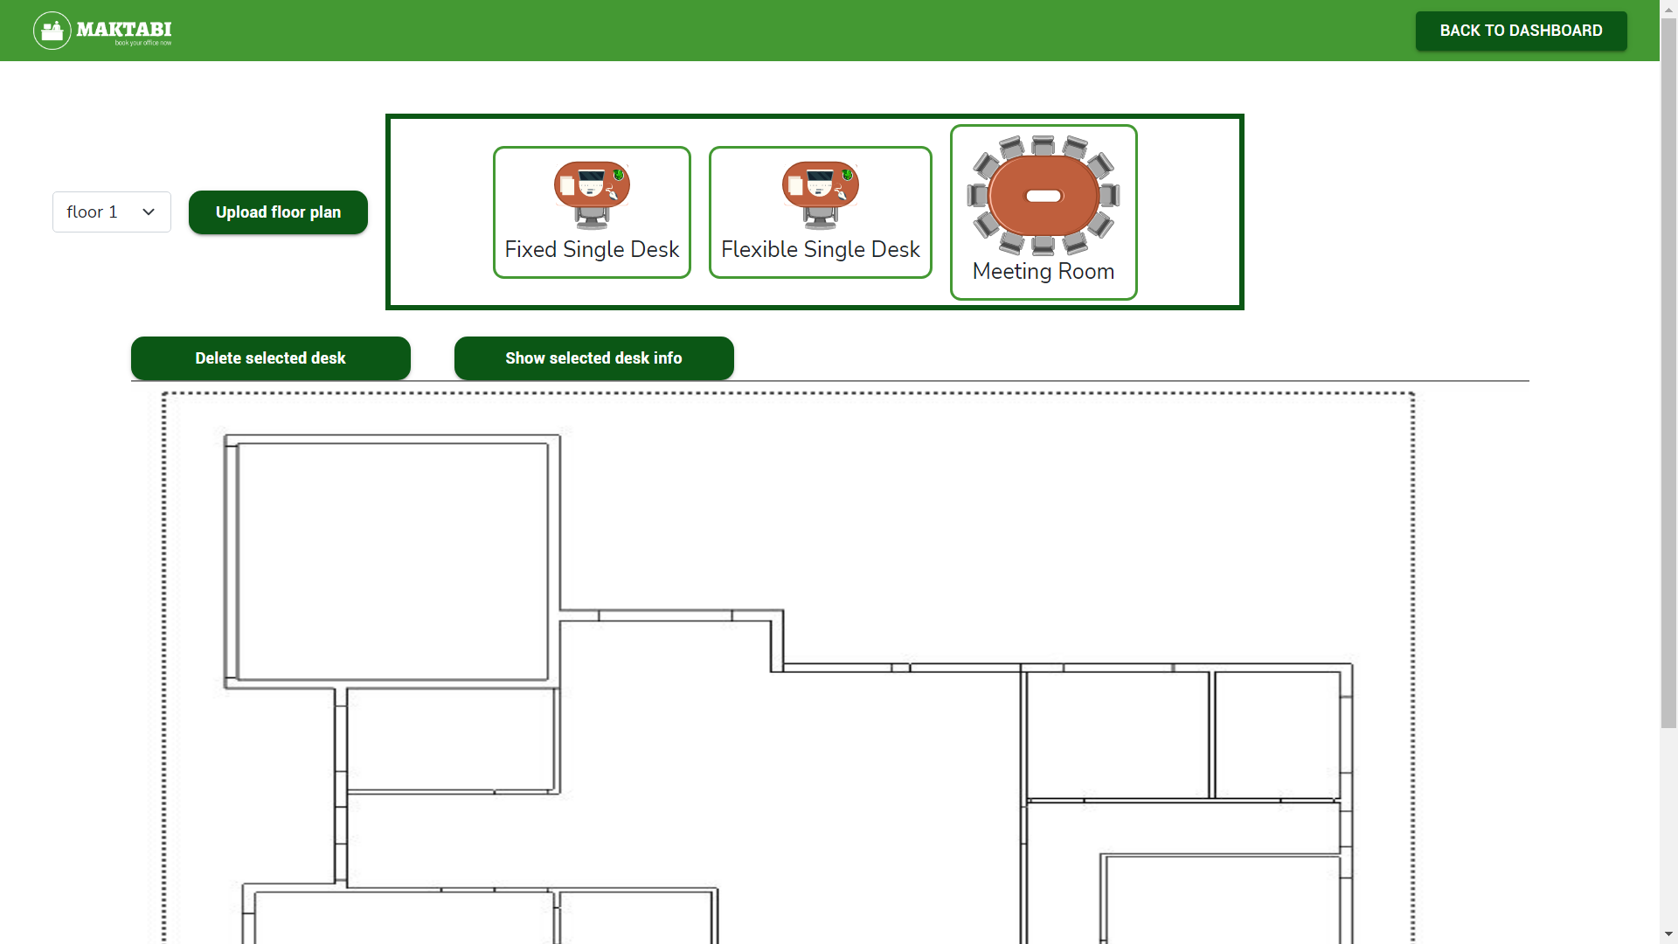
Workspace Admin

Slide 19
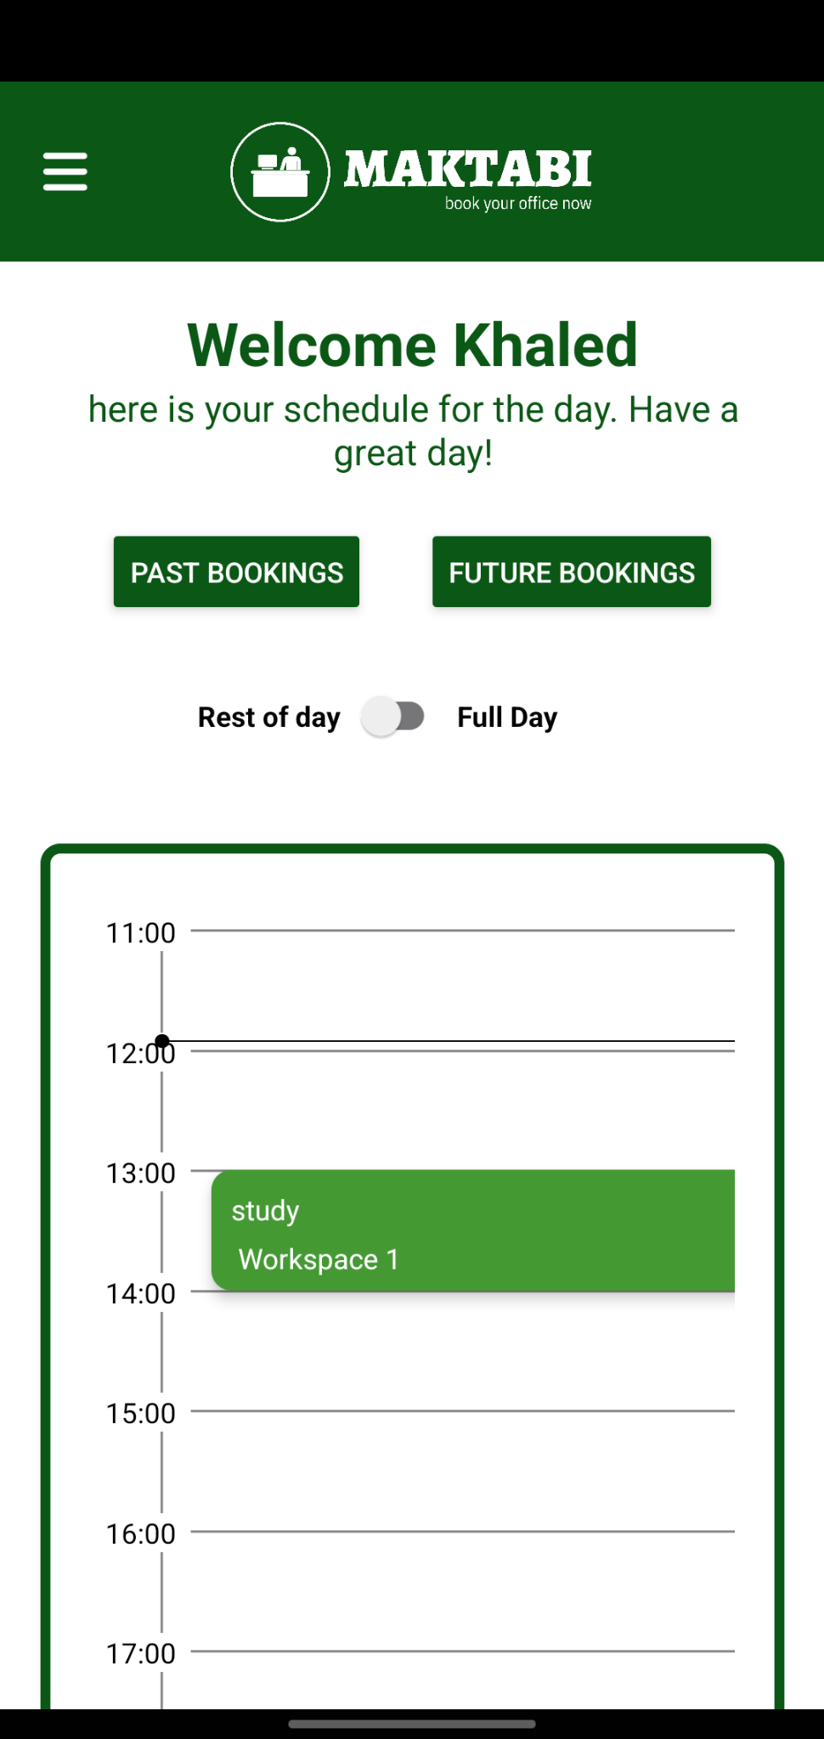
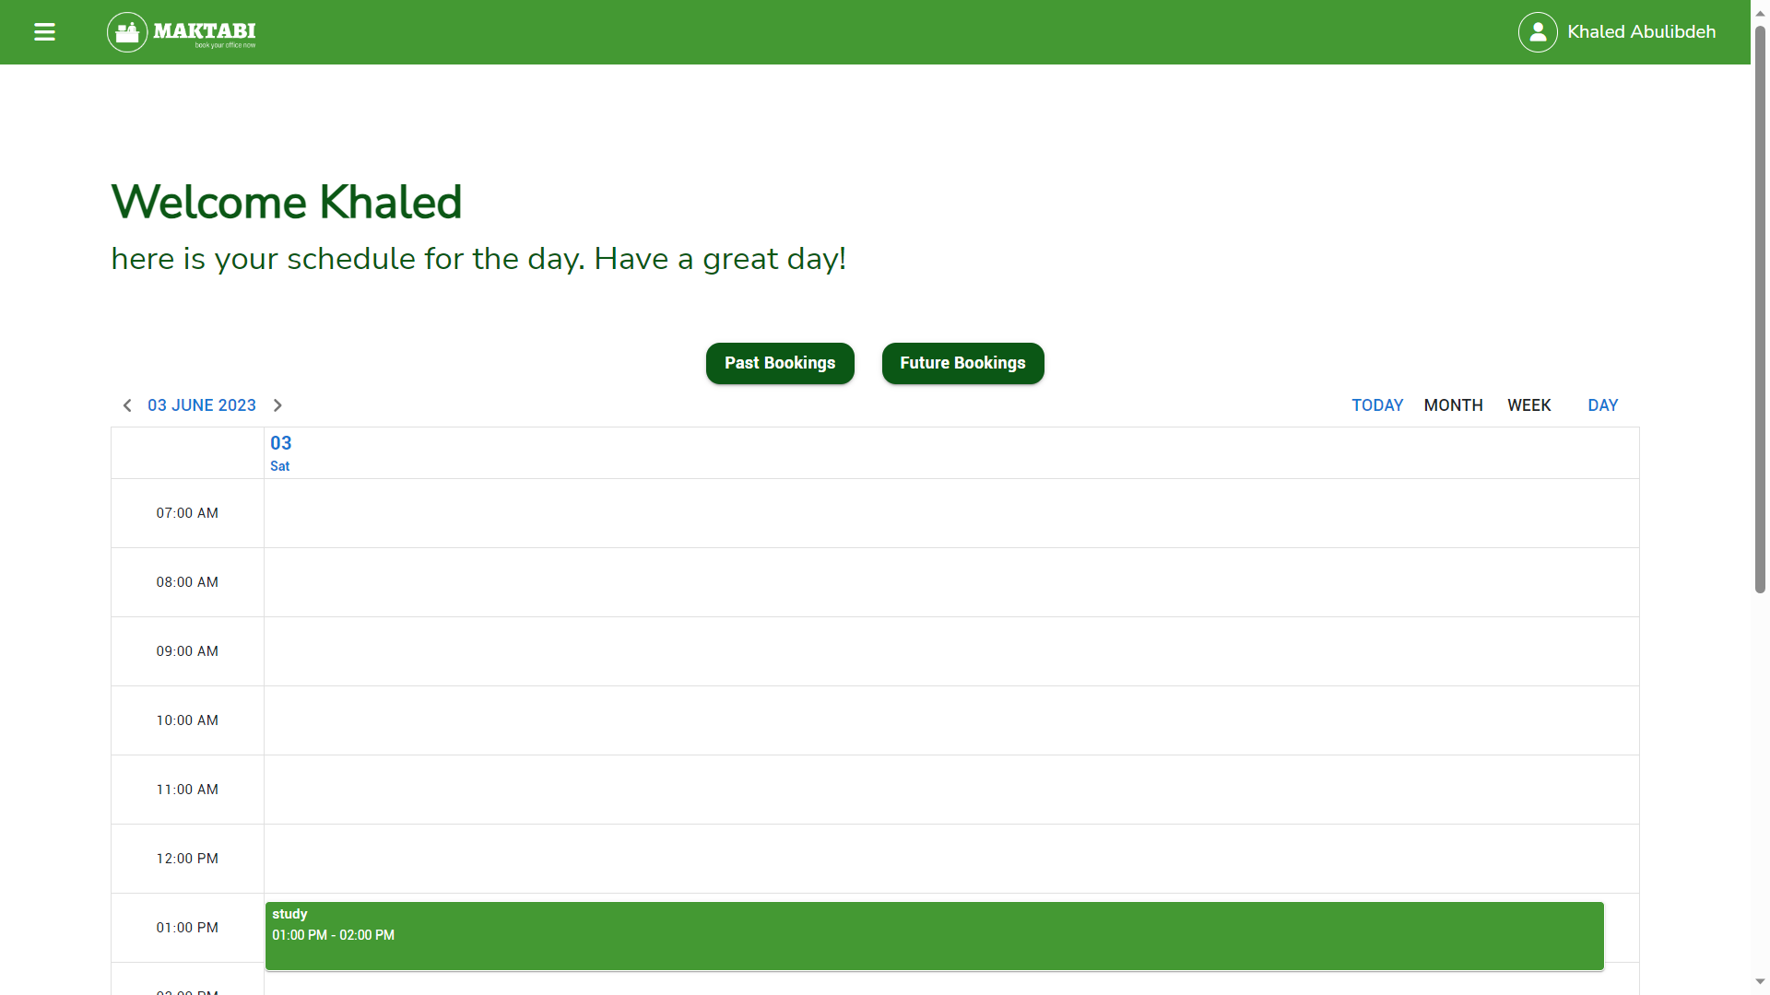
User Account

Slide 20
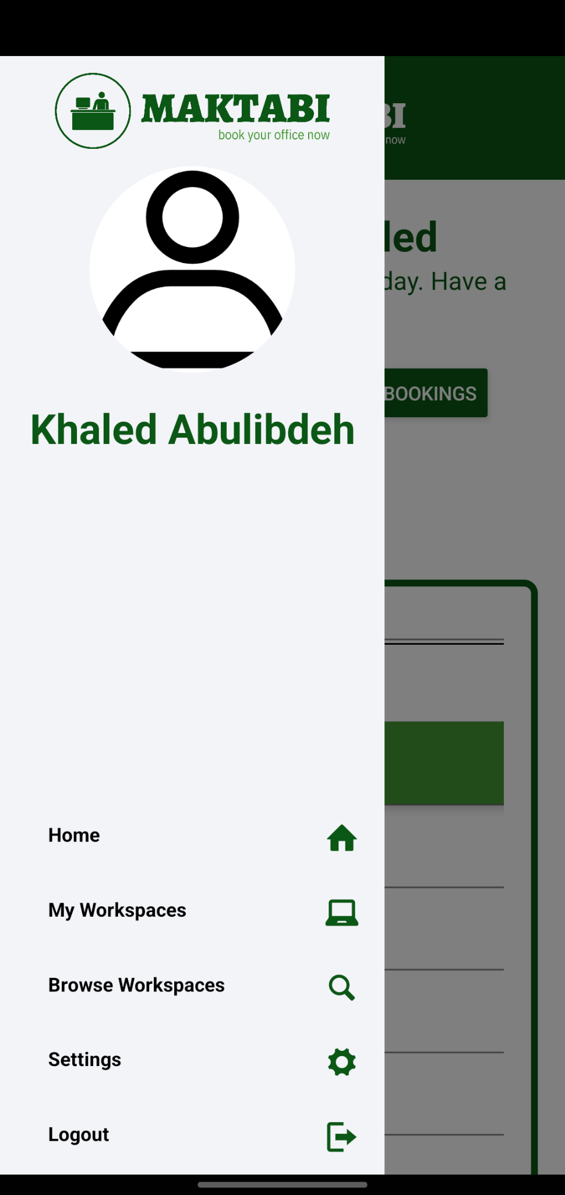
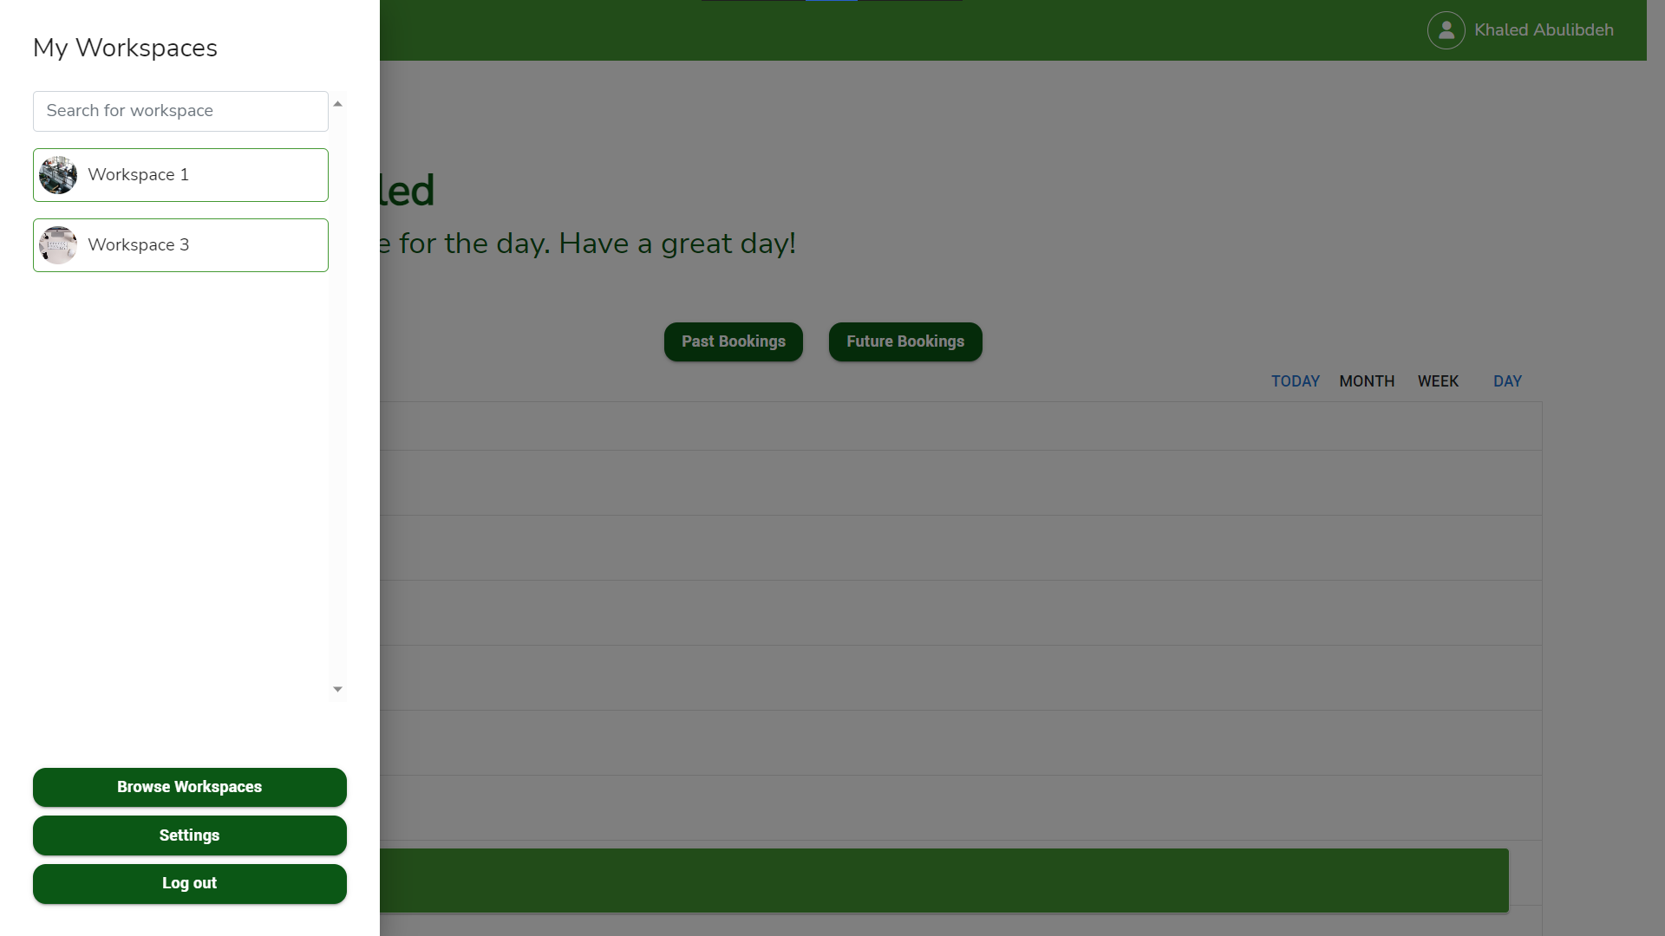
User Account

Slide 21
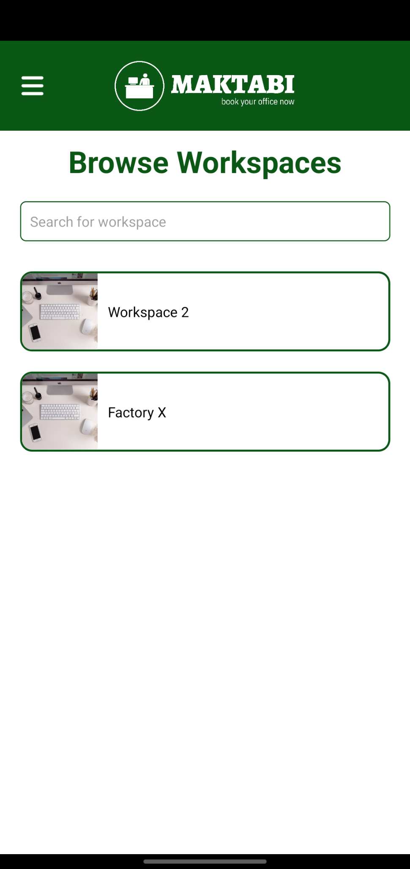
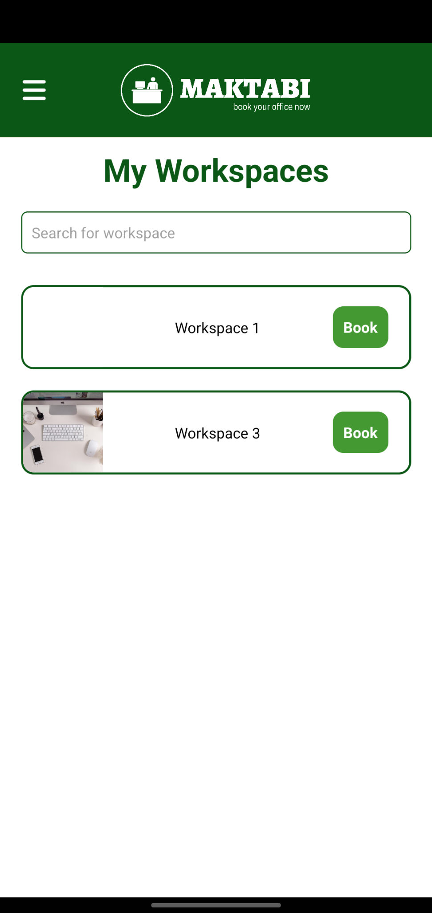
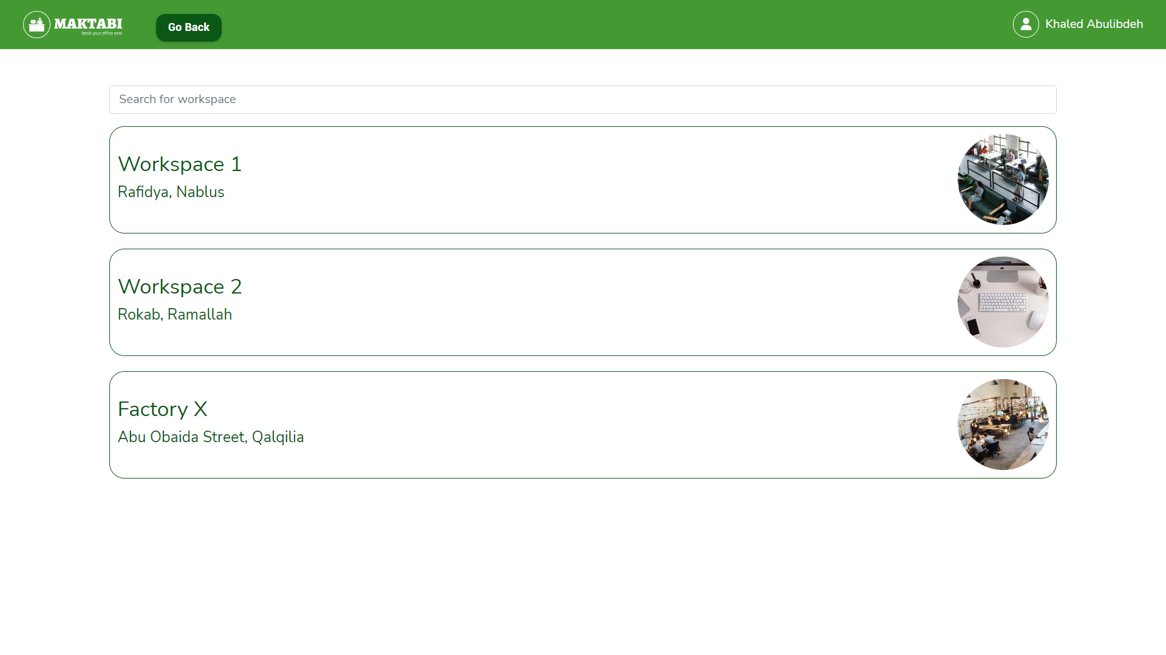
User Account

Slide 22
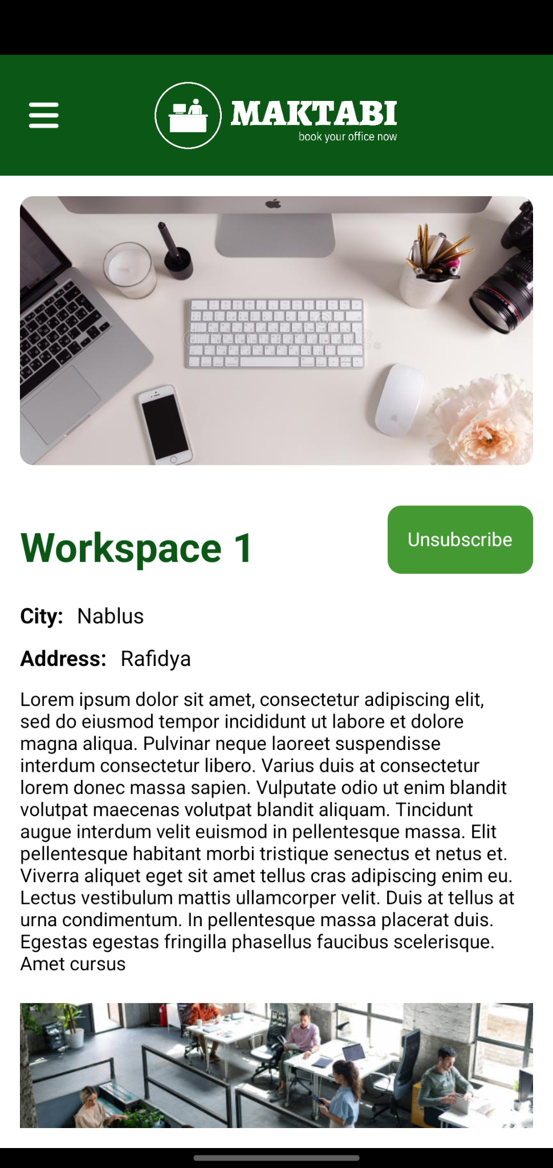
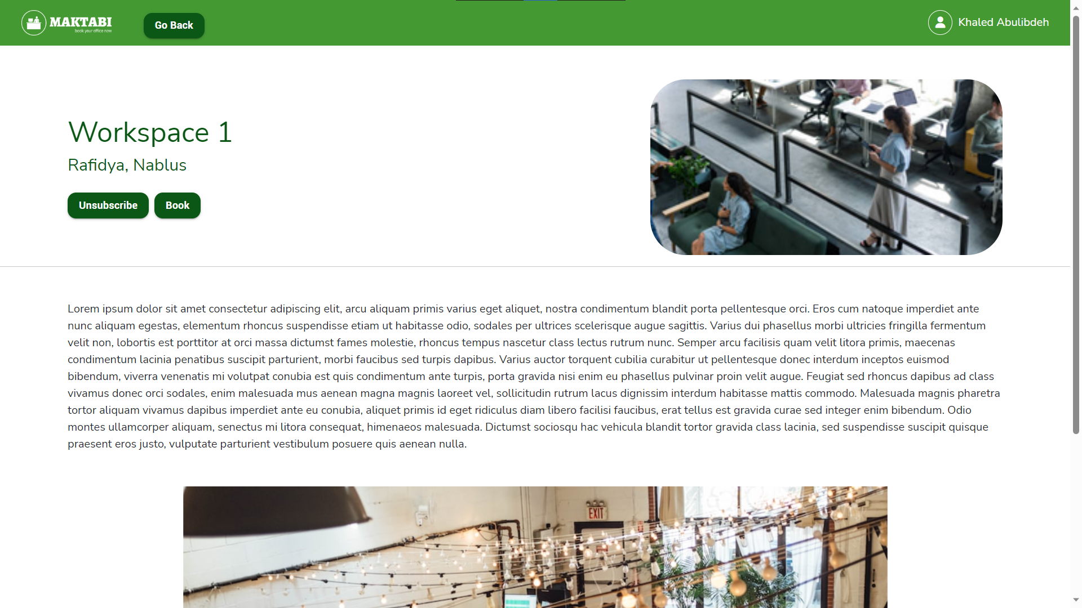
User Account

Slide 23
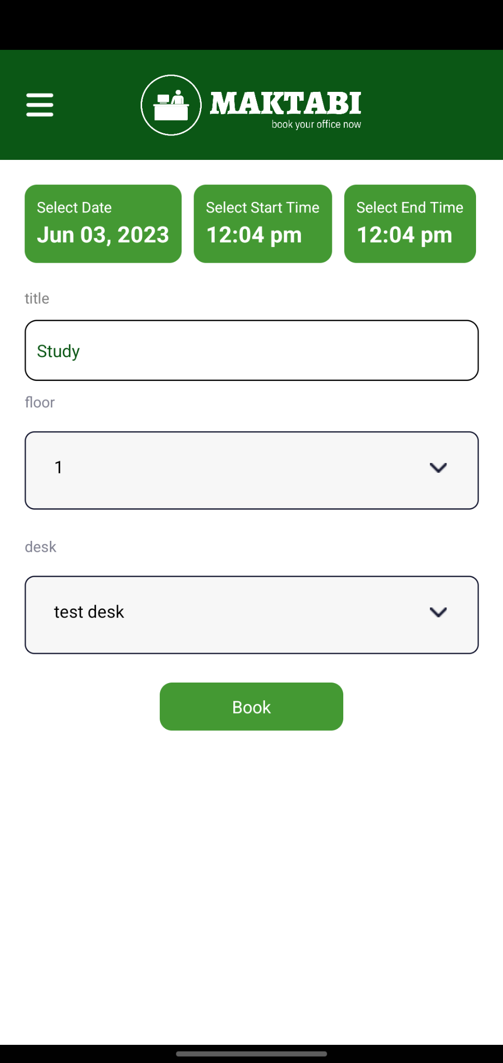
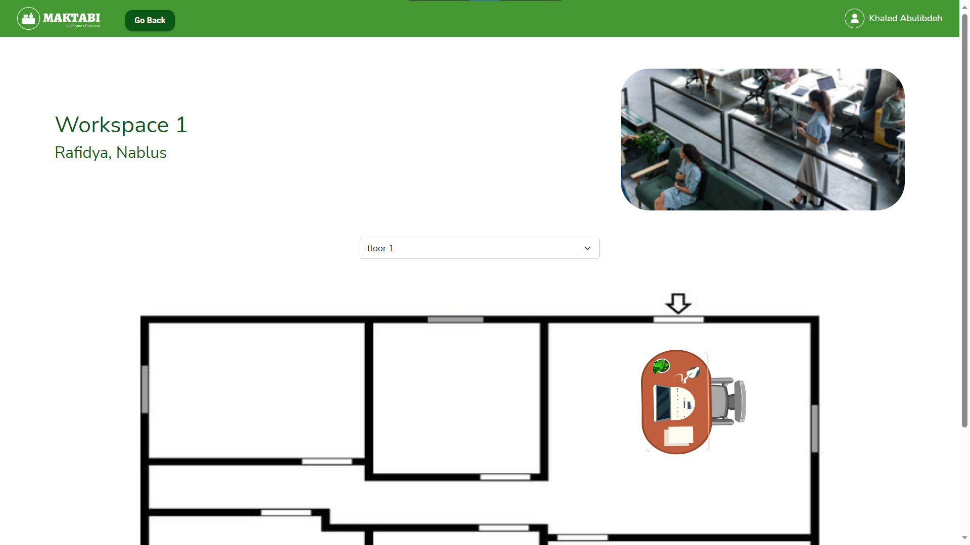
User Account

Slide 24
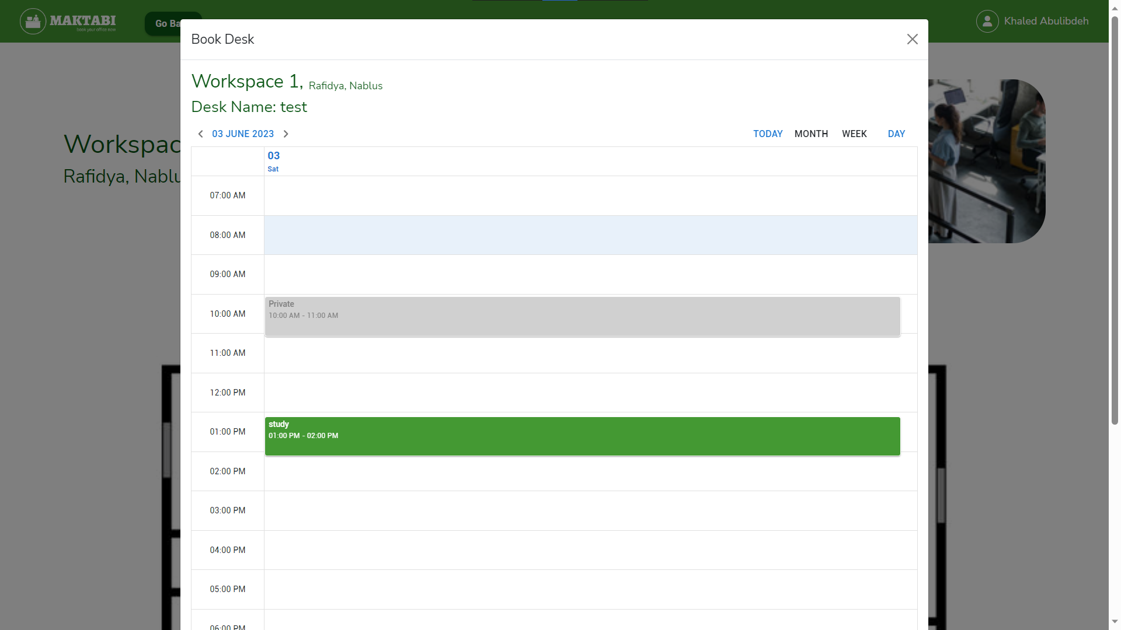
User Account

Slide 25
Future Work
05

Slide 26
Future Work
01
Educational institutions Customization
02
Adding Cafe Mode
03
Further improvements to the mobile application
04
Further improvements to the website’s look and feel

Slide 27
THANKS!
Questions?

