Slide 1
Dystopia game
Amjd , Iyad , Haytham

Slide 2
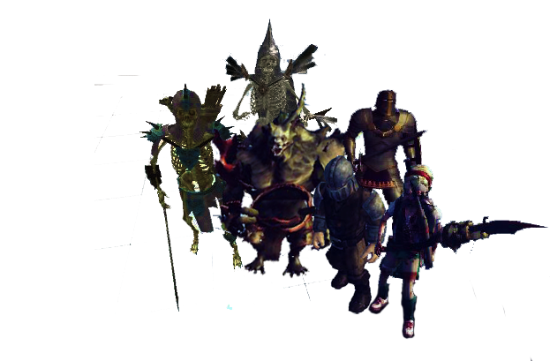
Outline
Dystopia
2
1- Introduction.
2- Design:
2.1- Problem to be solved.
2.2- Tools used
2.3- Story
2.4- Algorithms we designed.
2.5- Challenges
3- Future work.
4- Conclusion.

Slide 3
Introduction
Dystopia
History of video games :
game development started 30 years ago.
achieved great success.
An enormous level of technical development that integrates sound, image and motion in the virtual world.
video game industry has become a major industry.
video game industry around the world is estimated at about $ 70 billion a year.
Video games are classified according to the way they play and interact.it could be:
1) 3rd - person controller
2) 1st – person controller

Slide 4
What is new ?
Dystopia-Design
Why people would play our game dystopia ?
Virtual reality support.
Re-playable.
Difficulty based on player experience.

Slide 5

Tools used
Dystopia
4
Cross-platform game engine by Unity Technologies.
Unity is a multiplatform game engine.
Has a free version. has tons of tutorials, resources and great support . immediately see the results without need to compile and build.

Slide 6

Tools used
Dystopia
4
3D modeling program for a wide range of drawing applications.
Used for architectural, interior design, landscape architecture.
Easy to use, good for both programmers and artists.

Slide 7

Tools used
Dystopia
4
Allow create unique characters.
3D character animation and rigging.
Good for programmers and artist .

Slide 8

Tools used
Dystopia
4
3D modeling and rendering software.
control the number polygons models (Performance).
connect unattached objects –output of mixamo (hair and shoes).

Slide 9

Tools used
Dystopia
4
Free to use.
Uses the phone and cardboard to play PC VR games .
No need to buy expensive VR headset (oculus).

Slide 10
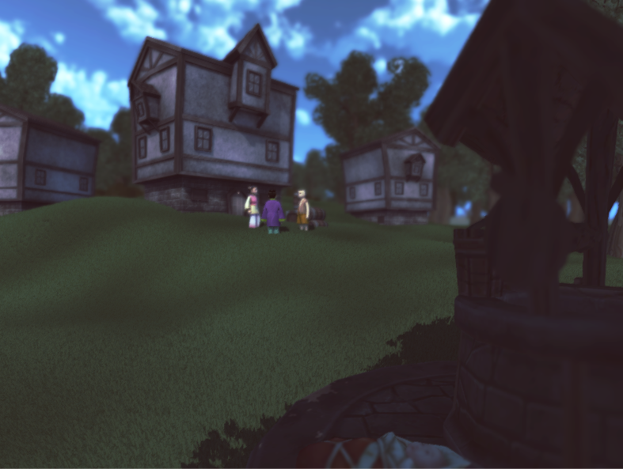
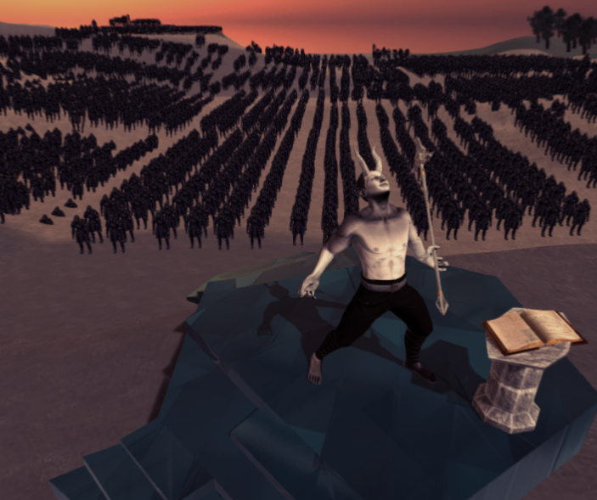
Story
Dystopia
3
Screenshots from the game.

Slide 11
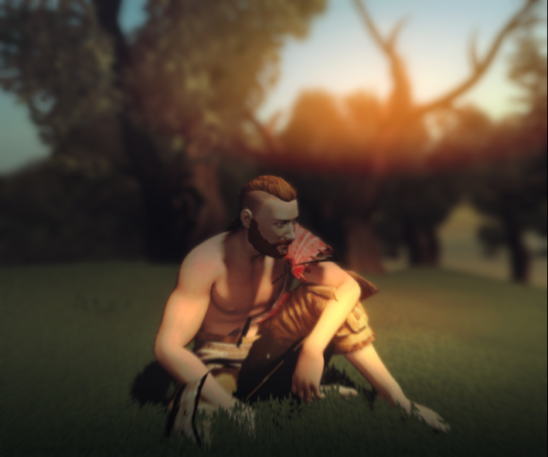
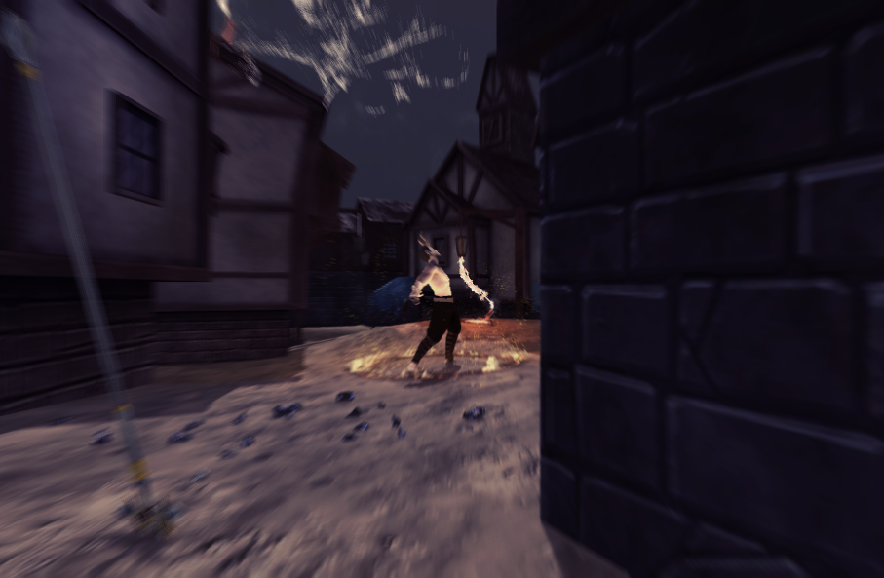
Dystopia
3
- The Story of Dystopia
Screenshots from the game.

Slide 12
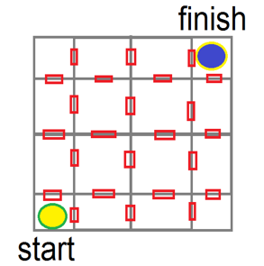
Algorithms
Dystopia-Design
5
1- Auto Generated Maze algorithm
Runs once every time the scene loaded.
Each room has common door with nearby room.
Guaranteed solution every time.

Slide 13
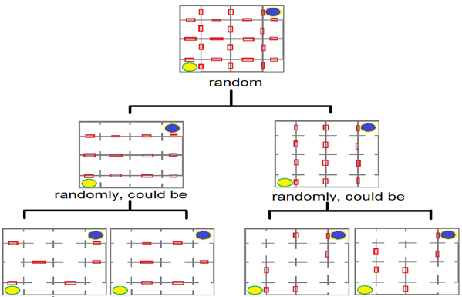
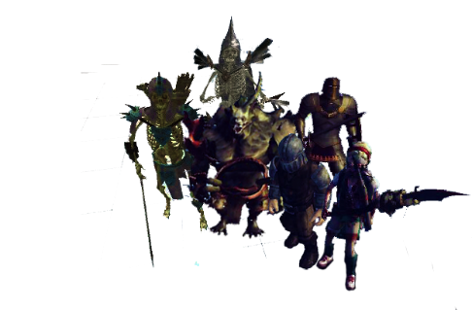
Algorithms
Dystopia-Design
5

Slide 14
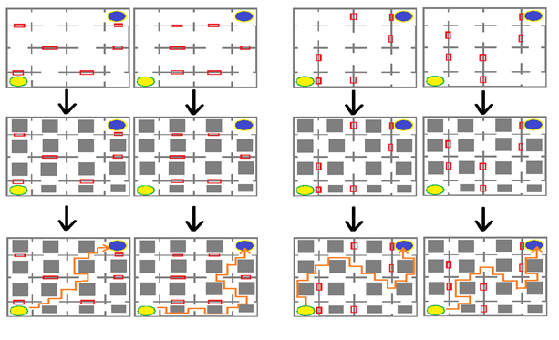
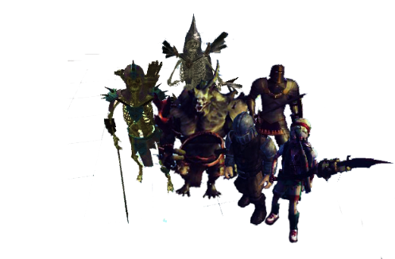
Algorithms
Dystopia-Design
5

Slide 15

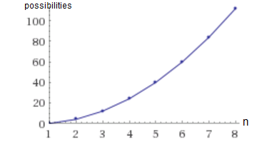
Algorithms
Dystopia-Design
5
- Number of possibilities (an)
- Dimension of the maze (n)

Slide 16
Dystopia-Design
Algorithms
2- Game controller.
Control the sequence of the story.
Calculate player score for each level
1) Enemies killed by the player.
2) Number of collectable items did he get
3) Areas discovered
4) Amount of damage received.
Sets the level of difficulty for each level.
Save and load game (using persistent object).

Slide 17
Dystopia-Design
Algorithms
3- Smart NPC :
- Goal is to make game more realistic through smart battle system .
- Attack strategy.
- The core of NPC: makes the decision depending on (player health, his health, player score).

Slide 18
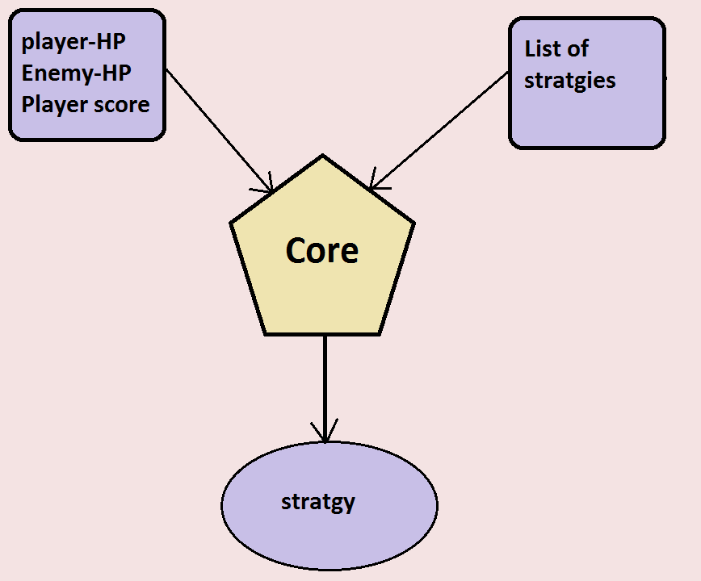
Dystopia-Design
Algorithms

Slide 19
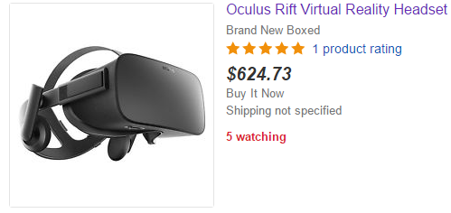
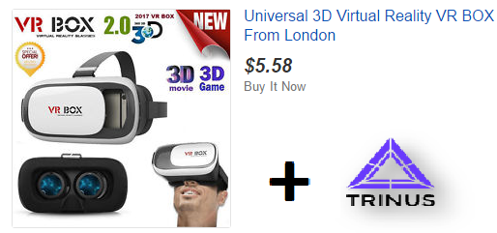
Challenges
Dystopia-Design
6
Virtual reality glass is very expensive , we solve it by using Trinus tool .

Slide 20
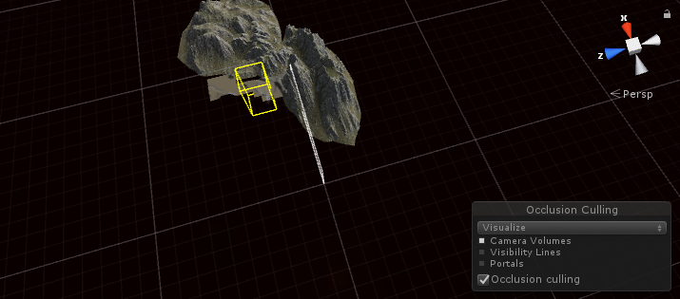
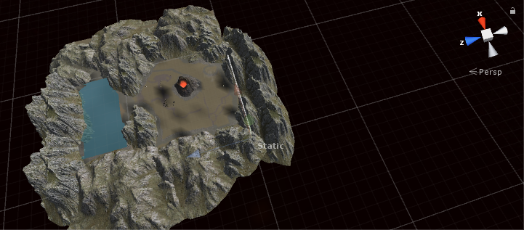
Challenges
Dystopia-Design
6
2- Low Fps and performance problem, solved by using :
Occlusion Culling :feature that disables rendering of objects when they are not currently seen by the camera.
With Occlusion Culling
Without Occlusion Culling

Slide 21
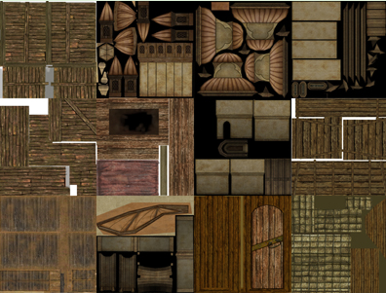
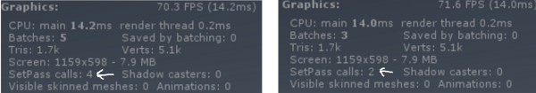
Challenges
Dystopia-Design
6
Designing the objects in terms of number of draw calls, by Combining meshes of the same material & texture together and combine objects with different materials by making single texture for group of objects.

Slide 22
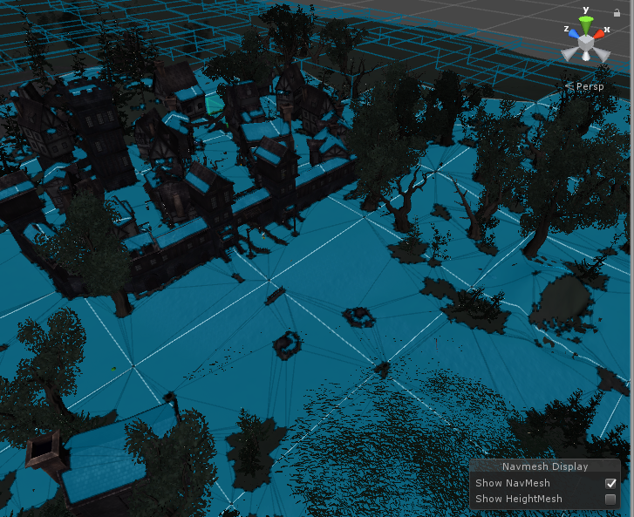
Challenges
Dystopia-Design
6
How to make the enemy interacte with ground to move smarter , find the shortest way and avoid walls and trees .
Solved by Navmesh.

Slide 23
Future work
Dystopia
12
- Add more puzzles.
- Add new levels, weapons, characters.
- Support multiplayer.
- Make the NPC create the strategy in battle.

Slide 24
Conclusion
Dystopia
12
After you know what is dystopia ,you will find that our game ins more cheaper than other virtual reality games ,and we have a complex algorithms that the unity draw it at run time not as the other games ,and our game has a simple lite objects and intelligence in design so it can work on any computer with a good properties.

Slide 25
Dystopia game
Amjd , Iyad , Haytham
Thank you

