Slide 1

CVs Segmentation & Analysis Using Image Processing & NLP Techniques
Haneen Abu Amsha
Yousef Odeh
Supervisor: Dr. Hamed AbdAlhaq

Slide 2


Motivation
01
02
Electronic recruitment Job
Facilitate matching process between job posts and CVs

Slide 3


Motivation
03
04
Organized way to extract information from CVs.
Analyzing CVs dynamically.

Slide 4
Goals
Facilitate the process of sorting and evaluation a massive amount of CVs rather than evaluated it manually
Extract important information to the recruitment process
which describes Cvs better.
Dealing with any type of CVs
Building foundation stone for Job Recommendation
System.

Slide 5
Outline
01
Methodology
1.1 CV preprocessing
1.2 CV Segmentation
1.3 CV Classification
02
Evaluation
2.1 Dataset
2.2 Accuracy of Segmentation
2.3 Accuracy of Classification
03
Feature Extraction

Slide 6
Image
Processing
Techniques, Preprocessing
Algorithm, OCR, Regex

Slide 7
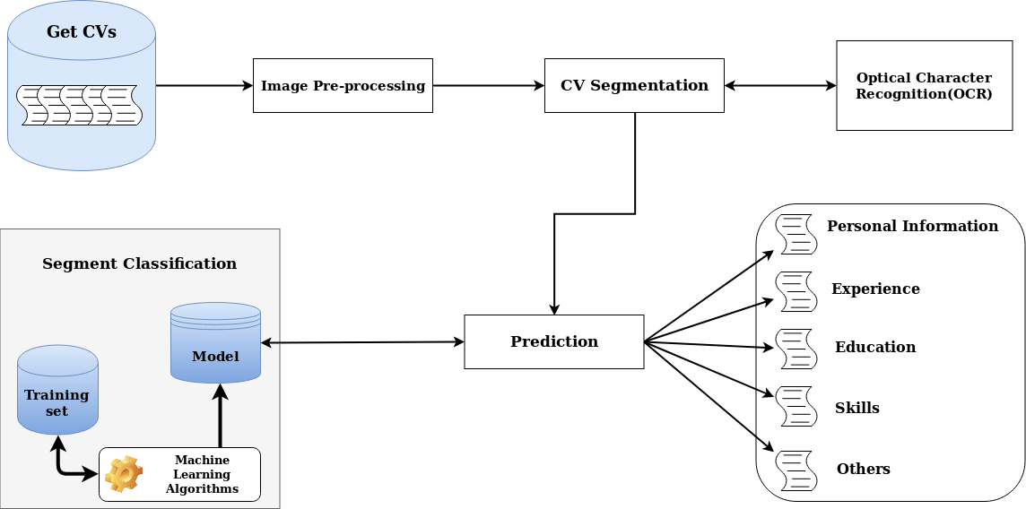
The pipeline
of the proposed model.

Slide 8

CV preprocessing
Converting to image
Remove unnecessary lines
-Dealing with any type as an image.
-pdf is converted to image.
Horizontal and vertical lines affect the segmentation process in a negative way.
STRENGTHS
WEAKNESS
OPPORTUNITIES
THREATS
Preprocessing
Resizing image
Threshold and Dilation
-More clear when extract text using OCR.
-Fixing image size on 900*1000.
-Thresholding affect the text if CVs in different colors and background.
-Dilation affects the segmentation of CVs

Slide 9
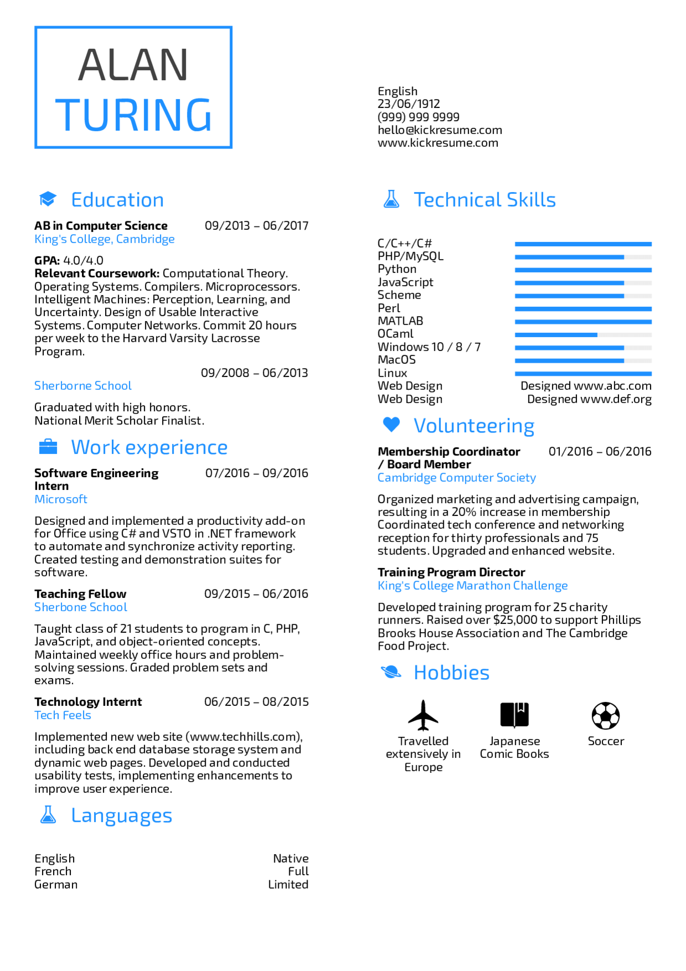
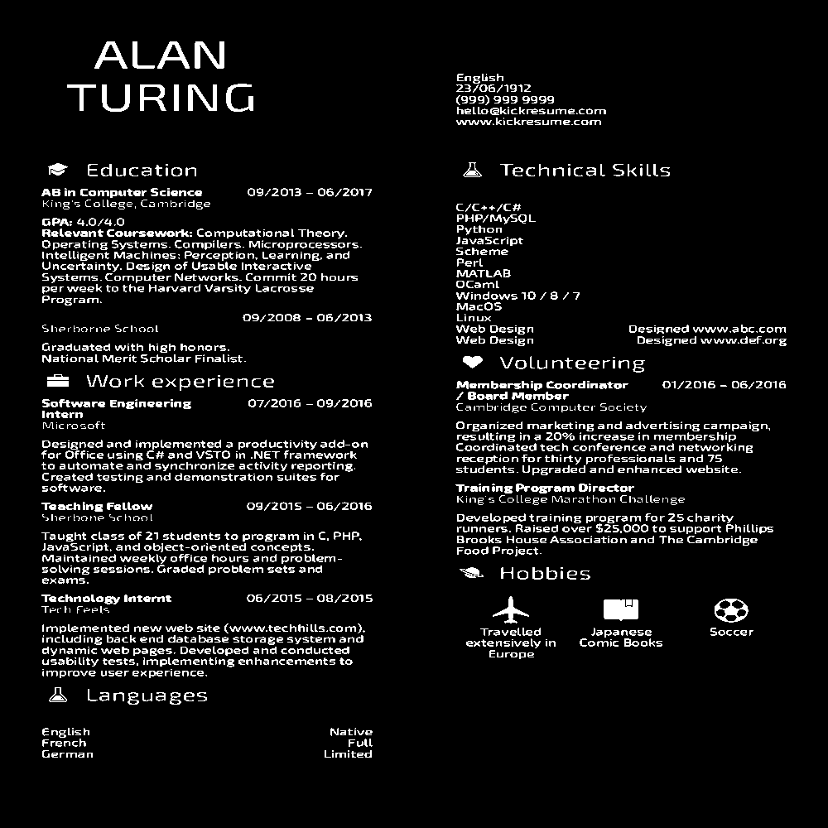

CV preprocessing
01
02
03
Origin Image
Image Threshold
image dilation

Slide 10

Optical Character Recognition
Why OCR ?
Optical Character Recognition (OCR) was the best method to enable converting different types of documents and images to text and enabling extracting text from images.

Slide 11
CV
Segmentation
Calculate the distance
Find the distance between headlines.
After previous preprocessing steps, the following steps will achieve segmentation.
Extract headlines
Extracting headlines from text to find the distance between them.
OCR
Converting the image to string.
Find ROI
Detecting the region of interest from all CV.

Slide 12
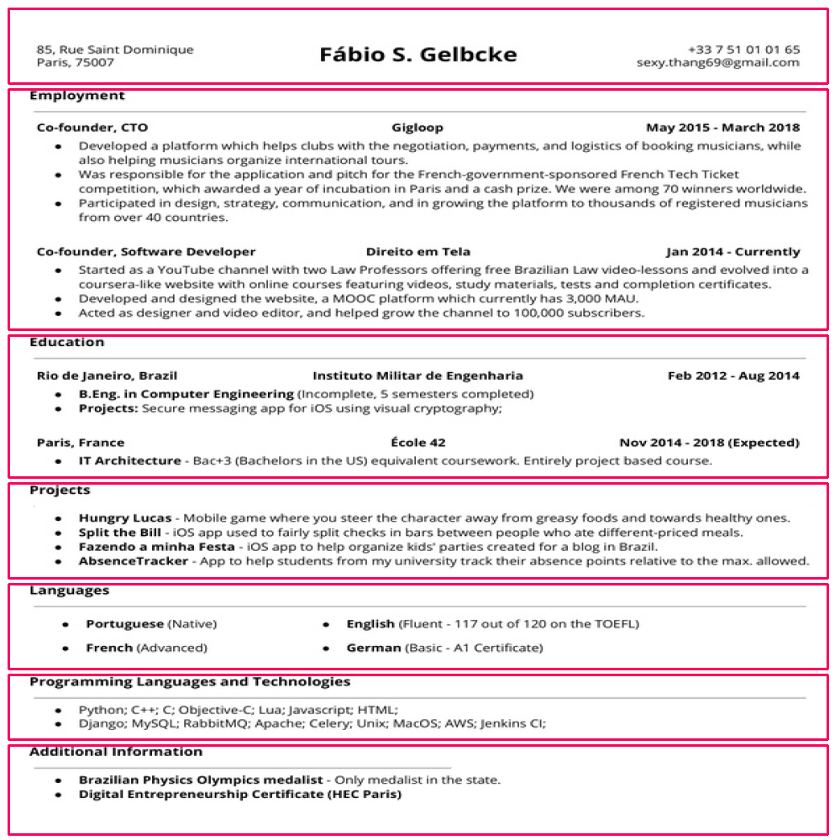
The result from the Segmentation process.
Segment each section into separate one using Image Processing techniques.
-One column.

Slide 13
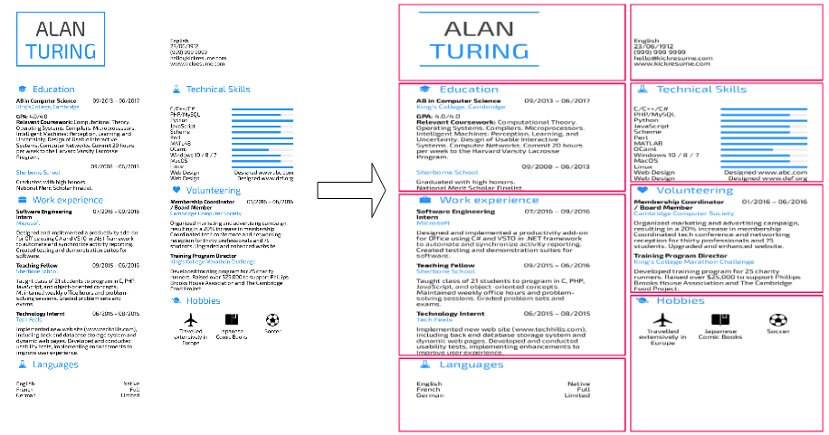
The result from the Segmentation process.
Segment each section into separate one using Image Processing techniques.
-Two column.

Slide 14

Text Classification using scikit_learn, Python and NLTK.
Machine Learning

Slide 15
Segment Classification
Converting text to numbers
Text Preprocessing
To convert values using the bag of words model into tfidf values.
To remove special characters and numbers from text using Regex.
Training text classification model
Scikit
Learn
Training and Test Sets
Using Random Forest Algorithm to train our model.
We divide our data into 80\% training set and 20\% test set.
Evaluating the model
Using precision, recall, and F-measure.

Slide 16
Segment Classification
Skills
Here is the segments we got from classification
Experience
Education
Segment 4
Personal Information
Segment 3
Segment 2
Segment 1

Slide 17
Model Evaluation

Slide 18
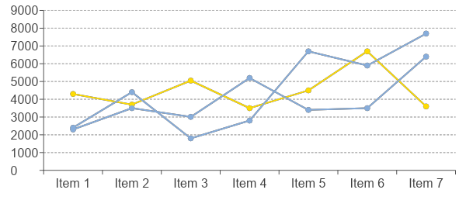
Dataset
80%
20%
Description
We have 50 CVs for training set and 20 CVs for testing.
Training
Testing

Slide 19
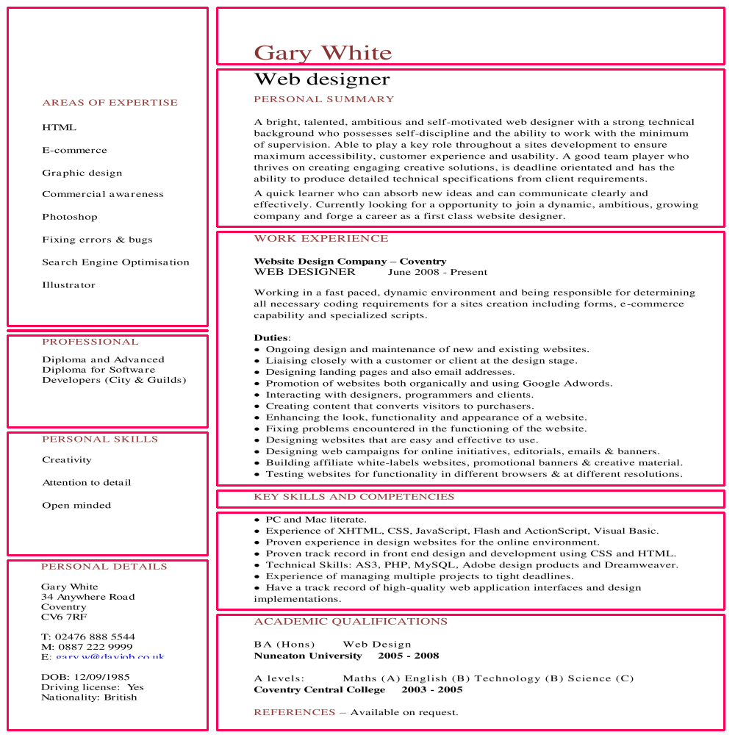
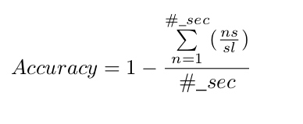
Performance of CV Segmentation
Accuracy training data
We got the accuracy of the training set using the following equation:
The accuracy is approximately 97% applied on 50 CVs. 3% is a problem due to OCR or CVs quality.

Slide 20
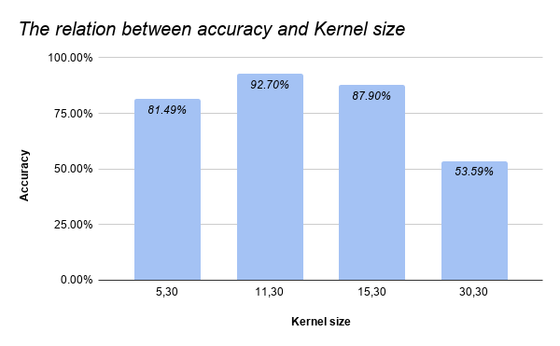
Performance of CV Segmentation
Accuracy testing data
We got the accuracy of the testing set using the following equation:
The accuracy is approximately 92.7% applied on 20 CVs.

Slide 21
Performance of Segment Classification
Accuracy
The accuracy is approximately 86.2% applied on 50 CVs.
Model | Avg P (%) | Avg R (%) | Avg F (%)
Random Forest | 92 | 82.4 | 86.2
SVM | 91.4 | 79 | 84.4
Bernoulli Naive Bayes | 84.6 | 84.4 | 84.4
Gaussian Naive Bayes | 67 | 70 | 68.96
Random Forest results are achieved better results.

Slide 22

Feature Extraction
The last phase for Job Recommendation System.
Extracting the most important information from skills and experience section like: Python, C++, Java and so on.

Slide 23
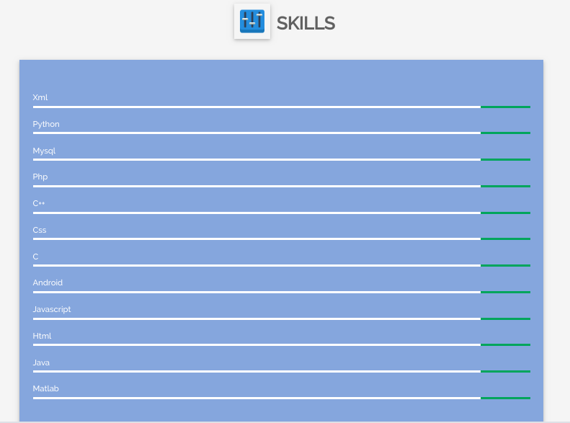
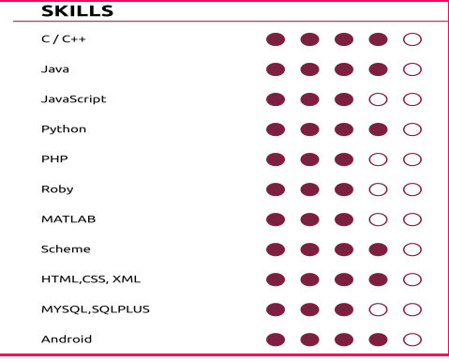
Feature Extraction Example
Extraction Skills

Slide 24
Future Work
Job Recommendation System.
Error spelling correction.
Expand our work to include all fields.

Slide 25
Thank You
Thanks for coming today

