Slide 1
PalDonor

Slide 2
Table of Contents
Idea
Objectives and features
Motivations and Problem Description
Technical Details

Slide 3
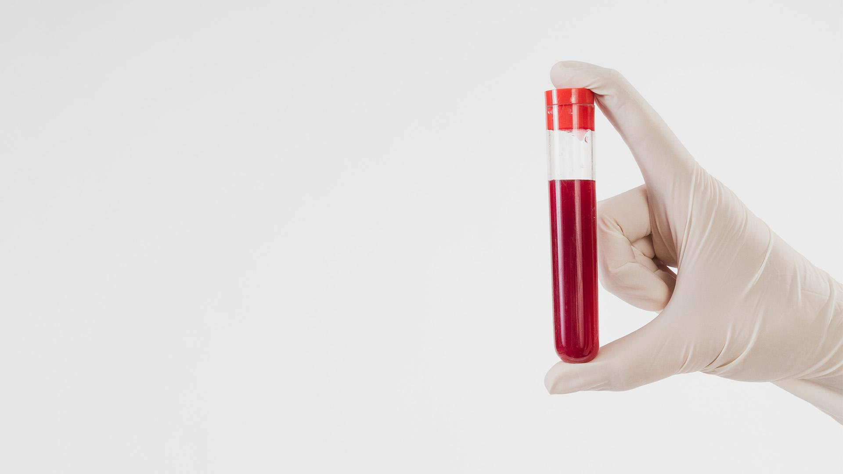
Idea
Blood donation is a vital process. So we will create an application that make this process easier for medical centers and donors.

Slide 4
Objectives
Make Donation easier for medical centres by being able to send notifications for users to donate.
Make Donation easier for users by being able to schedule appointment to donate.

Slide 5
Features
User Features
Hospital Features
Adminstator Features
Schedule donation appointment.
View centers on map
View open cases in centers
Receive notifications about cases.
Share tools to be borrowed
Borrow tool.
Receive notfications about tool borrow requests.
View donation log and status and QR-Code.
Edit personal information.
Add new case.
View open cases.
Scan donor QR-Code.
Add donor to the system.
Edit donor status.
Send urgent notifications for users.
View current centers
Add new center
View center statistics
Reset center password

Slide 6
Motivations and Problem Description
Creating base of frequent donors
Easier donation process
Benefit people
When hospitals and people post that they are in need to blood units on social media, few people may react with them posts. So we decided to create this application that will provide:
By scheduling for donations from homes
A reliable, strong base
By posting medical tools

Slide 7

Technical
Front-end: React for Web applications
React-native for Mobile applications

Slide 8
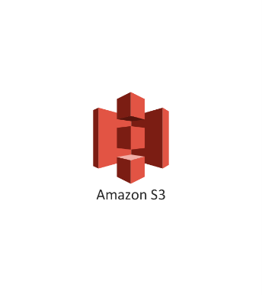


Technical
Back-end: Nodejs for server
MongoDB for database
AWS S3 for store images

Slide 9
Our Team
Mohammad Qasedo
Suhaib Hamdallah

Slide 10
Thanks!

