Slide 1
Graduation Project ‘2’
Vaccination System
Group Team :
Amr Badawi , Ahmad Nasasrah & Mohammad Saleem
Supervised By : Dr. Nizar Awartani

Slide 2
Contents
Abstract
Introduction
Technology
MVC
Security
Web Service
Performance
Android Requirements
Conclusion

Slide 3
Abstract
The project will be talking about the possibility of making the vaccination process simple and effective as possible.
The project is two environments: Web & Android .
We tried to build a system with a friendly interface to be comfortable and easy to use as possible.
Colors picked from google materials guide.

Slide 4
Introduction
Traditional way for vaccination process these days has many problems and reasons makes it not an effective way such as :
Totally depend on ‘Handbook’ that will be held by mother in every time she went to the vaccination center.
Also need a lot of money for papers and manpower and more many things.
Our system should :
Reduce money and manpower needed for vaccination process
No longer dependance on “HandBook”

Slide 5
Technology
The Web part of the project is development using MVC Grails technology "Groovy on Rails"
Is an open source web application framework that uses Groovy programming language (which is in turn based on the Java platform).
Providing a stand-alone development environment and hiding much of the configuration detail from the developer.

Slide 6
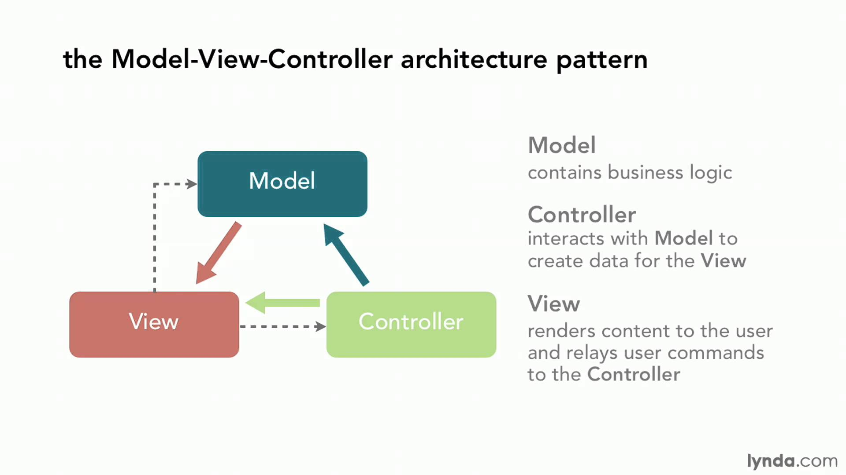
MVC
Model–View–Controller (MVC) : It divides a given application into three interconnected parts in order to separate internal representations of information from the ways that information is presented to and accepted from the user.

Slide 7
MVC Details - Model
Domain classes: are the core to business application.
  They hold state about business processes and implement behavior.
  They are linked together through relationships; one-to-one, one-to-many, or many-to-many.
GORM : Grails' object relational mapping (ORM) implementation.
  Creates a "virtual object database" that can be used from within the programming language.
  Under the hood it uses Hibernate
Hibernate:
  Very popular and flexible open source ORM solution
  Maps the domain classes to database tables.

Slide 8
MVC Details - Controller
A controller fulfills the C in the Model View Controller (MVC) pattern
Is responsible for handling web requests.
Provides model data to the view.
interprets user actions such as button clicks.

Slide 9
MVC Details - View
Displays the model data, and sends user actions (e.g. button clicks) to the controller .
Summary :
The MVC design pattern inserts a controller class between the view and the model to remove the model-view dependencies
The model, and possibly the view, can be made reusable without modification.
The users get stable software quickly, the company saves money, and the developers don't go insane.

Slide 10

Security
Spring Security is a framework that focuses on providing both authentication and authorization to Java applications.
Features
Comprehensive and extensible support for both Authentication and Authorization
Protection against attacks like session fixation, cross site request forgery, etc

Slide 11
Web Service
Web services provide a standard means of interoperating between software applications running on a variety of platforms and frameworks.
We use web service to connect between two environments (web & android).
Functions to render data for all requests from android.
Data returned will be as json array.

Slide 12
Performance
To make the system work in high performance the system should uploaded on server instead of run it locally .
The server we need for our system is not a expensive one , it’s just need a server with acceptable size and good performance , for example server with 3G - 6G RAM we think it’s enough and fulfills the obligation .

Slide 13
Android Requirements
Minimum SDK version : Integer designating the minimum API level required for the application to run .
In this system minSdk = 19
Maximum SDK version : Integer designating the maximum API level that .
In this system maxSDK = 25

Slide 14
Conclusion
We hope that our system will help in managing vaccination process and make difference in that way.
Future Plans :
Notify mothers before a fixed time of next visit to the center.
Add charts on main screen for vaccinations amount in the center and percentage of childs who missed there’s visits.

