Slide 1


An-Najah National University
Faculty of Engineering
Civil Engineering Department
HARRIS WATER DISTRIBUTION NETWORK
Prepared by:
Tamer Sultan Mousa Ziadeh
Supervisor:
Dr. Hafez shaheen

Slide 2
Presentation Layout
Introduction.
Objectives.
Description of the Study area.
Design WDN.
Results.
Recommendations.

Slide 3
INTRODUCTION
Importance of water
قال الله تعالى :{ وجعلنا من الماء كل شئ حي} صدق الله العظيم. سورة الأنبياء الآية 30
Importance of Water Distribution Networks (WDNs)
People who live in different locations, whom their homes are not located in the same area and there is considerable distance between them. they need to have water distribution networks (WDNs).

Slide 4
Objectives
Apply the theoretical background which we have learned through the last four years with the reality and practical life.
Design the water distribution net work of Harris by using WATERCAD software.
Studying and analyzing the water consumption and estimating the losses.

Slide 5
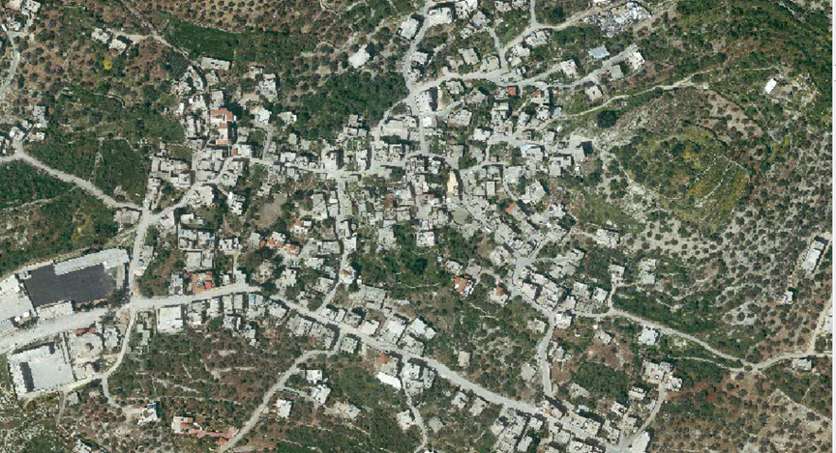
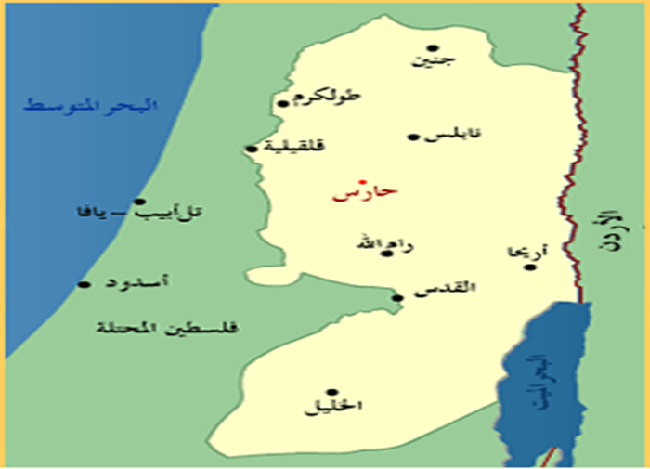
Study area

Slide 6
DESCRIPTION OF THE STUDY AREA
Location
  Harris is a Palestinian village located in the middle of the west south of Nablus city. It lies on a hill at an elevation of 570 m. It spread over an area estimated at 1,500 acres. Harris is also located northwest of the city of Salfeet, about 7 km away.
Population
  The number of the population, according to the statistics in 2012 is about 3,454 persons.

Slide 7
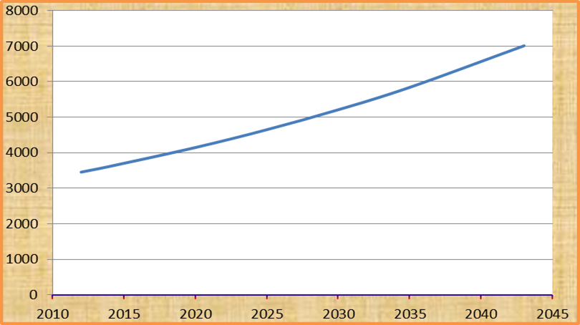
DESCRIPTION OF THE STUDY AREA

Slide 8
DESCRIPTION OF THE STUDY AREA
Rain
Average annual rainfall in Harris = 660 mm .
The average number of rain days = 50-70 days./year
Temperature
Rates of temperature in summer about (25° – 32°) C.
Rates of temperature in winter about (6° – 15° ) C.

Slide 9
DESCRIPTION OF THE STUDY AREA
From question area :
Per capita consumption of water 57L/capita/day.
Average number of persons per family 8.

Slide 11
Methodology

Slide 12
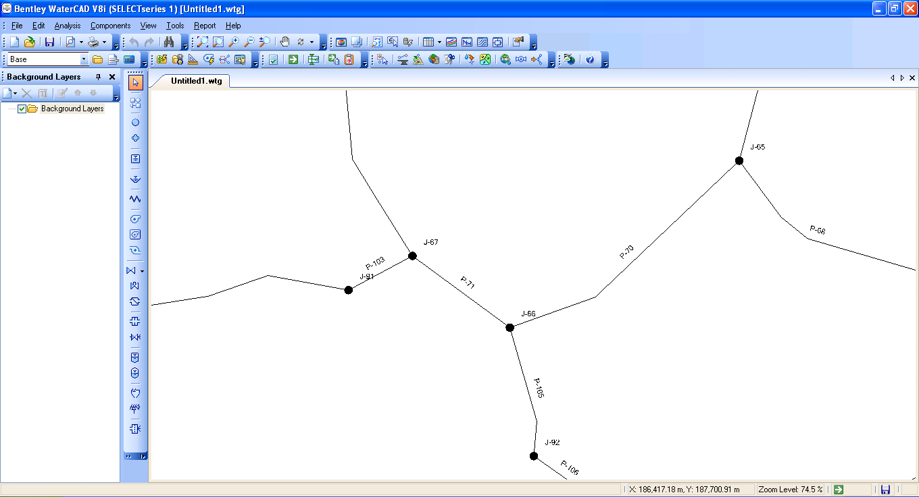
WATER CAD Software
Water CAD
Water CAD is a computer software used for analyze the water distribution networks. It can be used for different types of application in the distribution system analysis such as a simple network design.
Water CAD analysis output are : the flow for each pipe in the network and the velocities, the pressure for each node and the total head, the head loss in each pipe and more of hydraulic output analysis.

Slide 13
wdn analysis
Present Per Capita Water Demand & estimate growth rate
We take the 2/L/C/D from the difference between the consumption in 2012 and 2011
Divided by the current population 3454 .
Present per Capita Water Demand
Present water based on questioner is 57 L/C/d. The future water consumption will be 57 + (30*2) =117 L/C/d.

Slide 14
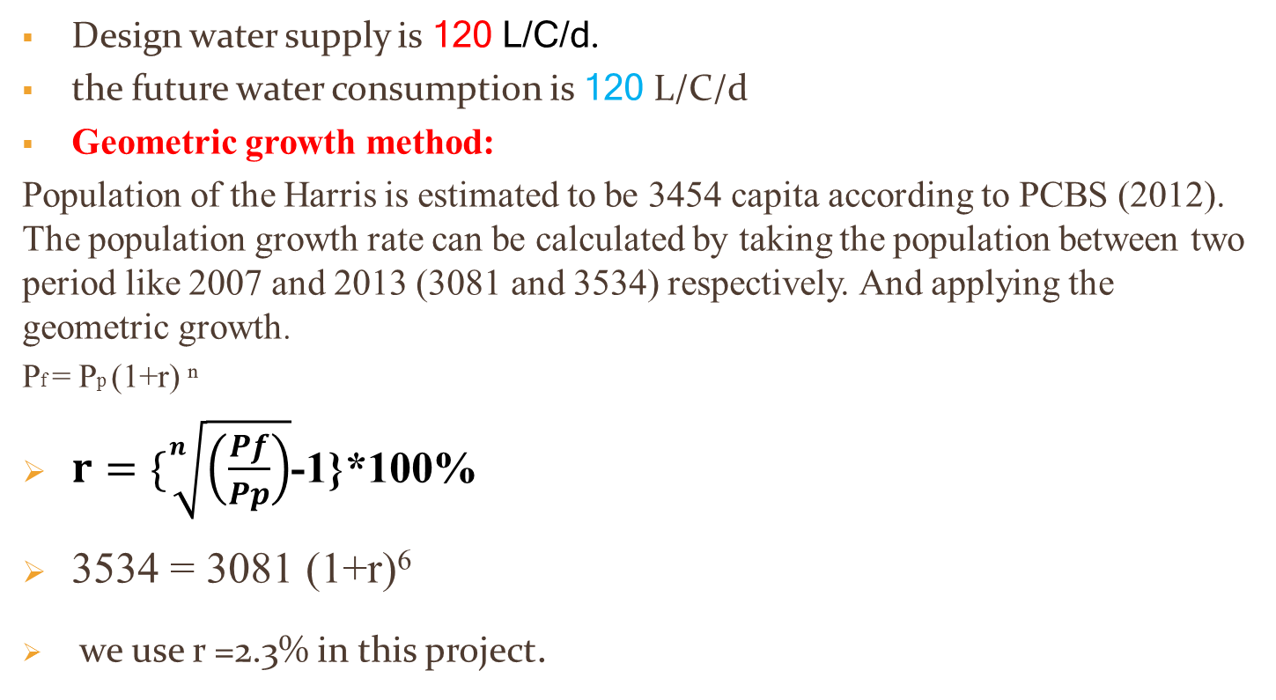
wdn analysis
Design water supply is 120 L/C/d.
the future water consumption is 120 L/C/d
Geometric growth method:
Population of the Harris is estimated to be 3454 capita according to PCBS (2012). The population growth rate can be calculated by taking the population between two period like 2007 and 2013 (3081 and 3534) respectively. And applying the geometric growth.
Pf = Pp (1+r) ⁿ
$r=\{\sqrt[n]{\left(\frac{Pf}{Pp}\right)}$-1}*100%
3534 = 3081 (1+r)⁶
we use r =2.3% in this project.

Slide 15
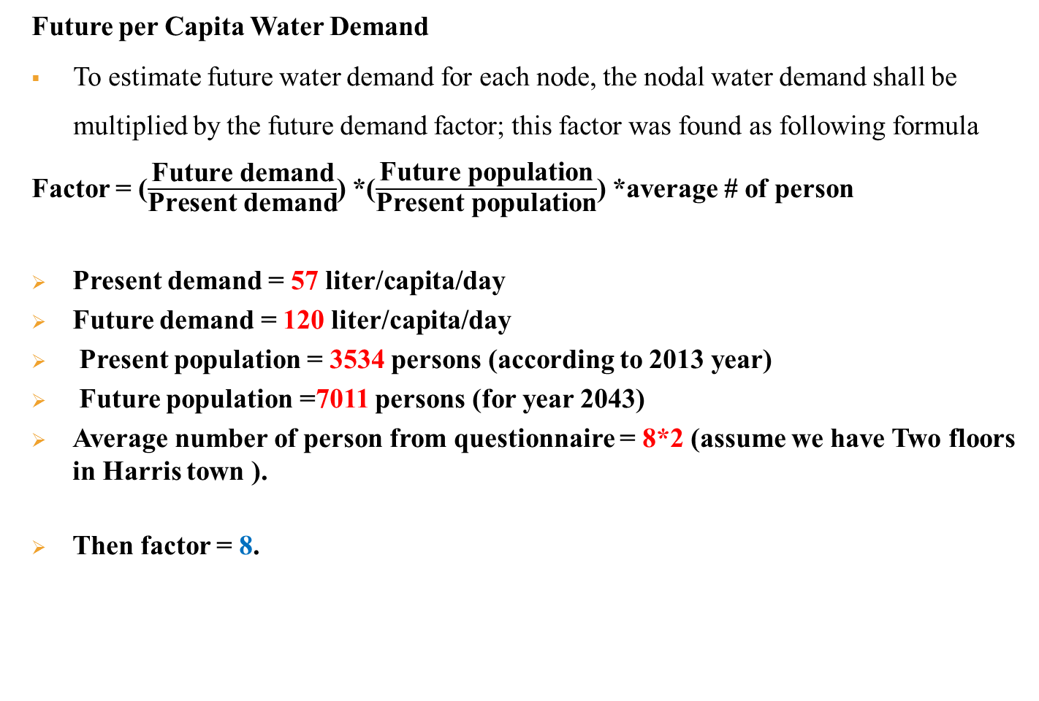
wdn analysis
Present vs. Future Per Capita Water Demand
Future per Capita Water Demand
To estimate future water demand for each node, the nodal water demand shall be multiplied by the future demand factor; this factor was found as following formula
Factor = ($\frac{\text{Future} \text{demand}}{\text{Present} \text{demand}}$) *($\frac{\text{Future} \text{population}}{\text{Present} \text{population}}$) *average # of person
Present demand = 57 liter/capita/day
Future demand = 120 liter/capita/day
Present population = 3534 persons (according to 2013 year)
Future population =7011 persons (for year 2043)
Average number of person from questionnaire = 8*2 (assume we have Two floors in Harris town ).
Then factor = 8.

Slide 16
WDN Analysis
Calculate the demand for each node:
J-16: Number of houses=6
Demand=6*8 =48 m³/day

Slide 17
Design wdn
Harris WDN
33 nodes
38 Pipes
4 Loops
Reservoir = 406

Slide 18
Output data description
Table 7.4b: The pressure head, demand, and elevation for nodes when the reservoir supply the network directly (without tank).

Slide 19
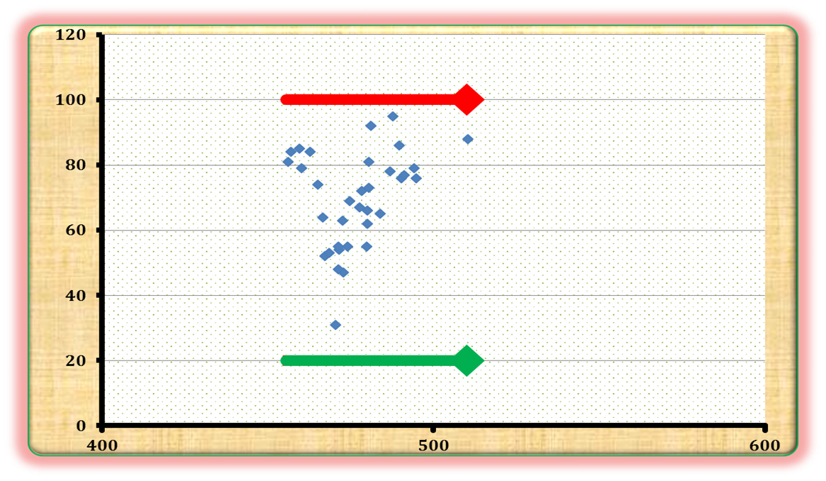
Output data description
Figure : the pressure head at nodes when the reservoir supply the network directly (without tank).

Slide 20
Output data description
Table 7.4c: The velocity and diameter for each pipe

Slide 21
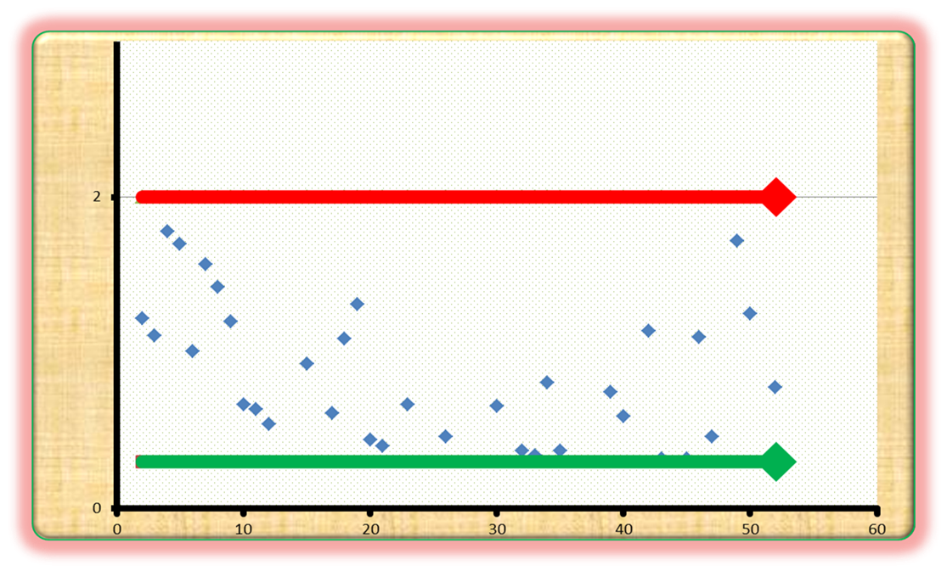
Output data description
Figure 7.3.c: velocity for each pipe when the reservoir supply the network directly (without tank).

Slide 22
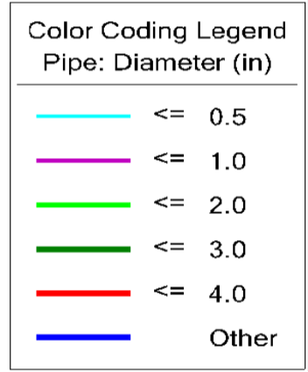
Design wdn

Slide 23
Output data description
Table 7.6a: The pressure head, demand, and elevation for nodes when the reservoir supply tank and the tank supply the network

Slide 24
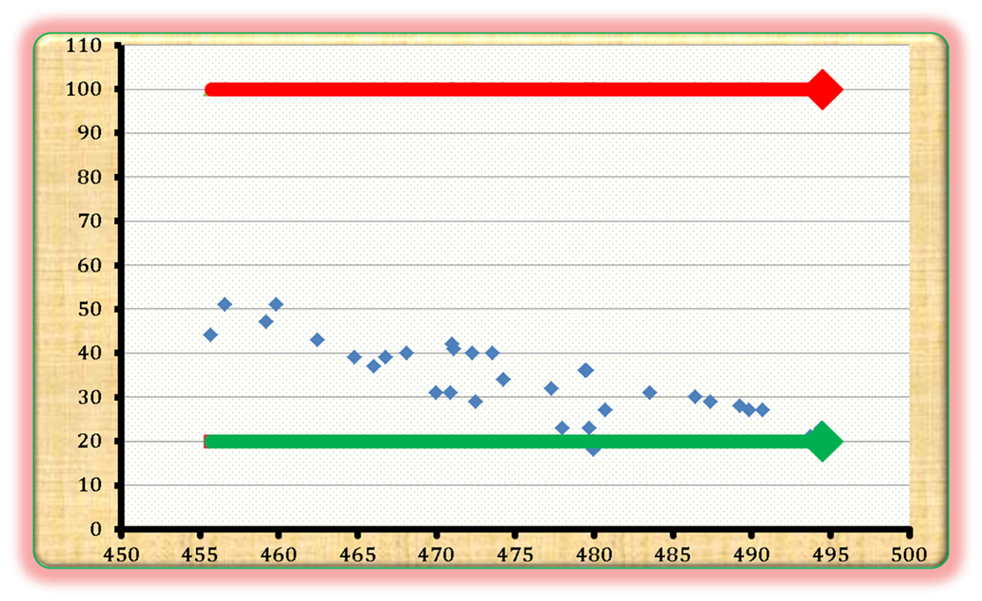
Output data description
Figure7.5a : the pressure head at nodes when the reservoir supply tank and the tank supply the network

Slide 25
Output data description
Table 7.6b: The velocity and diameter for each pipe

Slide 26
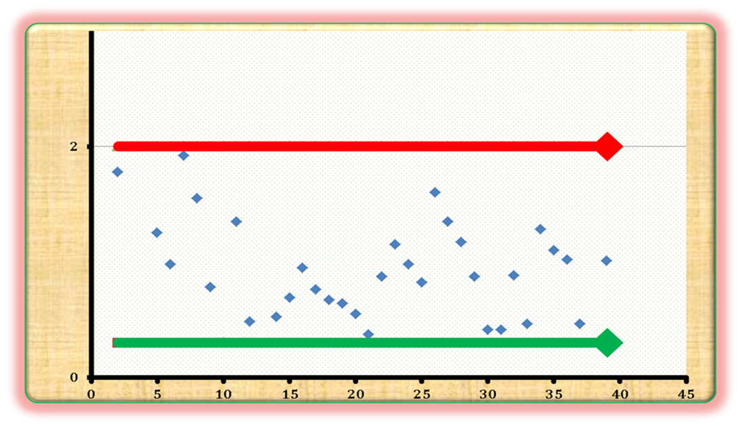
Output data description
Figure 7.5b: Velocity for each pipe

Slide 27
Design wdn

Slide 28
Design of tank
The daily consumption is 800 cubic meter.
We are design the elevated tank for storing 400 cubic meter.
The dimension of tank is :
Area equal 100 m² ( 10*10).
height = 4 m.

Slide 30
Recommendation and conclusion
In model one(reservoir feed the network directly)
Maximum velocity in the network equal 1.78 m/s and the minimum velocity 0.32 m/s .so Velocities in all pipes satisfy the criteria(0.3-2)m/s
Maximum pressure in the network equals 95 m (9.5bar) and the minimum pressure equal 31 m (3.1bar) so the pressures in all junctions satisfy the criteria(20-100)m.

Slide 31
Recommendation and conclusion
In model two (reservoir supply tank and the tank supplying the network)
We solve problems of pressure by:
Pressure head has equal 16 bar (160 m) at reservoir.
Using elevated tank at height 8 m.
Maximum velocity in the network equal 1.92 m/s and the minimum velocity 0.3 m/s .so Velocities in all pipes satisfy the criteria.
Maximum pressure in the network equals 51 m (5.1bar) and the minimum pressure equal 18 m (1.8bar) so pressure in all junctions satisfy the criteria, although 18 m is less than min 20 m. it is not important because this value for (J-18) located near the tank.

Slide 32
Recommendation and conclusion
For A comparison between model one and two:
For pipe-7, the velocity equal 1.92 m/s for model two, and 1.57 m/s for model one.
We choose the second design. Because this system has major water source (reservoir) and tank, which stores water for half of day that equal 400 cubic meters. Thus in the event of a stop in the water supply, tank will be supplying the network. The pressure values in the model two are lower than the values in model one and this mean using small diameter which leads to less cost.

Slide 33
THANKS FOR YOUR ATTENTION
Thank You…

