Slide 1

An-Najah National University
Facility Of Engineering And Information Technology
Department of Building Engineering
Graduation Project 1
An Integrated Design for Municipal Development & Lending Fund Building
.
Prepared By: Raghda Jaradat.
Tasneem Abu Zant.
Lina Shakhshir.
Submitted To: Dr. Ahmad Haj Saleh.

Slide 2
Content:
Introduction and site analysis
Architectural design
Environmental design
Structural design
Electrical design
Safty design
Quantity surveying
Mechanical design

Slide 3
Introduction:
This project is an integrated design for a municipal development &lending fund building, located in Ramallah city .
This building has eight floor ,
The total area of the building = 2730 m2

Slide 4
Site analysis

Slide 5
Project location
And
adjacent building
Sun path , wind
And noise
The shading

Slide 6
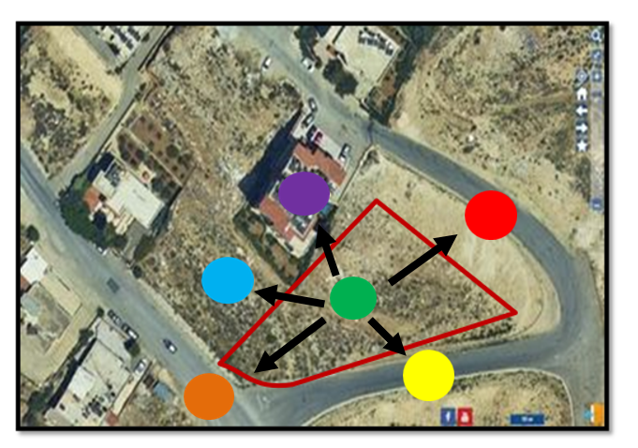
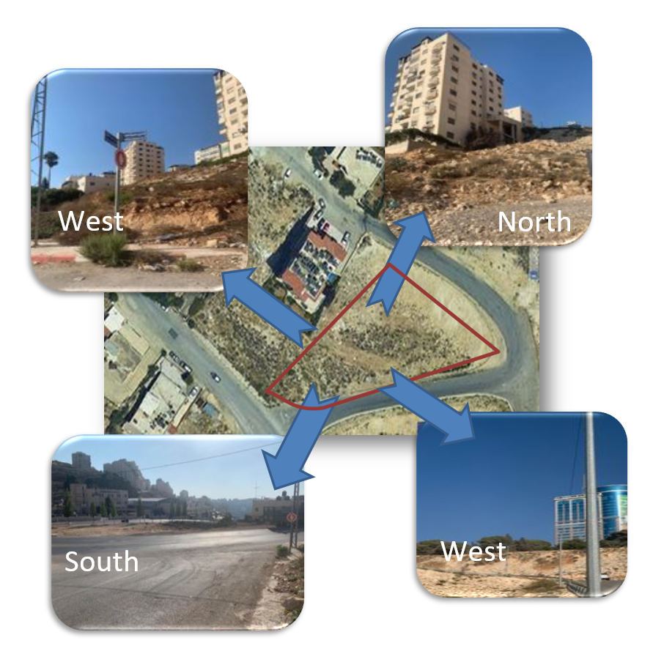
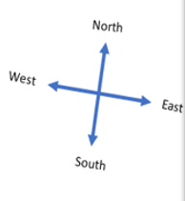
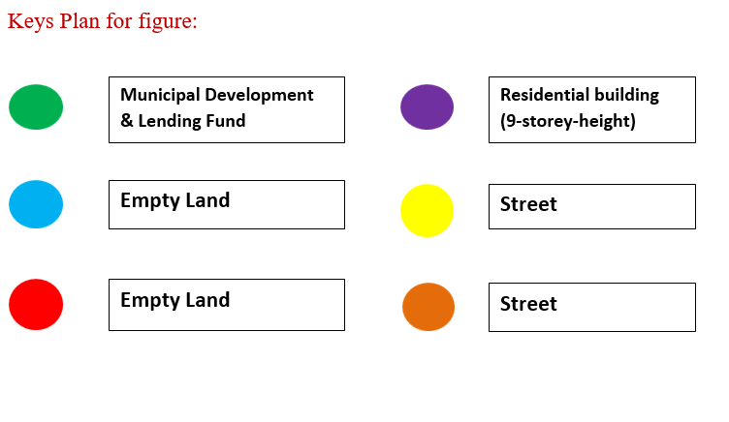
Project location and adjacent building:

Slide 7
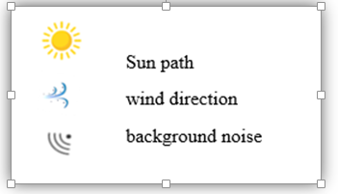
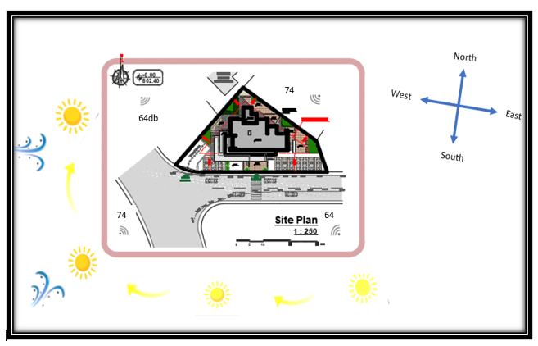
Sun path, wind and noise :

Slide 8
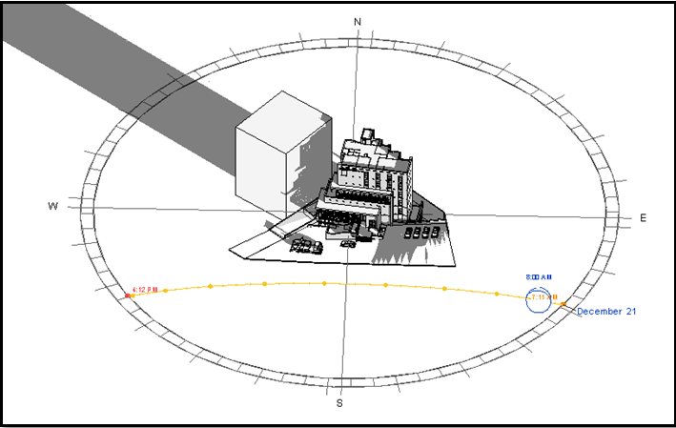
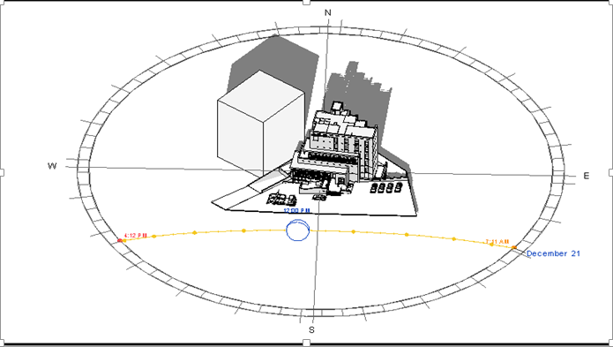
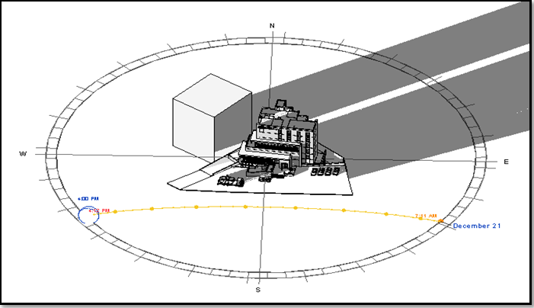
Shading:
At 21st December at winter
At 8:00AM
At 12:00PM
At 4:00PM

Slide 9
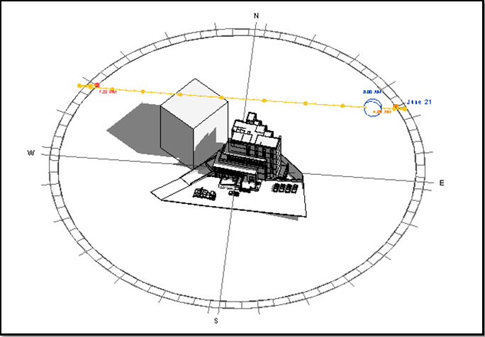
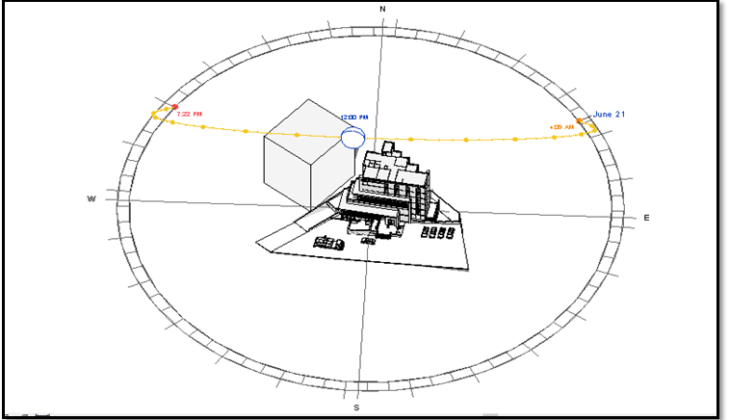
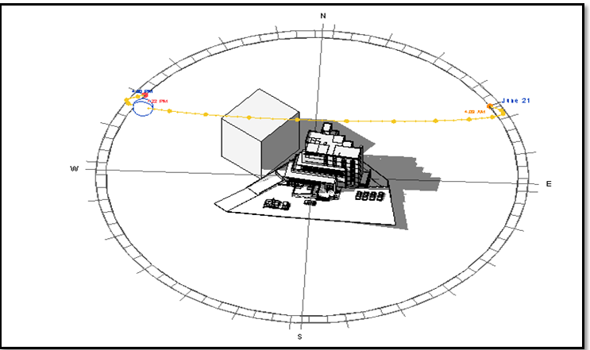
At 21st June at summer

Slide 10
Architectural aspects:

Slide 11
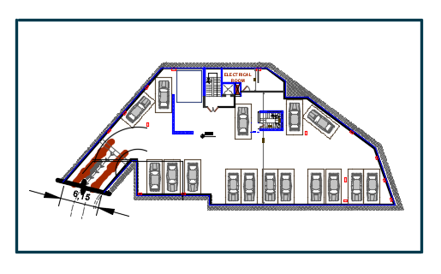
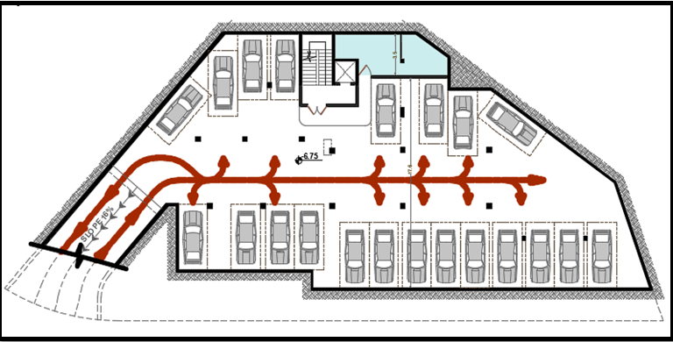
The architectural plans before and after modification:
Basement 2:
Before modification
After modification

Slide 12
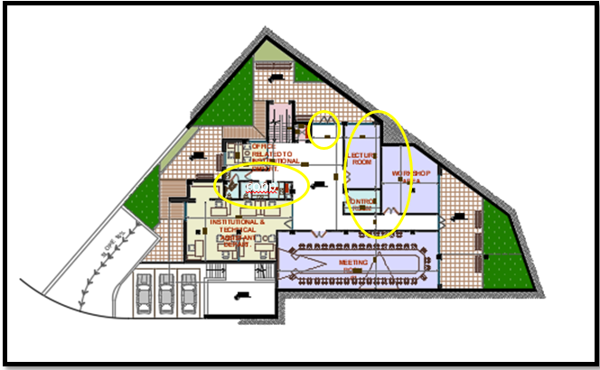
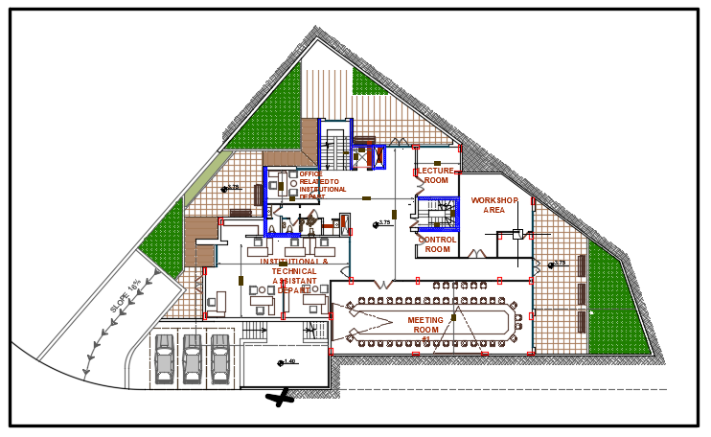
Basement 1 :
Before modification
After modification

Slide 13
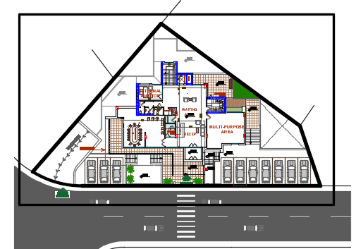
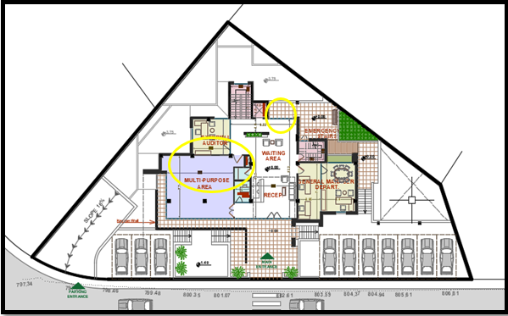
Ground floor :
Before modification
After modification

Slide 14
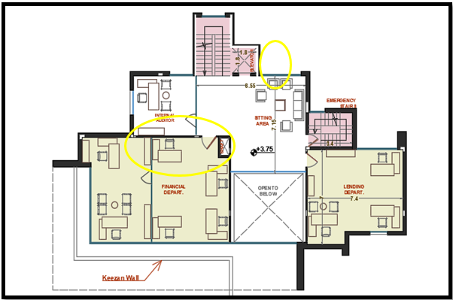
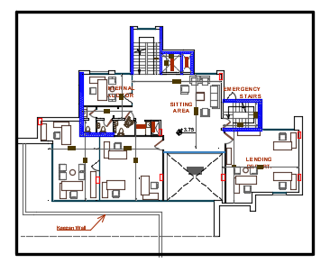
First floor :
Before modification
After modification

Slide 15
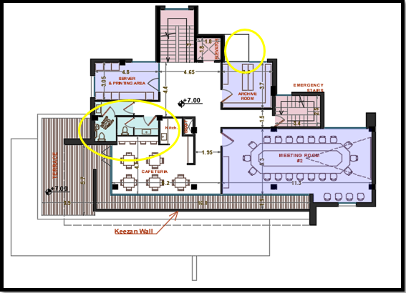
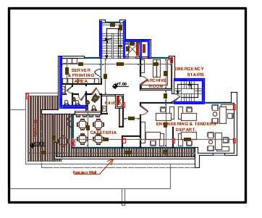
Second floor :
Before modification
After modification

Slide 16
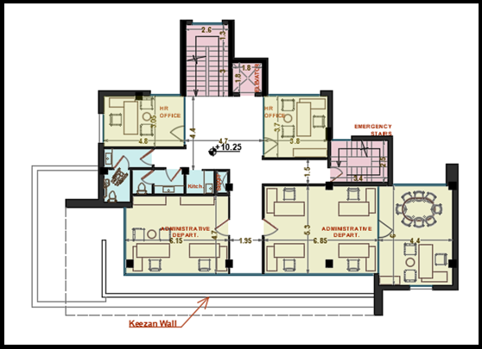
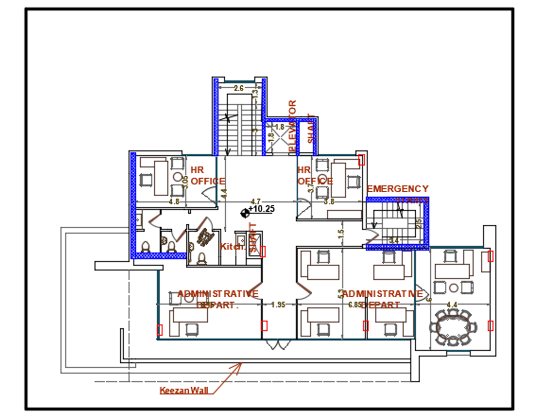
third floor :
Before modification
After modification

Slide 17
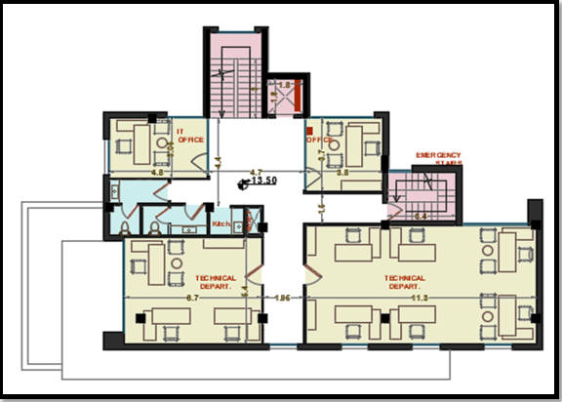
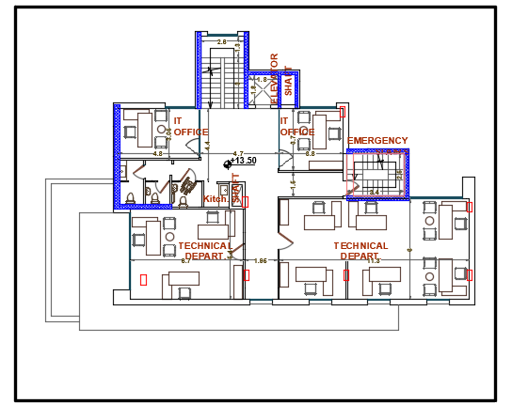
Forth floor :
Before modification
After modification

Slide 18
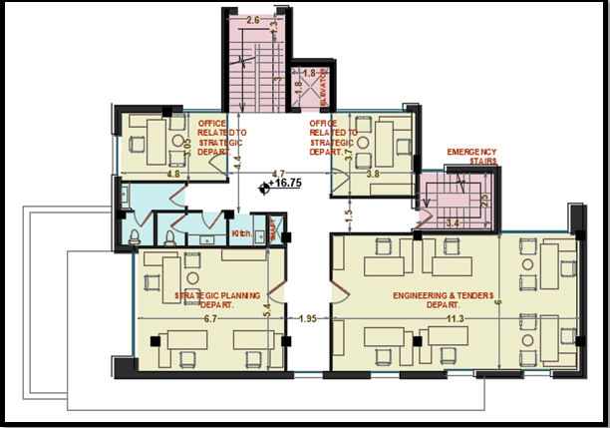
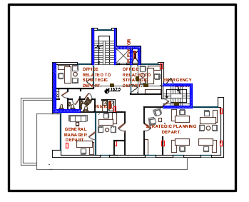
Fifth floor :
Before modification
After modification

Slide 19
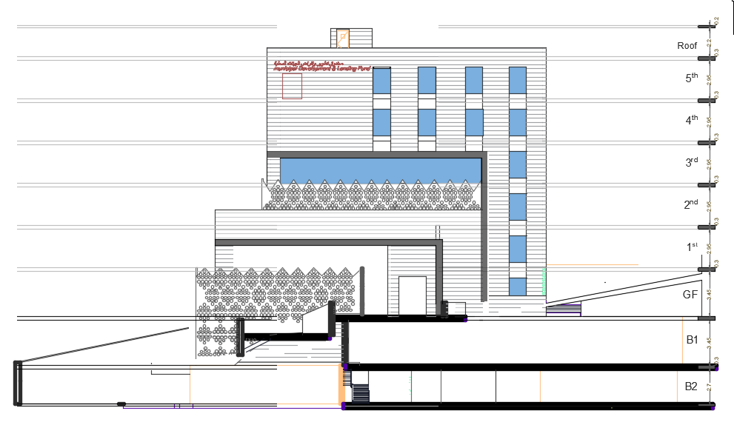
Elevations:
South
After modification

Slide 20
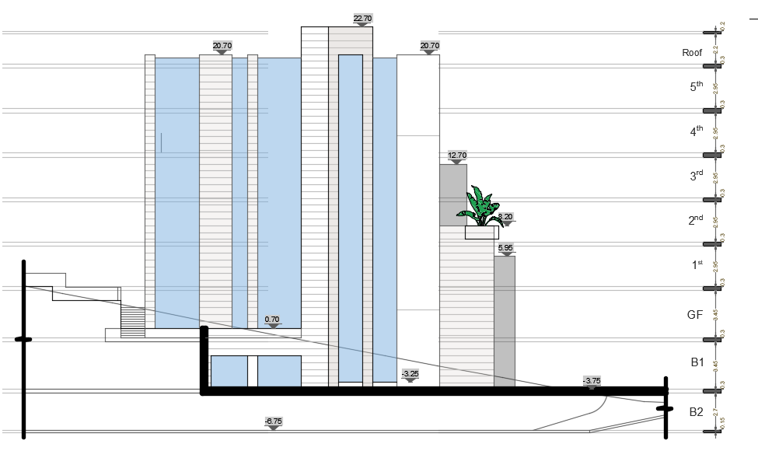
North :

Slide 21
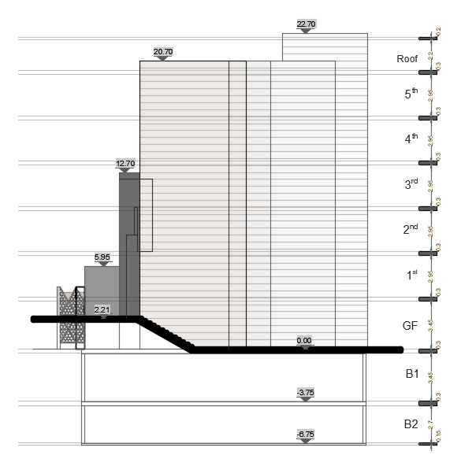
East :

Slide 22
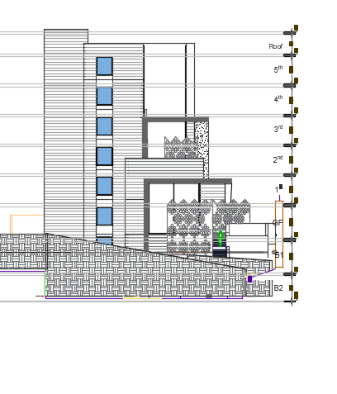
West :
After modification

Slide 23
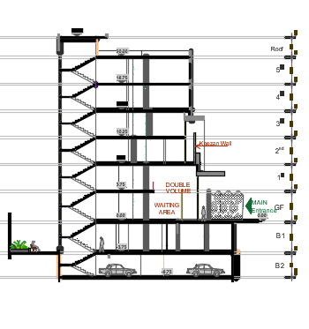
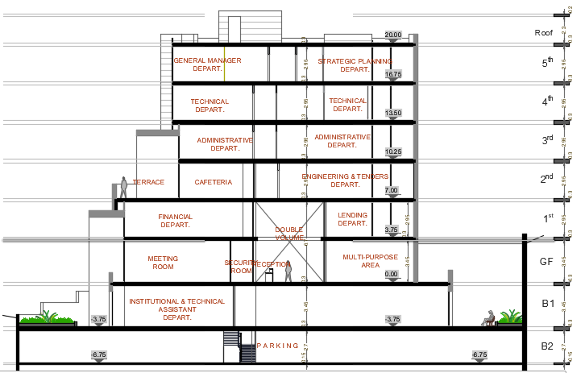
Sections:
Section A-A
Section B-B

Slide 24
Environmental aspects:

Slide 25
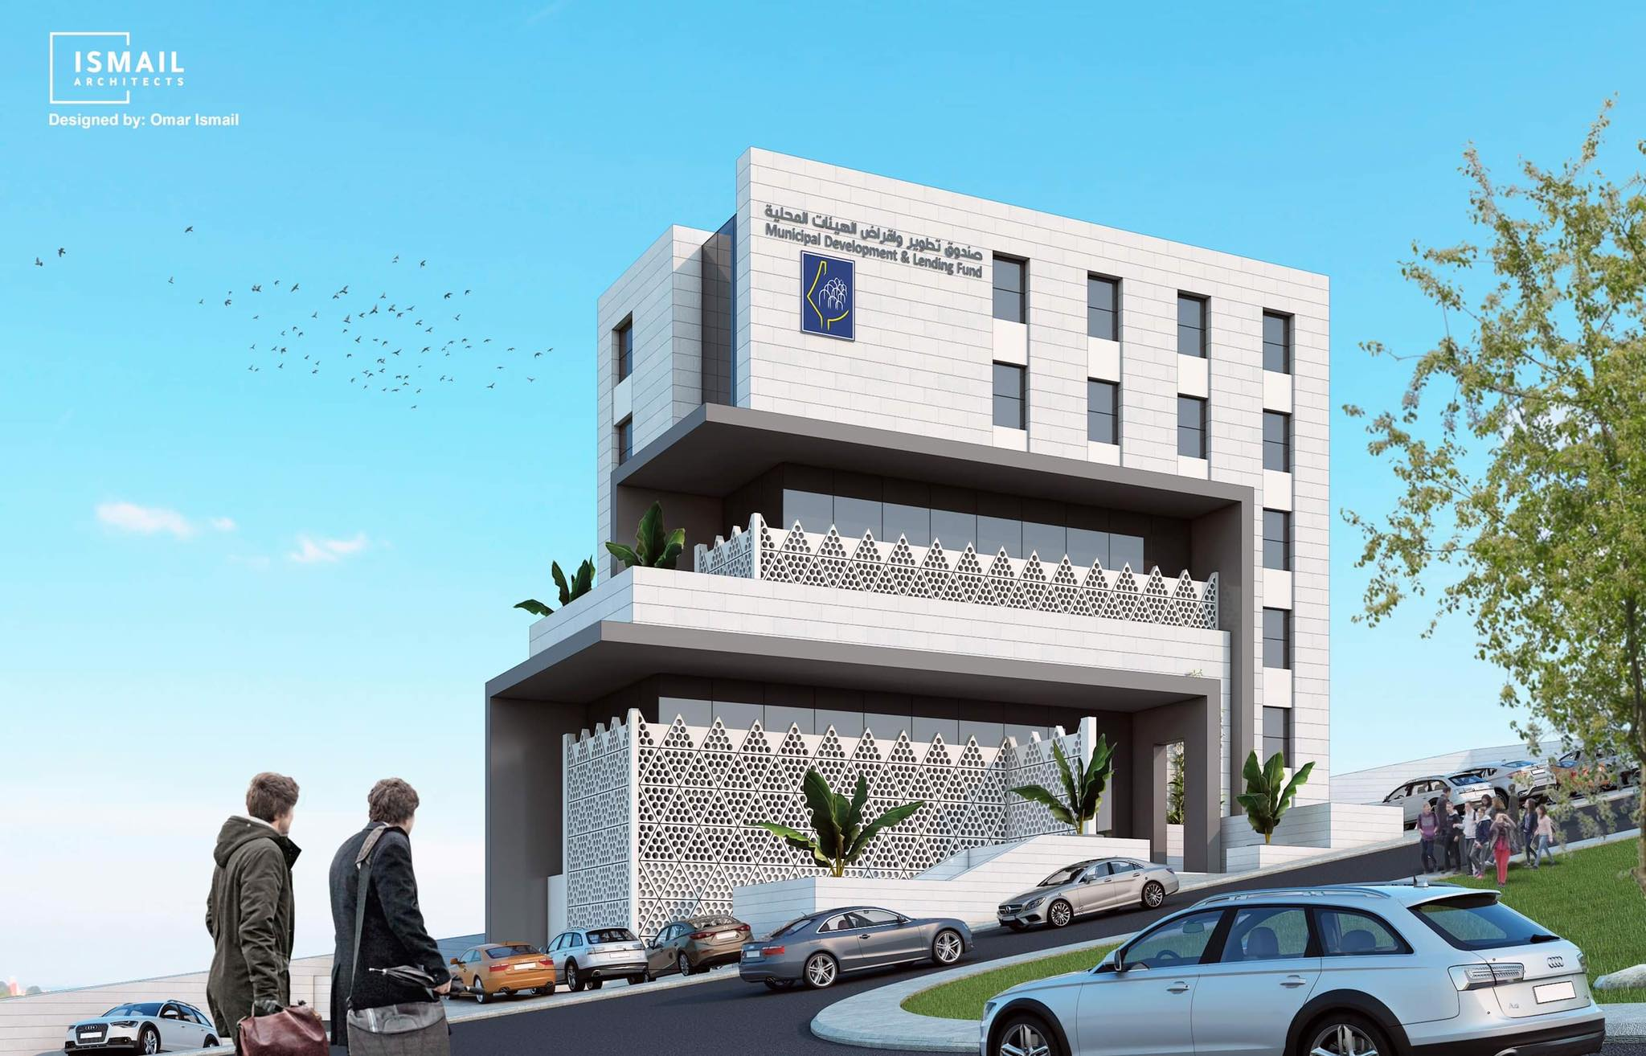
Introduction:
Kezan wall:

Slide 26
The basic parameter in environmental aspects:
Daylight factor
Heating and cooling

Slide 27
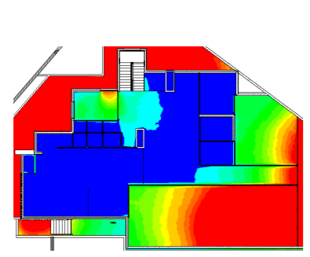
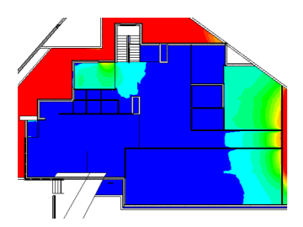
Basement 1 :
Before modification
After modification

Slide 28
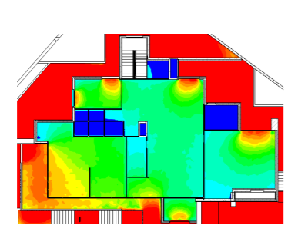
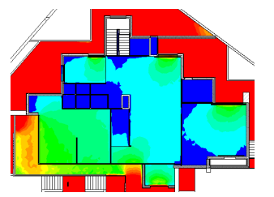
Ground floor :
Before modification
After modification
After modification the daylight factor was improved because we used many solution like:
Blackout the glass
Use curtains.

Slide 29
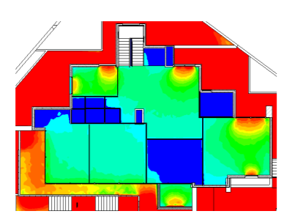
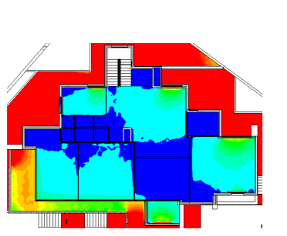
First floor:
Before modification
After modification

Slide 30
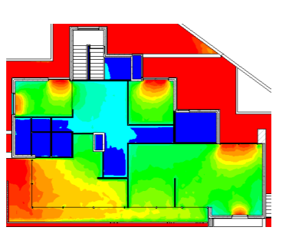
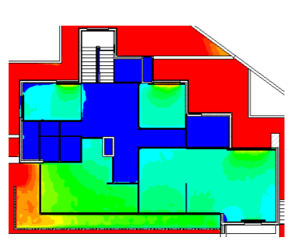
Second floor :
After modification
Before modification

Slide 31
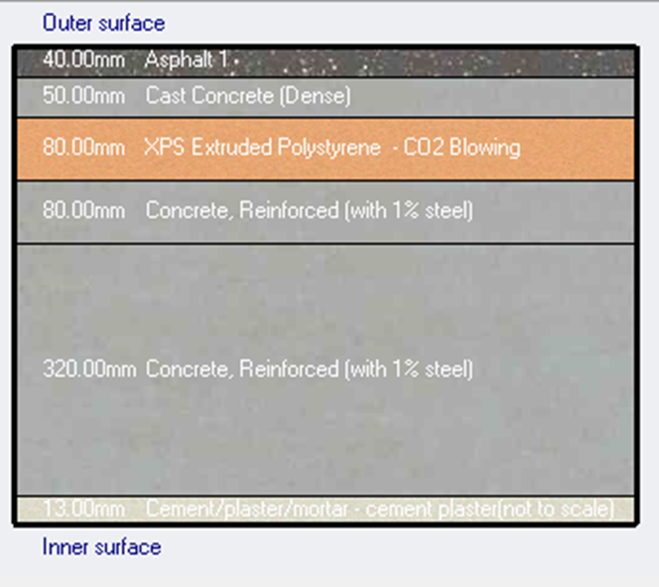
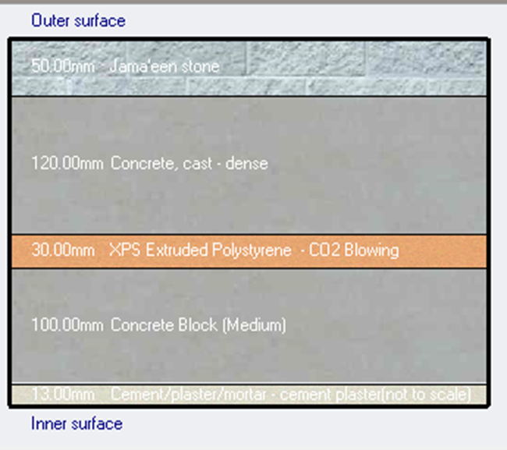
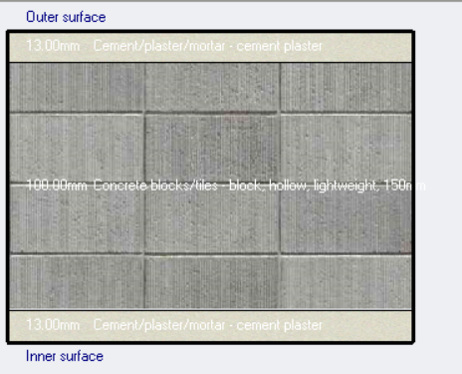
materials used
External wall
Internal partition
Flat roof

Slide 32
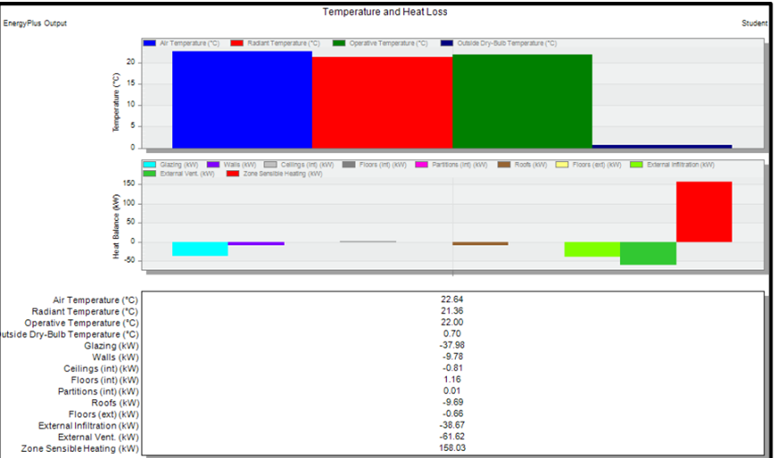
Heating and Cooling load

Slide 33
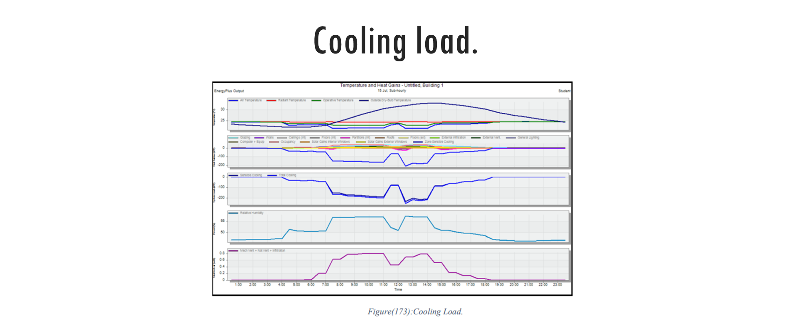

Slide 34
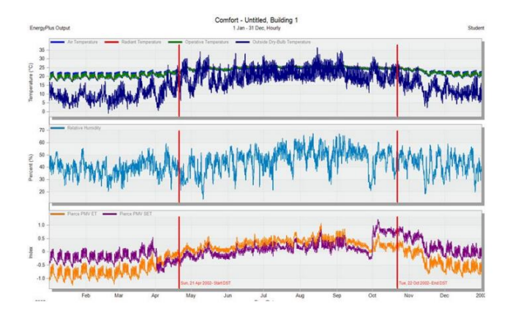
Thermal comfort:

Slide 35
Structural Aspects:

Slide 36
General information
Codes:
ACI-318-19
materials
Concrete 28MPa
Steel 420MPa
loads
Live load =3.90KN/m2
SID =4.5KN/m2
Concrete brick wall = 18KN/m2
slab
one way ribbed slab

Slide 37
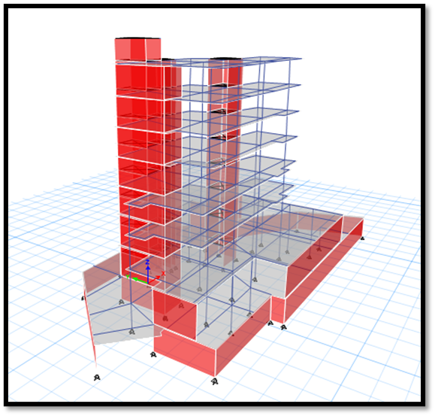

3D Model :

Slide 38
Checks:
ETABS Checks
To ensure that the calculation is done correctly and to adopt the design results from ETABS; some checks are required:
compatibility check
Equilibrium check
Stress-strain check
period check
deflection check
drift check
Modal mass participate ratio check (MPMR)
All checks were done for the three parts and all were acceptable.

Slide 39

Compatibility check :

Slide 40
Equilibrium check:
Error % | Etabs Results (KN) | Manual calculation(KN) | Load
0% | 11536.8451 | 11537.17 | Live load
0% | 11363.4177 | 11362.820 | SID
2.5% | 20115 | 19615.409 | Dead load

Slide 41
Internal force check:
Stress strain check:
column check:
Error % | Etabs result(KN) | Manual calculation (KN)
2.723 % | 4671.2682 | 4547.457
Slab check:
Error % | Etabs result (KN) | Manual calculation (KN)
4.1% | 31.245 | 32.585

Slide 42

Seismic check
period check
Base-shear check
Drift check
Seismic zone:2A
Soil profile: SD
Ca=0.22
Cv=0.32
R=5.5

Slide 43

Period Check
Tmanual = 0.868
Tetabs = 0.879 Tetabs < T manual

Slide 44

Base shear Check
W=38530.99
V Manual= 2550.402

Slide 45

Drift check:

Slide 46




Design of structural elements
Columns
Details of column 600 x 300
Details of column 600x600
longitudinal section for column (60*30).

Slide 47


Design of slabs:
Reinforcement for slabs.
Additional Top reinforcement in Horizontal direction (for zones above the minimum)

Slide 48

One way ribbed slab

Slide 49

Reinforcement

Slide 50


Beams
Beams Dimention = 350 x 800
Types of beam : Hidden beam.

Slide 51


Shear walls:

Slide 52


Reinforcement for shear wall

Slide 53


Footing

Slide 54

Stairs

Slide 55



Water Tank
Top Reinforcement for water tank
Section A-A for water tank.

Slide 56


Basement wall

Slide 57

Electro-Mechanical Aspet

Slide 58







Electro-Mechanical aspects

Slide 59

Artificial lighting

Slide 60







Slide 61








Slide 62




Slide 63


Slide 64


For Reception
And waiting area
Lux>400
Glare <22
Uniformity >.6
Standard lighting design
Lux =727lux
Glare =12
Uniformity =.2
DIALux results
lighting in reception and
Waiting area
Lux =727>400lux
Glare 12<22
Uniformity .2<.6

Slide 65


Slide 66


Slide 67


Slide 68



Slide 69


Slide 70



Acoustical design - INSUL9.0 program
For interior partitions
For Ceiling

Slide 71


Acoustical design - INSUL9.0 program
For external glass wall
For floor

Slide 72


Acoustical design -EASE program
Model of speaker
Speaker specification

Slide 73


Results of simulations
Meeting room model from EASE
Meeting room Reverberation time

Slide 74

The number of speaker in meeting room
Area of multipurpose hall= 48.90m².
Clear height = 3.30m.
tan$\frac{θ}{2}$ = $\frac{x}{2.1}$
x = 3m
The coverage area for the speaker = 3² × π=28.26 m ².
The number of speaker = (Area of meeting room)/(Coverage area ) =48.90/28.26= 2 Speakers

Slide 75


Results of simulations
Meeting room STI
Meeting room Articulation loss

Slide 76


Results of simulations
Meeting room sound pressure level
Meeting room total SPL

Slide 77
Drainage system
Black water
Gray water
Rain water

Slide 78


Slide 79


Slide 80



Drainage fixture units(DFU's )
Black water
Gray water

Slide 81

The diameter, slope and pipe type

Slide 82
Water supply system
Types of pipes:
Steel for Vertical pipes
PVC for horizontal and branch pipes

Slide 83


Pipes diameter :

Slide 84

HVAC system
VRF system has been considered
Design capacity = 322.65
• Heating load capacity
252.61 KW
• Cooling load capacity
322.65 KW

Slide 85


Slide 86


Sample of calculation
Volumetric flow rate for third floor spaces
Volumetric flow rate for forth floor spaces

Slide 87



Slide 88


Slide 89


Slide 90


hvac system
Third floor
Forth floor

Slide 91


hvac derange
Third floor
forth floor

Slide 92


Slide 93

Power Design

Slide 94

power design

Slide 95




Used fire fighting system:
1- Sprinkler system
2- Estinguisher system
3- Fire hose station
4- FM200
5- Fire alarm system

Slide 96

Fire alarm system

Slide 97


Slide 98

Total unit cost = 1774.36 / m2

Slide 99




Slide 100



Slide 101


