Slide 1

An-Najah National University
Engineering Collage
Civil Engineering Department
Foundation design of Al-Wasef complex
Under the Supervision of:
Dr. Sami Al Hijjaw
Prepared by:
Mohammad Shalabi
Ahmed Al- Qasarwah
Iman Bani Shamseh
May 2012

Slide 2
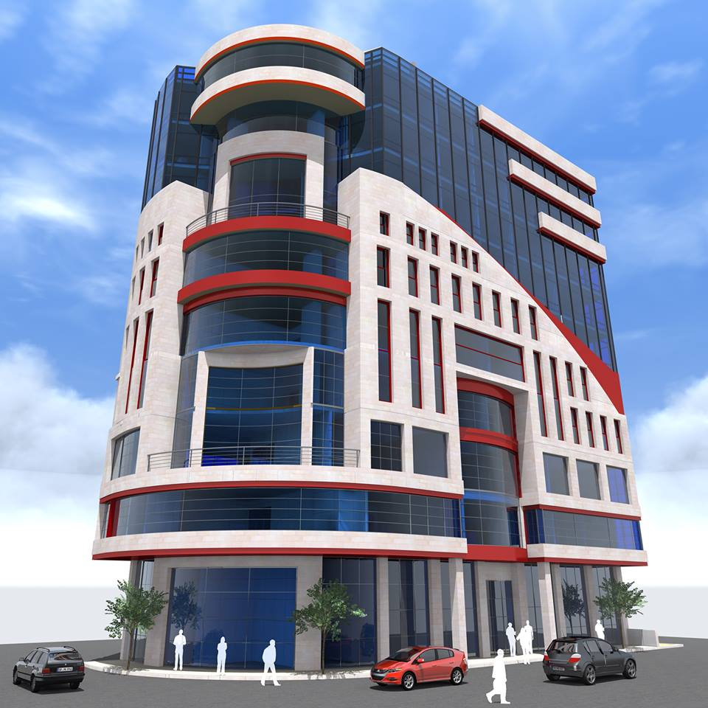

Slide 3
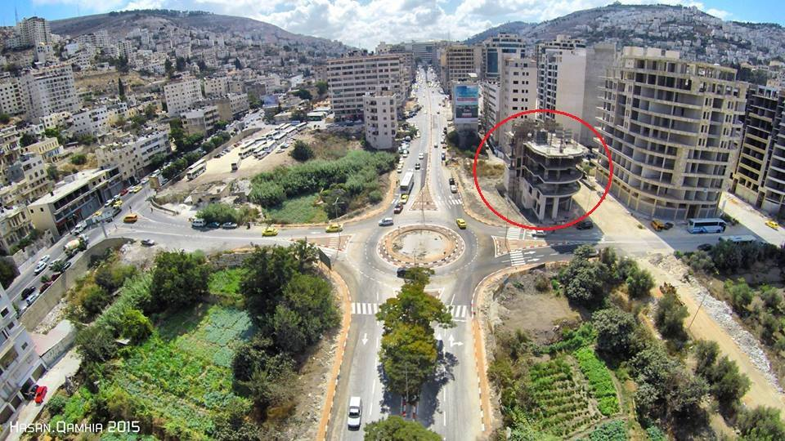

Slide 4
Project Description
Type of the building: commercial building .
Location: Nablus city, In Albsateen region, near to the west lot.
Number of stories: 13 story, 3 stories settle below ground(basement) , one story at the level ground , and 9 stories above the ground.
Total area of the building: 6400m² .

Slide 5
Scope of Project
Select the most suitable types of foundations for the project.
Design the selected footings.
Estimate costs of the foundations designed.
Foundations are the part of building which receive and transmit the loads to the supporting soil or rocks.

Slide 6
Many factors should be taken into consideration in choosing foundation types such as soil properties , economic factors, engineering practice, ....etc .
There are two types of foundations : shallow & deep foundations.

Slide 7
Types of shallow foundation
Isolated Footing.
Combined Footing.
Mat or Raft Foundations.
Strap or Cantilever Footings.

Slide 8
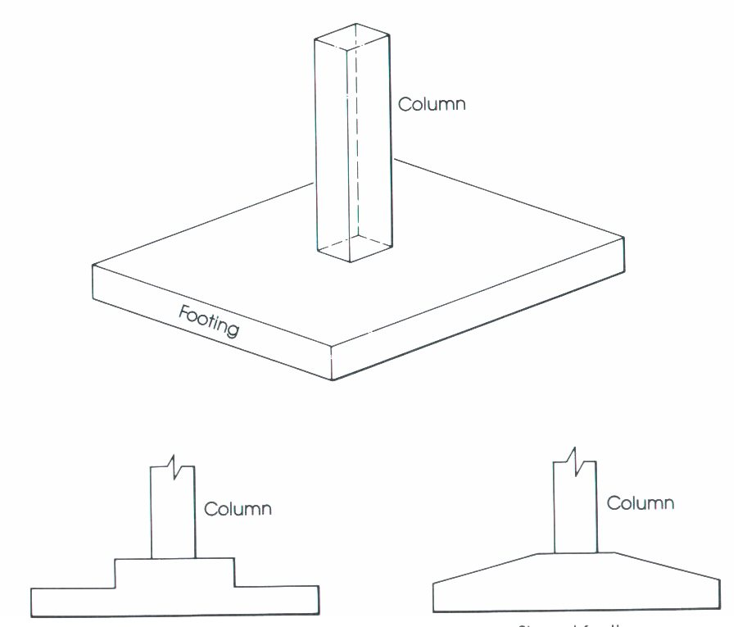
Isolated Footings
Are used to support single columns.
This is one of the most economical types of footings and is used when columns are spaced at relatively long distances.
Its function is to spread the column load to the soil , so that the stress intensity is reduced .

Slide 9
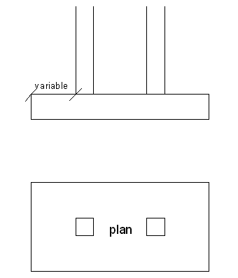
Combined footing
1) When there are two columns so close to each other & in turn the two isolated footing areas would overlap.
2) When the combined stresses are more than the allowable bearing capacity of the soil.
3) When columns are placed at the property line.

Slide 10
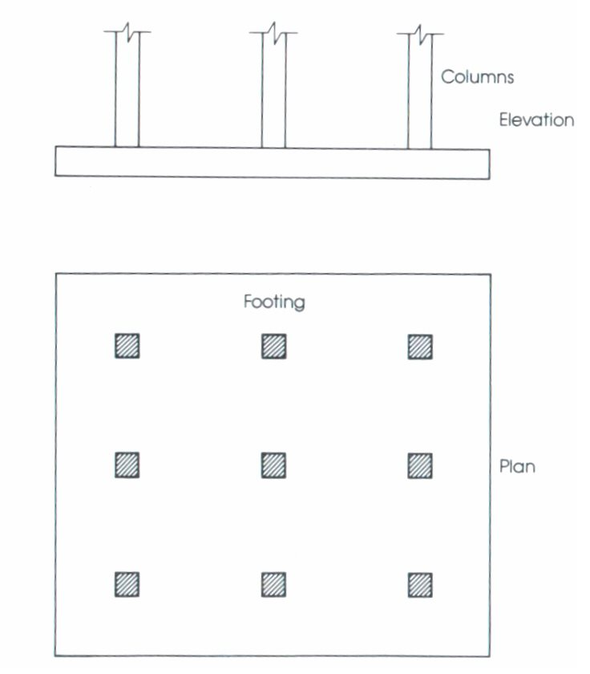
Mat or Raft Foundations
Are used to spread the load from a structure over a large area, normally the entire are of the structure .
They often needed on soft or loose soils with low bearing capacity as they can spread the loads over a larger area.
They have the advantage of reducing differential settlements.

Slide 11
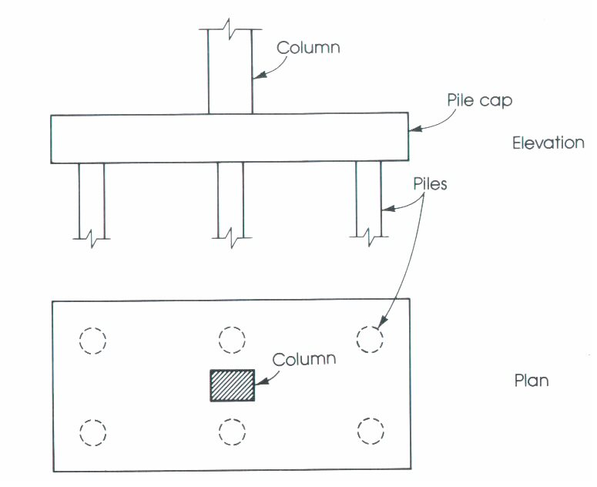
Deep foundation- pile footing
They are long & slender members that are used to carry & transfer the load of the structure to deeper soil or rocks of high bearing capacity, when the upper soil layer are too weak to support the loads from the structure.
Piles costs more than shallow foundations; so the geotechnical engineer should know in depth the properties & conditions of the soil to decide whether piles are needed or not.

Slide 12
Bearing capacity
Bearing capacity is the ability of soil to support a load from structural foundation failure or differential settlement.
There are three modes of failure that limit bearing capacity:
General shear failure.
Local shear failure.
Punching shear failure.

Slide 13
Geotechnical investigation
The investigation report obtained at ARABEX office.
Three bore holes were drilled to the depths of ( 15, 15 , and 20) meter .
Representative samples were tested:

Slide 14
Results of soil testing
Borehole No. | Depth (m) | Moisture Content (%) | Passing 200 (%) | PI | Cohesion (KN/m²) | Angle of Internal frictionᶲ (°)
1 | 0.0-7.0 | 18.6 | 78 | 15.7 | 12 | 15
 | 7.0-20.0 | 9.2 | - | NP
2 | 0.0-0.50 | 14.7 | 82 | 11.3
 | 0.50-2.5 | 19.1 | 74 | 10.6
 | 2.5-15.0 | 16.8 | 79 | 17.4 | 10 | 15
3 | 0.0-0.50 | 12.5 | 80 | 12.2
 | 0.50-2.5 | 18.3 | 73 | 11.8
 | 2.5-15.0 | 19.4 | 83 | 18.7 | 12 | 15

Slide 15
Result
According to the results of soil testing ,by using Terzagi equation ,it`s found that the bearing capacity of soil is equal to 202 mega pascal (2kg/cm²) at a minimum depth of ten meters (10m) from street level

Slide 16
Recommendations
The bearing capacity on the surface of the foundation level should be 2.5 kg/ cm² ( improved to be in safe side)
Recommended foundation type : mat or raft foundation .
It recommended to protect the building from the effects of water and prevent water to reach under foundation .

Slide 17
Structural design
Column loads are calculated using (sap program), the structure subjected to the following loads:
1) Dead Load (own weight).
2) Super imposed dead load =300 kg/m2.
3) Live load =800 kg/m2.
Using ACI code, the ultimate loads are calculated considering
load combination :
Pu =1.2Dead + 1.6Live.
Material characteristics used in this project are:
f’c =280kg/cm2 (B 350)
Where:
f’c is the compressive strength of concrete
fy = 4200 kg/cm2
Where:
fy is the yield strength of steel

Slide 18
NO . Of | Ultimate
Column | Load (ton)
C1A | 1223
C1B | 1120
C1C | 1140
C1D | 850
C2A | 800
C2B | 884
C2C | 850
C2D | 818
C3A | 500
C3B | 636
C3C | 640
C3D | 610
C3E | 680

Slide 19
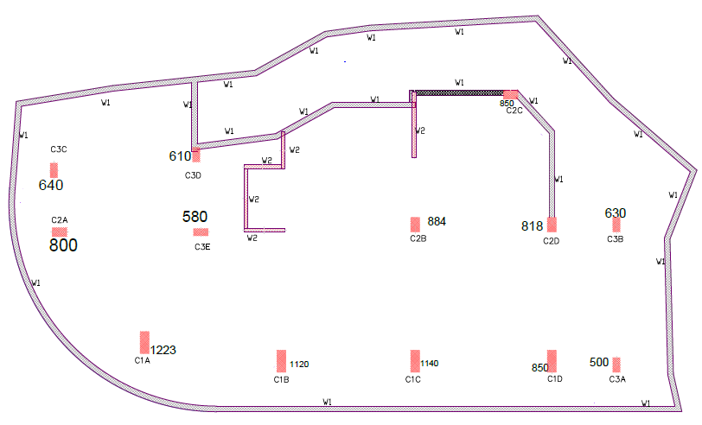

Slide 20
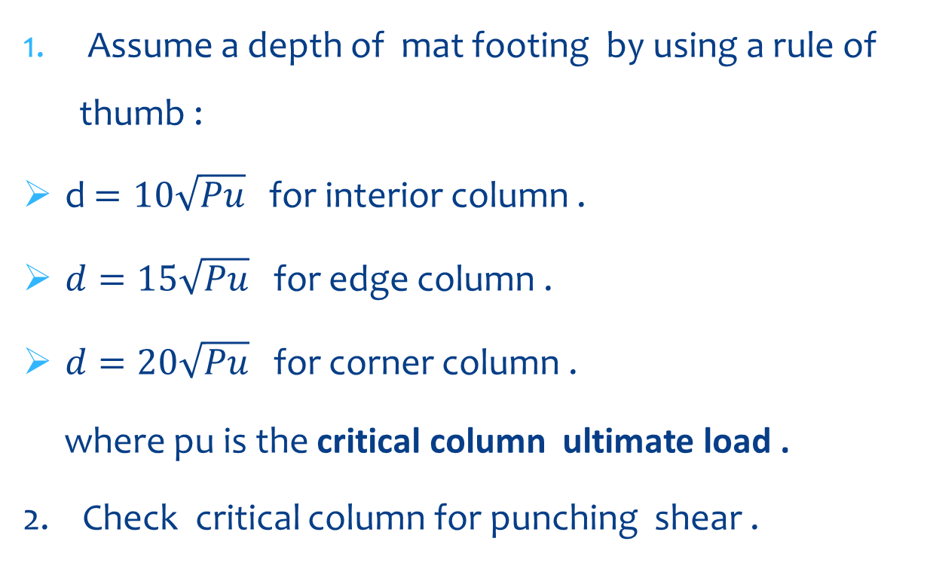
To find the depth of foundation:
Assume a depth of mat footing by using a rule of thumb :
d $=10\sqrt{Pu}$ for interior column .
$d=15\sqrt{Pu}$for edge column .
$d=20\sqrt{Pu}$for corner column .
where pu is the critical column ultimate load .
2. Check critical column for punching shear .

Slide 21
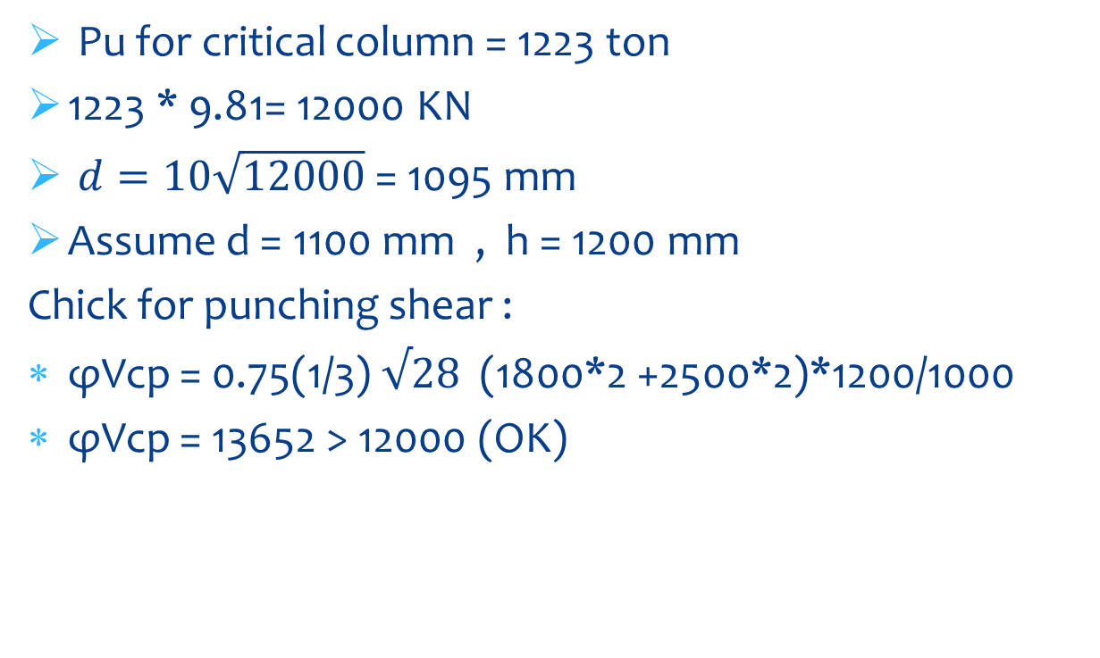
To find the depth of foundation:
Pu for critical column = 1223 ton
1223 * 9.81= 12000 KN
$d=10\sqrt{12000}$ = 1095 mm
Assume d = 1100 mm , h = 1200 mm
Chick for punching shear :
φVcp = 0.75(1/3)$√28$ (1800*2 +2500*2)*1200/1000
φVcp = 13652 > 12000 (OK)

Slide 22
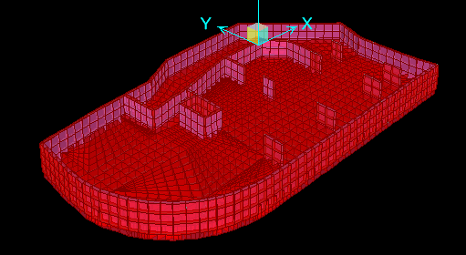
3D – Mat Foundation

Slide 23
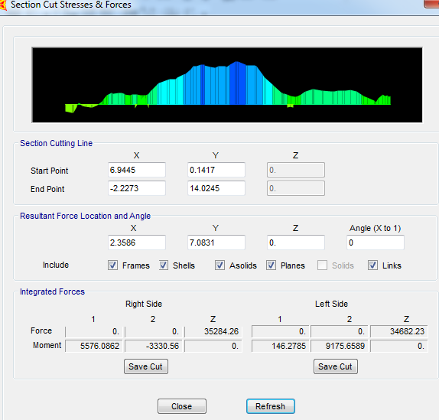
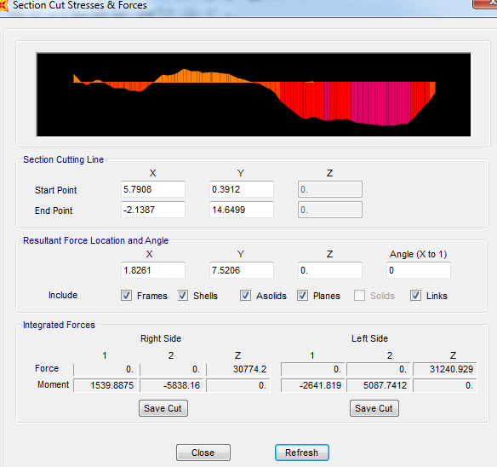
Maximum moment in (X) and (Y)directions
The values of maximum moment in (X),(Y) directions are taken from SAP14.The figures below show the moment in (X),(Y) direction.

Slide 24
Reinforcement
reinforcement in x direction:
we take the maximum moment at the face of columns
the area of reinforcement will calculate by the
Equation:
As =p*b*d
1)at the face of column (from Sap program)
Mu =1100KN.m/m
Use ρmin=0.0077
As = 0.0033 * 1000 * 1100 = 3630 mm²
use 10Ф18 mm/m
Also between the columns use 10Ф18 mm/m

Slide 25
Reinforcement
reinforcement in y direction:
we take the maximum moment at the face of columns
the area of reinforcement will calculate by the
Equation:
As =p*b*d
1)at the face of column (from Sap program)
Mu =1600KN.m/m
Use ρmin=0.0033
As = 0.0033 *1000*1100= 3630 mm²
use 10Ф18 mm/m
Also between the columns use 10Ф18 mm/m

Slide 26
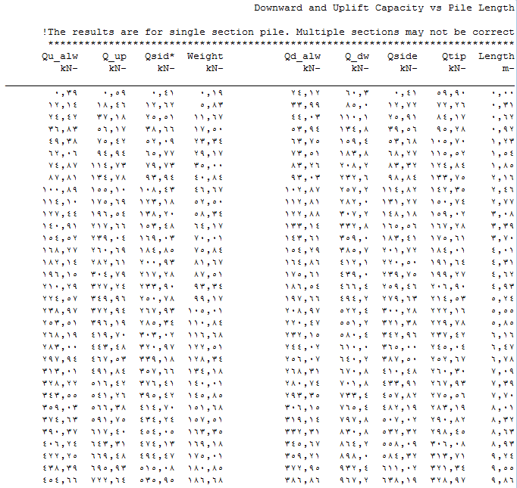
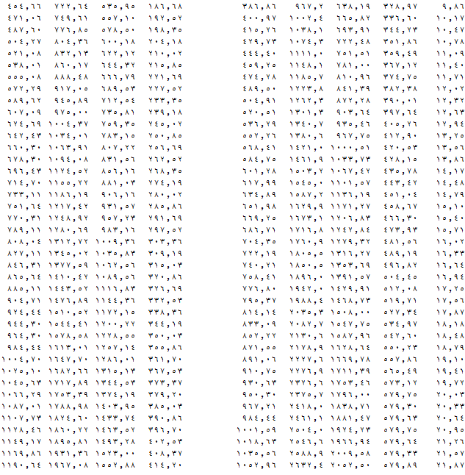
PILES FOUNDATIONS
Design of Piles:
A computer program called AllPiles is used to prepare allowable bearing capacity with each pile length and diameter, table below shown the result:

Slide 27
Dimensions of piles and capacities (KN)
Diameter in m Length in m | 14 | 16 | 18 | 20
0.6 | 308 | 352 | 411 | 448
0.8 | 435 | 532 | 615 | 684
1 | 601 | 704 | 833 | 950

Slide 28
one types of piles is selected in the design of pile foundation in this project which has a diameter of 1 meter and a length of 20 meters :
The pile capacity of this pile = 950 KN

Slide 29
Table below shows the allowable applied load and the No. of piles with cap’s dimensions that each group of column has.
Column No | Service Load ( KN ) | Allowable capacity of pile (KN) | Service load / Allowable capacity | No. of piles | Dimension of cap(m*m)
C1A | 8570 | 950.3 | 9.018 | 9 | 6.3 * 6.3
C1B | 7848 | 950.3 | 8.258 | 8 | 6.3 * 6.3
C1C | 7988 | 950.3 | 8.406 | 9 | 6.3 * 6.3
C1D | 5956 | 950.3 | 6.267 | 6 | 6.3 * 3.8
C2A | 5606 | 950.3 | 5.899 | 6 | 6.3 * 3.8
C2B | 6194 | 950.3 | 6.518 | 7 | 6.3 * 6.3
C2C | 5956 | 950.3 | 6.267 | 6 | 6.3 * 3.8
C2D | 5732 | 950.3 | 6.031 | 6 | 6.3 * 3.8
C3A | 3503 | 950.3 | 3.683 | 4 | 3.8 * 3.8
C3B | 4415 | 950.3 | 4.645 | 5 | 6.3 * 6.3
C3C | 4485 | 950.3 | 4.719 | 5 | 6.3 * 6.3
C3D | 4274 | 950.3 | 4.497 | 5 | 6.3 * 6.3
C3E | 4765 | 950.3 | 5.014 | 5 | 6.3 * 6.3

Slide 30
Reinforcement Details of Piles
The equations below is used to determine the area of steel :
Calculate Mu
Mn = Mu/0.9
Mn = R*b*d² : Mn , b and d are known .
Find R
From ACI tables using the value of R we’ll find ρ
As = ρ * b * d

Slide 31
Example Of Design Cap
For column C1A:
P1U= Ultimate load on C1A = 12000 KN .
No. of pile around C1A= 9 piles .
12000KN/ 9piles = 1333 KN per each pile .
Shear force = 400 KN
Ultimate moment= 2.5 *4000 =10000KN.m
Mn= Mu/Ø = 10000/0.9=11100KN.m
Mn=Rbd˄2, for C1A :
R= 1.46 so p= 0.0036 then As= p*b*d= 0.0036 * 3600 * 1100= 14256 mm˄2

Slide 32
Cap reinforcement in two directions (main steel only ) is shown in table :
Cap Number | Reinforcement in long direction | Reinforcement short direction
Cap of C1A | 31Ø32 | 31 Ø32
Cap of C1B | 32Ø32 | 32Ø32
Cap of C1C | 31Ø32 | 31 Ø32
Cap of C1D | 24Ø32 | 14Ø16
Cap of C2A | 23Ø32 | 26Ø32
Cap of C2B | 26Ø32 | 26Ø32
Cap of C2C | 24Ø32 | 26Ø32
Cap of C2D | 24Ø32 | 26Ø32
Cap of C3A | 22Ø25 | 22Ø25
Cap of C3B | 18Ø25 | 18Ø25
Cap of C3C | 18Ø25 | 18Ø25
Cap of C3D | 18Ø25 | 18Ø25
Cap of C3E | 18Ø25 | 18Ø25

Slide 33
Comparison Of Costs
For pile footing
Quantity of all pile for concrete
The quantity of concrete in cubic meter (m˄3)
For each column:
Pile Volume = No. Of piles * length of pile
Area of pile = Π/4 * Diameter˄2
= Π/4 * 100˄2 = 7854 cm˄2 .
The table below summarized the quantity of estimation for all piles:

Slide 34
Volume of concrete for piles
NO . Of | NO . Of | Length of | Cross section | Total volume for
Column | Piles | pile (M) | area (M²) | each column (M³)
C1A | 9 | 20 | 0.7854 | 141.372
C1B | 8 | 20 | 0.7854 | 125.664
C1C | 9 | 20 | 0.7854 | 141.372
C1D | 6 | 20 | 0.7854 | 94.248
C2A | 6 | 20 | 0.7854 | 94.248
C2B | 7 | 20 | 0.7854 | 109.956
C2C | 6 | 20 | 0.7854 | 94.248
C2D | 6 | 20 | 0.7854 | 94.248
C3A | 4 | 20 | 0.7854 | 62.832
C3B | 5 | 20 | 0.7854 | 78.54
C3C | 5 | 20 | 0.7854 | 78.54
C3D | 5 | 20 | 0.7854 | 78.54
C3E | 5 | 20 | 0.7854 | 78.54
 |  |  | Total volume | 1272.348

Slide 35
Quantity of pile caps for concrete
Caps volume:
Volume of each cap= Area * height
This is summarized in table shown below:
Table 7.2 Volume of concrete for caps
NO . Of | First | Second | Hight | Total volume for
Column | dimension (M) | dimension (M) | (M) | each Cap (M³)
C1A | 6.3 | 6.3 | 1.2 | 47.628
C1B | 6.3 | 6.3 | 1.2 | 47.628
C1C | 6.3 | 6.3 | 1.2 | 47.628
C1D | 6.3 | 3.8 | 1.1 | 26.334
C2A | 6.3 | 3.8 | 1.1 | 26.334
C2B | 6.3 | 6.3 | 1.1 | 43.659
C2C | 6.3 | 3.8 | 1.1 | 26.334
C2D | 6.3 | 3.8 | 1.1 | 26.334
C3A | 3.8 | 3.8 | 0.9 | 12.996
C3B | 4.8 | 4.8 | 0.9 | 20.736
C3C | 4.8 | 4.8 | 0.9 | 20.736
C3D | 4.8 | 4.8 | 0.9 | 20.736
C3E | 4.8 | 4.8 | 1 | 23.04
 |  |  | Total volume | 390.123

Slide 36
Now total volume for concrete = Volume for all piles + volume for all caps
So total volume= 390.123 + 1272.348= 1662.471 m˄3
Quantity of steel for piles and caps
Length of pile used = 12 m, but length of steel required = 12+12 = 24m, because of lap splices .
This is summarized in the table shown below:

Slide 37
total volume of steel for piles
NO . Of | NO . Of | Area of | Length of | Total volume for
Column | Piles | steel (M²) | steel bars(M) | each column (M³)
C1A | 9 | 0.00393 | 24 | 0.84888
C1B | 8 | 0.00393 | 24 | 0.75456
C1C | 9 | 0.00393 | 24 | 0.84888
C1D | 6 | 0.00393 | 24 | 0.56592
C2A | 6 | 0.00393 | 24 | 0.56592
C2B | 7 | 0.00393 | 24 | 0.66024
C2C | 6 | 0.00393 | 24 | 0.56592
C2D | 6 | 0.00393 | 24 | 0.56592
C3A | 4 | 0.00393 | 24 | 0.37728
C3B | 5 | 0.00393 | 24 | 0.4716
C3C | 5 | 0.00393 | 24 | 0.4716
C3D | 5 | 0.00393 | 24 | 0.4716
C3E | 5 | 0.00393 | 24 | 0.4716
 |  |  | Total volume | 7.63992

Slide 38
The length of steel bars in each direction of cap = the length in other direction – cover +2*d. of the cap
The table below show steel reinforcement for caps and total volume of steel needed :

Slide 39
NO . Of | Direction | Area of steel | Length of bar | Volume
Column |  | needed (M²) | needed (M²)
C1A | ONE | 0.025 | 8 | 0.2
 | TWO | 0.025 | 8 | 0.2
C1B | ONE | 0.02564 | 8 | 0.20512
 | TWO | 0.02564 | 8 | 0.20512
C1C | ONE | 0.025 | 8 | 0.2
 | TWO | 0.025 | 8 | 0.2
C1D | LONG | 0.019 | 8 | 0.152
 | SHORT | 0.0208 | 5.5 | 0.1144
C2A | LONG | 0.01786 | 8 | 0.14288
 | SHORT | 0.0208 | 5.5 | 0.1144
C2B | ONE | 0.02079 | 8 | 0.16632
 | TWO | 0.02079 | 8 | 0.16632
C2C | LONG | 0.019 | 8 | 0.152
 | SHORT | 0.02079 | 5.5 | 0.114345
C2D | LONG | 0.019 | 8 | 0.152
 | SHORT | 0.02079 | 5.5 | 0.114345
C3A | ONE | 0.01064 | 5.5 | 0.05852
 | TWO | 0.01064 | 5.5 | 0.05852
C3B | ONE | 0.01425 | 6.5 | 0.092625
 | TWO | 0.01425 | 6.5 | 0.092625
C3C | ONE | 0.01425 | 6.5 | 0.092625
 | TWO | 0.01425 | 6.5 | 0.092625
C3D | ONE | 0.01425 | 6.5 | 0.092625
 | TWO | 0.01425 | 6.5 | 0.092625
C3E | ONE | 0.01425 | 6.5 | 0.092625
 | TWO | 0.01425 | 6.5 | 0.092625
 |  |  | Total volume | 3.45729

Slide 40
Volume of steel and concrete for mat footing :
Total volume of concrete = depth * Area of Mat.
Volume = 1.2* 553.3 = 664 m³

Slide 41
Volume of steel for mat footing
In x direction :
Volume of steel = area of steel * length in x direction
V = 0.05445 * 4 bars * 12 m/bar = 2.6 m³
In y direction :
Volume of steel = area of steel * length in x direction
V = 0.118 * 19 = 2.24 m³
Total volume of steel = 2.6 + 2.24 = 4.84 m³

Slide 42
Comparison between mat and pile footing
The following table summarized the comparison:
Comparison | Pile footing | Mat footing
Volume of concrete (m³) | 1272.348 | 664
Volume of steel (m³) | 7.63 | 4.84

Slide 43
RECOMMENDATION
Mat footing is better to apply for this reasons :
easier from work than the pile footing .
Less cost .
The effect of Settlement little compering with pile footing .

Slide 44
Thank you

