Slide 1

An-Najah National University
Faculty of Engineering and Information Technology
Department of Mechanical and Mechatronics Engineering
Graduation Project 2:
Design and manufacture a leafy vegetables harvesting machines.
Supervisor:
Dr.Osayd Abdulfattah
Group members:
Eng. Mohammad Toubeeh
Eng. Alaa Toubeeh
Eng. Abdallah Aljohari
Eng. Wasem Ashour

Slide 2
General question about the project
What is the main objective ?
What is the harvesting ?
What is the type of harvesting in palestine?
What is the main components of the machine ?
How does the machine works ?
What is the result ?

Slide 3
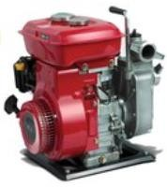
Components:
Engine: 5 hp , 3.7 Kw , 3000 RPM , single cylinder, 4 strokes, air-cooled recoil petrol engine

Slide 4
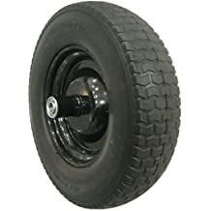
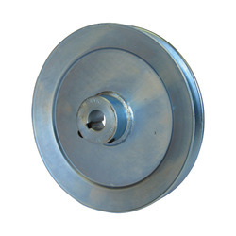
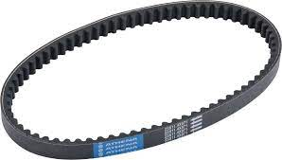
Wheel:Facilitates movement, transportation, or work performance in the machine.
Pulley:used to transmit energy and motion by a flexible rope, cord, cable, chain, or belt.
V-Belt Drive: used to transmit power or torque from the driving component to the driven component.

Slide 5
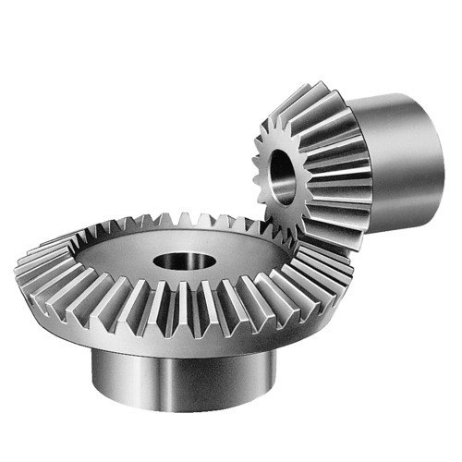
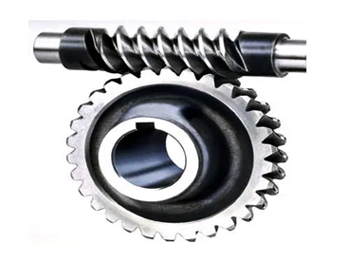
Bevel gear: used in differential drives, which can transmit power to two axles spinning at different speeds.
Worm gear :to change the direction of shaft rotation and to decrease speed and increase torque between non-parallel rotating shafts.
sprockets : transmit rotary motion between two shafts where gears are unsuitable or to impart linear motion to a track, tape

Slide 6
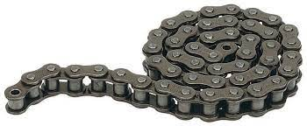
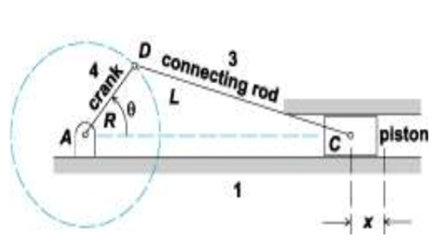
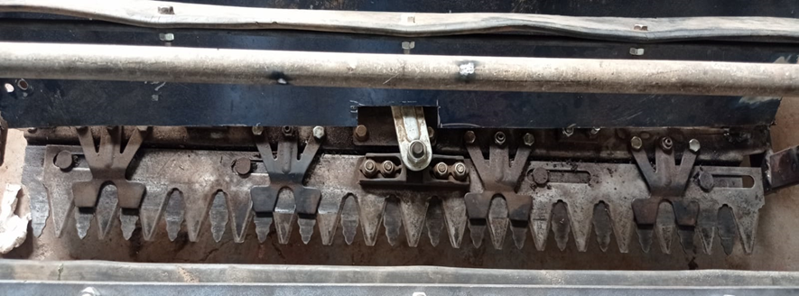
Roller chain : transmission of mechanical power on many kinds of domestic, industrial and agricultural machinery, including conveyors, wire- and tube-drawing machines.
Slider crank :convert a rotary motion and force into reciprocating motion and force.
Reciprocating blades: the mechanism is reciprocating cutter blade slides over fixed blade and creates scissoring action responsible for cutting the crops.

Slide 7
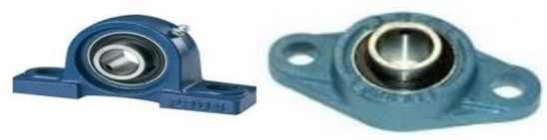
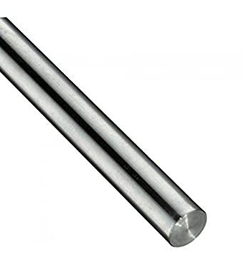
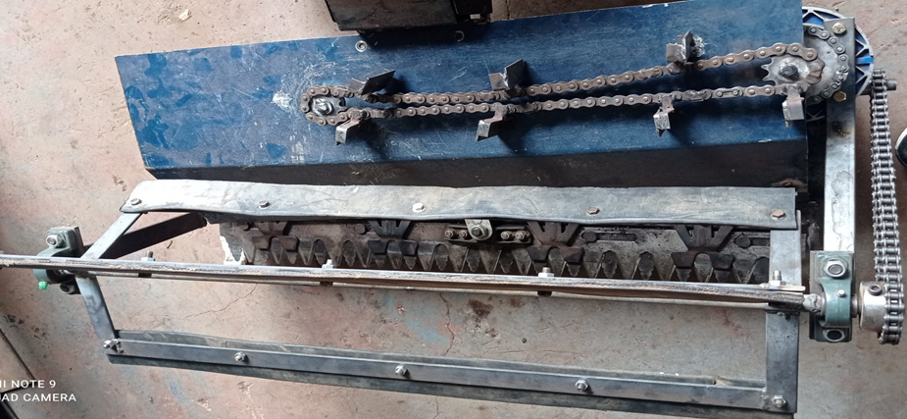
Bearing : is used to support the rotating shaft with the help of compatible bearings.
Shaft : is a rotating machine element, usually circular in cross section, which is used to transmit power from one part to another, or from a machine which produces power to a machine which absorbs power.
Collecting Mechanism:consists of a header assembly which is a blade that collect the crops to the center of the machine.

Slide 8
No. | Part name | The number of part | Material selection
1 | Wheel | 2 | rubber
2 | pulley | 6 | Cast iron
3 | v-belt | 3 | rubber
4 | Bevel gear | 1 | 304 stainless steel
5 | Worm gear | 1 | Housing: Die-Cast Aluminum Alloy Worm Gear-Copper
6 | Sprocket | 4 | 304 stainless steel
7 | Roller Chain | 3 | alloy steel
8 | Shaft | 3 | 40c8 steel / chromium steel-45
9 | Cutter knife | 1 | Sheet metal stainless steel
10 | Bearing | 2 | Cast Iron and Bearing Steel
11 | Slider crank | 1 | Sheet metal and plastic
12 | Collecting Mechanism | 1 | Cast Iron and rubber

Slide 9
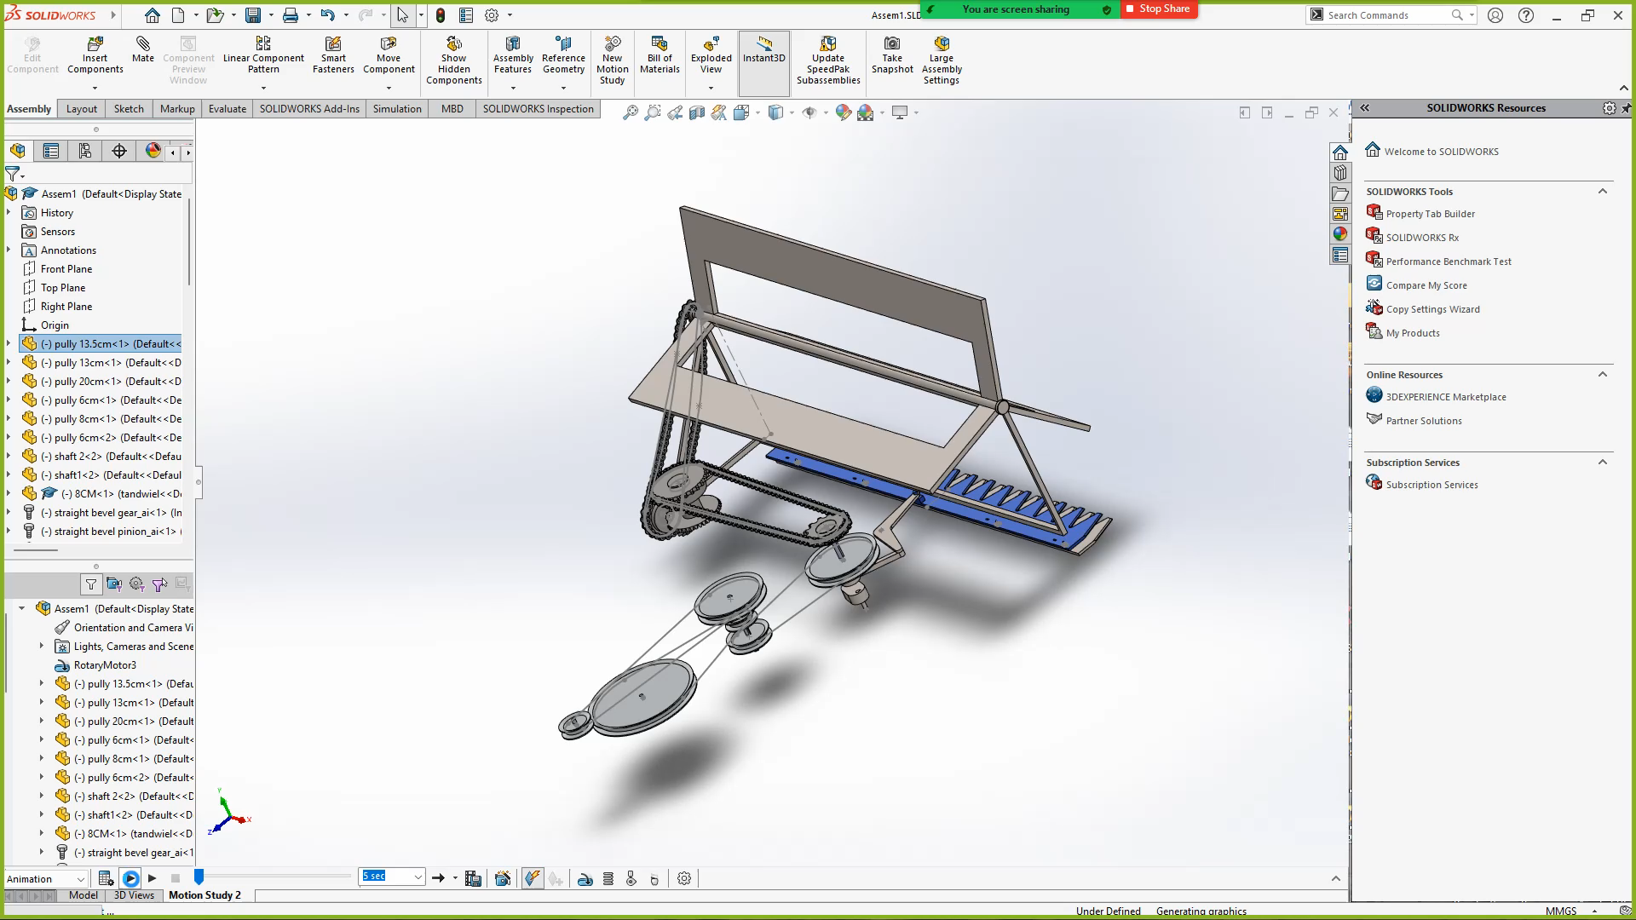
  Operation.

Slide 10
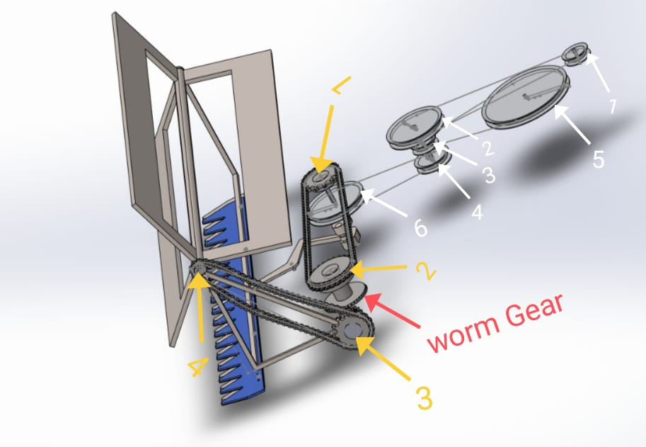

Slide 11
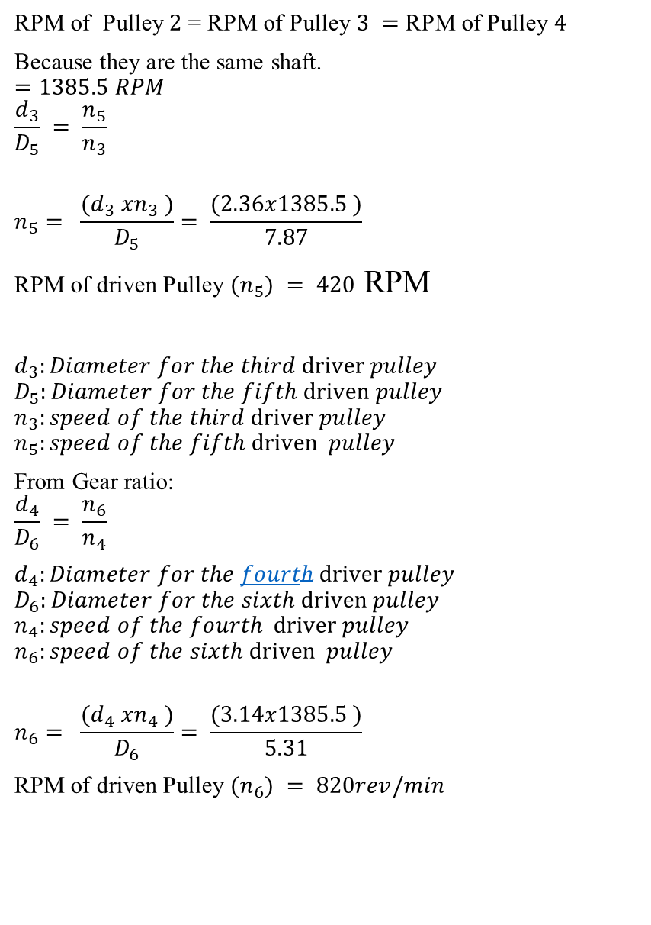
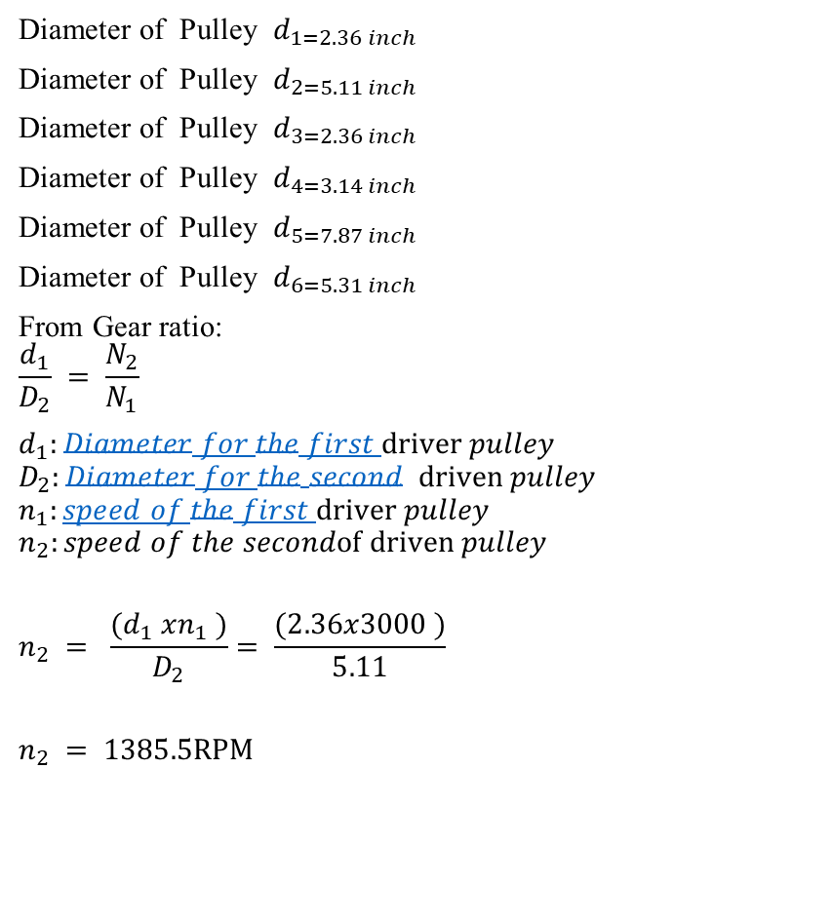
DESIGN OF MACHINE
Design for Pulleys
RPM of Pulley $2$ = RPM of Pulley $3 =$ RPM of Pulley $4$
Because they are the same shaft.
$$=1385.5 RPM$$
$$\frac{d_{3}}{D_{5}} = \frac{n_{5}}{n_{3}}$$
$$n_{5}= \frac{(d_{3} xn_{3} )}{D_{5}}= \frac{(2.36x1385.5 )}{7.87}$$
RPM of driven Pulley $(n_{5}) = 420$ RPM
$d_{3}:Diameter for the third driver pulley$
$$D_{5}:Diameter for the fifth driven pulley$$
$$n_{3}:speed of the third driver pulley$$
$$n_{5}:speed of the fifth driven pulley$$
From Gear ratio:
$$\frac{d_{4}}{D_{6}} = \frac{n_{6}}{n_{4}}$$
$d_{4}:Diameter for the fourth driver pulley$
$$D_{6}:Diameter for the sixth driven pulley$$
$$n_{4}:speed of the fourth driver pulley$$
$$n_{6}:speed of the sixth driven pulley$$
$$n_{6}= \frac{(d_{4} xn_{4} )}{D_{6}}= \frac{(3.14x1385.5 )}{5.31}$$
RPM of driven Pulley $(n_{6}) = 820rev/min$
Diameter of Pulley $d_{1=2.36 inch}$
Diameter of Pulley $d_{2=5.11 inch}$
Diameter of Pulley $d_{3=2.36 inch}$
Diameter of Pulley $d_{4=3.14 inch}$
Diameter of Pulley $d_{5=7.87 inch}$
Diameter of Pulley $d_{6=5.31 inch}$
From Gear ratio:
$$\frac{d_{1}}{D_{2}} = \frac{N_{2}}{N_{1}}$$
$d_{1}:Diameter for the first driver pulley$
$$D_{2}:Diameter for the second driven pulley$$
$$n_{1}:speed of the first driver pulley$$
$$n_{2}:speed of the secondof driven pulley$$
$$n_{2} = \frac{(d_{1} xn_{1} )}{D_{2}}= \frac{(2.36x3000 )}{5.11}$$
$$n_{2} = 1385.5RPM$$

Slide 12
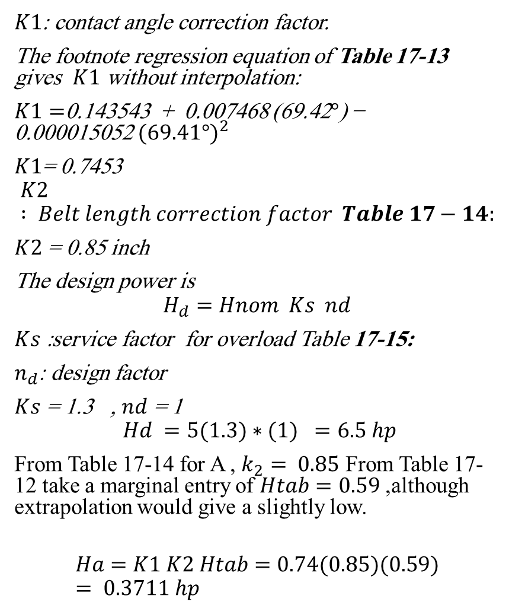
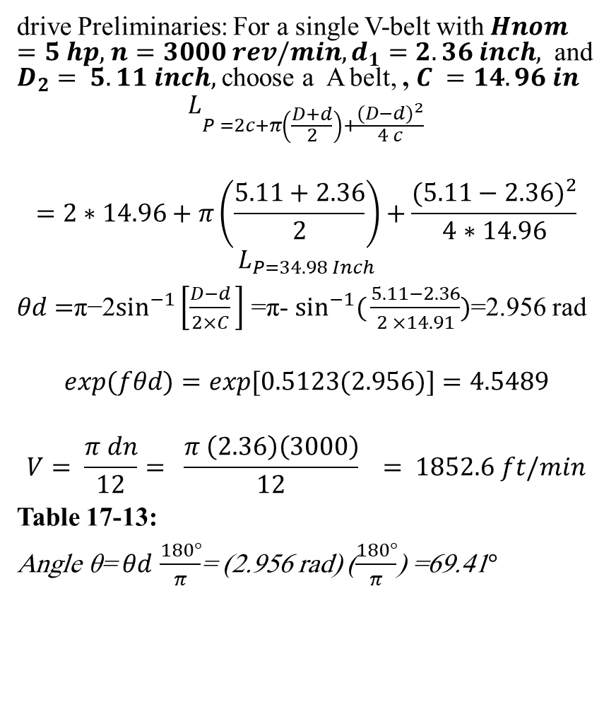
Pulley design associated with the motor
drive Preliminaries: For a single V-belt with $Hnom=5 hp,$ $n=3000 rev/min, d_{1}=2.36 inch,$ and $D_{2}= 5.11 inch,$choose a A belt, , $C =14.96 in$
$$L_{P =2c+π\left(\frac{D+d}{2}\right)+\frac{{(D−d)}^{2}}{4 c}}$$
$$=2∗14.96+π\left(\frac{5.11+2.36}{2}\right)+\frac{{(5.11−2.36)}^{2}}{4∗14.96}$$
$$L_{P=34.98 Inch}$$
$θd​=$π−2$\sin^{−1}\left[\frac{D−d}{2×C}​\right]$ =π- $\sin^{−1}({\frac{5.11−2.36}{2 ×14.91})}$=2.956 rad
$$exp(fθd)=exp[0.5123(2.956)]=4.5489$$
$$V= \frac{π dn}{12}= \frac{π \left(2.36\right)\left(3000\right)}{12}​ = 1852.6 ft/min$$
Table 17-13:
Angle θ= $θd$ $\frac{180°}{π}$​= (2.956 rad) ($\frac{180°}{π}$​) =69.41$°$
$K1$: contact angle correction factor.
The footnote regression equation of Table 17-13 gives $K1​$ without interpolation:
$K1​=$0.143543 + 0.007468 (69.42$°$) − 0.000015052${ (69.41°)}^{2}$
$K1$= 0.7453
$$K2 : Belt length correction factor Table 17−14:$$
$K2$ = 0.85 inch
The design power is
$$H_{d}=Hnom ​ Ks ​ nd$$
$Ks$ :service factor for overload Table 17-15:
$n_{d}$: design factor
$Ks$ = 1.3 , $nd$ = 1
$$​ Hd =5(1.3)∗(1) =6.5 hp$$
From Table 17-14 for A , $k_{2}= 0.85$ From Table 17-12 take a marginal entry of $Htab=0.59$ ,although extrapolation would give a slightly low.
$$Ha​=K1 ​K2 ​Htab​=0.74(0.85)(0.59)= 0.3711 hp$$

Slide 13
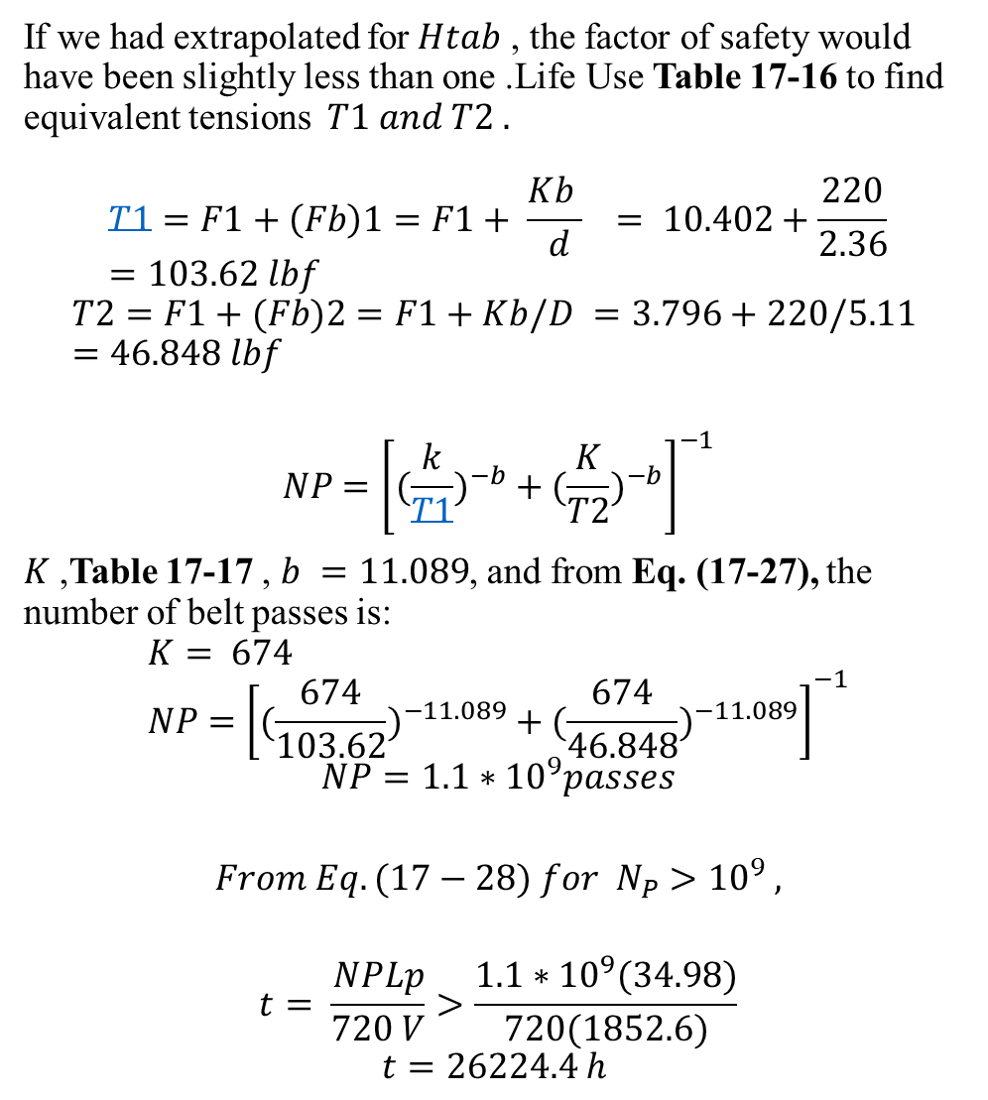
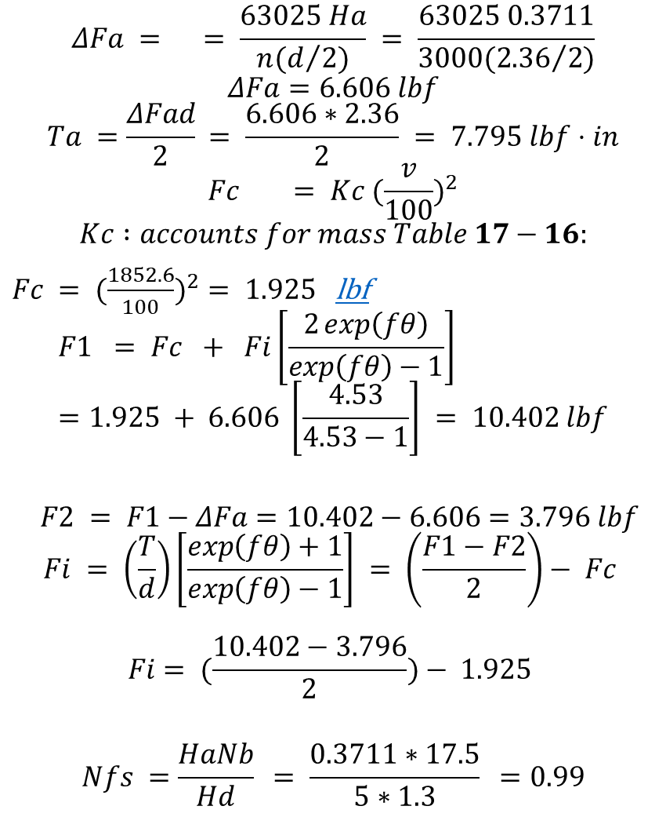
$$ΔFa = ​ = \frac{63025 Ha​}{n(d/{2)}} = \frac{63025 0.3711}{3000({2.36}/{2)}}$$
$$ΔFa=6.606 lbf$$
$$Ta ​=\frac{ΔFa​d​}{2}​= \frac{6.606∗2.36}{2} = 7.795 lbf⋅in$$
$$Fc​ = Kc ({\frac{v}{100})}^{2}$$
$$Kc :accounts for mass Table 17−16:$$
$Fc​ = ({\frac{1852.6}{100})}^{2}= 1.925$lbf
$$F1 ​= Fc ​+ Fi​\left[\frac{2\exp\left(fθ\right)}{exp\left(fθ\right)−1}\right] =1.925 + 6.606 \left[\frac{4.53}{4.53−1}\right] = 10.402 lbf$$
$$F2 ​= F1​−ΔFa​=10.402−6.606=3.796 lbf$$
$$Fi ​= \left(\frac{T}{d}\right)\left[\frac{\exp\left(fθ\right)+1}{exp\left(fθ\right)−1}\right] = \left(\frac{F1−F2}{2}\right)− Fc​$$
$$Fi​= (\frac{10.402−3.796}{2})− 1.925$$
$$Nfs =\frac{Ha​Nb}{Hd} = \frac{0.3711∗17.5}{5∗1.3} =0.99$$
If we had extrapolated for$Htab$ ​, the factor of safety would have been slightly less than one .Life Use Table 17-16 to find equivalent tensions $T1​ and T2​ .$
$$​$$
$$T1​=F1​+\left(Fb​\right)1​=F1​+ \frac{Kb }{ d} ​​= 10.402+\frac{220}{2.36}=103.62 lbf$$
$$T2​=F1​+(Fb​)2​=F1​+Kb/D ​​=3.796+220/5.11 ​=46.848 lbf​$$
$$NP​​={\left[({\frac{k}{T1})}^{−b}+({\frac{K}{T2})}^{−b}\right]}^{−1}$$
$K$,Table 17-17 , $b =11.089$, and from Eq. (17-27), the number of belt passes is:
$$K= 674 \\ NP​​={\left[({\frac{674}{103.62})}^{−11.089}+({\frac{674}{46.848})}^{−11.089}\right]}^{−1}$$
$$NP=1.1∗{10}^{9}passes$$
$$From Eq. (17−28) for N_{P}​>{10}^{9} ,$$
$$t= \frac{NP​Lp​​}{720 V}>\frac{1.1∗{10}^{9}(34.98)}{720(1852.6)}$$
$$t=26224.4 h$$

Slide 14
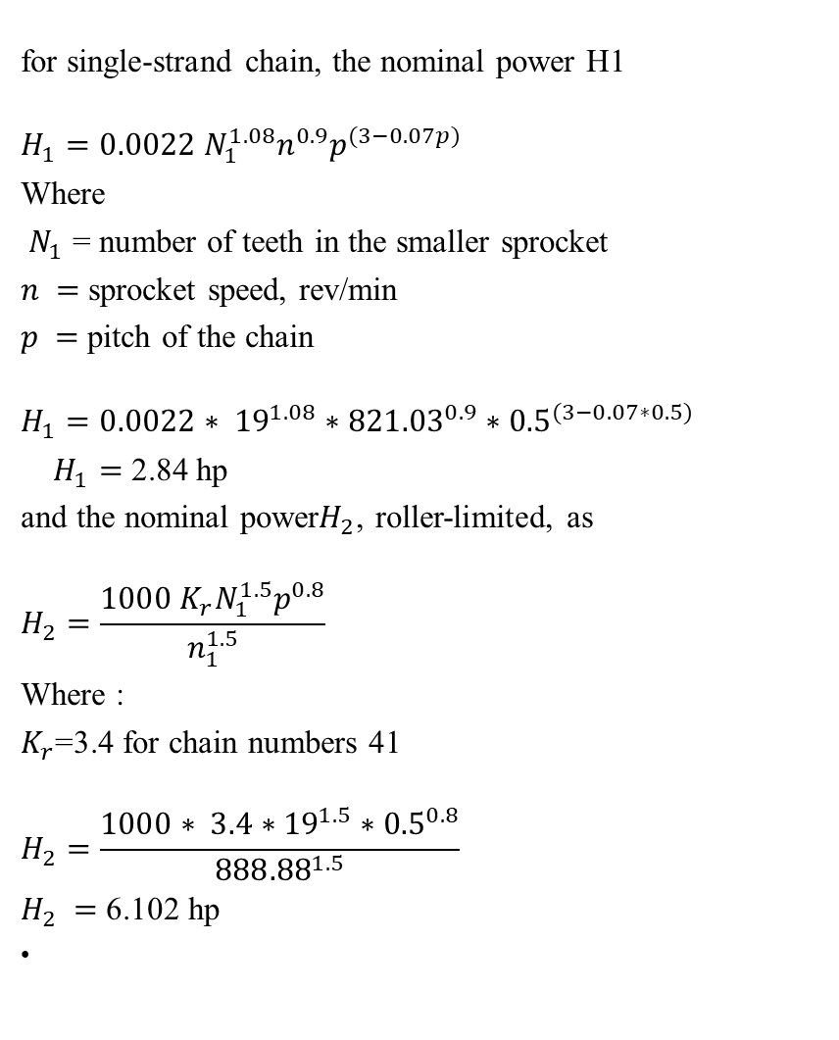
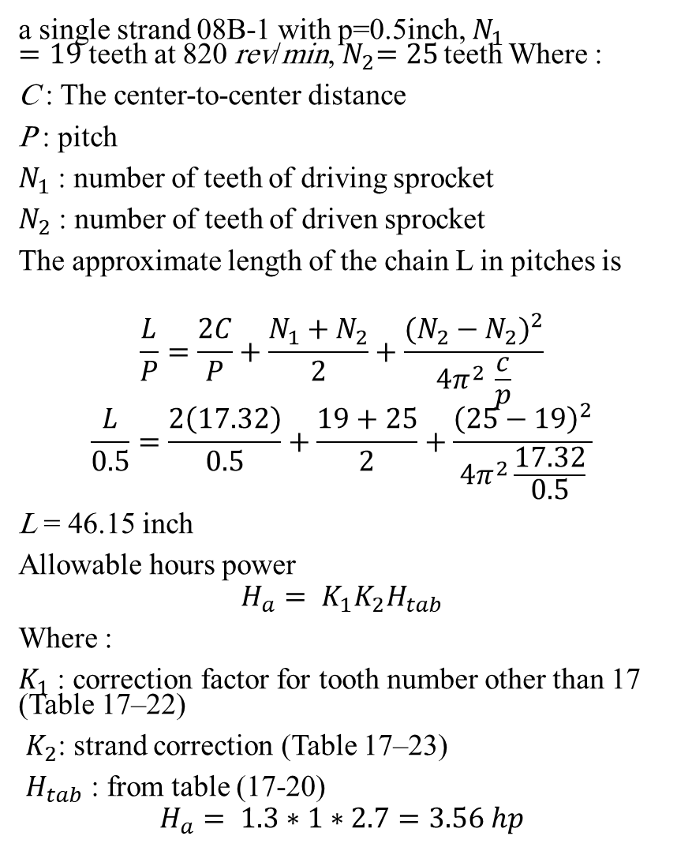
Design Roller Chain
for single-strand chain, the nominal power H1
$$H_{1}=0.0022 N_{1}^{1.08}n^{0.9}p^{(3−0.07p)}$$
Where
$N_{1}$ = number of teeth in the smaller sprocket
$n =$ sprocket speed, rev/min
$p =$ pitch of the chain
$$H_{1}=0.0022∗ {19}^{1.08}∗{821.03}^{0.9}∗{0.5}^{(3−0.07∗0.5)}$$
$H_{1}=$ 2.84 hp
and the nominal power$H_{2}$, roller-limited, as
$$H_{2}=\frac{1000 K_{r}N_{1}^{1.5}p^{0.8}}{n_{1}^{1.5}}$$
Where :
$K_{r}$=3.4 for chain numbers 41
$$H_{2}=\frac{1000∗ 3.4∗{19}^{1.5}{∗0.5}^{0.8}}{{888.88}^{1.5}}$$
$H_{2} =$ 6.102 hp
a single strand 08B-1 with p=0.5inch, $N_{1}=19$ teeth at 820 rev/min,${ N}_{2}=25$ teeth Where :
C : The center-to-center distance
P : pitch
$N_{1}$ : number of teeth of driving sprocket
$N_{2}$ : number of teeth of driven sprocket
The approximate length of the chain L in pitches is
$$\frac{L}{P}=\frac{2C}{P}+\frac{N_{1}+N_{2}}{2}+\frac{{(N_{2}−N_{2})}^{2}}{4π^{2 }\frac{c}{p}}$$
$$\frac{L}{0.5}=\frac{2\left(17.32\right)}{0.5}+\frac{19+25}{2}+\frac{{\left(25−19\right)}^{2}}{4π^{2}\frac{17.32}{0.5}}$$
L = 46.15 inch
Allowable hours power
$$H_{a}= K_{1}K_{2}H_{tab}$$
Where :
$K_{1}$ : correction factor for tooth number other than 17 (Table 17–22)
$K_{2}$: strand correction (Table 17–23)
$H_{tab}$ : from table (17-20)
$$H_{a}= 1.3∗1∗2.7=3.56 hp$$

Slide 15
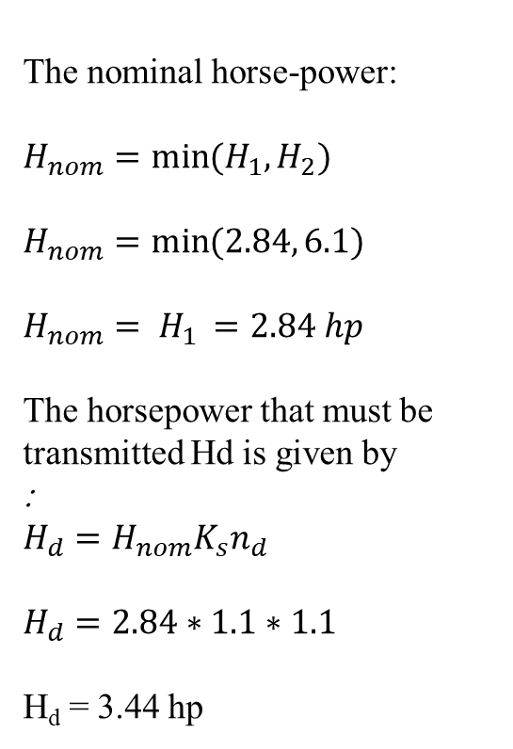
The nominal horse-power:
$H_{nom}=\min{(H_{1},}H_{2})$
$H_{nom}=\min{(2.84,}6.1)$
$$H_{nom}= H_{1 }=2.84 hp$$
The horsepower that must be transmitted Hd is given by
:
$$H_{d}=H_{nom}K_{s}n_{d}$$
$$H_{d}=2.84∗1.1∗1.1$$
H_{d} = 3.44 hp

Slide 16

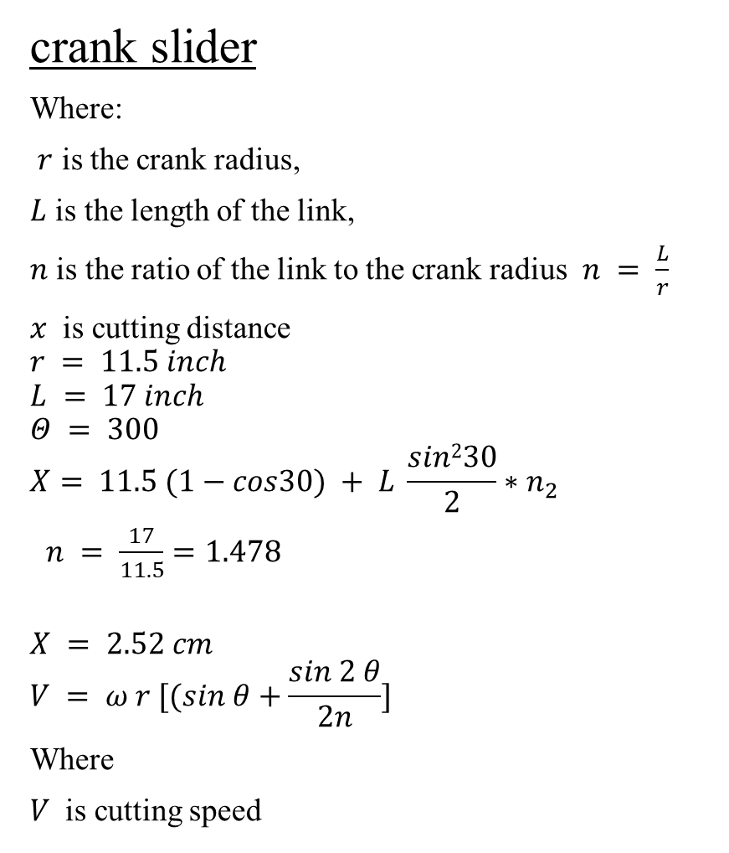
Design cutting distance
From gear ratio
$\frac{N1}{N2}=\frac{D1}{D2}$
$$\frac{1385.5}{N_{2}}=\frac{13.5}{8}$$
$$N_{2}= 821.03 rpm$$
ω = $\frac{2∗ π∗N}{60}$
$$ω= 85.97 rad/sec$$
$$V= 783.97 inch/sec$$
crank slider
Where:
$r$ is the crank radius,
$L$ is the length of the link,
$n$ is the ratio of the link to the crank radius $n = \frac{L}{r}$
$x$ is cutting distance
$$r = 11.5 inch$$
$$L = 17 inch$$
$$Θ = 300$$
$$X= 11.5 (1−cos30) + L \frac{sin230}{2}∗n_{2}$$
$n = \frac{17}{11.5}=1.478$
$$X = 2.52 cm$$
$$V = ω r [(sin θ+\frac{sin 2 θ}{2n}]$$
Where
$V$ is cutting speed

Slide 17
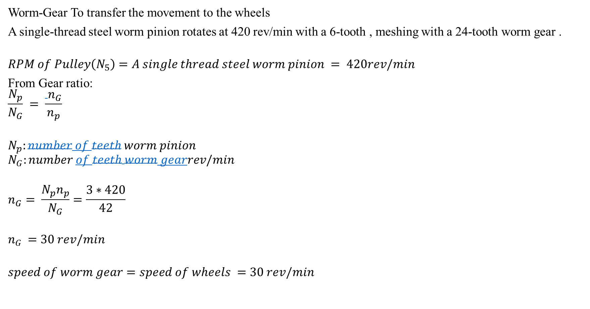
Design Worm-Gear connect with wheels
Worm-Gear To transfer the movement to the wheels
A single-thread steel worm pinion rotates at 420 rev/min with a 6-tooth , meshing with a 24-tooth worm gear .
$$RPM of Pulley\left(N_{5}\right)=A single thread steel worm pinion = 420rev/min$$
From Gear ratio:
$$\frac{N_{p}}{N_{G}} = \frac{ n_{G}}{n_{p}}$$
$$N_{p}:number of teeth worm pinion$$
$$N_{G}:number of teeth worm gearrev/min$$
$$n_{G}= \frac{N_{p}n_{p}}{N_{G}}=\frac{3∗420}{42}$$
$$n_{G }=30 rev/min$$
$$speed of worm gear=speed of wheels =30 rev/min$$

Slide 18

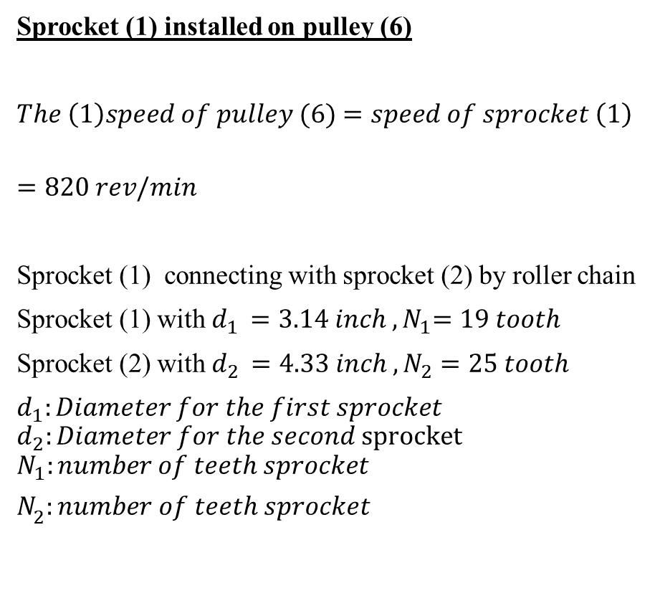
Design Collecting Mechanism
Sprocket (1) installed on pulley (6)
$The \left(1\right)speed of pulley (6)$ $=speed of sprocket \left(1\right)$
$$=820 rev/min$$
Sprocket (1) connecting with sprocket (2) by roller chain
Sprocket (1) with $d_{1 }{=3.14 inch , N}_{1}=19 tooth$
Sprocket (2) with $d_{2 }=4.33 inch{ , N}_{2}=25 tooth$
$d_{1}:Diameter for the first sprocket$
$$d_{2}:Diameter for the second sprocket$$
$$N_{1}:number of teeth sprocket$$
$$N_{2}:number of teeth sprocket$$
From Gear ratio:
$$\frac{N_{1}}{N_{2}} = \frac{ n_{2}}{n_{1}}$$
$$n_{1}:speed of sprocket$$
$$n_{2}:speed of sprocket$$
$$n_{2}= \frac{N_{1}n_{1}}{N_{2}}=\frac{19∗820}{25}$$
$$n_{2 }=630 rev/min$$

Slide 19
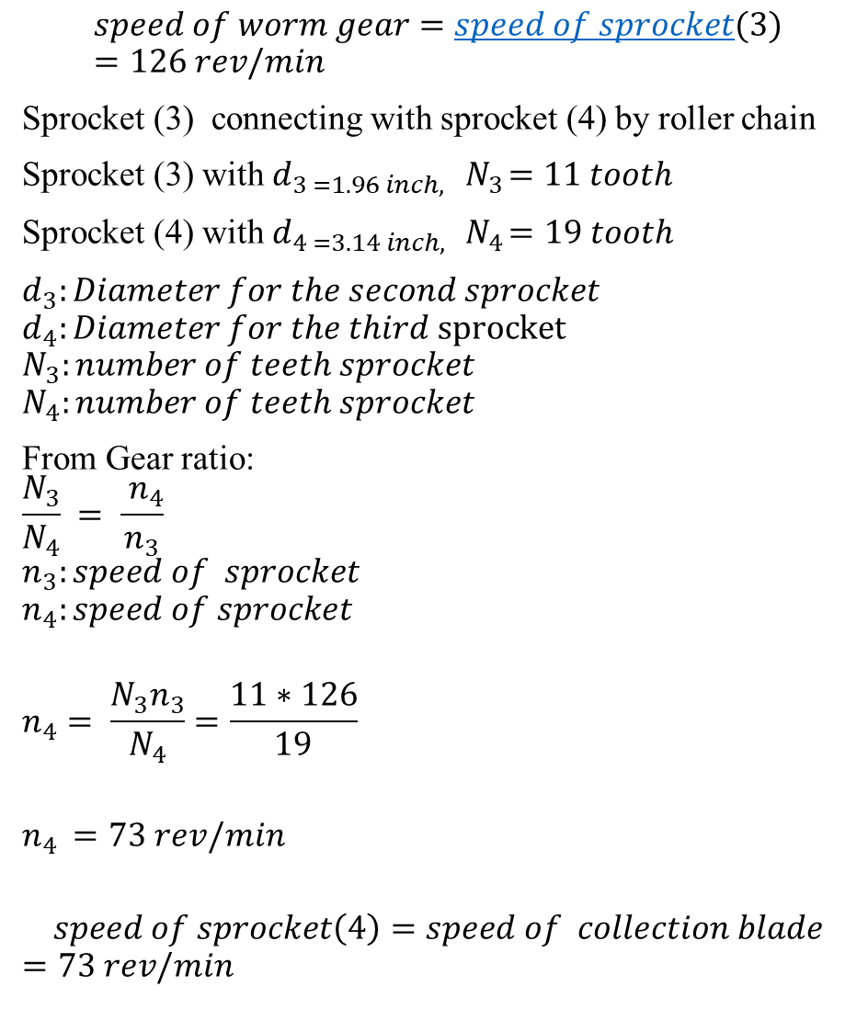
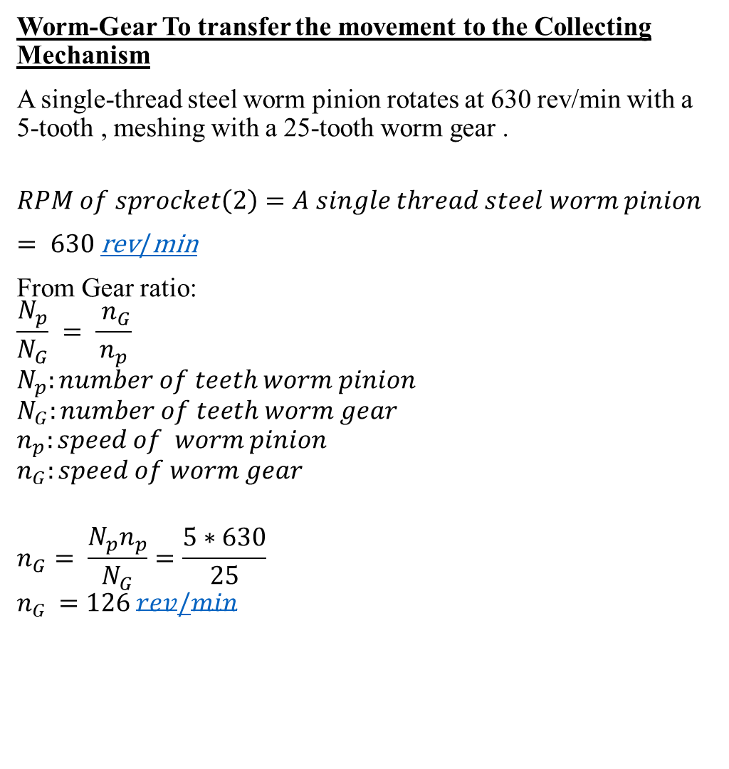
$$speed of worm gear=speed of sprocket(3)=126 rev/min$$
Sprocket (3) connecting with sprocket (4) by roller chain
Sprocket (3) with $d_{3 =1.96 inch,}{ N}_{3}=11 tooth$
Sprocket (4) with $d_{4 =3.14 inch,}{ N}_{4}=19 tooth$
$d_{3}:Diameter for the second sprocket$
$$d_{4}:Diameter for the third sprocket$$
$$N_{3}:number of teeth sprocket$$
$$N_{4}:number of teeth sprocket$$
From Gear ratio:
$$\frac{N_{3}}{N_{4}} = \frac{ n_{4}}{n_{3}}$$
$$n_{3}:speed of sprocket$$
$$n_{4}:speed of sprocket$$
$$n_{4}= \frac{N_{3}n_{3}}{N_{4}}=\frac{11∗126}{19}$$
$$n_{4 }=73 rev/min$$
$$speed of sprocket\left(4\right)=speed of collection blade$$
$$=73 rev/min$$
Worm-Gear To transfer the movement to the Collecting Mechanism
A single-thread steel worm pinion rotates at 630 rev/min with a 5-tooth , meshing with a 25-tooth worm gear .
$$RPM of sprocket\left(2\right)=A single thread steel worm pinion$$
$= 630$rev/min
From Gear ratio:
$$\frac{N_{p}}{N_{G}} = \frac{ n_{G}}{n_{p}}$$
$$N_{p}:number of teeth worm pinion$$
$$N_{G}:number of teeth worm gear$$
$$n_{p}:speed of worm pinion$$
$$n_{G}:speed of worm gear$$
$$n_{G}= \frac{N_{p}n_{p}}{N_{G}}=\frac{5∗630}{25}$$
$$n_{G }=126 rev/min$$

Slide 20
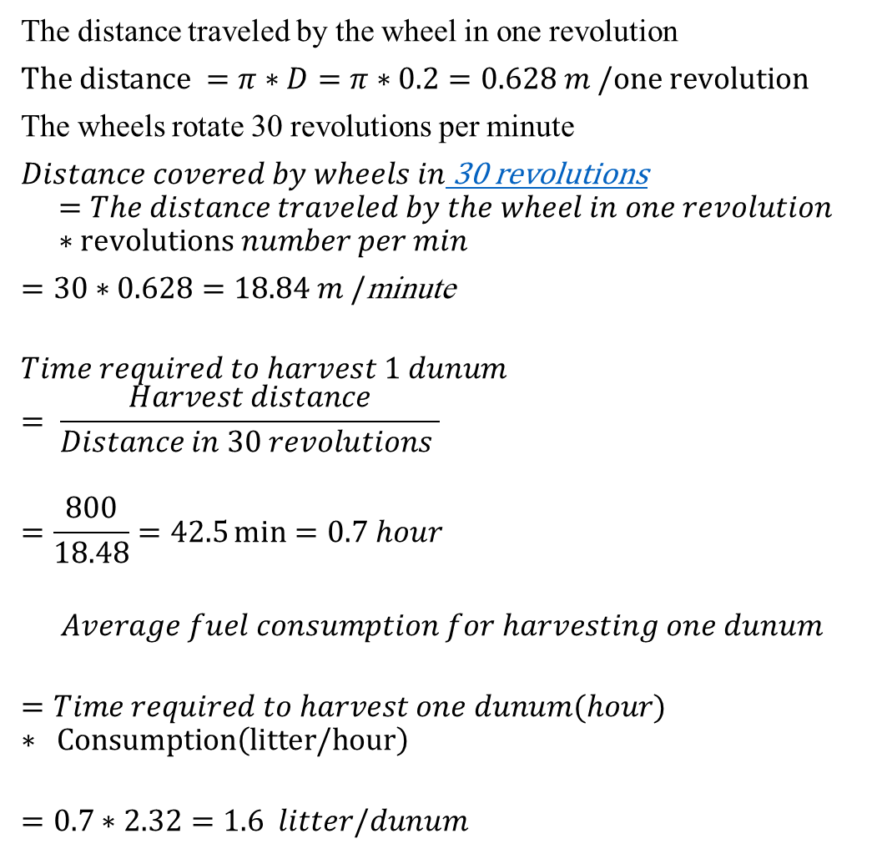
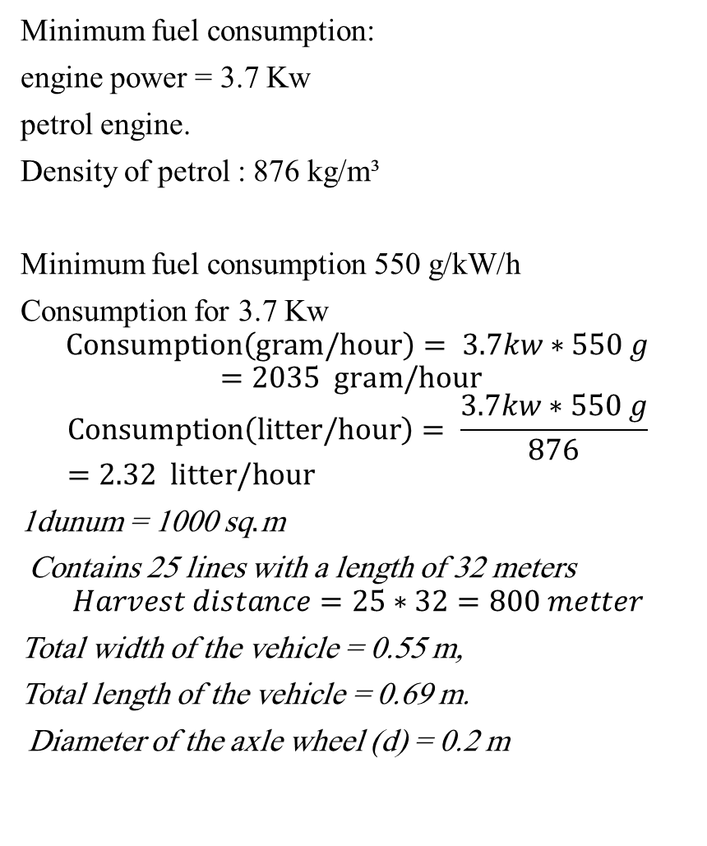
Results for harvesting done by the designed machine
Minimum fuel consumption:
engine power = 3.7 Kw
petrol engine.
Density of petrol : 876 kg/m³
Minimum fuel consumption 550 g/kW/h
Consumption for 3.7 Kw
$$Consumption\left(gram/hour\right)= 3.7kw∗550 g$$
$$=2035 gram/hour$$
$$Consumption\left(litter/hour\right)= \frac{3.7kw∗550 g}{876}=2.32 litter/hour$$
1dunum = 1000 sq.m
Contains 25 lines with a length of 32 meters
$$Harvest distance=25∗32=800 metter$$
Total width of the vehicle = 0.55 m,
Total length of the vehicle = 0.69 m.
Diameter of the axle wheel (d) = 0.2 m
The distance traveled by the wheel in one revolution
$The distance =π∗D=π∗0.2=0.628 m /one revolution$
The wheels rotate 30 revolutions per minute
$Distance covered by wheels in$ 30 revolutions
$$=The distance traveled by the wheel in one revolution∗revolutions number per min$$
$=30∗0.628=18.84 m /$minute
$$Time required to harvest 1 dunum$$
$$= \frac{Harvest distance}{Distance in 30 revolutions }$$
$$=\frac{800}{18.48}=42.5\min{=0.7 hour}$$
$$Average fuel consumption for harvesting one dunum$$
$$=Time required to harvest one dunum(hour)∗ Consumption\left(litter/hour\right)$$
$$=0.7∗2.32=1.6 litter/dunum$$

Slide 21
Specification of the reaper machine
No. | Descriptions | Details
1 | Name of the harvesting machine | Reaper
2 | . Working width | 120 cm
3 | Height of the machine | 110 cm
4 | Length of the machine | 170 cm
5 | Cutting bar width | 90 cm
6 | Source of. Power | Single cylinder, 4 strokes, air-cooled recoil petrol engine
7 | engine power | hp 5 , 3.7 Kw
8 | Engine speed | 3000 RPM
9 | Types of wheel | Two-Wheel barrow tire
10 | Number of machine Operator | One man
11 | Minimum fuel consumption | 550 g/kW/h

Slide 22
Comparison between manual harvesting and machine harvesting
 | requirements
operations to harvest | manual harvesting | machine harvesting
labor for cutting | 4 person -4 hour/dunam | 1 person – 0.7hour/dunam
labor for collection | 2 person -3 hour/dunam | -
Labor cost rate | ₪15/hour/person | 50₪/hour/person
Total labor requirement | 6 person/dunam | one person
Total hour | 22 hour/dunam | 0.7 hour
operational costs | - | 35 ₪
Total cost/ dunam | 330 ₪ | 70 ₪

Slide 23
Conclusion:
Finally , The machine will have the more advantages such as simple structure, easy to use, low cost, easy maintenance , cutting and combining processes with high efficient , and this machine can be operated manually by just one person.this design is particularly beneficial to farmers for increased production because it speeds up the harvesting process and so reduces the time required to harvest the same quantity of yield , It also helps to advance and enlighten the field of initiating and developing similar projects and unleashing creativity and the spirit of innovation to study and design agricultural machinery

Slide 24
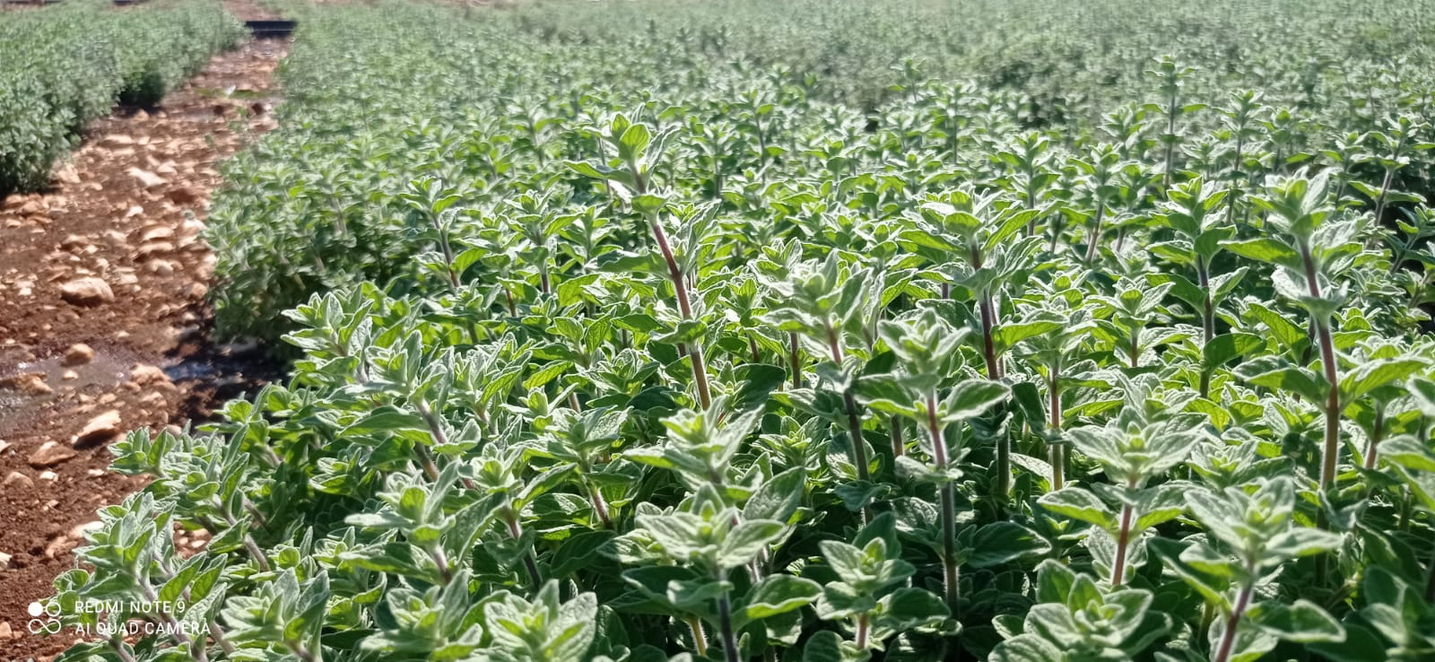
Thanks

