Slide 1
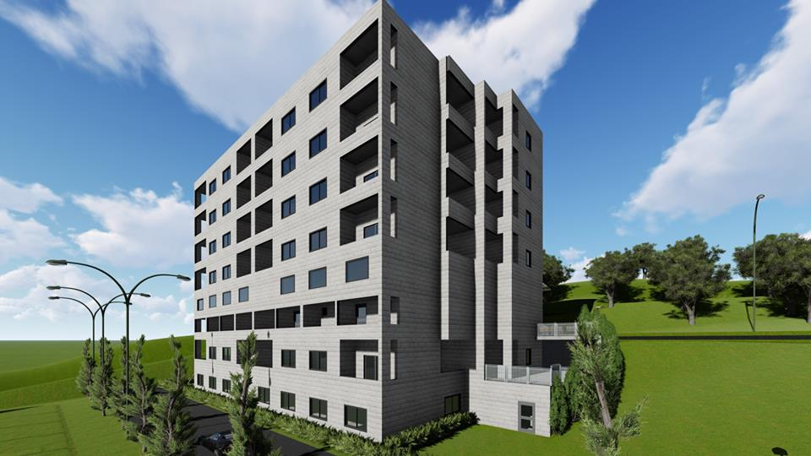
Structural Analysis and Design of a Residential Building
Graduation Project Report II
Prepared By:-
Faris Atwan
Tarek Deeb
Mohammad Akhras
Yasmine Habash
Under Supervision of:
Dr. Riyad abdel-karim
Fall 2018

Slide 2
Outline:
Introduction.
Seismic Analysis Approach.
Preliminary Design.
3D Structural Analysis.
Structural design.

Slide 3
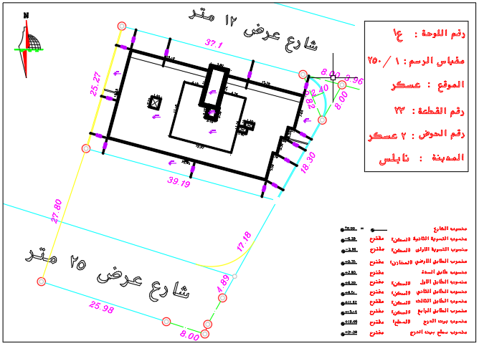
Project location :

Slide 4
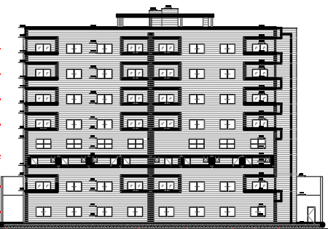
Project Description:
This Building consists of 7 floors:
Two basement floors.
Ground floor.
Four top floors.
Total Area of building = 4732 m²
+
m²

Slide 5
Materials:
Structural Materials:
Concrete.( 24 MPa ) ( 28 MPa )
Reinforcement steel.(420 MPa)
Non-Structural Materials:
Material | γ in KN/m³
Aggregate | 18
Tile | 26
Normal weight block | 12
Light weight block | 6
Plaster | 23

Slide 6
Codes in Our Project:
The Codes used in this project are the following :
ACI 318-14 (American Concrete Institute): building code requirements of structural concrete and commentary.
ASCE7-2010 (American Society of Civil Engineers).
IBC 2012.

Slide 7
Loads:
Gravity Loads:
Dead Load
Live Load
Lateral Loads:
Earthquake Load.
wind load

Slide 8
Gravity Loads:
Own weight (OW)
= 3.7 KN/m²
Dead(D)
Superimposed (SID)
= 5.5 KN/m²
Live(L)
Live Load(L)
= 5 KN/m²

Slide 9
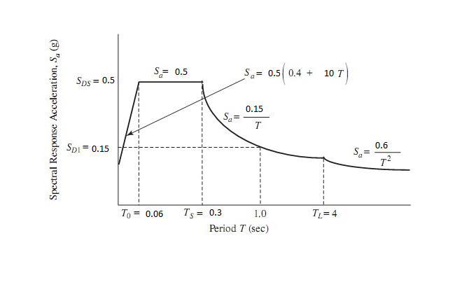
Earthquake Loads:
According to IBC we use response spectrum curve to identify the earthquake loads.

Slide 10
Load combinations:
1) 1.4D
2) 1.2D+1.6L
3) 1.3D+1L+1.3EQ_{x}+0.39EQ_{y}
4) 1.3D+1L+1.3EQ_{y}+0.39EQ_{x}
5) 0.8D+1.3EQ_{x}+0.39EQ_{y}
6) 0.8D+1.3EQ_{y}+0.39EQ_{x}
7) 1.07D+0.7EQ_{x}+0.21EQ_{y}
8) 1.07D+0.7EQ_{y}+0.21EQ_{x}
9) 1.053D+0.75L+0.525EQ_{x}+0.158EQ_{y}
10) 1.053D+0.75L+0.525EQ_{y}+0158EQ_{x}
11) 0.53D+0.7EQ_{x}+0.21EQ_{y}
12) 0.53D+0.7EQ_{y}+0.21EQ_{x}
13) D
14) D+L

Slide 11
Structural System:
-The structural system that we use in our project is frame system (slab-beam-column) system.
-The slab system used in the building is one way ribbed slab for floors

Slide 12


Software Program:

Slide 13
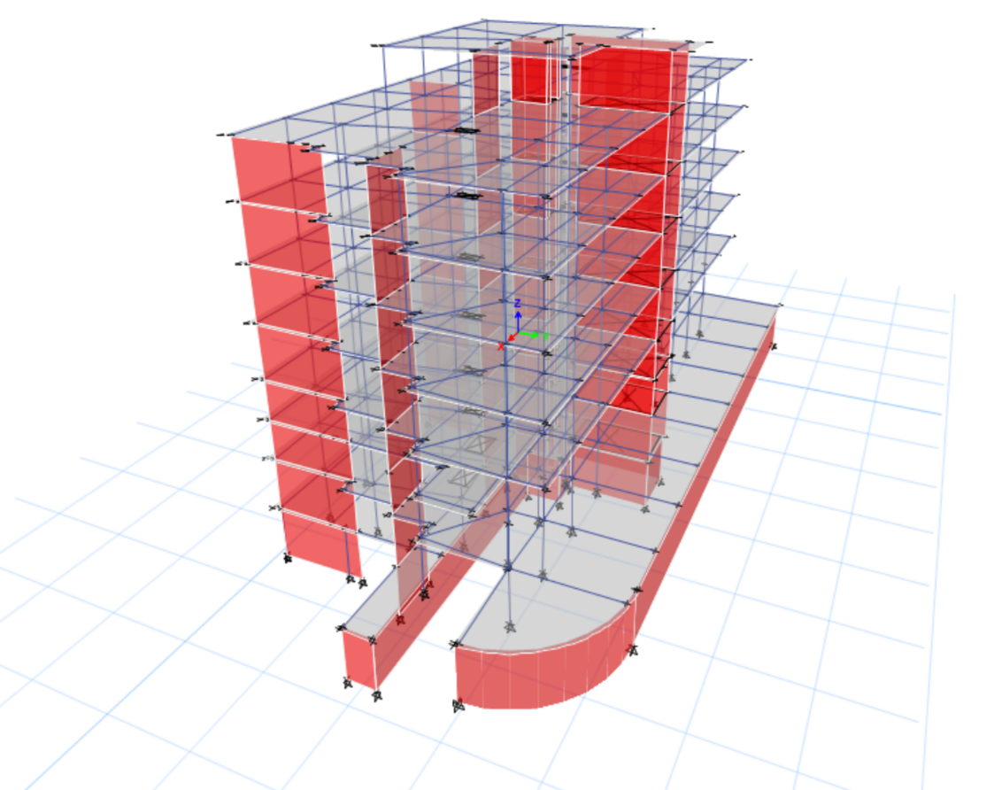
3D Modeling:

Slide 14
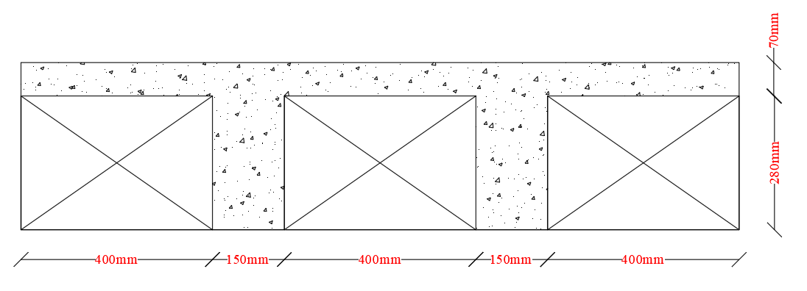
Preliminary Design:
Slab:
The selected system was one – way ribbed slab as shown below:

Slide 15
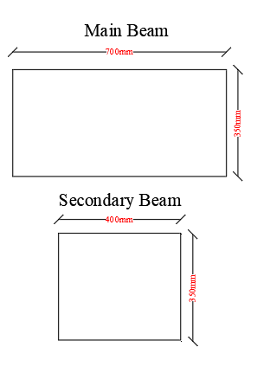
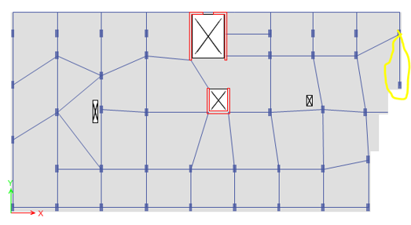
Preliminary Design:
Beams:
we will use hidden beams in Y-Direction:

Slide 16
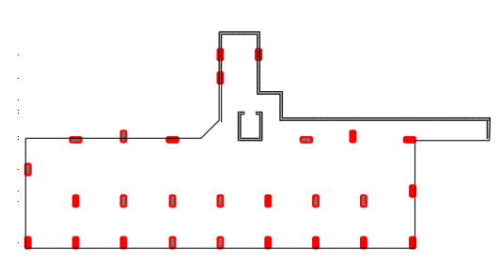
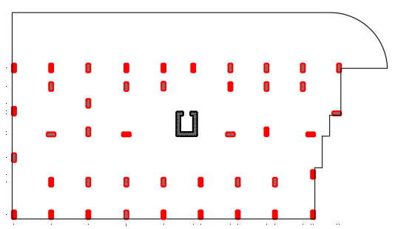
Preliminary Design:
Columns:
Column distribution.
For basement 2
For basement 1 and Floors

Slide 17
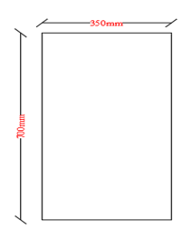
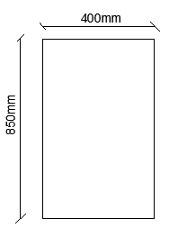
Preliminary Design:
Columns:
Column Cross-section.

Slide 18
Seismic Analysis Approach:
Ground motion input parameters
Exceedance probability 2%
In 50 years
S_{S}=0.5
S₁=0.25
The risk category is “Ⅱ“
The importance factor equal 1

Slide 19
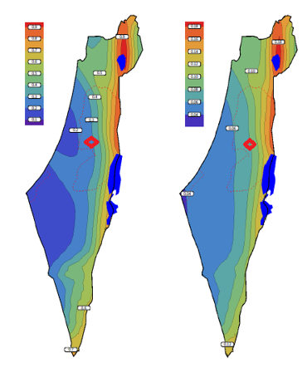
Seismic Analysis Approach:

Slide 20
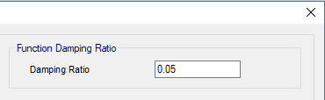
Seismic Analysis Approach:
Damping factor must be less than 10%

Slide 21
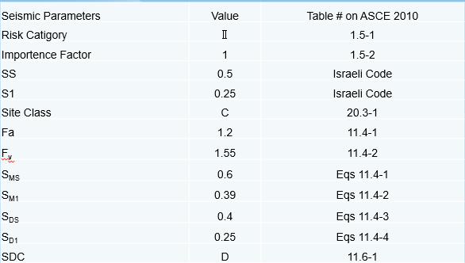
Seismic Analysis Approach:
Seismic Parameters

Slide 22
Seismic Analysis Approach:
Response Spectrum :

Slide 23

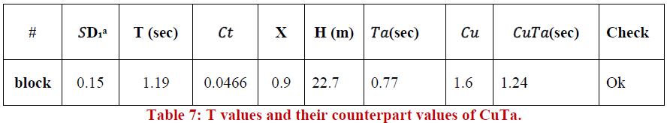
Seismic Analysis Approach:
Period limit check:
From Etabs:
From Calculation:

Slide 24
Seismic Analysis Approach:
Diaphragm Rigidity
The length to width ratio of the diaphragms in each block is less than 3 as shown in the table :

Slide 25
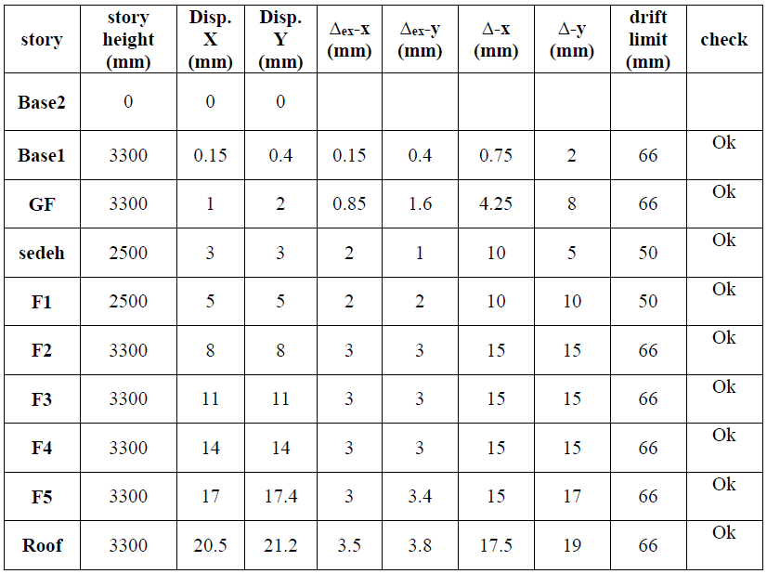
Seismic Analysis Approach:
Drift Check :

Slide 26

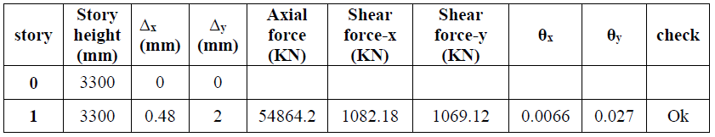
Seismic Analysis Approach:
Second order effect:

Slide 27
Seismic Analysis Approach:
Irregularity Checks
We have 13 checks in ASCE-10 for irregularity
Vertical irregularity checks
Horizontal irregularity checks

Slide 28
ETABS 2016 Model and Checks.
ETABS Checks
Equilibrium Check
Stress-Strain Check
Compatibility Check

Slide 29
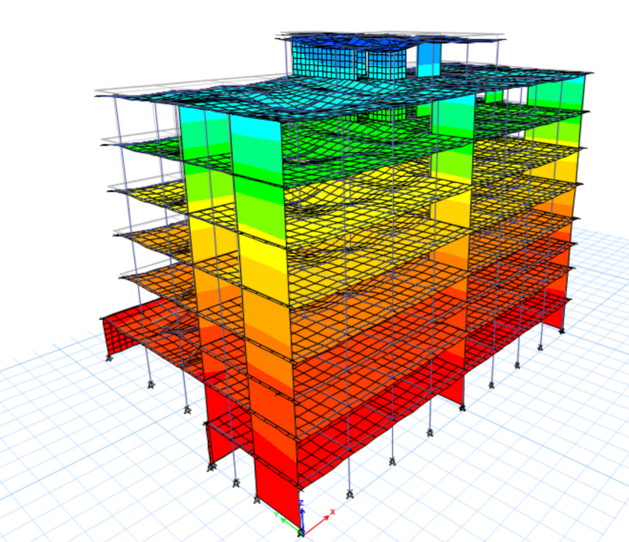
ETABS 2016 Model and Checks.
Compatibility Check:
The model moves as
one unit so we can say
that our modeling is OK.

Slide 30
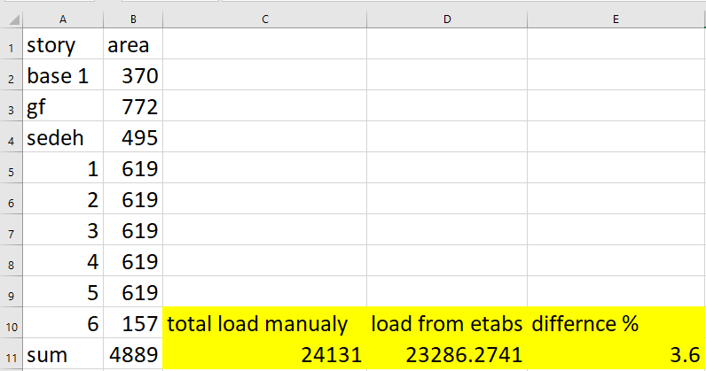
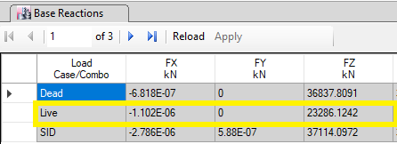
ETABS 2016 Model and Checks.
Equilibrium Check:
Manual Live Load:
Etabs Live Load:
The difference less than 5%

Slide 31
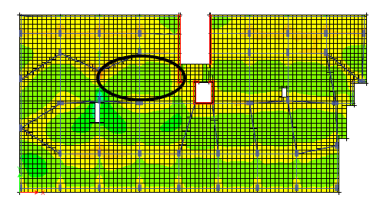

ETABS 2016 Model and Checks.
Stress-Strain Check:
From ETABS
Right -ve M = 13.37 KN.m
Left -ve M = 7.24 KN.m
M ETABS= $\frac{ M^{−}Left + M^{−}Right }{2}$ + $M^{+}$
= $\frac{13.37+7.24 }{2}$ + 3.234 = 13.54 KN.m
M manually = $\frac{Wu {Ln}^{2}}{8}$ = $\frac{12 .5{(8.5)}^{2}}{8}$ = 14.2 KN.m
Error % = |$\frac{14.2−13.54}{14.2}$ | *100% = 4.6% < 5%

Slide 32
Design:
We design all the structural elements in our project:
Slabs.
Beams.
Columns.
Shear walls.
Footings.

Slide 33
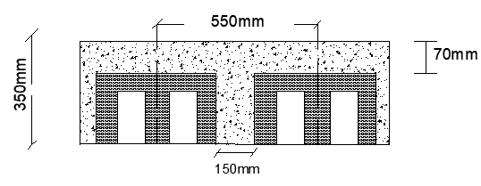
Slab Design:
The structural system of slab is one way ribbed slab of 350 mm thickness with hidden beams.
.Slab Thickness = 350mm
.Web width = 150 mm
.Flange Thickness= 70 mm

Slide 34
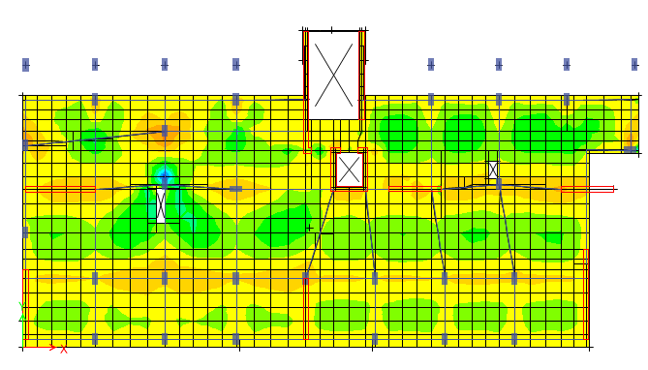
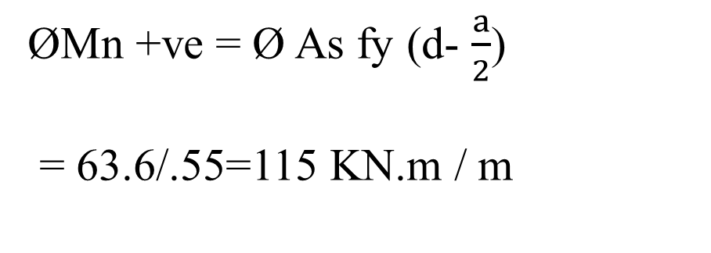
Slab Moments:
Positive Moment:
ØMn +ve = Ø As fy (d- $\frac{a}{2}$)
= 63.6/.55=115 KN.m / m

Slide 35
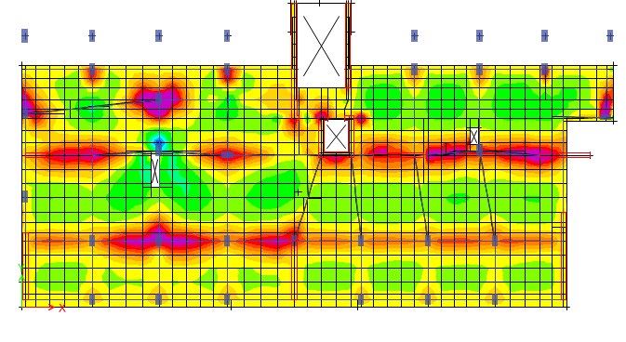
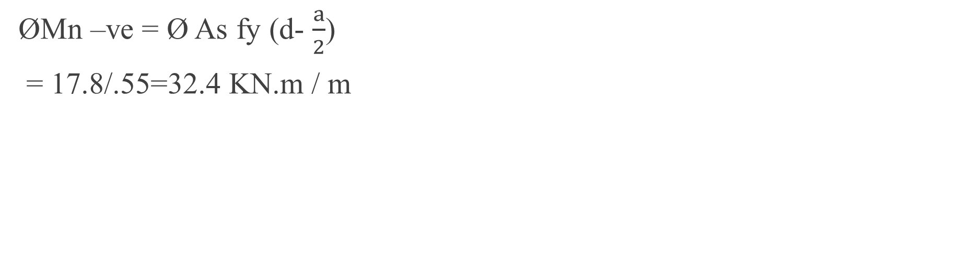
Slab Moments:
Negative Moment:
ØMn –ve = Ø As fy (d- $\frac{a}{2}$)
= 17.8/.55=32.4 KN.m / m

Slide 36
Slab Moments:
M-ve E-Tabs < ØMn-ve for Green and Yellow areas
ρ _{min} = 0.0033
As _{min} = 153.45 mm²/rib → bottom steel 2Ф10/rib
M_{max}-ve E-Tabs = 32.4 KN.m > ØMn-ve for Red areas
ρ = 0.0048
As = 226 mm²/rib → 2ϕ12/rib
M_{max}+ve E-Tabs < ØMn+ve for All Slabs
ρ = 0.0033
As = 562.65 mm²/550mm →3ϕ16/rib
Use Shrinkage steel ϕ8/300mm

Slide 37
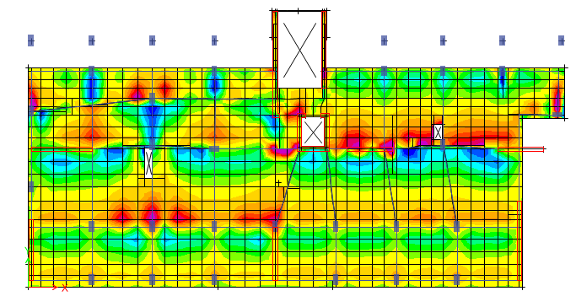
Slab Shear :
Concrete Resistance of shear :
Vu = 57 KN
If Vu < Ø Vc , No need for shear reinforcement.
Although the slabs does not need shear stirrups. Stirrups must be used to hold the bottom bars.
Stirrups 1ϕ10 / 300mm

Slide 38
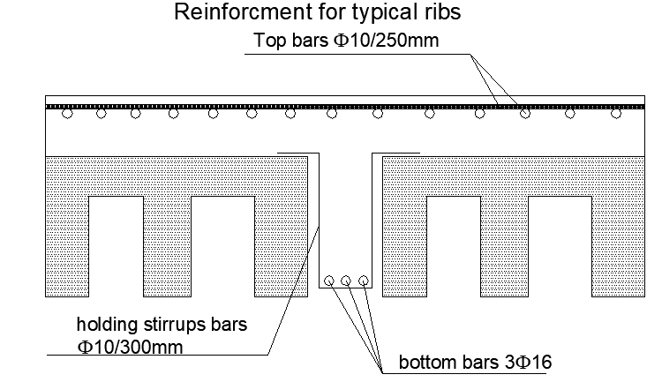
Slab Section:

Slide 39
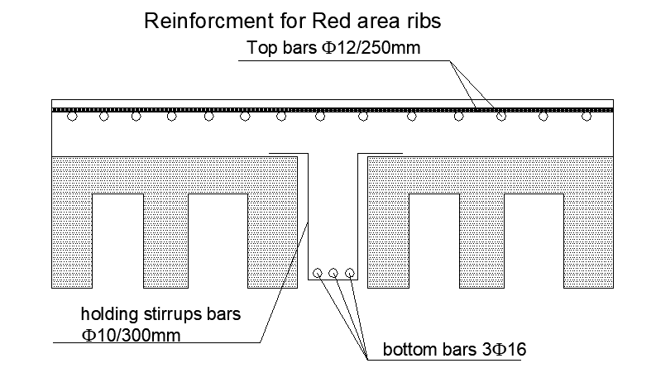
Slab Section:

Slide 40
Beam Design:
All beams in our Building are hidden.
Depth (mm) | Width (mm) | Type | Beam
350 | 700 | Hidden beam | B 70*35
350 | 400 | Hidden beam | B 40*35

Slide 41
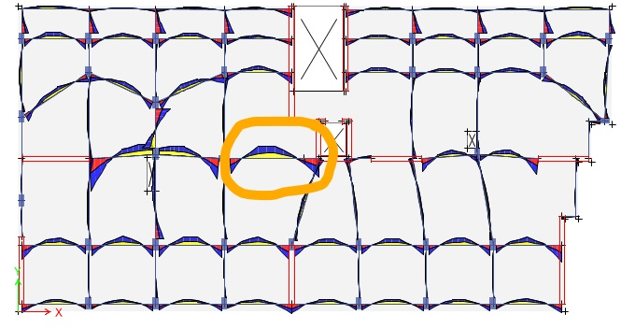
Beam Design (B110 )
Hidden Beam “B110” in the 1st story was chosen to check reinforcements. Beams width and depth are 70cm and 35cm respectively.

Slide 42
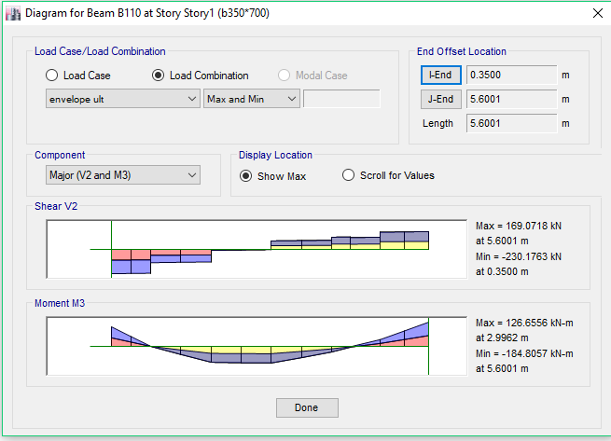
Beam “B110” Internal Forces:
Mu +ve manually = 126 kN.m
Mu -ve manually = 185 kN.m
Vu = 230KN

Slide 43
Beam “B110” reinforcement:
+ve As = 1218 mm² > As min = 670 mm² → Top Bars 6ϕ16
-ve As = 1847mm² > As min = 670 mm² → Bottom Bars 10ϕ16
T_{th} = 8.8 KN.m > Tu → No need for tensional reinforcement
ØVc = 133 KN < Vu → closed stirrups Ф10/100mm

Slide 44
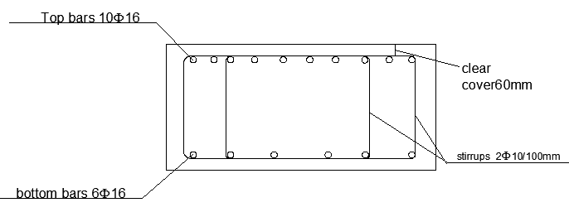
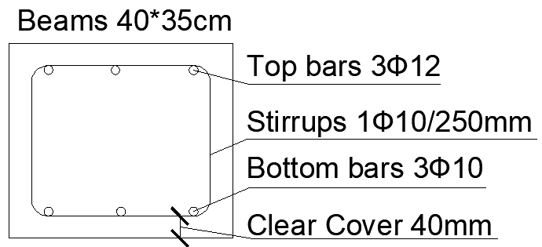
Beams Section:

Slide 45
Columns Design:
Two columns in the project differs in dimensions and lengths:
Type | Length
Typical stories | 3.3m
ground floor story | 8 columns are 5.6m and the rest is 3.3m.
1st basement story | 3.3m
2nd basement story | 3.3m
**the Dimensions of Columns is 700*350 Expect the columns with length 5.6m is 850*400

Slide 46
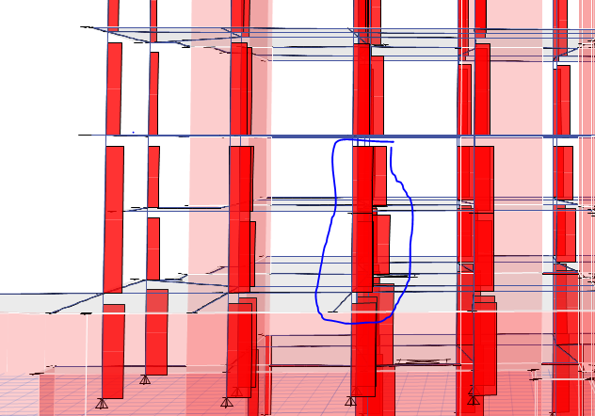
Columns Design:
Column “C7” which has the max. compression load was chosen to check reinforcement in the ground floor.

Slide 47
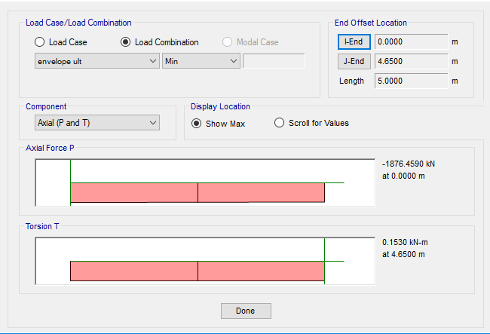
Ground floor Column “C7” Internal forces:
Pu =1876 KN

Slide 48
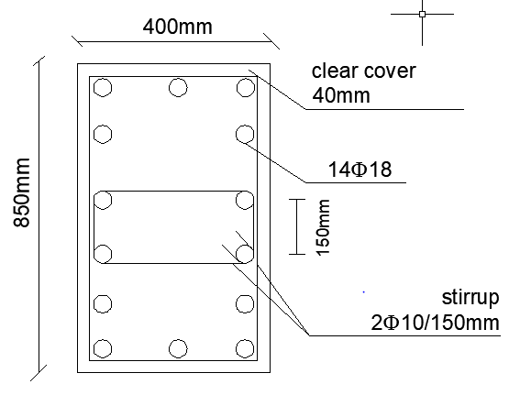

Columns 85cm*40cm Design:
Slenderness ratio:
$\frac{K L}{r}$ = 20.5< 22
Slenderness can be neglected.
Ag = 340,000 mm2
ρ min = 0.01
As min = 3400 mm2
ØPn = 4313 KN > Pu

Slide 49
Walls Design:
Two types of walls in this project
Building Non Bearing walls
Basement Shear walls

Slide 50
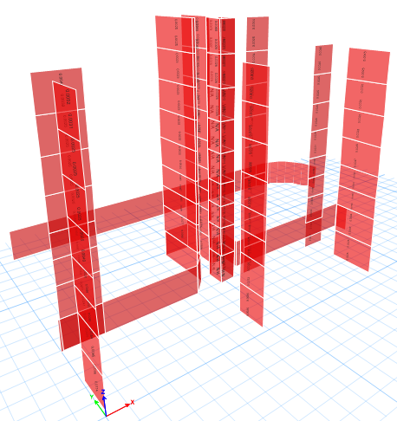
Non Bearing Walls Design:
Thickness = 300mm

Slide 51
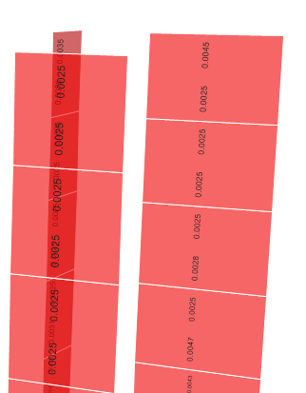
Non Bearing Walls Design:
Sample design and detailing of shear wall:
Almost of piers have min.steel ratio 0.0025 expect two piers have steel ratio 0.0045.

Slide 52
Non Bearing Walls Design:
ρmin bottom_{vertically} = 0.0025
As _{min vertically} = 0.0025 *300*1000 =750 mm²/m
ρ upper_{vertically} = 0.0045
As _{min vertically} = 0.0045 *300*1000 =1350 mm²/m
Use Ø14/250mm at each face of the wall as vertical steel for
shear walls
ρmin _{horizontally} = 0.0025
As _{Shrinkage horizontally} = 0.0025 *300*1000 = 750 mm²/m
Use Ø12/250mm at each face of the wall as horizontal steel

Slide 53
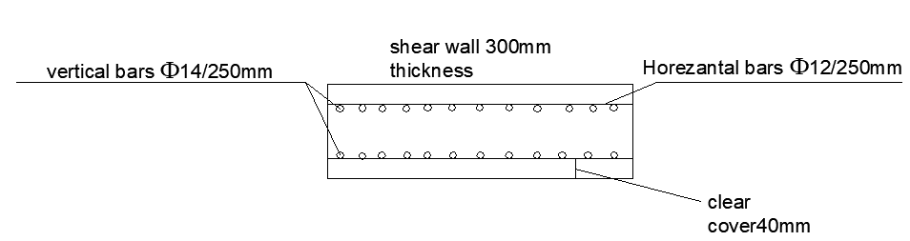
Non Bearing Walls Reinforcement

Slide 54
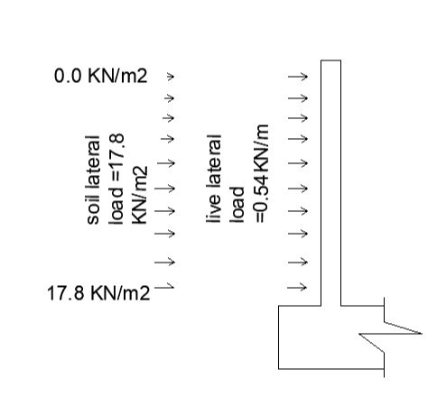
Basement Wall Design:
Wall thickness = 300mm
γ soil = 20 KN / m³
Ka = 0.27
f’c = 24 MPa
fy = 420 Mpa
q soil = γ Ka * 3.3m = 17.8 KN / m²
q Live = Ka * Live load = 0.54 KN / m²

Slide 55
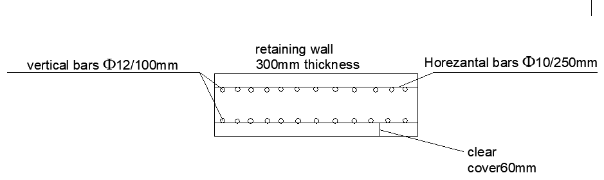
Basement Wall Design:
Max +ve Moment = 12.86 KN.m
Max -ve Moment = 5.68 KN.m
ØVc = 53 KN > Vu=23 KN.

Slide 56

Foundation Design:
The foundation system we used is a mat Foundation system.
We used Safe software program to design the foundations.

Slide 57
Foundation Details:
The allowable bearing capacity for soil in the location of the
building is 240 KN/m².
Thickness of each foundation was chosen based on wide beam shear and punching shear.
Our foundation thickness is 1000 mm.

Slide 58
Foundation Checks:
Wide beam shear check.
Deflection check.
Stresses check.

Slide 59
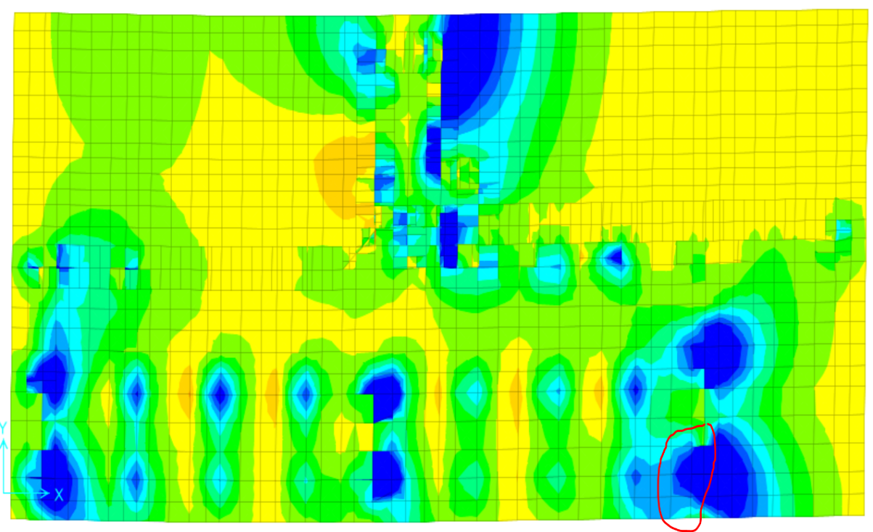
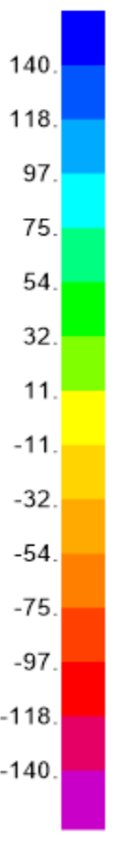
Wide Beam Shear Check:
Ø Vc = Ø/6 λ √𝑓′𝑐 b d = 140 KN
As shown in the figure the range is between (-140 to140); the areas with the dark blue exceedes 140 KN
These areas are within the distance of 270mm (effective depth) from the supports.
So there is no need for wide shear reinforcement steel in the foundation.

Slide 60
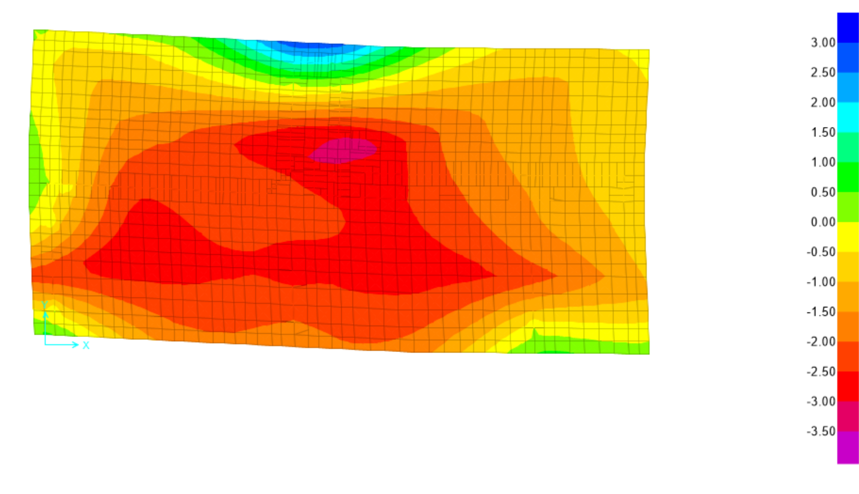
Deflection Check:
The maximum allowable deflection for foundation equals 3.5mm
The maximum deflection in this foundation equals 3.15mm < 3.5mm.. OK

Slide 61
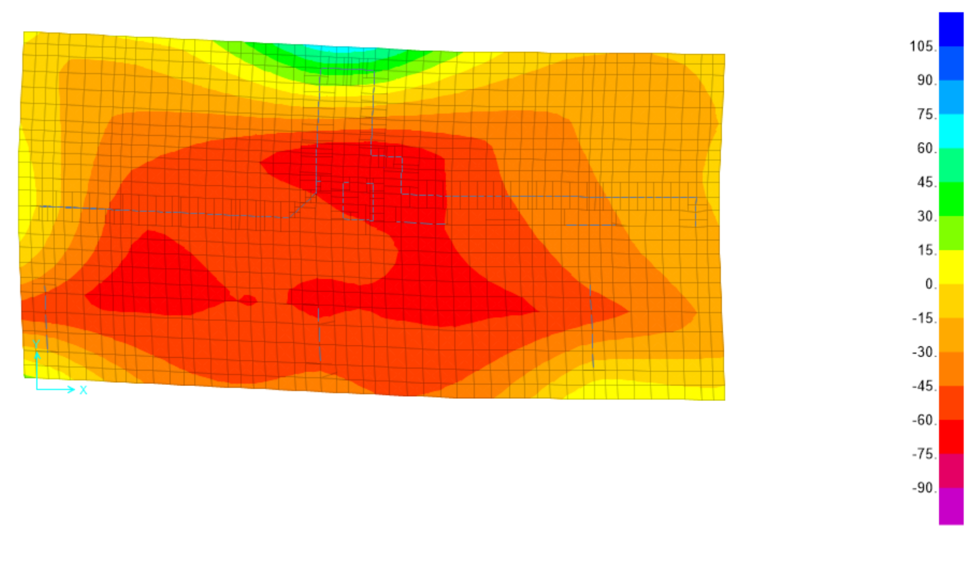
Stresses Check:
Maximum soil pressure equals 75 KN/m² which is smaller than the allowable bearing capacity of the soil = 240 KN/m²

Slide 62
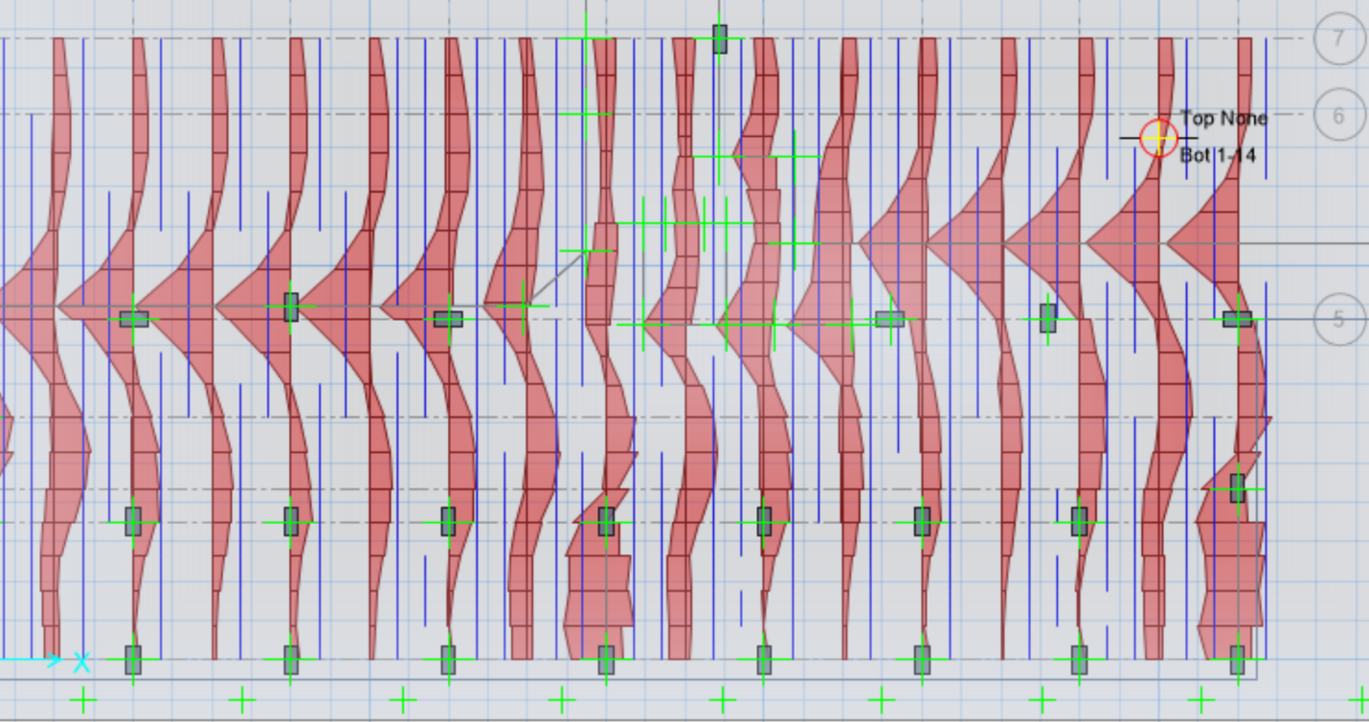
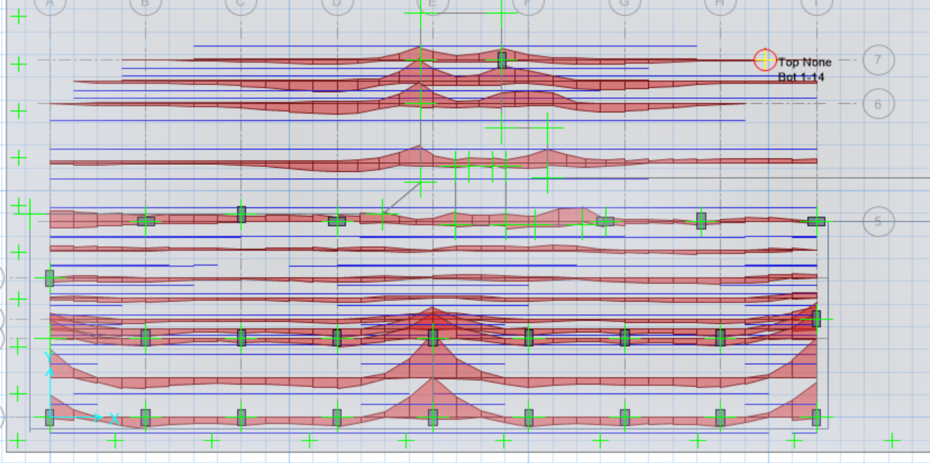
Flexure Design using SAFE:
Steel distribution in Y direction.
Steel distribution in X-direction.

Slide 63

Flexure In Y-Direction:

Slide 64

Flexure In X-Direction:

Slide 65
References:
ACI Committee 318 “Building Code Requirements for Structural Concrete (ACI 318M-14)” American concrete institute, Michigan, 2011.
ASCE Committee (2010), “American Society of Civil Engineers, Minimum Design Loads for Buildings and Other Structures” American Society of Civil Engineers, Virginia 20191, 2010.
IBC 2012

