Slide 1
Optimum Sizing for Anaerobic Digester for Electricity Generation
Presented by:
Rula Abdalhaq
Sara kharouf
Supervised by:
Dr. Abdelrahim AbuSafa

Slide 2
Outlines
Our Study
Objectives
Constraints
Plant Design
Economical Analysis
Results
Conclusion

Slide 3
Our study
Optımum sizing for BD
Raw Material
Plant Design
Economic Analysis
Figure 1

Slide 4
Objectives
The main objective of this work is to find the optimal size of BD in Palestine through:
1. Examine the potential of biogas production from animal manure.
2. Calculating the levelized energy cost (LEC) from BD Based on the bio digesters volume
3. Find the optimum Bio digester volume based on LEC.

Slide 5

Constraints
Profit
LEC $<$ Local Electricity Cost
LEC < Local Electricity Cost
Construction
Height of BD $<$ 20m
Height of BD < 20m
Temperature
The heating temperature must be with consideration of cost.
Collection
Technical
Obtaining the Raw material
Lack of technical elements sizes
Figure 2

Slide 6
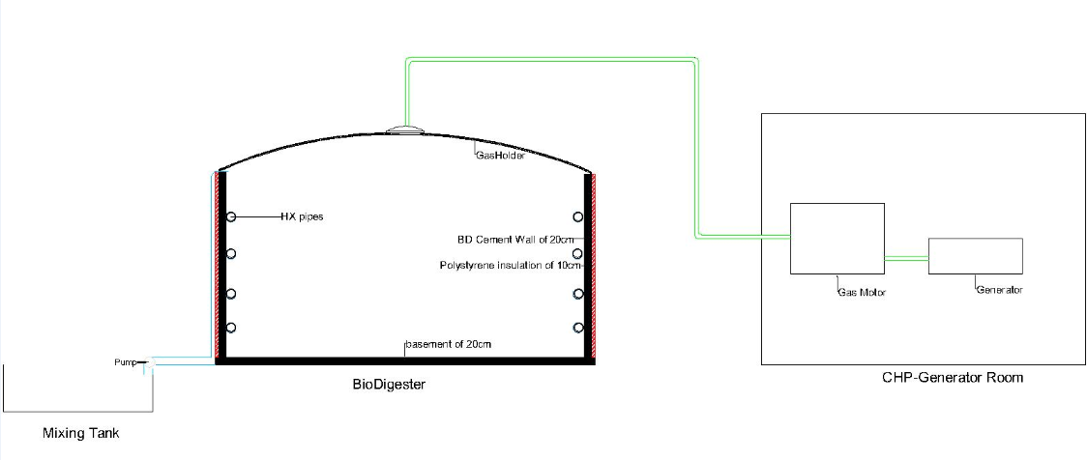
Plant Design
Figure 3

Slide 7
Design parameters
Biogas production
Heat exchanger
Insulation selection
Pumps and piping system
CHP generator

Slide 8
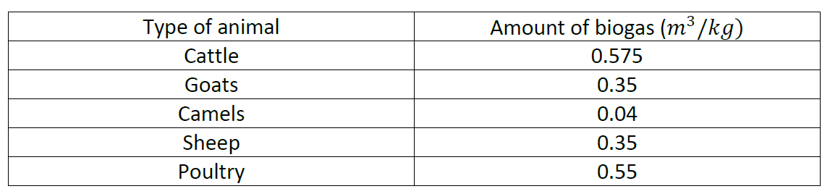
Biogas
Table1

Slide 9





Biogas
$M_{D}$=
1,494 kg/day
$M_{w}$=
5,869 kg/day
$M_{wd}$=
13,446 kg/day
$M_{ww}$= 4,377 kg/day
𝑊_𝑎=
9,069 kg/day
$M_{bio}$=
14,940 kg/day
Figure 4

Slide 10
Thermal Elements
Importance of thermal environment.
Essential thermal elements: Heat exchanger and insulation.
Worst case scenario: winter night with average temperature of 5c°.

Slide 11
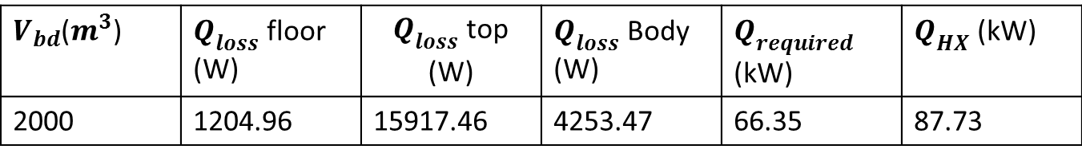
Thermal Elements
Heat Exchanger:
Stainless steel pipes
$V_{bd}$($m^{3}$) | $Q_{loss}$ floor (W) | $Q_{loss}$ top (W) | $Q_{loss}$ Body (W) | $Q_{required}$ (kW) | $Q_{HX}$ (kW)
2000 | 1204.96 | 15917.46 | 4253.47 | 66.35 | 87.73
Table3

Slide 12
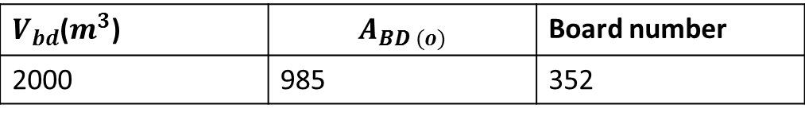
Thermal Elements
Insulation:
Polystyrene Boards:240cm*120cm*10cm
$V_{bd}$($m^{3}$) | $$A_{BD (o)}$$ | Board number
2000 | 985 | 352
Table2

Slide 13
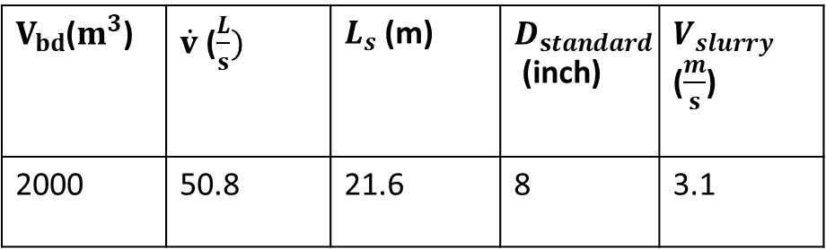
Pumps & Piping system
Piping system:
$V_{bd}$($m^{3}$) | $\dot{v}$ ($\frac{L}{s})$ | $L_{s}$ (m) | $D_{standard}$ (inch) | $V_{slurry}$ ($\frac{m}{s}$)
2000 | 50.8 | 21.6 | 8 | 3.1
Table3

Slide 14
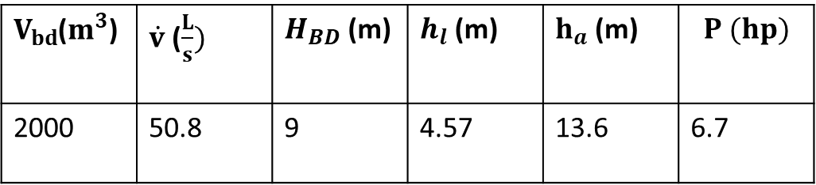
Mechanical & Electrical Elements
Pumps:
$V_{bd}$($m^{3}$) | $\dot{v}$ ($\frac{L}{s})$ | $H_{BD}$ (m) | $h_{l}$ (m) | $h_{a}$ (m) | $$P (hp)$$
2000 | 50.8 | 9 | 4.57 | 13.6 | 6.7
Table4

Slide 15
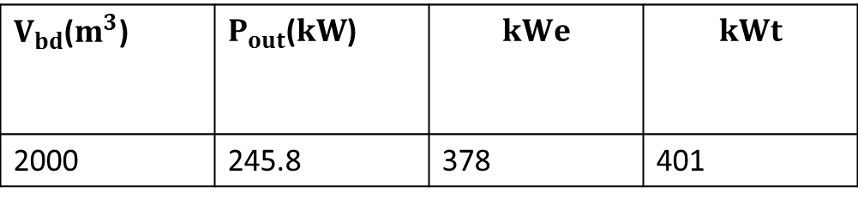
Mechanical & Electrical Elements
CHP- generator:
$V_{bd}$($m^{3}$) | $P_{out}$($kW$) | $$kWe$$ | $$kWt$$
2000 | 245.8 | 378 | 401
Table5

Slide 16
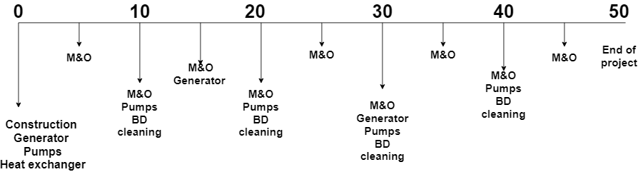
Economic Analysis
Payments Flow chart
Figure 5

Slide 17
Result
Piping system
CHP generator
Insulation
Total cost
LEC
SPP

Slide 18
Piping System
Figure 6

Slide 19
Piping System
Figure 7

Slide 20
CHP Generator
Figure 8

Slide 21
CHP Generator
Figure 9

Slide 22
Insulation
Insulation thickness differs with outside conditions

Slide 23
Total Cost
Figure 10

Slide 24
LEC
Figure 11

Slide 25
SPP
Figure 12

Slide 26
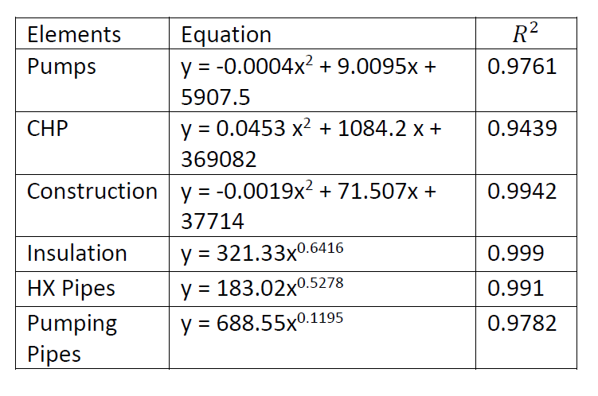
Implication
Table6

Slide 27
Conclusion
1. It is feasible to use biogas as a source of electricity was approved in the Palestinian market.
2. On average, the production cost for each kWh of electricity from biogas is 0.067 ILS.
3. Depending on the location and the investor, the SPP of the project is between (2-8) years.

