Slide 1
Assessment of Sports Hall & Students Affairs in the Arab American University
Prepared By: Aya Nayef Sulaiman
Batool Jameel Mubaslat
May Ahmad Sawaftah
  Supervied by : Eng. Reema Nassar

Slide 2
Contents:
→ Chapter One :. Project Definition.
→ Chapter Two : General introduction.
→ Chapter Three : Methodology.
➔Quantity Surveying
➔ Cost Estimate
➔ Time Schedule
→ chapter Four : Results and Analysis.

Slide 3
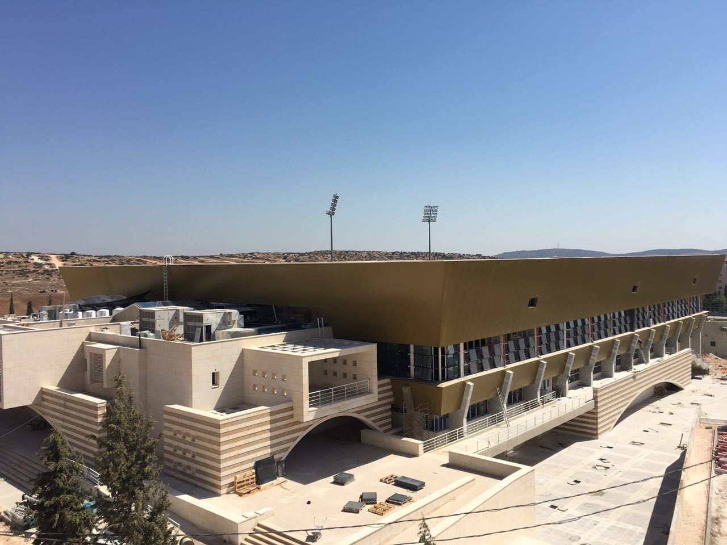
Chapter one: Project Definition

Slide 4
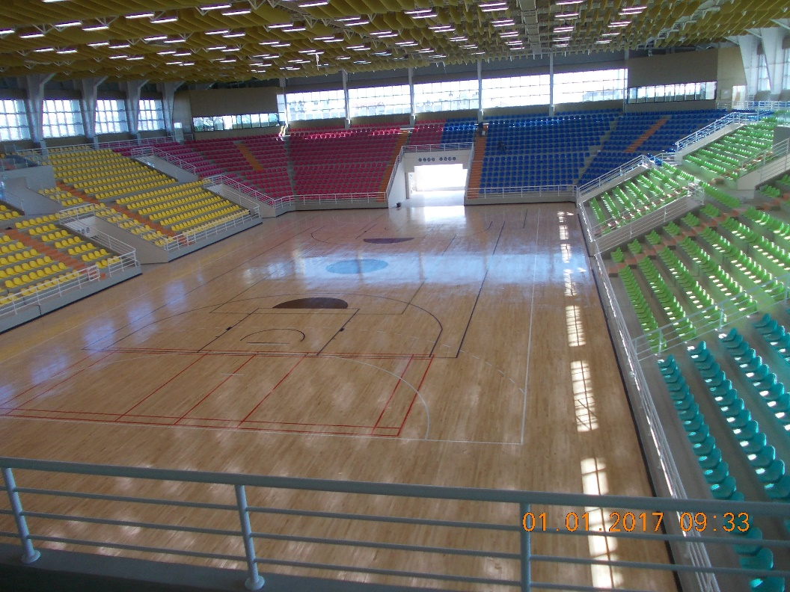
Sport hall
Area for each floor
Area | Floor | Item#
2475 m² | Ground Floor | 1
1123 m² | First floor | 2
4931 m² | Second floor | 3

Slide 5
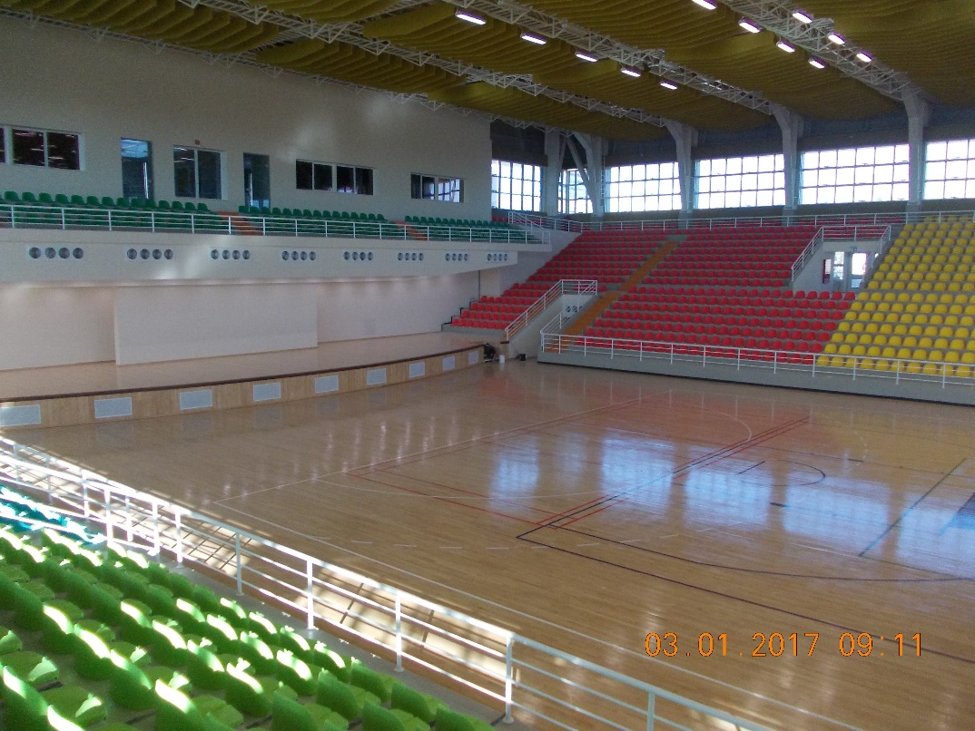
Function of sport hall
Play courts | Meeting room
Apparatus room | Caretakers
Cleaning room | Storage
Service room | Changing Room
Service corridor | Mal WC
Event Stage | Female w.c
Aerobics | Instructor
Sound system | Mechanical room
Press | TV/Radio
VIP stages

Slide 6
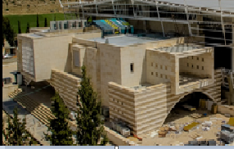
Students affairs
Area for each floor
Area | Floor | Item#
1230 m² | Ground Floor | 1
818 m² | First Floor | 2
721 m² | Second Floor | 3

Slide 7
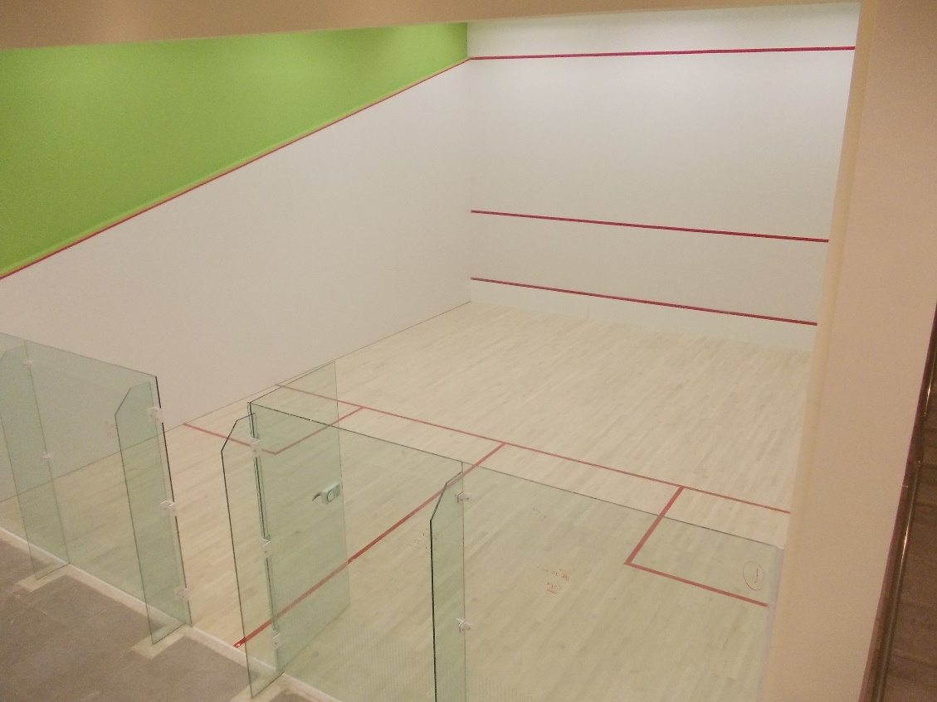
Functions of student affairs
 | Functions of student affairs
Foyer | control room
Male WC | changing rooms
sports activities front desk | Female WC
service room | reception first floor
Fitness | Squash
Trans. /Elc. Room | Bowling
Cafeteria | interactive entertainment
billiard & ping-pong | Kitchen

Slide 8

Chapter two: General introduction.
Project Management
  Definition
  Functions
  Planning phase
    Quantity surveing
    Time Secdule
    Cost Estimate

Slide 9
Project Delivery System.
Contract →Unit Price
→ Lump Sum :-1- Definition.
2- Musleh Company.
3- Document.
BOQ

Slide 10
Chapter three: Methodology
Documents
Visiting Site.
WBS

Slide 11
WBS
SPORT HALL AND STUDENT AFFAIRS
SPORT HALL
Student Affairs
External Work
finishing
Skeleton
finishing
Skeleton
Ground Floor
First Floor
Second Floor
Ground floor
First Floor
Second Floor
Basement
Ground Floor
First Floor
Second Floor
Basement
Ground Floor
First Floor
Second Floor

Slide 12
Quantity Surveying
Definition:- the estimated quantities of materials required on a project are normally determined by professional surveyor or engineer.
Data Required.
Importance.
Our Quantity Surviving :- Our Quantity.
Waste factor.
Problems During calculation
Sample Calculation.

Slide 13
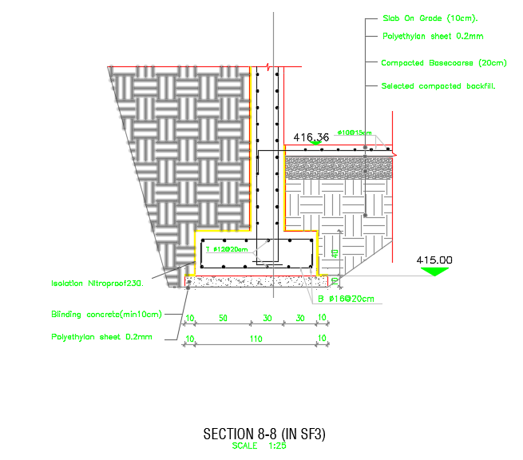
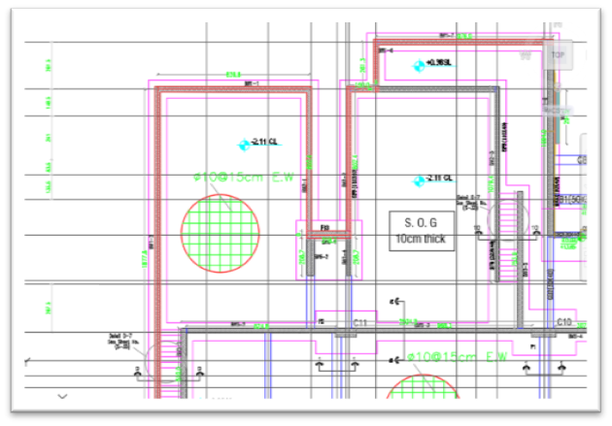
Shear Wall Footing

Slide 14
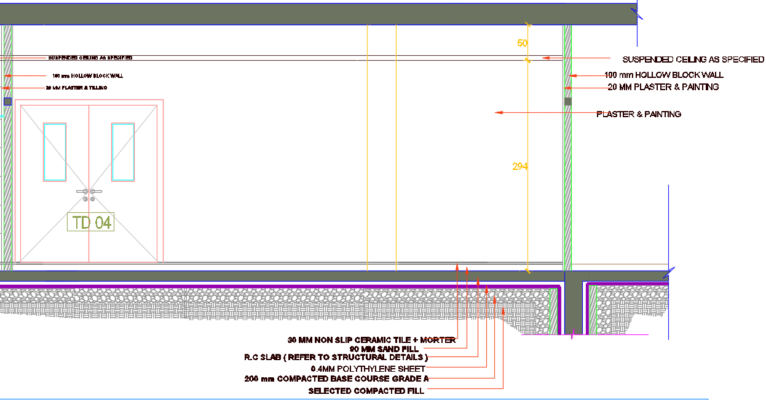
Section in sport hall in ground floor.
Finishing Detailing

Slide 15
Time Scheduling
Definition
Importance
Time Scheduling steps
  Activities
  Logic relation ships
  Productivity rate
  Resources
  Duration

Slide 16
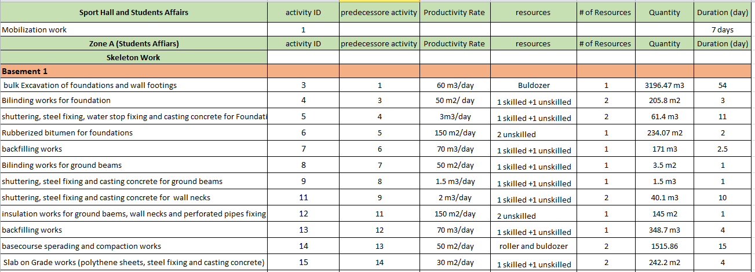

Slide 17
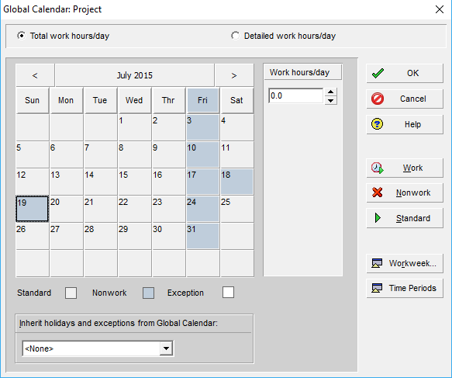
Primavera
  - calendar
Activities with durations
Bar Chart

Slide 18
Cost Estimate
Definition
Types of cost estimate
Pricing
Sample calculation

Slide 19
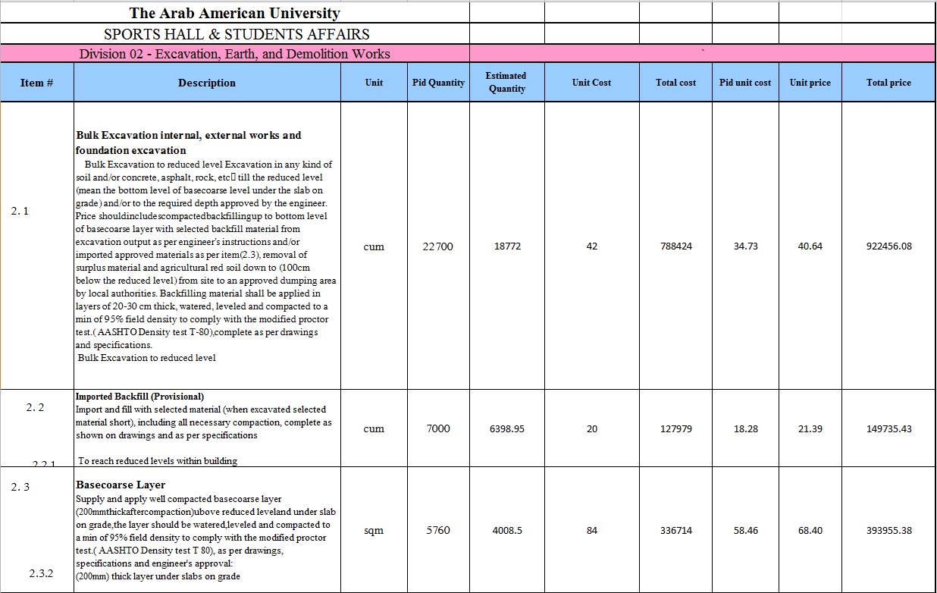

Slide 20
Chapter four: Results and Analysis for price
Results:
Total price of the project 38,809,647.64 Nis.
Analysis :
  The total calculated price is 38,809,647.64Nis while the actual bid price was almost 37 Million, the difference due to:
    - The actual percentage of profit and taxies maybe less than our assumptions.
    - Discount’s that the contractor company maybe gets from suppliers.
    The way they price the items.
  The price per m2 of the project equals 2573.7 Nis

Slide 21
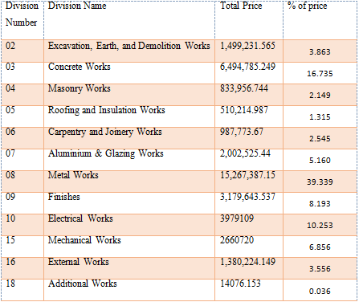

Slide 22
Chapter four: Results and Analysis for time
Results:
After entering the duration of each activity to the Primavera and re-scheduling the project, the duration of the project is 603 days (work days) and 719 days (calendar days).

Slide 23
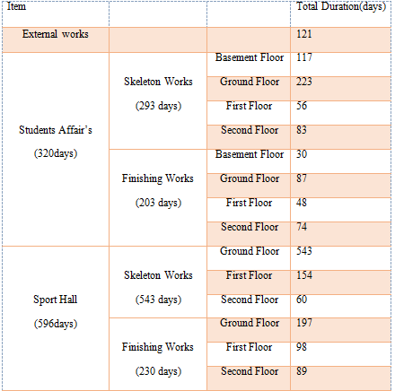

Slide 24

THANK YOU

