Slide 1
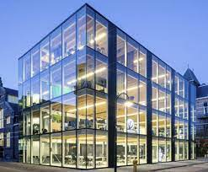
Smart
Building
Supervised by : Dr. Emad Natsheh
Students : Bara’a Bouzia , Noura Darwazeh

Slide 2
TABLE OF CONTENTS
01
04
ABOUT THE PROJECT
What we learned
02
PROJECT GOALS
03
PROJECT Idea
05
Enhancement

Slide 3
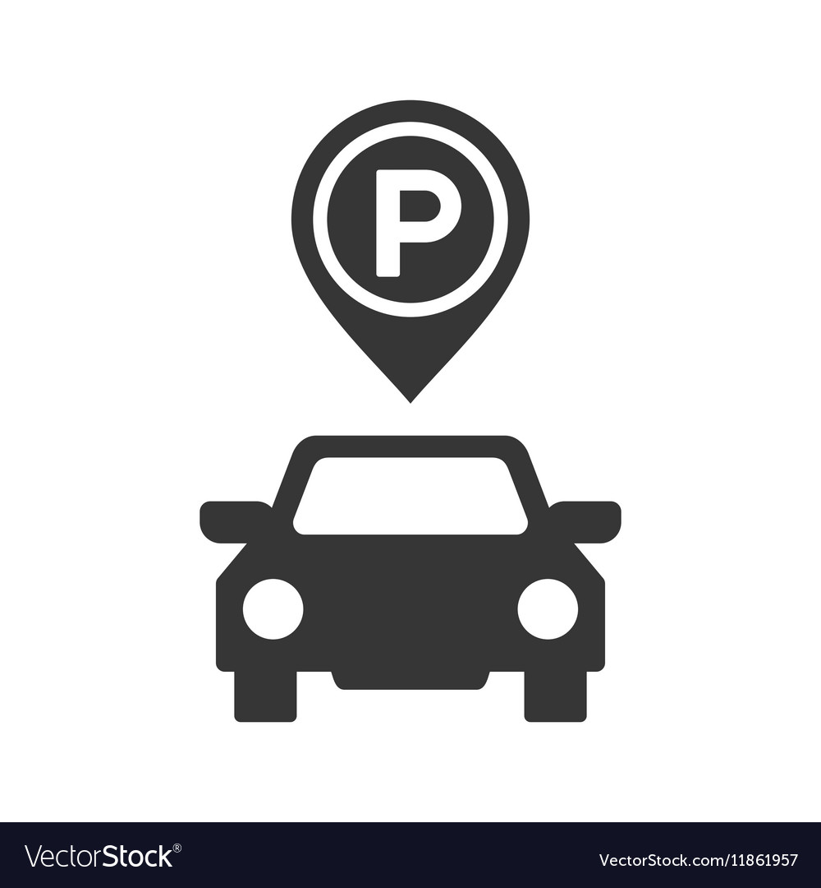


ABOUT THE PROJECT
Elevator
Parking
Gas sensor
We solved the problem of payment among the residents of the building when using the elevator by charging a card with a certain number of steps,
and the number of these steps is reduced by the number of floors used
We solved the problem of congestion
in the parking lot by dividing the parking
into two parts, one for the residents of
the building and other for the guests.
We solved the problem of a gas leak
inside the building by using the gsm
module

Slide 4


PROJECT GOALS
Securing the building elevator through the use of a card for each user, so reduces the occurrence of problems among the residents of the building about paying the subscription.
Securing the building door by opening it only through a valid password.
Allowing the residents of the building to park their car in the parking and also allowing their guests to park their car in a smooth and easy way through Mobile App.
Sensing the occurrence of any gas leakage, then automatic and direct contact with the firefighter.

Slide 5
Project Idea
02
03
01
The idea of our project came when
04
we noticed that there were problems among the residents of the building about paying the elevator subscription fees and the unequal use of the elevator among the residents of the building, so we tried to solve that by using a charged card,
we noticed that the guests complained that there was no place to park their car, so we decided to allocate a place for them to put their car.
We noticed a delay in the arrival of a firefighter when a gas leak occurred, so we decided to make a quick contact with the firefighter when a gas leak occurred
we noticed the entry of strange people so we try to solve that by setting the password for the building door

Slide 6

What we learned
we learned the Arduino language, and how to deal with the pieces through the data sheet, interlocking them and downloading the code on them.

Slide 7
Enhancement
we can develop our project by :
*adding a special mobile app to the user by creating an account on it and knowing how many steps there are, and able to charge a specific number of steps by filling in its information and through a Visa Card
*adding another mode when entering the elevator through the fingerprint in case the user forgets his card.
*Also, instead of using buttons for the elevator, it can work
according to the sound, which determines which floor it wants, so it becomes smarter

Slide 8
Quotation:
“If the plan does not work , change the plan not the goal ”

Slide 9
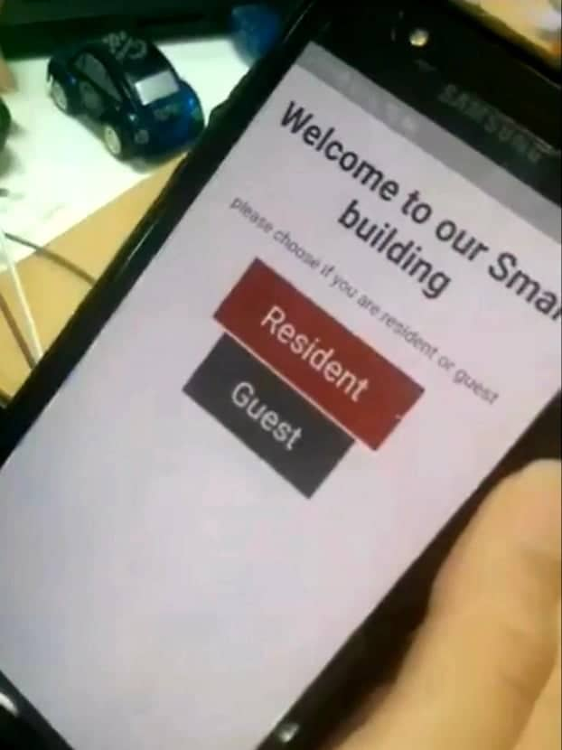
Additional pictures of the project
Mobile app

Slide 10
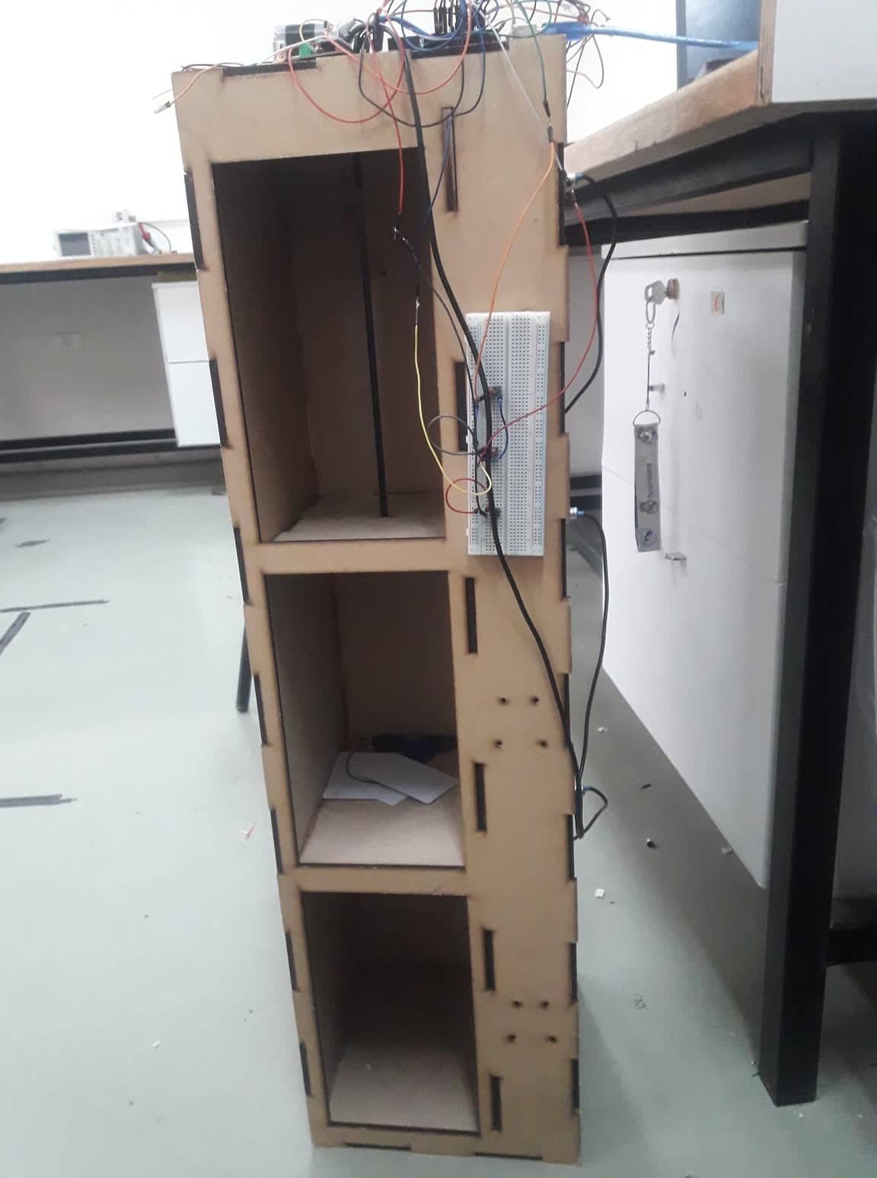
Elevator

Slide 11
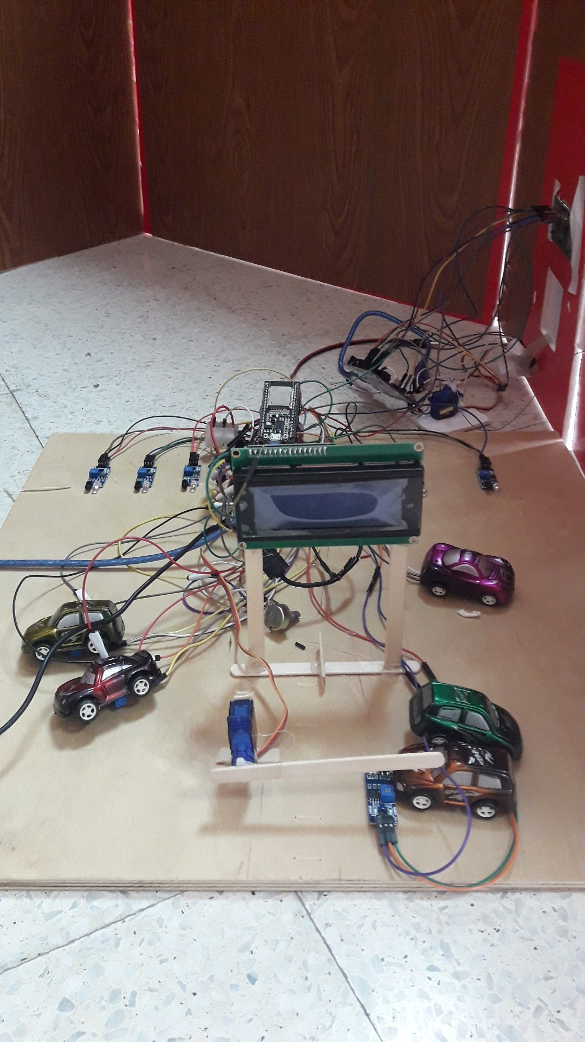
Parking

Slide 12
Thanks For listening

