Slide 1

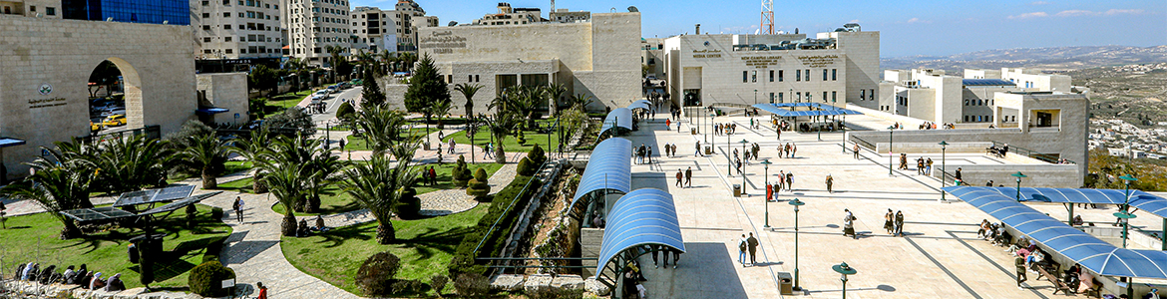


An-Najah National University
Faculty of Engineering and Information Technology
Department of Computer Engineering
Graduation Project II – 10636582/7
Date: 2025.06.25

Slide 2

Multifunctional Beverage Preparation and Dispensing System
iDrink Station
Ahmad Ghassan Atallah
Khaled Mohammad Saadeh

Slide 3


Dr. Hanal Abu-Zant
I would like to express my sincere gratitude to An-Najah National University, the leading educational institution in Palestine. I extend my sincere appreciation to the faculty members who have guided me over the past five years, especially my distinguished supervisor, Dr. Hanal Abu Zant, whom I thank from the bottom of my heart for her invaluable support. I also extend my sincere thanks to my family and everyone who contributed to the success of this achievement.

Slide 4


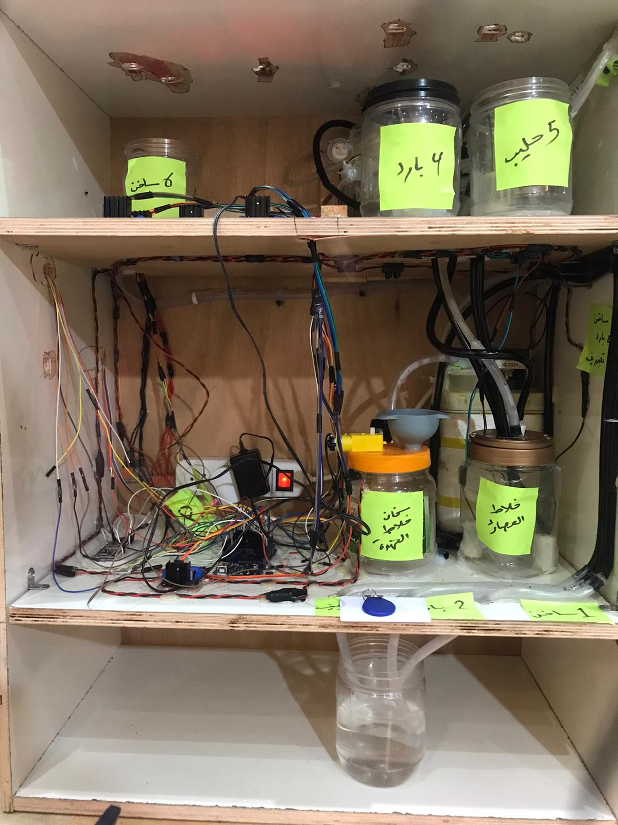
CONTENTS
Chapter One: Introductory
Chapter Two: Constraints and Standards
Chapter Three: Hardware Components
Chapter Four: Methodology

Slide 5

01
Introductory

Slide 6


Abstract
Project Name: iDrink Station
Purpose: Smart machine for preparing cold and hot beverages automatically.
Benefits: Supports digital transformation in vending services
iDrink Station is a smart beverage vending machine that prepares both cold and hot drinks automatically using Arduino and ESP32.
Control Options:
Keypad (manual control)
Mobile app (remote control)
RFID card (user authentication & activation)
Main Components:
Arduino Mega, ESP32, pumps, heaters, mixers, LCD
Features:
Mixes water with juice concentrate, coffee, or tea
Displays drink type, temperature, and cup count
Supports cleaning mode and payment validation
Use Cases:
Offices, cafes, public spaces, educational centers, small kiosks

Slide 7




Problems and Work Limitations
Experience Challenges
Budget Constraints
A limited budget forced us to use basic components, avoid expensive modules, and creatively manage space and wiring.
We lacked experience in hardware wiring, component integration, and system logic. Most progress was made through trial, error, and continuous learning.
Technical Issues
Time Constraint
We faced tubing leaks, pump drips, and synchronization problems. Fixes required manual adjustments and careful code logic.
The tight academic schedule limited testing and polishing. Still, we stayed motivated and built a functional prototype under pressure.

Slide 8
02
Constrains and Standards

Slide 9


Standards / Codes
Project Standards
Communication Standards
We followed academic and practical standards to ensure system stability, safety, and future scalability.
Used IEEE-based protocols (UART, I2C) for communication between ESP32, Arduino, and sensors.
Coding Guidelines
Wi-Fi Practices
Used Arduino best practices: clear code structure, modular design, and meaningful variable names for better readability.
Applied ESP32 best practices: proper library usage, memory handling, and non-blocking code for stable real-time control.
System Design
User Feedback
Modular system split into cold drink, hot drink, and cleaning units to allow easy upgrades and maintenance.
LCD and mobile UI follow intuitive design—clear layout, buttons, and status feedback after each action.

Slide 10
03
Hardware Components

Slide 11

Hardware Components
External Casing (Wooden Frame)
Provided structure, protected components, and separated liquid and electronic sections for better organization and safety.
Arduino Mega 2560
Serves as the main controller, managing pumps, sensors, LCD, keypad, and RFID—ideal due to its high I/O pin count.
ESP32 Module
Handles Wi-Fi communication, connects to the backend, and sends received commands to Arduino Mega via serial interface.

Slide 12
Hardware Components
RFID Reader (MFRC522)
Used to power the system ON/OFF and confirm payments with authorized cards—enabling access control and simulating cashless payment.
4x4 Keypad
Enables manual control—users can select drink type and number of cups without using the web app.
I2C LCD Display (20x4)
Shows real-time info like startup, drink selection, filling status, and payment—enhancing user experience with clear feedback.

Slide 13
Hardware Components
Voltage Regulators & Resistors
Used for stable 5V/3.3V power and safe logic level shifting between modules like ESP32, RFID, and sensors—ensuring reliable operation.
Bimetallic Thermostat (Mechanical)
Controls heater temperature mechanically—automatically cuts power at ~70°C to prevent overheating, with no code or sensors needed.
Screw Terminal
Power Distribution Block
Simplifies wiring by grouping power and ground lines—connects multiple components to Arduino through just two main wires.

Slide 14
Hardware Components
Power Supply
System powered by two 12V sources and six L298N drivers—ensuring stable voltage and sufficient current for all components.
Breadboards & Jumper Wires
Used for flexible prototyping and testing of components before final assembly—enabled quick debugging using various jumper wire types.
L298N Driver Module
Controls direction and speed of pumps and mixers—enables efficient, bidirectional motor control with stable power delivery.

Slide 15
Hardware Components
Pumps and Motors
Controlled via H-bridge drivers for precise timing and direction. Includes pumps for juices, water, milk, hot drinks, and two mixers for blending before dispensing.
Pumps and Motors
Controlled via H-bridge drivers for precise timing and direction. Includes pumps for juices, water, milk, hot drinks, and two mixers for blending before dispensing.
Flow Sensors (6 Units)
Measure liquid volume via pulse signals—Arduino counts pulses to ensure accurate flow rate and consistent cup filling.

Slide 16
Hardware Components
Heater Unit
Hot Water Line
Heats water for hot drinks like coffee or milk—works with the hot water pump to deliver warm beverages.
Check Valves One-Way
Prevent backflow and dripping—ensure liquid flows in one direction only, improving hygiene and reducing waste.
Tubing & Connectors
Food-grade tubes used to route liquids between components—pressure balancing and tight fittings ensured leak-free, safe flow.

Slide 17
04
Methodology

Slide 18






Development Tools and Languages
iDrink Station Development
Code Editor
Combined embedded systems (Arduino & ESP32) with web technologies to build a fully automated drink machine.
Used VS Code for both firmware and web app—offering extensions, syntax highlighting, and Git integration.
Firmware Development
ESP32 Programming
Used Arduino IDE to program the Arduino Mega in C/C++ for controlling pumps, sensors, LCD, keypad, and RFID.
Programmed in C++ using Arduino-style libraries—managed Wi-Fi, received web commands, and sent to the Arduino.
Front-End Framework
Back-End Server
Built using React to create a responsive web app for drink selection, cleaning, and system monitoring.
Used Node.js to handle API requests and connect the web interface with ESP32 for real-time command delivery.
Circuit Design
Designed using Proteus to plan and simulate circuit connections before building the real system.

Slide 19



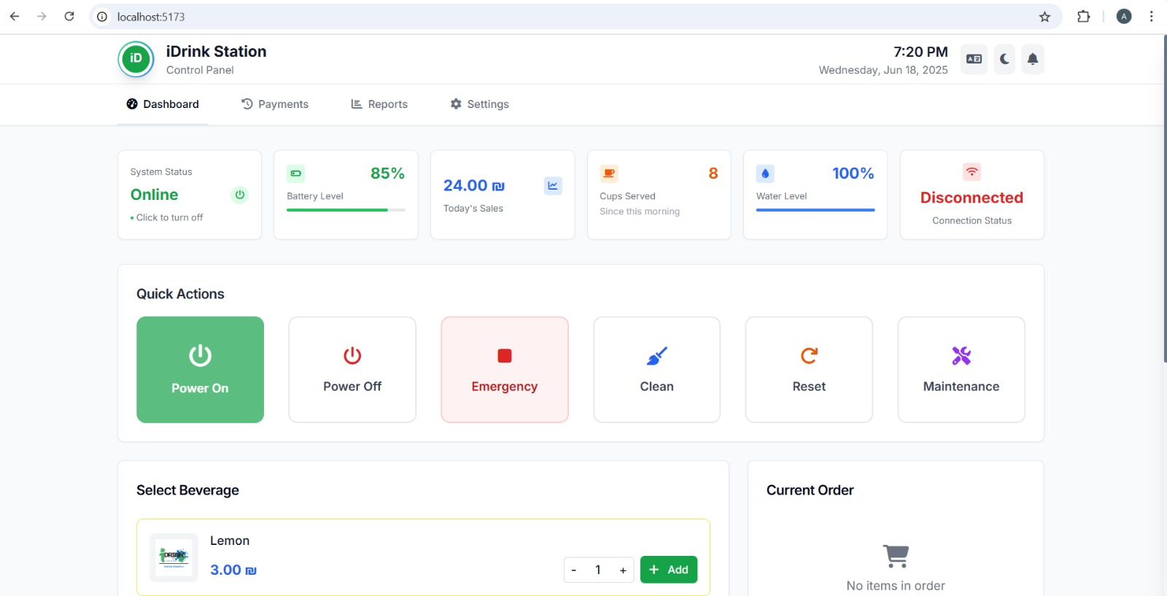


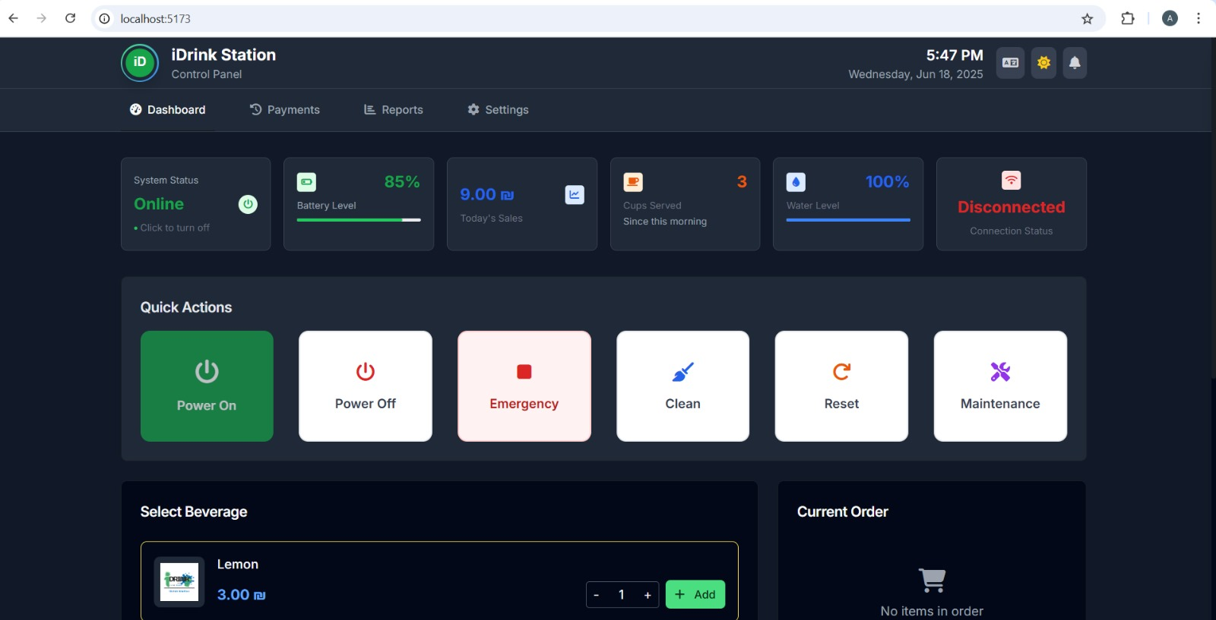
Programming Languages Used:
C/C++ Programming
JavaScript / JSX
Node.js Usage
Used for programming the Arduino Mega and ESP32 to handle sensor data, motor control, and communication logic.
Used in React for building the front-end interface. JSX allowed for modular UI components and interactive controls.
Used in the back-end to manage server logic, API endpoints, and real-time interactions between user and system.
HTML/CSS Design
System Overview
Used for structuring and styling the web application, ensuring responsiveness and a user-friendly experience.
Modern web development allowed us to create an efficient, connected, and interactive vending system that bridges the gap between physical hardware and remote control.

Slide 20

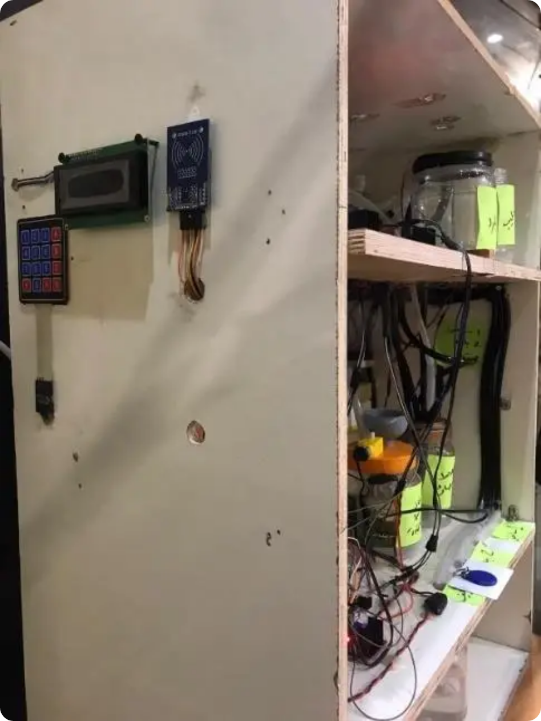
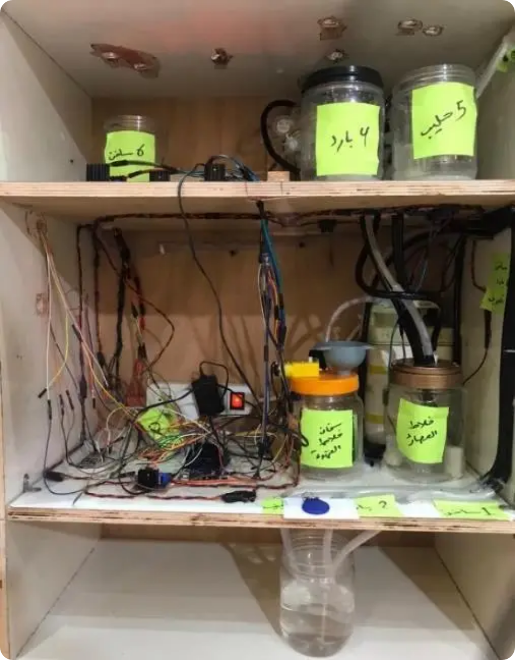
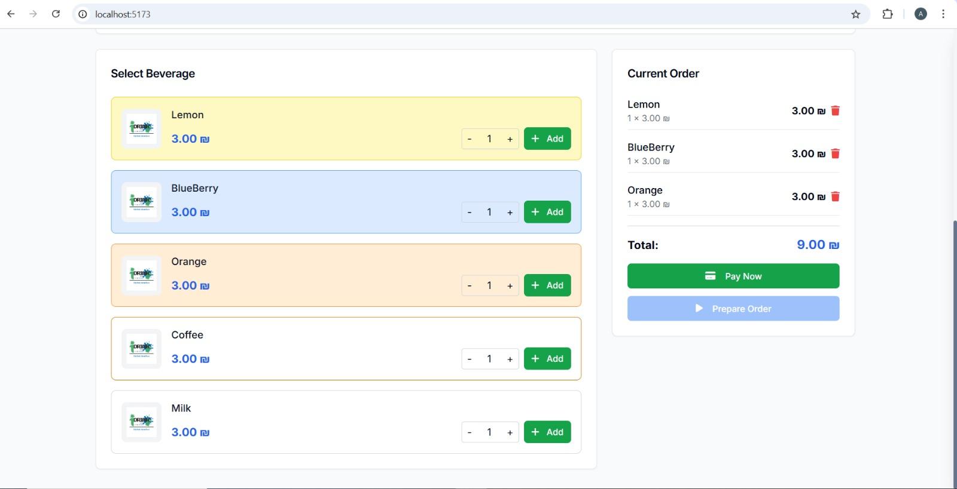
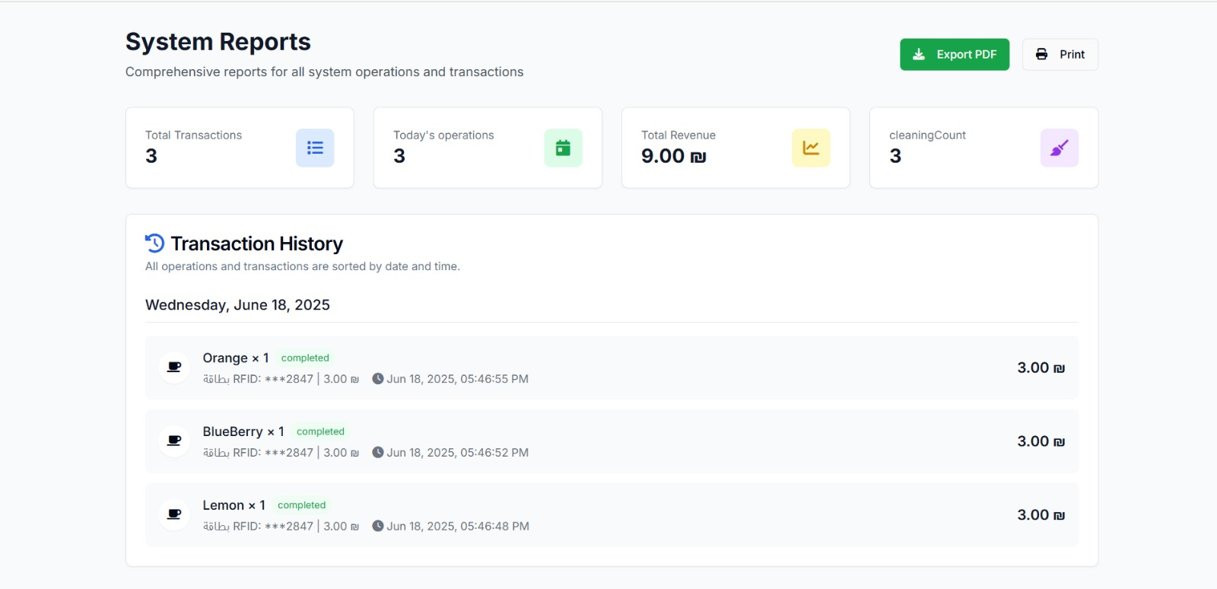
Final Solution

Slide 21
Thank You

