Slide 1

TO BUY LIST software project
Supervisor: Dr.Anas Toma

Slide 2


Raghad Marie
Team members
Seema Ziyad

Slide 3
Project Analysis
INTRODUCTION
MOTIVATION
PROJECT
IMPLEMENT
DESIGN
DEMO
FUTURE WORK

Slide 4

MOTIVATION
Many people may face problems in shopping by forgetting the list of orders to be purchased, as well as participating in the lists of orders among family members or friends so that everyone is allowed to add purchases they need, or forgetting the supermarket places and who is closest to the user, and he may need to go to several markets at the same time . Thus, we developed an application that alerts the user to his nearest supermarket, saving his time and effort and enabling him to choose among products from several stores.

Slide 5

INTRODUCTION
Our project is a mobile app and website that streamlines shopping by creating a smart shopping list, calculating the shortest path to stores, and providing notifications when near a store. It saves time, allows sharing of lists among family members, and offers monthly purchase reports. Our unique application aims to revolutionize the way people shop.

Slide 6





Project Features
Shopping
Lists
Friends
Stores
Maps
Notification
A user can create as many lists as he likes , User can also share the lists with family members and send requests to the list from another participant.
The user can send friend requests and share lists with each other.
The user can browse the stores and choose the products he wants in his list .
The map feature that shows the user the route in the least time and the shortest way to all stores
It also shows on the map the number of purchases from each store
Notifications appear when a person is about to reach the store, reminding him of his approach and location

Slide 7



Project Features
Chats
Offers
Website
A user can chat with his friends and create group with them .
The offers added from all stores are displayed on the offers page so the user can browse and add them to his list.
Through the website, the shop can add its products and offers so then it appears in the user side .

Slide 8








Project Tools
NodeJS ( backend language for mobile app )
Firebase ( database for notification and chats )
Flutter (frontend language for mobile app )
HTML (frontend language for web app )
CSS (frontend language for web app )
PHP ( backend language for web app )
MYSQL ( database server to store data )
JavaScript ( backend language for mobile app )

Slide 9
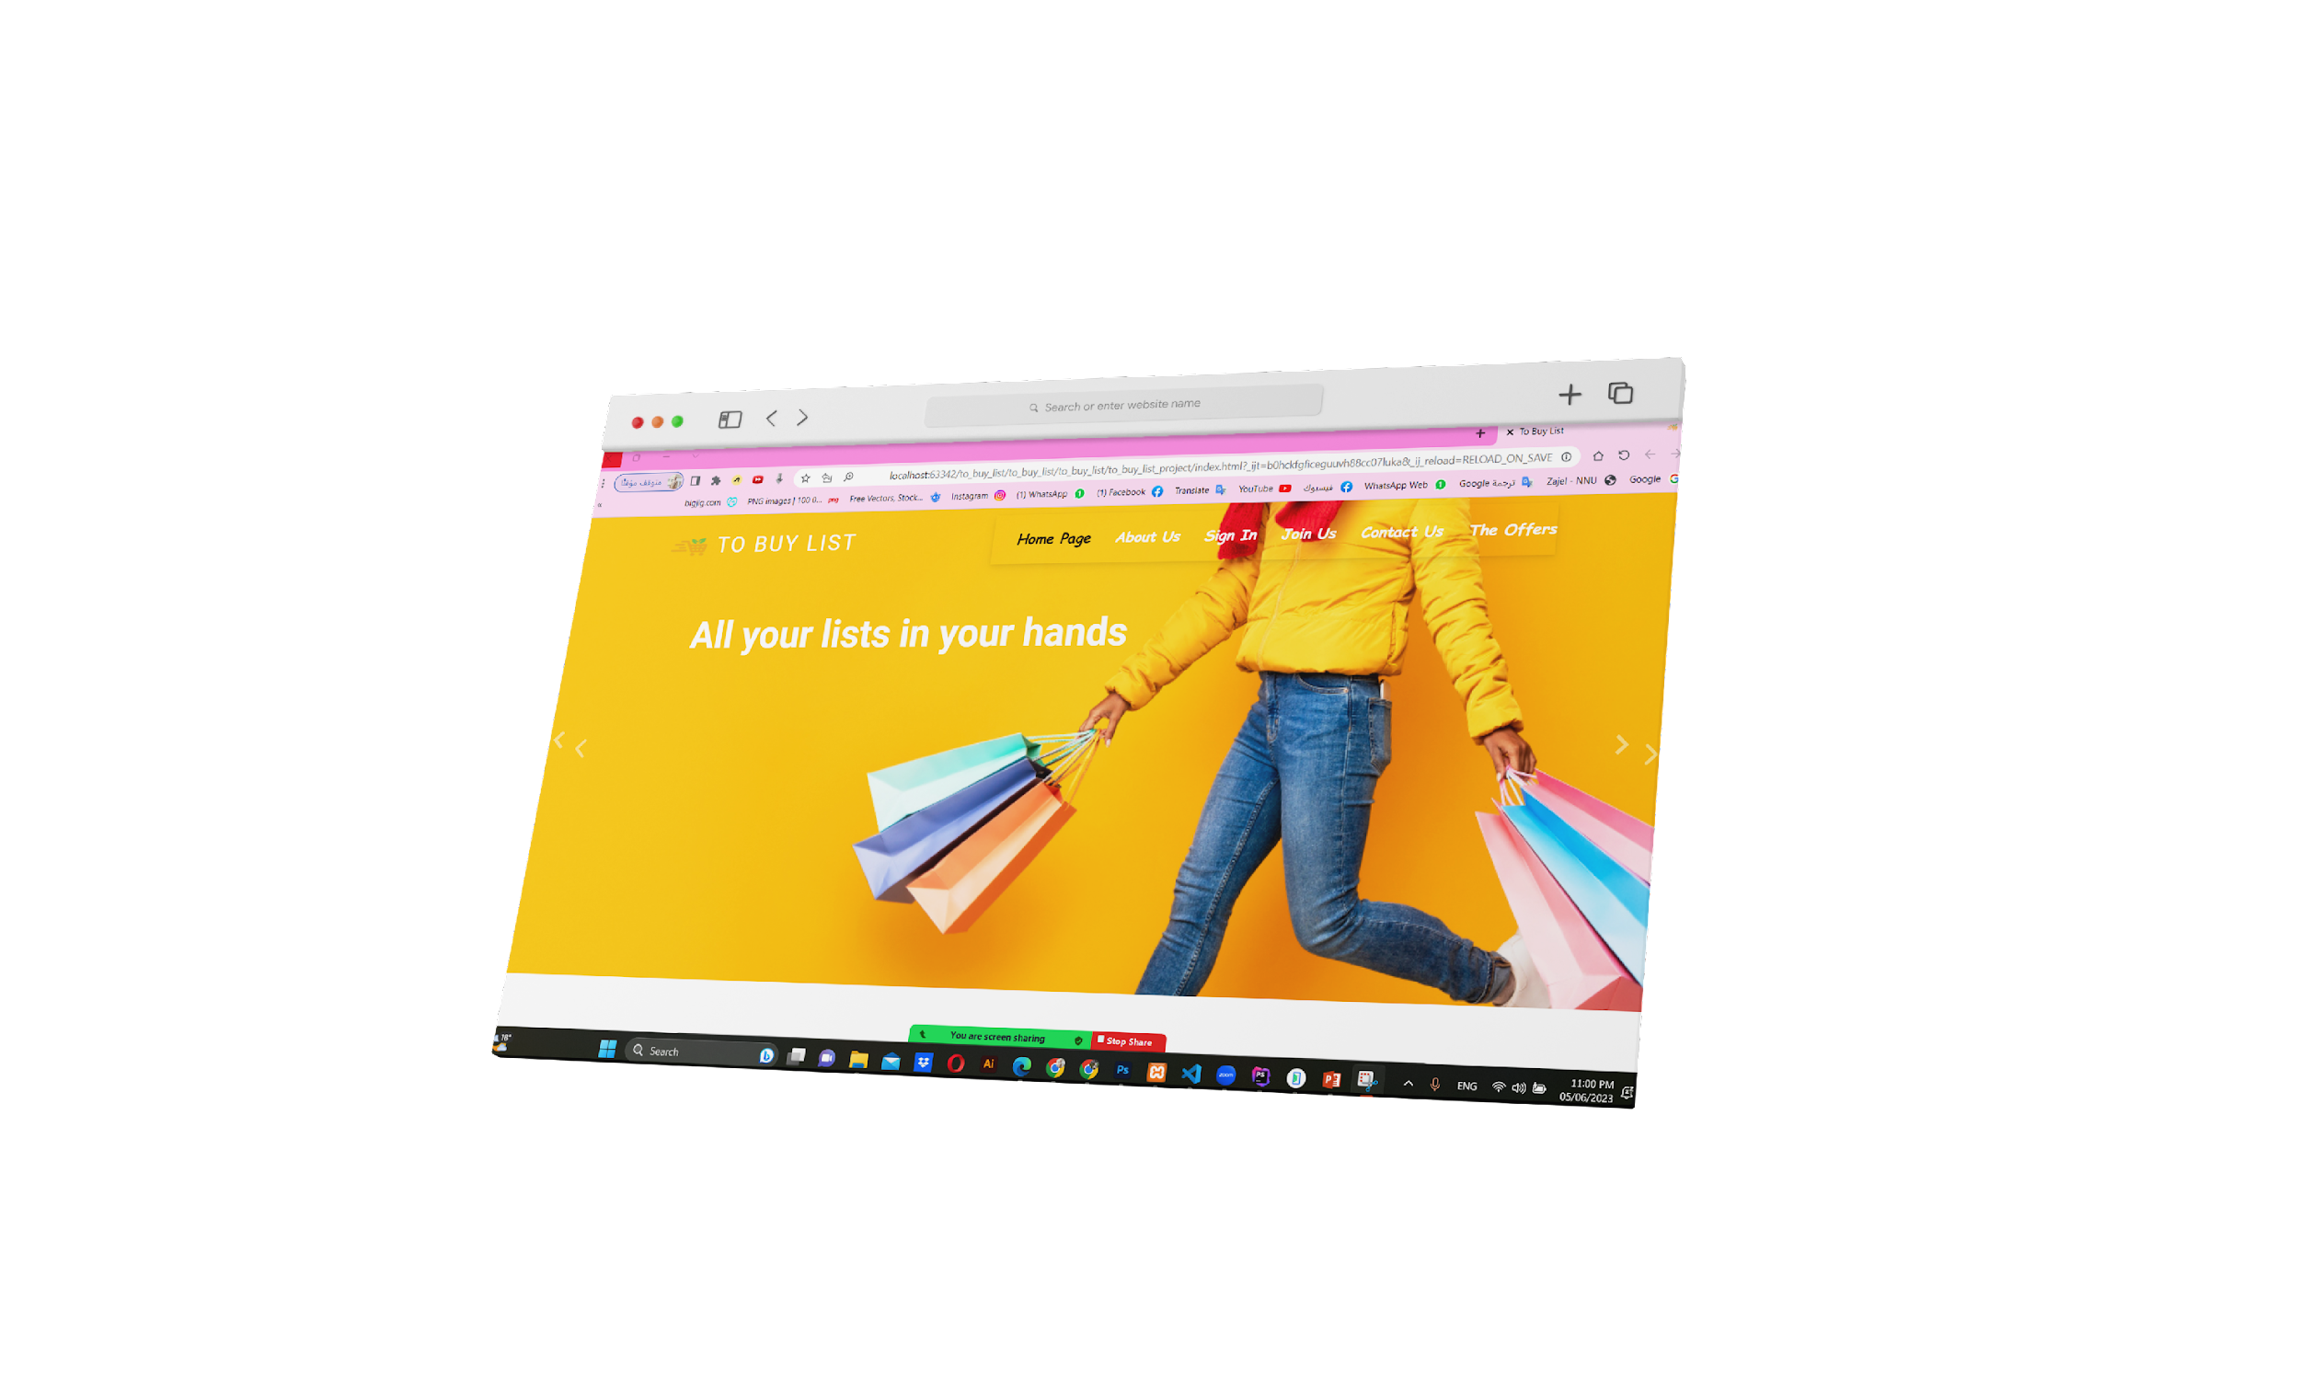
Project Analysis
Tasks
Management Objectives
Home Page
Customer Objectives
Resources

Slide 10
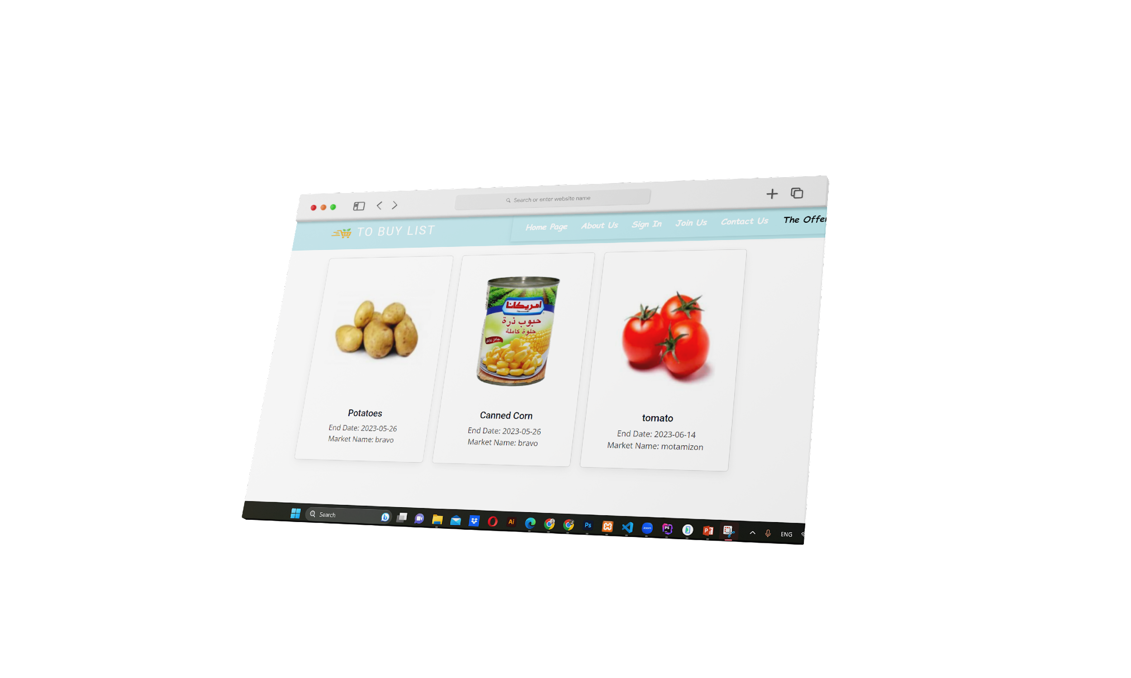
Project Analysis
Tasks
Management Objectives
Offer Page
Customer Objectives
Resources

Slide 11
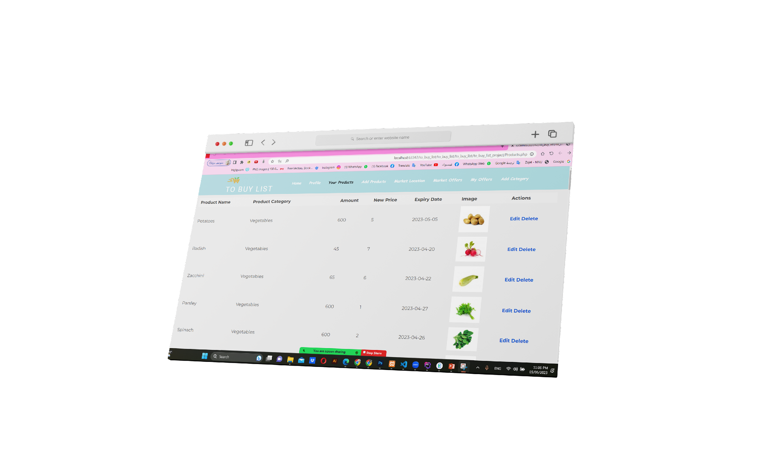
Project Analysis
Tasks
Management Objectives
Product Page
Customer Objectives
Resources

Slide 12
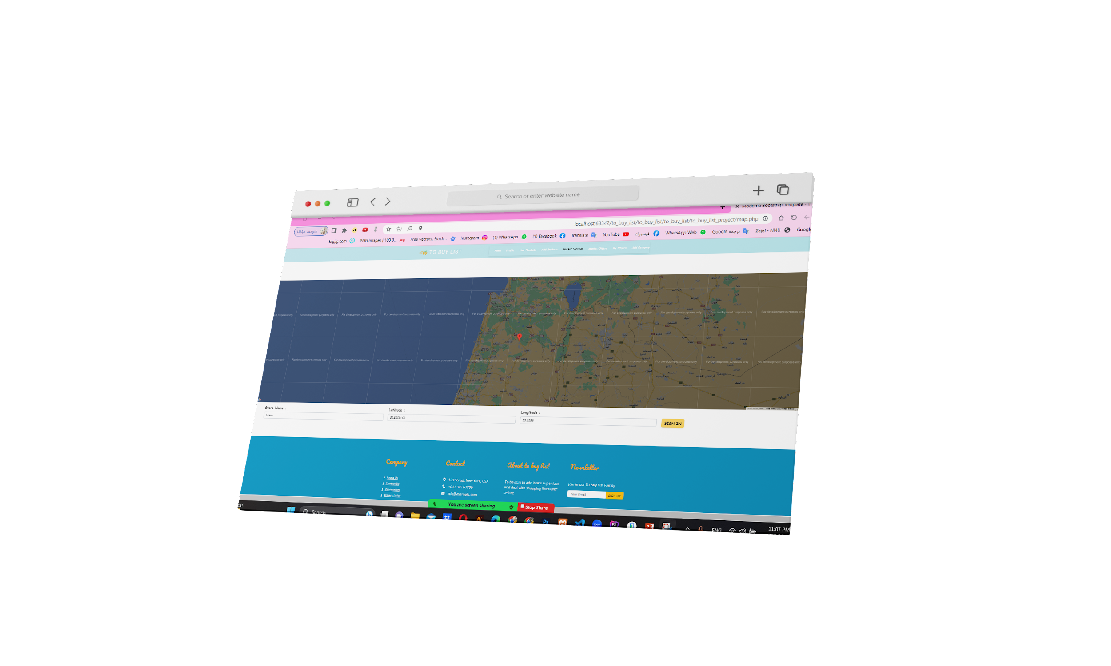
Project Analysis
Tasks
Management Objectives
Location Page
Customer Objectives
Resources

Slide 13
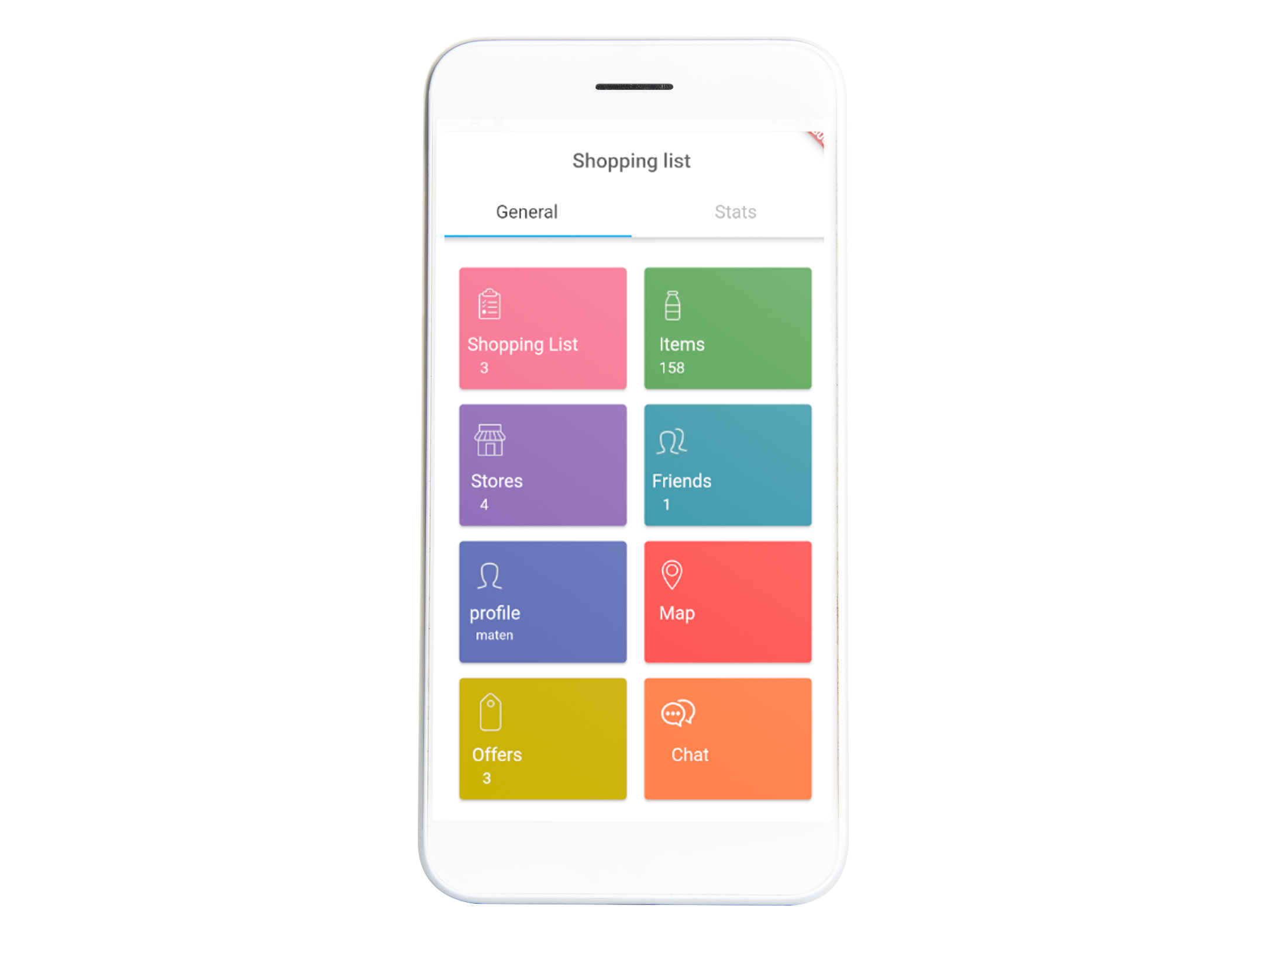
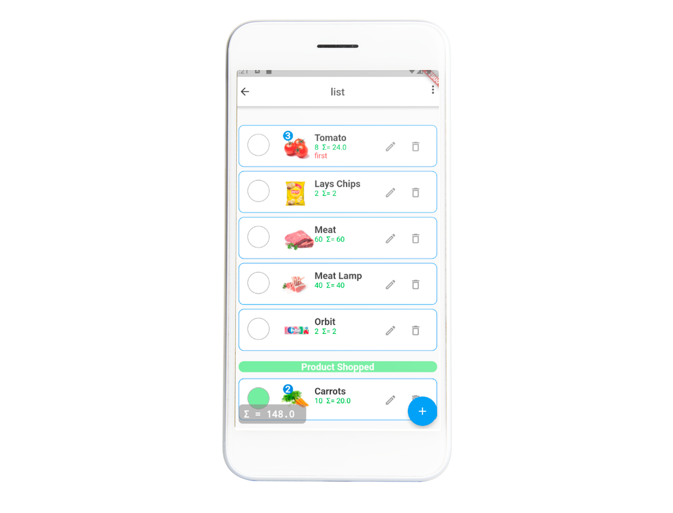
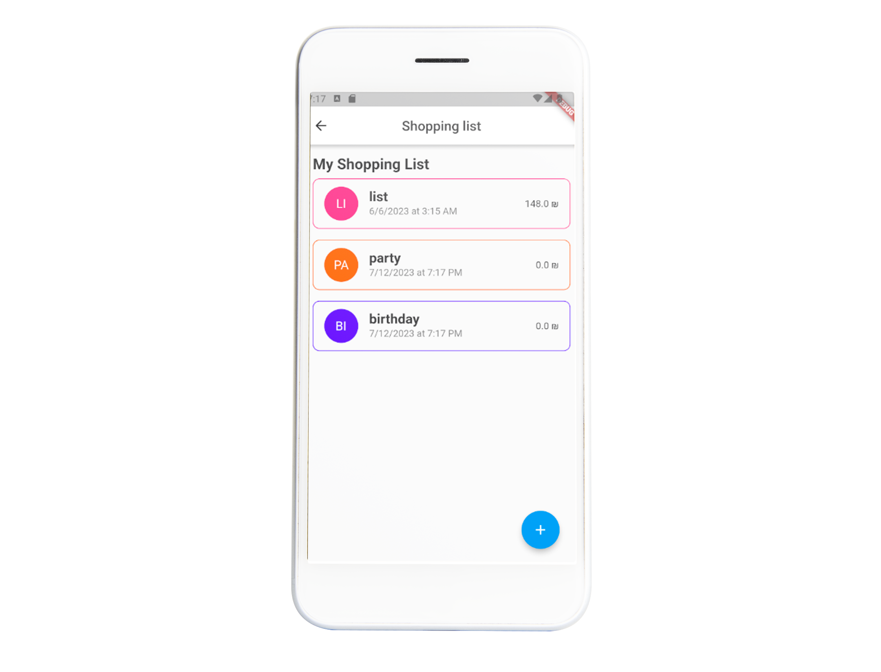
Project Analysis
Tasks
Management Objectives
Customer Objectives
Resources

Slide 14
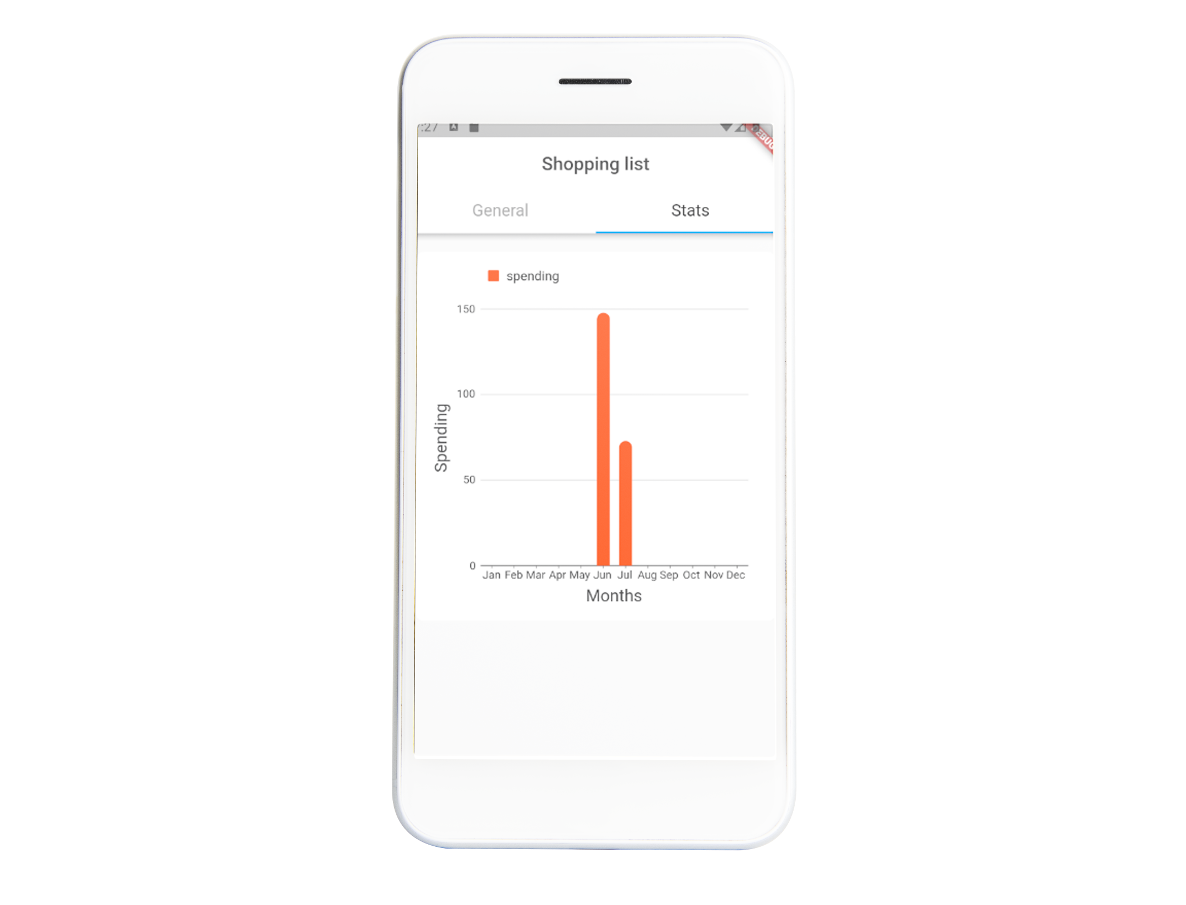
Project Analysis
Tasks
Management Objectives
Spending chart
The system gives monthly reports on purchases and total payments.
Customer Objectives
Resources

Slide 15
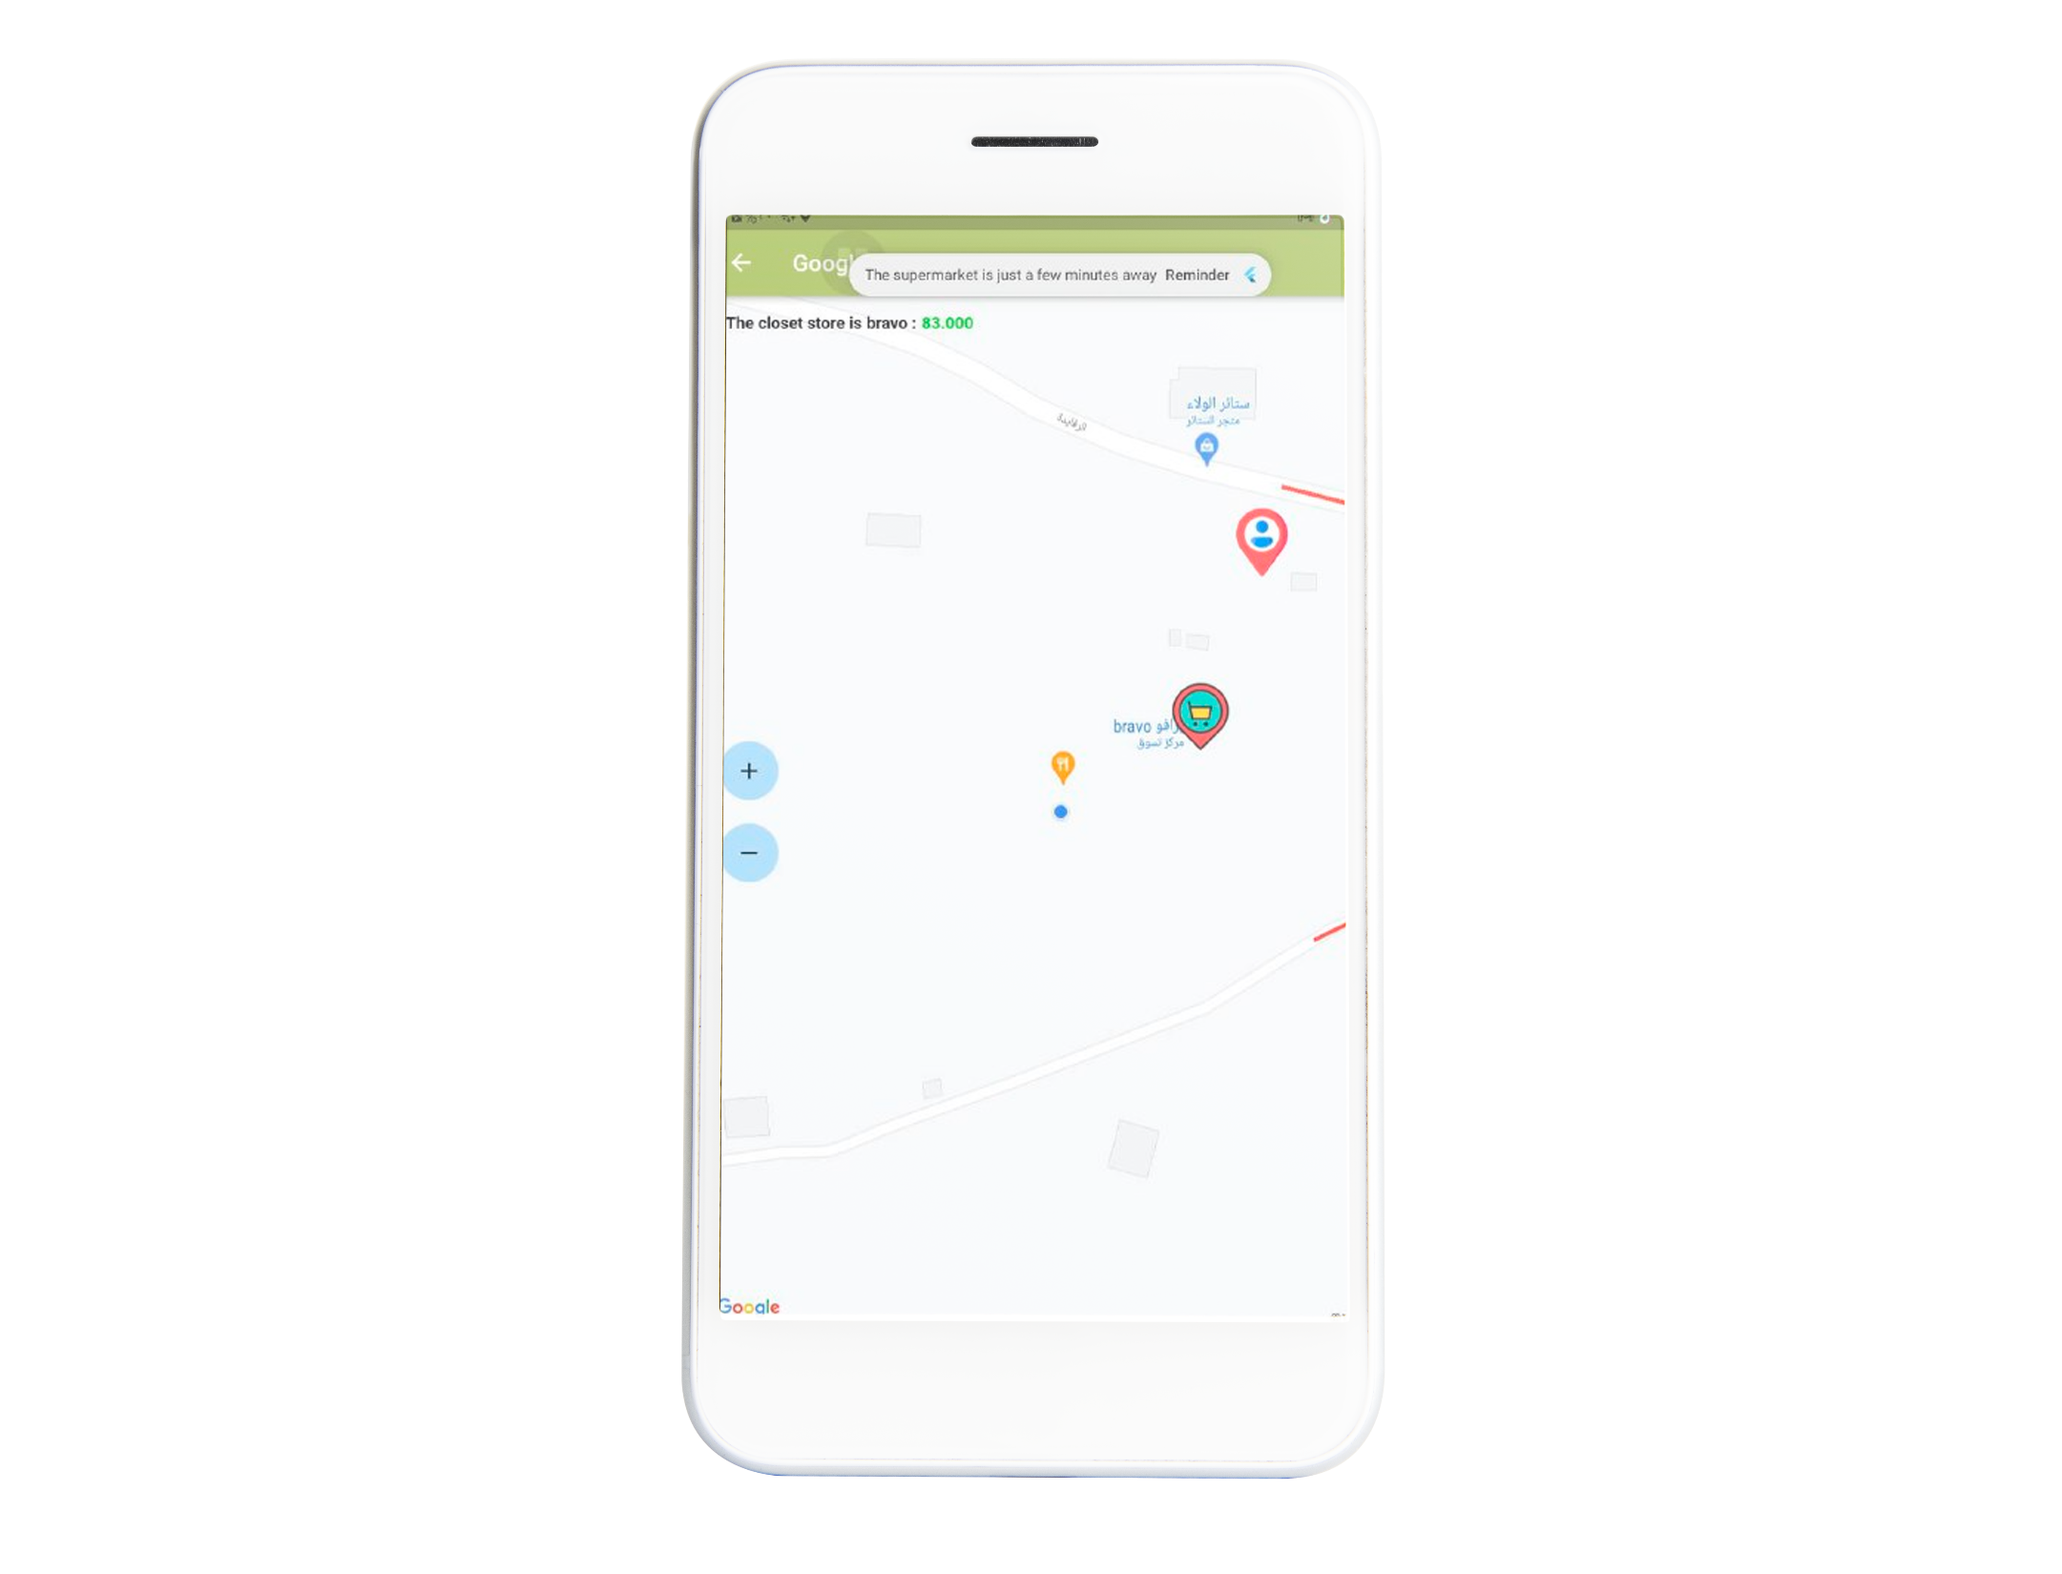
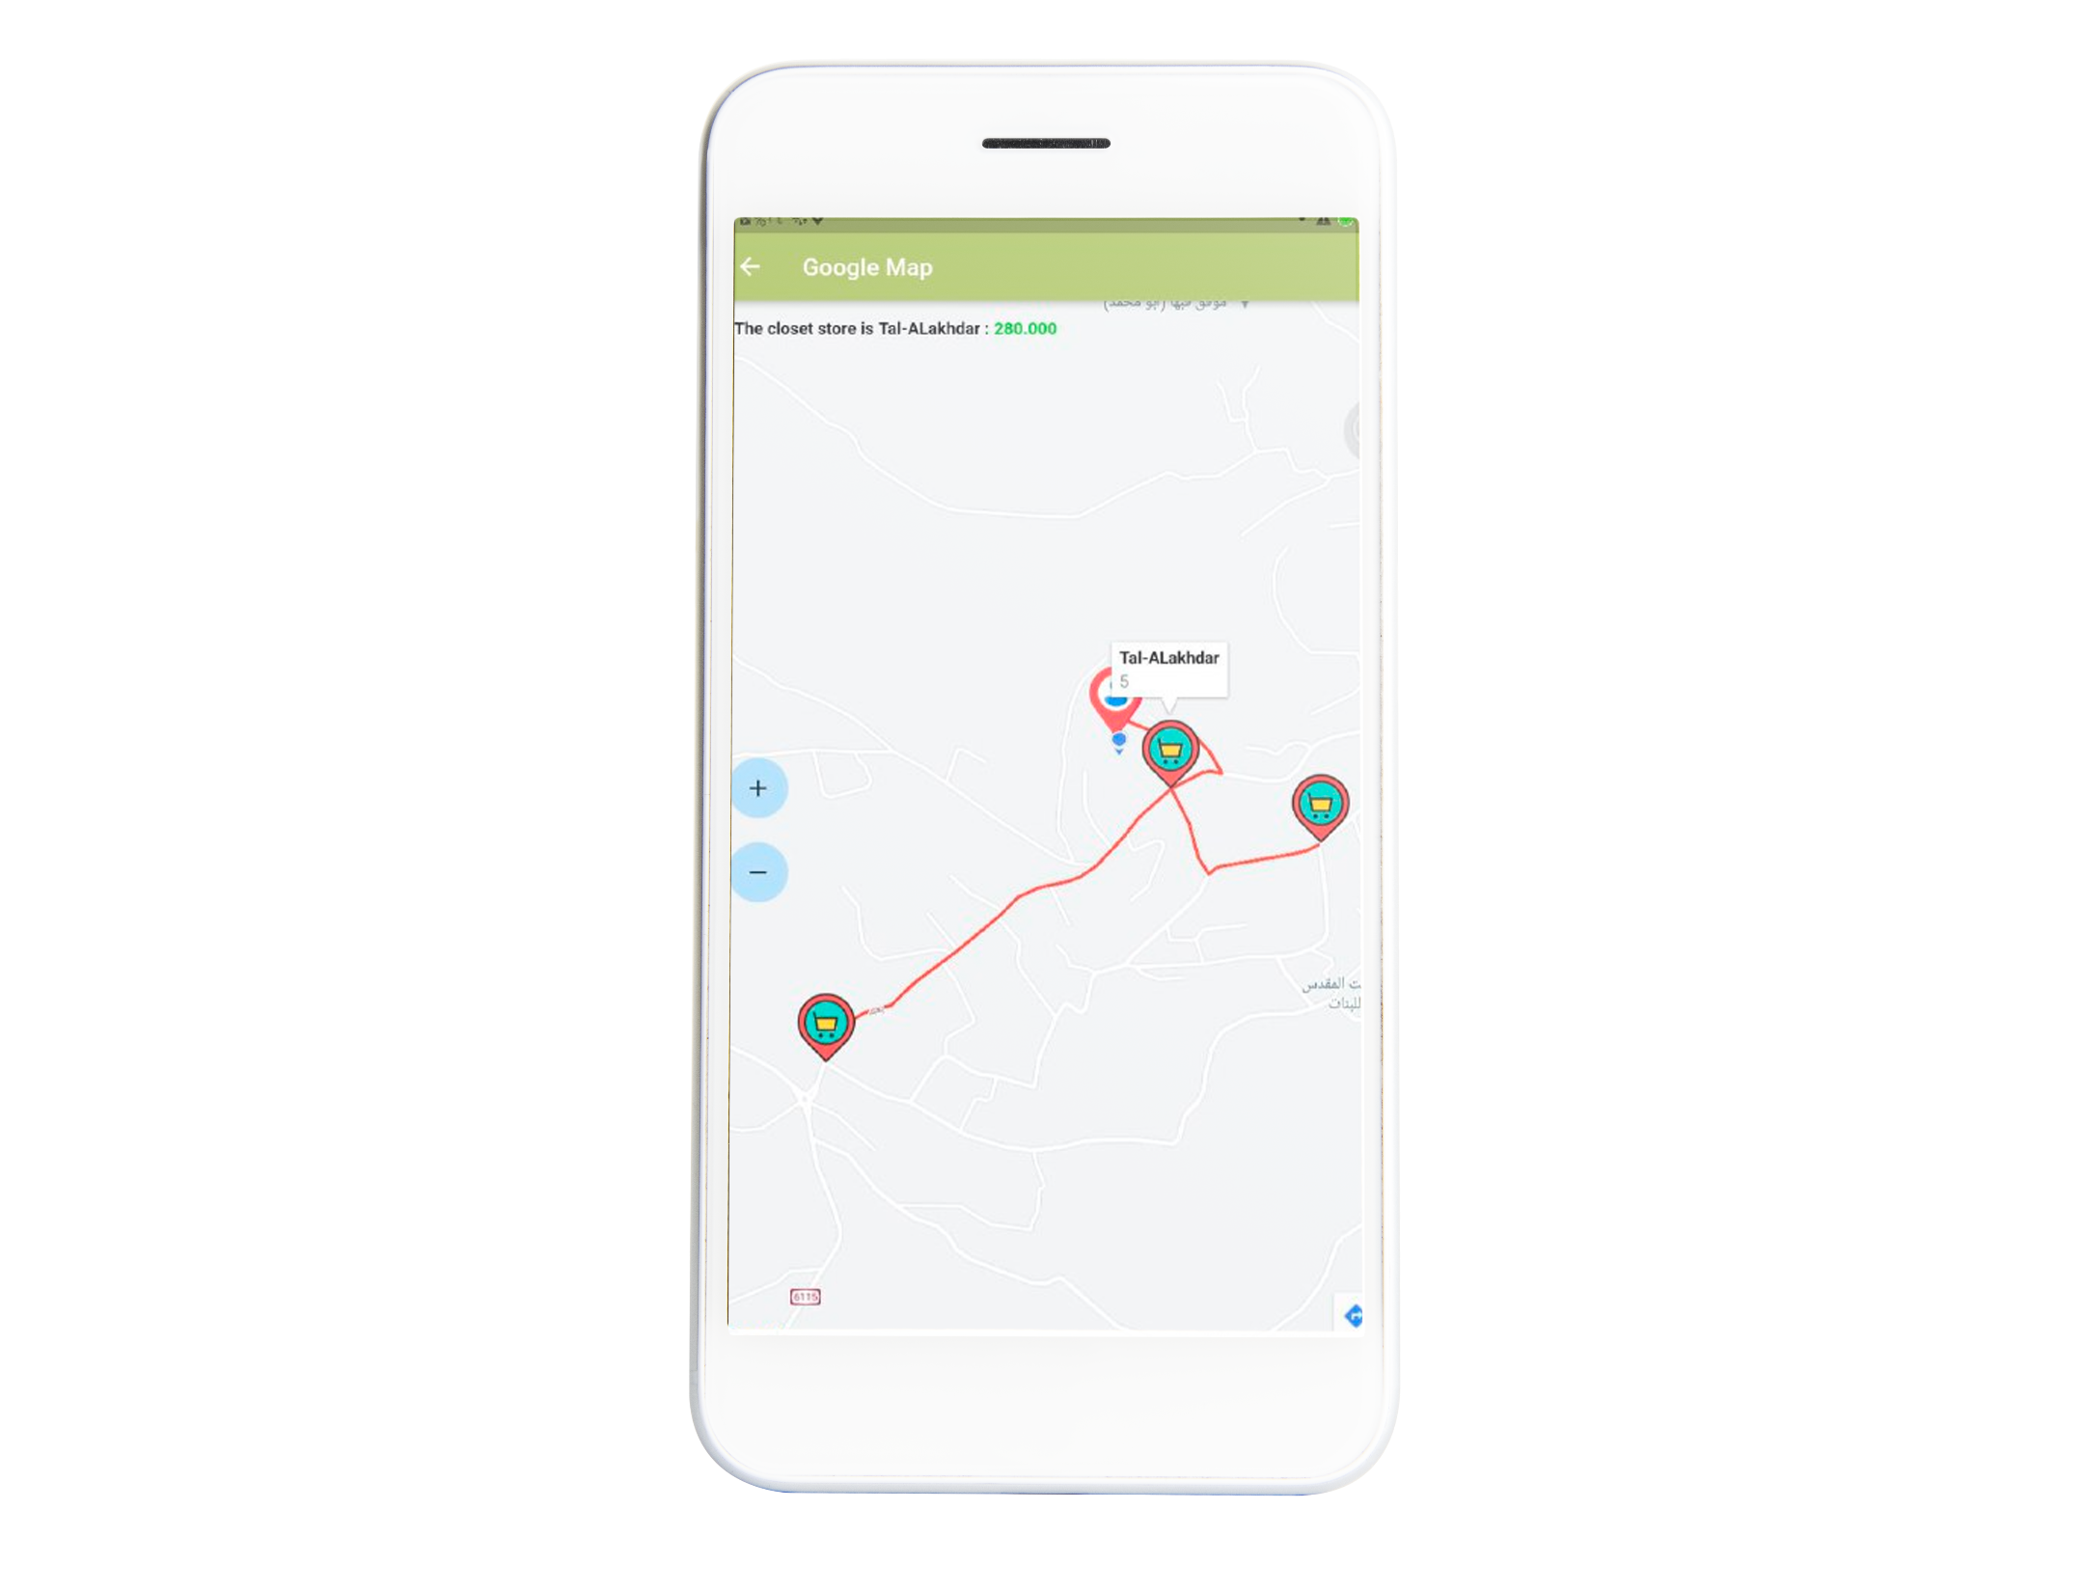
Project Analysis
Tasks
Management Objectives
Map Page
the user the route in the least time and the shortest way to all stores
It also shows on the map the number of purchases from each store
Customer Objectives
Resources

Slide 16
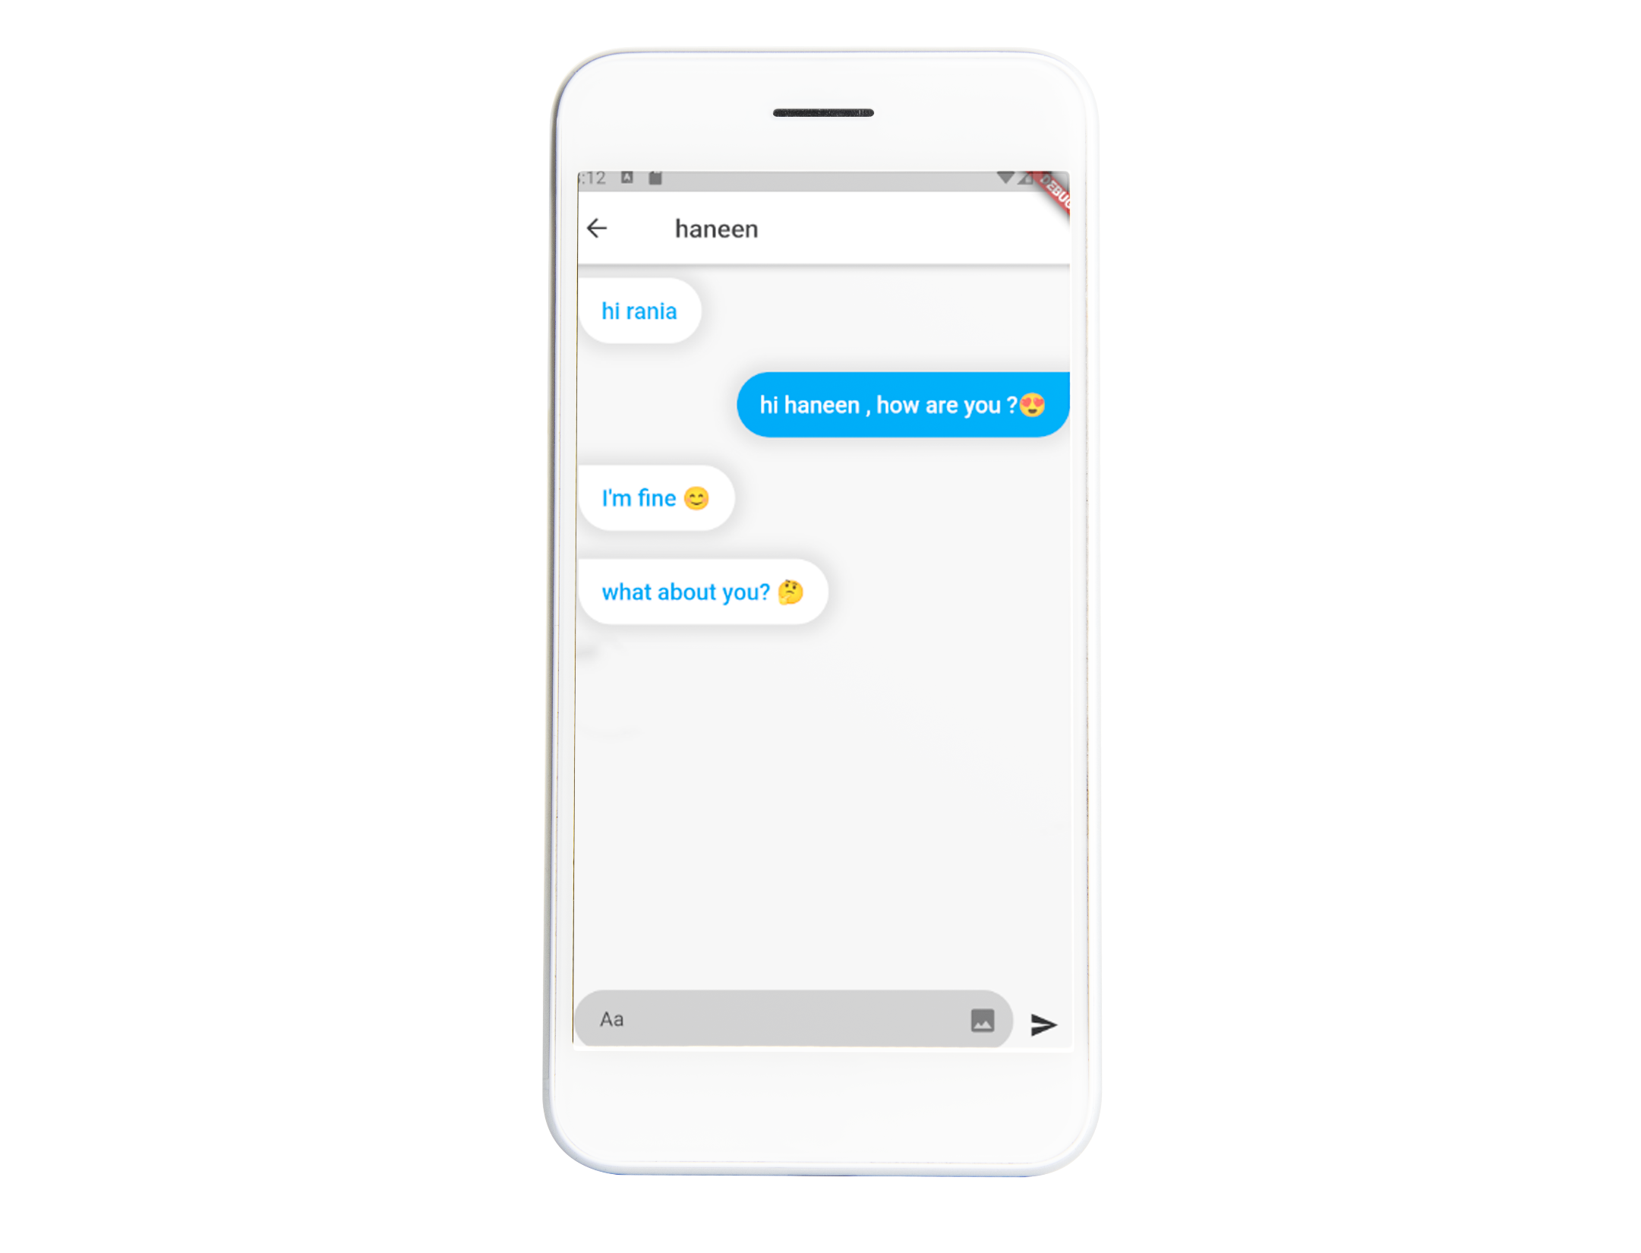
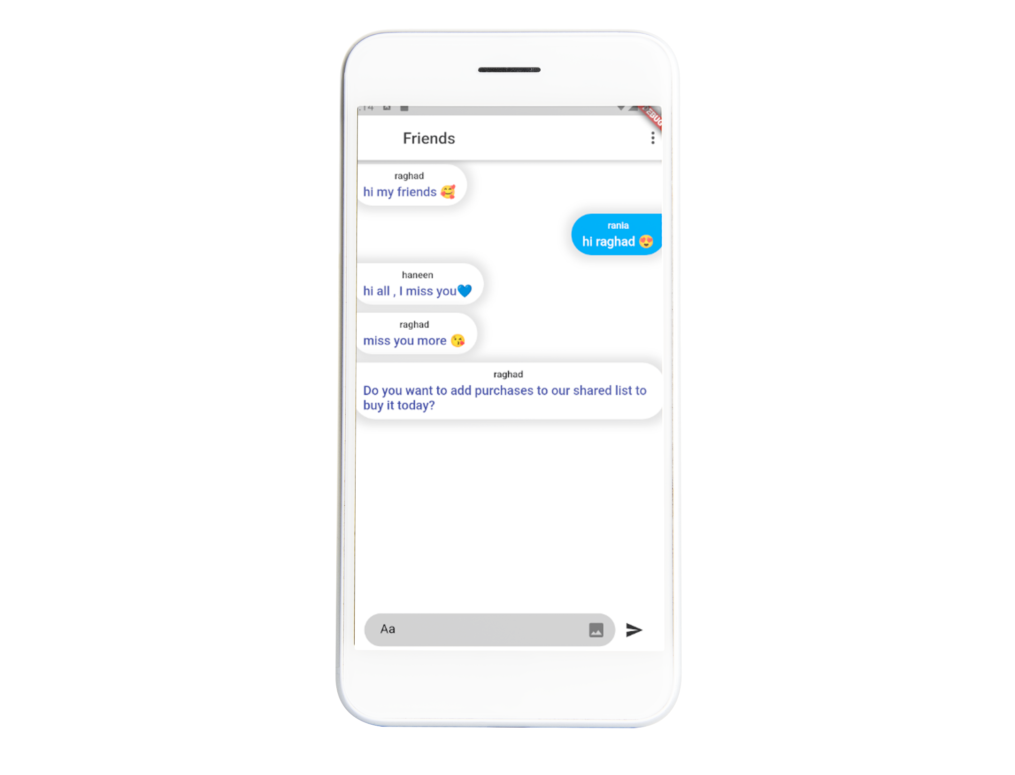
Project Analysis
Tasks
Management Objectives
Chat Page
Group Page
Customer Objectives
Resources

Slide 17
Demo

Slide 18
CONCLUTION
We have successfully implemented a smart system that calculates the shortest path to stores for an optimized shopping experience. This feature ensures that users can efficiently complete their purchases with minimal travel distance, as indicated by the calculated routes displayed on an integrated map, and a notification system .
our app tracks users' monthly expenses,allowing them to monitor their spending habits and make informed financial decisions.
One of the unique features of our app is the ability to share the shopping list among family members.Married couples and parents with children .

Slide 19



FUTURE WORK
Flexible Mapping
delivery services
Integrating other mapping services alongside Google Maps to provide users with more options and flexibility, catering to their individual preferences.
Explore partnerships with popular online shopping platforms to seamlessly integrate online ordering and delivery services within the app, providing users with a comprehensive shopping experience.
Continuous Maintenance
Text To Speech
Regular Maintenance and Performance Optimization: Continuous updates and performance enhancements should be prioritized to ensure the app remains efficient, reliable, and compatible with the latest operating systems and devices.
Incorporate text-to-speech technology to convert written notifications into audio messages. This can be achieved by leveraging existing speech synthesis libraries or APIs.

Slide 20
Thank You

