Slide 1
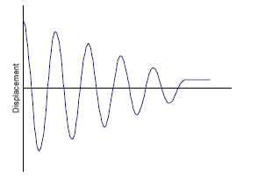
What is the Damping ?
Damping is a dissipation of
energy from a vibrating structure.
The term dissipate is used to mean
the transformation of mechanical
energy into other form of energy and, therefore, a removal of mechanical energy from the vibrating system.
Types of Damping :
Viscous damping.
Coulomb or Dry Friction Damping.
Material or Solid or Hysteretic Damping.
Magnetic Damping.

Slide 2
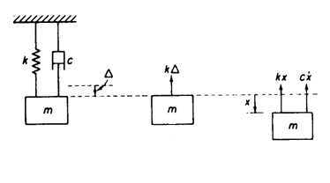



Viscous Damping
Viscous damping is the dissipation of energy that due to the movement of bodies in a fluid medium.
Free Vibration with Viscous Damping:
Free body diagram for a viscously damped simple system.
To study the vibration of this system, the following assumptions
are made:
The mass is rigid and has no damping.
The spring is massless and has no damping (linear elastic).
3. The damper has neither mass nor elasticity.
Treating the mass as a free body and applying Newton’s second low of motion yields
The following parameters are then defined
and
Then the equation of motion becomes

Slide 3




Depending on the values of ζ we have three damped cases:
Overdamped System (ζ>1) : The system returns (exponentially decays) to equilibrium without oscillating. Larger values of the damping ratio ζ return to equilibrium slower. In this case the roots of the characteristic equation are both real and negative.
For the initial conditions , the constants C₁ and C₂ are obtained as,
and
    Critically Damped system (ζ = 1): The system returns to equilibrium as quickly as possible without oscillating. This is often desired for the damping of systems such as doors. In this case we get a double negative real root.
    With the initial condition we get then for the constant:
    and

Slide 4

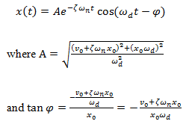
    Underdamped System (0 < ζ< 1): The system oscillates with gradually decreasing amplitude to zero. the roots in this case are complex conjugate.
    The roots are in this case obtained to:
    Substituting these roots into the general solution,
    The constants C₁and C₂ for the initial conditions x₀ and v_{0­} are obtained
    So that we get after inserting them into the previous Equ.

Slide 5




  Measurement of Viscous Damping
Vibration Method; Logarithmic Decrement:
is defined as the natural logarithm of the ratio of any two successive amplitudes.
Since t₂ = t₁ + τ_{d} where τ_{d} is the period of damped vibration
The logarithmic decrement (δ) is obtained from this equation to
The logarithmic decrement is dimensionless and is actually another form of the dimensionless damping ratio . Once δ is known, can be found by solving the last equation
For small damping values :

Slide 6
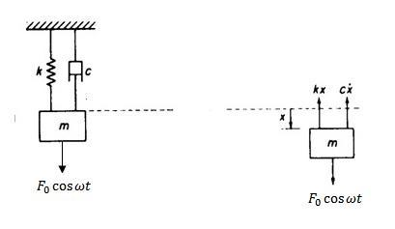


Forced Vibration with Viscous Damping
applying Newton's second law of motion
The homogenous solution for underdamped system is given as:
The particular solution form is
The amplitude X and the phase angle φ
and

Slide 7
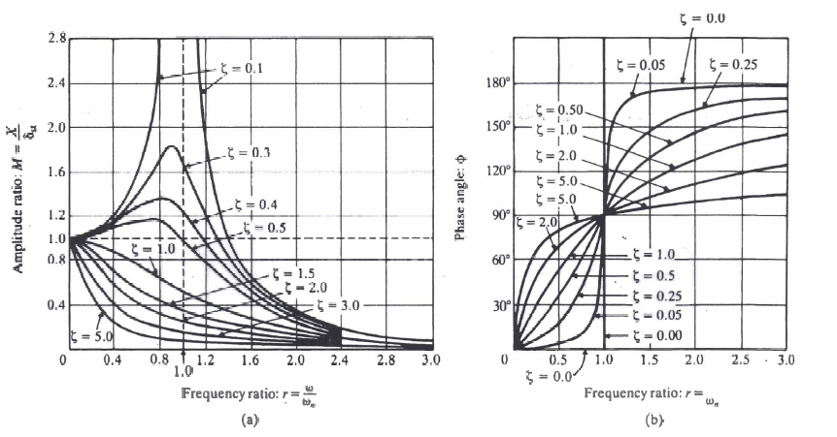

From the figure (a) we can note that:
For 0 < 𝜁 < 0.7 , the maximum value of M occurs when
which is lower than the undamped natural frequency and the natural damped frequency .
The maximum value of X occurs when and is given by , and the value of X at ω = ω_{n} by
From the figure (b) we can note that:
For an undamped system (𝜁 = 0), the phase angle is 0 for 0 < r < 1, which means that the excitation and response are in phase, and 180˚ for r > 1, and that means that they are out of phase.
For 𝜁 > 0 and 0 < r < 1, the response lags the excitation, because the phase angle is 0 < ϕ < 90˚.
For 𝜁 > 0 and r > 1, the response leads the excitation, because the phase angle is 90˚ < ϕ < 180˚.
For 𝜁 > 0 and r = 1, the phase difference between the excitation and the response is 90˚.
For 𝜁 > 0 and r >> 1, the response and the excitation are out of phase, because the phase angle approaches 180˚.

Slide 8
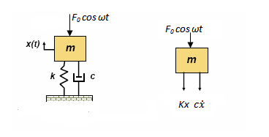




Force Transmitted
The force transmitted F_{T} can be determined as
where
and
The quantity , is called the force transmissibility

Slide 9
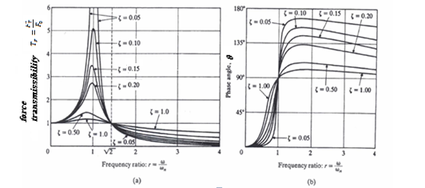

The value of is unity at r = 0 and close to unity for small values of r, independent of the damping ratio
For an undamped system at resonance (r = 1) .
The force transmissibility, , attains a maximum for at the frequency ratio
The force transmitted is equal to the driving force at ω/ω_{n} =
As the damping in the system is increased, the magnitude of the force transmitted gets smaller as long as

Slide 10
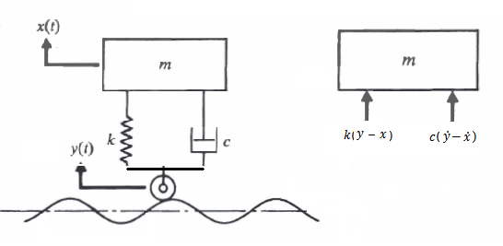
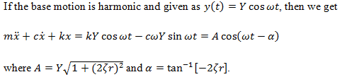



Effect of the Damping on the Vibration Amplitudes by Base Motion Excitation
Applying the second law of motion on
the free-body diagram leads to
by solving the equations we will get :
and
the ratio of the amplitude of the response x_{p}(t) to that of the base motion y(t) , X/Y ,is called the displacement transmissibility

Slide 11
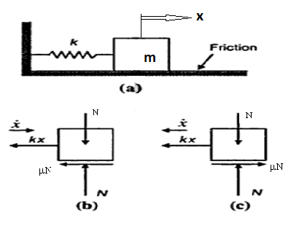

The Coulomb Damping:
The damping force is constant in magnitude but opposite in direction to that of the motion of the vibrating body. It is caused by friction between rubbing surfaces that are either dry or have insufficient lubrication.
Free Vibration with Coulomb Damping:
In this figure there are tow cases :
Case 1 :
x and positive or x is positive and is negative.
using Newton’s second law:
and the solution of the equation will be
where
Case 2:
x is positive and is negative or both are negative.
and using Newton’s second law:
and the solution of the equation will be

Slide 12
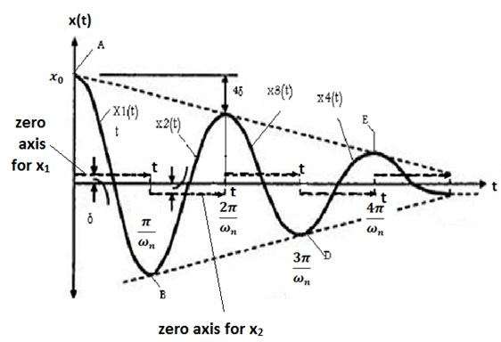

Motion of the mass with coulomb damping:
The motion in the first half cycle
at initial condition : and
the constants will be :
and the Eq. becomes :
This means that the vibration amplitude is
reduced about 2δ in half cycle.
2. The motion in the second half cycle
At the initial conditions, the constants will be :
And the Eq. becomes:
Note the following characteristics of a system with coulomb damping:
1. The equation of motion is nonlinear with coulomb damping.
2. The natural frequency of the system is unchanged with the addition of coulomb damping.
3. The motion is periodic with coulomb damping.
4. The system comes to rest after some time with coulomb damping.
5. The amplitude reduced linearly with coulomb damping.

Slide 13
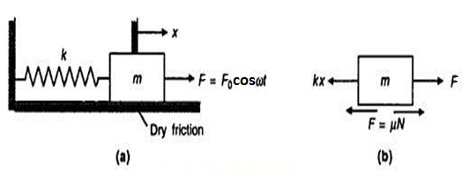



Forced Vibration with Coulomb Damping
The equation of the motion :
the energy dissipated by dry friction damping
In a full cycle of motion is given by :
If the equivalent viscous damping constant is
denoted as , the energy dissipated during
a full cycle will be
where
the steady-state response :
The amplitude X
The phase angle(φ) :

Slide 14
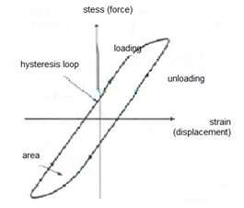
The Structural (Hysteresis) Damping
The damping caused by the friction between the internal
planes that slip or slide as the material deforms is called hysteresis
(or solid or structural) damping .
The Coulomb-friction model is as a rule used to describe energy
dissipation caused by rubbing friction. While as structural damping
(caused by contact or impacts at joins), energy dissipation is
determined by means of the coefficient of restitution of the two
components that are in contact.
This form of damping is caused by Coulomb friction at a structural joint. It depends on many factors such as joint forces or surface properties .
Area of hysteresis loop is energy dissipation per cycle of motion- termed as per-unit-volume damping capacity (d):
The purpose of structural damping is to dissipate vibration energy in a structure, thereby reducing the amount of radiated and transmitted sound

Slide 15
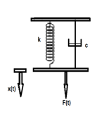
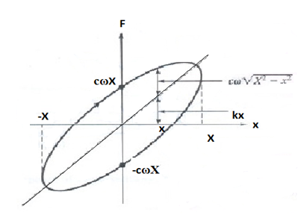

Free Vibration with Hysteresis Damping
By the applying the Newton's second law :
For a harmonic motion of frequency ω and amplitude X :
The damping coefficient c is assumed to be inversely proportional
to the frequency as
The energy dissipated by the damper in a cycle of motion becomes

Slide 16
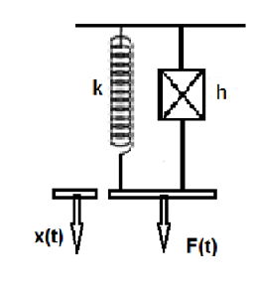



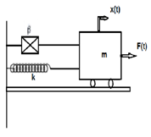


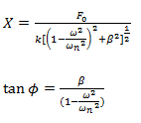
Complex Stiffness
the force displacement relation can be expressed by:
let is a constant indicating dimensionless measurement of damping.
is called the complex stiffness of the system .
the energy loss per cycle :
Forced Vibration with Hysteresis Damping:
The system is subjected to harmonic force ;
The equation of motion can be expressed as
The particular solution is
where
and

Slide 17
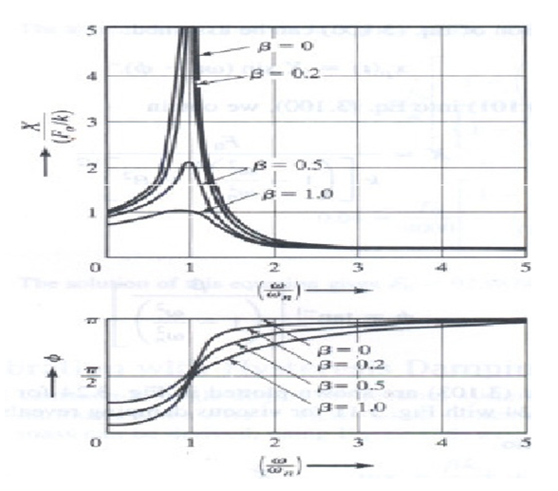

The amplitude ratio reaches its
maximum value of at the
resonant frequency in the case of
hysteresis damping , while
it occurs at a frequency below
resonance in the case of viscous
damping .
The phase ϕ has a value
in the case of hysteresis damping .
This indicates that the response can
never be in phase with the forcing
function in the case of hysteresis
damping .

Slide 18



Measurement of Damping
Hysteresis Loop Method:
Depending on inertial and elastic conditions the hysteresis loop will change but the work done in the conservative forces will be zero, consequently work done will be equal to energy dissipated by damping only without normalizing with respect to mass.
The energy dissipation per hysteresis loop of hysteretic damping is
And the initial max potential energy is
the loss factor of hysteretic damping is given by :
Then ,the equivalent damping ratio for hysteretic damping is

Slide 19
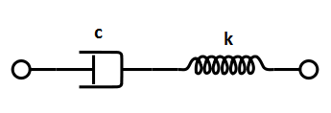
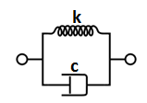
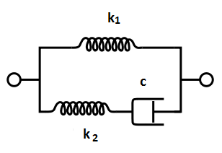
  Models of Hysteresis Damping (Structural Damping ):
The Maxwell Model
The Maxwell model can be represented by a purely
viscous damper and a purely elastic spring connected in series.
The Kelvin–Voigt Model
also called the Voigt model, can be represented by a purely
viscous damper and purely elastic spring connected in parallel .
Standard Linear Solid Model
The standard linear solid (SLS) model, (Zener model), is a method
of modeling the behavior of viscoelastic material using a linear
combination of springs and damper.

Slide 20
Magnetic Damping
A phenomenon that has been observed for many years by which vibrating, oscillating or rotating conductors are slowly be brought to rest in the presence of a magnetic field
The damping effects of magnetic induction are also proportional to the speed of the moving object hence making the braking phenomenon extremely smooth. It is hence the objective of this project to further investigate the aforementioned damping effects in the case of rotating discs, with the focus being not on the strength of the magnetic field or the speed of the disc, but on the various possible orientations of the applied magnetic field in relation to the disc.

