Slide 1
Design of a Wastewater Collection Network for Kofur Laqif along with Cost Estimate and Assessment of Potential Alternatives for Locations of Wastewater Treatment Plants
Prepared by
Mariam Jaber
Supervisor
Dr. Mohammad N. Almasri
2017

Slide 2
Outlines
Introduction
Objectives
Study Area
Methodology
Results

Slide 3


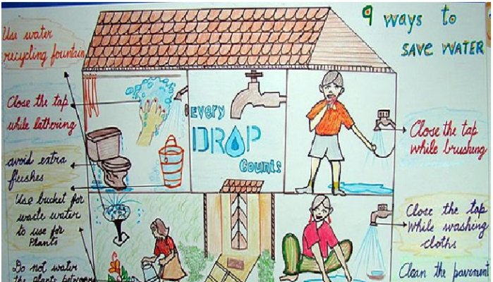
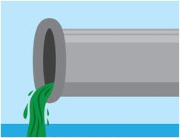
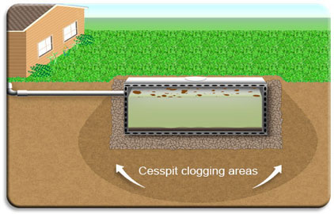

Slide 4

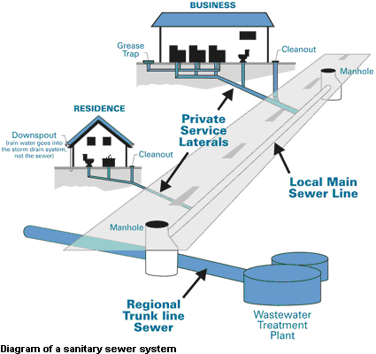

Slide 5
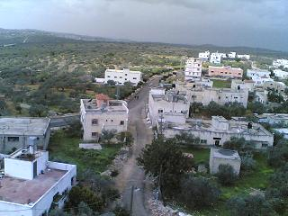


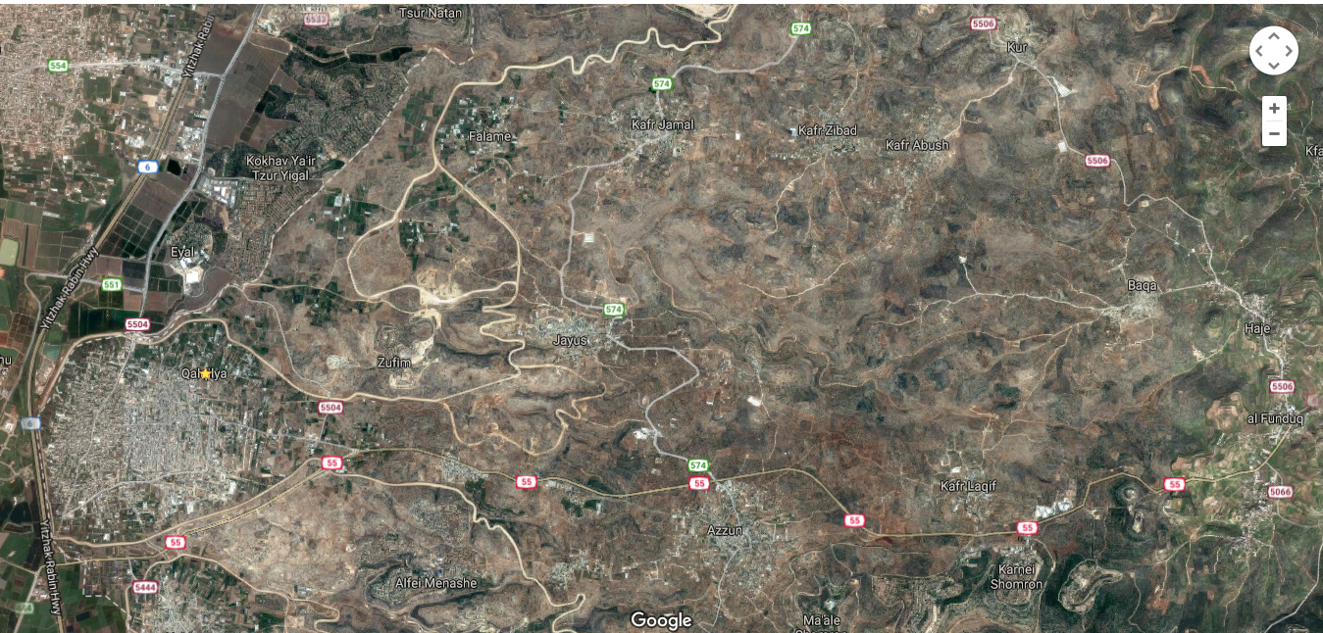
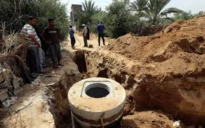
Objectives
To design a wastewater collection network for a part of kofur laqif Village using Sewer CAD.
& calculate the cost
&location of Wastewater Treatment Plant

Slide 6
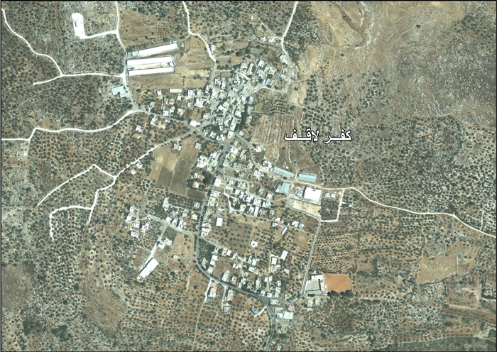
Study Area
350
245
West, N
East, Q
r= 2.01%
1997
699
2007
856
7692 m3/mon

Slide 7
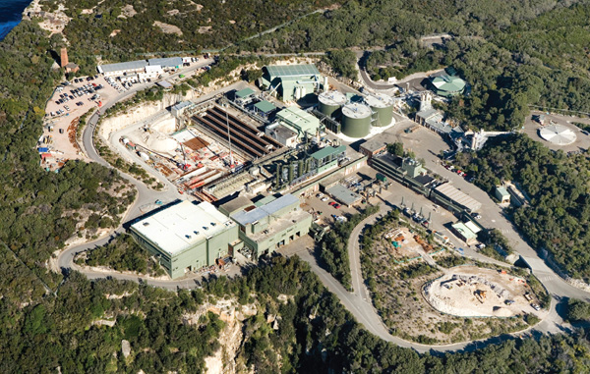






Methodology
7
6
Location of WWTP
Determine problem
Selection of study area
Data Collection
5
Cost Estimation
4
Design WWCN
3
Loads
Determination
2
1

Slide 8
Data collection
Data
AutoCAD
Village Council
Contour
GIS
Village Council
Population
word
PCBS
Communities
GIS
Dr
Settlements
GIS
Dr

Slide 9

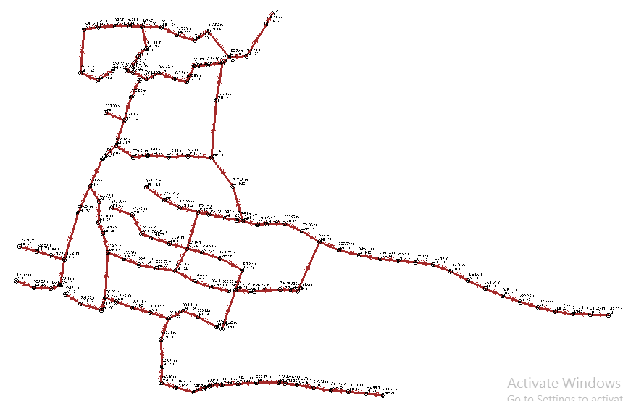
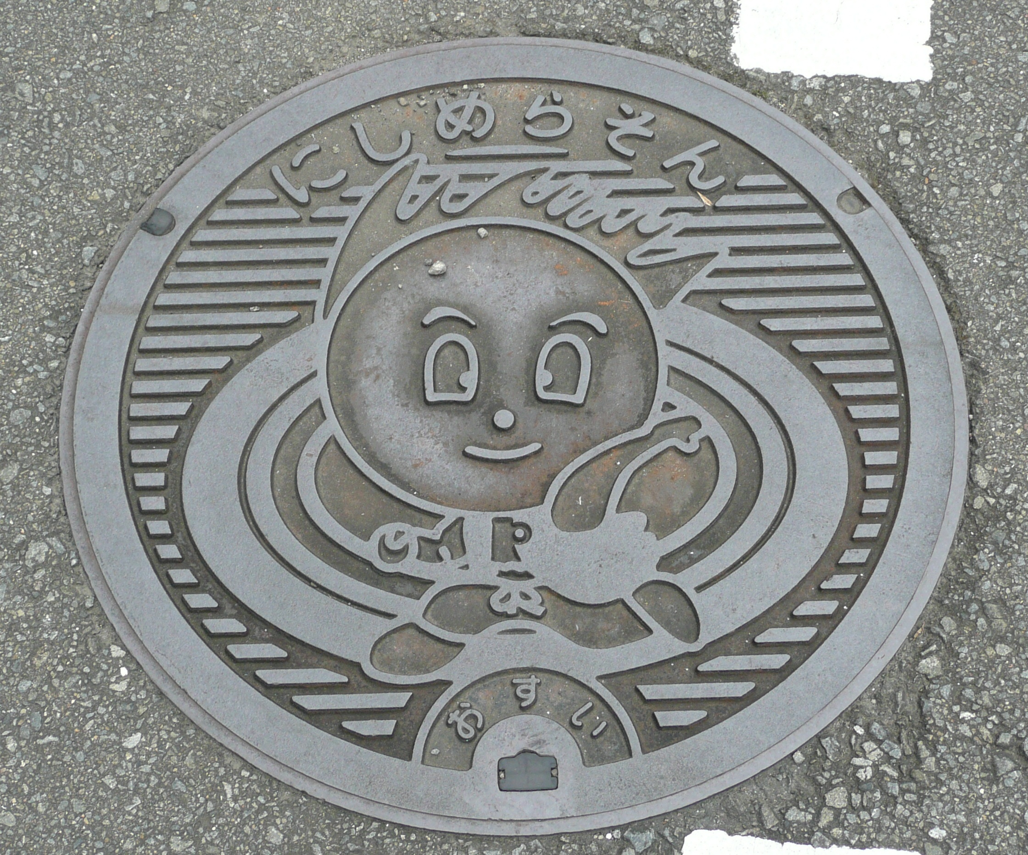
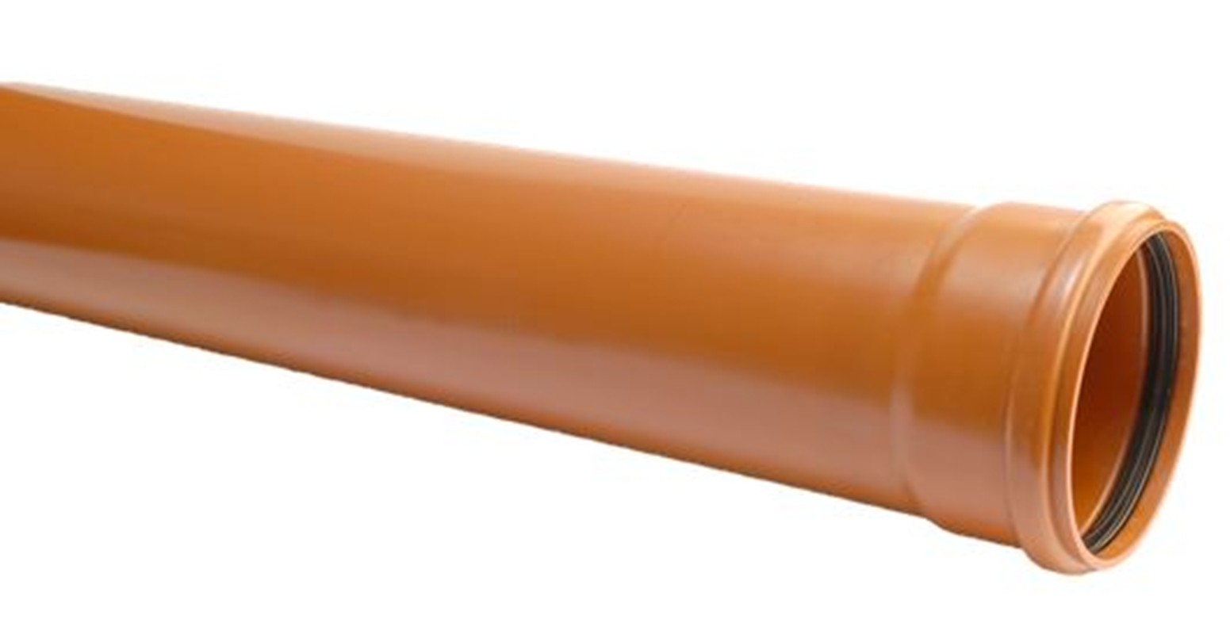
Network

Slide 10
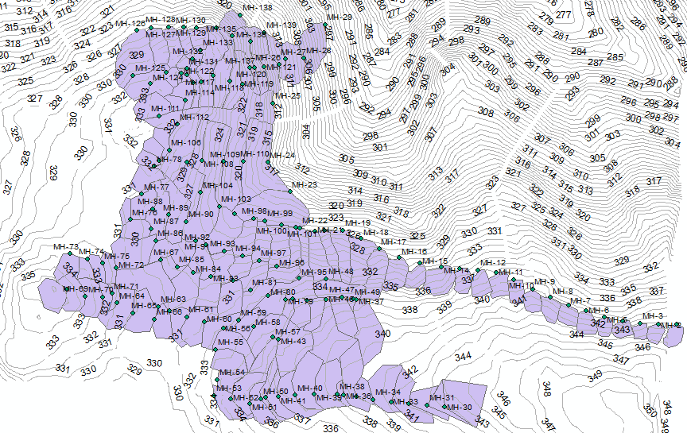
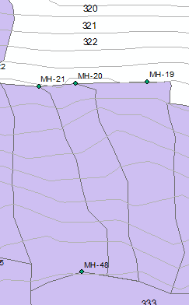
Load calculations

Slide 11
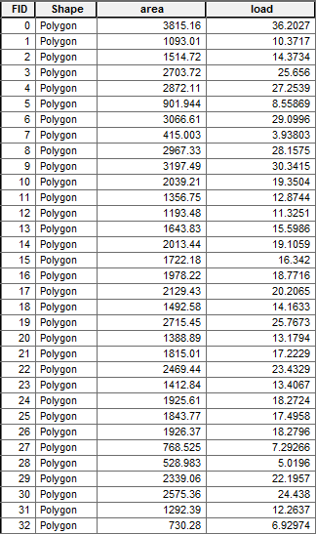
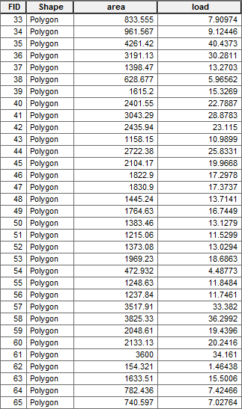


Slide 12
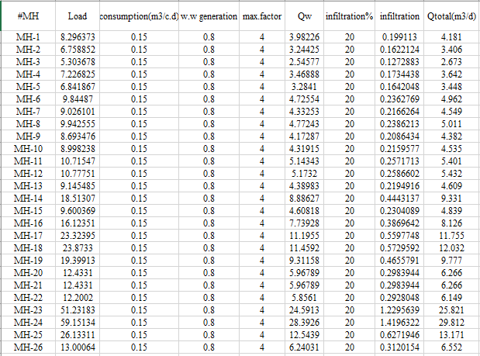

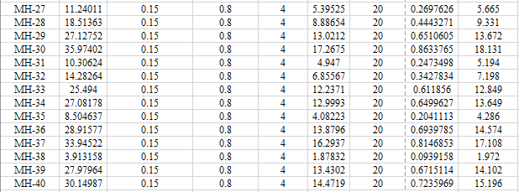

Slide 13
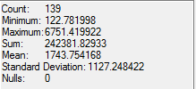
Total Load = MH. Load of WW generation + MH. Load of Infiltration
P =2250 c
For MH-20:
Total load = (1388.89*2250/242381.82933)*0.15*0.8*4
+ 0.2*(1388.89*2250/242381.82933)*0.15*0.8
= 6.498 m3/d

Slide 14
Design constrains
Velocity
Cover
Slope
0.6-3m/s
1-5m
1-15%
80%
Partial flow

Slide 15



Slide 17
Before
After

Slide 18
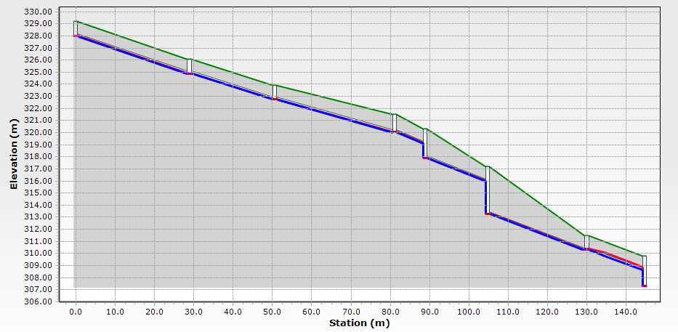
Data profile

Slide 19
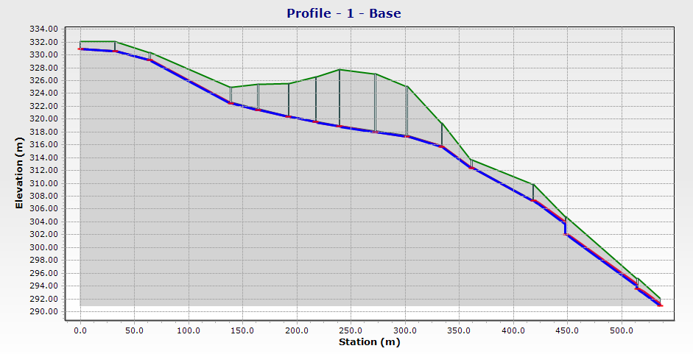

Slide 20



Slide 21


Slide 22

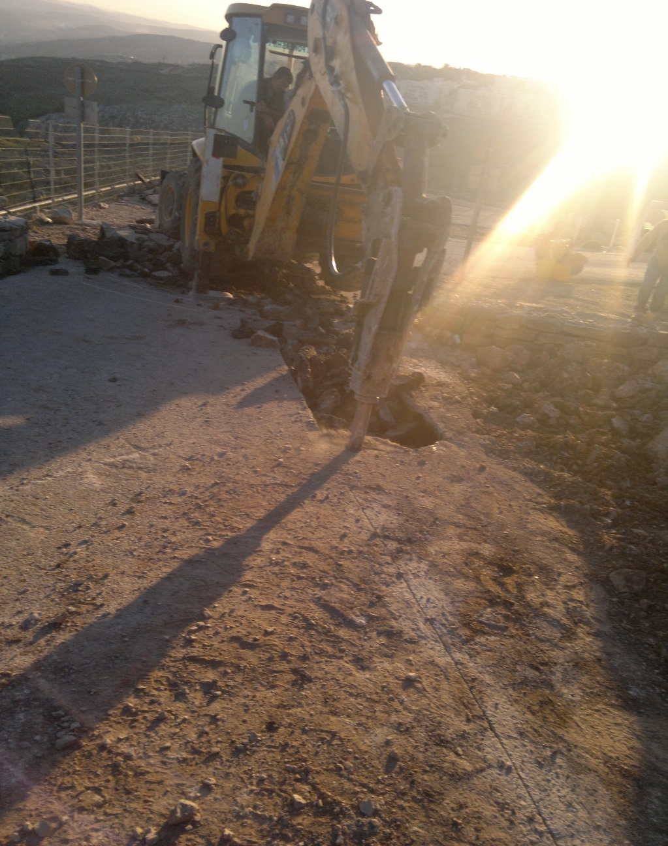
Excavation
For 8 in pipe
Cost/m³ | Cost ($)
1 | 12

Slide 23
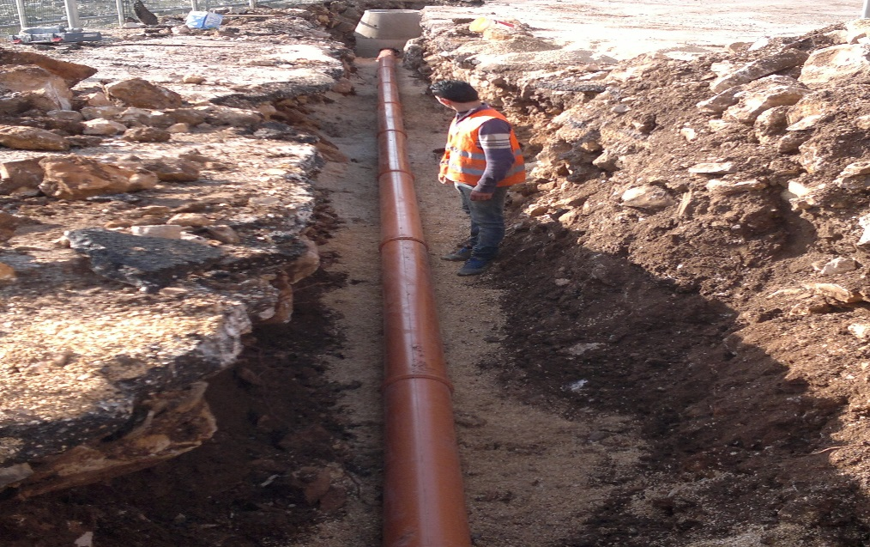
Pipes
Diameter (in) | Unit price ($)
8 | 13
10 | 18
12 | 40

Slide 24
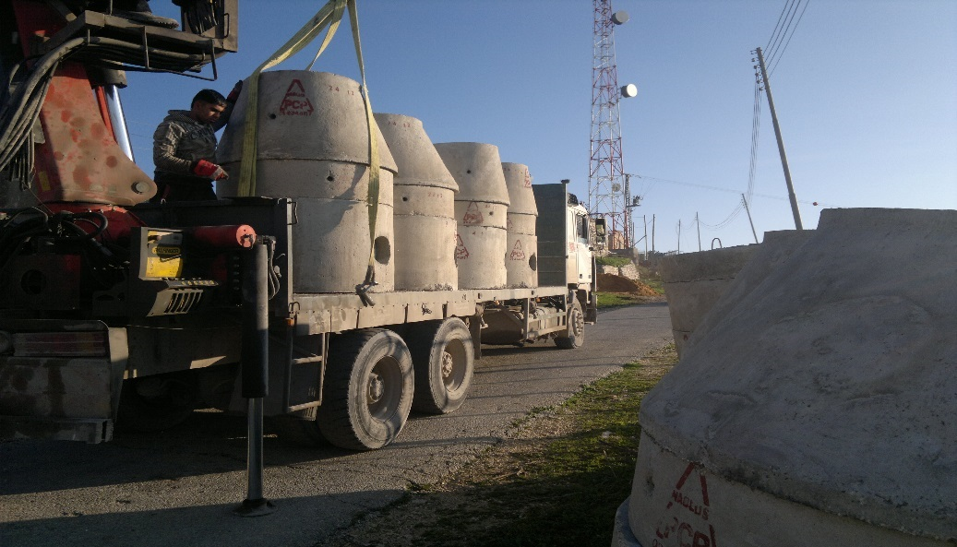
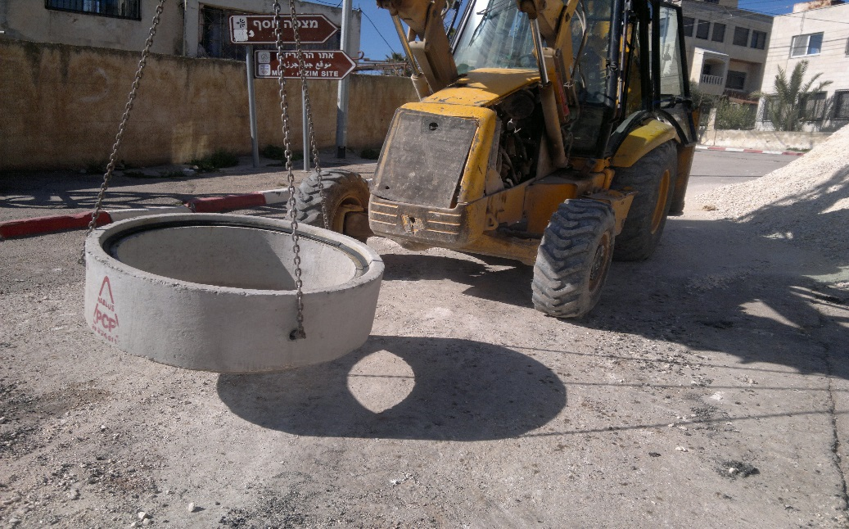
Manholes
MH element | Dimensions | Cost
Base | 100×60 | $99
 | 100×80 | $115
Cone | 100×75 | $99
Cover | 100×20 | $61
Ring | 100×30 | $54
 | 100×40 | $56
 | 100×50 | $57

Slide 25
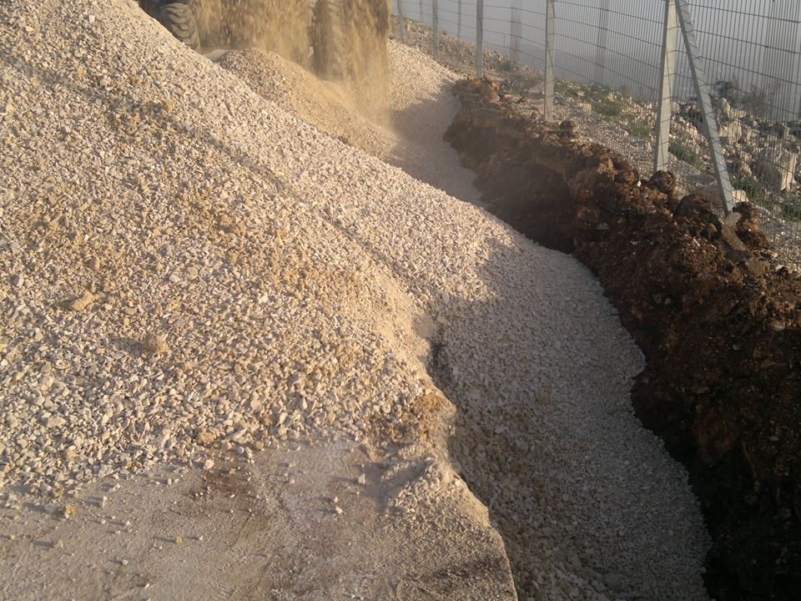
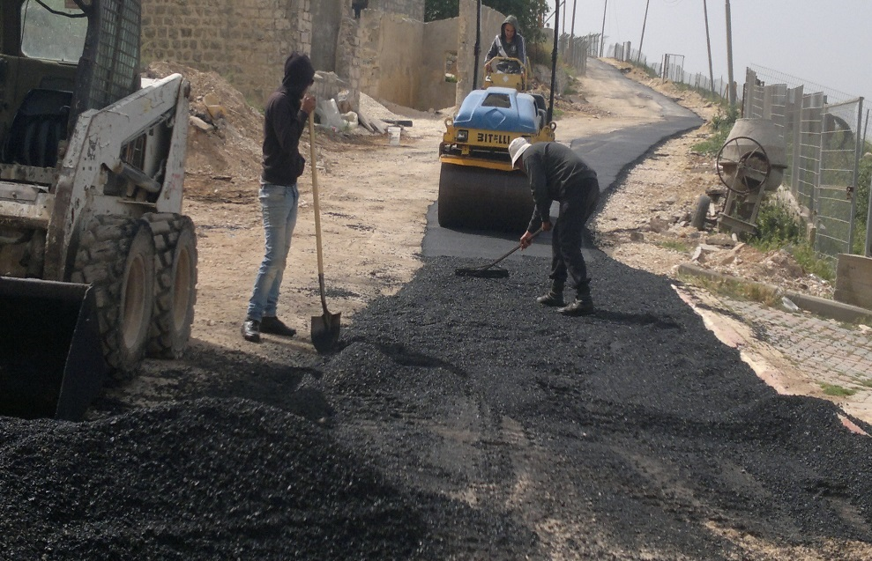
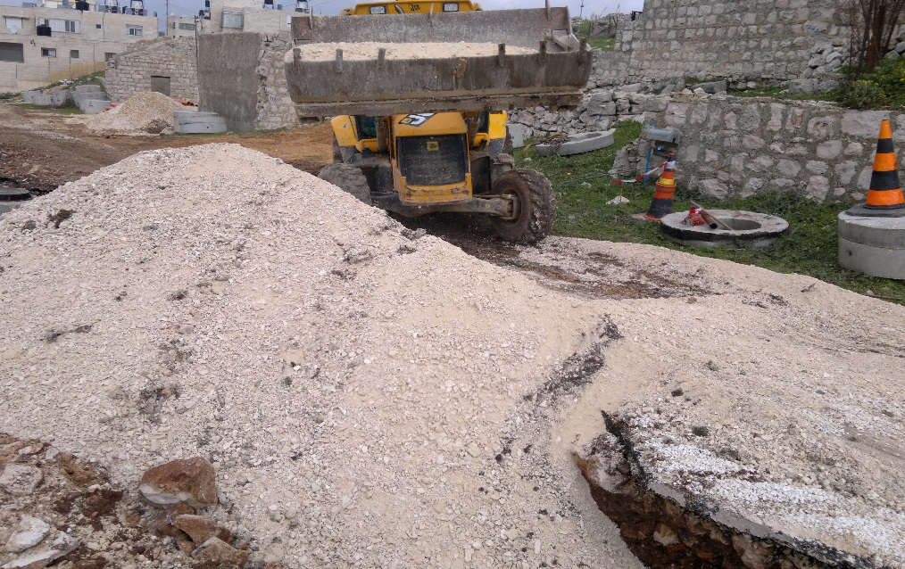
Asphalt
Unit Price ($) per 1 m² | 18

Slide 27
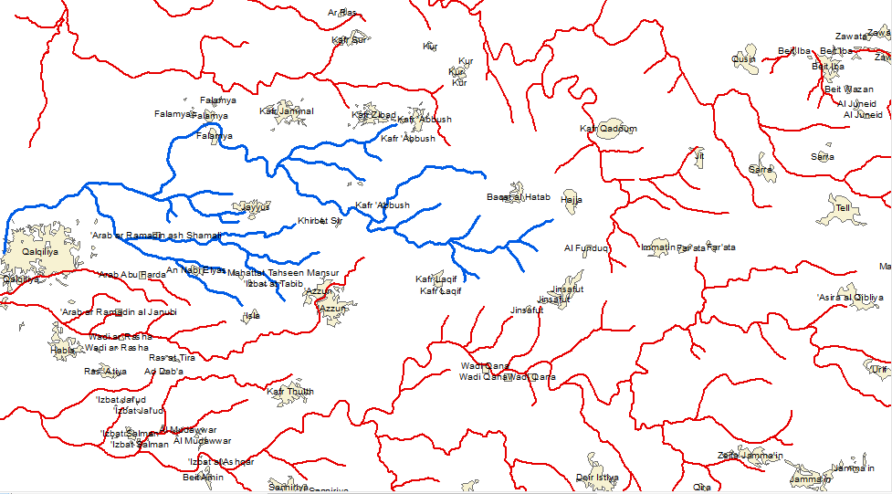
Wastewater Treatment Plant Location

Slide 28
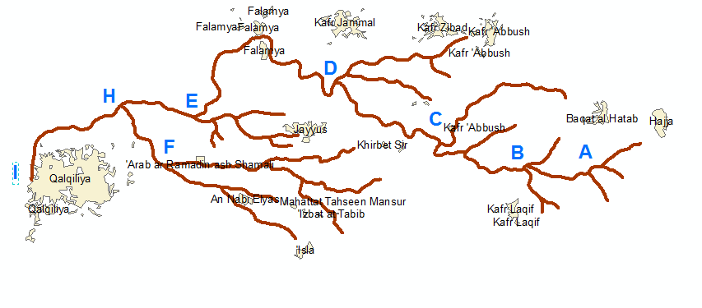

Slide 29
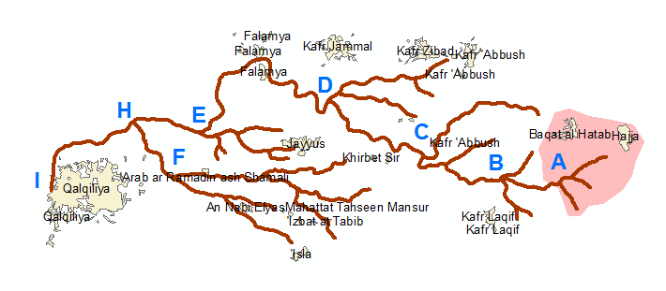

Slide 30
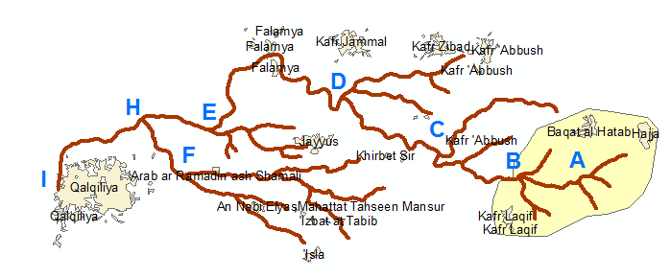

Slide 31
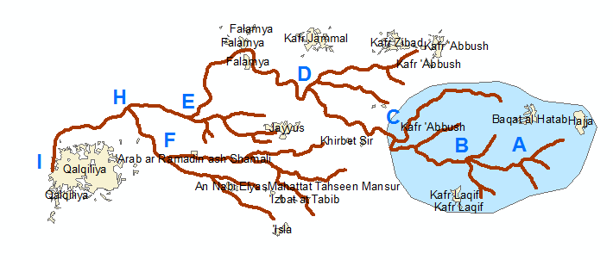

Slide 32
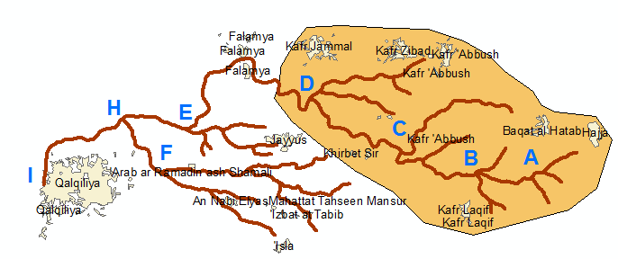

Slide 33
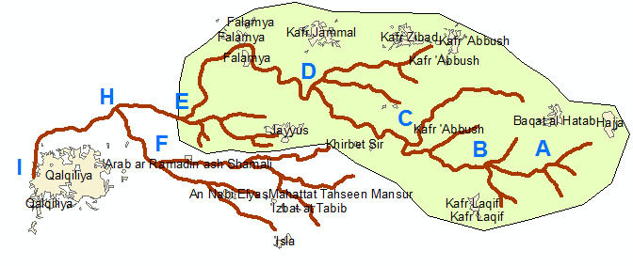

Slide 34
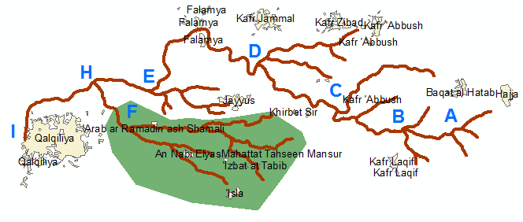

Slide 35
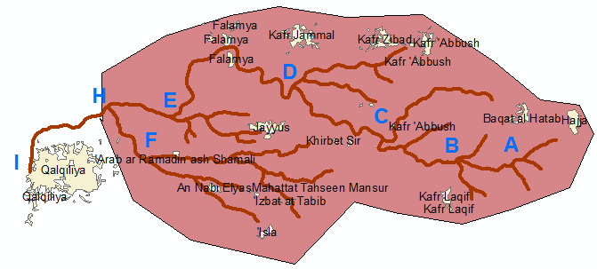

Slide 36
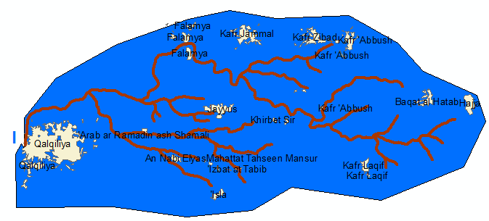

Slide 37
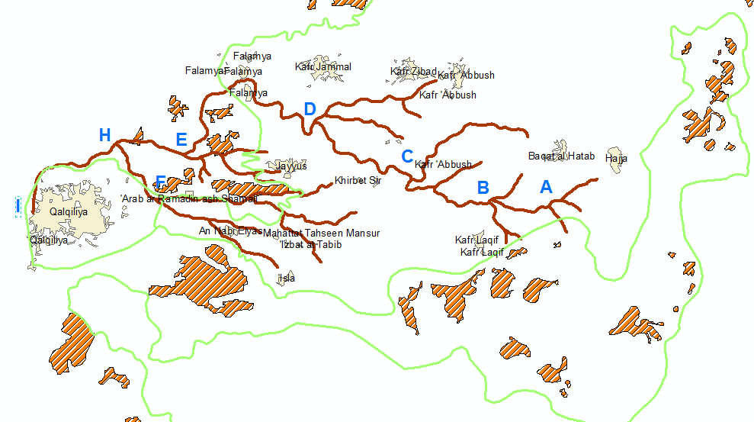

Slide 38
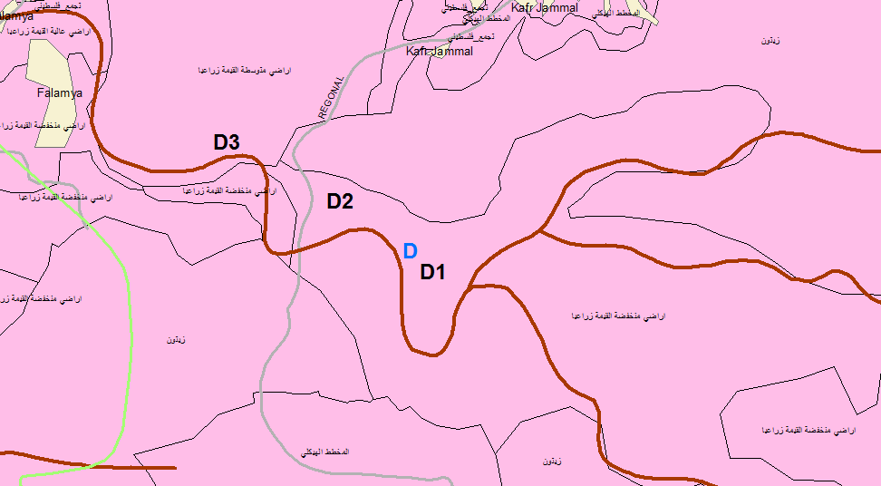

Slide 39



