Slide 1



ATM
Rashed Ammouri & Ibrahim Tayeh & Yousef Salman
Supervisor: Dr. Hanal Abuzant ​& Muhannad Al-Jabi
An-Najah National University, Faculty of Engineering ​
Department of Computer Engineering, ​
June 2026 ​

Slide 2



Introduction
Automated cash handling is increasingly important due to the demand for secure, efficient, and cost‑effective currency exchange. This project presents a smart ATM prototype dedicated to intelligent denomination exchange, supporting both accumulation and change‑dispensing for banknotes and coins.

Slide 3




Problem
Many businesses need a compact machine that can break large denominations into smaller ones accurately. Commercial ATMs are expensive and complex for single‑purpose exchange, while simple change machines often lack intelligent recognition, optimized dispensing logic, and real‑time inventory monitoring.

Slide 4



Objective
  Recognize inserted banknotes using Raspberry Pi image processing
  Detect coin denominations using pulse‑based validation
  Support accumulation modes (coins / cash / hybrid)
  Dispense banknotes using arc positioning + vacuum routing + rollers
  Dispense coins using servo‑controlled gates
  Synchronize inventory wirelessly using ESP8266 + admin mobile app
  Improve mechanical accuracy using a homing limit switch

Slide 5


PROJECT STEPS
Step 1
Step 2
Step 3
User selects mode and inserts banknotes/coins
System validates currency and computes available change combinations
System dispenses banknotes/coins and syncs inventory to the mobile admin app

Slide 6
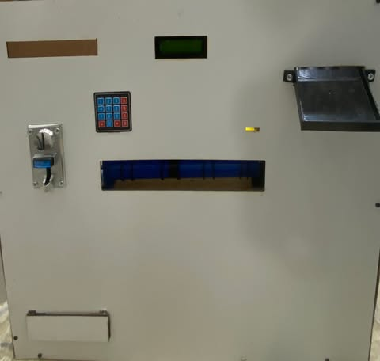
EXTERNAL DEVICE

Slide 7
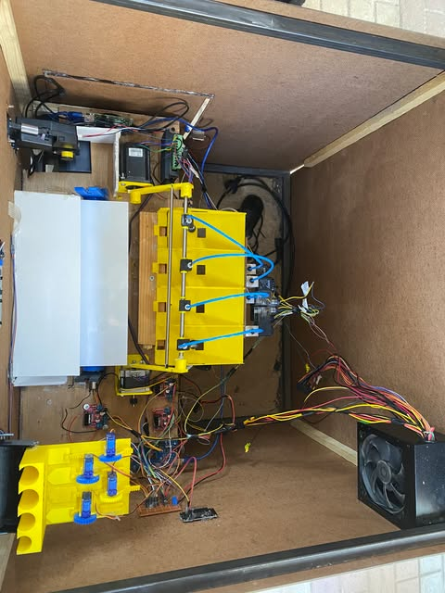
INTERNAL DEVICE

Slide 8



COINS
WORK

Slide 9

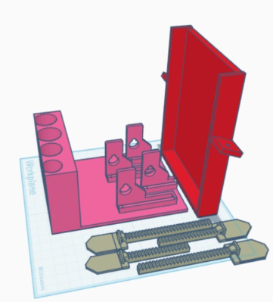
SERVO BASE

Slide 10
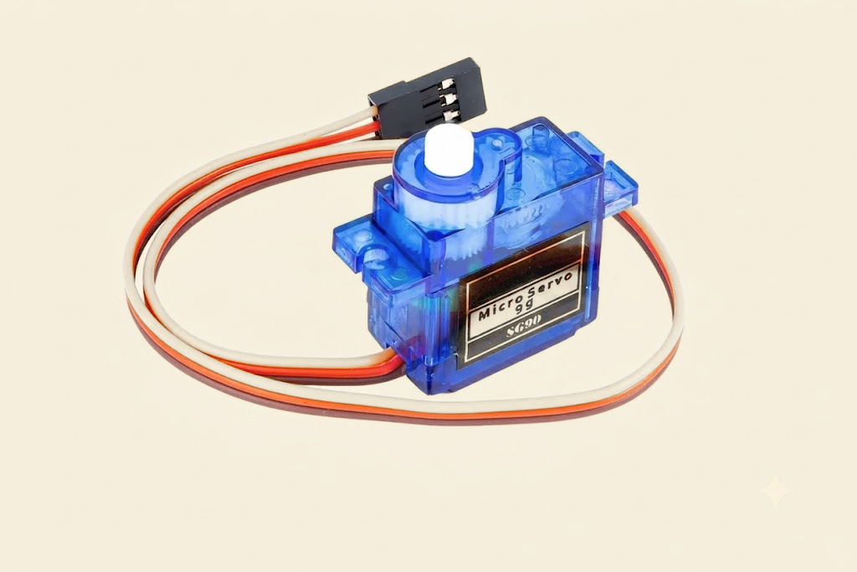
SERVO SG90

Slide 11
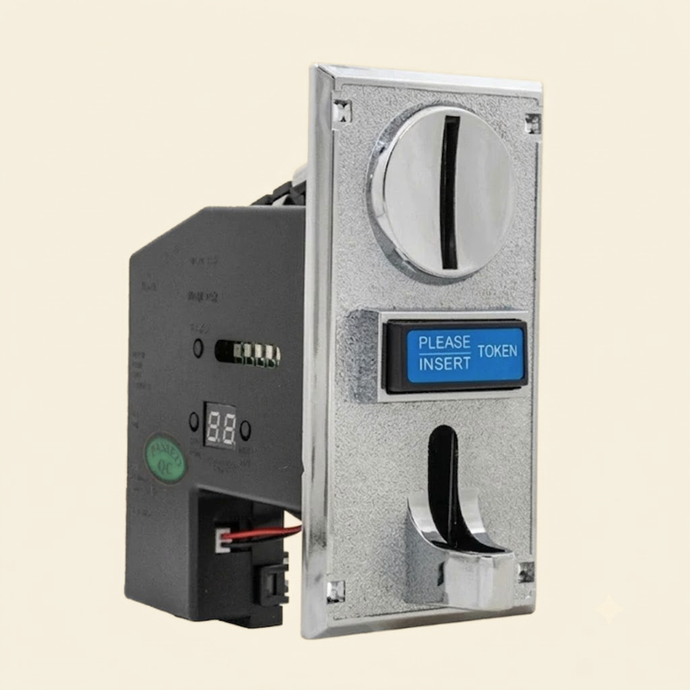
CION ACCEPTOR

Slide 12
CASH
WORK

Slide 13
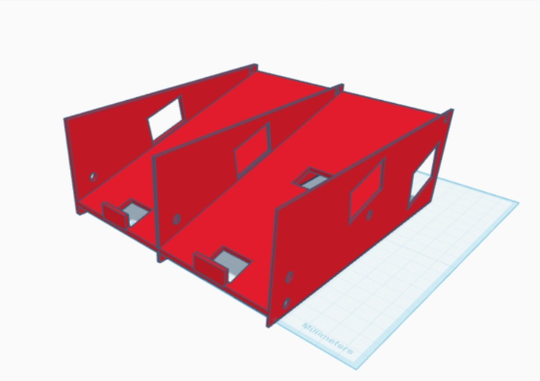
3D PRINTED STORAGE SLOTS

Slide 14
STEPPER ARM

Slide 15
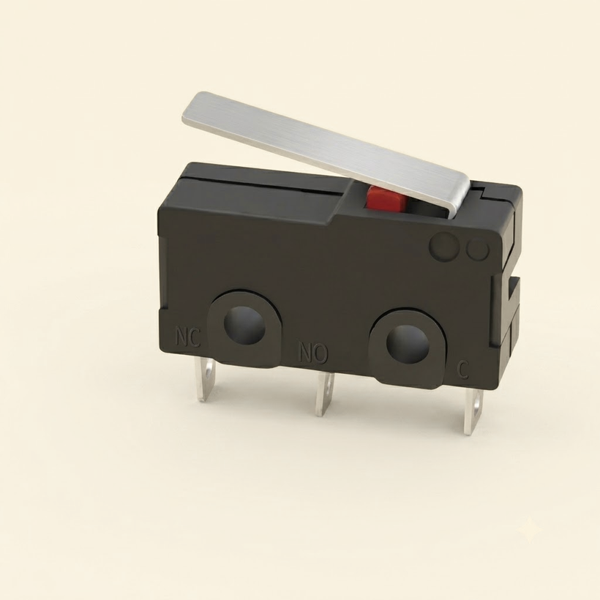
LIMIT SWITCH

Slide 16
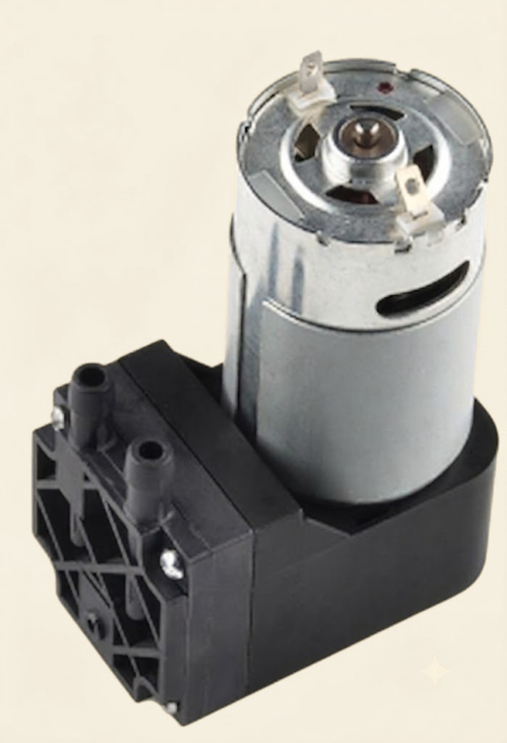
DC VACUUM

Slide 17
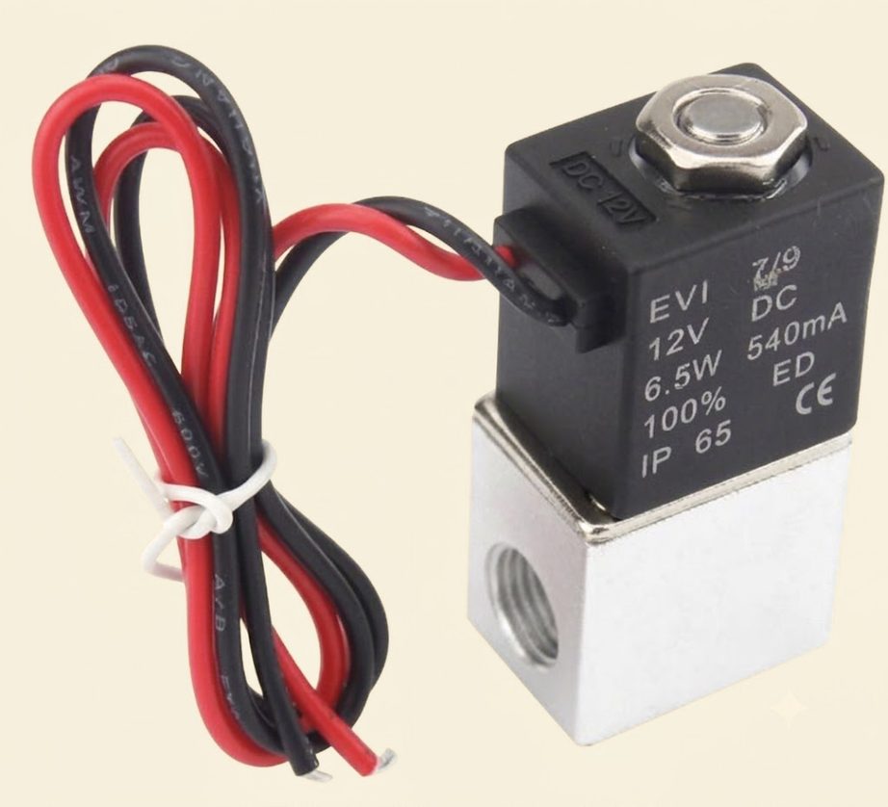
SOLENOID VALVES

Slide 18

PNEUMATIC TUBES

Slide 19
Electronic & Control Architecture

Slide 20
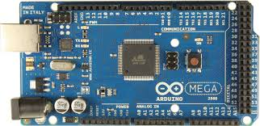
Arduino Mega 2560

Slide 21
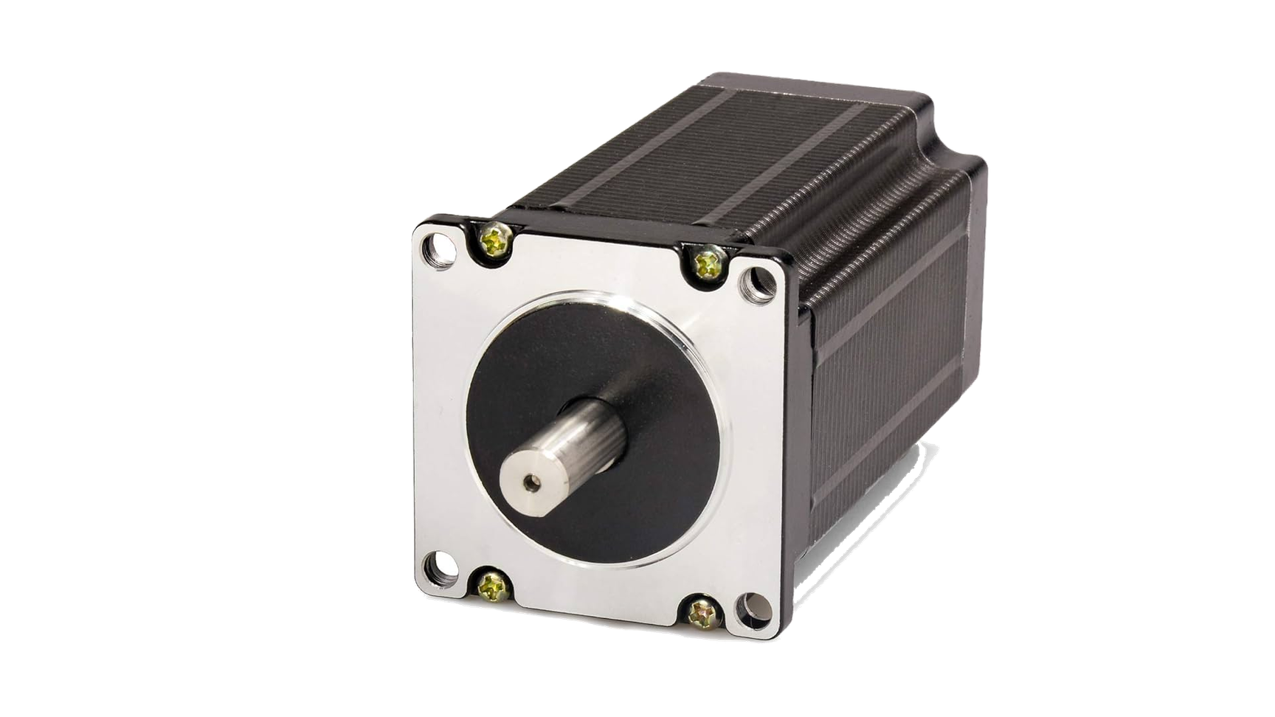
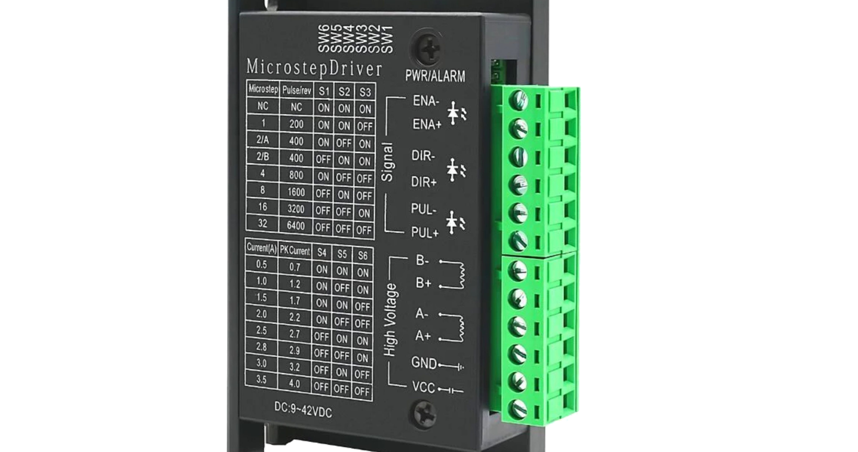
NEMA23 Stepper | TB6600 Driver

Slide 22
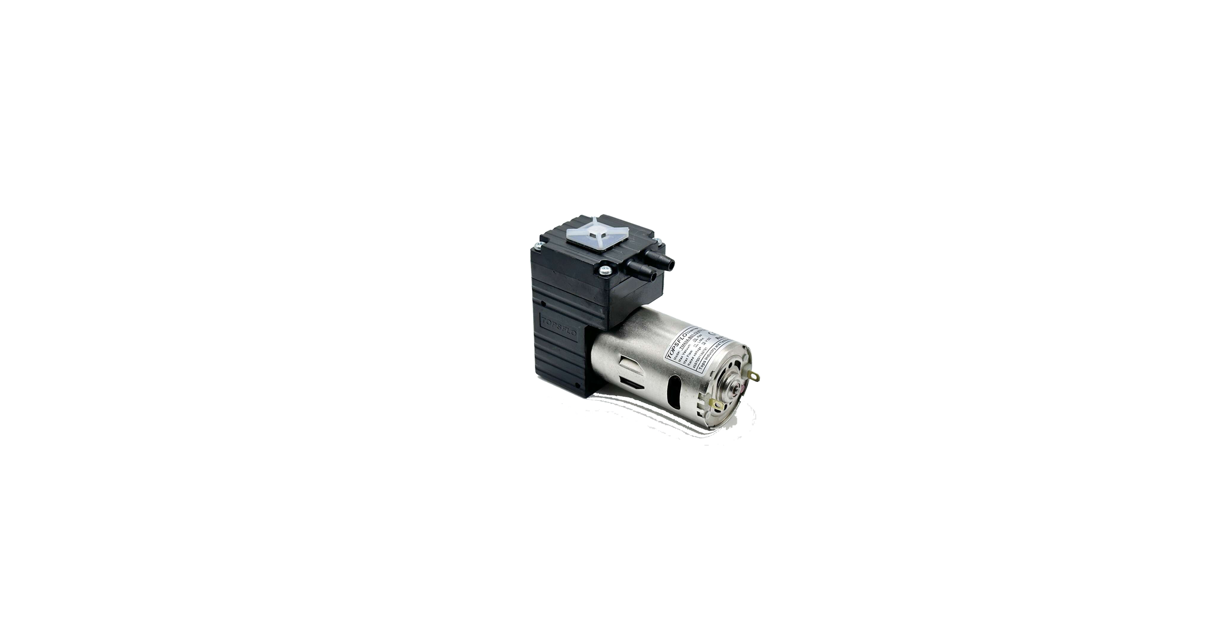
DC VACUUM

Slide 23
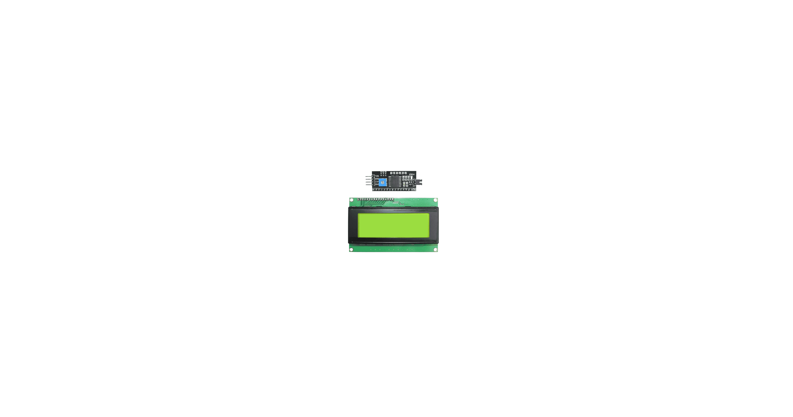
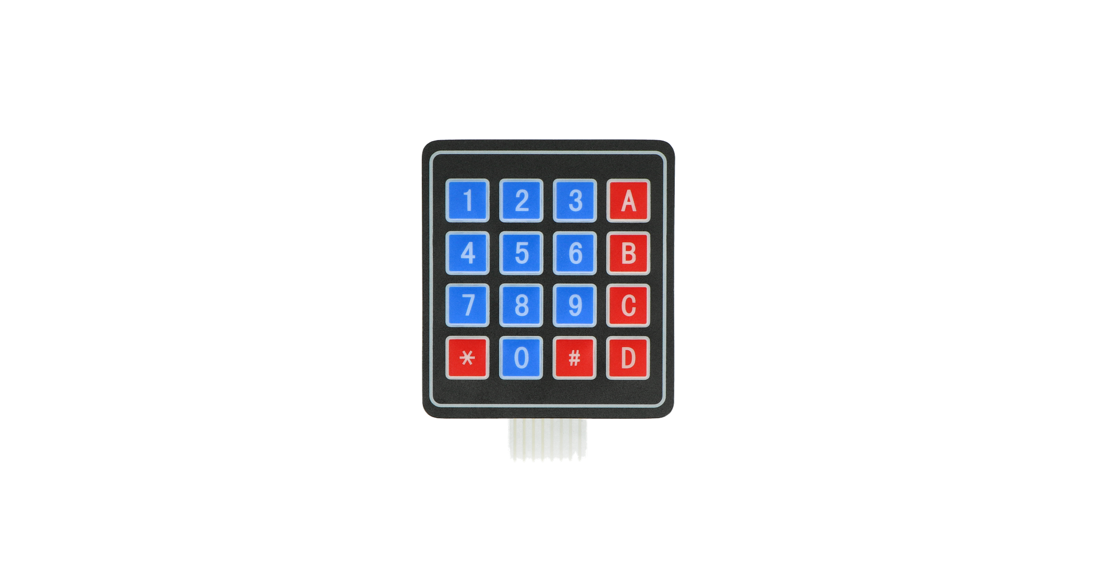
USER INTERFACE

Slide 24
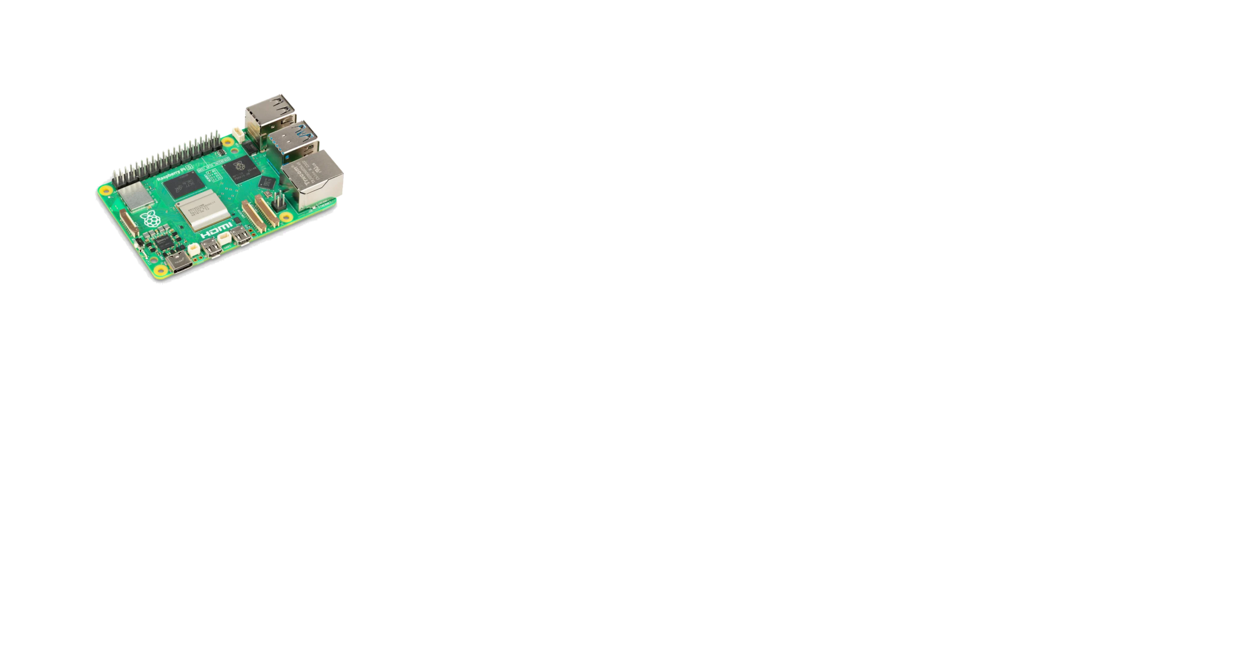
Raspberry Pi

Slide 25

CORONA SERVO

Slide 26

ESP8266

Slide 27
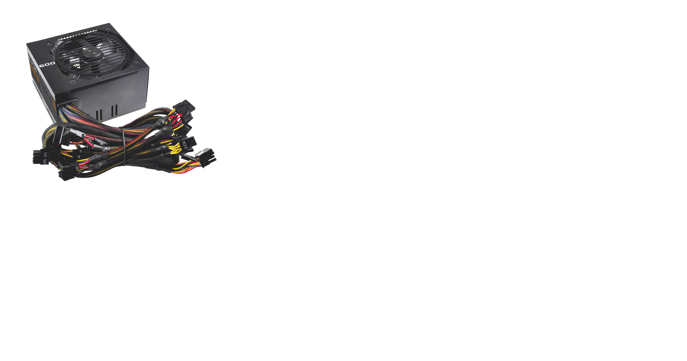
POWER SUPPLY

Slide 28
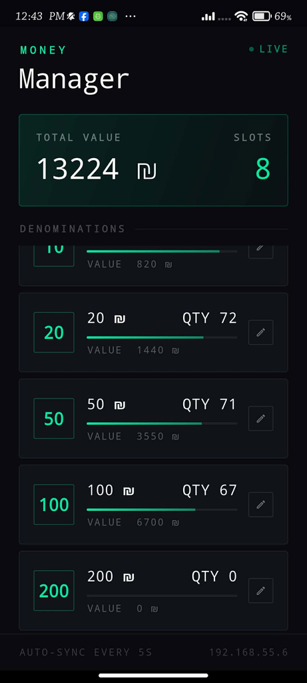
Mobile Application

Slide 29
SYSTEM STARTUP
  Select accumulation → coins
  Select target denomination/amount
  Insert coins (pulse counting)
  Sum updates on LCD
  Confirm when target reached
  Dispense required coin(s) + update inventory

Slide 30
ACCUMULATION MODE
COINS
  Select accumulation → coins
  Select target denomination/amount
  Insert coins (pulse counting)
  Sum updates on LCD
  Confirm when target reached
  Dispense required coin(s) + update inventory

Slide 31
ACCUMULATION MODE
CASH
  Select accumulation → cash
  Insert banknote
  Servo positions note under camera + LEDs ON
  Raspberry Pi recognizes value
  Confirm → store note
  When target reached → dispensing initiated

Slide 32
DISPENSING MODE
  Select dispensing mode + target amount
  System shows available combinations
  Inventory checked before execution
  Dispense banknotes (arc + vacuum)
  Dispense coins (servo gates)
  Sync inventory + return home

Slide 33

Result
  Validated banknotes using computer vision
  Accumulated and tracked inserted values accurately
  Dispensed multi‑denomination change using integrated motion + pneumatics
  Dispensed coins reliably using servo gates
  Updated inventory in real time on the mobile admin application

Slide 34



FUTURE WORK
  Expanding the image processing algorithm to improve recognition robustness under varying lighting conditions.
  Developing a more advanced mobile application with detailed transaction logs.
  Improving the external enclosure using industrial-grade materials for increased durability

Slide 35

THANK YOU

