Slide 1


Slide 2
Outline:
Introduction:
a ) General description of project b) Materials
c) Loads d ) Design codes and program used
Preliminary dimensions:
a) Concrete structural system
1. Slabs 2. Beams 3. Columns 4. Footings
b) Steel structural system
c) SAP verification checks
d) Column capacity check.
e) Dynamic analysis and check
3. 3D static analysis and design of steel structure.
4. 3D static analysis and design of concrete structure.

Slide 3
Introduction:
a ) General description of project:
• This project is a structural analysis and design of Al-Bireh International Stadium located in Al-Bireh City contains different structural systems.
• It consists of covered spectator seating on two adjacent sides of the playground only with seating capacity of 3600 are shown in the next slide.

Slide 4
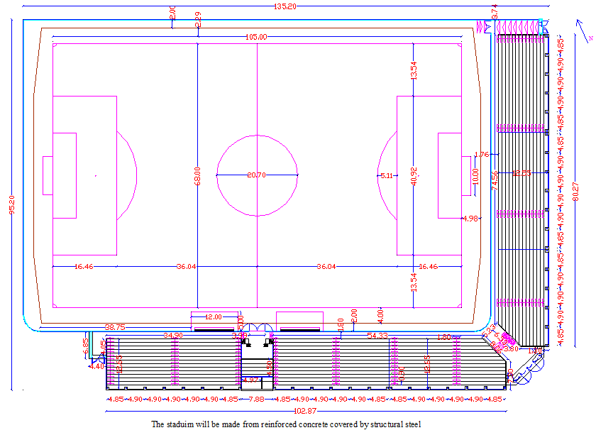

Slide 5
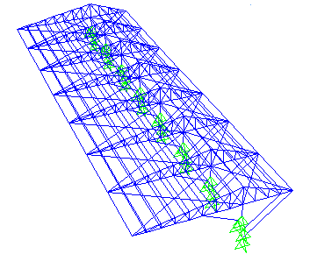
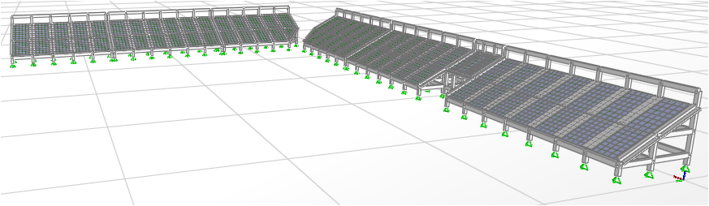
Concrete structure
Steel structure :
Cantilever system .
b) Materials :
Concrete structure :
B350 Kg/cm2 (Fc. = 28 MPa) , Fy = 420 MPa
Table of density and thickness of Materials is shown below .
Materials | Density (KN/m³ ) | Thickness (mm)
Plastering | 23 | 15
Tiling | 27 | 25
Mortar | 23 | 20
Gravel | 18 | 100
Masonry stone | 27 | 50
Plain concrete | 23 | 135
Block | 12 | 100

Slide 6
Steel structure :
A992 grade 50 will be used .
The welds will be used in design of connections (use Electrode 70XX which has ultimate tensile strength equal 480 MPa) .
The covering plates will be assumed to be EPs Sandwich panel (assume density equal 15 Kg/m³ and thickness equal 0.151 m ) .
c) Loads :
Concrete structure :
Gravity loads :
Live loads is 5 KN/m² , from code ASCE7_05 code for loads .
Dead loads are composed from slab and spectator seating, tiling , etc….. own weights .
Lateral loads :
Earthquakes loads :is critical on this structure.

Slide 7
Steel structure :
Gravity loads :
Live loads(snow) is 1 KN/ m2
Dead loads consist of structural elements weight .
Superimposed dead loads (EPs sandwich panel weight ) which equal 0.023kN/m².
Lateral loads :
Wind loads : 0.27 KN/m² , based on ASCE code
d) Design codes and program used :
a) ACI 318 – 08 for concrete design. b) ASCE7-05 Code
c) AISC/LRFD - 2005 for steel design. d) IBC2006 Code
e) SAP2000 (V 14.2.2) program is used .

Slide 8
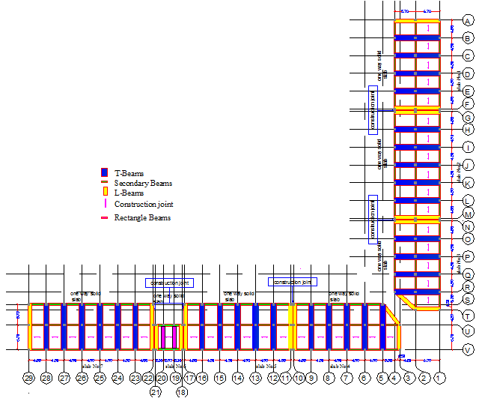
Preliminary design:
a) Concrete structural system
Distribution of structural elements are shown below in figure .

Slide 9
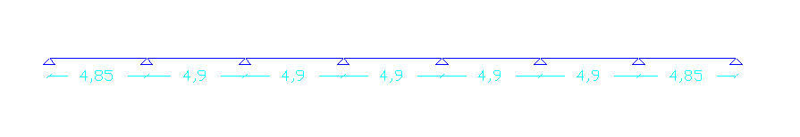
1. Slabs :(One way solid slab ).
Slab 7 is used as representative slab for all slabs, 1D model for slab is shown below :
Thickness of slab is determined based on Table 9.5(a) in ACI code.
Use 25 cm as thickness for slabs
Check slab thickness for wide beam shear is OK.
2. Beams :
Types of beams :
a. Main beams .
b. Secondary beams.
c. Tie beams .

Slide 10
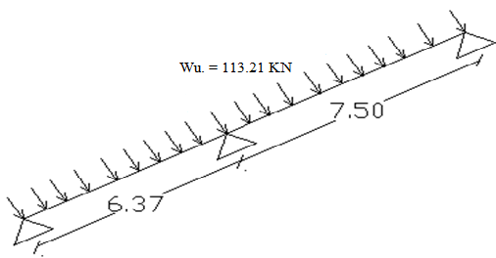
Main beams:
1D model for main
interior beams:
1. T- beams sections :
Beams thickness: Use beam with 70 cm in depth.
Flange width based on ACI318 – 2008 code:
Use b_{f} = 1.6 m = 1600 mm.
Beams dimensions are :
Web : thickness 0.45 m , width 0.5 m
Flange : thickness 0.25 m , width 1.6 m

Slide 11
2. L- beams sections dimensions :
Beams dimensions are :
Web : thickness 0.45 m , width 0.5 m
Flange : thickness 0.25 m , width 1.0 m
b. Secondary beams
1D model for secondary beams:
Beam dimensions (25 cm depth * 50 cm width) .
c. Tie beams
Use beam with 70cm depth and 50 cm width.

Slide 12
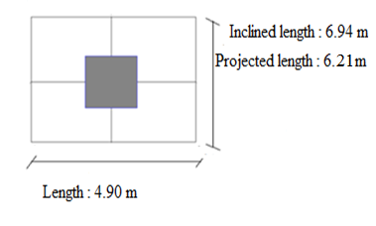
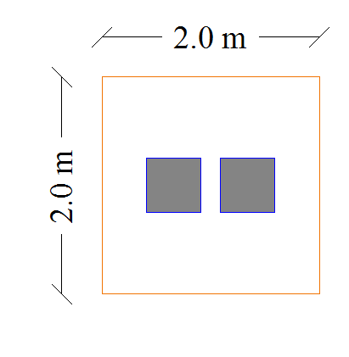
3. Columns :
Taking an interior column
Loads on column :
Total dead load = 626.62 KN
Live load = 152 KN
Column dimensions are 50 *50 cm .
4. Footing :
The footings are classified into five groups.
For Footing G4:
Allowable bearing capacity q _{all.} = 3 kg/cm² ( 300 kN/m² )
Footing dimensions are 2*2 m .
Thickness based on wide beam shear :
ǾV_{c} = V_{u} , d = 0.25 m. , Use d= 0.3m
Check footing for punching shear is OK .
Footing dimensions are 2*2*0.35 m .

Slide 13
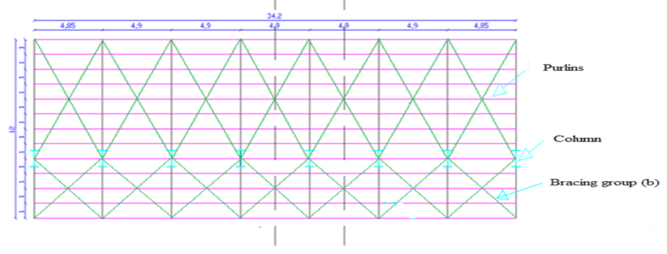
b) Steel structural system :
The spectator seating’s will be covered by steel structure system , take representative slab number 7 to design .
The figure below show distribution of trusses , columns , purlins and bracing.

Slide 14
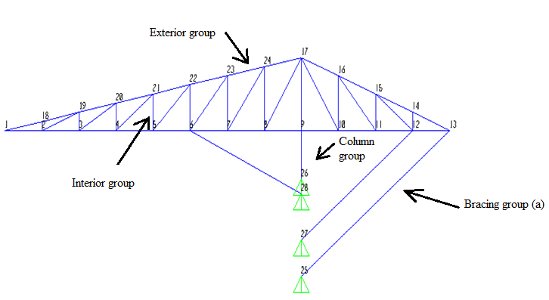

2D model for interior truss is shown below .
Joints loads :
Table of joints loads are shown below:
Joint number | Live Load (KN) | Wind load (KN ) | Covering load (KN )
13 , 17 | 2.45 | 0.7 | 0.06
14, 15 , 16 | 4.9 | 1.42 | 0.12
1 , 17 | 2.45 | 0.67 | 0.06
18, 19, 20, 21, 22, 23 ,24 | 4.90 | 1.35 | 0.12

Slide 15
3D model of steel structure will be designed by SAP program to determine the lightest members cross sections :
Members cross sections :
Check members for adequacy , each member is checked on tension and compression
All members are adequate
Members Groups | SAP Design Sections | Sections used
Exterior | 140X140X10 | 140X140X10
Interior | 80X80X5 | 80X80X10
Column | IPE300R | IPE330R
Braces(group a) | 70X49X3.6 | 70X70X10
Braces(group b) | 140X140X10 | 140X140X10
Purlins | 70X70X3.6 | 70X70X3.6

Slide 16
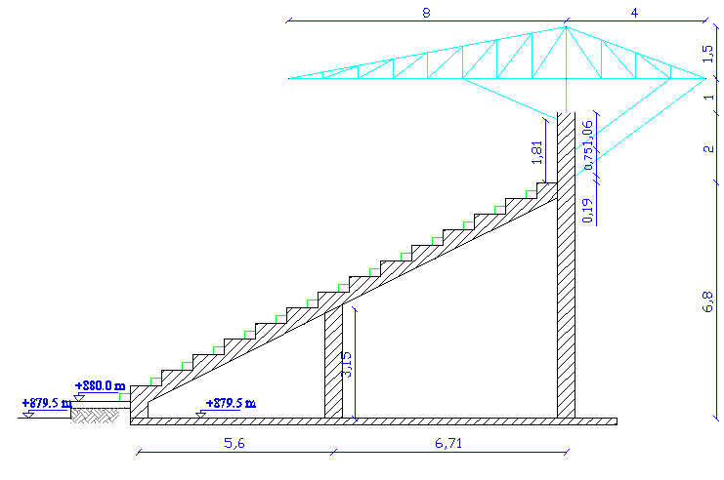
Check members for local and torsional buckling are satisfied .
2D model for structure is shown below:
c) SAP verification Checks :
Compatibility, Equilibrium and Stress – strain relationship checks
are OK .
For 3D steel and concrete structure (% error < 10 % ).

Slide 17
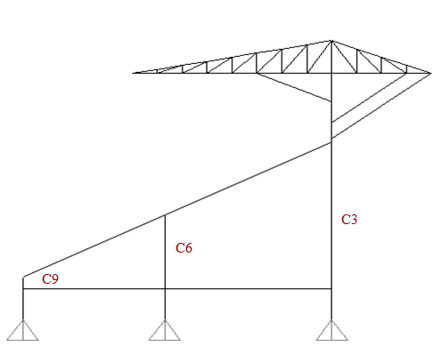
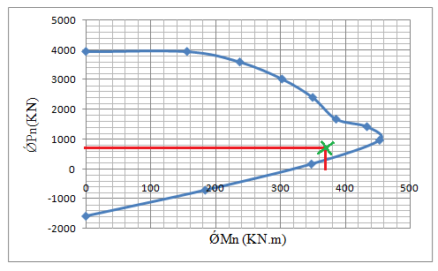
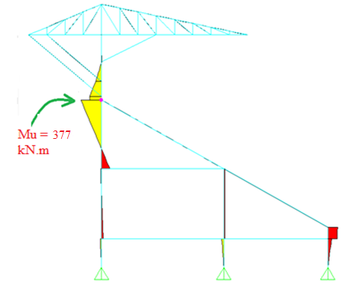
d) Column capacity check.
select column 3 to be checked .
• Based on axial load only:
Total ultimate load (Pu) on C3 = 1141.0 KN
Dimensions of square column (50*50cm) are
adequate based on the this load .
•The Interaction diagram for this column from 3D model is shown below.
Ultimate applied loads on column from SAP program are :
Axial force = 673 KN , Bending moment = 377 KN.m

Slide 18
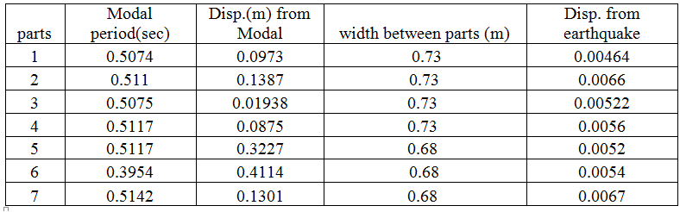
e) Dynamic analysis and check.
The structure will be analyzed under dynamic loads , modal
vector analysis and response spectrum will be used.
Two checks will be considered .
Displacement at the construction joints.
• Result :The lateral displacements for each part is less than the width of construction joints.

Slide 19
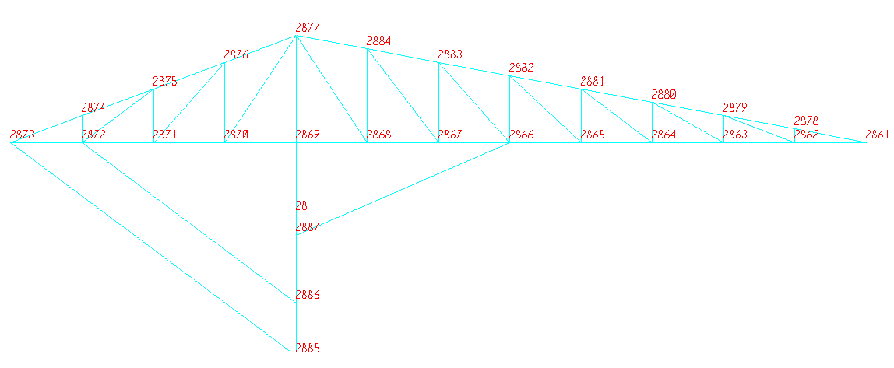
2.Period of structure.
The period from SAP program of structure is 0.51 second .
Value of period is small which mean the structure is ductile .
When Earthquake occurs (response spectrum method ) the
structure will move within 0.51 second , this mean the structure
is safe and ductile.
3. 3D Design of steel structure.
Connections of members are weld.
Joint labels are shown below.

Slide 20
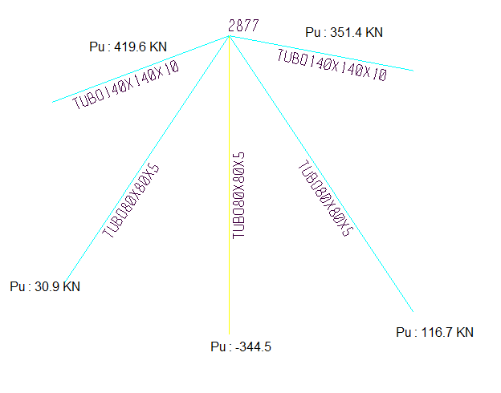
For joint 2877:
Ultimate loads in members at this connection are shown blow
After applying weld metal strength equation (P_{u- weld} (KN) = Ǿ( 0.707 a L_{weld} F_{w} )/ 1000) on member section TUBO80*80*10 with axial loads = 344.5 KN
▲The size of weld equal to 7.05 mm , this is greater than minimum limit ( 5mm ) and less than the maximum limit (8 mm)
• So use weld size equal to 7.1 mm for all welded connections .

Slide 21
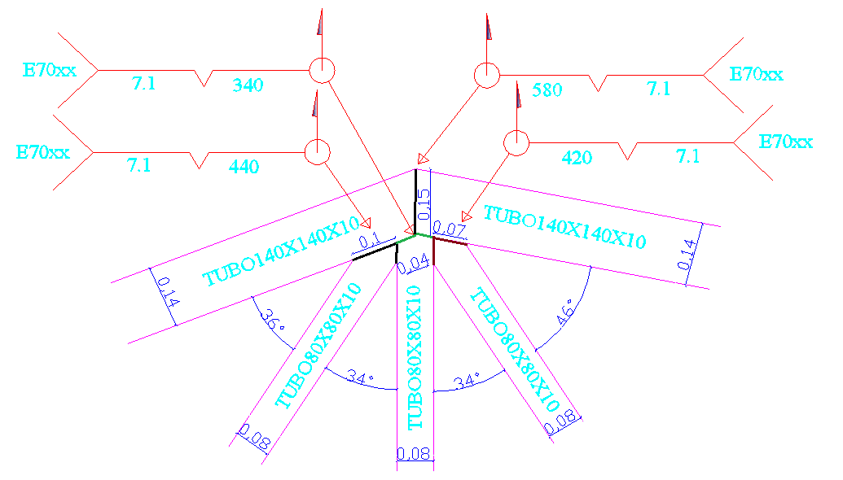
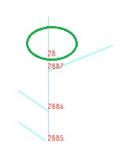

The plan for connection is shown in Figure below .
Base Plate:
For joint 28.
The dimensions of base plate are calculated based on this equation(Pp=_{c} (0.85f'c) A₁√(A₂/A₁) ≤ 1.7 f'c X A₁ ) on
AISC/LRFD -2005(see Equ. J8-2 ).
Use base plate with dimensions of 350X500 mm.
The plate thickness is equal 15 mm based on the following
equation : t = L

Slide 22
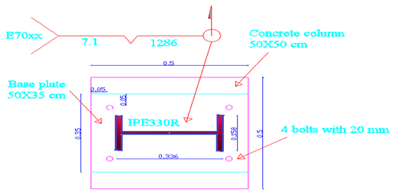
The base plate under steel column is shown below.

Slide 23
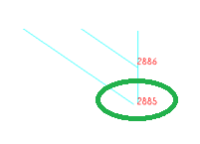
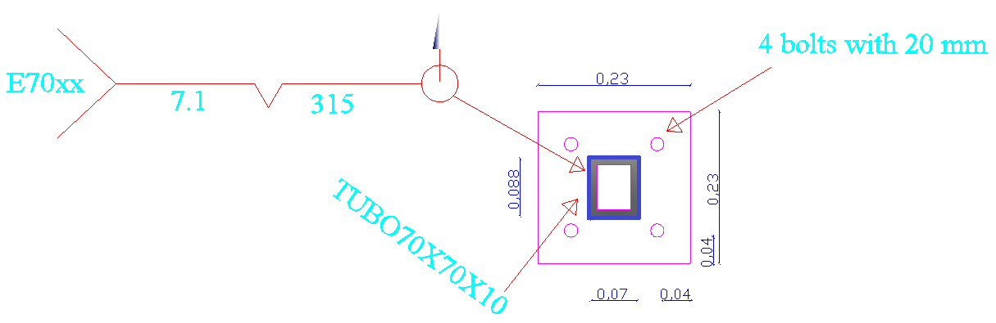
For joint 2885.
• Tension and shear is applied on This joint (tension = 165KN , shear = 124KN ), this is loads is checked based on the following equation :
→F_{nt. ̃} = 1.3 F_{nt.} – (F_{nt} / Ǿ F_{nv} ) F_{v} ≤ F_{nt} …….. see equation C-J3-6a
→ the check is …OK .
The dimensions for this base plate are 230X230 mm with
thickness 15mm , the plan is shown below .

Slide 24
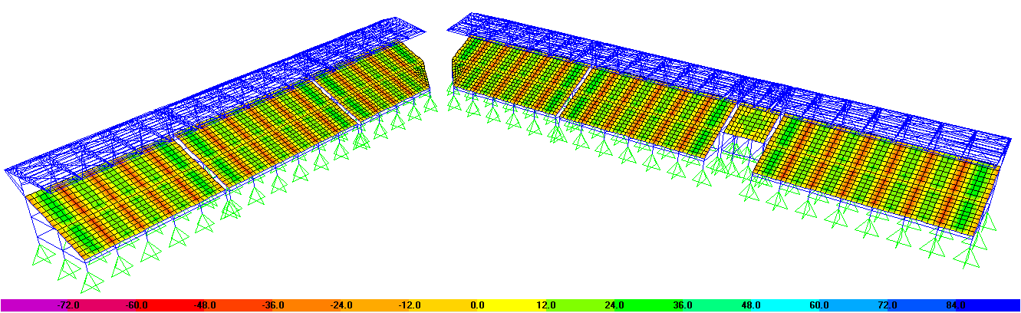
4. 3D static analysis and design of concrete structure.
Design of structural elements:
Slabs.
The moment diagram on the slab is shown below.
The area of steel are taken from SAP at each columns and at middle of spans for slap part 7 .
For exterior top, As = 427.6 mm2
For interior top , As = 728 mm2
For exterior bottom , As = 432.6 mm2
For interior bottom , As = 393.6 mm2

Slide 25
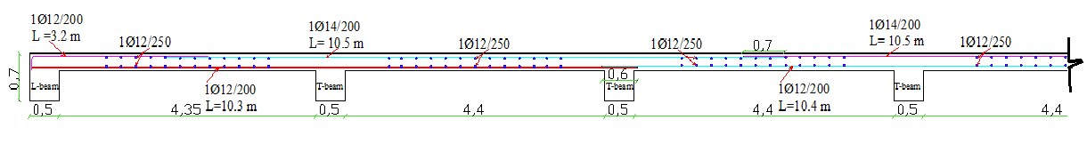
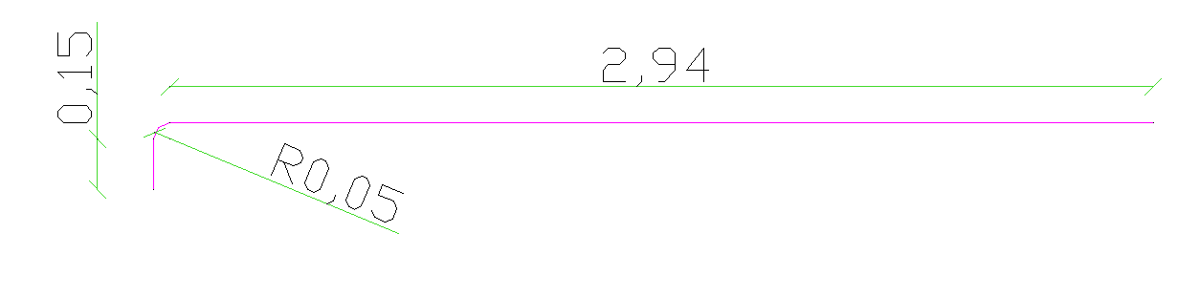
For exterior top, exterior bottom, interior bottom reinforcement steel
use A_{S} = 450 mm² , use 4Ø12/m
Interior top reinforcement use A_{S} = 728 mm², use 5Ø14/m
The distribution of reinforcement steel on part from slab are shown
below.
Hooks will be used for top reinforcement as shown below.

Slide 26
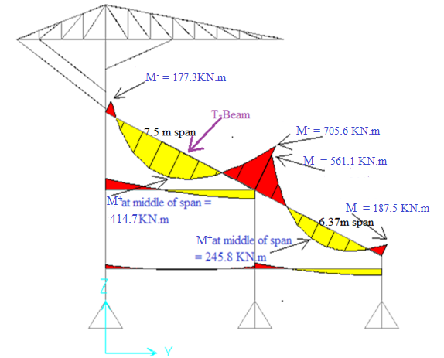
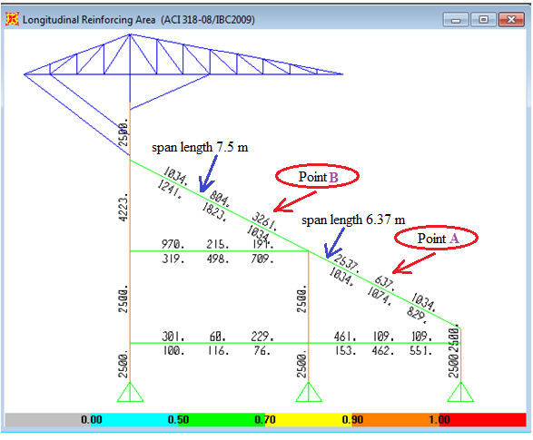
Beams.
Take one type of beams to explain (T-beams) that has largest
loads.
The moment diagram and longitudinal rebar for the beam are shown below.
The area of reinforcement steels are checked for minimum and
maximum reinforcement steels .

Slide 27
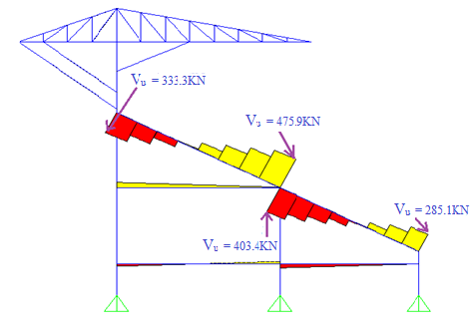
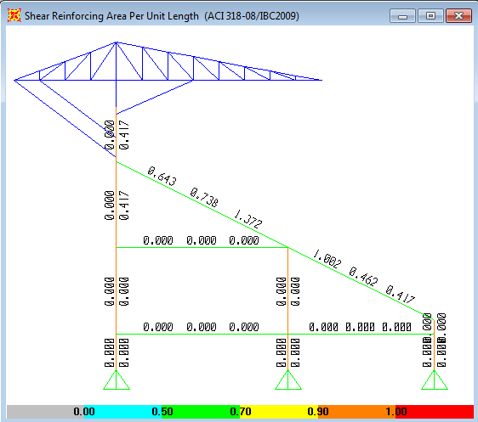
Bottom reinforcement steel are distributed in web
Top steel are divided in web and flange as (2/3 , 1/3
respectively ).
Distribution of longitudinal rebar for beam are shown in the
next slide.
Design for shear , the shear diagram and shear reinforcement
steel ratios of beam is shown below.
Check shear reinforcement ratios for minimum limit is OK.

Slide 28
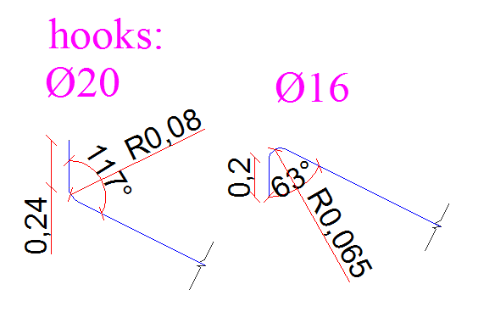
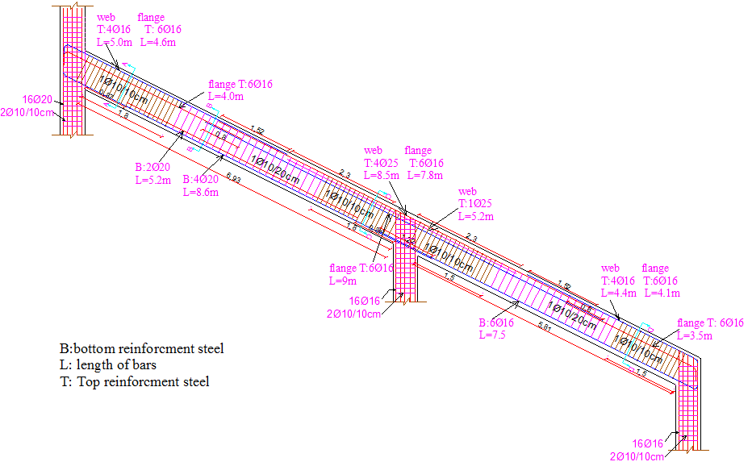
Diameter of stirrups that used are 10 mm .
The distribution of longitudinal bars and stirrups are shown
below.

Slide 29
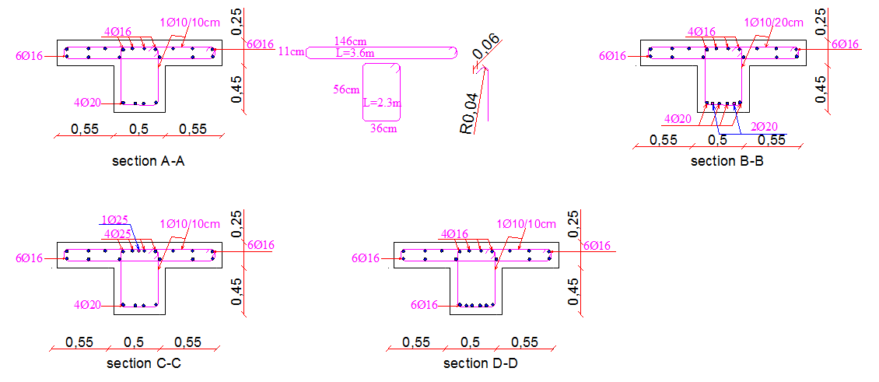
Section on beams are shown below.

Slide 30

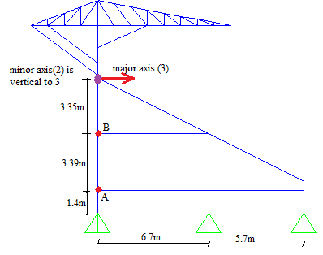
Columns.
The structure is considered sway ( unraced ) which checked with below equation in ACI code.
Q for structure part 7 = 10.7 > 5% , the story is unbraced .
Check column slenderness in sway structure.
Slenderness can be neglected If (KLu/r ) ≤ 22
Column (AB) that checked for slenderness is shown below.
(KLu/r ) = (1.42*2.69/0.15) = 25.5 ≥ 22 the column is slender.

Slide 31
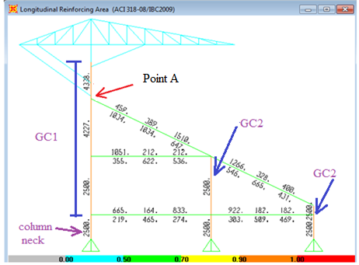
Two group of column will be designed depend on amount
of reinforcement steel.
Area of longitudinal rebar in columns are shown below.
For GC1.
Check for minimum moment is OK.
Stirrups diameter are 10 mm
Use 16Ø20, AS = 5024 mm2 > 4338 mm2…. OK.

Slide 32
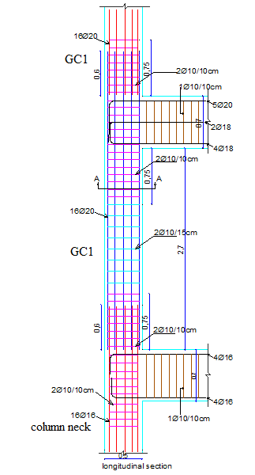
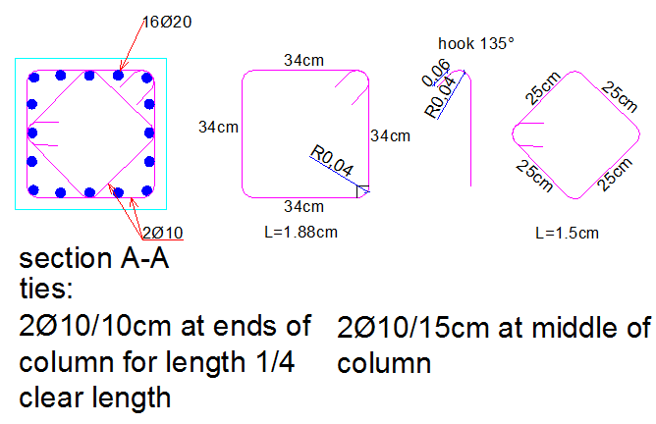
For GC2.
Use 16Ø16 , As = 3261 mm² > 2500 mm² …. OK.
For column neck.
Use 16Ø16
The stirrups are 2Ø10 for all column.
Stirrups spacing at ends column
and middle of column are 100,
150 mm respectively.
Distribution of steel in columns are
shown below.

Slide 33
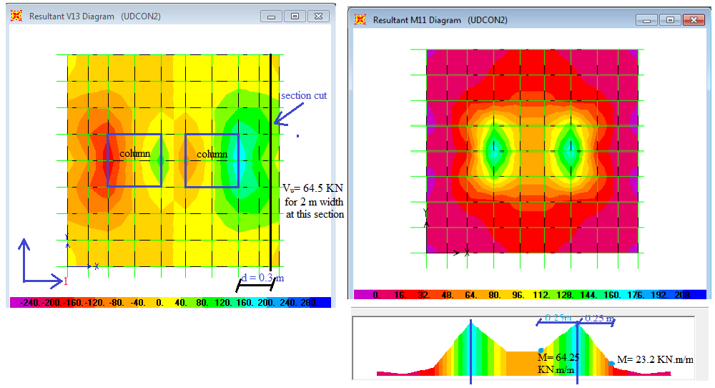
Footings.
For GF4 which dimensions are 2*2*0.35 m
The shear and moment diagram in x- direction of footing are
shown below.

Slide 34
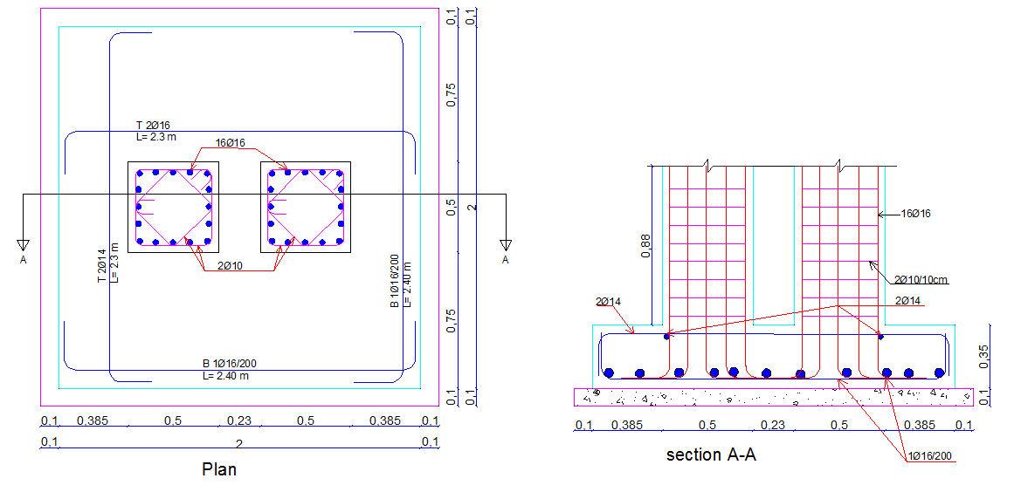
Take the value of moment from diagram and design it .
In two directions As< As_{min} →use As_{min} = 630 mm²/m.
Use 1Ø16/200 (11Ø16) in each direction at bottom of footing .
Use 2Ø14 in each direction at top of footing for fixing .
Distribution of steel in footing are shown below.

Slide 35


