Slide 1
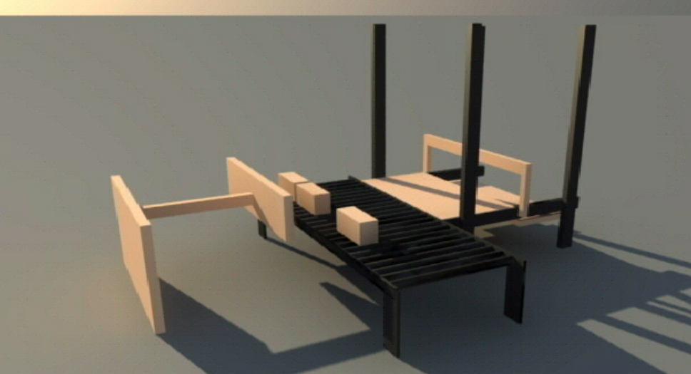

AN-NAJAH NATIONAL UNIVERSITY
FACULTY OF ENGINEERING
Supervisor: Dr. Nidal Farahat
Prepared by:
Iessa Asrawi
Islam Barhoum
Mahmoud Shreem
Mohammad Ali

Slide 2
Agenda
* Introduction
Definition of project .
Objective .
* Research parts
Mechanical part
Electrical part
Control and Software part (programming)
* Calibration and result
* Safety
* Summary

Slide 3

Definition of palletizer machine

Slide 4
Objective of project
Reduce the the cost.
Reduce the time .
Increase the quality.

Slide 5
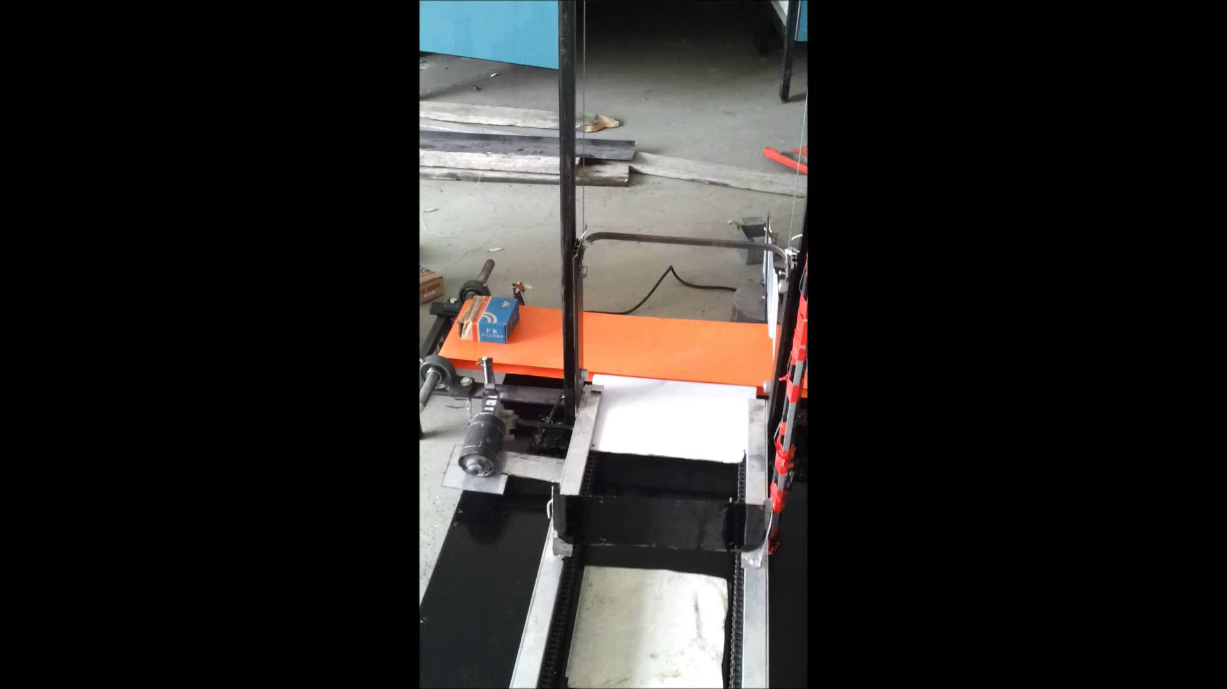
Principle of operation
Palletize machien

Slide 6
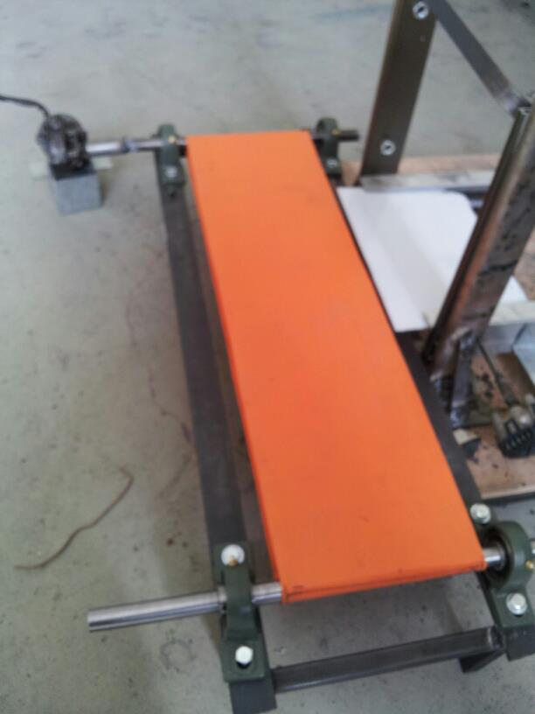
Mechanical parts
Belt Conveyor

Slide 7
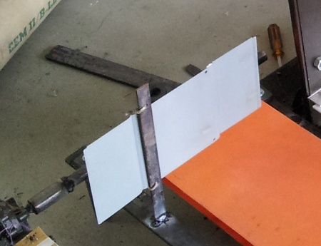
Stop plate

Slide 8
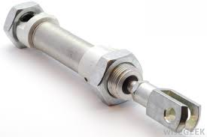
Mechanical parts
Pusher by piston

Slide 9
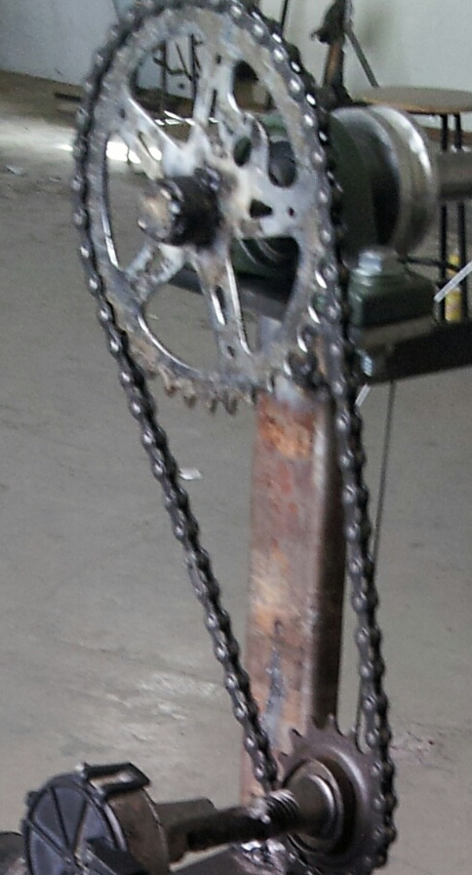
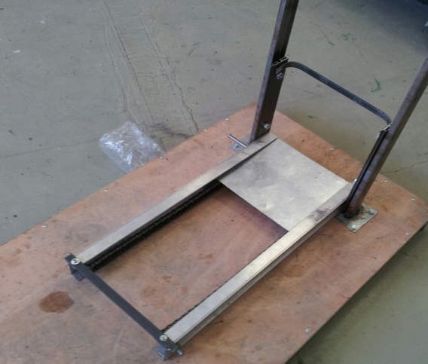
Mechanical parts
Sorting Machine:
Frame
Elevator

Slide 10
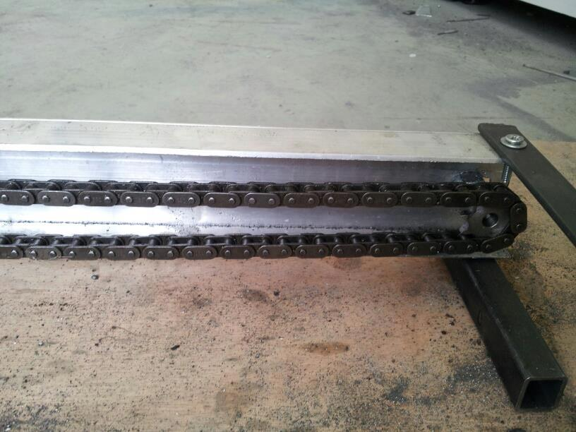
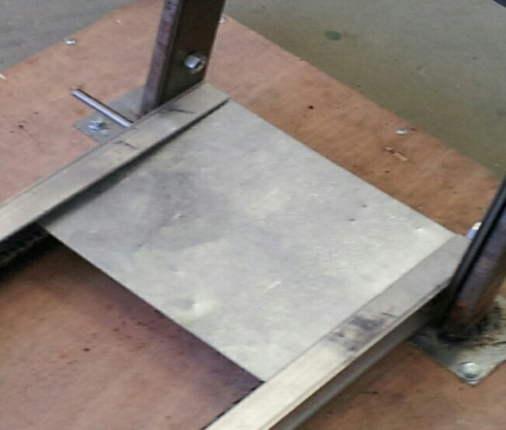
Mechanical part
Horizontal plate

Slide 11
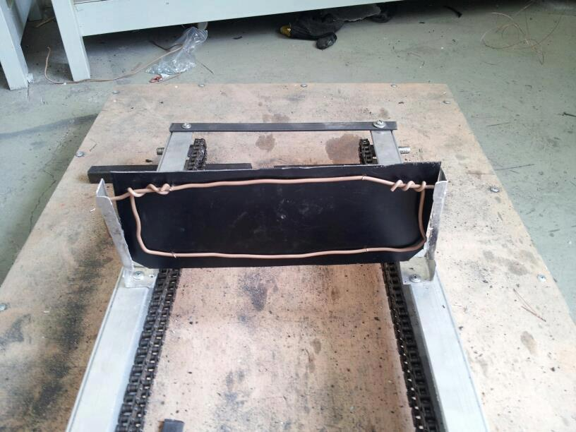
Gate or vertical plate

Slide 12
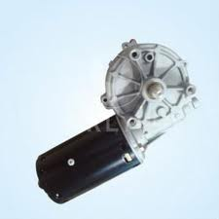
Electrical part
  type of motor :
  Direct Current (DC) Motors

Slide 13
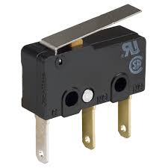
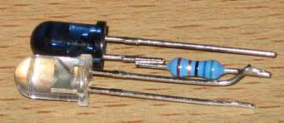
Electrical part
Sensors
Limit Switch
IR sensor

Slide 14
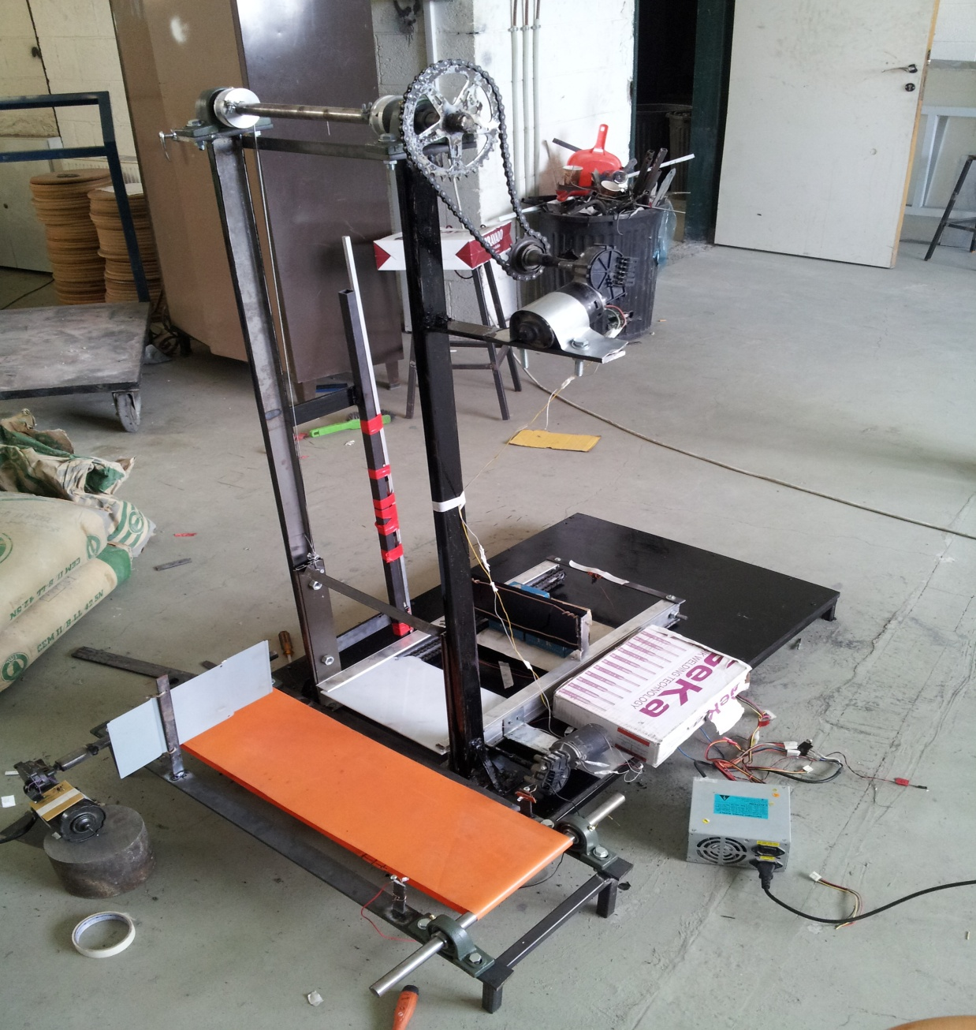
Electrical part

Slide 15
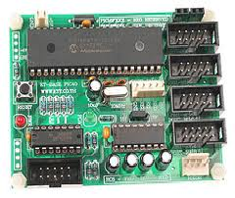
Control and Software part
  Form of microcontroller:
  . PIC microcontroller

Slide 16
Control and Software part
Microcontroller system is used to of the machine
The IR sensor count of the number of cartoon which will pass throw it .
The eight limit switches are used to control of operation machine .
The three of DC motors will turn on\off as controlled in programmed .

Slide 17
Calibration and result :
speed of conveyer : V = L/T
Gear ratio : N2/N1
tension of ropes : T1= T2 = W/2
60/15 = 0.04 m/s | Speed of conveyer
36/16 = 2.25 | Gear ratio
79/2 = 39.5 N | Tension of ropes

Slide 18
safety
Safety should be a primary concern for every project.
Emergency stop : for turn off the machine when any problem happened
Protection circuits: for protect the circuits from high current ,voltage and polarity
mechanical safety

Slide 19
Summary
We finished this project successfully at our potential available.
We learn from this project how to make a mechatronics design system .
this project can develop in future for used in factories .
This machine available to used in many type of cartoons and more than one production line

Slide 20
Thank you for listening

