Slide 1
BALL COLLECTING AND SORTING ROBOT
Hardware Project 2024
Presented By : Mohammad Alkhateeb Ahmad Hawwari
Supervisor Dr. Luai Malhis

Slide 2

Content
01
02
03
04
05
06
07
Introduction
Design and Development
Components
Features
Limitations
Future Work
Acknowledgement

Slide 3


Introduction
Collecting the balls during practice sessions or after
matches in tournaments can be rather
Time- consuming in sports l ike tennis and golf. We propose a robotic approach to this problem, whereby we automate the
procedure of collecting the balls.

Slide 4





Design and Development
car base
Stand to the arm
base to claw

Slide 5

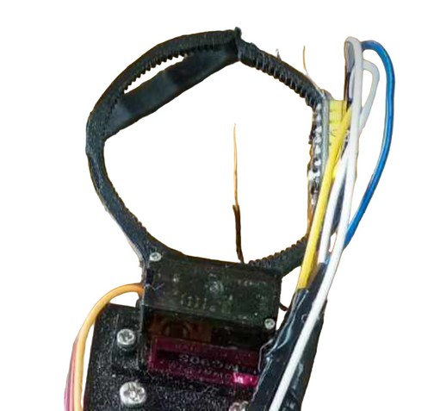

Design and Development
base to Arm
claw
base to base

Slide 6
ESP 32 Code: Hosts a web page with manual and automatic mode
controls.
Arduino Code: Manages ball detection, color
sorting, and movement control based on sensor
data.

Slide 7
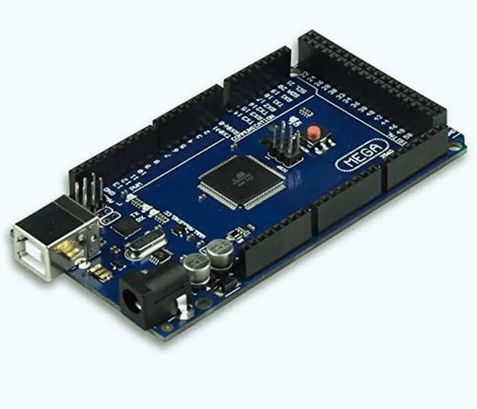
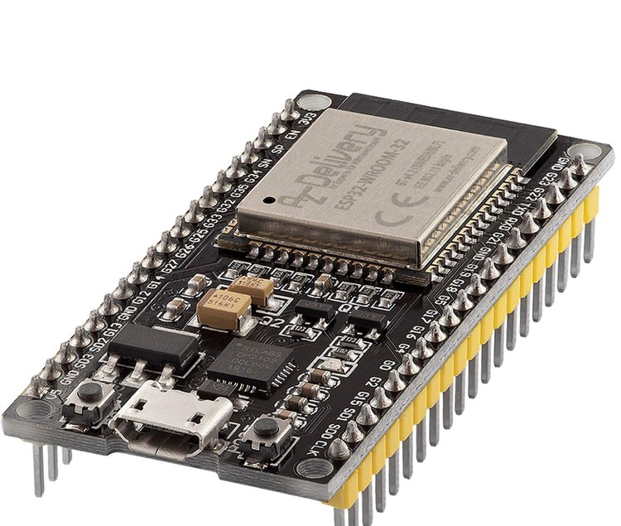
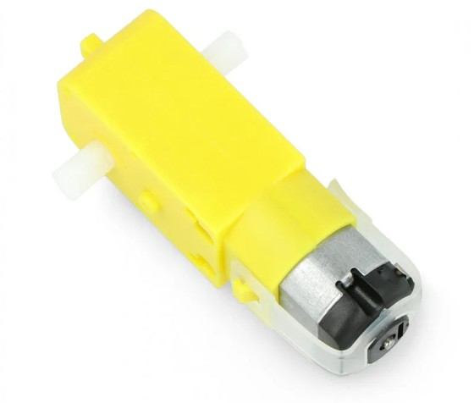
Hardware Components
Arduino Mega
ESP32 Module
DC motors
4 DC motors for wheel movement.
Facilitates wireless control via a web interface.
Central controller for the robot.

Slide 8
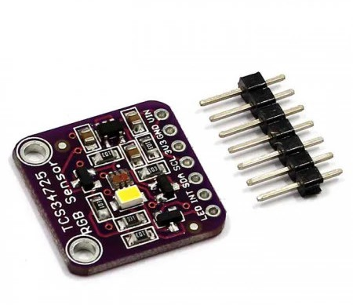
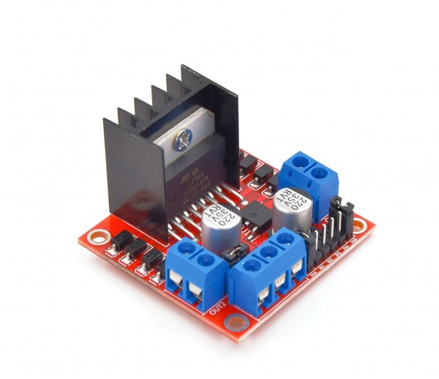
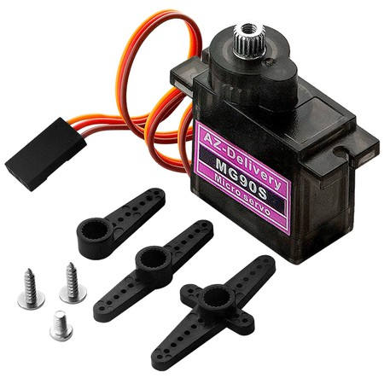
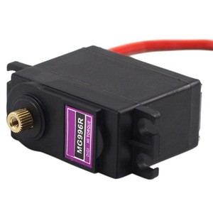
Hardware Components
servo motors
Color sensor
H-Bridge (L298N)
3 servo motors for arm control.
Color sensor (TCS34725) and ultrasonic sensor for object detection.
Controls the direction of DC motors.

Slide 9



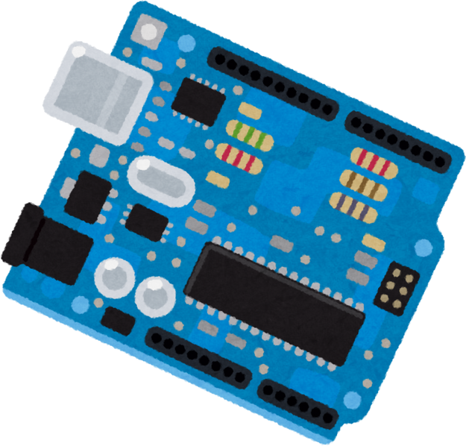
Features
Feature 1
Movement Control: Control the robot' s movement using DC
motors in manual and automatic modes.
Feature 2
Arm Control: Control the robotic arm to pick up, sort, and place balls in separate baskets.
Feature 03
Color Sorting: Use a color
sensor to distinguish between red and green balls and sort
them accordingly.
Feature 4
Ultrasonic Sensor: Detect
obstacles and assist in ball location.

Slide 10
Limitations
Size
Hardware problems
Time

Slide 11
Future Work
1 . Image Processing Application: Adding the
Raspberry Pi and image processing will greatly reduce the errors of some sensors, such as the ultrasonic sensor and the cooler
sensor.
Interface Enhancement: Improving the web interface for our robot, also adding more
functionalities that can be done within i ts capacities.
CAR size: Enlarging the size of the car as a whole and the arm to f i t larger balls in the future, as this robot becomes suitable for
other games such as football.

Slide 12
Acknowledgements
We would like to express our deepest appreciation to our supervisor, Dr. Luai Malhis, for his outstanding assistance during the project, Our families, doctors, friends and colleagues for their support.

